Slide 1
Final Project
Judge Greenberger

Slide 2
Overview
Who?
Rockhurst University
What?
Social Media Data
Twitter
Instagram
Facebook
Website & Mobile Analytics
Google analytics

Slide 3
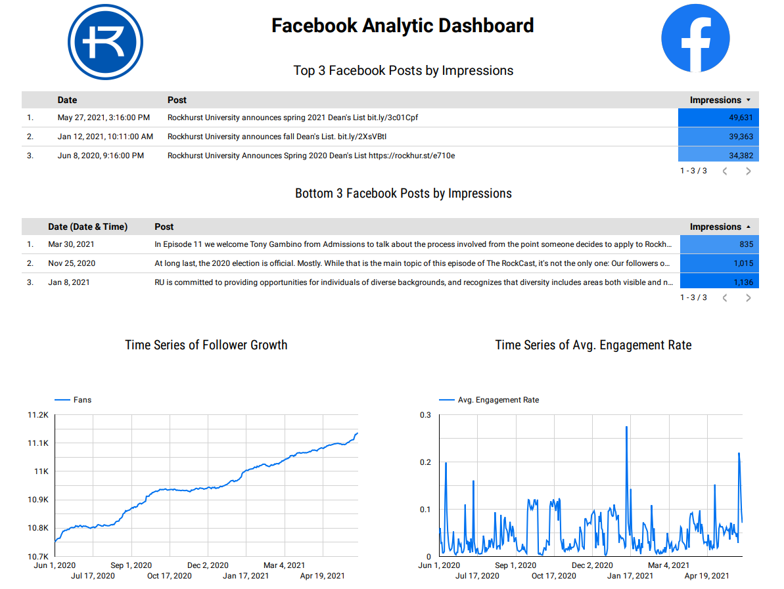
Social Media Analytics
Notes:
Follower Growth
Continuous & Positive
Engagement Rate
Peak Points located either at beginning of school year or key school breaks
Top posts
All related to the dean’s list as it draws the largest audience, what other posts could draw similar audiences?

Slide 4
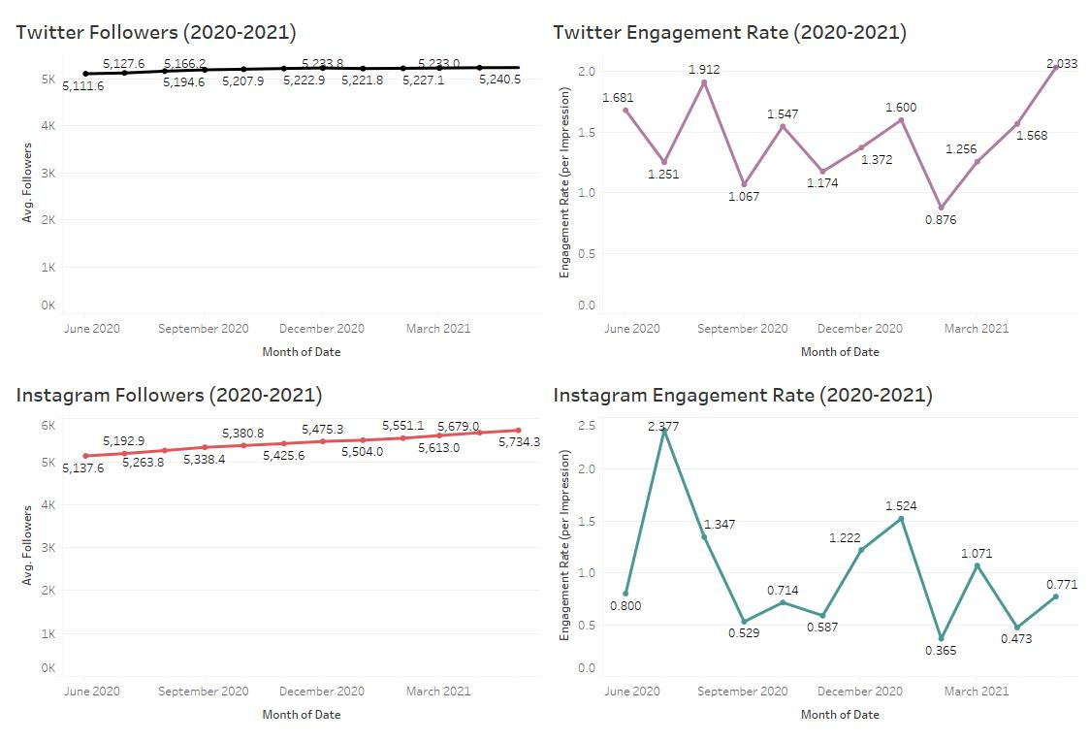
Social Media Analytics Continued
Notes:
Twitter followers are also trending in a positive direction, but more chaotic
Instagram followers trending in a positive direction as well but still not as stable as facebook fans
Engagement rate for instagram shows a boost right before school starts during the months of July-August(2.4 rate) with a deadzone during
Peak school time, September-December(~0.6 rate).
As for twitter we see the same trend of high engagement rate right before school starts in August (1.9), but the rate doesn’t drop off too much like the Instagram account
As you can see it stays above 1 almost the whole time before peaking again at 2 in April.

Slide 5
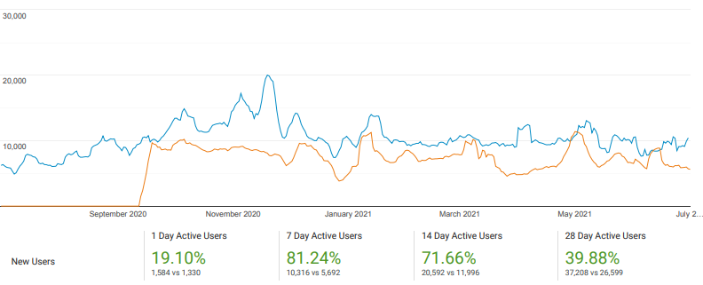
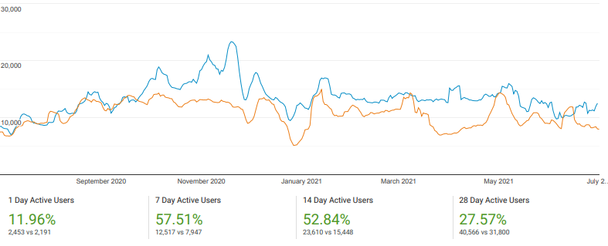
Web Analytics
Users YOY (2019-2020)
New Users YOY (2019-2020)
2020 = Blue
2019 = Orange
Notes:
Looking at the YOY analysis of users and new users it is clear that 2020, represented in Blue, has been a much better year
For the website as both users are up about 50% over a 7 day span and new users are up about 81% over a 7 day span

Slide 6
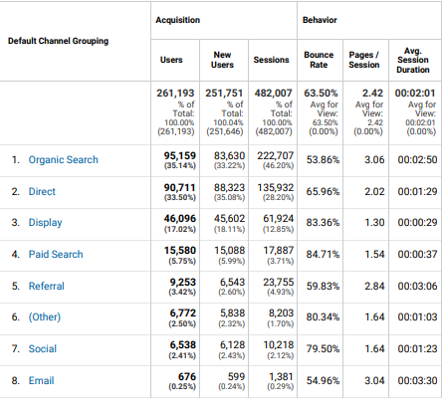
Web Analytics
Channel Data
Notes:
Looking at the top 10 channels from which traffic comes into the website we see an interesting story.
The majority of users visit the site from organic search via some sort of web browser (35.1%) as well as putting in the direct url to the site (33.5%)
However, the majority of new users visit the site from the direct url (%35) and only 33% enter the site from organic search methods.
On top of this we see that Paid searches only take up about 5.7-5.9% of the channel source of traffic for new or old users showcasing
That a simplified url and investment in organic searches is more important for the sites success than paid advertisement

Slide 7
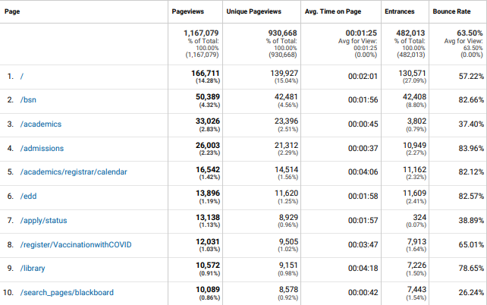
Website Analytics
Bounce Rate & Page Views
Notes:
Looking solely at page views we can see the most popular pages are the home page “/”, bookstore “/bsn”, academics page “/academics”, and admissions “admissions”
While the homepage is the most viewed page it’s Bounce Rate is an indicator that it does a good job of capturing the viewers attention and redirecting them to another site on the page
As the bounce rate is 57% which is lower than the avg bounce rate for the whole site at 63%. As for the avg. time on page it is 2 minutes which is 45 seconds longer than the avg. time for the whole site.
While the bounce rate of the homepage is better than the avg. for the site it still is a case for improvement as lowering this means Rockhurst is doing a better job of capturing the users attention longer

Slide 8
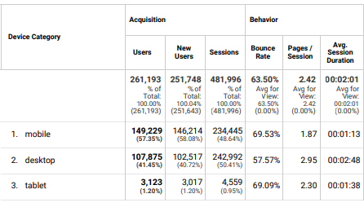
Mobile Analytics
Desktop Vs. Mobile
Notes:
Looking at the desktop vs mobile data associated with the website we can see that the majority of new users and users come from the mobile device
As there were more than 40k more new users and users from the mobile devices than desktop
While there are more mobile users all around their bounce rate, pages per session and avg. session duration all are sustainably lower than their desktop counterpart
So, clearly there is some sort of attention issue with mobile users navigating the site, either information is too hidden, or not enough eye catching information is present on the landing page.

Slide 9
Conclusion
Keep Social Media Audience engaged all throughout the year!
Stories
Polls
Giveaways
Focus on already well-established organic search methods
Reduce scrolltime!
Notes:
These polls, stories, and giveaways would continuously bring the audience back to the social media page to engage with whatever Rockhurst put out
In the instance of a giveaway it could be as simply as “any follower who reposts this is entered into the drawing for …” where it could be anything ranging from
A “walk & talk” with father curran, rockhurst apparel, or coupons to a KC restaurant.
The organic search methods seem to reign far superior in drawing in audiences on top of the simplified URL that allows for easy direct url entry.
Investing more time and resources into improving the organic search method is more valuable than spending money on paid advertisements for the website
A lot of the information on the mobile and desktop website is hidden behind a large amount of scrolling down the page. While this would be good to keep
Users scrolling and seeing more, if they don’t see any of it at first glance then they won’t be interested enough to keep scrolling, especially on a mobile device.
So, changing the website so that there’s a automatic side-scrolling display box which houses important information like newsworthy events, Rockhurst’s graduation statistics,
And any other attention gathering information would keep the user on the page longer and give them more available site links without the user needing to do any scrolling
This would allow for a much lower bounce rate and a higher avg. time on the site improving the sites analytics and helping reach some of the sites goals.

Slide 10
Thanks!

