Slide 1



Slide 2

What is a Database Application?
Why Backend Testing is so important?
Front-end Testing vs. Back-end Testing
QA’ing Data- who is responsible?
What should we test in the database?
Knowledge required for the Database Test Engineers
Database Testing Phases
Database Testing Methodologies
©MindQ Systems Pvt.Ltd.,

Slide 3
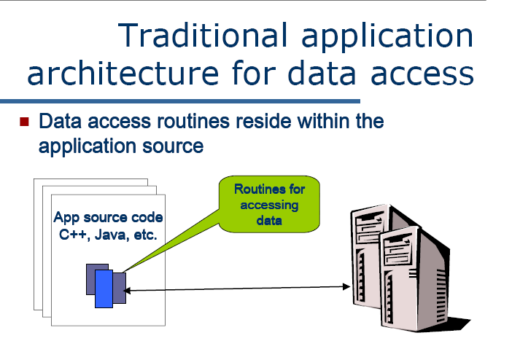
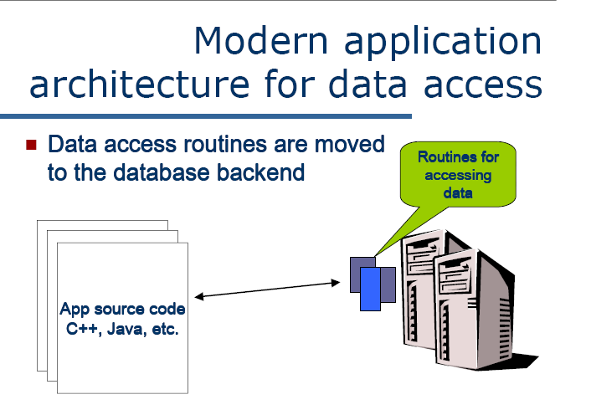
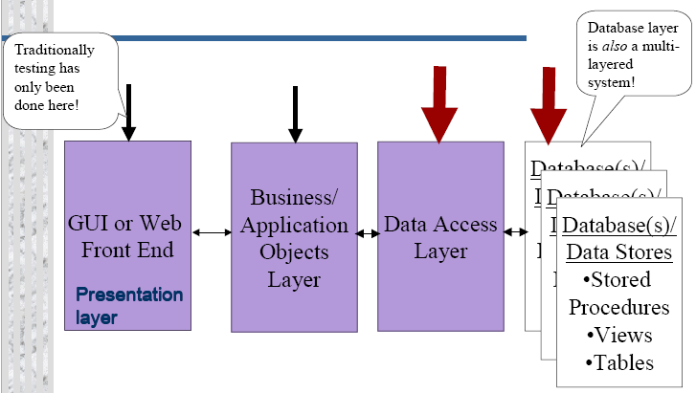
©MindQ Systems Pvt.Ltd.,

Slide 4
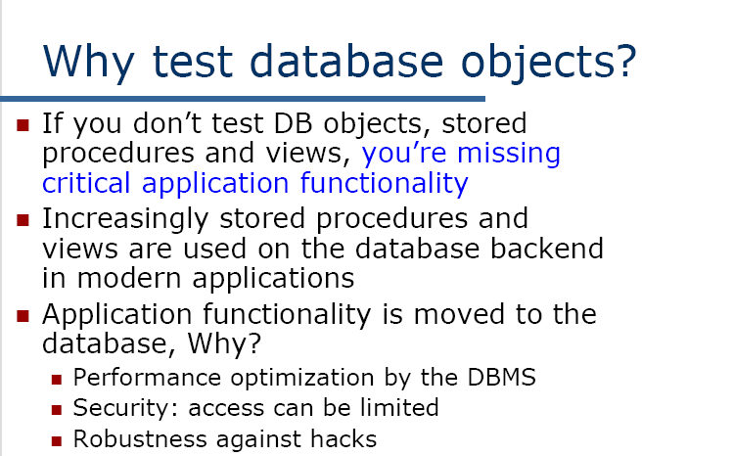
©MindQ Systems Pvt.Ltd.,

Slide 5
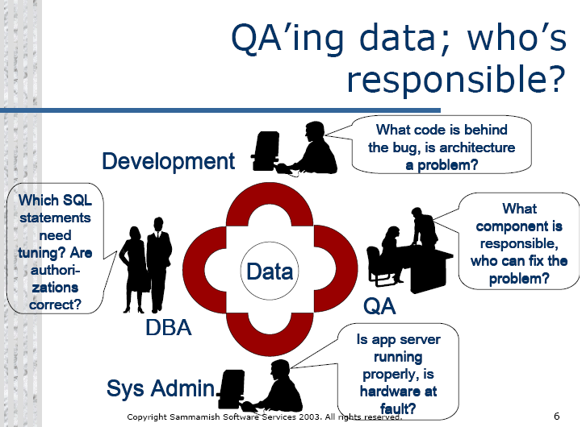
©MindQ Systems Pvt.Ltd.,

Slide 6
Database Testing basically include the following:
  Data Validity Testing
  Data Integrity Testing
  Performance Testing
  Testing of Stored Procedures, Triggers and Functions
©MindQ Systems Pvt.Ltd.,

Slide 7
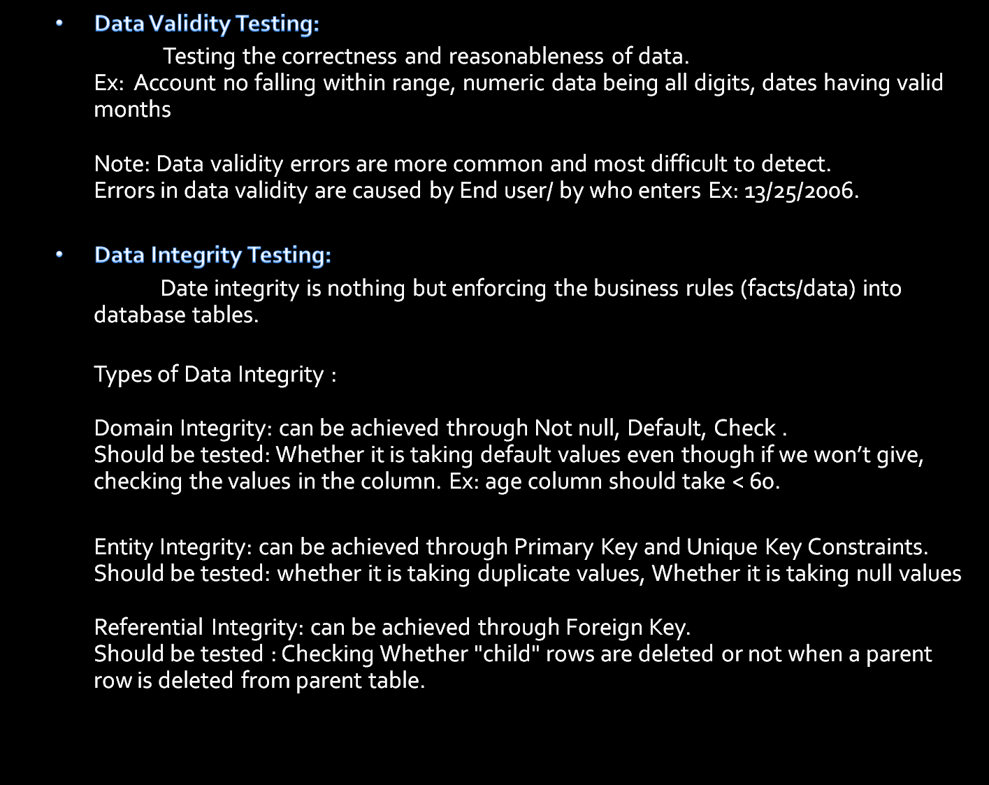
©MindQ Systems Pvt.Ltd.,

Slide 8
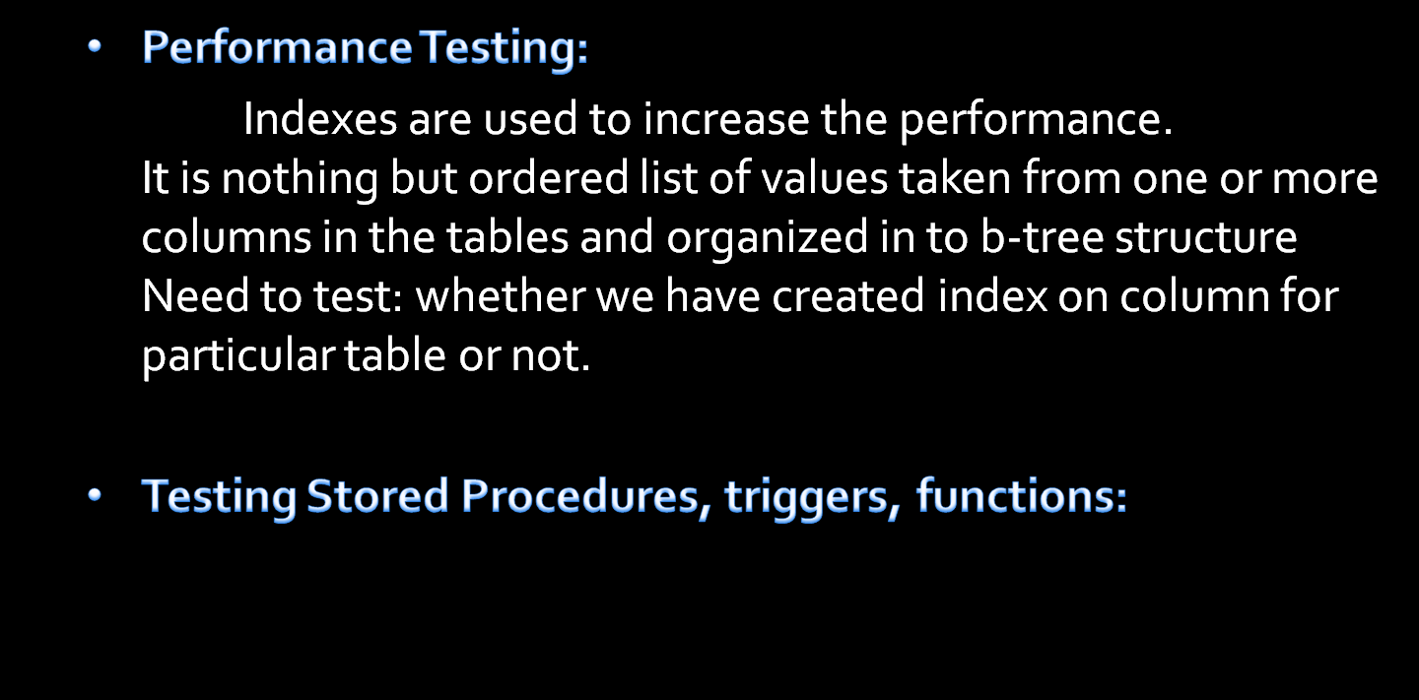
©MindQ Systems Pvt.Ltd.,

Slide 9
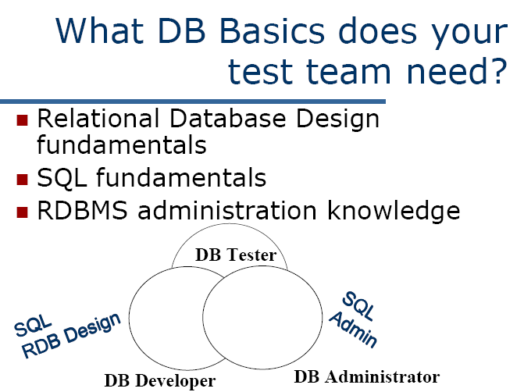
©MindQ Systems Pvt.Ltd.,

Slide 10
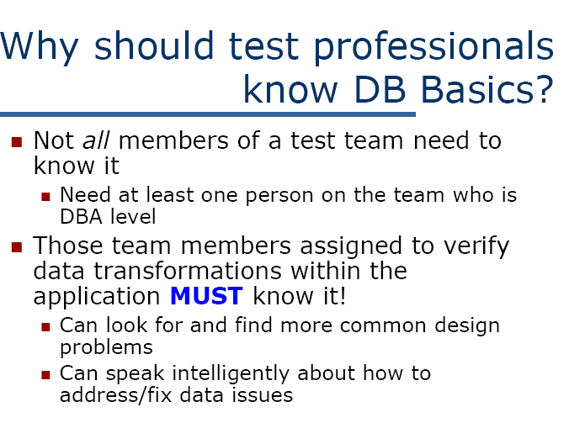
©MindQ Systems Pvt.Ltd.,

Slide 11
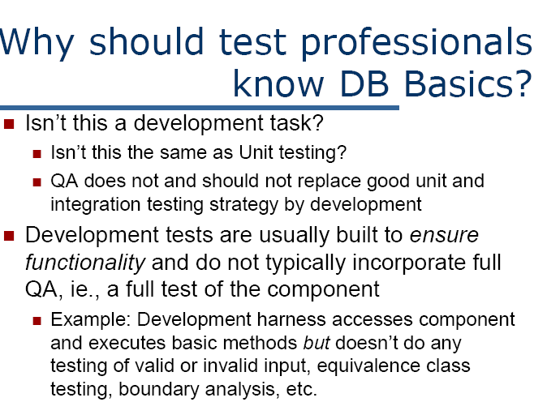
©MindQ Systems Pvt.Ltd.,

Slide 12
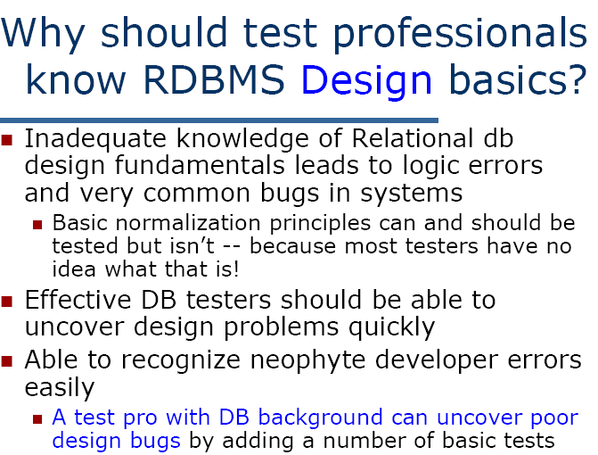
©MindQ Systems Pvt.Ltd.,

Slide 13
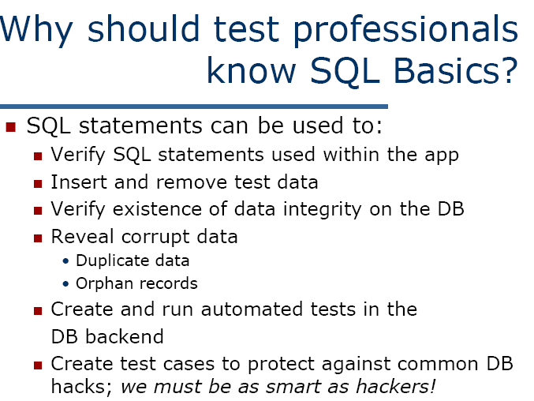
©MindQ Systems Pvt.Ltd.,

Slide 14
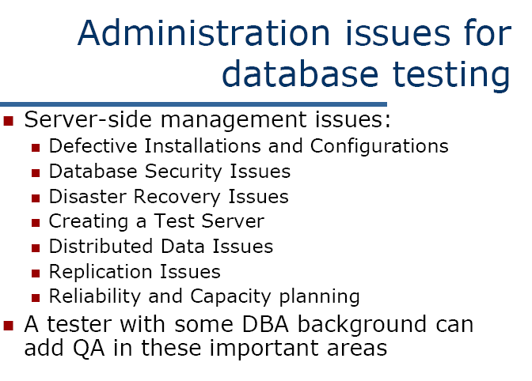
©MindQ Systems Pvt.Ltd.,

Slide 15


There are several phases in back end testing.
The first step is to acquire design specifications for an SQL server.
The second step is test specification design.
The next step is to implement the tests in this design with SQL code.
  The test specification design should contain information concerning
  component testing (individual pieces of the system),
  regression testing (previously known bugs),
  integration testing (several pieces of the system put together),
  and then the entire system (which will include both front and back ends).
Component testing will be done early in the development cycle. Integration and system tests (including interfaces to front ends and nightly processes) are performed after the component tests pass. Regression testing will be performed continuously throughout the project until it is finished. The back end usually does not have an independent beta test, as it only exercised by the front end during the beta test period. The last step is to deliver users a quality product.
©MindQ Systems Pvt.Ltd.,

Slide 16


Back end test methodology has many things in common with front end testing and API testing.
Many test methods can be used for back end testing. The following are the are more effective approaches in back end testing.
  Structural testing
  functional testing.
Structural Testing:
A back end can be broken down into a finite number of testable pieces based on a back end’s structure. Tests will verify each and every object in a type of structure.
Functional Testing:
A back end can be broken down into a finite number of testable pieces based on application’s functionality. The test focus is on functionality of input and output but not on the implementation and structure. Different projects may have different ways to break down.
©MindQ Systems Pvt.Ltd.,

Slide 17

There are many other test methods that can be applied to back end testing. Many test methods can be used for back end testing.
Boundary Testing:
Many columns have boundary conditions. For example, in a column for percentages, the value can not be less than zero and can not be greater than 100%. We should find out these types of boundary conditions and test them.
Stress Testing:
It involves subjecting a database to heavy loads. For incidence, many users heavily access the same table that has a large number of records. To simulate this situation, we need to start as many machines as possible and run the tests over and over.
©MindQ Systems Pvt.Ltd.,

Slide 18


