Slide 1
Project: CS 755 Advanced Pattern Recognition and Machine Learning
Pace University - New York
Instructor: Sung Hyuk Cha
By
Jagadesh Varma Nadimpalli

Slide 2
Exponentially Weighted Linear Regression Moving Averages

Slide 3
OVERVIEW
Introduction
Background
Dataset
Data Exploration
Stationary Test
Moving Average Methods
Integrated Smoothing Approach
Residuals and Evaluation
Key Takeaways & Future Scope
Works Cited

Slide 4
INTRODUCTION
1

Slide 5
Moving averages (MAs) are one of the most widely used statistical tools in time series forecasting, particularly in fields such as economics, finance, and signal processing. Their primary purpose is to smooth fluctuations in data over time, providing a clearer view of underlying trends and patterns. Moving averages are especially important in the analysis of time series data because they help to reduce the noise inherent in real-world data, allowing analysts to focus on the broader movements or trends.

Slide 6
BACKGROUND
2

Slide 7
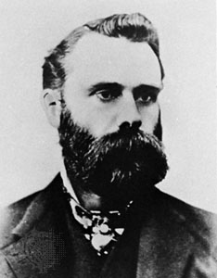
Charles H. Dow, the co-founder of The Wall Street Journal and creator of the Dow Jones Industrial Average.
The moving average concept, first employed in economics and finance in the early 20th century, gained prominence during the 1920s and 1930s as analysts sought ways to interpret the fluctuating data of rapidly changing financial markets. Initially introduced to detect underlying trends by averaging values over a specified period to eliminate short-term fluctuations, the Simple Moving Average (SMA) became a fundamental tool in technical analysis, used by traders to predict stock price movements. Over time, variations such as the Cumulative Moving Average (CMA) and the Exponentially Weighted Moving Average (EWMA) were developed. The CMA continually updates the average as new data points become available, while the EWMA, introduced in the 1960s, assigns more weight to recent observations, making it more sensitive to recent trends and changes. These advancements made moving averages, especially EWMA, increasingly popular in fields like control systems and economics, where quick adaptation to changes is essential.

Slide 8
DATASET
3

Slide 9
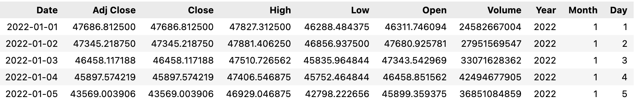
The dataset used in this analysis consists of stock data for Bitcoin (BTC-USD), obtained from Yahoo Finance. The time-period for the data ranges from January 1, 2022, to November 30, 2024. The dataset includes various stock market features such as the opening price, closing price, highest price, lowest price, and trading volume for each trading day within the specified time frame.

Slide 10
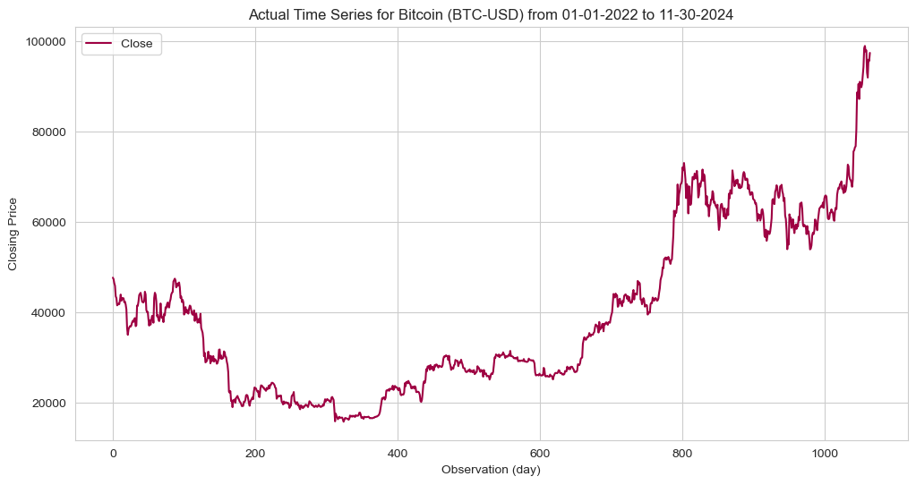

Slide 11
DATA EXPLORATION
4

Slide 12
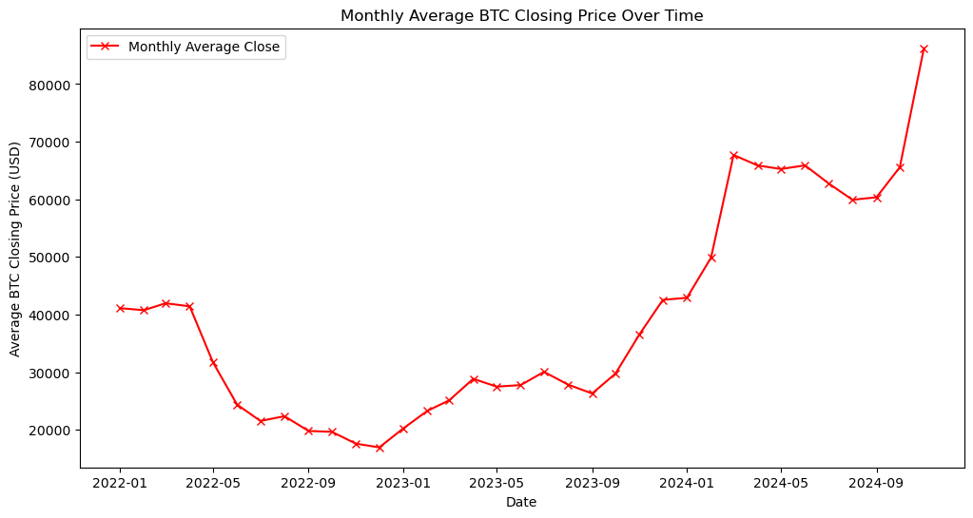
In this analysis, I calculated the monthly average closing price of Bitcoin by grouping the data by year and month, then taking the mean of the 'Close' values. The results were plotted over time, with each data point representing the average closing price for a given month, providing a clear visualization of the Bitcoin price trend.

Slide 13
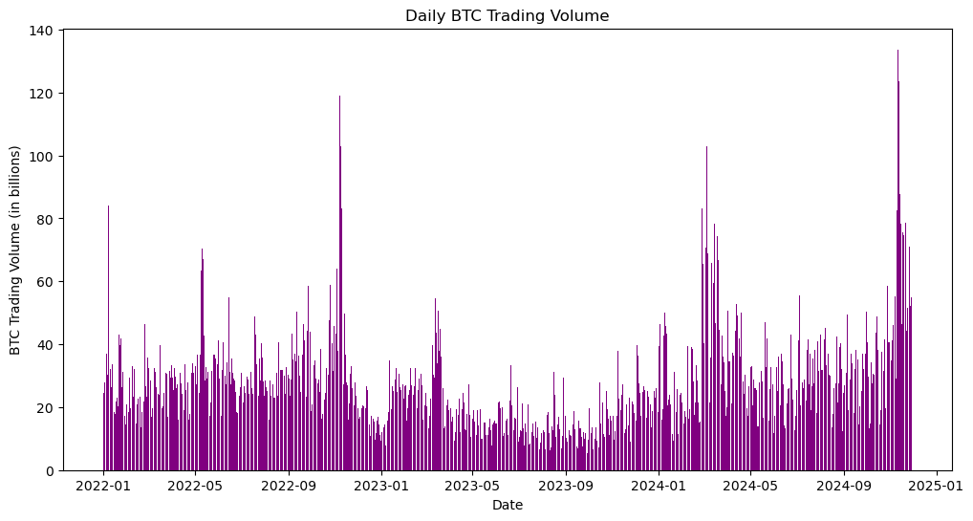
In this analysis, I visualized the daily Bitcoin trading volume by plotting a bar chart with the 'Date' on the x-axis and the trading volume (in billions) on the y-axis. This allowed for a clear representation of the fluctuations in Bitcoin trading activity over time.

Slide 14
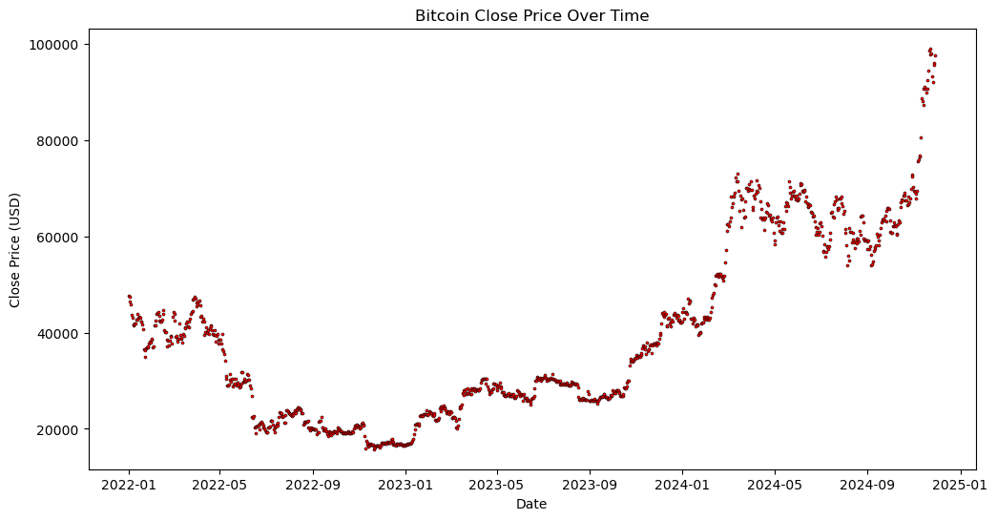
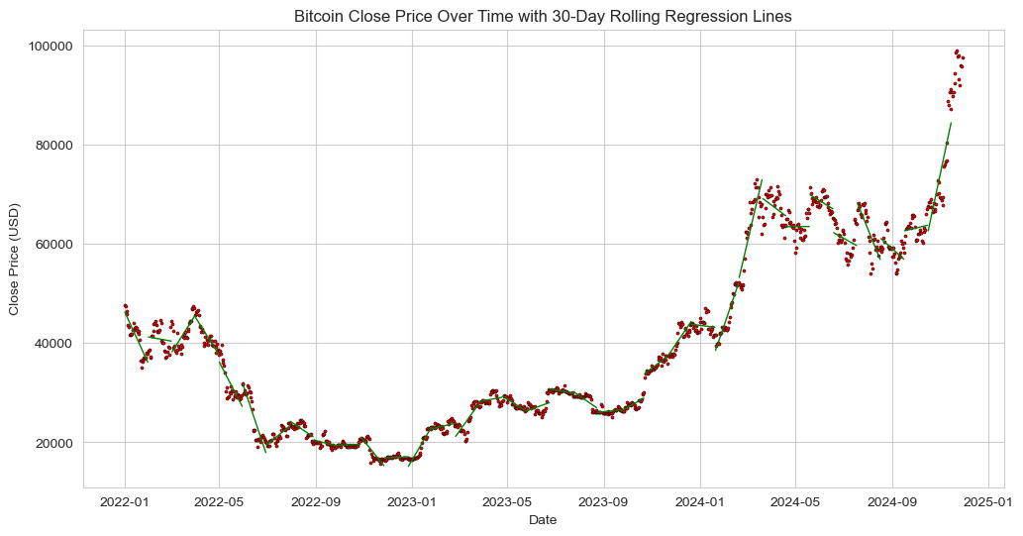
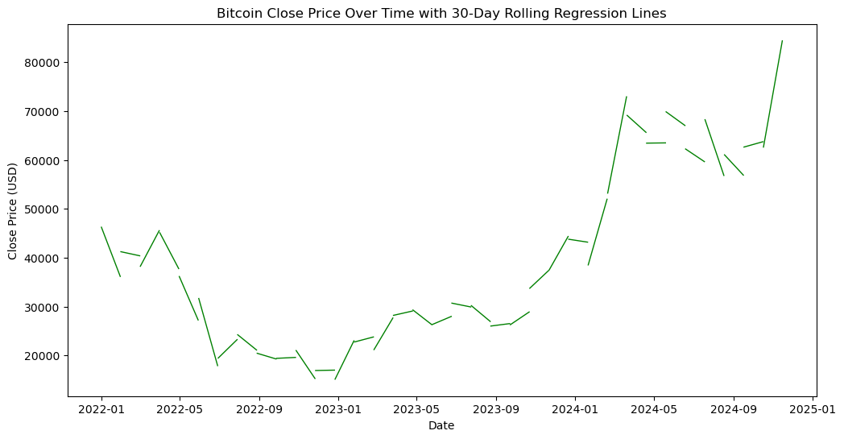
The first plot shows a scatterplot of Bitcoin's closing price over time, providing a visual representation of daily price fluctuations. In the second plot, a 30-day rolling regression line is added to the scatterplot, illustrating how the linear trend of the closing price evolves over time in smaller windows. Finally, the third plot displays the same 30-day rolling regression lines, but without the scatterplot, focusing solely on the trend analysis of Bitcoin's closing price over time with the same rolling window technique.

Slide 15
STATIONARY TEST
5

Slide 16

Augmented Dicker Fuller test (ADF)
I used the Augmented Dickey-Fuller (ADF) test to check the stationarity of the Bitcoin closing price series. The test returns an ADF statistic of 1.074958, with a p-value of 0.994997, which is well above the typical significance threshold of 0.05. The critical values at the 1%, 5%, and 10% levels are -3.437, -2.864, and -2.568, respectively, which the ADF statistic does not exceed. Since the p-value is high and the ADF statistic is greater than the critical values, the series is considered non-stationary, indicating that it exhibits trends or seasonality that must be addressed before further analysis or forecasting.

Slide 17
MOVING AVERAGE METHODS
6

Slide 18

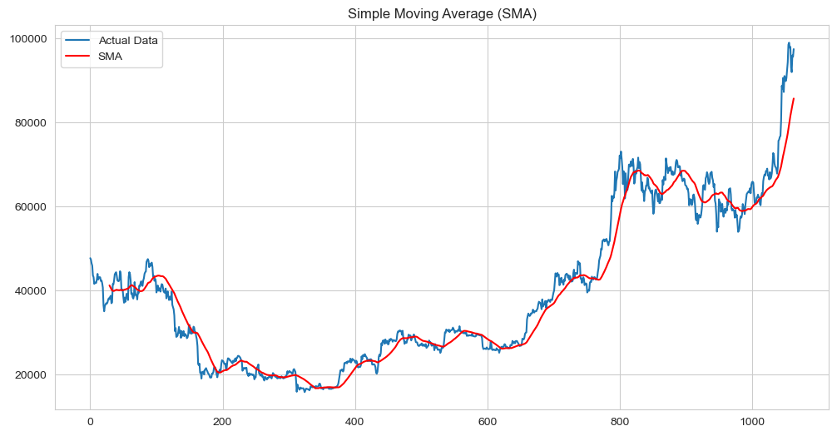
Simple Moving Average (SMA)
The Simple Moving Average (SMA) is the most basic form of MA, where each point in the data series is given equal weight.

Slide 19
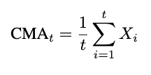
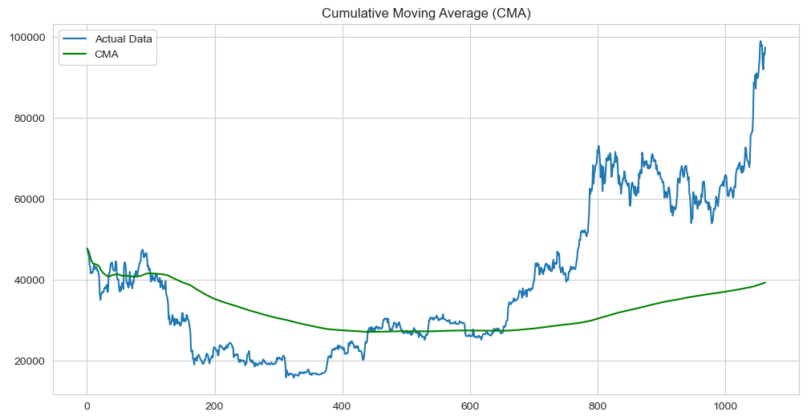
Cumulative Moving Average (CMA)
The Cumulative Moving Average (CMA) is the average of all data points up to a certain time t. Unlike the Exponential Moving Average (EMA) and Exponentially Weighted Moving Average (EWMA), the CMA does not assign different weights to the data points; it treats each data point equally.

Slide 20

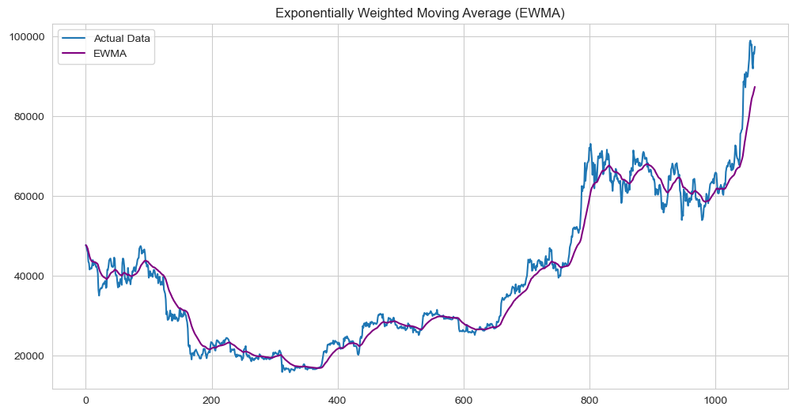
Exponentially Weighted Moving Average (EWMA)
The Exponentially Weighted Moving Average (EWMA) assigns exponentially decreasing weights to older data points, emphasizing more recent data

Slide 21

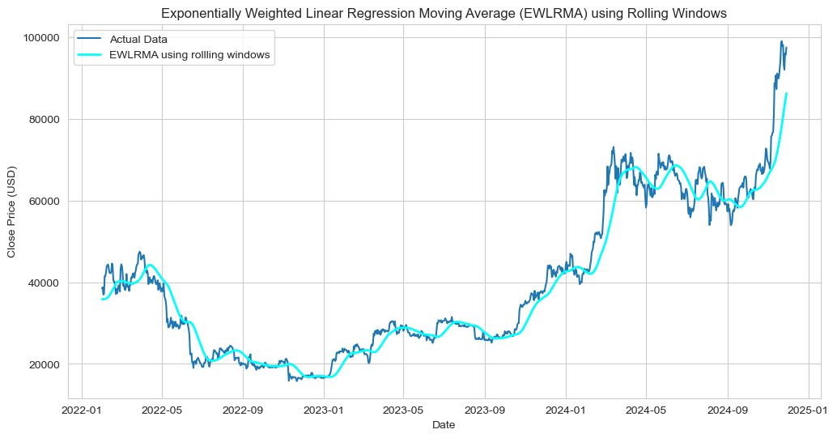
EWLRMA using rolling windows
Exponentially Weighted Linear Regression Moving Average (EWLRMA) using rolling windows, on the other hand, considers overlapping windows that move one data point at a time. As the window shifts, it includes new data points and discards old ones, ensuring that the most recent data points are always part of the current window.

Slide 22
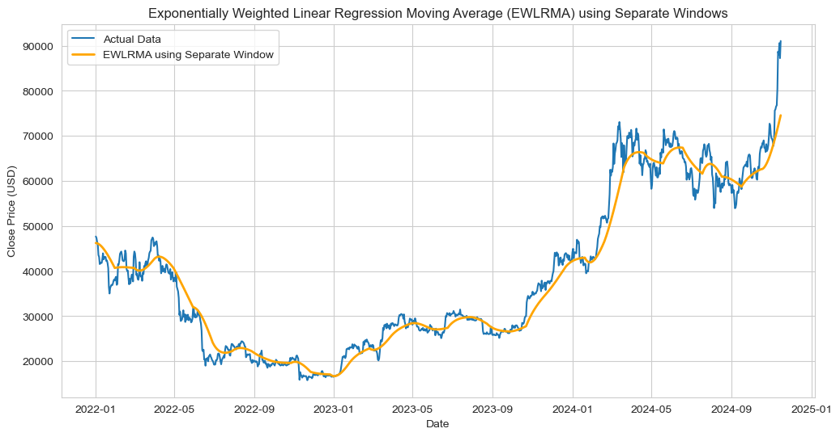
EWLRMA using separate windows
Exponentially Weighted Linear Regression Moving Average (EWLRMA) using separate windows applies linear regression on distinct, non-overlapping windows of data. Each window is considered independently, meaning that once a window is processed and the predictions are made, the next window starts from the subsequent data point.

Slide 23
INTEGRATED SMOOTHING APPROACH
7

Slide 24
Integrated smoothing of Exponentially Weighted Linear Regression Moving Average (EWLRMA) and Exponentially Weighted Moving Average (EWMA) was developed to address the gap observed between the separate window approach of EWLRMA and the more continuous smoothing behavior of EWMA. The idea is to combine the strengths of both methods by blending the predictions from linear regression (EWLRMA) with the simple exponentially weighted smoothing (EWMA). This approach allows for a more flexible and adaptive smoothing technique that benefits from both methods: the trend-capturing ability of linear regression and the smoothness provided by exponential weighting. The integrated smoothing technique uses a blending factor, λ, which combines the predictions from both methods in a way that can adaptively switch between them depending on the smoothing needs of the data. The blending factor λ was chosen through a trial & error method as of now, where values of λ are manually adjusted to optimize the smoothing behavior.

Slide 25
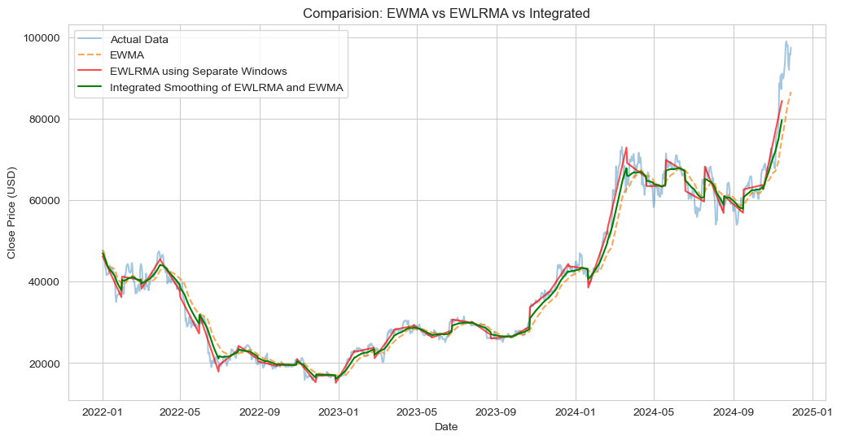

Slide 26
RESIDUALS & EVALUATION
8

Slide 27
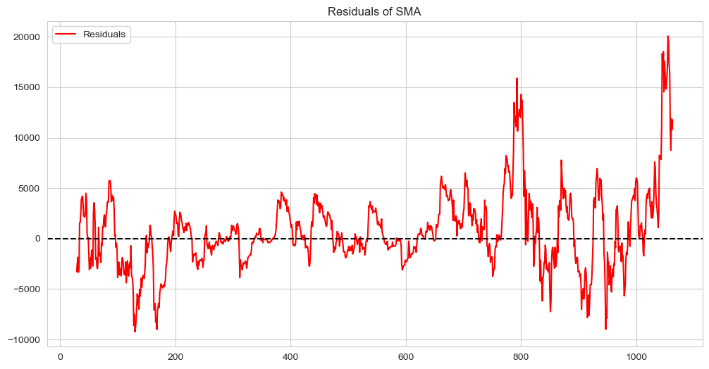
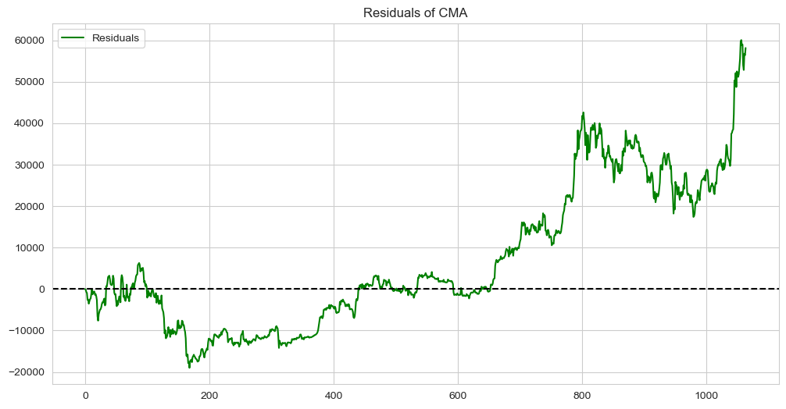
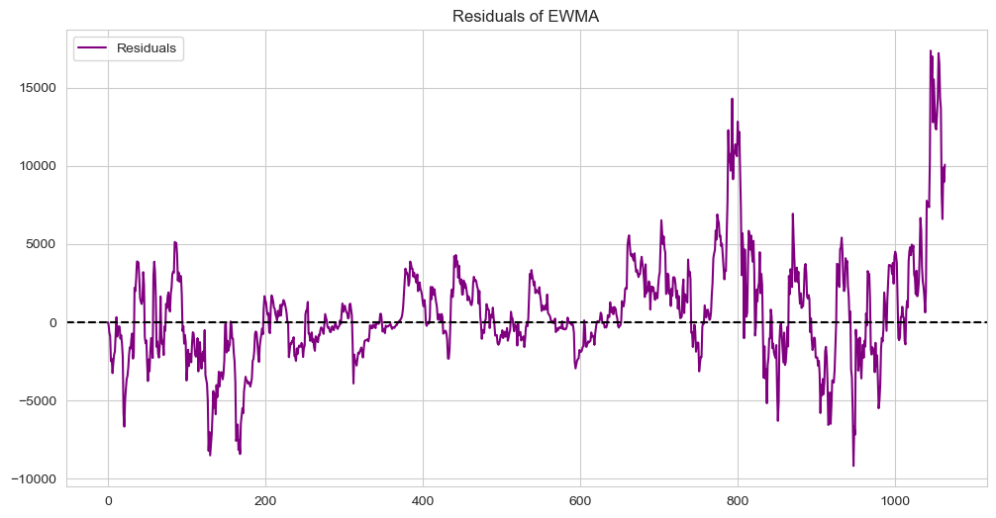
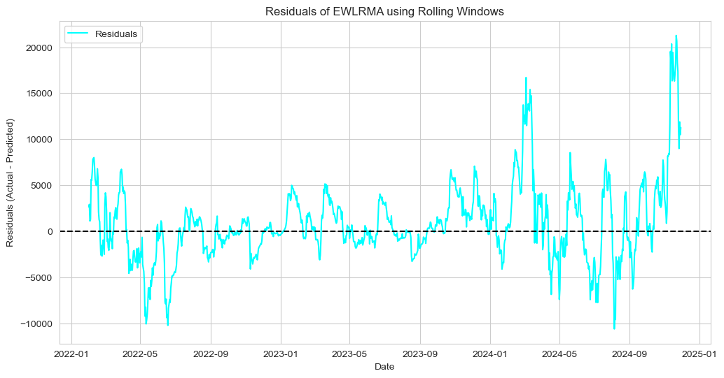
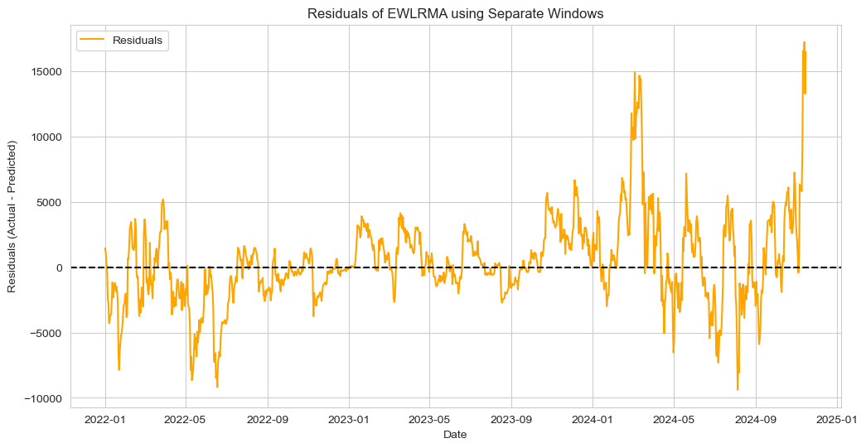
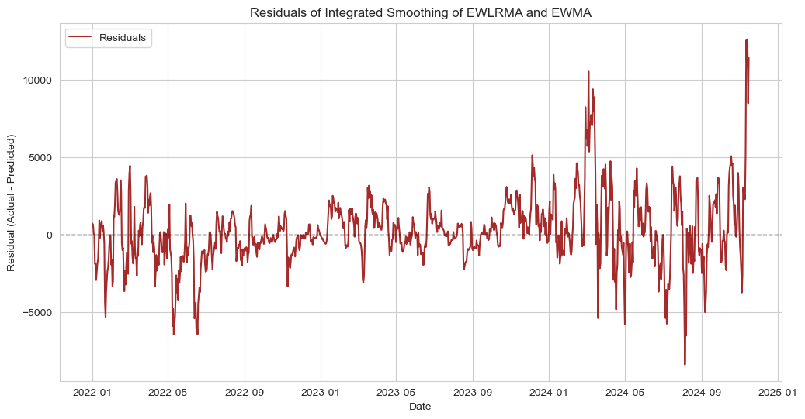
Residual Plots

Slide 28
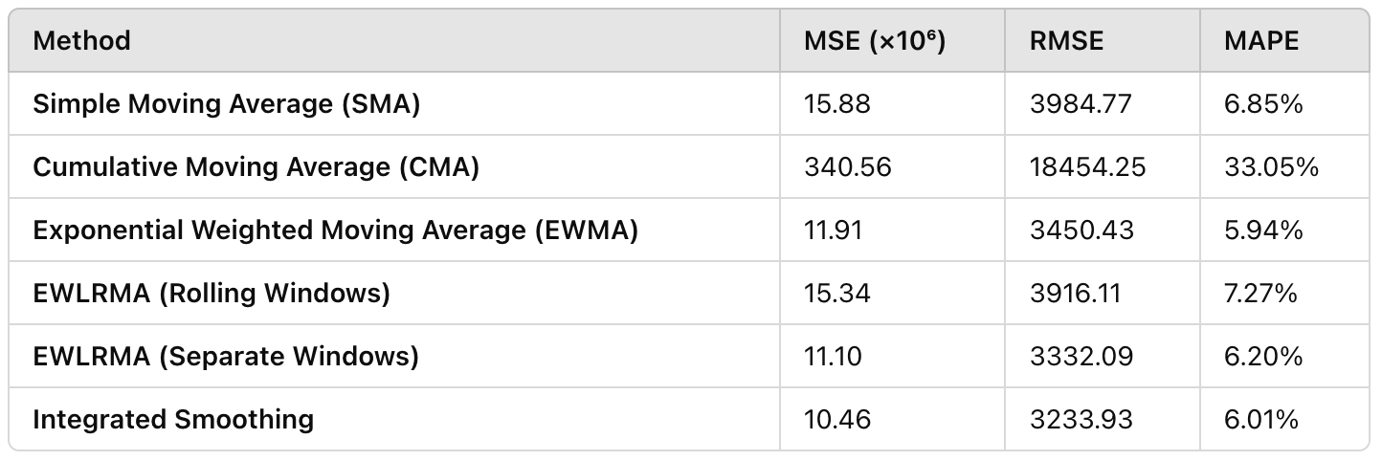
Metrics

Slide 29
KEY TAKEAWAYS & FUTURE SCOPE
9

Slide 30
Integrated Smoothing Efficiency : Integrated Smoothing demonstrates the lowest MSE and RMSE among all methods, making it a more accurate approach compared to traditional methods like EWMA. This highlights its potential as a superior alternative for time series forecasting.
Improving the Blending Factor: Refining the blending factor used in moving averages can further enhance forecasting accuracy. Future work could focus on deriving a mathematical formula to optimize this factor dynamically.
Incorporating Trading Volume: Integrating the volume feature with the closing price could provide deeper insights into market behavior. This opens opportunities for improved time series forecasting by capturing both price trends and trading activity.

Slide 31
WORKS CITED
10
[1] M. J. S. Liu and W. D. Chen, “Differencing and its impact on time
series forecasting,” International Journal of Forecasting, vol. 22, no. 2,
pp. 159-172, 2016.
[2] J. R. Norris and M. C. Gale, “Time series decomposition using the
Hodrick-Prescott filter,” Journal of Economic Studies, vol. 48, no. 4,
pp. 512-523, 2017.
[3] A. Simons and T. B. Long, “Forecasting time series with seasonal
patterns: A comparison of methods,” Journal of Applied Econometrics,
vol. 35, no. 7, pp. 1041-1062, 2020.
[4] G. S. Maddala and S. L. Wu, “Time series econometrics: A comparative
study of methods,” Journal of Econometrics, vol. 35, no. 3, pp. 126-148,
2014.
[5] W. H. Greene, “Econometric analysis: Linear regression models and
applications,” Econometric Theory, vol. 22, no. 5, pp. 1567-1589, 2018.
[6] G. U. Yule, “On the method of least squares applied to time series,”
Philosophical Transactions of the Royal Society A: Mathematical, Phys-
ical and Engineering Sciences, vol. 226, no. 1, pp. 47-75, 1927.
[7] C. H. Anderson and B. L. Moore, “Advanced linear regression tech-
niques in time series analysis,” Journal of Forecasting and Statistical
Models, vol. 45, no. 2, pp. 201-220, 2019.
[8] R. H. Shumway and D. S. Stoffer, Time Series Analysis and Its
Applications: With R Examples, Springer, 2010.
[9] G. E. P. Box, G. M. Jenkins, and G. C. Reinsel, Time Series Analysis:
Forecasting and Control, 5th ed. Hoboken, NJ: Wiley, 2015.
[10] R. S. Pindyck and D. L. Rubinfeld, Time Series and Econometric
Forecasting: Methods and Applications, Prentice Hall, 1991.
[11] C. Chatfield, The Analysis of Time Series: An Introduction, Chapman
and Hall/CRC, 2016.
[12] R. C. Hill and W. E. Griffiths, Principles of Econometrics: Time Series
Analysis, Wiley, 2018.
[13] J. Mackey and M. Peterson, “The difference in time series forecasting
accuracy: A review of models,” Journal of Business and Economic
Statistics, vol. 36, no. 1, pp. 1-16, 2018.
[14] M. Yusoff and N. M. R. Kamaruddin, “Decomposition techniques in
time series analysis,” Journal of Time Series Analysis, vol. 25, no. 4,
pp. 453-469, 2017.
[15] S. Makridakis and S. Hibon, “Forecasting methods and applications in
time series analysis,” International Journal of Forecasting, vol. 32, no.
3, pp. 733-745, 2018.
[16] J. Bentley and R. Wilson, “A review of linear regression techniques for
time series data,” Journal of Statistical Planning and Inference, vol. 67,
no. 4, pp. 295-310, 2020.
[17] C. Brooks, Introductory Time Series Analysis for Economists: Linear
Models and Their Application, Cambridge University Press, 2018.
[18] M. A. Rahman and S. M. Mollah, “Forecasting with time series
decomposition models,” Journal of Econometric Analysis, vol. 37, no.
3, pp. 180-195, 2019.
[19] J. M. Bates and C. W. Granger, “Forecasting economic time series using
autoregressive models,” Journal of Econometrics, vol. 43, no. 2, pp. 171-
189, 2020.
[20] D. Lam and H. Li, “Trend analysis in time series data: An introduction
and applications,” Journal of Forecasting, vol. 27, no. 6, pp. 1095-1112,
2018.
[21] J. Taylor and P. L. Shi, “Advanced linear regression techniques for time
series forecasting,” Journal of Applied Statistical Analysis, vol. 56, no.
2, pp. 277-293, 2021.

Slide 32
THANKS!
ANY QUESTIONS?

Slide 33

Oh!

