Slide 1
Exponentially Weighted Moving Linear Regression
Pace University - New York
Jagadesh Varma Nadimpalli

Slide 2
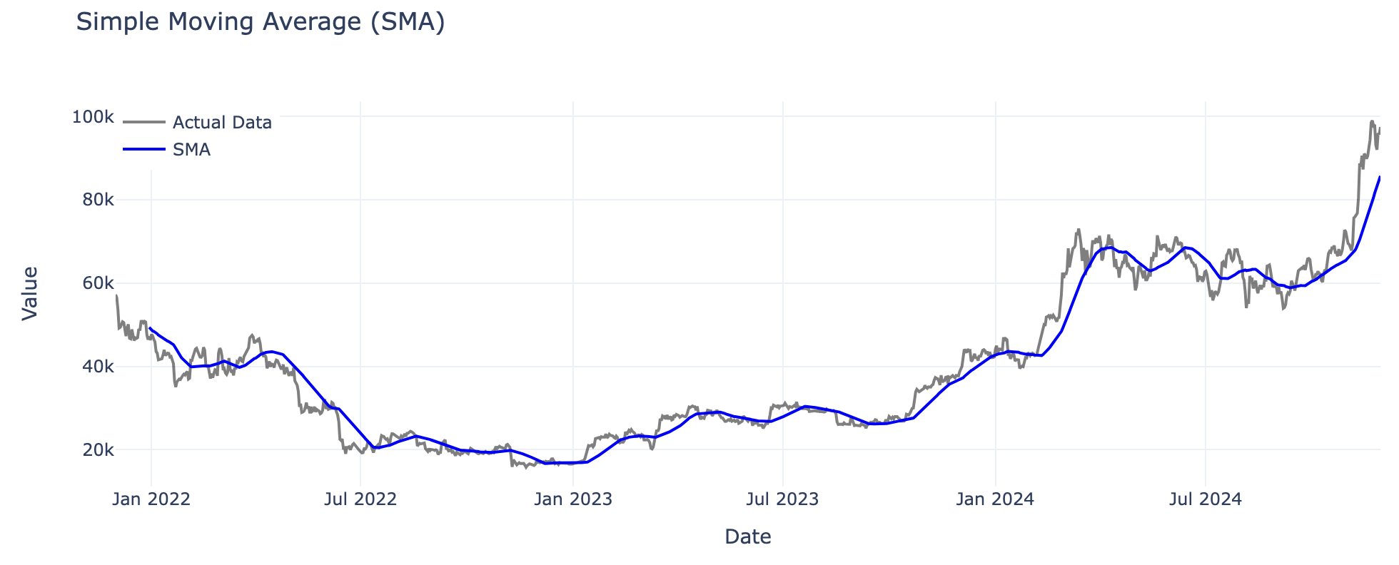
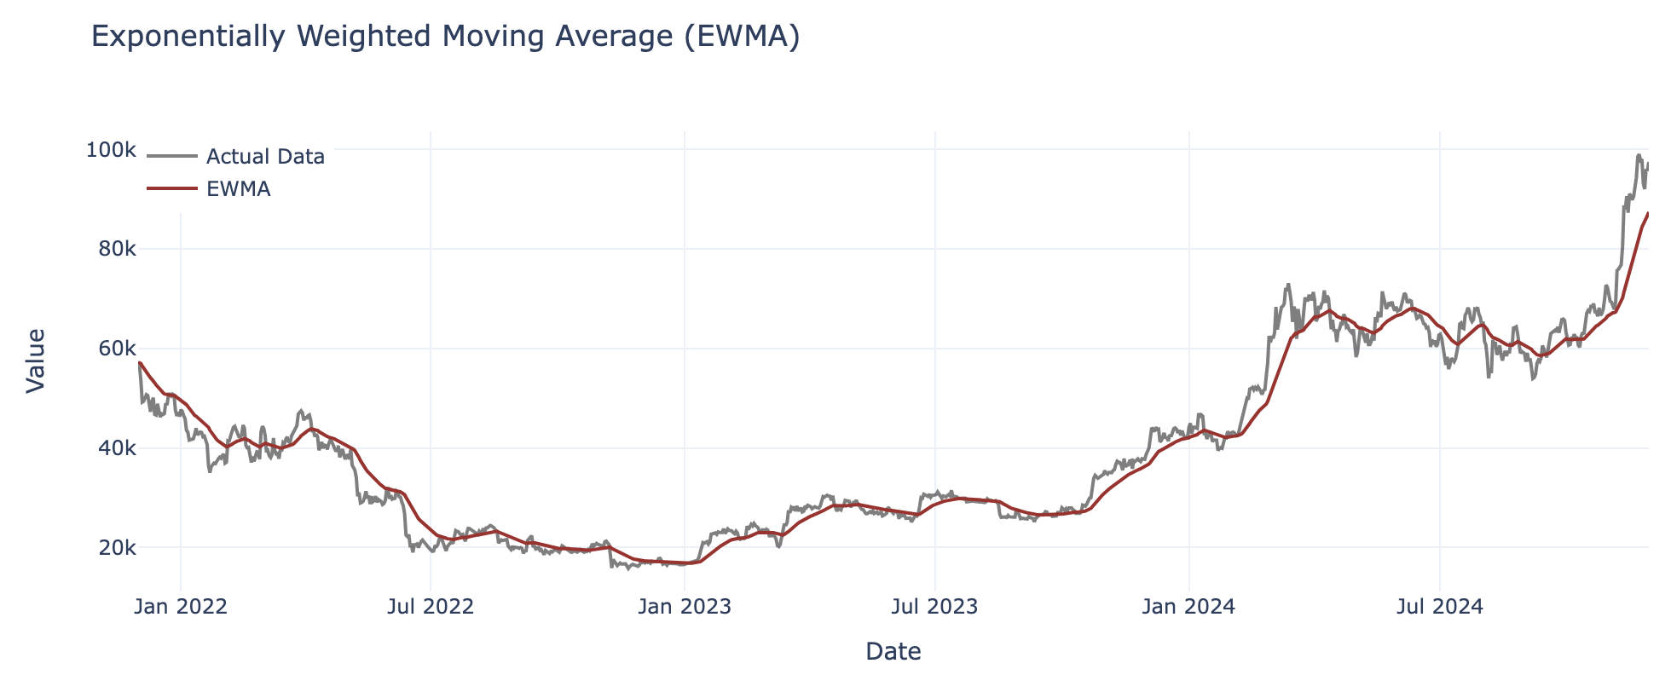
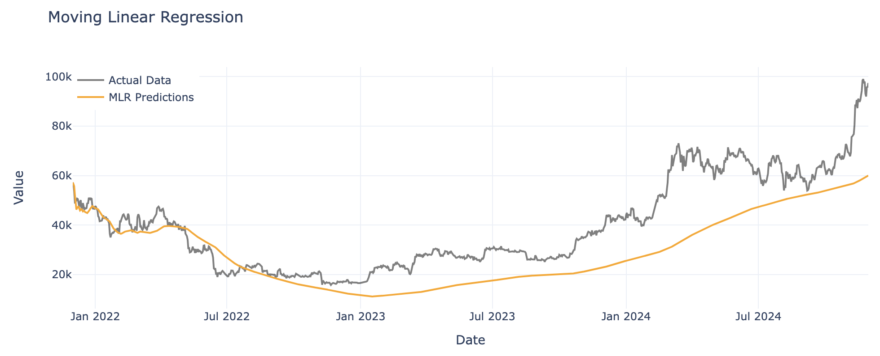
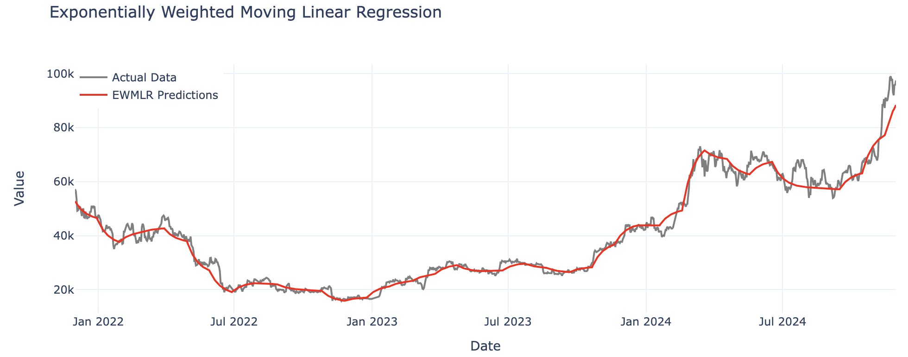

Slide 3
Problem
Exponentially Weighted Moving Average (EWMA), while effective at detecting small shifts in non-stationary datasets by prioritizing recent data, often fail to capture larger shifts, long-term patterns, or significant trends over time; on the other hand, traditional linear regression excels at modeling linear inter-variable relationships but lacks the adaptability needed for changing patterns and non-stationary behavior.

Slide 4

Objectives
To combine the exponential smoothing of EWMA with the adaptability of linear regression to:
reduce error rates
capture long-term trends
less sensitive to outliers

Slide 5
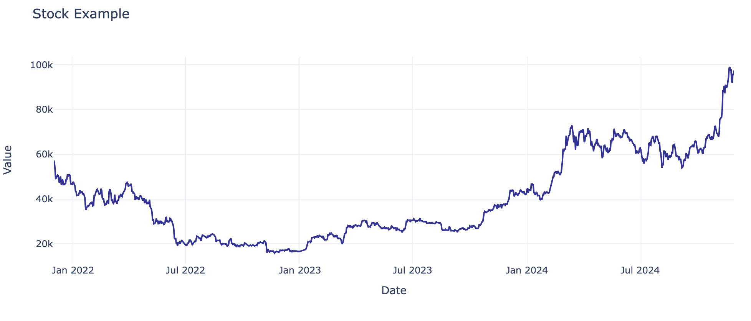

Slide 6
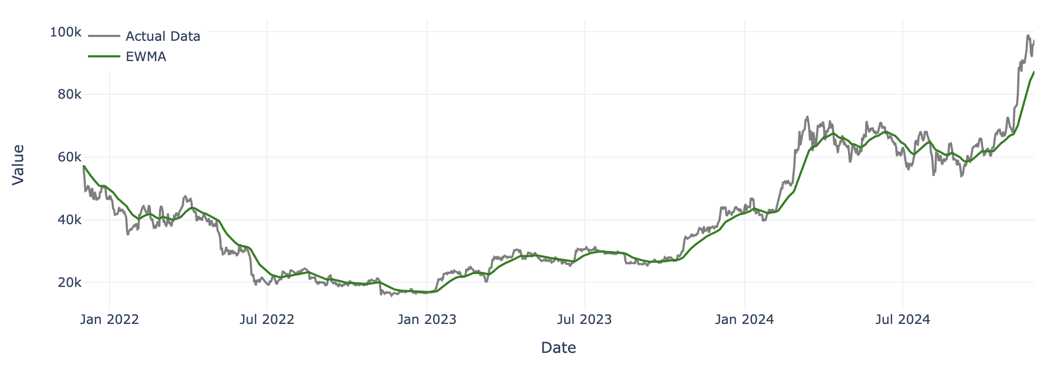
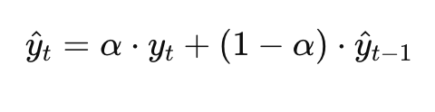
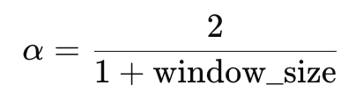
Estimate ( ŷ )
Higher Importance
Reduced Importance
What does Exponentially Weighted Moving Average (EWMA) do?
Where:

Slide 7

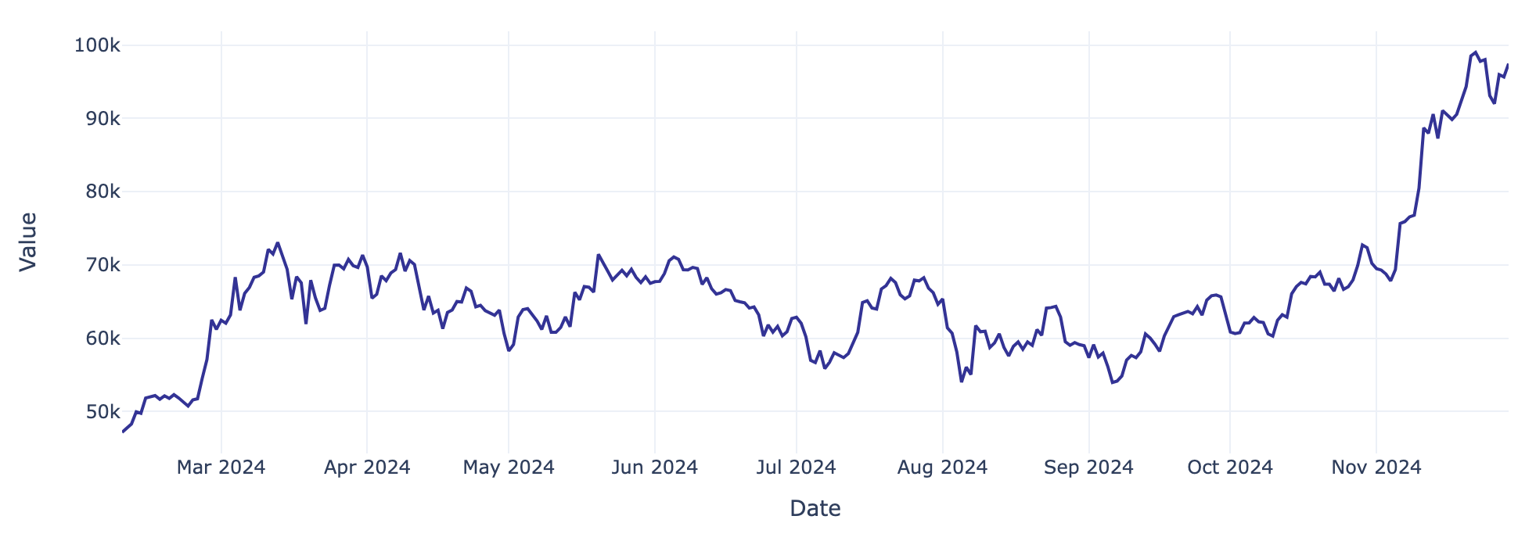
How does Exponentially Weighted Moving Linear Regression work?
Window Size = 30

Slide 8

Why it matters?
1. It adapts to changing trends

Slide 9
Why it matters?
2. It avoids overreacting to random spikes

Slide 10
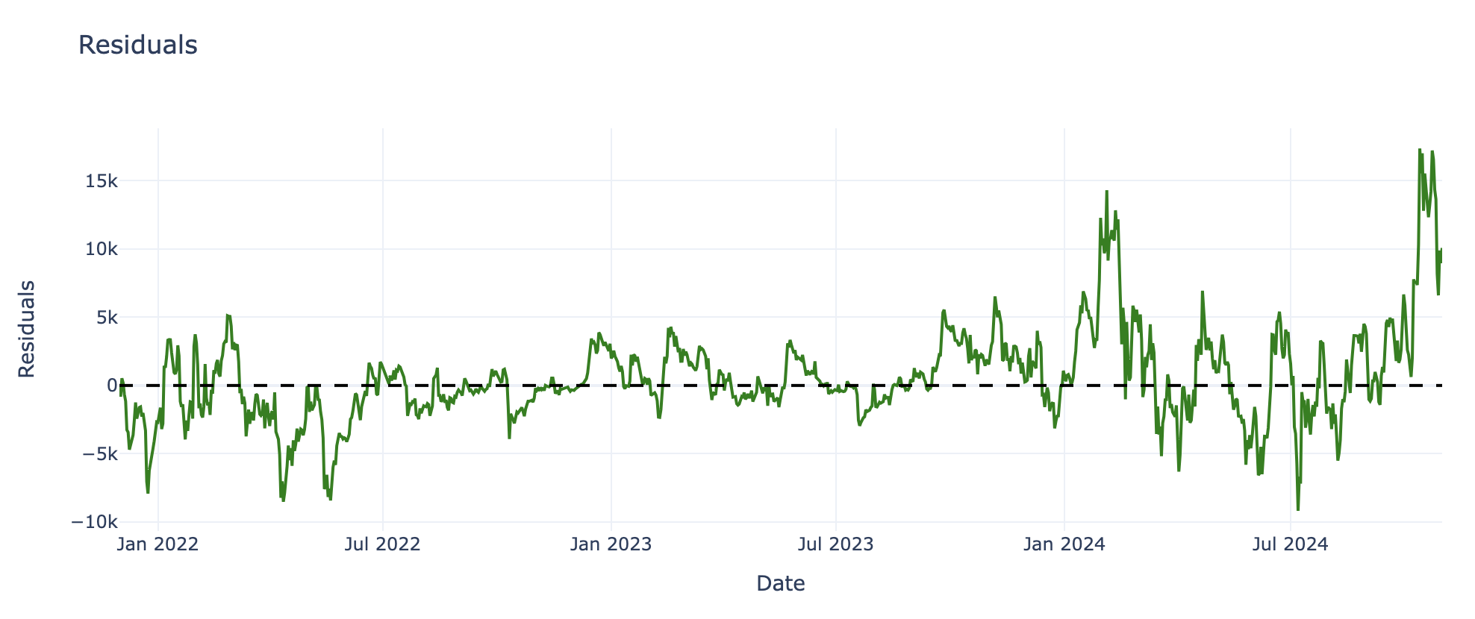
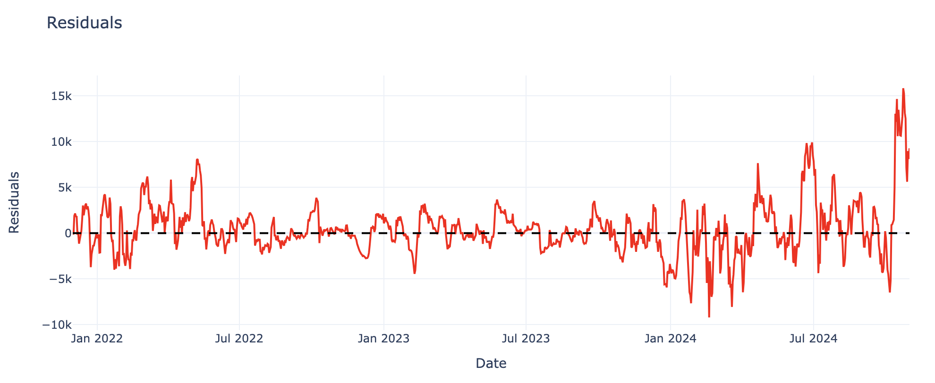
Why it matters?
EWMA
Reference Line
3. It has less error rates
EWMLR
Reference Line

Slide 11
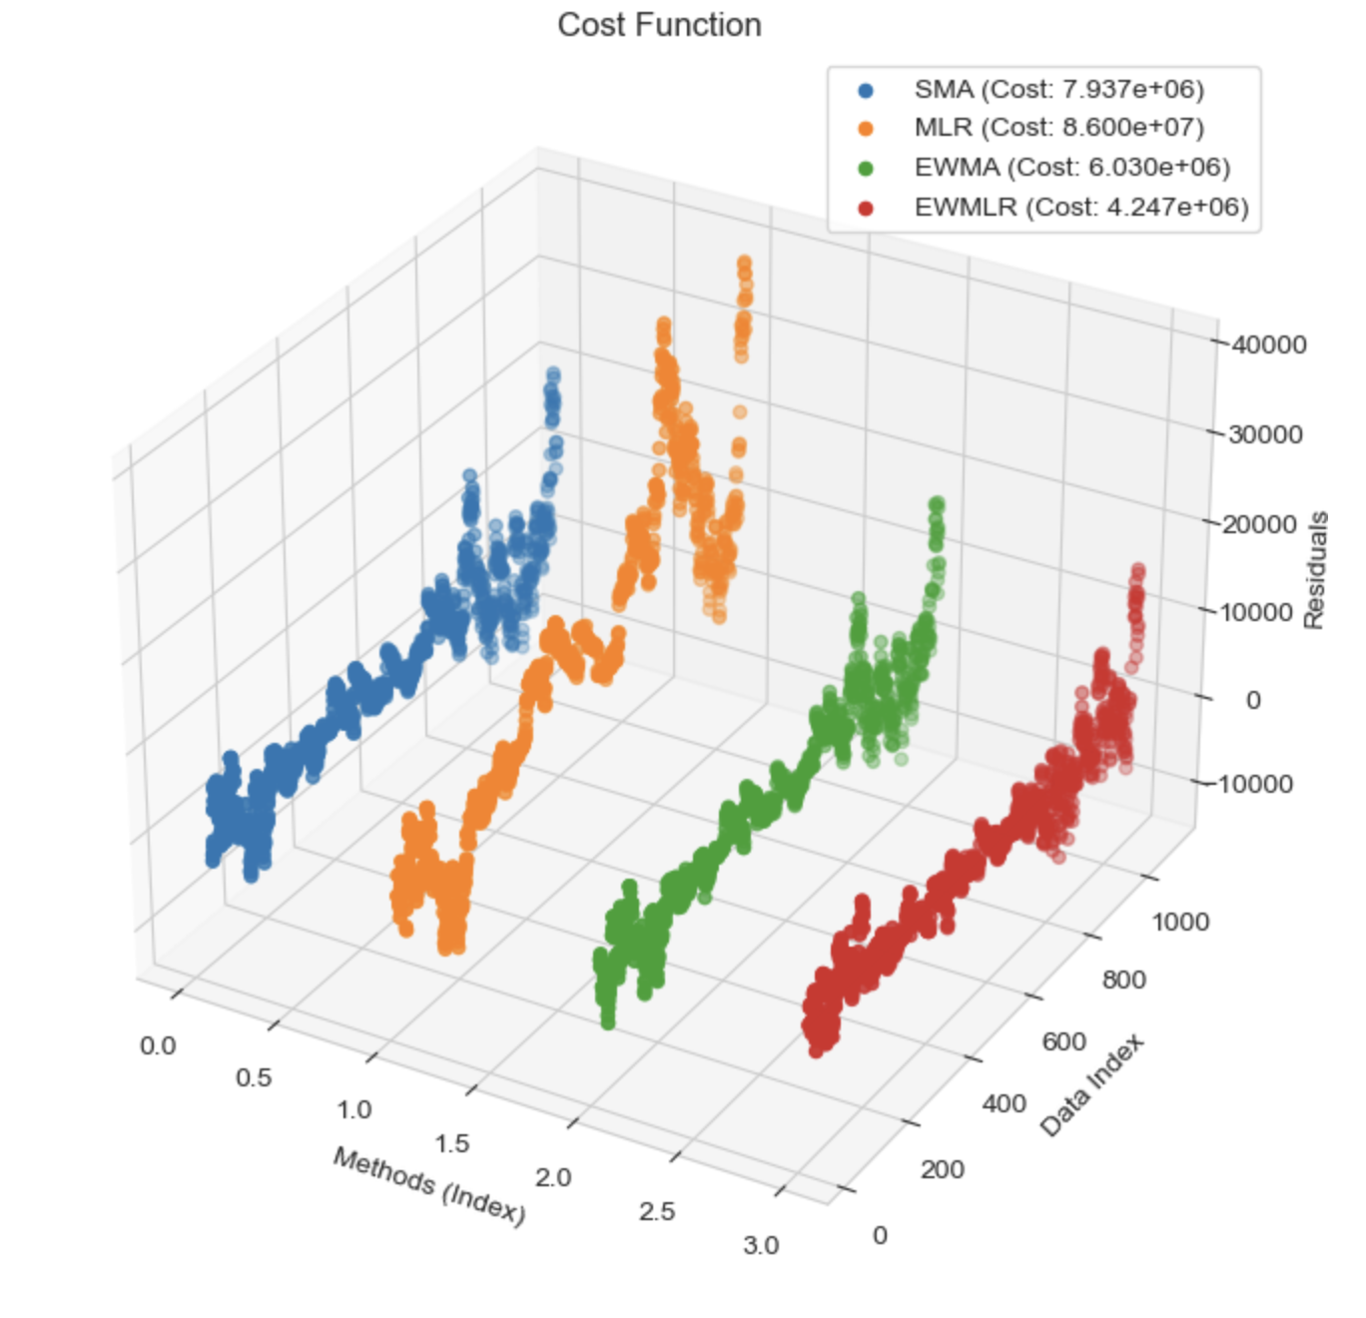
Cost Function

Slide 12
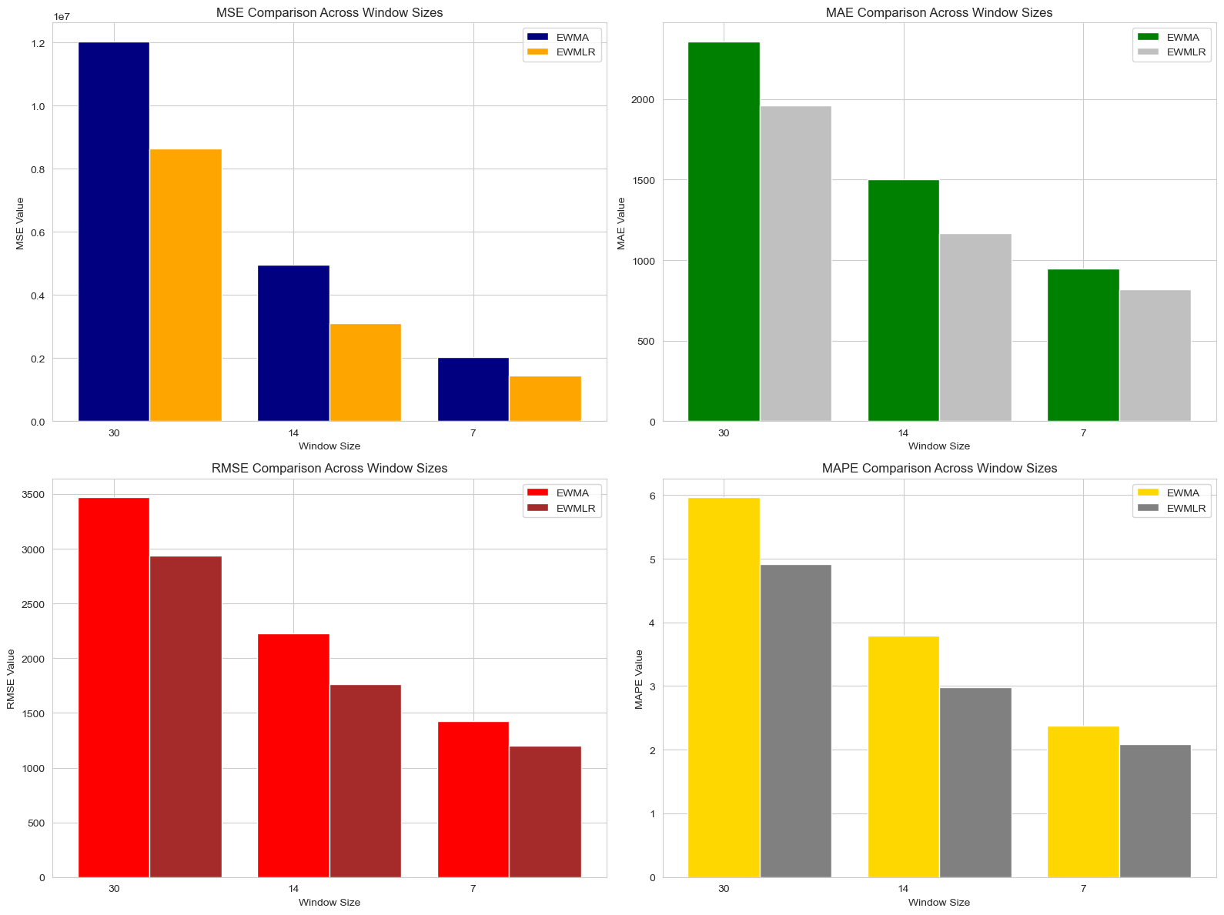

Slide 13

Conclusions
EWMLR consistently outperforms EWMA.
Suitable for dynamic and complex data.
Balances Smoothing and Predictive Accuracy.

Slide 14

Dataset
From: December 01, 2021
To: November 30, 2024
Source: Yahoo Finance

Slide 15

Thank You!

