Slide 1

FLOWER SPECIES IDENTIFICATION USING DEEP CONVOLUTIONAL NEURAL NETWORKS
Under the Esteemed Guidance of
Mr. K.S.H.P Kumar M.Tech
Assistant Professor
Department of Computer Science and Engineering
Presented by:
P . Lakshmi Niharika(189P1A0564)
D . Bhanu Prasad(189P1A0560)
M . Jayasai Suryaraj(189P1A0581)
N . Jagadesh Varma(189P1A0562)

Slide 2
PROJECT ABSTRACT
Automatic identification and recognition of medicinal plant species in environments such as forests, mountains and dense regions is necessary to know about their existence. In recent years, plant species recognition is carried out based on the shape, geometry and texture of various plant parts such as leaves, stem, flowers etc. While modern search engines provide methods to visually search for a query image that contains a flower, it lacks in robustness because of the intra-class variation among millions of flower species around the world Images of the plant species are acquired using the built-in camera module of a mobile phone. Feature extraction of flower images is performed using a Transfer Learning approach (i.e. extraction of complex features from a pre-trained network). A machine learning classifier such as Logistic Regression or Random Forest is used on top of it to yield a higher accuracy rate. It is observed that, CNN combined with Transfer Learning approach as feature extractor outperforms all the handcrafted feature extraction methods such as Local Binary Pattern (LBP) by using VGG19 pretrained model Architecture. we are obtaining 90.52% accuracy for the project .

Slide 3
EXTISTING SYSTEM
Identification and recognition of medicinal plant species in environments such as forests, mountains and dense regions is necessary to know about their existence. In recent years, plant species recognition is carried out based on the shape, geometry and texture of various plant parts such as leaves, stem, flowers etc. Flower based plant species identification systems are widely used. While modern search engines provide methods to visually search for a query image that contains a flower, it lacks in robustness because of the intra-class variation among millions of flower species around the world. Hence in this we are proposing deep learning model to predict efficient detection of flower species.

Slide 4
DISADVANTAGES OF EXISTING SYSTEM
Large number of Species to be discriminated from one flower to another.
Different species that are extremely similar to one another.
Same species that vary in their Morphology.

Slide 5
PROPOSED SYSTEM
We have developed a deep learning network for classification of different flowers. For this, we have used kaggle category flower data-set having 4242 images of flowers. The data collection is based on the data flicr, Google images, Yandex images. You can use this dataset to recognize plants from the photo. The pictures are divided into five classes: Daisy, Tulip, Rose, Sunflower, Dandelion. For each class there are about 800 photos. Photos are not high resolution, about 320x240 pixels. Photos are not reduced to a single size, they have different proportions. This method for classification of flowers can be implemented in real-time applications and can be used to help botanists for their research as well as camping enthusiasts.

Slide 6
ADVANTAGES OF PROPOSED SYSTEM
There is high accuracy and efficiency in predicting the type of flower.
This will help Botanist for their research for finding new species from different flowers.
Model can be deployed into a Web Application.

Slide 7
HARDWARE REQUIREMENTS
Processor : Intel Core-i3
Hard Disk : 100 GB
RAM : 4 GB
SOFTWARE REQUIREMENTS
Operating System : Windows 10
Coding Language : Python
Front-End : Python

Slide 8
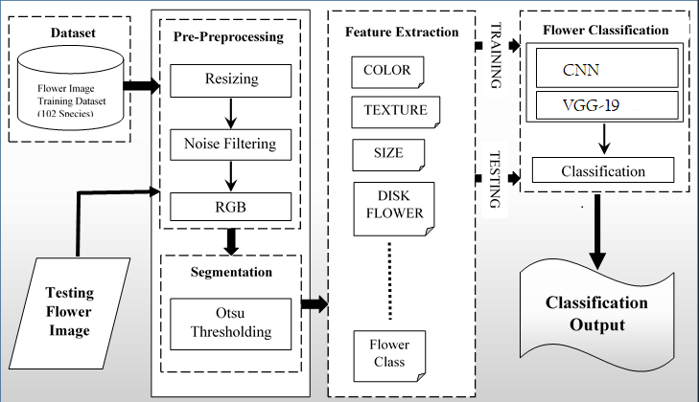
SYSTEM ARCHITECTURE

Slide 9
MODULES
There are four main modules considered for Implementation of Flower Species Identification Using Deep Convolutional Neural Network.
Data Gathering
Data Pre-Processing
Processing
Interpretation

Slide 10
DATA GATHERING
Here we try to load the dataset from kaggle website using JSON file. Here the dataset what we use for our application is flowers-recognition dataset. This dataset contains 4242 images of flowers. The data collection is based on the data flicr, google images, yandex images. You can use this dataset to recognize plants from the photo.
DATA PRE-PROCESSING
Data pre processing is a technique that is used to convert raw data into a clean dataset. A general rule of the thumb is to assign 80% of the dataset to training set and therefore the remaining 20% to test set.

Slide 11
PROCESSING
In this phase the model extracts features such as color and shape of the flower used for training. Each of the training images will be passed through a stack of layers which includes convolutional layer, pooling layer and fully connected layer of Convolutional Neural Network(CNN).
INTERPRETATION
Now the model is ready to take an unknown image of a flower and predict its name from the knowledge it gained during training and validation. Once the classification is done by the model it displays the flower species name to which it belongs.

Slide 12
ALGORITHMS
CONVOLUTION NEURAL NETWORK(CNN)
CNN(Convolutional Neural Network) is a powerful algorithm for image processing. These algorithms are currently the best algorithms we have for the automated processing of images. Many companies use these algorithms to do things like identifying the objects in an image.
CNNs have broken the mold and ascended the throne to become the state-of-the-art computer vision technique. Among the different types of neural networks (others include recurrent neural networks (RNN), long short term memory (LSTM), artificial neural networks (ANN), etc.), CNNs are easily the most popular.

Slide 13
There are three types of layers in a Convolutional Neural Network:
Convolutional Layer: In a typical neural network each input neuron is connected to the next hidden layer. In CNN, only a small region of the input layer neurons connect to the neuron hidden layer.
Pooling Layer: The pooling layer is used to reduce the dimensionality of the feature map. There will be multiple activation & pooling layers inside the hidden layer of the CNN.
Fully-Connected layer: Fully Connected Layers form the last few layers in the network. The input to the fully connected layer is the output from the final Pooling or Convolutional Layer, which is flattened and then fed into the fully connected layer.

Slide 14
TRANSFER LEARNING
Transfer learning for machine learning is when existing models are reused to solve a new challenge or problem. Transfer learning is not a distinct type of machine learning algorithm, instead it’s a technique or method used whilst training models.
The knowledge developed from previous training is recycled to help perform a new task. The new task will be related in some way to the previously trained task, which could be to categorize objects in a specific file type. The original trained model usually requires a high level of generalization to adapt to the new unseen data.
Transfer learning means that training won’t need to be restarted from scratch for every new task. Training new machine learning models can be resource-intensive, so transfer learning saves both resources and time. The accurate labelling of large datasets also takes a huge amount of time.

Slide 15
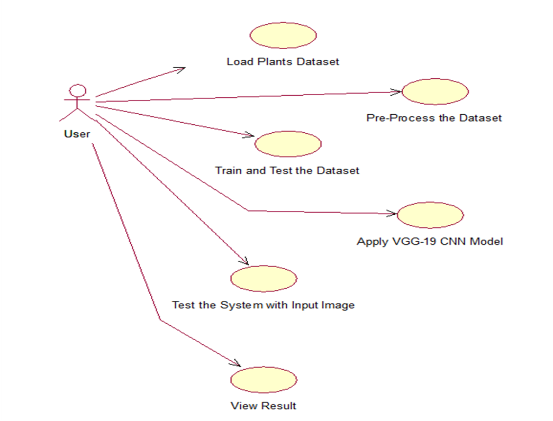
UML DIAGRAMS
USE CASE DIAGRAM

Slide 16
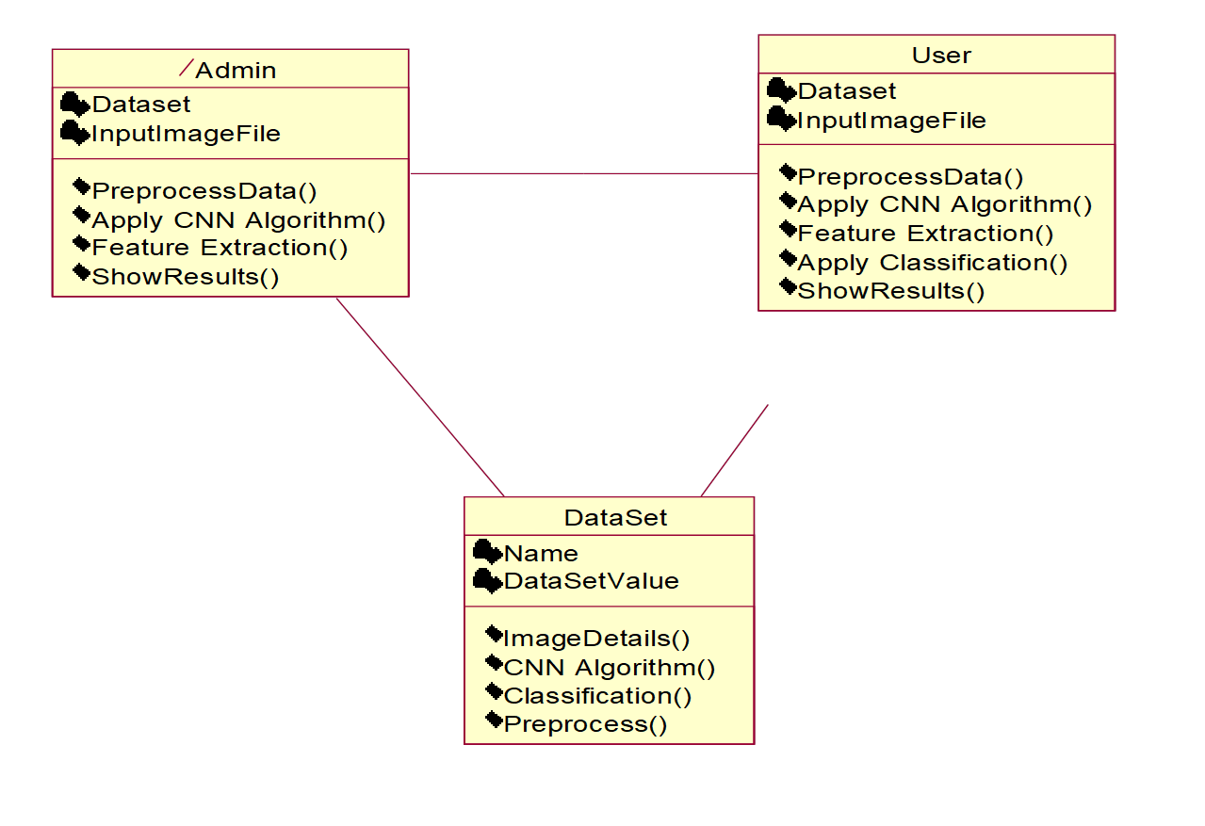
CLASS DIAGRAM

Slide 17
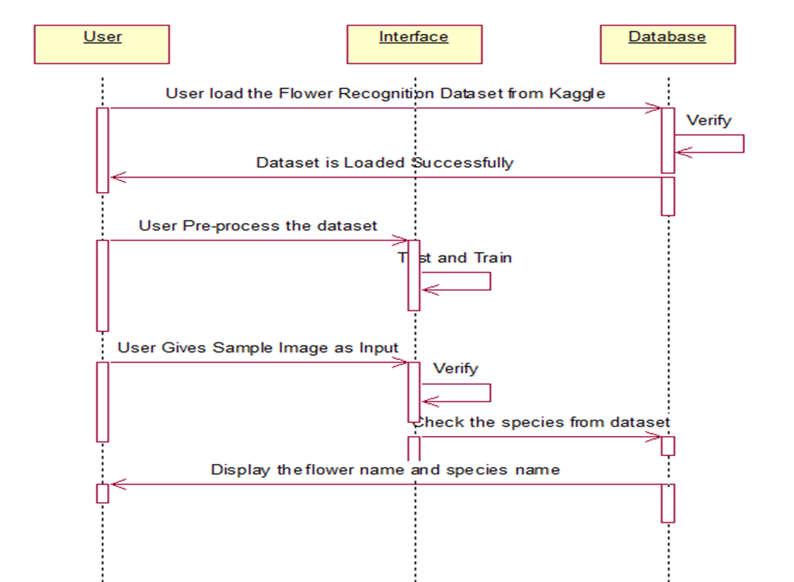
SEQUENCE DIAGRAM

Slide 18

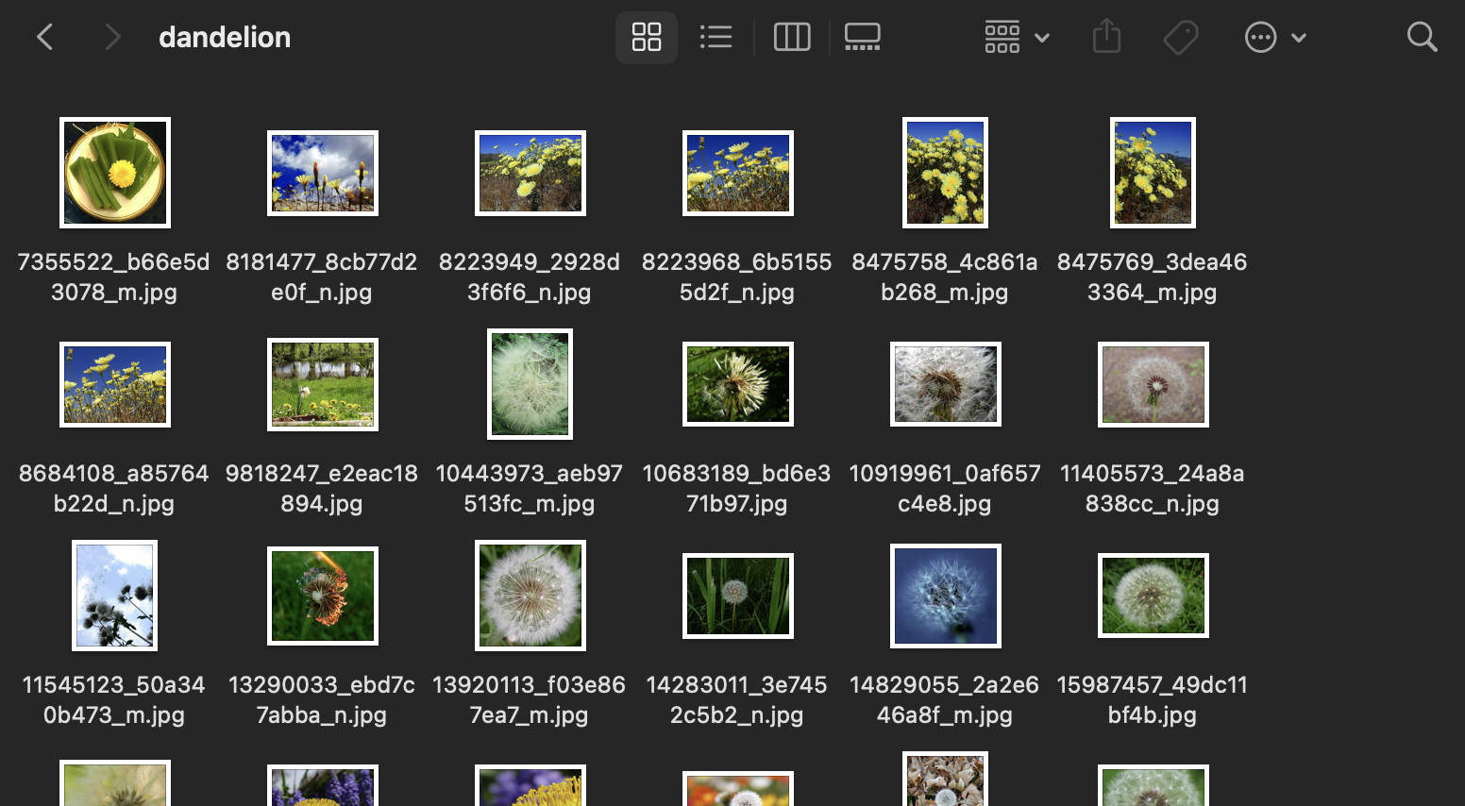
SAMPLE SCREENSHOTS
DATASET

Slide 19
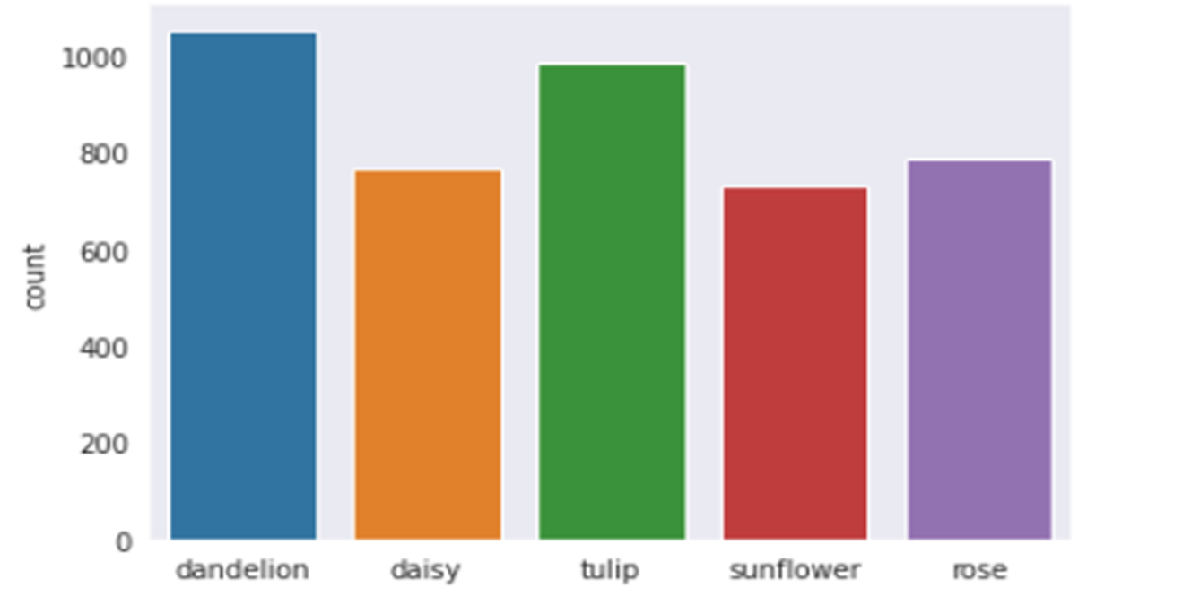
GRAPH REPRESENTING INDIVIDUAL SPECIES COUNT IN THE DATASET

Slide 20
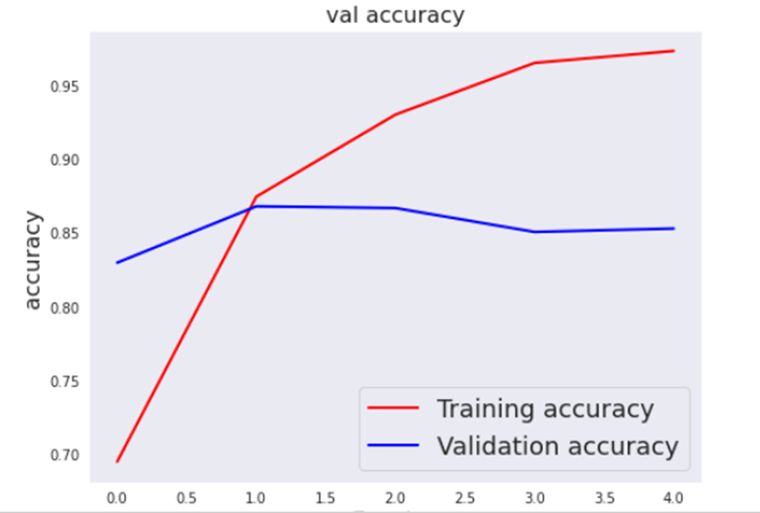
TRAINING ACCURACY vs VALIDATION ACCURACY

Slide 21
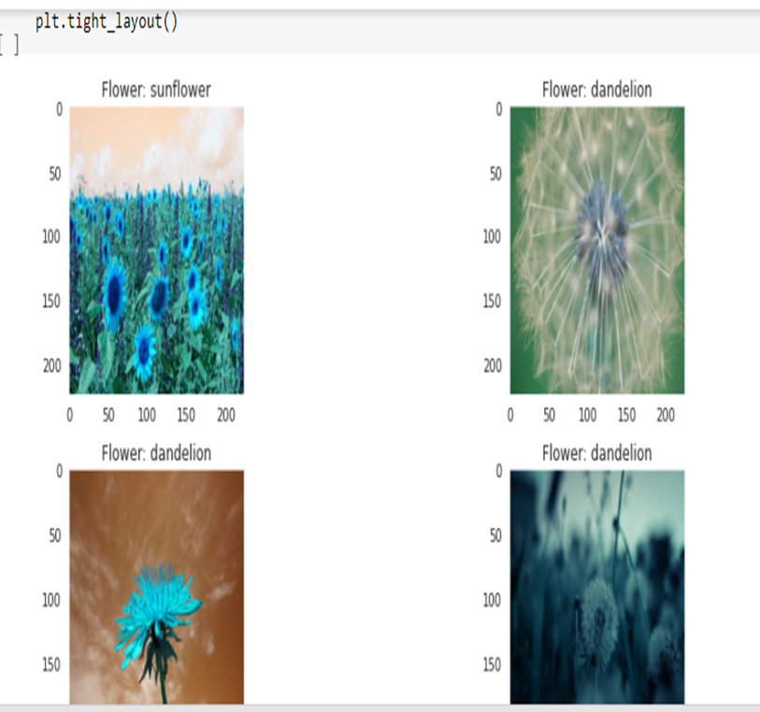
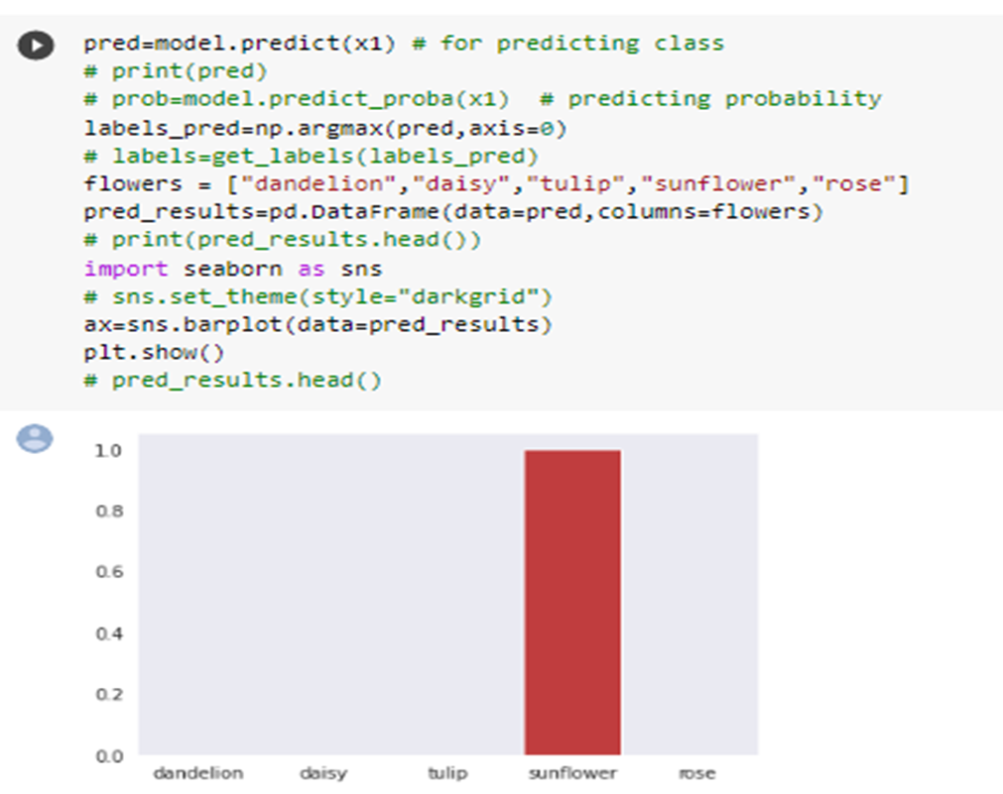
CLASSIFIED IMAGE AND BARPLOT

Slide 22
CONCLUSION
The proposed work is a faster way to train a Convolutional Neural Network (CNN) with a smaller dataset and limited computational resource such as CPU. As there are millions of flower species around the world, this system could easily be adapted by training more number of flower species images to recognize different species around the world. Thus, the future work would be to construct a larger database with not only flower images, but also with leaves, fruits, bark etc., collected from different sources around different parts of the world. This system would also be useful to identify plants for medicinal purposes such as in case of first aid. The user can quickly take an image of the plant species and get information about it to decide whether or not it can be used for first aid. The crucial part in building such a system is the training dataset which needs to be prepared either by manually taking pictures of the plants around the city or by using public datasets.

Slide 23
FUTURE SCOPE
Image Recognition can be used to extract not only the linear measurements typical of botanical descriptions (leaf length, leaf width, petal length, etc.), but also more sophisticated and precise descriptions such as mathematical models of leaf shapes.
In coming days, Computer Vision can be vital in Improving data glasses that uses video sensor technology to record environmental conditions and supports users in real time via the Internet using the collected information.

Slide 24
THANK YOU !

