Slide 1


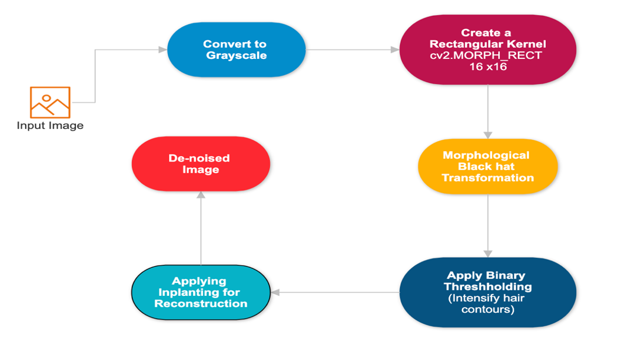
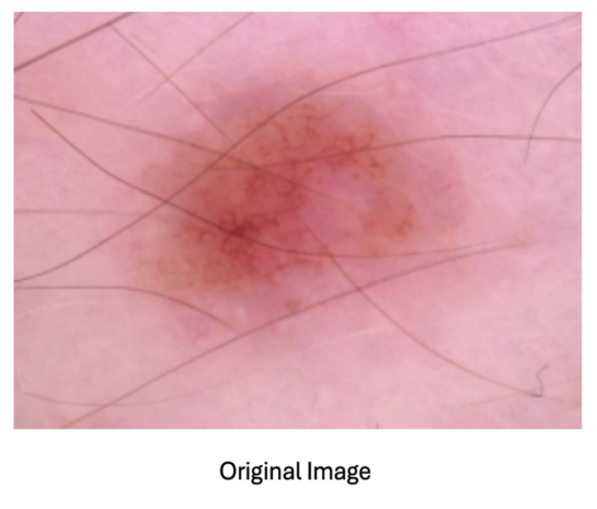
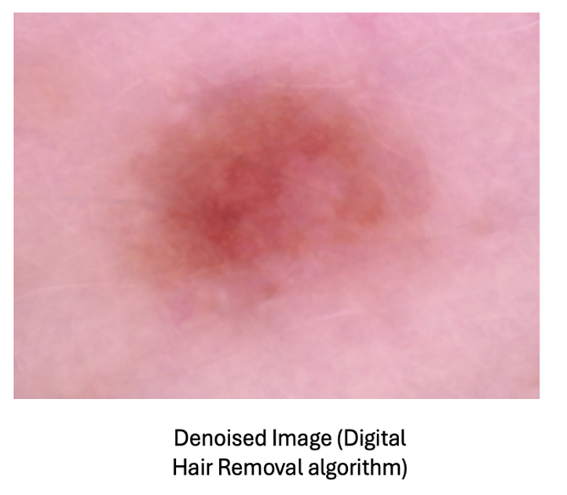
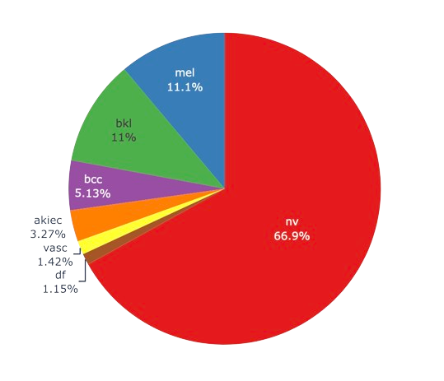
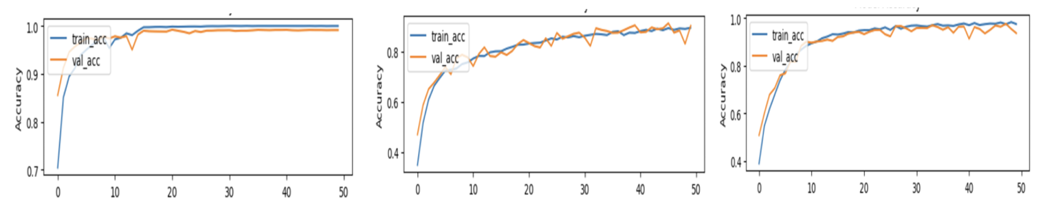
Vision Transformers and EfficientNetV2
for Skin Cancer Diagnosis
Student: Jagadesh Varma Nadimpalli
Professor: Krishna Mohan Bathula
Analytics Capstone Project CS 668, Pace University – New York
BACKGROUND
LITERATURE REVIEW
One in five Americans will develop skin cancer in their lifetime, making it the most common form of cancer in the U.S.
Skin cancer treatments cost over $8 billion annually, emphasizing the need for effective prevention and early detection strategies.
The five-year survival rate for localized melanoma is 99%, which significantly decreases to 68% and 30% as the cancer progresses to more advanced stages.
Affects over 3 million annually with basal cell carcinoma (BCC) increasing by 145% and squamous cell carcinoma (SCC) by 263% from 1976-1984 to 2000-2010. [1]
Digital Hair removal algorithm and image Comparison
Research shows that VGG-19 outperforms VGG-16 in skin cancer classification, demonstrating the enhanced capabilities of CNNs in complex image analysis.
EfficientNet, notable for its efficiency and fewer parameters, achieved 84.4% accuracy in the ImageNet challenge, while transfer learning with models like Mobile-Net addresses the lack of labeled data in skin cancer research.
Utilizing the Noisy Student (EfficientNet-L2) model has addressed class distribution issues, and DenseNet-121 has significantly improved melanoma detection with up to 95% accuracy on the ISIC dataset.
The study explores Vision Transformer and Swin Transformer, which excel in capturing spatial relationships and offer more scalability and flexibility than traditional CNNs, enhancing skin cancer classification accuracy and efficiency.
EFFICIENTNETV2
EVALUATION
DATASET
EfficientNetV2 optimizes its architecture by strategically adjusting layers, employing a mix of MBConv (Mobile Inverted Bottleneck Conv) and Fused-MBConv layers for increased efficiency in processing.
EfficientNetV2 [3] differs from EfficientNet [2] by incorporating Fused- MBConv layers in earlier stages to speed up training, reducing the reliance on depth-only scaling used in EfficientNet.
Utilized pre-trained EfficientNet and EfficientNetV2 models from TensorFlow & Keras, incorporating global average pooling and ReLU activation functions in my model building. This approach, based on transfer learning, significantly enhances performance and streamlines development by providing a strong foundation without the necessity for large-scale training data.
EfficientNet Models: EfficientNet (B0, B1, B2, B3, B4, B5, B6, B7)
EfficientNetV2 Models: EfficientNetV2 (B0, B1, B2, B3, S, M, L)
Model Training Sessions:
First Training Session: Utilized fifteen versions of EfficientNet and EfficientNetV2 models trained for ten epochs on a dataset of 10,015 images. Outcomes indicated that EfficientNetV2 models generally outperformed the original EfficientNet versions.
Second Training Session: Focused on the best-performing EfficientNetV2 models (B0, B1, B2) using an augmented dataset to enhance diagnostic accuracy. Image augmentation techniques were applied to ensure unbiased frequency across diagnoses. The EfficientNetV2 B2 model showed notable accuracy and stability.
Third Training Session: Extended the training to fifty epochs with a reduced learning rate (0.001) for final model refinement. The session disregarded previous histories to ensure fresh evaluations and leveraged predefined functions to maintain consistency in layer architectures and hyperparameters. After final model training the EfficientNetV2 and Vision Transformers performances are shown below.
Model Testing Phases:
First Testing Phase: Employed a hold-out test image set to evaluate the models. The EfficientNetV2 B2 model achieved the highest accuracy at 98.5%, followed by the Swin Transformer model at 94.64%, and the ViT8x8 model at 91.27%. Confusion matrices from this phase illustrated the diagnostic accuracy of each model on 5,818 skin cancer images.
Second Testing Phase: Tested against an external image set containing 1,230 images from the ISIC 2018 Task 3 image directory. The EfficientNetV2 B2 model again led with a 70.41% accuracy, followed by the Swin Transformer model at 65.04%, and the ViT8x8 model at 63.5%. This phase highlighted the need for further architectural improvements and robust testing on external datasets to achieve state-of-the-art performance.
The dataset is hosted on Harvard Dataverse and can be accessed through this direct link: HAM10000 Dataset on Harvard Dataverse.
The dataset comprises 10,015 dermatoscopic images which are labeled with one of seven different categories of skin lesions. Each image is provided with a corresponding diagnosis based on expert dermatoscopic analysis, ensuring high reliability for training purposes.
Types of Skin Cancer in the Dataset:
Melanocytic nevi (nv)
Melanoma (mel)
Benign keratosis-like lesions (bkl)
Basal cell carcinoma (bcc)
Actinic keratosis
intraepithelial carcinoma (akiec)
Vascular lesions (vasc)
Dermatofibroma (df)
ViT 8x8 (COMPACT VISION TRANSFORMER)
Vision Transformers leverage a self-attention mechanism to effectively prioritize and process various parts of an image, capturing complex relationships and dependencies that traditional Convolutional Neural Networks (CNNs) might overlook.
Unlike CNNs, which primarily detect local features, Vision Transformers analyze both local and global contexts within an image. This ability to integrate comprehensive image insights typically results in better performance on tasks requiring a holistic view, especially when trained on large datasets.
In the Vision Transformer architecture, input images are first split into fixed-size patches. These patches are then flattened and linearly embedded before being processed. This initial step transforms the 2D image data into a sequence of 1D tokens, analogous to words in a sentence, which the transformer can process.
After embedding, the sequence of image patches (tokens) passes through multiple layers of transformer encoders. Each encoder layer consists of multi-head self-attention mechanisms and position-wise feed-forward networks.
I have adapted the standard Vision Transformer architecture to better suit smaller 32x32 pixel images by developing the vit8x8 model, which utilizes smaller 8x8 pixel patches for more detailed feature extraction. This modified approach allows for enhanced resolution of attention within the compact image dimensions, starting with a custom Patches layer that precisely extracts these smaller patches, optimizing the model for datasets with limited image resolution.
EfficientNetV2B2 ViT 8x8 Swin Transformer
Image Denoising Technique
For image denoising Digital Hair Removal Algorithm is applied. The following are the steps involved:
Image Loading and Grayscale Conversion: The algorithm loads an original image and converts it to grayscale to simplify data processing.
Applying Black Hat Morphological Operation: It employs a Black Hat morphological operation to highlight dark structures like hair against lighter skin.
Thresholding for Hair Detection: A binary thresholding technique is then applied to isolate these dark structures from the rest of the image.
Image Inplanting to Remove Hair: Finally, the detected hair is digitally removed using inplanting, which reconstructs the underlying skin area affected by hair in the image.
SWIN TRANSFORMER
REFERENCES
The Swin Transformer [4] refines the original Vision Transformer architecture by introducing a hierarchical structure that processes images in shifted windows, allowing for efficient scale handling and a reduction in computation compared to the standard Vision Transformer.
This approach maintains the use of self-attention but localizes it within non-overlapping windows and across different resolutions, which enhances the model's ability to capture both fine details and broader contextual information more effectively.
I developed a Swin Transformer model that adapts transformer principles for vision tasks, particularly for handling 32x32 image inputs. The model first uses a Conv2D layer with a 4x4 kernel and stride of 4 to down-sample the image, transforming each 32x32 input into an 8x8 grid of 96-dimensional embeddings while preserving spatial structures.
American Academy of Dermatology. "Skin Cancer Statistics." American Academy of Dermatology, www.aad.org/media/stats-skin-cancer. Accessed 30 Apr. 2024.
Tan, Mingxing, and Quoc Le. "Efficientnet: Rethinking model scaling for convolutional neural networks." International conference on machine learning. PMLR, 2019.
Tan, M., and Q. V. Le. "Efficientnetv2: Smaller models and faster training. arXiv 2021." arXiv preprint arXiv:2104.00298.
Liu, Ze, et al. "Swin transformer: Hierarchical vision transformer using shifted windows." Proceedings of the IEEE/CVF international conference on computer vision. 2021.

