Slide 1
ConnectTel Telecom
Customer Churn Prediction
End-to-End Machine Learning Project | EDA · Modelling · SHAP Explainability
Dataset
Models
Best AUC
IBM Telco
7,043 customers
21 raw features
Logistic Regression
Random Forest
XGBoost (Tuned)
0.8423
Recall → 80%
Random Forest wins
Business Intelligence | Data Science Project | 2026

Slide 2
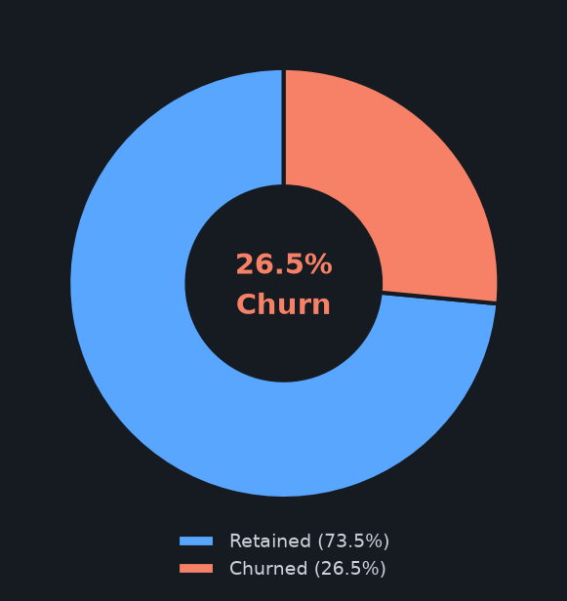
Business Problem & Dataset
Why churn prediction matters and what the data looks like
7,043
26.5%
Total Customers
Churn Rate
21
32
Raw Features
Engineered Features
80/20
11
Train / Test Split
Missing TotalCharges
Business Goal
Acquisition costs 5–25× more than retention · Telecom churn = 15–25% p.a. · Goal: AUC-ROC ≥ 0.84, Recall ≥ 78%

Slide 3
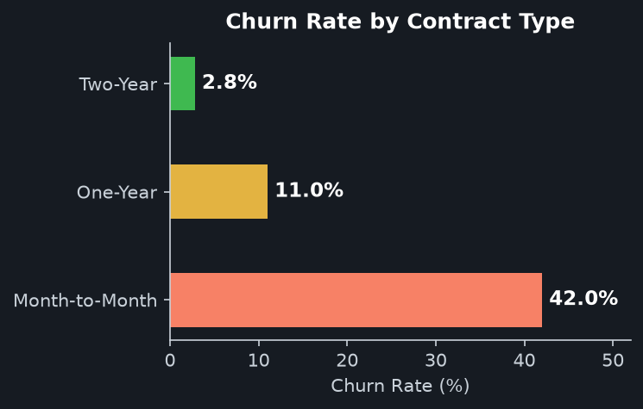
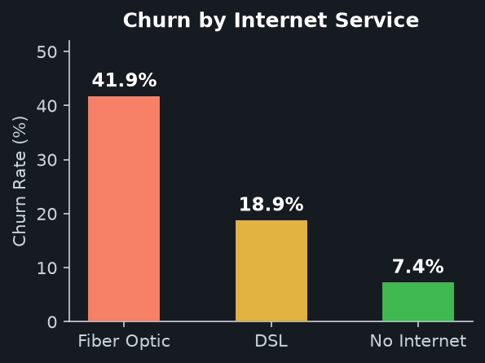
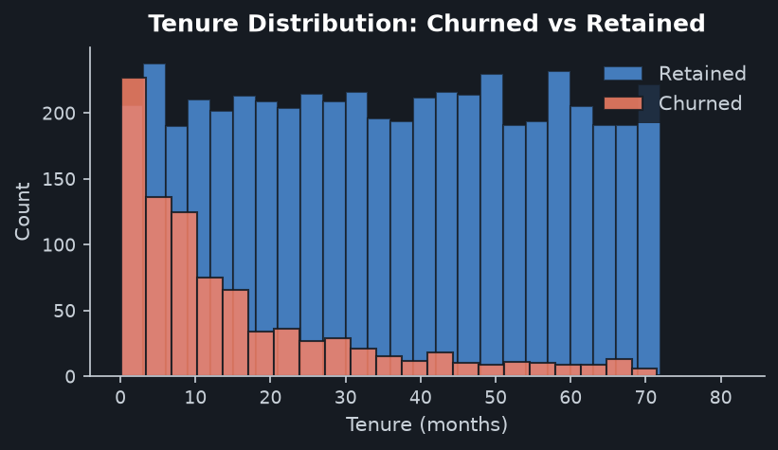
EDA Insights
Three dominant patterns that drive churn at ConnectTel
▶ Contract
▶ Internet
▶ Tenure
Month-to-month subscribers are ~14× more likely to churn than two-year contracts.
Fiber Optic users churn at ~42% — highest of all service types.
~50% of churners leave within 12 months. Early onboarding is critical.

Slide 4
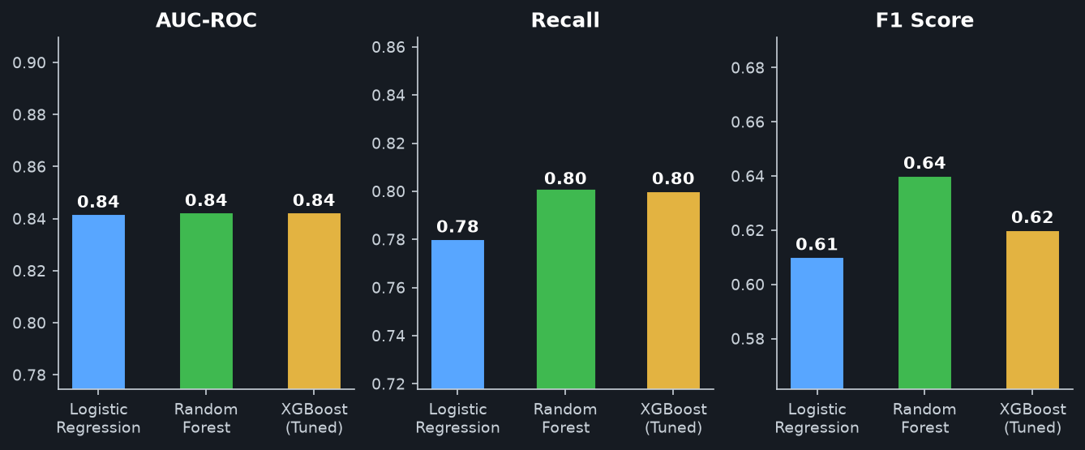
Model Comparison
Logistic Regression · Random Forest · XGBoost — Test-Set Performance
Key Takeaways
✔ All three models exceed AUC-ROC 0.80 target ✔ Random Forest leads on Recall (80%) — critical for catching at-risk customers
✔ Class-balanced training (class_weight='balanced') handles 26.5% minority churn class ✔ XGBoost tuned via GridSearchCV: 16 configs × 5-fold stratified CV

Slide 5
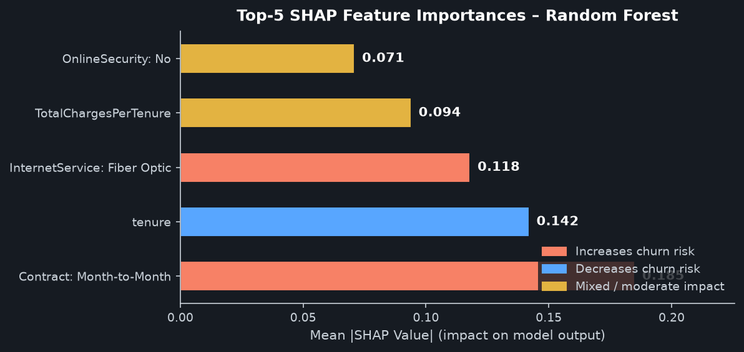
Explainable AI – SHAP Interpretability
Understanding WHY the model predicts churn, not just IF
Contract drives churn
Month-to-month = #1 predictor. Converting to annual plans has the highest single ROI.
Tenure = loyalty
Longer tenure strongly reduces churn. First-year onboarding is highest leverage.
Fiber Optic risk
High monthly cost + month-to-month contract amplifies churn probability significantly.
What is SHAP?
SHAP (SHapley Additive exPlanations) assigns each feature a contribution score for every individual prediction. Beeswarm plots show global patterns; waterfall plots explain a single customer. Enables trust, auditability, and actionable business insight.

Slide 6
Strategic Retention Recommendations
Translating model insights into business actions for ConnectTel
01
Contract Migration Campaign
02
Fiber Optic Satisfaction Programme
03
First-Year Onboarding & Nurture
Target Month-to-Month subscribers with tenure < 12 months and predicted churn probability > 0.60.
Offer discounted upgrade to 1-Year or 2-Year contracts.
📈 Expected: 15–20% reduction in early-tenure churn.
Proactively survey Fiber Optic customers monthly.
Bundle OnlineSecurity & TechSupport at preferential loyalty rates.
📈 Target: reduce Fiber churn rate from ~42% → ~28%.
Structured onboarding for all new customers (months 1–12).
Automated retention offers at 3-month & 6-month tenure marks.
📈 Track NPS scores monthly; escalate detractors immediately.
Recommendations derived from Random Forest (Best Model) + SHAP Feature Attribution | ConnectTel Churn Project 2026

