Slide 1
CASE STUDY- WADA PAV
(A CASE STUDY DONE TO OPEN AND SUCCESSFULLY RUN A WADA PAV CENTRE AT SHIVAJI NAGAR , PUNE)
-A DESIGN THINKING APPROACH
By- JAGILI BHANU PRAKASH DAIVAJNA

Slide 2
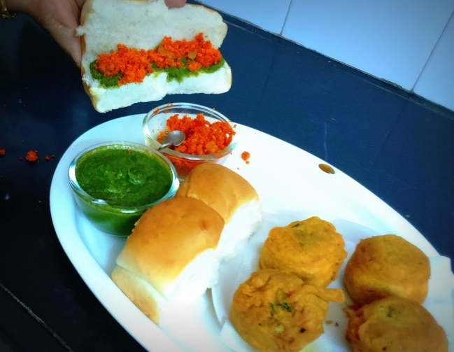
BUSINESS PROBLEM: A man wants to open a wada pav shop at Shivaji nagar, Pune But there are 4 more wada pav shops around the same location. He is not able to understand the strategy to take over his clients.
Checklist for starting the outlet –
Decide the name.
Get the required food licences .
Keep your investment money ready.
Get associated with swiggy, zomato, UBEREats etc.
Do more of market research about the location and nearby competitors outlets
Start marketing aggressively and give offers .
Name chosen : Royal wada Pav centre.

Slide 3


Based on market research done. Following decisions are taken and offers are implemented.
WHAT IS THE PRICE OF EACH PAV-
Price data of local competitors are collected.
**Prices of Royal Wada Pav centre are set low when compared to competitors price. **(taken average price of nearby competitors and rounded off)
HOW WILL HE DIFFERENTIATE FROM OTHER COMPETITORS-
**Unique type of special wada pav served on Sundays** . (This is not followed in other shops- they just follow regular menu all days. )
For example - Corn wada pav, Maggi wada pav , Pizza wada pav , Schezwan wada pav is prepared and sold on sundays.
**Offers on big orders**
Rs.5 off on order of any two types of pav.
Rs.10 off on order of any 3 types of pav.

Slide 4
Highlights of Royal wada pav centre.
Social media presence :
Instagram, facebook, whatsapp order, justdial orders, food blogs on wordpress.
Home delivery partners :
Zomato, swiggy, uberEats.
Payment mode options :
BHIM , Gpay, Phonepay, UPI, cash.
High hygiene and varieties in menu.
Parking availability and good ambience.

Slide 5
How will you bring insights when he has no data of his shop?
Strong branding and deep market knowledge.
Shop name | Rating | Quality of food | Service | Pricing
Competitor2- Ashok wada pav centre. | 3.8 | Poor | Moderate | High
Competitor 3- The wad pav café | 4.5 | Good | Good | High
Competitor 4 – Rahul wad pav shop | 4 | Good | Poor | Moderate
Competitor1 – A1 wada pav | 4.2 | Moderate | Good | High

Slide 6
Positioning : Why will the customer come to Royal Wada pav.
Food is prepared in a hygienic environment.
Best in Quality of Wada pavs
Good Standard raw materials are used in preparation.
Affordable prices keeping in mind the middle and low income group people too.
Best services and amenities compared to others.
LOW PRICE WITH BEST QUALITY WADA PAVS.
******End of case study*******
*******THANKYOU*******

