Slide 1
ElectroMacroDiff V5.5: Pocket-Electronic Macrocycle Discovery for JAK2
RTRP II-II 2026 Project Presentation | Date: 28-May-2026
1,113
V5.5 candidates
Team Members: Member 1, Member 2, Member 3, Member 4, Member 5
Mentor: To be added
Domain: AI for Drug Discovery / Computational Biology
-12.7
Best Vina-GPU
54/54
Validation checks
1

Slide 2
Contents
Narrative aligned to the supplied RTRP presentation template
Introduction and problem statement
Requirement and objectives
Architecture and implementation
MED vs EMD benchmark evidence
Docking, pocket-fit, and top candidate results
3D dashboard and validation
Limitations, learnings, and V6 roadmap
2

Slide 3
Introduction
Why JAK2 macrocycle generation needs an evidence-first workflow
JAK2 inhibitors require balancing potency, selectivity, ADMET feasibility, and binding-pocket fit.
Macrocycles can improve conformational control, but valid ring closure and linker novelty are difficult.
ElectroMacroDiff V5.5 connects generation, docking, pocket-electronic scoring, and 3D review into one auditable pipeline.
Project aim: generate and prioritize pocket-fitted JAK2 macrocycle candidates.
Current claim: pocket/electronic-conditioned generation plus post-generation docking and pocket rescoring.
Not claimed: wet-lab validation or full residue-level protein-conditioned diffusion.
3

Slide 4
Requirement
The system must be scientifically honest, reproducible, and useful for review
Need | Implementation in EMD V5.5
Functional | Curate JAK2 ligands, generate macrocycles, dock, rescore, rank, export dashboard.
Non-functional | Low-resource runnable workflow; explicit logs; no fake metrics; clear limitations.
End-user benefit | Reviewers can inspect top candidates, metrics, pose evidence, and project maturity.
Acceptance | All outputs must trace to project CSV/JSON/PDB/PDBQT artifacts.
4

Slide 5
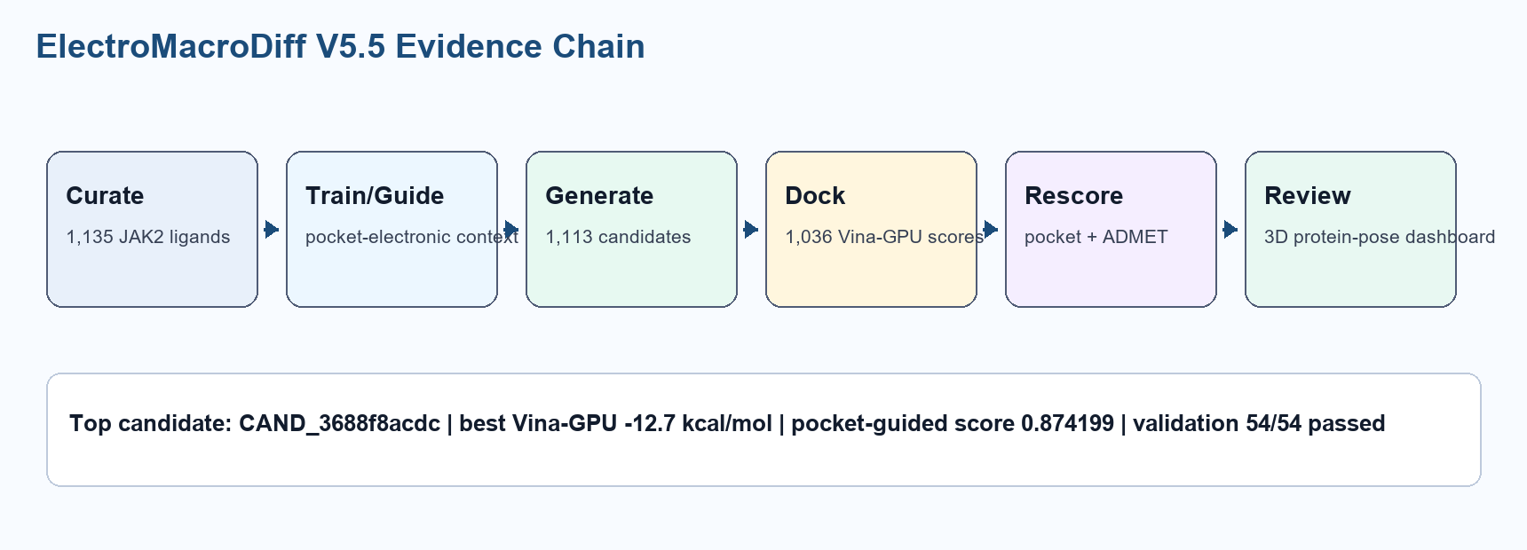
Design
Evidence chain from curated ligands to protein-ligand 3D review
5

Slide 6
Implementation
V5.5 introduced pocket/electronic-conditioned decision points
Pocket profile: hydrophobic, donor/acceptor, aromatic, charge proxy, and residue-contact features.
Generation: anchor/linker decisions, exact linker novelty enforcement, and validity/reward gate.
Docking: Vina-GPU 2.1 scoring against JAK2 5AEP grid.
Dashboard: real candidate table plus protein-pose 3D viewer.
Output | Value
Candidates | 1,113
Docked scores | 1,036
Raw attempts | 87,287
Valid outputs | 1,113
Unit tests | 40/40
Validation | 54/54
6

Slide 7
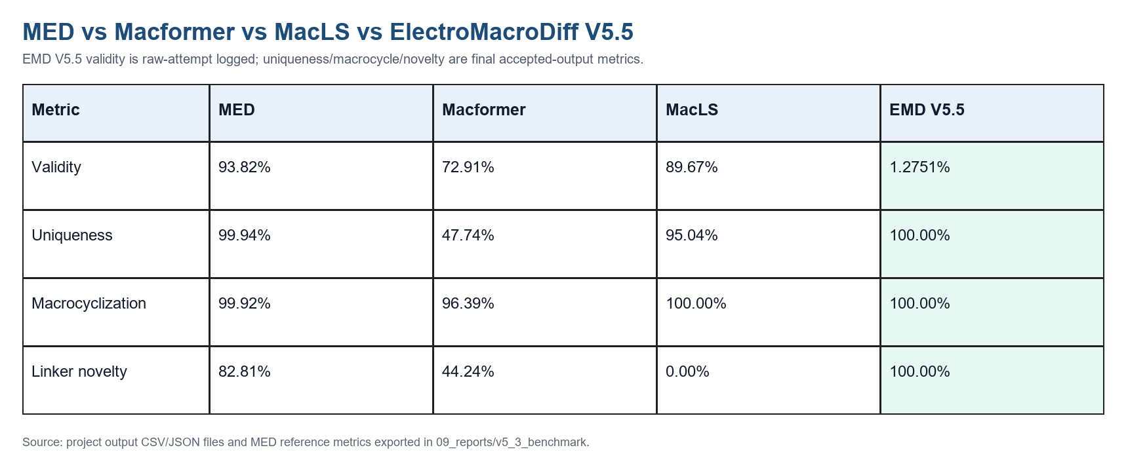
Benchmark Image
MED-style comparison, with EMD scope clearly labeled
7

Slide 8
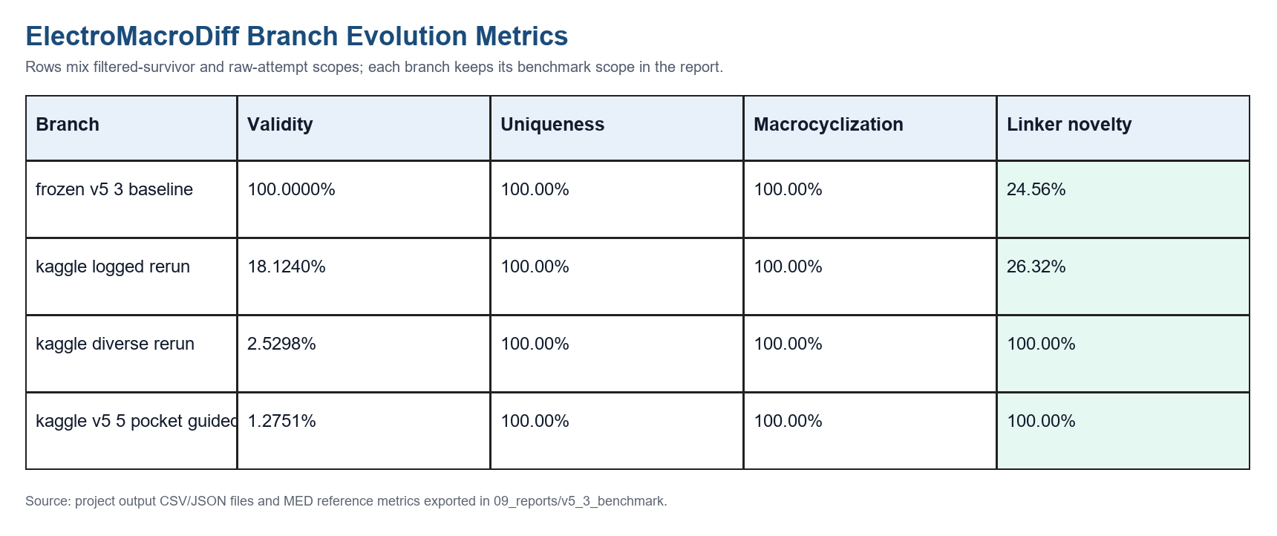
Version Evolution
EMD branches show the tradeoff between novelty gating and raw validity
8

Slide 9
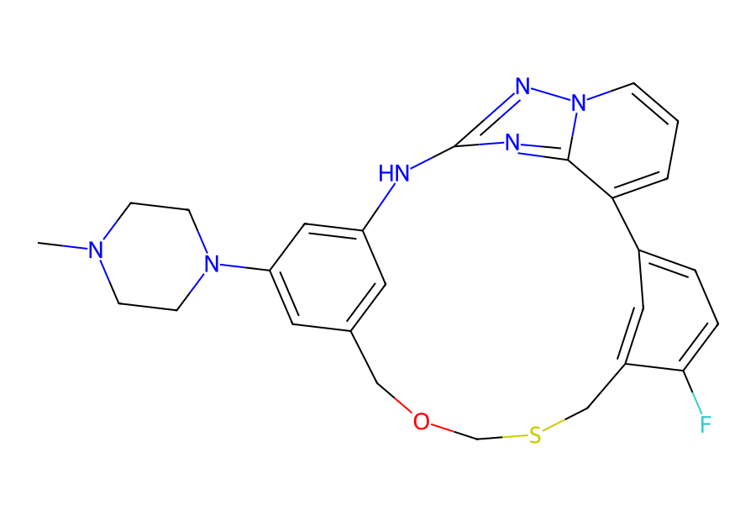
Docking and Pocket Fit
Top-ranked candidate combines strong docking with pocket-electronic evidence
-12.7
Best Vina-GPU kcal/mol
0.810776
Pocket fit score
0.874199
Final score
0.4132
QED
Top candidate: CAND_3688f8acdc
Macrocycle ring size: 16; Lipinski violations: 0.
Pocket scoring combines electrostatic, H-bond, hydrophobic, and aromatic contact components.
Top contact residues include ARG:A:980, TYR:A:931, ASN:A:981, LEU:A:932, ASP:A:939, and LYS:A:882.
9

Slide 10
3D Dashboard
Real receptor and pose files are now directly reviewable
Viewer embeds real JAK2 receptor PDB and 1,036 real docked pose texts.
Candidate list supports direct click-to-open with rank, Vina, pocket fit, contact count, and pose status.
Controls include protein+pose, pose-only, protein-only, surfaces, atom labels, bond lengths, contact labels, and docking grid box.
Important: the viewer does not invent structures.
If a pose is missing, the interface reports it as unavailable.
All candidate metrics come from interface/data.js generated from project output files.
10

Slide 11
Project Status
Complete as a computational evidence package; benchmark gaps are explicit
Completed: data curation, features, V5.5 generation, docking, pocket scoring, ADMET proxy scoring, final ranking, dashboard, validation.
Evidence package: candidate CSVs, docking scores, pose files, pocket profile JSON, reports, interface data, tests.
Validation passed: 54/54 checks; unit tests passed: 40/40.
Remaining scientific gaps: experimental validation, MD stability, free-energy estimation, residue-level learned pocket encoder.
Honest benchmark status: EMD V5.5 is target-specific and auditable; it does not fully beat MED on MED's macrocycle-generation benchmark.
11

Slide 12
Learnings and Future Scope
The next leap is V6 protein-conditioned generation
Area | Outcome
Learning | End-to-end evidence matters more than isolated generator scores.
Learning | Raw-attempt logging prevents false benchmark claims.
Learning | 3D review makes candidate evidence understandable to non-coding reviewers.
V6 | Train residue-level interaction encoder using PDBbind/PLINDER/BioLiP-style contact data.
V6 | Condition anchor and linker generation on aligned pocket poses, not only global pocket features.
12

Slide 13
Thank You
Computational candidates only - experimental validation remains required
Project: ElectroMacroDiff V5.5
Target: JAK2 5AEP
Submission package includes PPTX, IQAC DOCX, research paper draft, comparison images, and artifact summary.
13

