Slide 1
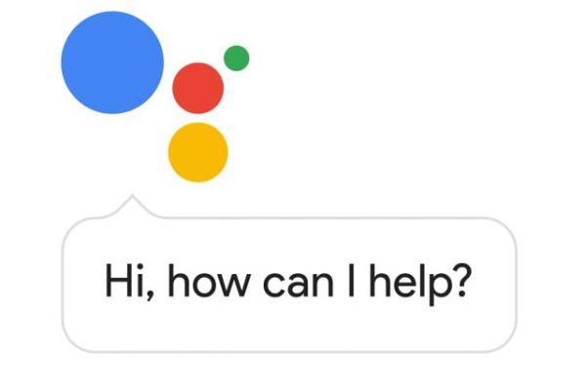

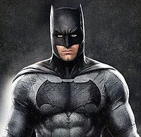
Active Vision in Robotics
Sorry, I don’t understand!
Ok Google!
Where’s my cup of tea?
Let me explore the environment and find it for you
Siddharth Ancha
Jagjeet Singh
Active Vision Agent
Notes:
Letting the robot learn where to look

Slide 2
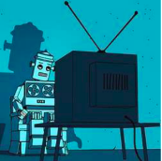


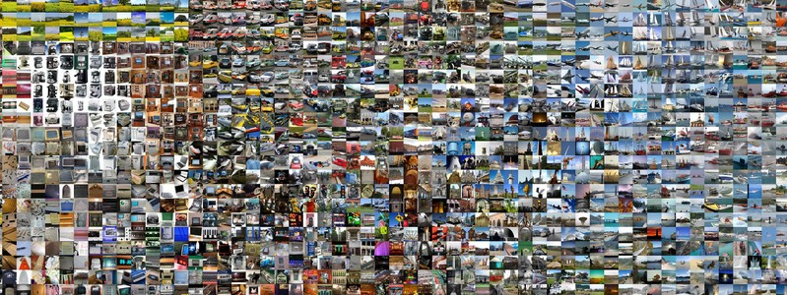
Motivation
Modern Computer Vision is all about non-interactive data
Learning agent has no control on
what images to look at
Notes:
Modern computer vision, non-interactive data
no control
Active Vision is the set up where learning agent can decide what to see for optimal learning

Slide 3
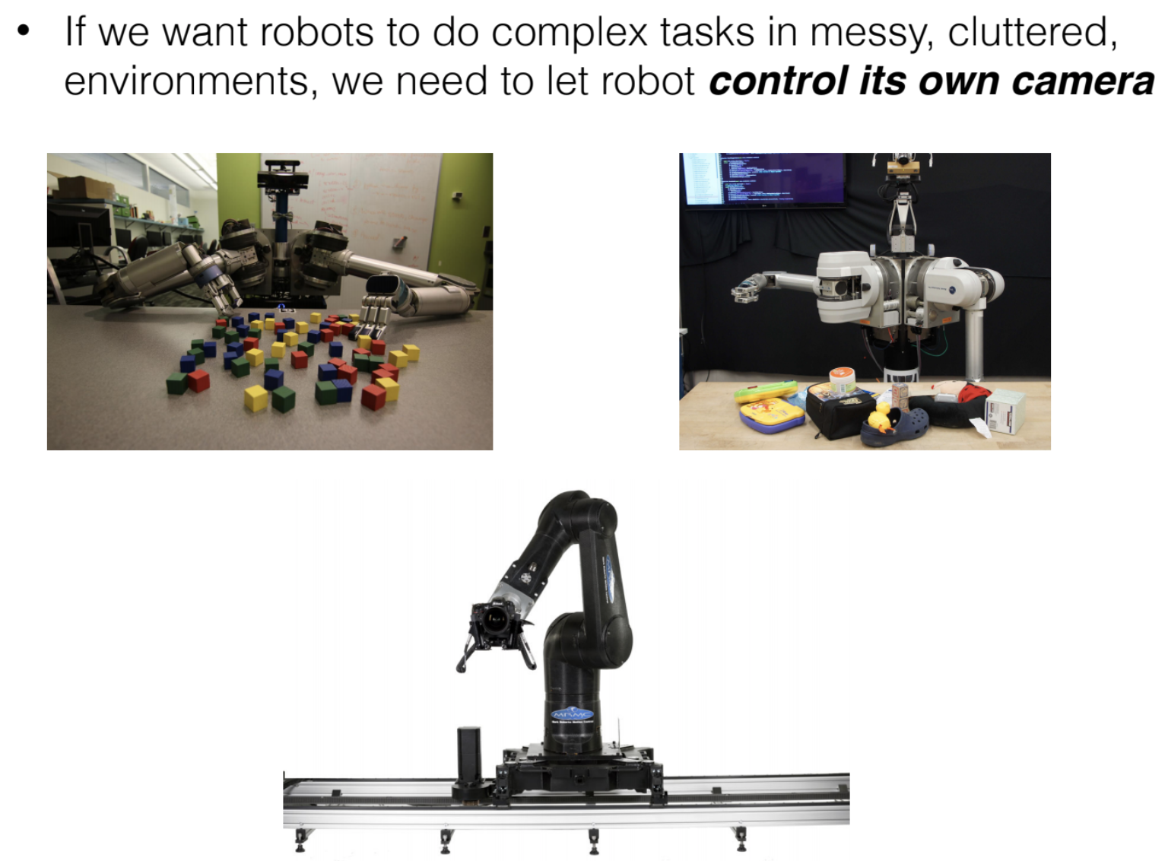
Active Vision for Robotics

Slide 4
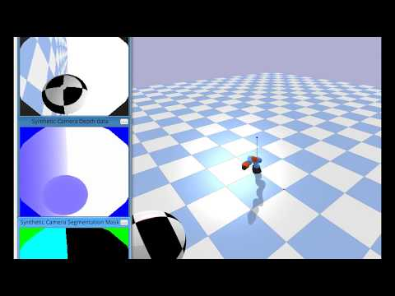

Slide 5
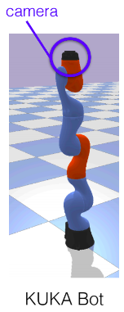
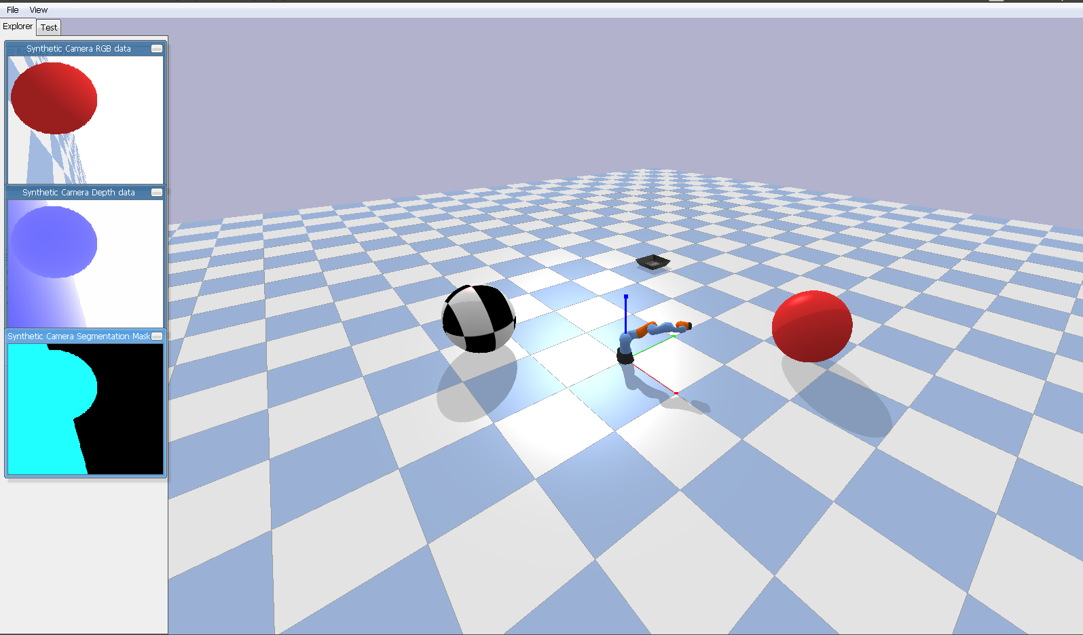
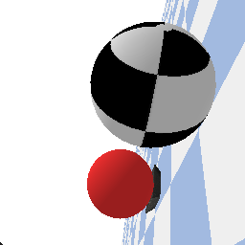
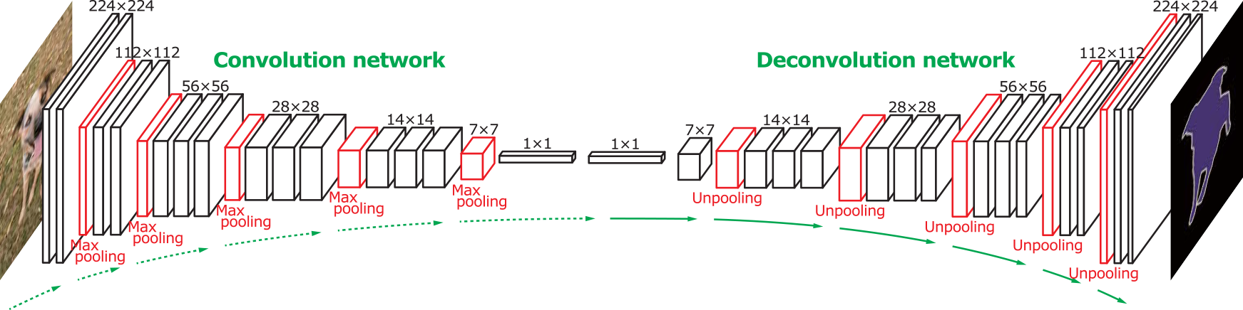

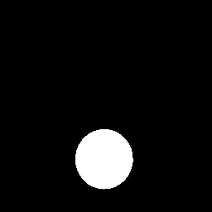
Flow chart of the task
Agent
Action
Environment
step
Scene
Visual: One-shot segmentation
Next Image
RL
Target
Initialize
Input
Network output
Target
Image
Predicted Mask
Reward
Notes:
Agent has to learn 2 components: Vision and RL
Environment gives the visual input to the Vision component.
Visual component predicts segmentation mask
RL component maps segmentation mask to robot actions.

Slide 6
Part 1: One-shot Segmentation
Notes:
2 independent streams: Visual and RL

Slide 7
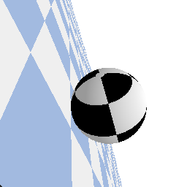
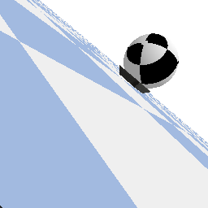
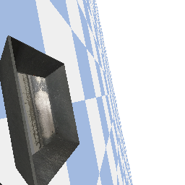
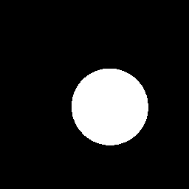
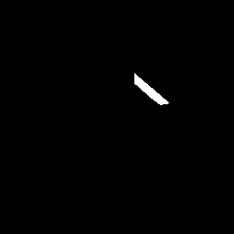
Segmentation
One-shot segmentation
Train
Test
Train
Test
Image
GT mask
Image of already seen class
GT mask of target image
Scene Image
Target Image of an unseen class
Current Image
Target Image
Predicted mask
Predicted mask
Predicted mask
Predicted mask
Notes:
Vision part 2 inputs, segmented output
Unlike conventional segmentation, this generalizes to new objects in testing.

Slide 8
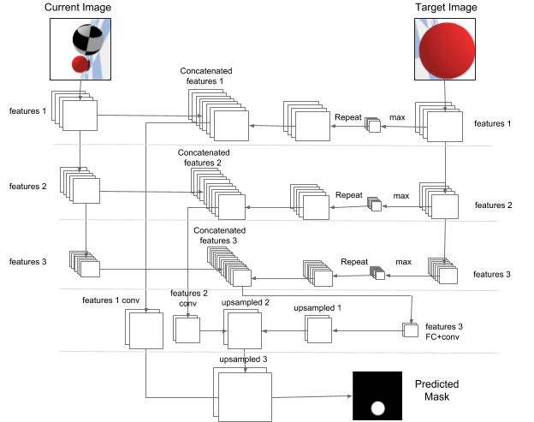
Network
Architecture
Notes:
Fully Convolution Network
Key components are tiling of pooled target image features to input image features, skip connections and upsampling using deconvolution

Slide 9
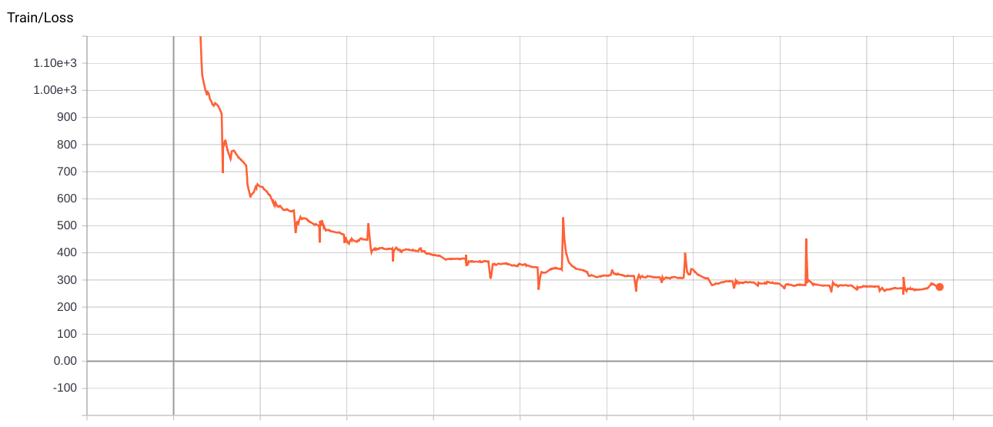
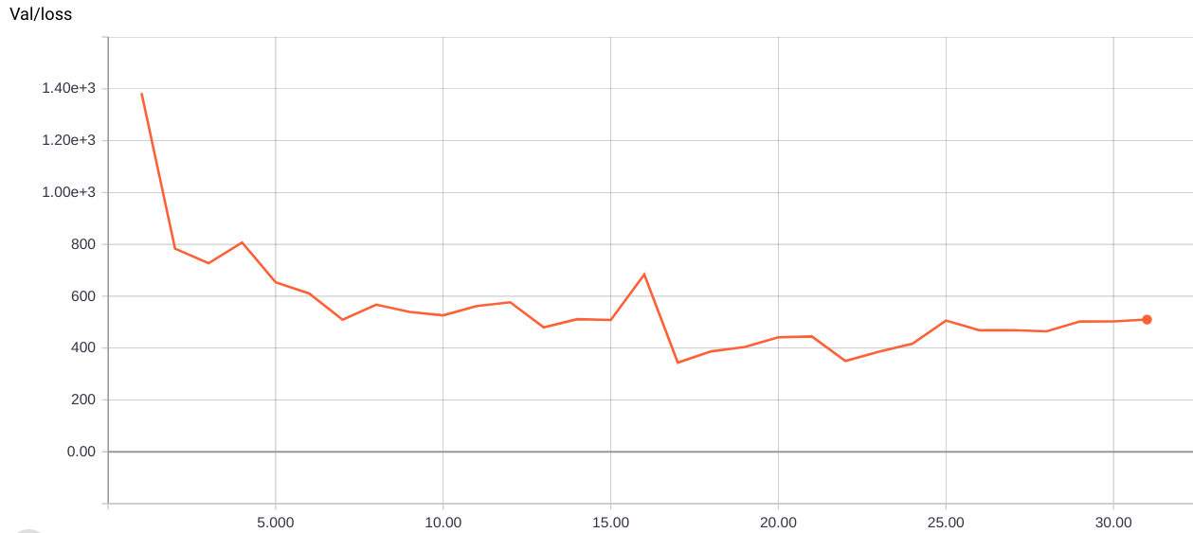
Results - loss curves
Train Loss (30 epochs)
Validation Loss (evaluated after every epoch)
Notes:
Here are the train and validation loss curves.

Slide 10
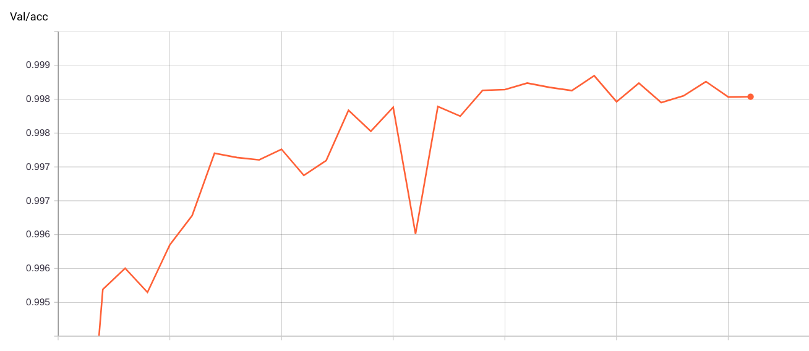
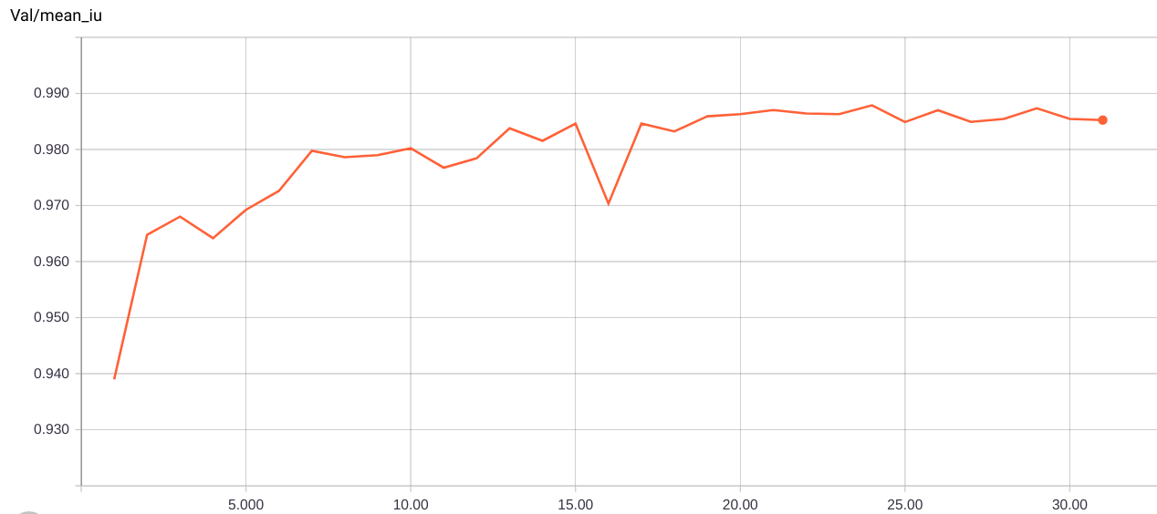
Results - evaluation metrics
Accuracy (best: 99.85%)
Mean IU (best: 98.7%)
Notes:
Accuracy and Mean Intersection over union

Slide 11
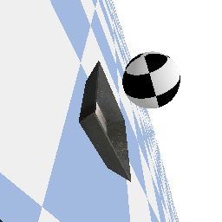
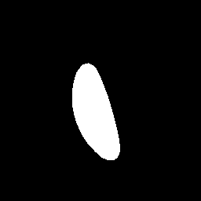
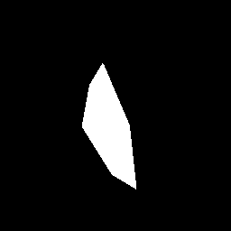
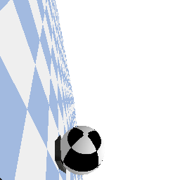
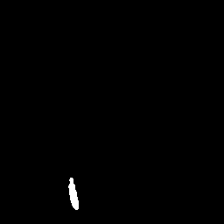
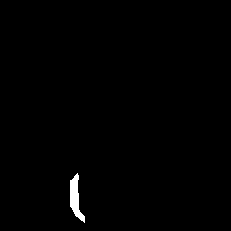
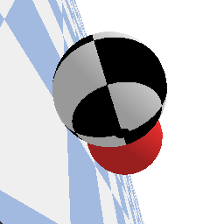
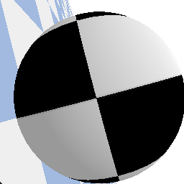


Results - sample validation images
Current Image
Target Image
Predicted mask
GT mask

Slide 12
Part 2: Vision to Actions

Slide 13
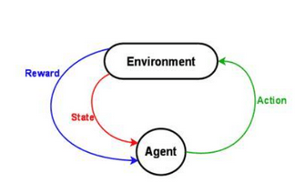
Vision to Actions
Vision gives us segmentation masks of target object.
How to map to robot actions.
Because this is in simulation, we can use RL!

Slide 14
Vision to Actions
RL works well only with low dim. state & action spaces, and dense rewards! We try to achieve these.
State Space
Input is final segmentation from Vision Part -- high dimensional (256x256)
Trick: convert Segmentation (R^{256x256}) → Bounding boxes (R⁴)
Action Space
We could use Torques for robot motors → continuous spaces are hard for RL
We use a discrete space
Ask the agent only for directions of movement Left / Right / Up / Down / Front / Back
Use Inverse Kinematics of robot to infer link orientations and motor torques.
Reward
Percent of object occupying camera input. Aim to max. visibility of target object & zoom in. Note that this is a dense reward. So we only needed to train for a 100 episodes.
→ We don’t use anything fancy -- simple Deep Q-Learning ←

Slide 15
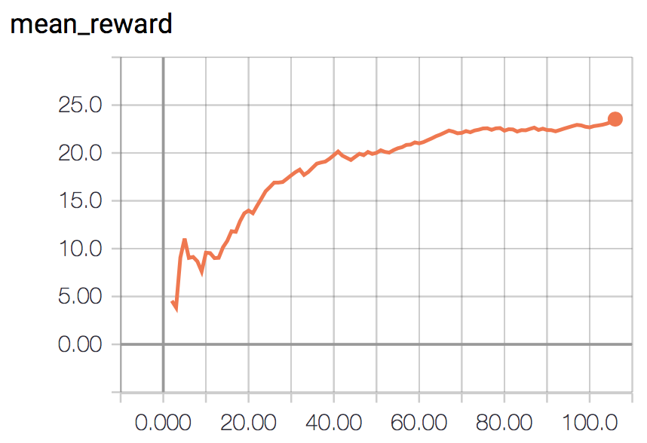
Vision to Actions
Customary training curve

Slide 16
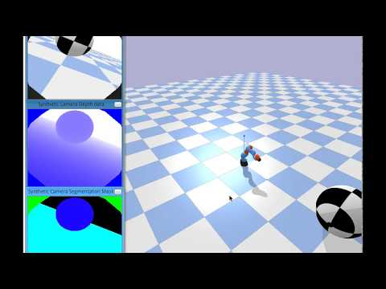

Slide 17
Some future directions
Short term
End to end (joint) training of Vision and RL parts
Train and Test on more diverse objects
Handling partially occluded objects
Long term
Transfer to real world robot
Augment agent with memory / sequence models

Slide 18

Thank You!

