Slide 1
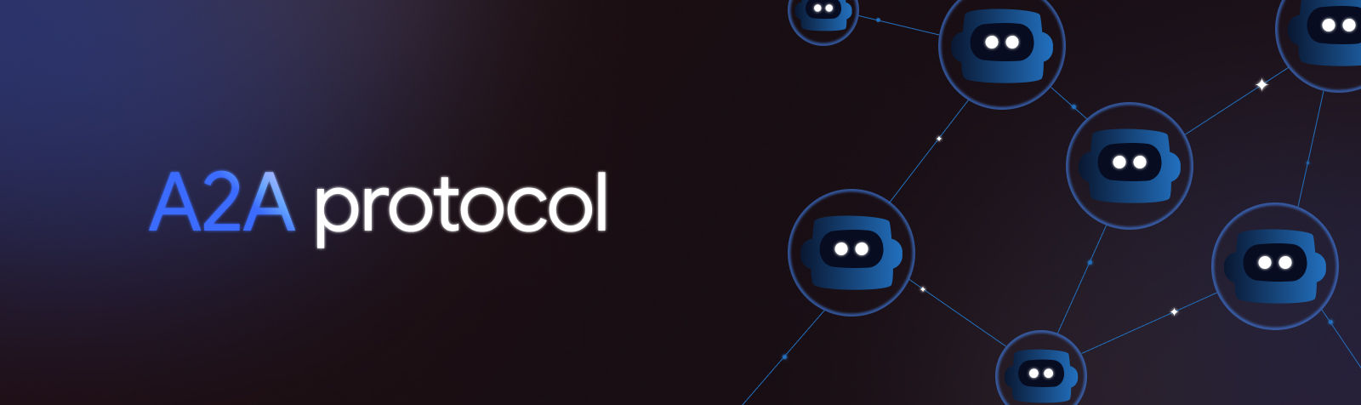

Slide 2
Agent2Agent (A2A) Protocol is an open standard designed to enable seamless communication and collaboration between AI agents.
In a world where agents are built using diverse frameworks and by different vendors, A2A provides a common language, breaking down silos and fostering interoperability.

Slide 3
What is A2A?
Agent2Agent (A2A) Protocol is an open standard designed to solve a fundamental challenge in the rapidly evolving landscape of artificial intelligence:
How do AI agents, built by different teams, using different technologies, and owned by different organizations, communicate and collaborate effectively?

Slide 4
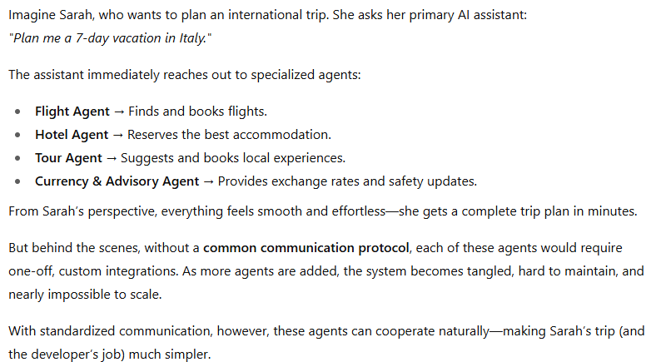

Slide 5
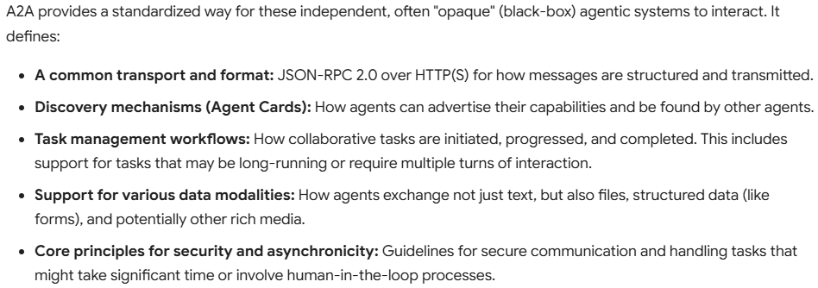
A2A Solution

Slide 6
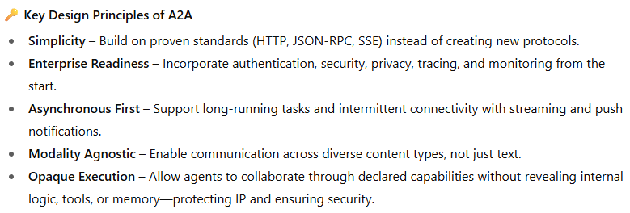

Slide 7
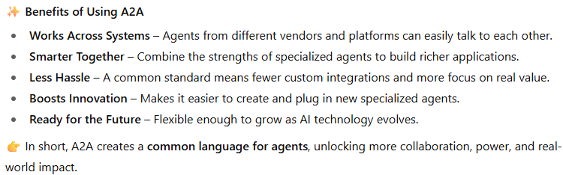

Slide 8
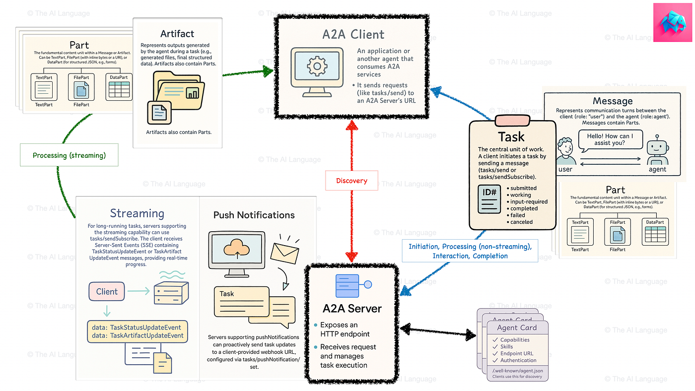

Slide 9
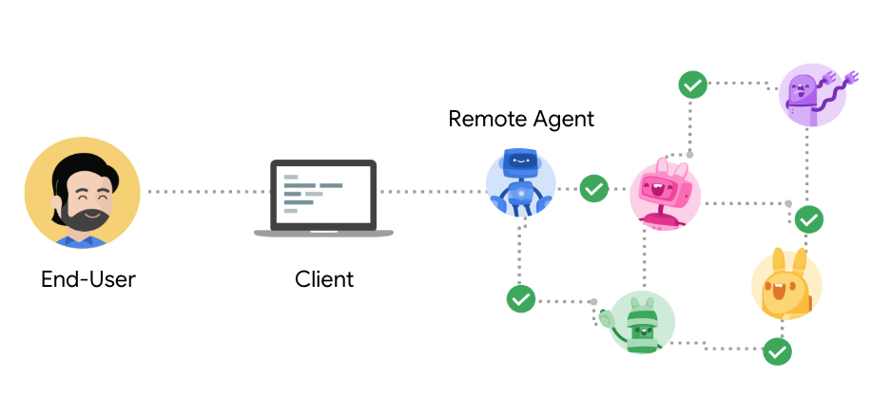
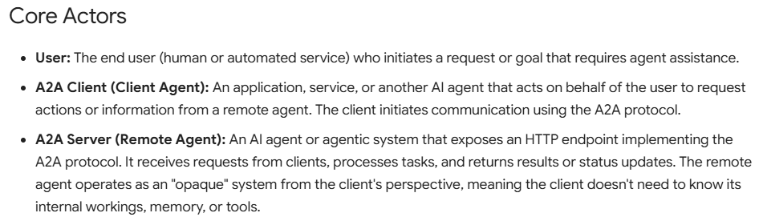
Key Concepts in A2A

Slide 10
Fundamental Communication Elements

Slide 11
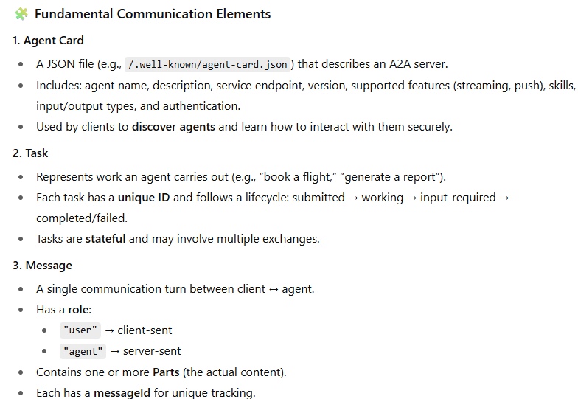
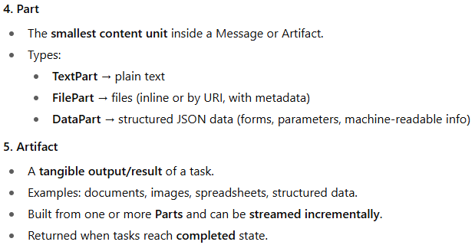

Slide 12
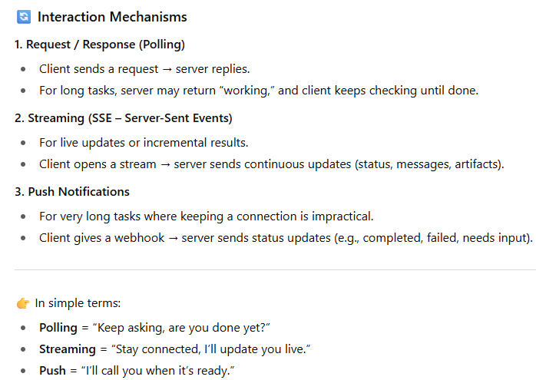

Slide 13
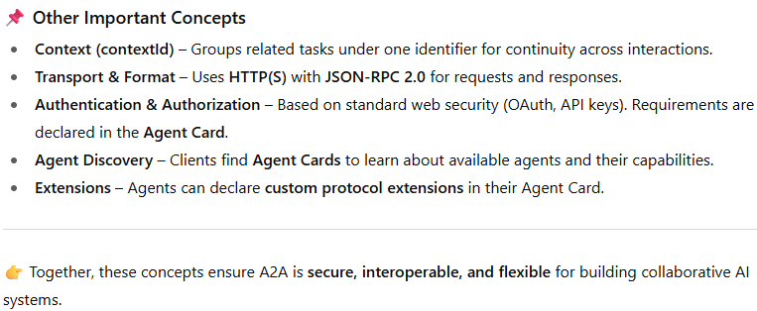

Slide 14
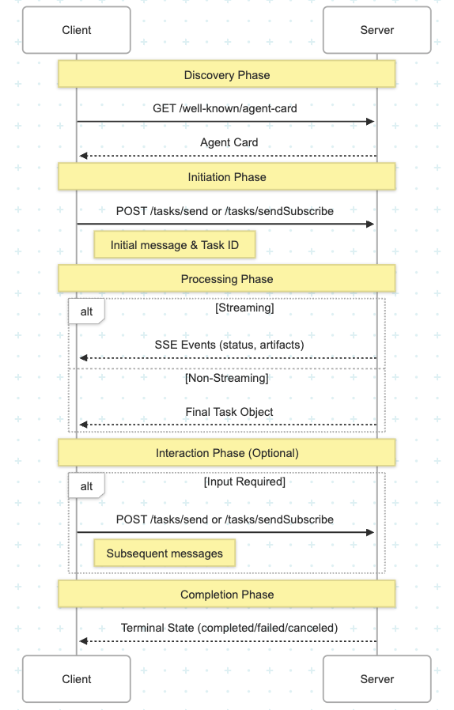

Slide 15
A2A and MCP:
Complementary Protocols for Agentic Systems

Slide 16
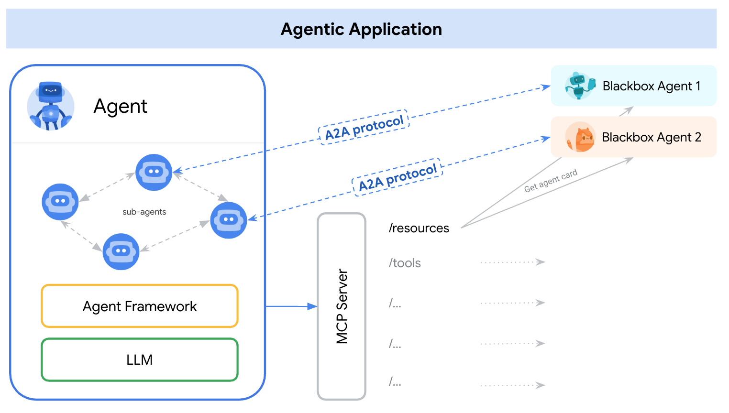

Slide 17
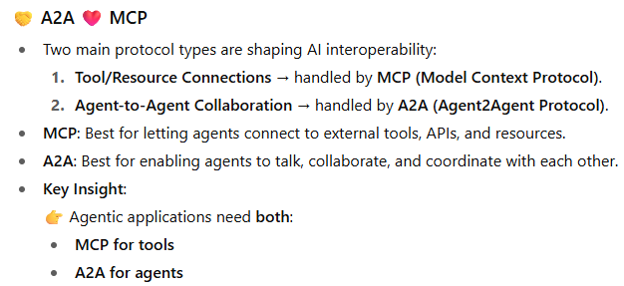

Slide 18
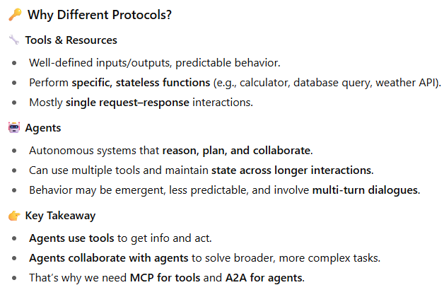

Slide 19
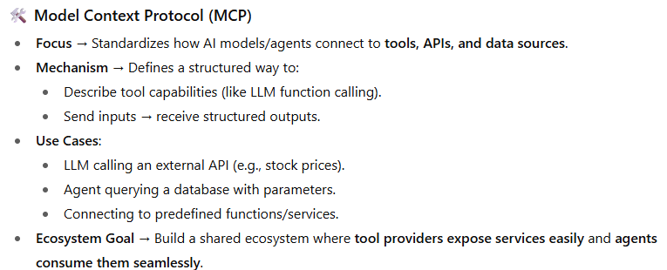

Slide 20
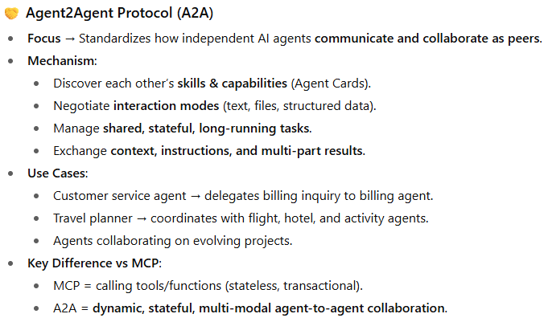

Slide 21
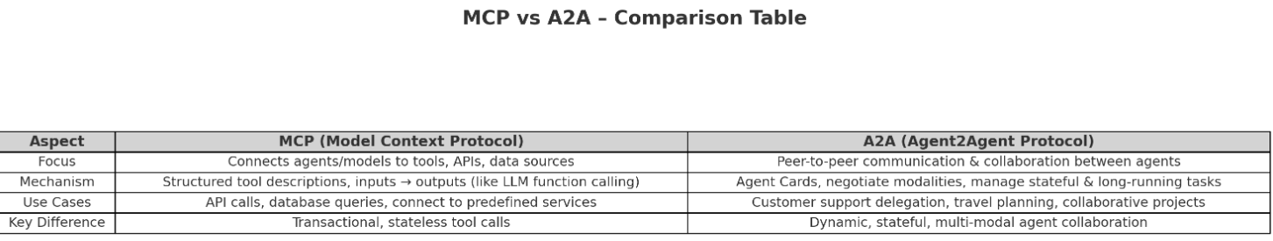

Slide 22

How A2A and MCP Complement Each Other
An agentic application might use A2A to communicate with other agents, while each agent internally uses MCP to interact with its specific tools and resources.

Slide 23
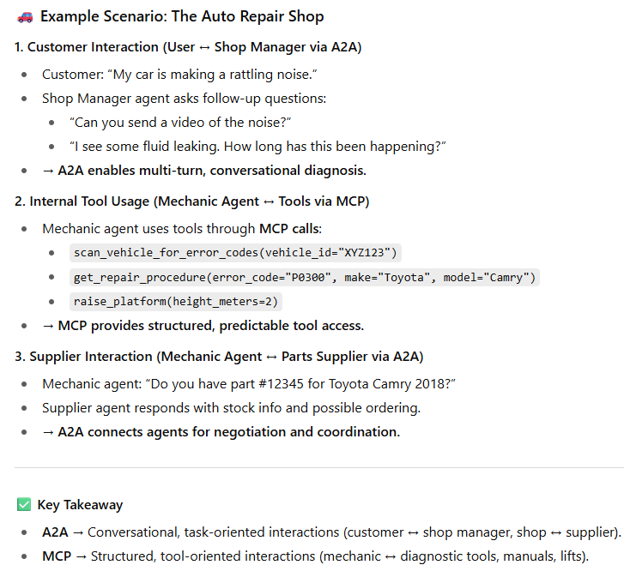

Slide 24
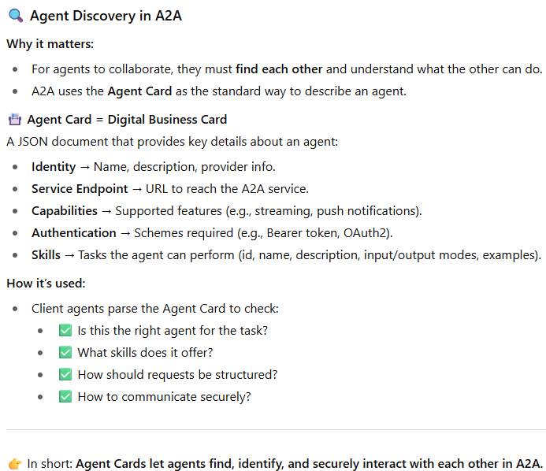

Slide 25
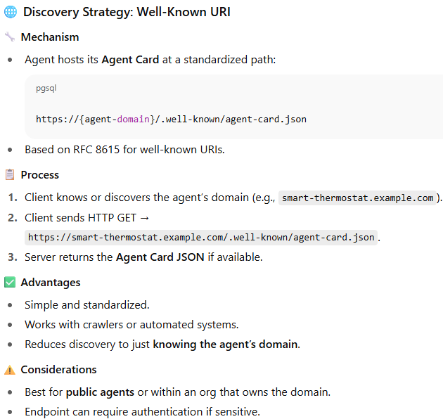

Slide 26
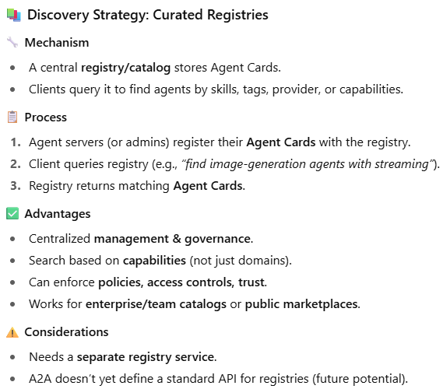

Slide 27
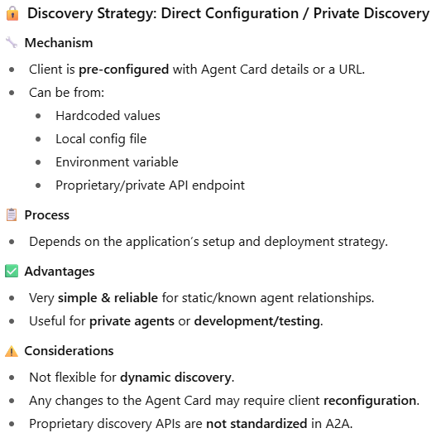

Slide 28
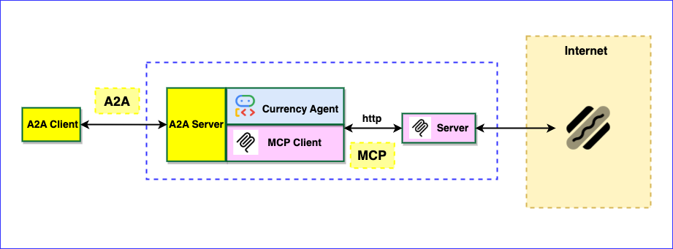
Currency Agent eg

Slide 29
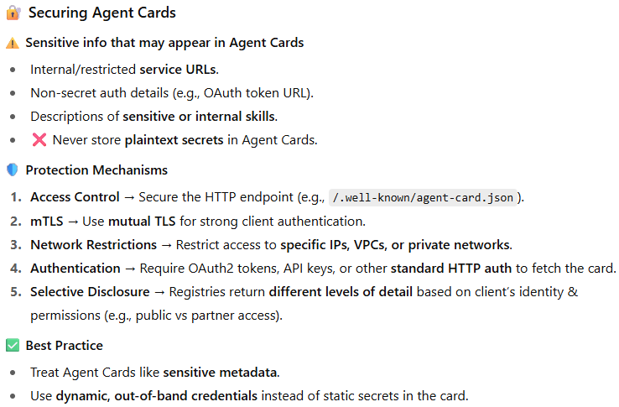

Slide 30
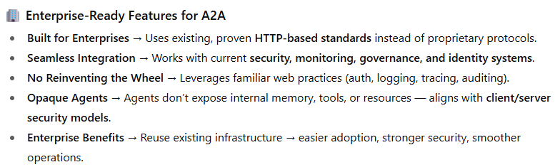

Slide 31
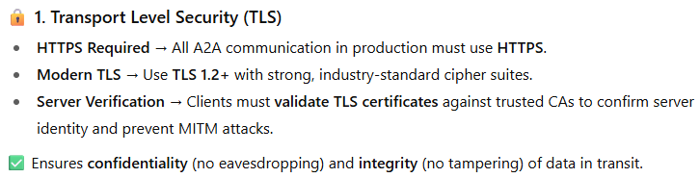

Slide 32
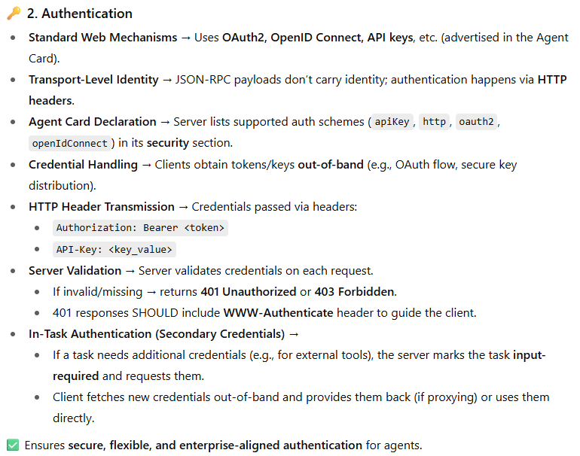

Slide 33
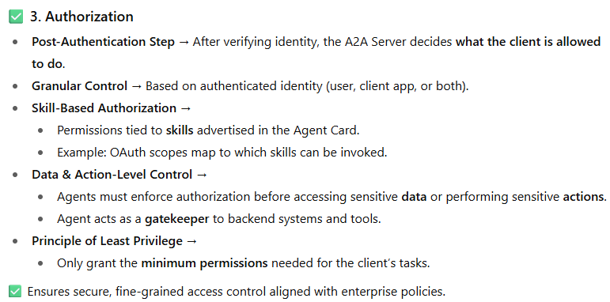

Slide 34
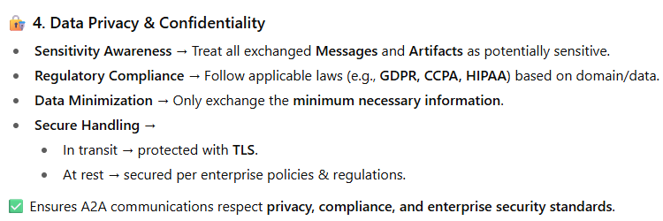

Slide 35
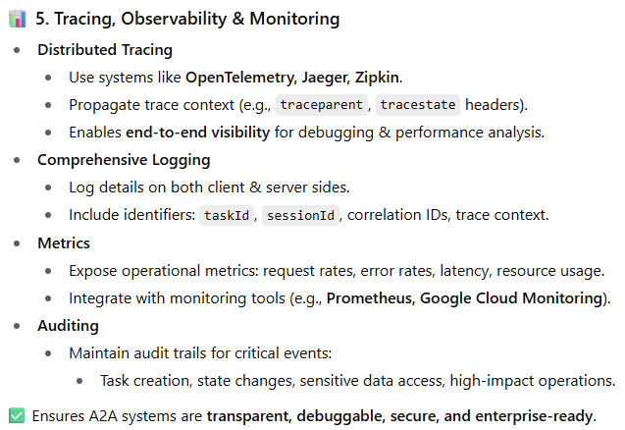

Slide 36
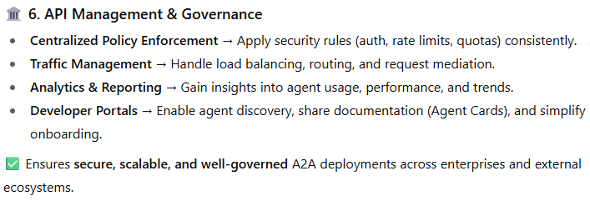

Slide 37
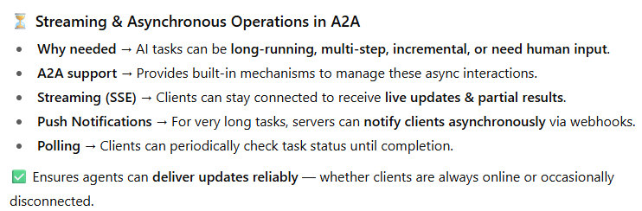

Slide 38
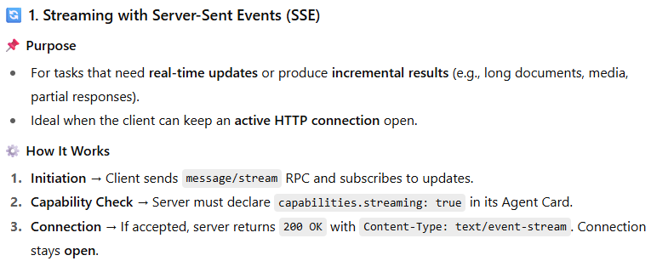
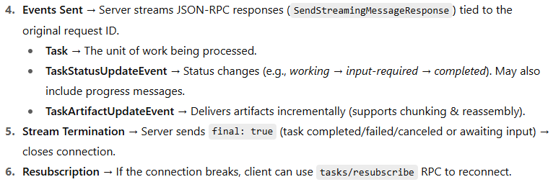

Slide 39
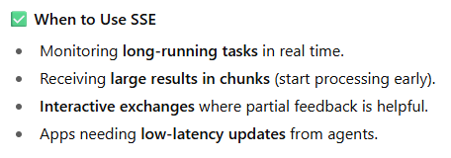

Slide 40
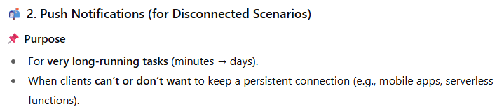

Slide 41
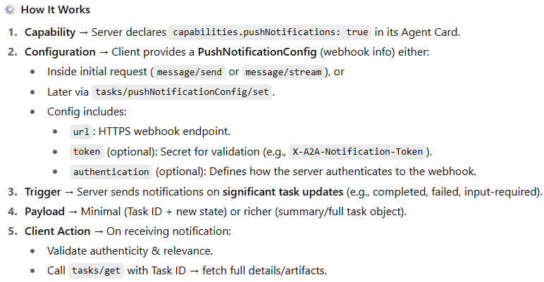

Slide 42
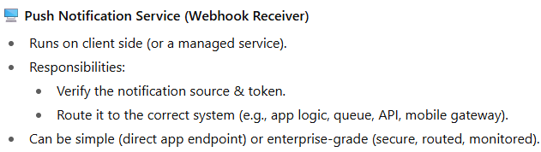

Slide 43
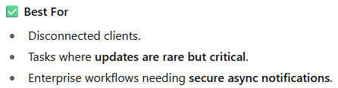

Slide 44
Security Considerations for Push Notifications

Slide 45
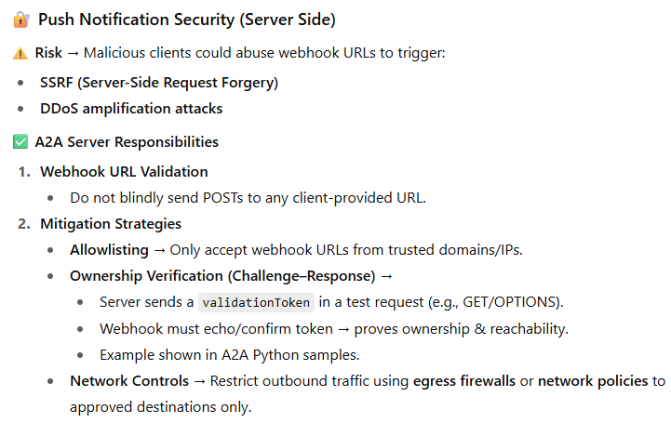

Slide 46
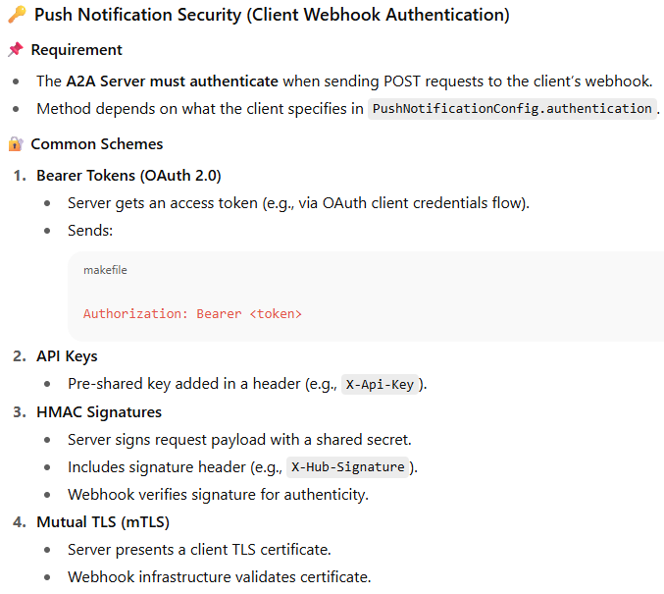

Slide 47
Client Webhook Receiver Security (When Receiving Notifications from A2A Server)

Slide 48
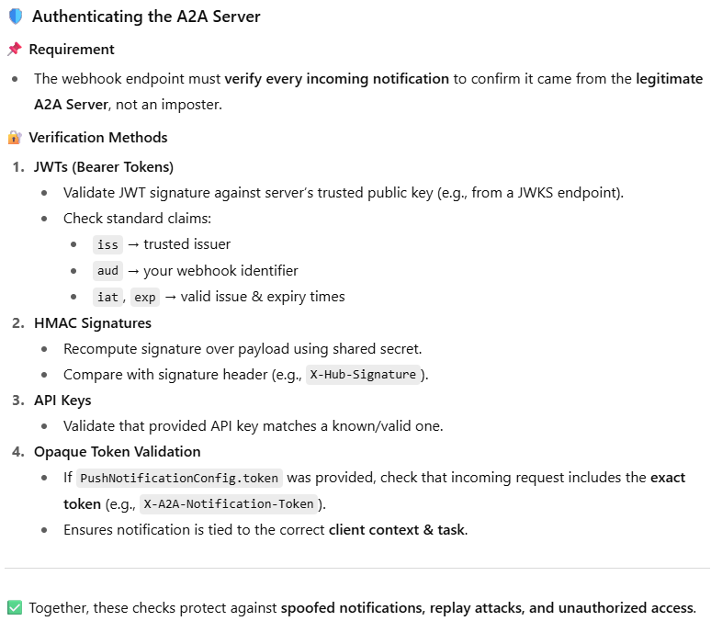

Slide 49
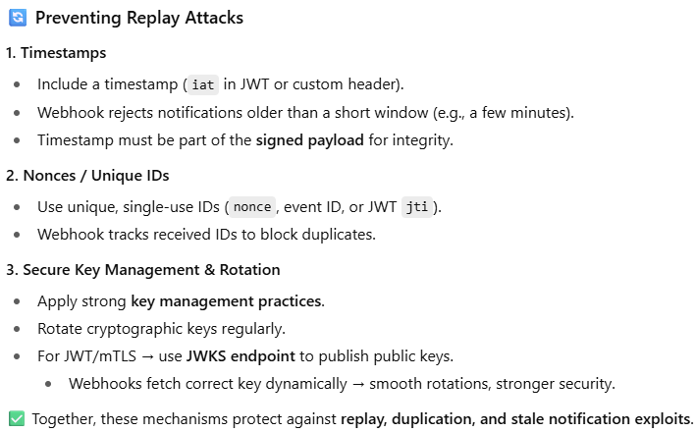

Slide 50
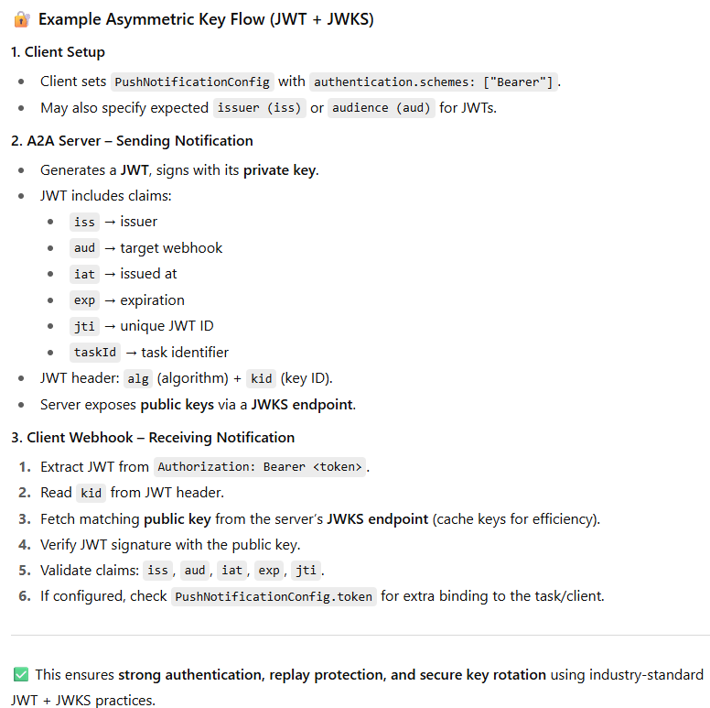

Slide 51
What is Agent Development Kit

Slide 52
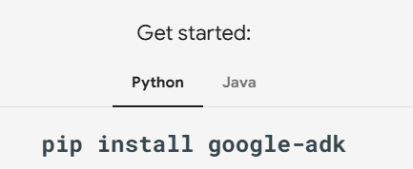
Agent Development Kit (ADK) is a flexible and modular framework for developing and deploying AI agents. While optimized for Gemini and the Google ecosystem, ADK is model-agnostic, deployment-agnostic, and is built for compatibility with other frameworks.
ADK was designed to make agent development feel more like software development, to make it easier for developers to create, deploy, and orchestrate agentic architectures that range from simple tasks to complex workflows.

Slide 53
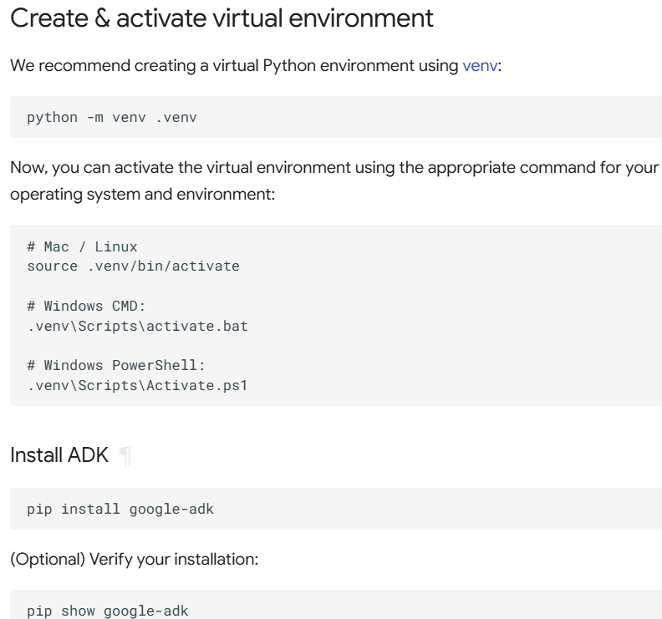

Slide 54
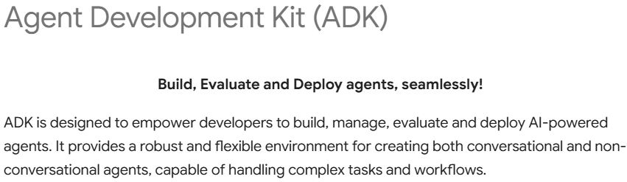

Slide 55
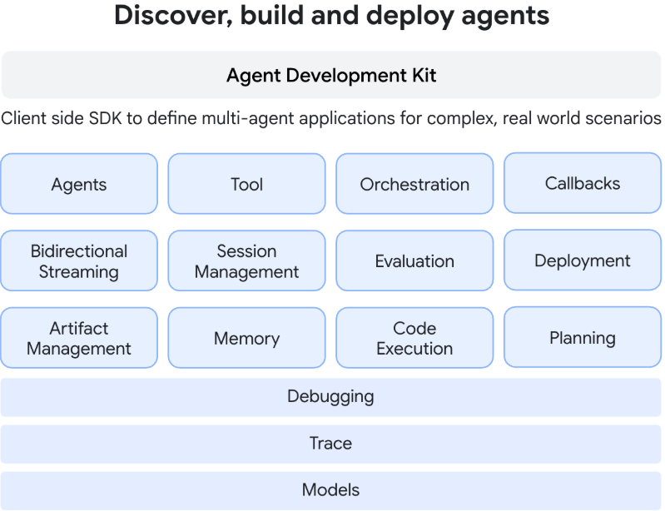

Slide 56


Slide 57


Slide 58


Slide 59


Slide 60


Slide 61


Slide 62



Slide 63



Slide 64


Slide 65


Slide 66
Agents Working Together: Multi-Agent Systems
While each agent type serves a distinct purpose, the true power often comes from combining them.
Complex applications frequently employ where:
LLM Agents handle intelligent, language-based task execution.
Workflow Agents manage the overall process flow using standard patterns.
Custom Agents provide specialized capabilities or rules needed for unique integrations.

Slide 67
LLM Agent

Slide 68


Slide 69


Slide 70


Slide 71


Slide 72


Slide 73


Slide 74


Slide 75


Slide 76


Slide 77
Advanced Configuration & Control

Slide 78



Slide 79


Slide 80
from pydantic import BaseModel, Field
class CapitalOutput(BaseModel):
capital: str = Field(description="The capital of the country.")
structured_capital_agent = LlmAgent(
# ... name, model, description
instruction="""You are a Capital Information Agent. Given a country, respond ONLY with a JSON object containing the capital. Format: {"capital": "capital_name"}""",
output_schema=CapitalOutput, # Enforce JSON output
output_key="found_capital" # Store result in state['found_capital']
# Cannot use tools=[get_capital_city] effectively here
)

Slide 81



Slide 82
Planner

Slide 83



Slide 84



Slide 85


Slide 86


Slide 87
Code Execution

Slide 88

Code executor
File reference - LLMagent All

Slide 89
Workflow Agents

Slide 90


Slide 91


Slide 92
Sequential agents

Slide 93


Slide 94



Slide 95

subagent.py
SequentialAgent(sub_agents=[CodeWriterAgent, CodeReviewerAgent, CodeRefactorerAgent])
This ensures the code is written, then reviewed, and finally refactored, in a strict, dependable order. The output from each sub-agent is passed to the next by storing them in state via .

Slide 96
Loop agents

Slide 97


Slide 98



Slide 99

Ref -LoopAgent

Slide 100
Parallel agents

Slide 101


Slide 102


Slide 103



Slide 104

ref - parallel.py

Slide 105
Custom agents

Slide 106
Custom agents provide the ultimate flexibility in ADK, allowing you to define arbitrary orchestration logic by inheriting directly from BaseAgent and implementing your own control flow.
This goes beyond the predefined patterns of SequentialAgent, LoopAgent, and ParallelAgent, enabling you to build highly specific and complex agentic workflows

Slide 107
What is a Custom Agent?
A Custom Agent is essentially any class you create that inherits from google.adk.agents.BaseAgent and implements its core execution logic within the _run_async_impl asynchronous method.
You have complete control over how this method calls other agents (sub-agents), manages state, and handles events.

Slide 108


Slide 109


Slide 110

Implementing Custom Logic:
The core of any custom agent is the method where you define its unique asynchronous behavior.
This method allows you to orchestrate sub-agents and manage the flow of execution.

Slide 111


Key Capabilities within the Core Asynchronous Method:

Slide 112


Slide 113
Design Pattern Example:
StoryFlowAgent

Slide 114
Let's illustrate the power of custom agents with an example pattern:
A multi-stage content generation workflow with conditional logic.
Goal: Create a system that generates a story, iteratively refines it through critique and revision, performs final checks, and crucially, regenerates the story if the final tone check fails.
Why Custom?
The core requirement driving the need for a custom agent here is the conditional regeneration based on the tone check. Standard workflow agents don't have built-in conditional branching based on the outcome of a sub-agent's task.
We need custom logic (if tone == "negative": ...) within the orchestrator.

Slide 115
Part 1: Simplified custom agent Initialization
We define the StoryFlowAgent inheriting from BaseAgent. In __init__, we store the necessary sub-agents (passed in) as instance attributes and tell the BaseAgent framework about the top-level agents this custom agent will directly orchestrate.
part1_storyflow.py

Slide 116
Part 2: Defining the Custom Execution Logic
This method orchestrates the sub-agents using standard Python async/await and control flow.
part2_storyflow.py
Explanation of Logic:
The initial story_generator runs. Its output is expected to be in ctx.session.state["current_story"].
The loop_agent runs, which internally calls the critic and reviser sequentially for max_iterations times.
They read/write current_story and criticism from/to the state.
The sequential_agent runs, calling grammar_check then tone_check, reading current_story and writing grammar_suggestions and tone_check_result to the state.
Custom Part: The if statement checks the tone_check_result from the state. If it's "negative", the story_generator is called again, overwriting the current_story in the state. Otherwise, the flow ends.

Slide 117
Part 3: Defining the LLM Sub-Agents
These are standard LlmAgent definitions, responsible for specific tasks.
Their output key parameter is crucial for placing results into the session.state where other agents or the custom orchestrator can access them.
part3_storyflow.py

Slide 118
Part 4: Instantiating and Running the custom agent
Finally, you instantiate your StoryFlowAgent and use the Runner as usual.
part4_storyflow.py
full_storyflowagent.py

Slide 119
Multi-Agent Systems in ADK

Slide 120


Slide 121
1. ADK Primitives for Agent Composition

Slide 122
ADK provides core building blocks—primitives—that enable you to structure and manage interactions within your multi-agent system.

Slide 123



Slide 124

Workflow Agents as Orchestrators
# Conceptual Example: Sequential Pipeline
from google.adk.agents import SequentialAgent, LlmAgent
step1 = LlmAgent(name="Step1_Fetch", output_key="data") # Saves output to state['data']
step2 = LlmAgent(name="Step2_Process", instruction="Process data from {data}.")
pipeline = SequentialAgent(name="MyPipeline", sub_agents=[step1, step2])
# When pipeline runs, Step2 can access the state['data'] set by Step1.

Slide 125

# Conceptual Example: Parallel Execution
from google.adk.agents import ParallelAgent, LlmAgent
fetch_weather = LlmAgent(name="WeatherFetcher", output_key="weather")
fetch_news = LlmAgent(name="NewsFetcher", output_key="news")
gatherer = ParallelAgent(name="InfoGatherer", sub_agents=[fetch_weather, fetch_news])
# When gatherer runs, WeatherFetcher and NewsFetcher run concurrently.
# A subsequent agent could read state['weather'] and state['news'].

Slide 126


Slide 127
# Conceptual Example: Loop with Condition
from google.adk.agents import LoopAgent, LlmAgent, BaseAgent
from google.adk.events import Event, EventActions
from google.adk.agents.invocation_context import InvocationContext
from typing import AsyncGenerator
class CheckCondition(BaseAgent): # Custom agent to check state
async def _run_async_impl(self, ctx: InvocationContext) -> AsyncGenerator[Event, None]:
status = ctx.session.state.get("status", "pending")
is_done = (status == "completed")
yield Event(author=self.name, actions=EventActions(escalate=is_done)) # Escalate if done
process_step = LlmAgent(name="ProcessingStep") # Agent that might update state['status']
poller = LoopAgent(
name="StatusPoller",
max_iterations=10,
sub_agents=[process_step, CheckCondition(name="Checker")]
)
# When poller runs, it executes process_step then Checker repeatedly
# until Checker escalates (state['status'] == 'completed') or 10 iterations pass.

Slide 128




Slide 129
# Conceptual Example: Using output_key and reading state
from google.adk.agents import LlmAgent, SequentialAgent
agent_A = LlmAgent(name="AgentA", instruction="Find the capital of France.", output_key="capital_city")
agent_B = LlmAgent(name="AgentB", instruction="Tell me about the city stored in {capital_city}.")
pipeline = SequentialAgent(name="CityInfo", sub_agents=[agent_A, agent_B])
# AgentA runs, saves "Paris" to state['capital_city'].
# AgentB runs, its instruction processor reads state['capital_city'] to get "Paris".

Slide 130



Slide 131
# Conceptual Setup: LLM Transfer
from google.adk.agents import LlmAgent
booking_agent = LlmAgent(name="Booker", description="Handles flight and hotel bookings.")
info_agent = LlmAgent(name="Info", description="Provides general information and answers questions.")
coordinator = LlmAgent(
name="Coordinator",
model="gemini-2.0-flash",
instruction="You are an assistant. Delegate booking tasks to Booker and info requests to Info.",
description="Main coordinator.",
# AutoFlow is typically used implicitly here
sub_agents=[booking_agent, info_agent]
)
# If coordinator receives "Book a flight", its LLM should generate:
# FunctionCall(name='transfer_to_agent', args={'agent_name': 'Booker'})
# ADK framework then routes execution to booking_agent.

Slide 132

AgentTool.py

Slide 133
2. Common Multi-Agent Patterns using ADK Primitives

Slide 134


Slide 135
# Conceptual Code: Coordinator using LLM Transfer
from google.adk.agents import LlmAgent
billing_agent = LlmAgent(name="Billing", description="Handles billing inquiries.")
support_agent = LlmAgent(name="Support", description="Handles technical support requests.")
coordinator = LlmAgent(
name="HelpDeskCoordinator",
model="gemini-2.0-flash",
instruction="Route user requests: Use Billing agent for payment issues, Support agent for technical problems.",
description="Main help desk router.",
# allow_transfer=True is often implicit with sub_agents in AutoFlow
sub_agents=[billing_agent, support_agent]
)
# User asks "My payment failed" -> Coordinator's LLM should call transfer_to_agent(agent_name='Billing')
# User asks "I can't log in" -> Coordinator's LLM should call transfer_to_agent(agent_name='Support')

Slide 136


Slide 137
# Conceptual Code: Sequential Data Pipeline
from google.adk.agents import SequentialAgent, LlmAgent
validator = LlmAgent(name="ValidateInput", instruction="Validate the input.", output_key="validation_status")
processor = LlmAgent(name="ProcessData", instruction="Process data if {validation_status} is 'valid'.", output_key="result")
reporter = LlmAgent(name="ReportResult", instruction="Report the result from {result}.")
data_pipeline = SequentialAgent(
name="DataPipeline",
sub_agents=[validator, processor, reporter]
)
# validator runs -> saves to state['validation_status']
# processor runs -> reads state['validation_status'], saves to state['result']
# reporter runs -> reads state['result']

Slide 138


Slide 139
# Conceptual Code: Parallel Information Gathering
from google.adk.agents import SequentialAgent, ParallelAgent, LlmAgent
fetch_api1 = LlmAgent(name="API1Fetcher", instruction="Fetch data from API 1.", output_key="api1_data")
fetch_api2 = LlmAgent(name="API2Fetcher", instruction="Fetch data from API 2.", output_key="api2_data")
gather_concurrently = ParallelAgent(
name="ConcurrentFetch",
sub_agents=[fetch_api1, fetch_api2]
)
synthesizer = LlmAgent(
name="Synthesizer",
instruction="Combine results from {api1_data} and {api2_data}."
)
overall_workflow = SequentialAgent(
name="FetchAndSynthesize",
sub_agents=[gather_concurrently, synthesizer] # Run parallel fetch, then synthesize
)
# fetch_api1 and fetch_api2 run concurrently, saving to state.
# synthesizer runs afterwards, reading state['api1_data'] and state['api2_data'].

Slide 140


Slide 141
# Conceptual Code: Hierarchical Research Task
from google.adk.agents import LlmAgent
from google.adk.tools import agent_tool
# Low-level tool-like agents
web_searcher = LlmAgent(name="WebSearch", description="Performs web searches for facts.")
summarizer = LlmAgent(name="Summarizer", description="Summarizes text.")
# Mid-level agent combining tools
research_assistant = LlmAgent(
name="ResearchAssistant",
model="gemini-2.0-flash",
description="Finds and summarizes information on a topic.",
tools=[agent_tool.AgentTool(agent=web_searcher), agent_tool.AgentTool(agent=summarizer)]
)
# High-level agent delegating research
report_writer = LlmAgent(
name="ReportWriter",
model="gemini-2.0-flash",
instruction="Write a report on topic X. Use the ResearchAssistant to gather information.",
tools=[agent_tool.AgentTool(agent=research_assistant)]
# Alternatively, could use LLM Transfer if research_assistant is a sub_agent
)
# User interacts with ReportWriter.
# ReportWriter calls ResearchAssistant tool.
# ResearchAssistant calls WebSearch and Summarizer tools.
# Results flow back up.

Slide 142


Slide 143
# Conceptual Code: Generator-Critic
from google.adk.agents import SequentialAgent, LlmAgent
generator = LlmAgent(
name="DraftWriter",
instruction="Write a short paragraph about subject X.",
output_key="draft_text"
)
reviewer = LlmAgent(
name="FactChecker",
instruction="Review the text in {draft_text} for factual accuracy. Output 'valid' or 'invalid' with reasons.",
output_key="review_status"
)
# Optional: Further steps based on review_status
review_pipeline = SequentialAgent(
name="WriteAndReview",
sub_agents=[generator, reviewer]
)
# generator runs -> saves draft to state['draft_text']
# reviewer runs -> reads state['draft_text'], saves status to state['review_status']

Slide 144


Slide 145
# Conceptual Code: Iterative Code Refinement
from google.adk.agents import LoopAgent, LlmAgent, BaseAgent
from google.adk.events import Event, EventActions
from google.adk.agents.invocation_context import InvocationContext
from typing import AsyncGenerator
# Agent to generate/refine code based on state['current_code'] and state['requirements']
code_refiner = LlmAgent(
name="CodeRefiner",
instruction="Read state['current_code'] (if exists) and state['requirements']. Generate/refine Python code to meet requirements. Save to state['current_code'].",
output_key="current_code" # Overwrites previous code in state
)
# Agent to check if the code meets quality standards
quality_checker = LlmAgent(
name="QualityChecker",
instruction="Evaluate the code in state['current_code'] against state['requirements']. Output 'pass' or 'fail'.",
output_key="quality_status"
)
# Custom agent to check the status and escalate if 'pass'
class CheckStatusAndEscalate(BaseAgent):
async def _run_async_impl(self, ctx: InvocationContext) -> AsyncGenerator[Event, None]:
status = ctx.session.state.get("quality_status", "fail")
should_stop = (status == "pass")
yield Event(author=self.name, actions=EventActions(escalate=should_stop))
refinement_loop = LoopAgent(
name="CodeRefinementLoop",
max_iterations=5,
sub_agents=[code_refiner, quality_checker, CheckStatusAndEscalate(name="StopChecker")]
)
# Loop runs: Refiner -> Checker -> StopChecker
# State['current_code'] is updated each iteration.
# Loop stops if QualityChecker outputs 'pass' (leading to StopChecker escalating) or after 5 iterations.

Slide 146


Slide 147
# Conceptual Code: Using a Tool for Human Approval
from google.adk.agents import LlmAgent, SequentialAgent
from google.adk.tools import FunctionTool
# --- Assume external_approval_tool exists ---
# This tool would:
# 1. Take details (e.g., request_id, amount, reason).
# 2. Send these details to a human review system (e.g., via API).
# 3. Poll or wait for the human response (approved/rejected).
# 4. Return the human's decision.
# async def external_approval_tool(amount: float, reason: str) -> str: ...
approval_tool = FunctionTool(func=external_approval_tool)
# Agent that prepares the request
prepare_request = LlmAgent(
name="PrepareApproval",
instruction="Prepare the approval request details based on user input. Store amount and reason in state.",
# ... likely sets state['approval_amount'] and state['approval_reason'] ...
)
# Agent that calls the human approval tool
request_approval = LlmAgent(
name="RequestHumanApproval",
instruction="Use the external_approval_tool with amount from state['approval_amount'] and reason from state['approval_reason'].",
tools=[approval_tool],
output_key="human_decision"
)
# Agent that proceeds based on human decision
process_decision = LlmAgent(
name="ProcessDecision",
instruction="Check {human_decision}. If 'approved', proceed. If 'rejected', inform user."
)
approval_workflow = SequentialAgent(
name="HumanApprovalWorkflow",
sub_agents=[prepare_request, request_approval, process_decision]
)

Slide 148
All these patterns provide starting points for structuring your multi-agent systems.
You can mix and match them as needed to create the most effective architecture for your specific application.

Slide 149
Build agents with Agent Config

Slide 150



Slide 151




Slide 152


ADK agentconfig

Slide 153



# yaml-language-server: $schema=https://raw.githubusercontent.com/google/adk-python/refs/heads/main/src/google/adk/agents/config_schemas/AgentConfig.json
name: assistant_agent
model: gemini-2.5-flash
description: A helper agent that can answer users' questions.
instruction: You are an agent to help answer users' various questions.

Slide 154



Slide 155


Slide 156


Slide 157


Slide 158
Using Different Models with ADK

Slide 159


Slide 160
Using Google Gemini Models

Slide 161


Slide 162

https://cloud.google.com/vertex-ai/generative-ai/docs/models

Slide 163



Slide 164
Tools

Slide 165



Slide 166


Slide 167



Slide 168


Slide 169



Slide 170


Slide 171


Slide 172


Slide 173

refere - #tools.py

Slide 174



Slide 175

# yaml-language-server: $schema=https://raw.githubusercontent.com/google/adk-python/refs/heads/main/src/google/adk/agents/config_schemas/AgentConfig.json
agent_class: LlmAgent
name: main_agent
model: gemini-2.5-flash
instruction: >
You are the first point of contact for customer support of an analytics tool.
Answer general queries. If the user indicates urgency, use the 'check_and_transfer' tool.
tools:
- name: support_demo.tools.check_and_transfer
# Reference sub-agents by config file (do NOT inline their fields here)
sub_agents:
- config_path: support_agent.yaml
# yaml-language-server: $schema=https://raw.githubusercontent.com/google/adk-python/refs/heads/main/src/google/adk/agents/config_schemas/AgentConfig.json
agent_class: LlmAgent
name: support_agent
model: gemini-2.5-flash
instruction: >
You are the dedicated support agent. Mention that you are a support handler
and help the user with their urgent issue in a concise, actionable way.

Slide 176




Slide 177
Built-in tools

Slide 178



Slide 179
Available Built-in tools
Google Search
The google_search tool allows the agent to perform web searches using Google Search. The google_search tool is only compatible with Gemini 2 models.
Ref - search_agent

Slide 180
Code Execution
The built_in_code_execution tool enables the agent to execute code, specifically when using Gemini 2 models.
This allows the model to perform tasks like calculations, data manipulation, or running small scripts.
Ref: calc

Slide 181
Vertex AI RAG Engine
The vertex_ai_rag_retrieval tool allows the agent to perform private data retrieval using Vertex AI RAG Engine.
When you use grounding with Vertex AI RAG Engine, you need to prepare a RAG corpus before hand.

Slide 182
Vertex AI Search
The vertex_ai_search_tool uses Google Cloud's Vertex AI Search, enabling the agent to search across your private, configured data stores (e.g., internal documents, company policies, knowledge bases).
This built-in tool requires you to provide the specific data store ID during configuration.

Slide 183
BigQuery
These are a set of tools aimed to provide integration with BigQuery, namely:
list_dataset_ids: Fetches BigQuery dataset ids present in a GCP project.
get_dataset_info: Fetches metadata about a BigQuery dataset.
list_table_ids: Fetches table ids present in a BigQuery dataset.
get_table_info: Fetches metadata about a BigQuery table.
execute_sql: Runs a SQL query in BigQuery and fetch the result.

Slide 184
Model Context Protocol Tools

Slide 185
What is Model Context Protocol (MCP)?
The Model Context Protocol (MCP) is an open standard designed to standardize how Large Language Models (LLMs) like Gemini and Claude communicate with external applications, data sources, and tools. Think of it as a universal connection mechanism that simplifies how LLMs obtain context, execute actions, and interact with various systems.
MCP follows a client-server architecture, defining how data (resources), interactive templates (prompts), and actionable functions (tools) are exposed by an MCP server and consumed by an MCP client (which could be an LLM host application or an AI agent).
Two primary integration patterns:
Using Existing MCP Servers within ADK: An ADK agent acts as an MCP client, leveraging tools provided by external MCP servers.
Exposing ADK Tools via an MCP Server: Building an MCP server that wraps ADK tools, making them accessible to any MCP client.

Slide 186



Slide 187
1. Using MCP servers with ADK agents (ADK as an MCP client) in adk web

Slide 188


Slide 189
Example 1: File System MCP Server
ref - /home/ilg/a2a-adk/mcp_agent

Slide 190
2. Building an MCP server with ADK tools (MCP server exposing ADK)
This pattern allows you to wrap existing ADK tools and make them available to any standard MCP client application.

Slide 191


Slide 192


Mysql Agentic eg

Slide 193


Airline eg

Slide 194

Workflow flow chart showing requests between all processes

