Slide 2
Domain1:
Cloud Computing Concepts & Architectures

Slide 3
Here are five key points summarizing the domain:
Conceptual Foundation – This domain establishes the fundamental concepts of cloud computing, defining key terminology, models, and controls that serve as the basis for the rest of the CCSK Study Guide.
Cloud Benefits & Adoption – Cloud computing provides agility, resilience, security, and cost efficiency, but these benefits are only achieved through a proper understanding and adoption of cloud-native capabilities rather than a simple "lift-and-shift" approach.
Cloud vs. Traditional Computing – It outlines the key differences between cloud and traditional IT environments, guiding security professionals in leveraging cloud-native approaches for enhanced security and efficiency.
Standardization & Harmonization – The Cloud Security Alliance aligns its framework with established standards such as NIST SP 800-145, ISO/IEC 22123-1:2023, and ISO/IEC 22123-2:2023, ensuring consistency in cloud security principles.
Guidance for Security Professionals – The domain provides a shared understanding of cloud computing, assisting Cloud Service Customers (CSCs) and stakeholders in making informed security decisions and effectively managing cloud risks.

Slide 4
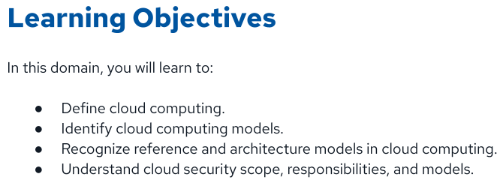

Slide 5
Defining CloudComputing

Slide 6
What Cloud Computing manages ?
Resource Abstraction – Cloud computing abstracts underlying infrastructure, enabling efficient management of shared resources and optimizing their utilization.
Rapid Orchestration & Provisioning – It allows for quick provisioning, scaling, and decommissioning of resources, ensuring flexibility and operational efficiency.
On-Demand Utility Model – Cloud operates on a pay-as-you-go model, providing computing resources as a utility, reducing upfront infrastructure costs.
Key Benefits – It enhances collaboration, agility, elasticity, availability, resiliency, and cost efficiency, making IT operations more scalable and responsive.
Scalability & Elasticity – The cloud dynamically scales resources up or down based on demand, ensuring optimal performance without over-provisioning.

Slide 7
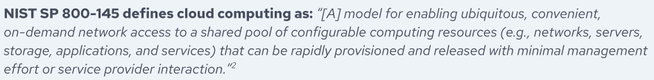

U.S. National Institute of Standards
International Organization for Standardization (ISO)
& International Electrotechnical Commission (IEC

Slide 8
Abstraction & Orchestration

Slide 9
Abstraction & Orchestration – Cloud computing abstracts physical resources into virtual machines (VMs) and automates provisioning, networking, and management through orchestration.
Multi-Tenancy with Isolation – Multiple Cloud Service Customers (CSCs) share resource pools while being securely isolated to maintain confidentiality, integrity, and segregation of data.
Resource Management & Fair Usage – Cloud Service Providers (CSPs) enforce resource allocation policies, ensuring fair access, preventing overuse, and maintaining service availability.

Slide 10
Cloud Computing Models

Slide 11
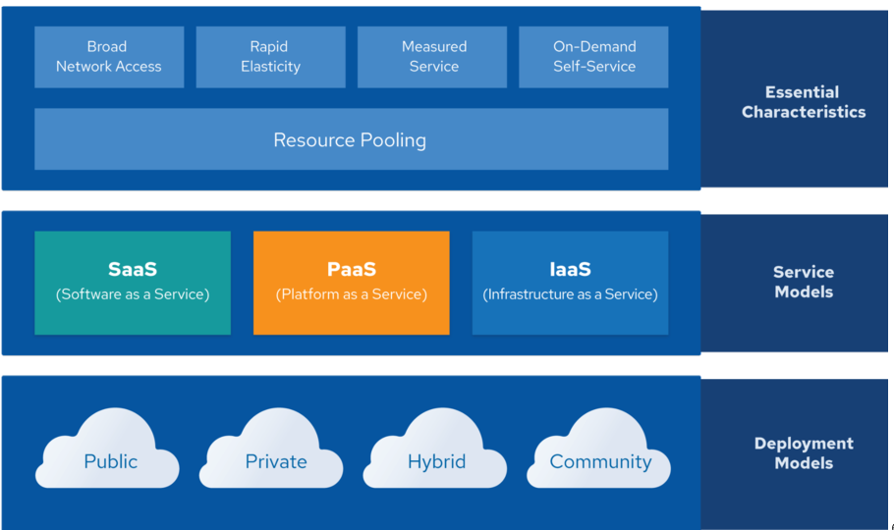
NIST Description - cloud computing based on essential characteristics.

Slide 12
Essential Characteristics

Slide 13
Essential Characteristics
Resource Pooling – Cloud computing dynamically allocates pooled physical and virtual resources to multiple CSCs.
Broad Network Access – Services are accessible over the internet via various devices like mobile phones, laptops, and IoT devices.
Rapid Elasticity – Resources scale automatically, appearing unlimited to CSCs and available on demand.
Measured Service – Cloud usage is monitored, metered, and billed based on actual consumption, ensuring cost efficiency.
On-Demand Self-Service – CSCs can request and provision cloud resources automatically without human intervention.

Slide 14
Cloud Service Models

Slide 15
Cloud Service Models & Evolution – NIST defines three flexible cloud service models (SaaS, PaaS, IaaS) as a descriptive tool rather than a rigid framework, though cloud technologies continue to evolve beyond these categories.
Standard References & CSA Adoption – Security professionals can refer to ISO/IEC 22123-3 and NIST 500-292 for deeper insights, but CSA primarily adopts the concise and widely used NIST model for research and guidance.

Slide 16
Infrastructure as a Service

Slide 17
IaaS & Virtual Infrastructure Management – Infrastructure as a Service (IaaS) provides access to fundamental computing resources like networking, storage, and virtual machines (VMs). While the physical infrastructure is abstracted and orchestrated into resource pools, CSCs are responsible for managing the virtualized environment, including provisioning, networking, storage, and application deployment.
Orchestration, APIs & Security Considerations – APIs play a crucial role in orchestrating cloud resources, typically accessed via web-based interfaces forming the cloud management plane. This enables CSCs to control and manage VMs, networks, and storage efficiently. However, since these management interfaces are network-accessible, they introduce security risks, making proper access controls and API security essential.

Slide 18
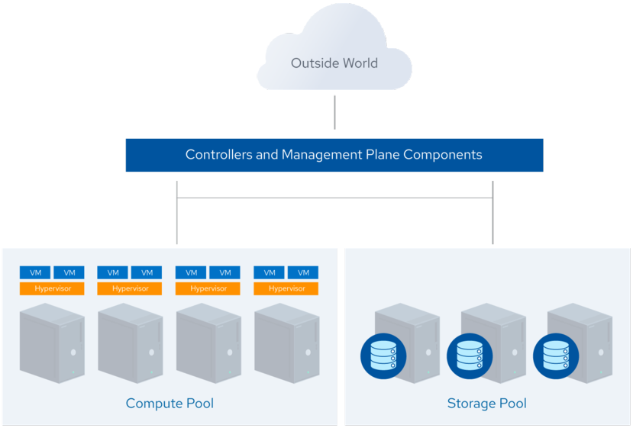
An IaaS compute platform with physical servers running hypervisors and orchestration software.
The cloud controller allocates resources, creates virtual instances, configures networking and storage, and brokers connectivity information for CSCs to access the instances

Slide 19
Platform as a Service

Slide 20
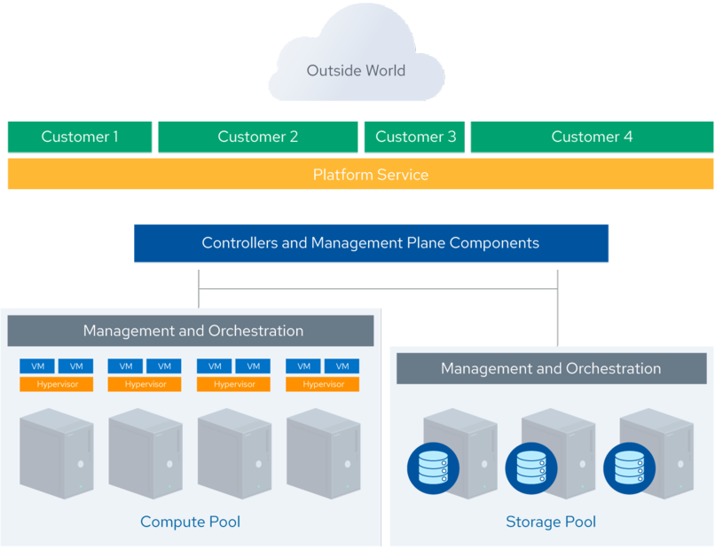
Platform as a Service (PaaS) simplifies application development by providing a managed environment for coding, databases, storage, and collaboration without requiring CSCs to handle underlying infrastructure.
Built on IaaS, PaaS abstracts servers, middleware, and integration layers, enabling seamless scaling and automation through APIs. Services like Database as a Service (DBaaS) allow CSCs to manage databases via APIs or web consoles without worrying about maintenance, scaling, or system updates.

Slide 21
Software as a Service

Slide 22
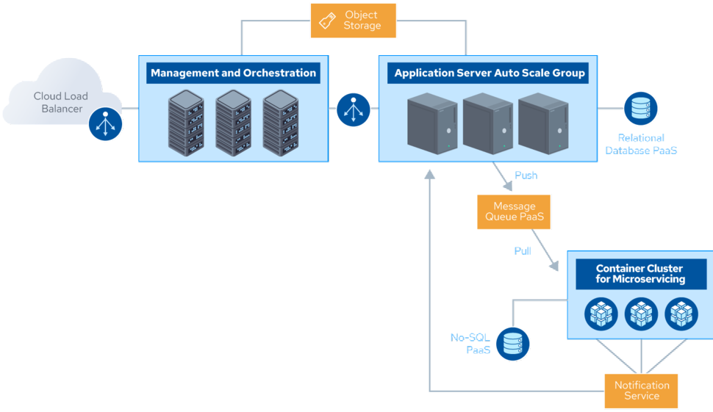
Fully Managed Applications – SaaS delivers complete applications managed by the CSP, allowing CSCs to focus only on configuration while accessing services via web browsers, mobile apps, APIs, or client applications.
SaaS Architecture & Benefits – Built on IaaS and PaaS for agility and resilience, SaaS includes an application logic layer, data storage, APIs, and presentation layers, enabling seamless access across various platforms.

Slide 23
Cloud Deployment Models

Slide 24
NIST and ISO/IEC use the same four cloud deployment models
Public Cloud: The cloud infrastructure is made available to the general public or a large industry group and is owned by a CSP.
Private Cloud: The cloud infrastructure is operated solely for a single organization. It may be managed by the organization or a third party and may be located on-premises or off-premises.
Community Cloud:The cloud infrastructure is shared by several organizations and supports a specific community with shared concerns (e.g., mission, security requirements, policy, and compliance considerations). It may be managed by the CSC(s) or a third party and may be located on-premises or off-premises.
Hybrid Cloud:The cloud infrastructure is a composition of two or more clouds (i.e., private, community, or public) that remain unique entities, but are bound together by standardized or proprietary technology that enables data and application portability (e.g., cloud bursting for load balancing between clouds).

Slide 25
CSA Enterprise Architecture Model

Slide 26
What is CSA ?
CSA Enterprise Architecture (EA) is a framework and methodology for designing secure cloud infrastructure.
It helps organizations evaluate security improvements, plan technology adoption, identify reusable security patterns, and assess CSPs and security vendors using a standardized approach.

Slide 27
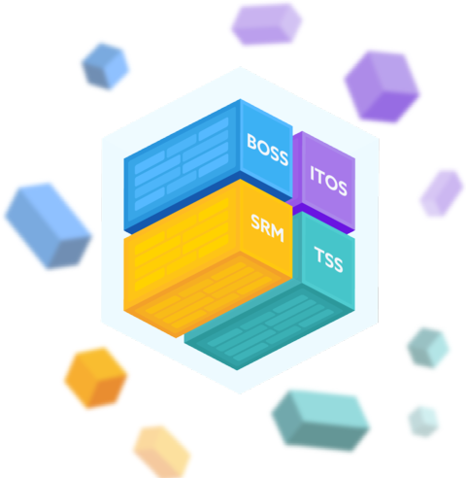
4 Industry standard architecture models
Business Operation Support Services (BOSS) – Uses Sherwood Applied Business Security Architecture (SABSA) for business security governance and risk management.
Information Technology Operation Services (ITOS) – Aligns with Information Technology Infrastructure Library (ITIL) for IT service management and operational efficiency.
Technology Solution Services (TSS) – Covers Infrastructure, Information, Application, and Presentation Services, guided by The Open Group Application Framework (TOGAF) for structured IT architecture.
Security and Risk Management (SRM) – Based on The Open Group Security Forum (formerly Jericho Forum) to address cloud security and risk management frameworks.

Slide 28
Cloud Security
Scope,
Responsibilities, &
Models

Slide 29
Shared Security Responsibility Model

Slide 30
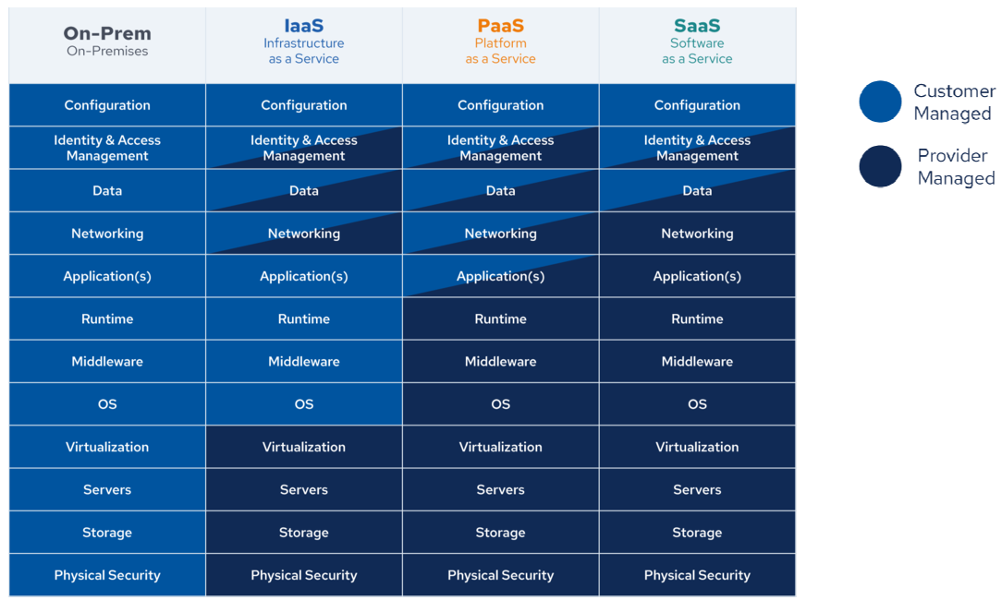

Slide 31
Security Responsibility & Control – Security responsibilities align with the level of control the CSC has over the cloud stack, varying across SaaS, PaaS, and IaaS.
SaaS & PaaS Security – In SaaS, the CSP manages most security while the CSC handles user access and entitlements.
In PaaS, the CSP secures the platform, while the CSC is responsible for application security, database protection, and authentication.
IaaS Security – The CSP provides foundational security like perimeter monitoring, while the CSC manages virtual network security, infrastructure protection, and system configurations.

Slide 32
CSA provides tools to help meet these requirements
Reference:-
The Consensus Assessments Initiative Questionnaire (CAIQ) is a standard template for CSPs to document their security and compliance controls.
https://cloudsecurityalliance.org/research/working-groups/consensus-assessments#_overview
The Cloud Controls Matrix (CCM), discussed in more detail in Domain 2, lists cloud security controls and maps them to multiple security and compliance standards. The CCM can also be used to document security responsibilities.
https://cloudsecurityalliance.org/research/working-groups/cloud-controls-matrix#_overview

Slide 33
Domain2:Cloud Governance and Strategies

Slide 34
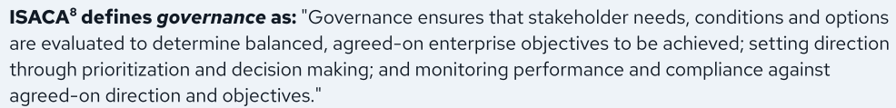
Cloud Governance and Strategies
This domain focuses on cloud governance with an emphasis on the role of security.
Enterprise governance plays a key role in an organization's success and helps in aligning the strategic, tactical,and operational capabilities of information and technology with the business objectives

Slide 35
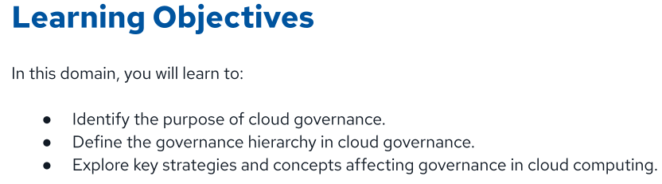

Slide 36
Cloud Governance

Slide 37
Effective Cloud Governance Requires:-
Need for Cloud Governance – Multi-tenancy, shared responsibility, and regulatory complexity necessitate strong governance to manage security and compliance in cloud environments.
Key Drivers for Adoption – Cost efficiency and faster time to market push organizations toward cloud adoption, transitioning from CapEx (investment-based) to OpEx (subscription-based) models.
Security Risks & Complexity – Lift-and-shift strategies often increase security risks due to complex cloud architectures and shared service models, requiring robust governance frameworks.

Slide 38
Risks Involved :-
Cloud Adoption & Innovation – Cloud enables rapid software development and deployment, accelerating innovation and time to market.
Governance & Risk Management – Faster deployment cycles introduce risks like misconfigurations, supply chain vulnerabilities, and compliance challenges, requiring governance to balance speed with security and control.

Slide 39
Two primary ways cloud affects security governance
Shared Responsibility Model – Security governance is shared between the CSP and CSC, with third-party providers sometimes involved. While responsibilities can be offloaded, accountability remains with the CSP or CSC, and compliance risk always rests with the CSC.
Cloud-Specific Differences – Cloud computing introduces technical and operational variations due to multi-tenancy, data geography, and regional failover capabilities.

Slide 40
Complexities that effective cloud governance has to address
Cloud might impose a loss of direct control over the IT infrastructure, forcing an organization to adopt a new governance framework and process
Cloud services and data may span multiple jurisdictions, forcing customers to comply with more laws and regulations, especially privacy requirements.
Visibility and transparency in some cloud services can be challenging.
Using cloud solutions does not mean outsourcing the organizational accountability of its controls to a third or fourth party.

Slide 41
Complexities that effective cloud governance has to address
Data ownership rights and classification as well as privacy control might not be intuitively clear and need careful examination
Most providers have a standard offering that cannot be customized according to all customer’s specific requirements.
Cloud providers might demonstrate different levels of maturity and a variety of services, licenses, and models, which complicates the adoption of a one-size-fits-all cloud policy.

Slide 42
Complexities that effective cloud governance has to address
Cloud services are often built on a chain of providers, which makes scoping governance activities challenging (e.g., a SaaS provider that is running on the infrastructure of an IaaS provider).
**Shared Responsibility Complexity** – Cloud responsibility models vary by provider and stack, requiring clear control delineation. Governance is further complicated by multiple stakeholders, including integrators, developers, DevOps teams, and brokers.
Hybrid cloud models can complicate governance due to the complexities of producing clear boundaries between provider responsibilities and customer responsibilities.

Slide 43
Complexities that effective cloud governance has to address
Compliance Over Testing – Cloud customers rely on compliance assessments rather than direct testing, depending on their responsibility layers. In IaaS, they must test applications while relying on third-party security reports and CSP certifications for overall compliance.
CPSs may change rapidly, which has to be accounted for in governance models.
Skill Requirements – Cloud adoption demands new expertise, including cloud auditing, security skills, and proficiency with cloud security tools

Slide 44
Cloud governance includes:
● Defining roles and responsibilities
● Conducting requirements and information gathering
● Managing risks
● Classifying data and assets
● Complying with legal and regulatory requirements
● Maintaining a cloud registry
● Establishing a governance hierarchy
● Leveraging cloud-specific security frameworks

Slide 45
Governance Hierarchy

Slide 46
A key aspect of cloud governance is establishing a governance hierarchy and defining decision-making processes and escalation paths. This ensures appropriate decision levels and clear accountability.
Key Frameworks for Security and Compliance
Risk Frameworks – Provide guidelines for evaluating cybersecurity risks, ensuring structured risk management. Examples: NIST 800-30, ISO 27005, CIS RAM, FAIR.
Program Frameworks – Define the components of a security program to ensure compliance and governance. Examples: NIST Cybersecurity Framework (CSF), ISO 27001, COBIT.
Control Frameworks – Offer a list of technical and procedural controls to secure cloud infrastructure. Examples: NIST 800-53, CIS Critical Security Controls (CIS CSC), CSA Cloud Controls Matrix (CSA CCM).

Slide 47
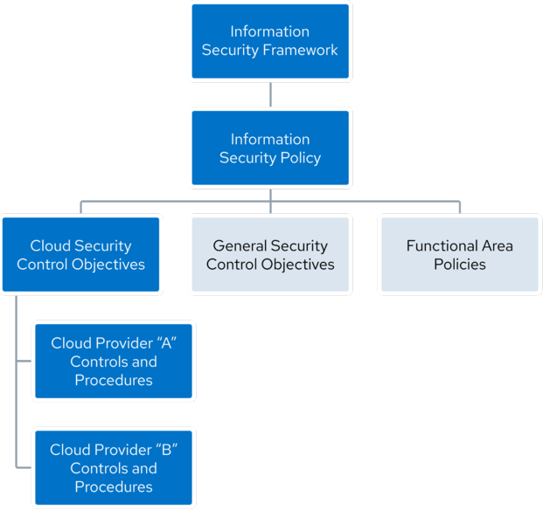
The output of these frameworks consists of structured governance documents that outline specific policies, processes, and actions for your organization.
Policies define an organization's security requirements by translating framework guidelines into actionable directives, ensuring compliance with regulatory standards.
Control Objectives are more specific than policies, focusing on desired security outcomes to reduce risk and maintain a secure environment, such as enforcing MFA for cloud logins. They set clear security goals for organizations.
Control Specifications & Technical Standards define the technical implementations needed to meet control objectives. For example, they may mandate enabling MFA for user access and enforcing it through technical policies.

Slide 48
Aligning with Requirements,
Standards, Best Practices, & Contractual Obligations

Slide 49
1. Align with Standards & Best Practices
Establish governance by following industry standards, best practices, and contractual obligations to ensure a secure cloud environment.
2. Understand Contractual Security Responsibilities
Review CSP contracts to clarify shared security responsibilities and compliance requirements, including obligations to customers and partners.
3. Leverage CSP Best Practices
Utilize CSP well-architected frameworks as security references while adapting them to fit specific organizational needs.

Slide 50
Consulting with Key Stakeholders
for
Cloud Security Strategy Alignment

Slide 51
Key Cloud Stakeholders to Align With
IT Department – Manages cloud infrastructure, deployment, and maintenance.
Security Team – Ensures cloud security, risk management, and compliance.
Compliance & Legal Team – Oversees regulatory adherence and legal obligations.
Finance Department – Manages cloud costs, budgeting, and financial planning.
Business Unit Leaders – Align cloud strategies with business objectives.
Development Team – Builds and deploys cloud-native applications.
Operations Team – Manages cloud performance, availability, and monitoring.
Project Management Office – Coordinates cloud adoption and implementation strategies.
Vendors & Service Providers – Supply cloud solutions, tools, and third-party integrations.
End Users – Utilize cloud services and provide feedback on usability and performance.

Slide 52
Cloud Security Frameworks

Slide 53
Cloud Security Frameworks: Key Aspects
Organized Security Control Objectives
Cloud security frameworks structure and prioritize security control objectives to achieve desired security outcomes systematically.
Cloud-Specific Considerations
These frameworks address cloud-specific challenges like on-demand resource allocation, shared responsibility models, and rapid elasticity to align security programs with cloud requirements.
Major Cloud Security Frameworks
Key frameworks include
CSA Cloud Controls Matrix (CCM),
ISO/IEC 27017,
BSI C5,
NIST 800-53,
PCI SSC Cloud Computing Guidelines,
NIST CSF V2, and
CSA Cloud Security Maturity Model (CSMM).

Slide 54
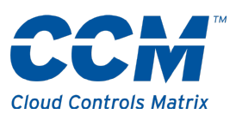
CSA Cloud Controls Matrix (CCM v4): Key Highlights
Comprehensive Security Coverage
CCM v4 structures 17 control domains, covering security aspects like governance, risk management, operational security, and data privacy, making it a valuable cloud security resource.
Alignment with Leading Standards
CCM aligns with major security frameworks, including ISO/IEC 27001/27002, PCI DSS (v3.2.1/v4.0), and NIST, ensuring compliance across multiple regulations.
Tailored for Cloud Environments
Designed for multi-tenant, distributed, and dynamic cloud systems, CCM addresses cloud-specific challenges, setting it apart from generic frameworks like NIST CSF.
Customizable Security Controls
Organizations can adapt controls to fit specific cloud architectures, delivery models (IaaS, PaaS, SaaS), and compliance needs.
Supports Cloud Governance
CCM helps organizations establish strong cloud governance, managing risks while aligning cloud security with business objectives and regulatory requirements.
Regular Updates & Best Practices
Continuously updated, CCM reflects evolving cloud security best practices, ensuring organizations have a reliable and up-to-date security framework.

Slide 55
CSA Security, Trust, Assurance,and Risk(STAR)Registry

Slide 56
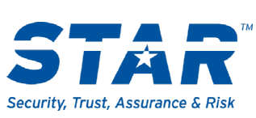
CSA STAR Registry – A public registry that documents cloud security and privacy controls, enhancing transparency and trust. Cloud providers submit CAIQ assessments, allowing organizations to evaluate CSP security practices and compliance.
CSA STAR Program: Key Components
CSA STAR Certification
Independent third-party evaluation of a CSP’s security controls against CSA Cloud Controls Matrix (CCM) and industry standards like ISO/IEC 27001.
Demonstrates that a CSP has implemented strong security practices.
CSA STAR Attestation
A collaboration between CSA and AICPA to integrate SOC 2 engagements with CSA CCM.
Provides rigorous third-party assessments, ensuring transparency and trust in cloud security practices.

Slide 57
Empowering Risk-Aware Cloud Decisions
The CSA STAR Program enables organizations to
evaluate security,
privacy, and
compliance practices
of cloud providers, ensuring informed, risk-aware decisions that enhance trust and reliability in cloud services.

Slide 58
Policies

Slide 59
Key Aspects of Information Security Policies
1) Foundation of Security Framework
Information security policies define how an organization protects its information assets and ensures alignment with business objectives.
Policies should be approved by business leadership to integrate security with strategic goals.
2) Core Information Security Policy
A top-level policy that governs the overall security program and references other security policies and control objectives.
Avoids excessive technical details, instead linking to supporting documents.
3) Supporting Security Policies
Specific policies cover areas such as acceptable use, data protection, identity management, mobile security, cloud usage, and third-party risk management.
Organizations can leverage security policy libraries from resources like SANS Institute and CIS for guidance and templates.

Slide 60
Gist:
Information security policies provide a structured approach to protecting an organization’s assets, with a top-level policy defining the security framework and specific policies covering critical security areas. Business leadership approval ensures alignment with strategic objectives.

Slide 61
Domain3: Risk, Audit and Compliance

Slide 62
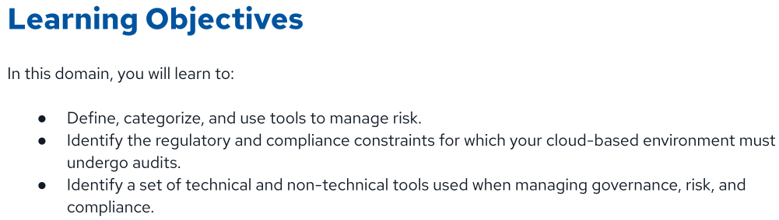

Slide 63
Cloud Risk Management

Slide 64
Explanation of Key Security Concepts
Asset – In this scenario, the cloud storage bucket containing customer personal information is considered an asset because it holds valuable and sensitive data that needs protection.
Threat Actor & Target – An attacker (threat actor) views this cloud storage bucket as a target because exploiting it could lead to unauthorized access, data theft, or other malicious activities.
Vulnerability – A misconfiguration in the cloud storage bucket is a vulnerability, meaning a security weakness that could be exploited. Examples include public access settings, weak authentication, or lack of encryption.
Attack Vector – To an attacker, this misconfiguration serves as an attack vector, meaning the path or method used to exploit the vulnerability and gain unauthorized access to the sensitive data stored in the bucket.
Summary
A cloud storage bucket holding sensitive data is an asset, and an attacker (threat actor) sees it as a target. If the bucket is misconfigured (vulnerability), it provides an attack vector, allowing unauthorized access or data breaches. Proper security configurations help mitigate this risk.

Slide 65
Understanding Risk in Cloud Storage
Data Leakage & Regulatory Fines
If the personal data stored in the cloud bucket is leaked due to a misconfiguration or attack, the company could face regulatory penalties, legal action, and reputational damage.
Data Loss or Corruption
If the data becomes unavailable or corrupted due to accidental deletion, cyberattacks (e.g., ransomware), or system failures, the company may suffer operational disruptions, financial losses, and compliance issues.
Summary
Risks associated with a cloud storage bucket include data leakage leading to regulatory fines and data unavailability or corruption, which can disrupt operations and impact business continuity.

Slide 66
Controls & Countermeasures to Reduce Risk
Access Control Policies
Restrict public access to storage buckets, ensuring only authorized users can access sensitive data.
Authentication & Authorization
Implement strong authentication (e.g., MFA) and role-based access control (RBAC) to limit access to critical data.
Encryption
Use encryption at rest and in transit to protect data from unauthorized access or interception.
Monitoring & Logging
Enable audit logs and real-time monitoring to detect suspicious activity and misconfigurations.
Automated Compliance Checks
Use security automation tools to continuously scan for misconfigurations and enforce compliance policies.
Summary
Controls like restricting public access, enforcing authentication, encrypting data, monitoring activity, and automating compliance checks help reduce the risk of data leakage, corruption, and regulatory penalties.

Slide 67
Threat Modeling & Risk Reduction in Cloud Security
Risk Reduction Through Controls
Implementing adequate security controls helps minimize risks to an acceptable level, ensuring data protection and regulatory compliance.
Understanding Assets & Threat Actors
Identifying critical assets (e.g., cloud storage, databases) and potential threat actors (e.g., hackers, insiders) is key to effective risk management.

Slide 68
Threat Modeling Process
Threat modeling involves analyzing where data is stored, how it flows across cloud services, and potential security threats to these processes.
Cloud-Specific Threat Modeling
In cloud environments, threat modeling requires assessing data locations, service interactions, access controls, and security configurations.
CSA Research & Application Security
Additional guidance on threat modeling and application security is available through CSA research and security frameworks.
Summary
Threat modeling helps organizations identify risks, assess data flows, and implement controls to reduce security threats to an acceptable level in cloud environments.

Slide 69
Cloud Security Alliance’s TopThreats
Insufficient Identity, Credentials, Access, and Key Management
Insecure Interfaces and APIs
Misconfiguration and Inadequate Change Control
Lack of Cloud Security Architecture and Strategy
Insecure Software Development
Unsecured Third-Party Resources
System Vulnerabilities
Accidental Cloud Data Disclosure
Misconfiguration and Exploitation of Serverless and Container Workloads
Organized Crime/Hackers/Advanced Persistent Threat (APT)
Cloud Storage Data Exfiltration
https://attack.mitre.org/

Slide 70
Understanding Cloud Risk Management

Slide 71
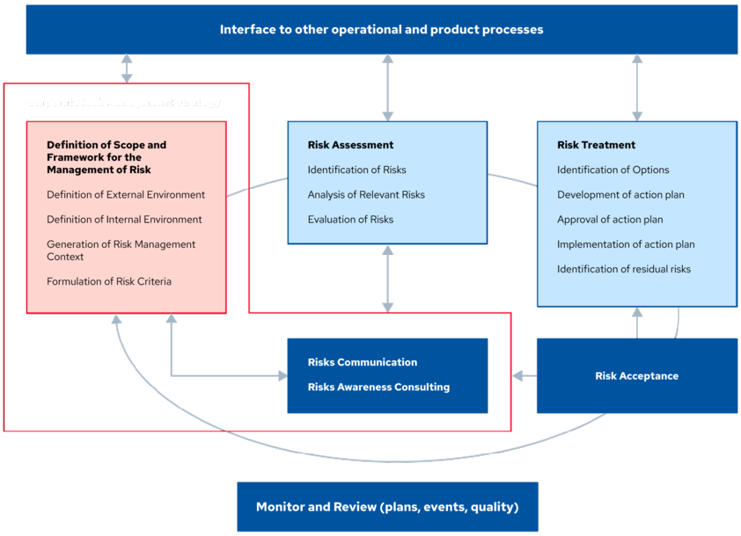
Comprehensive Cloud Risk Management Framework

Slide 72
Key Aspects of Risk Management in Cloud Computing
Structured Risk Management Approach
Identifies, assesses, and mitigates risks associated with cloud computing, ensuring security and compliance.
Similarities with On-Premises Risk Management
The core methodologies of risk management remain the same, but cloud-specific risks require tailored scope definition, risk evaluation, and treatment actions.
Cloud-Specific Risk Considerations
Unique challenges include shared responsibility models, data location concerns, multi-tenancy risks, and compliance complexities.
ENISA Risk Management Framework
The European Network and Information Security Agency (ENISA) provides a cloud-adaptable risk management framework that integrates with an organization's broader security strategy.
Integration into Business Processes
Effective cloud risk management should be embedded within operational workflows to ensure comprehensive security governance.

Slide 73
Corporate Risk Management Strategy

Slide 74
Cloud Risk Management & Business Alignment
Diverse Cloud Risk Appetites – Cloud adoption supports various corporate goals, each with different risk tolerances.
Corporate Risk Strategy as a Foundation – The overall corporate risk management strategy guides how business risks translate into cloud risk management.
Alignment of Business & Cloud Risks – Effective cloud security ensures that cloud risks are managed in line with broader business objectives.

Slide 75
Risk Assessment
Identify and analyze relevant risks to understand their potential impact on the organization.
This involves evaluating each risk to determine the likelihood of occurrence and the severity of its consequences

Slide 76
Risk Treatment
After assessing risks, develop and approve an action plan to mitigate, transfer, avoid, or accept each risk.
Implement these action plans and identify any residual risks that remain

Slide 77
Interface to Other Operational & Product Processes
Risk management should not be siloed;
it must interface with other business processes to ensure that risk considerations are embedded throughout the organization's operations and product lifecycle

Slide 78
Monitoring &Review(Plans,Events,Quality)
Continuously monitor risk management plans, events, and the quality of risk management activities.
Regular reviews ensure that risk management processes remain effective and adapt to any changes in the business environment.

Slide 79
Assessing Cloud Services

Slide 80
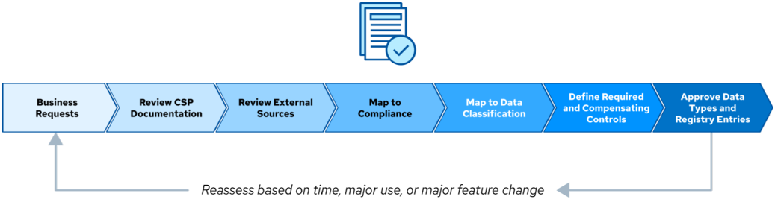
One of the first steps in managing cloud risks is having a systematic process to assess cloud providers and services.
This assessment should align with your business needs and risk tolerance.
Systematic Process for Evaluating and Approving Cloud Services

Slide 81
Business Requests
Key Considerations for Cloud Risk Management
Understanding Business Needs – Assess the purpose and objectives of cloud adoption, even if a specific service is not yet identified.
Identifying Data Involved – Determine the type, sensitivity, and regulatory requirements of the data to assess security needs.
Evaluating Risk Appetite – Align cloud adoption with the organization’s risk tolerance and compliance policies.
Ensuring Policy & Regulatory Compliance – Consider industry regulations and internal policies to mitigate risks associated with cloud usage.

Slide 82
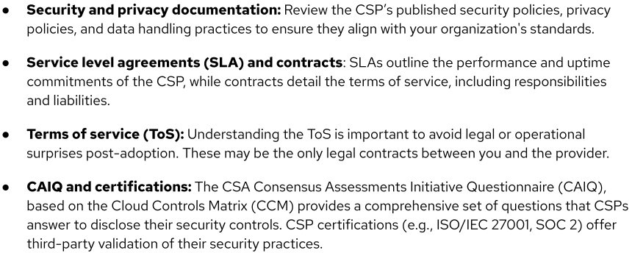
Review CSP Documentation

Slide 83
Business Requests
Key Considerations for Cloud Risk Management
Understanding Business Needs – Assess the purpose and objectives of cloud adoption, even if a specific service is not yet identified.
Identifying Data Involved – Determine the type, sensitivity, and regulatory requirements of the data to assess security needs.
Evaluating Risk Appetite – Align cloud adoption with the organization’s risk tolerance and compliance policies.
Ensuring Policy & Regulatory Compliance – Consider industry regulations and internal policies to mitigate risks associated with cloud usage.

Slide 84
Review External Sources
Research:
Investigate external reviews, reported vulnerabilities, and any past security and operational incidents involving the CSP to gauge their security posture and response capabilities

Slide 85
Map to Compliance Requirements
Key Considerations for Selecting a CSP
Regulatory Compliance Alignment – Ensure the CSP’s features and policies align with compliance requirements like GDPR, HIPAA, and PCI DSS.
Data Security Assurance – Verify that the CSP meets security and privacy standards to protect organizational data.
Risk & Compliance Management – Choosing a compliant CSP helps mitigate legal risks and maintain regulatory adherence.

Slide 86
Map to Data Classification
It’s acceptable to use a riskier service with less valuable or public data ?
Data sensitivity assessment: Assess the sensitivity of data in transit and at rest.
Not all data carries the same risk; thus, not all cloud services are required to meet the highest security standards.
Service approval based on datatype: Approve CSPs and their services based on the classification of data they will handle.
This approach allows for flexibility and efficient use of resources.

Slide 87
Define Required & Compensating Controls
Before final approval, security defines any required controls (e.g., configuration settings within the CSP) and any compensating controls (e.g., third-party tools) needed to use the service with the designated data types.

Slide 88
Approval Process
Evaluating and Approving CSP Services
Assess the CSP's services against the required data security and compliance criteria.
If they align with organizational needs, approve their use and document them in the cloud register to maintain visibility and control over cloud adoption.

Slide 89
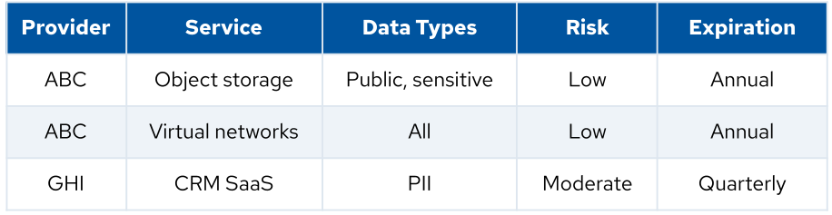
Cloud Register
Cloud Register Overview
A cloud register is a centralized repository of approved cloud services and their permitted data types based on risk levels.
It guides service selection, ensures compliance, and helps maintain secure data usage.
Cloud Registry Example

Slide 90
Compliance & Audit

Slide 91
Understanding Compliance in Cloud Security
Definition of Compliance
Compliance involves adhering to internal policies, laws, regulations, industry standards, and best practices to ensure secure and ethical operations.
Benefits of Compliance
Helps organizations meet ethical and legal obligations, operate safely in the market, and gain a competitive advantage by aligning with international standards.

Slide 92
Sources of Compliance Requirements
Regulatory Standards – National and international laws governing data processing, storage, and transfer.
Industry Standards – Sector-specific frameworks like PCI DSS for credit card handling, often with cloud-specific guidance.
Contracts – Legal agreements that impose specific compliance obligations.
Internal Policies & Standards – Organizational security policies, which may require updates to align with cloud environments.
Demonstrating Compliance
Organizations prove compliance through audits and conformity assessments, ensuring their security controls meet required standards.

Slide 93
Jurisdictions

Slide 94
Jurisdictional Challenges in Cloud Compliance
Cloud deployments often span multiple legal and regulatory jurisdictions, each with distinct data privacy and security laws.
This complexity increases as operations extend across regions, requiring careful compliance management.

Slide 95
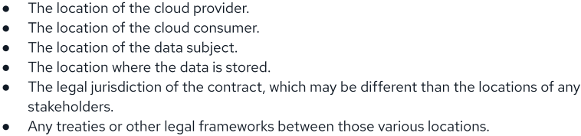
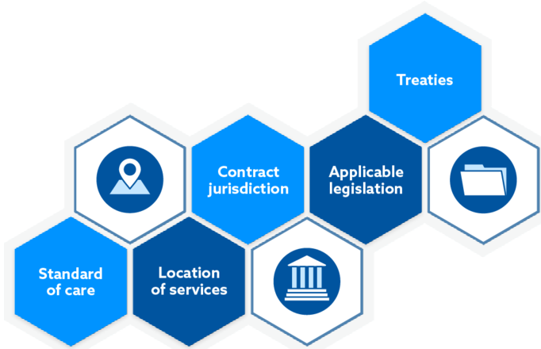
Cloud providers and cloud consumers operating in multiple regions will face a matrix of jurisdictions where various laws and regulations apply

Slide 96
Cloud-Relevant Laws & Regulations Examples

Slide 97
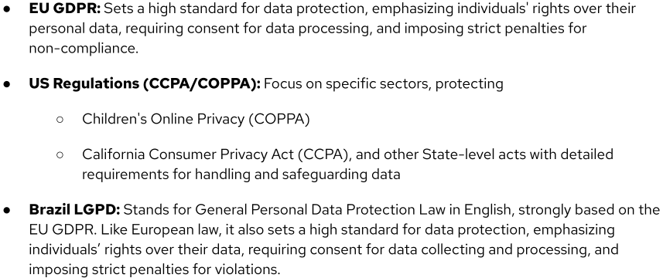
Privacy Laws & Regulation

Slide 98
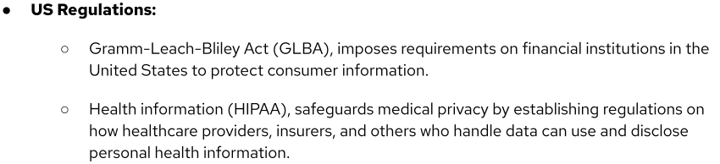

Slide 99
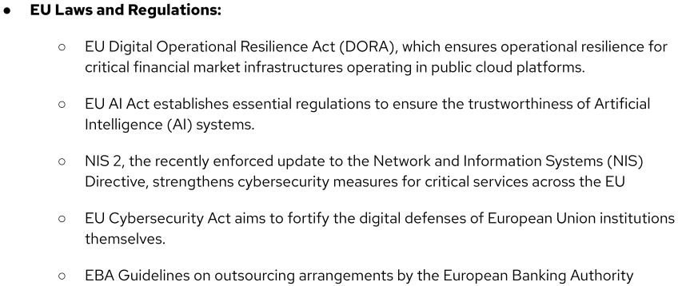

Slide 100
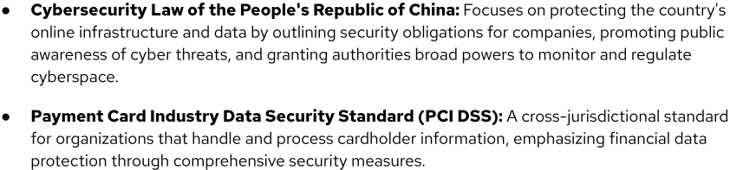

Slide 101
Compliance in the Cloud

Slide 102

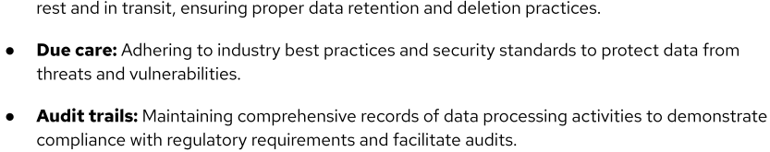

Slide 103
Adherence to Standards

Slide 104
Key Cloud Compliance Standards & Certifications
ISO/IEC 27001 (Information Security Management System - ISMS)
An international standard for managing information security through a risk-based approach.
Helps organizations implement security controls and management practices to protect sensitive data.
System and Organization Controls (SOC)
A compliance standard by AICPA for service organizations, focusing on security, availability, processing integrity, confidentiality, and privacy.
SOC reports provide assurance on security controls, essential for SaaS and tech companies handling customer data.
CSA STAR (Security Trust Assurance and Risk) Registry
Developed by CSA, the STAR Registry enables cloud providers to demonstrate compliance with industry standards.
Integrates cloud-specific controls from the Cloud Controls Matrix (CCM) for enhanced security transparency.

Slide 105
Compliance Inheritance

Slide 106
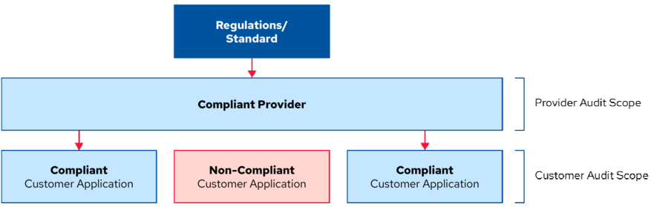
Cloud Compliance & Inheritance in Shared Responsibility
Shared Compliance Responsibility – In cloud environments, compliance is divided between the CSP and CSC, with each responsible for specific security controls.
Compliance Inheritance – Customers can inherit compliance from a certified CSP, reducing their burden for infrastructure-level controls.
E.g
using a PCI DSS-compliant cloud provider ensures compliance at the infrastructure level, but the CSC must secure their software and applications.
Independent Audits – Both CSPs and CSCs undergo separate audits to verify their respective compliance responsibilities, ensuring end-to-end security and regulatory adherence.
Audit Scope:
Provider
vs.
Customer Responsibilities

Slide 107
Artifacts of Compliance

Slide 108
Compliance Artifacts & Audit Responsibility
Definition & Purpose – Compliance artifacts include logs, documentation, and audit materials that serve as evidence for regulatory compliance.
Customer Responsibility – While CSPs provide some compliance artifacts, customers must ensure they gather the necessary materials for their audits.
Understanding Provider Offerings – Customers should evaluate what compliance artifacts the CSP provides and identify any gaps.
Filling Compliance Gaps – If certain data (e.g., server logs on a PaaS platform) is inaccessible, customers may need to enhance logging or create additional compliance documentation.

Slide 109
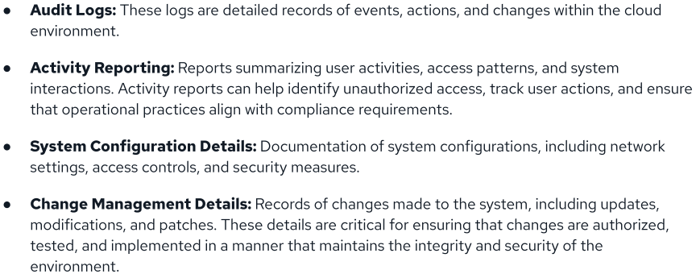
compliance artifacts

Slide 110
Governance, Risk, Compliance Tools & Technologies

Slide 111
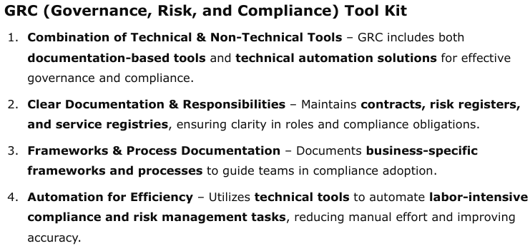

Slide 112
Domain4:
Organization Management

Slide 113
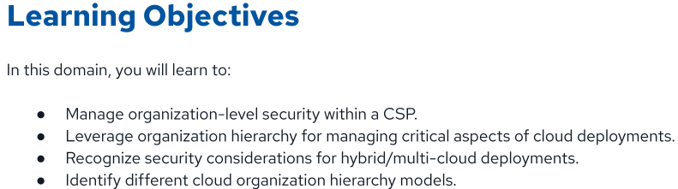

Slide 114
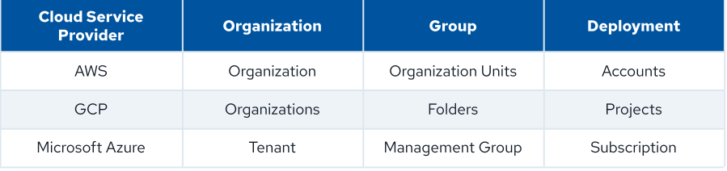
Definitions
An "organization" denotes the highest level of structure within a CSP cloud provider.
A "group" represents a collection of deployments.
A "deployment" refers to an isolated environment within a CSP cloud provider.
Cloud Service Provider Terminology Comparison

Slide 115
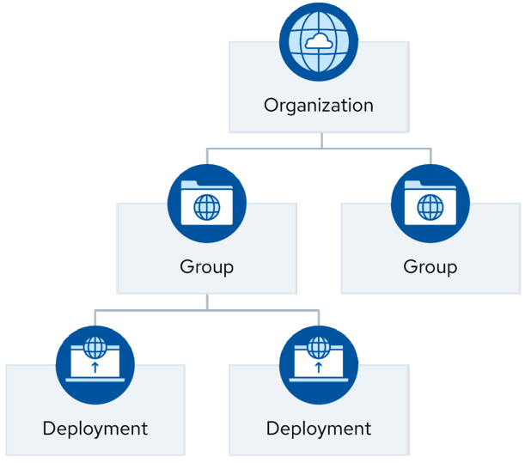
Hierarchical Structure for Cloud Resource Management

Slide 116
Organization Capabilities Within a Cloud Service Provider

Slide 117
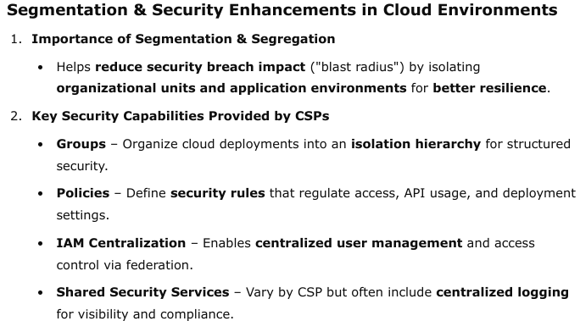

Slide 118
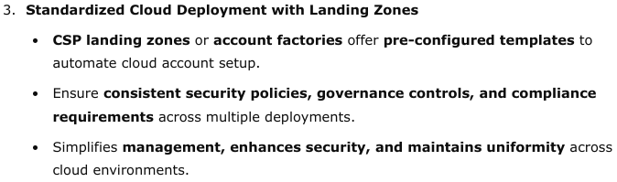

Slide 119
Building a Hierarchy Within a Provider

Slide 120
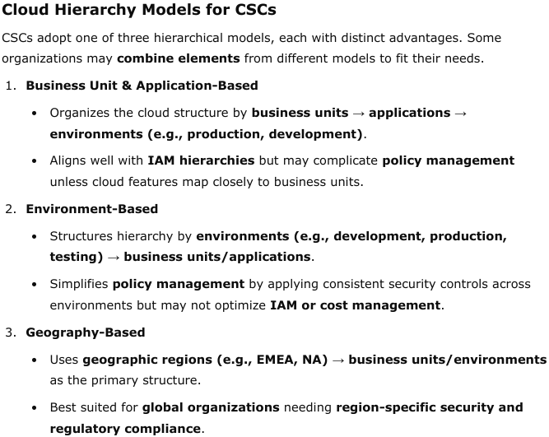

Slide 121
Managing Organization –
Level Security Within a Provider

Slide 122
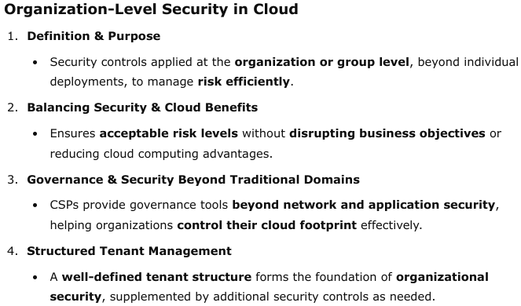

Slide 123
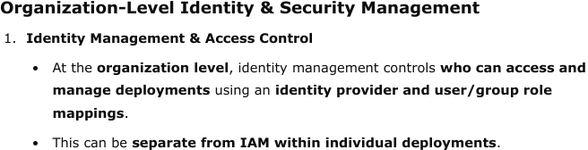
Identity Provider & User/Group/RoleMappings

Slide 124
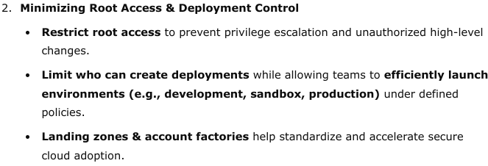
Identity Provider & User/Group/RoleMappings

Slide 125
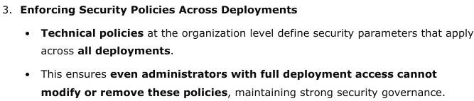
Identity Provider & User/Group/RoleMappings

Slide 126
CSP policies can be categorized into three levels based on their scope:

Slide 127
1) Organization-Wide Policies
Defined by the CSC, these policies apply to all deployments, though they remain limited due to the complexity of managing broad-scale exceptions.

Slide 128
2) Group-Level Policies
Applied to all deployments within a group, these policies accumulate and reinforce across sub-groups.
CSPs enforce them, prioritizing denial policies over lower-level rules.

Slide 129
3) Deployment-Level Policies
Tailored for Individual Deployments – Allow precise security adjustments based on specific needs.
Granular Security Controls – Useful for deployments requiring fine-tuned security settings beyond group-level policies.
Group-Level Policies Preferred – Generally, managing policies at the group level is more efficient, but deployment-level policies are necessary in certain scenarios.

Slide 130
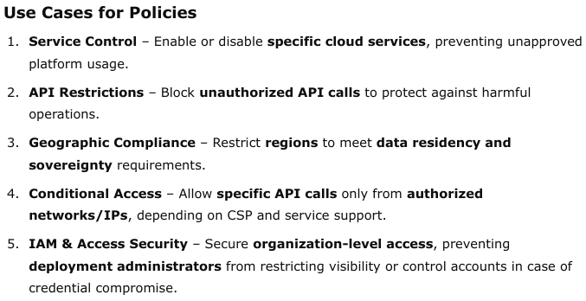
Policies

Slide 131
Common Organization Shared Services

Slide 132
Shared Services for Cloud Security & Governance
Consistency Across Deployments – While deployments are isolated, CSCs aim for uniform policy and risk management across them.
Consolidated IAM – A critical shared service, enabling centralized identity and access management across deployments.
Centralized Logging & Security Telemetry – Aggregates security data and logs into a single destination, improving threat detection, analysis, and compliance (e.g., SIEM integration).

Slide 133
Shared Services for Cloud Security & Governance
Threat Detection Services – CSPs provide real-time monitoring for malicious activity, enhancing incident response and security posture.
Centralized Cost Management – Uses tagging policies to allocate cloud costs to applications or business functions for better financial oversight.
Account Factories – Automate cloud account creation using Infrastructure as Code (IaC), ensuring standardized security and governance from the start.

Slide 134
Considerations for
Hybrid & Multi-Cloud Deployments

Slide 135
Securing Hybrid & Multi-Cloud Environments
Hybrid Cloud Security Challenges – Combines on-premises and public cloud, offering flexibility but requiring strong security integration across environments.
Multi-Cloud Complexity – Uses multiple CSPs to prevent vendor lock-in and optimize performance, but increases security and governance challenges.
Key Security Considerations – Focus areas include organization management, IAM, network security, and security tools to maintain a consistent security posture.

Slide 136
Organization Management for Hybrid CloudSecurity

Slide 137
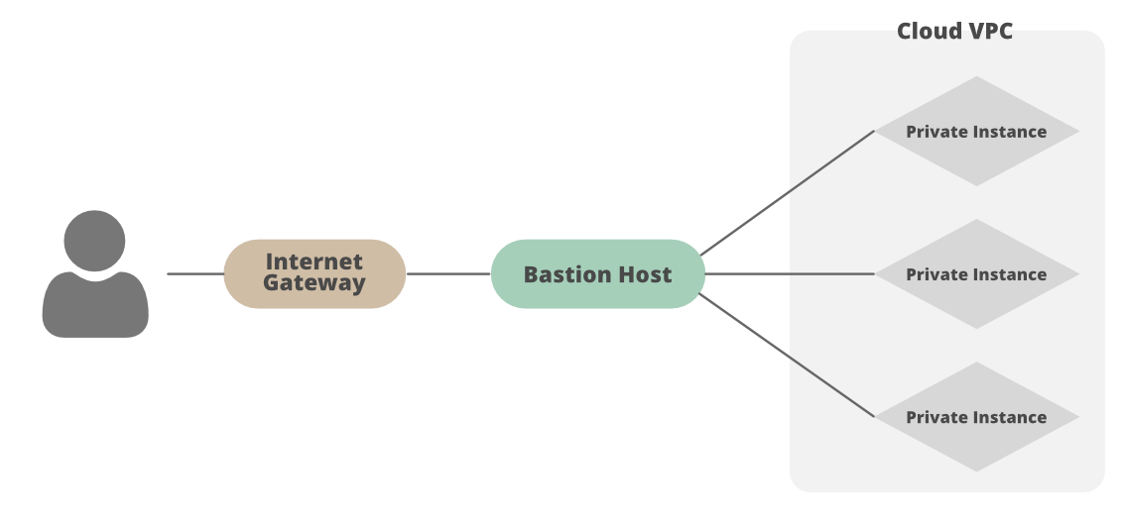
Key Considerations for Hybrid Cloud Security
Hybrid Cloud Integration – Connects on-premises data centers with a public cloud via VPN or dedicated links, requiring strong networking and security measures.
Identity and Access Management (IAM) – A compromised identity provider can impact both environments, making robust IAM essential.
Network Security – Weak network controls can expand the attack surface, so stringent security measures must be in place to minimize risks.
Tailored Security Controls – Cloud and data centers differ, so a single security model for both can create gaps. Security tools and strategies should be environment-specific.
Managing Hybrid Cloud Sprawl – Multiple data centers and cloud deployments can create complex security challenges. Mature CSCs consolidate connections into a centralized "bastion network" to enhance security and simplify management.

Slide 138
Organization Management for Multi-Cloud Security

Slide 139
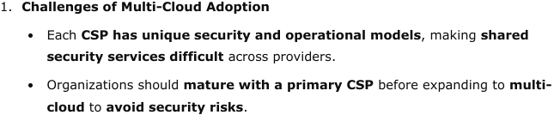
Key Considerations for Multi-Cloud Security & Strategy

Slide 140
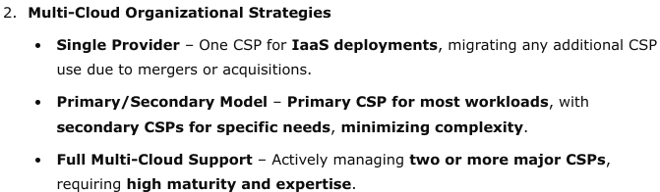
Key Considerations for Multi-Cloud Security & Strategy

Slide 141
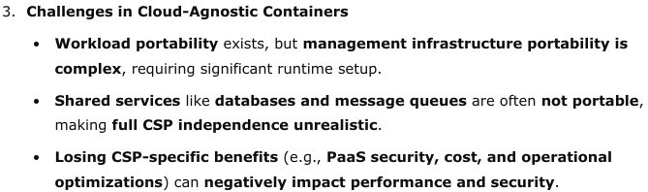
Key Considerations for Multi-Cloud Security & Strategy

Slide 142
Tooling & Staffing for IaaS/PaaSMulti-Cloud

Slide 143
Cloud Staffing & Expertise Considerations
Cloud Skill Development – Many CSCs transition without additional staff, requiring existing teams to learn cloud skills while managing traditional infrastructure.
CSP-Specific Expertise – Each CSP has unique requirements, and broader service adoption demands deeper knowledge. At least one SME per major CSP is recommended.
Primary/Secondary Strategy for Efficiency – Using a primary CSP for most workloads reduces the need for dedicated experts across multiple platforms.

Slide 144
Cloud Staffing & Expertise Considerations
Role of Managed Service Providers (MSPs) – Smaller organizations often outsource cloud expertise to MSPs, but accountability for security and governance remains with the CSC.
MSP Alignment – The MSP’s vision, strategy, and capabilities must align with the CSC’s long-term security and governance goals.

Slide 145
Organization Management
for
SaaS Hybrid & Multi-Cloud

Slide 146
Managing SaaS Security & Governance
1) SaaS Complexity vs. IaaS Security Responsibilities
Unlike IaaS, where security consolidation is possible, SaaS presents challenges due to diverse offerings and varying security maturity across providers.
2) SaaS Portfolio Management
Evaluate SaaS CSPs for security and compliance before authorization.
Maintain a central registry for approved SaaS providers.
Require strong business justification for adopting new SaaS within an existing service category.

Slide 147
Managing SaaS Security & Governance
3) Governance of SaaS Integrations
SaaS often integrates with other applications, requiring strict governance over data flow and security to prevent risks.
4) Key Security Tools for Managing SaaS CSPs
Federated Identity Brokers – Provide centralized user access management with pre-built integrations for major CSPs.
Cloud Access Security Brokers (CASB) – Control access, monitor usage, and enforce security policies for SaaS services.
API Gateways – Ensure visibility, security, and policy enforcement over API-based SaaS interactions.

Slide 148
Domain5:
Identity and Access Management

Slide 149
Identity and Access Management (IAM) in Cloud Security
1) IAM as the New Security Perimeter
IAM ensures only authorized entities can access the right resources.
In cloud environments, IAM protects sensitive data and services through web consoles and APIs exposed to the Internet.
2) Cloud vs. On-Prem IAM Management
Security concerns remain similar, but their impact is amplified in cloud environments.
Key Differences:
CSP-CSC relationship & shared responsibilities in IAM.
Consolidation of multiple administrative interfaces for data centers and services.
Public exposure of IAM interfaces in cloud environments.

Slide 150
Identity and Access Management (IAM) in Cloud Security
3) IAM Scope in Cloud Security
Focuses on IAM between organizations and cloud providers, including cross- cloud IAM.
Does not cover internal IAM for applications running within cloud infrastructure (e.g., enterprise IAM in IaaS).

Slide 151
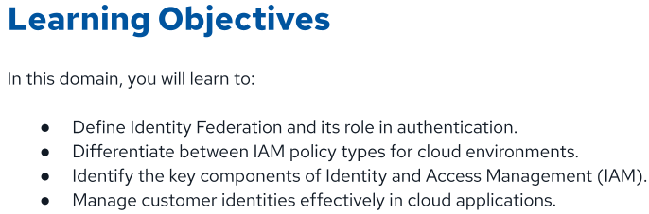

Slide 152
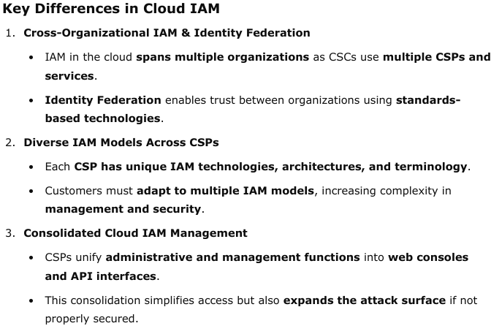
How IAM Is Different in the Cloud

Slide 153
Fundamental Terms

Slide 154
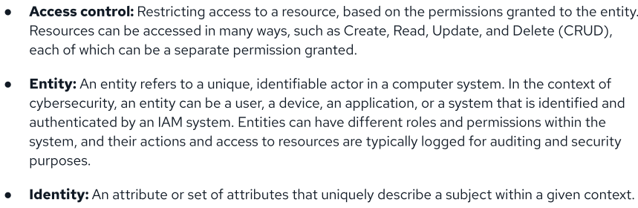

Slide 155
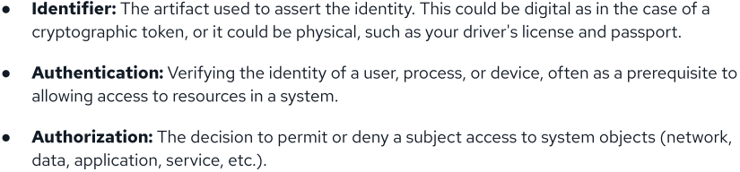

Slide 156
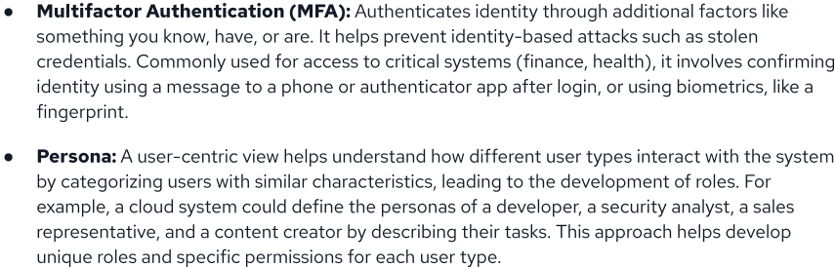

Slide 157
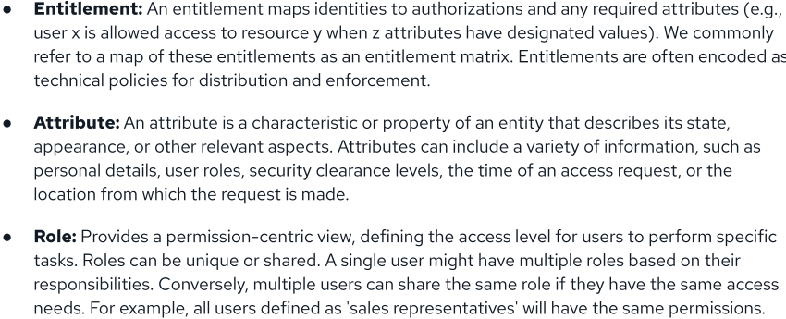

Slide 158
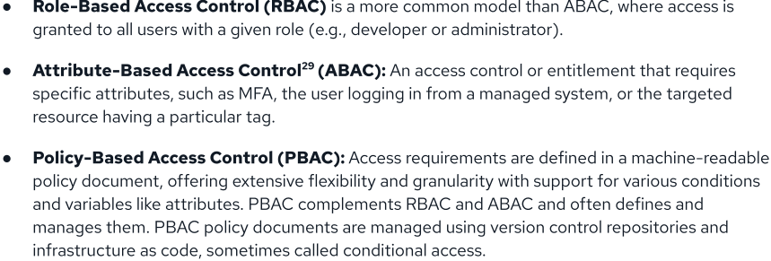

Slide 159



Slide 160


Slide 161

Federation

Slide 162


Common Federation Standards

Slide 163


How Federated Identity Management Works

Slide 164

Managing Users & Identities for Cloud Computing

Slide 165


Slide 166

Architectural Models for Federated Identity Management: Hub & Spoke vs. FreeForm

Slide 167

Strong Authentication & Authorization

Slide 168

Authentication & Credentials

Slide 169

Entitlement & Access Management

Slide 170

E.g

Slide 171

Privileged User Management

Slide 172
Domain6:
Security Monitoring

Slide 173


Slide 174


Slide 175

Cloud Monitoring

Slide 176

Logs & Events

Slide 177

Beyond Logs-Posture Management

Slide 178

Management Plane Logs

Slide 179
Service & Application Logs
Service & Application Logs – Track interactions within cloud services, capturing service-specific events like
load balancer activity and storage access logs.

Slide 180


Slide 181
Cloud Native Application Protection Platform (CNAPP)

Slide 182


Slide 183


Slide 184


Slide 185


Examples of Events to Monitor

Slide 186

Cloud Telemetry Sources

Slide 187

Log Storage & Retention

Slide 188

Cascading Log Architecture
Cascading log architecture is a hierarchical approach to log management.
With it, logs are collected, filtered, aggregated, and analyzed in a cascading fashion, flowing from one layer to another to facilitate centralized monitoring and analysis.

Slide 189

AI for Security Monitoring

Slide 190
Domain7:
Infrastructure & Networking

Slide 191


Slide 192


Slide 193

Foundational Infrastructure Security Techniques
Three foundational techniques

Slide 194

CSP Infrastructure Security Responsibilities

Slide 195

CSP Infrastructure Security Responsibilities

Slide 196

Infrastructure Resilience

Slide 197

Infrastructure Resilience

Slide 198
Cloud Network Fundamentals

Slide 199

Cloud networks are software-defined networks.
Enforcing strong separation between customer-tenant environments is essential.

Slide 200

Cloud Networks are Software-Defined Networks

Slide 201

SDN-Based Components

Slide 202

SDN-Based Components

Slide 203


SDN-Based Components

Slide 204


Slide 205

Cloud Connectivity

Slide 206

Cloud Connectivity

Slide 207
Cloud Network Security
&
Secure Architectures

Slide 208

Preventative Security Measures

Slide 209

Detective Security Measures

Slide 210

Infrastructure as Code

Slide 211


Slide 212

Zero Trust for Cloud Infrastructure & Networks

Slide 213

Zero Trust for Cloud Infrastructure & Networks

Slide 214

Zero Trust for Cloud Infrastructure & Networks

Slide 215

Zero Trust for Cloud Infrastructure & Networks

Slide 216

Software-Defined Perimeter & ZT Network Access

Slide 217

Software Defined Perimeter(SDP)

Slide 218

Software Defined Perimeter(SDP)

Slide 219

Software Defined Perimeter(SDP)

Slide 220

Zero Trust Network Access(ZTNA)

Slide 221

Secure Access Service Edge

Slide 222


Slide 223
Domain8:
Cloud Workload Security

Slide 224


Slide 225

Introduction to Cloud Workload Security

Slide 226

Types of Cloud Workloads

Slide 227

Impact on Workload Security Controls

Slide 228
Securing Virtual Machines

Slide 229
Virtual Machines (VMs) are full operating systems running on hypervisors, commonly used for cloud workloads due to their proximity to hardware and widespread familiarity.
They ensure strict isolation between workloads within and across customers.
Each VM operates with its own complete operating system stack.

Slide 230

Virtual Machine Challenges & Mitigation

Slide 231

Creating Secure VM Images with Factories
Secure Virtual Machine Image CreationProcess

Slide 232


Slide 233
Securing Containers
Container Image Creation
Container Image Definition – A lightweight, executable package containing an application's dependencies.
Dockerfile Usage – Created from a Dockerfile, ensuring a structured and repeatable build process.
Portability & Consistency – Enables seamless application deployment across various environments.
Immutable Infrastructure – Containers are not modified after deployment; instead, updates are handled by replacing them with new images.
Security Best Practices
Use secure base images to prevent vulnerabilities.
Store images in secure artifact repositories for controlled access and integrity.

Slide 234

Container Networking

Slide 235
Container Orchestration & Management Systems

Slide 236


Slide 237

Basic Kubernetes Setup with Load Balancer and Pods

Slide 238
Container Orchestration Security

Slide 239


Slide 240


Slide 241
Securing Serverless
and
Function as a Service

Slide 242

Serverless computing is a way for developers to write and deploy code without handling the underlying infrastructure.
The cloud provider manages the servers, which includes provisioning them, scaling them to handle different loads, and maintaining them.
This lets developers focus purely on coding, without worrying about the underlying work that goes into server management

Slide 243
Functions as a Service (FaaS)

Slide 244

FaaS Paradigm

Slide 245

FaaS Security Issues

Slide 246

IAM for Serverless

Slide 247
Securing AI Workloads

Slide 248


Slide 249
AI-System Threats

Slide 250

CSA has developed the CSA Large Language Model (LLM) Threats Taxonomy, which establishes a common taxonomy and definitions for key terms related to risk scenarios and threats to Large Language Models (LLMs).

Slide 251
AI Risk Mitigation and Shared Responsibilities

Slide 252


Slide 253


Slide 254


Slide 255


Slide 256
Domain9:Data Security

Slide 257
Data security is vital for organizational integrity, confidentiality, and customer trust, as well as regulatory compliance.
With cloud services expanding rapidly and cyber threats growing more sophisticated, a robust approach to safeguarding information is imperative

Slide 258


Slide 259

Cloud Storage
Types of Cloud Storage Solutions

Slide 260
Scalable & Cloud-Native Storage – Cloud object storage stores data as objects with metadata and unique identifiers, making it ideal for unstructured data like media files, backups, and logs.
Shared Responsibility Model – Cloud providers handle redundancy and availability, while customers manage data governance, backups, and encryption.

Slide 261
Volume/BlockStorage
Fixed & Flexible Storage – Volume/Block storage provides a reserved storage block that attaches to workloads like containers or VMs, functioning as a regular hard drive with independent management.
Customer Responsibility – While block storage offers low latency and flexibility, customers must manage redundancy, availability, encryption, and backups.

Slide 262
Database Storage
Structured Data Storage – Relational databases (SQL databases) organize data in structured tables with rows and columns.
Managed Cloud Services – Cloud providers offer managed SQL database services like Amazon RDS, Google Cloud SQL, and Azure SQL Database, supporting engines such as MySQL, PostgreSQL, Oracle, and SQL Server.
Flexible Data Storage – NoSQL databases store data in flexible formats like documents or key-value pairs, enabling efficient handling of unstructured data.
Scalability & Cloud Offerings – Highly scalable solutions like Amazon DynamoDB, Google Cloud Datastore, Oracle NoSQL Cloud DB, and Azure Cosmos DB support large-scale applications.

Slide 263
PaaS Storage Services – Includes logging (e.g., Amazon CloudWatch, Google Cloud Logging), message queues (e.g., Amazon SQS, Google Pub/Sub), and other storage options like caches and in-memory databases.
SaaS Cloud Storage – Services like Google Drive, Dropbox, and OneDrive provide secure, internet-based file access, sharing, and collaboration.

Slide 264
Data Security Tools and Techniques

Slide 265

Data Classification Scale

Slide 266
Identity and Access Management
IAM for Cloud Access – IAM systems control access to cloud resources, managing permissions for API calls and in-service operations.
IAM vs. Access Controls – IAM governs internal cloud access, while access controls can also regulate external access, using user-based IAM policies or resource-attached policies in IaaS and PaaS environments.

Slide 267
Access Policies
Defining Access & Permissions – Access policies specify who can access resources and what actions (permissions) they are allowed to perform.
Security & Network Rules – These policies enforce security boundaries by regulating resource access and controlling traffic flow through network policies.

Slide 268
Encryption and KeyManagement
Data Protection Through Encryption – Encryption converts data into unreadable ciphertext, accessible only with the correct decryption keys.
Secure Key Management – Key Management Systems (KMS) store encryption keys separately from the cloud provider, ensuring data confidentiality and integrity.

Slide 269
DataLoss Prevention
Data Protection & Security – DLP safeguards sensitive data (e.g., IP, customer information) by identifying, monitoring, and enforcing security policies to prevent unauthorized access or exfiltration.
Challenges in Cloud DLP – The vast and distributed nature of cloud data makes comprehensive scanning difficult, especially in IaaS and PaaS, making SaaS the primary focus for cloud DLP.
Effective Cloud DLP Strategy – A risk-based approach involving data assessment, prioritization, access controls, and a mix of cloud-native and third-party solutions helps protect enterprise cloud environments.

Slide 270

Cloud Data Encryption at Rest
Cloud Data Encryption Layers

Slide 271
Application Level Encryption
Encryption at the Application Layer – The application encrypts data before storing it in the database and decrypts it when retrieving information.
Protection of Sensitive Data – Used to secure specific data items like credit card details and personal sensitive information.

Slide 272

Application Level Encryption

Slide 273
File/API Encryption
Granular Encryption Control – Encrypts specific files or data accessed via APIs, offering more precise security than volume or object storage encryption.
Targeted Data Protection – Enhances security by applying encryption at the file or API level, ensuring sensitive data remains protected.

Slide 274
Database Encryption
Full Database Encryption – Encrypts the entire database to protect all stored data.
Selective Encryption – Encrypts specific tables or columns containing sensitive information.

Slide 275

Database Encryption

Slide 276

Object Storage Encryption

Slide 277


Volume Encryption in theCloud

Slide 278
Cloud Data Key Management Strategies

Slide 279
Client-SideEncryption
Customer-Controlled Encryption – Clients encrypt data before uploading it, ensuring the cloud provider only stores encrypted files without access to unencrypted data.
Use Cases & Limitations – Commonly used for backups, archiving, and rarely accessed data, as encrypted files cannot be actively processed in the cloud.

Slide 280
Server-Side Encryption
Provider-Managed Encryption – Server-side encryption is handled by the cloud provider, using keys stored within their infrastructure.
Ease of Use & Security Trade-Off – Simple to set up with no customer configuration required, but security depends on the provider’s encryption and key management.

Slide 281
Customer-Managed Encryption Keys
Customer-Controlled Key Management – Cloud provider KMS (e.g., AWS KMS, Google Cloud KMS, Azure Key Vault) allows customers to manage encryption keys while the provider handles encryption.
Key Lifecycle Management – Customers control Creation, Rotation, Usage, and Deletion (CRUD) of keys, ensuring separation of responsibilities and integration with cloud services.

Slide 282
Customer-Provided Encryption Keys
Enhanced Security & Control (BYOK) – Customers generate, control, and store their own master keys, ensuring greater control over encryption and the ability to revoke data encryption keys if needed.
Customer Responsibility – Requires managing the key lifecycle (rotation, storage, secure handling) and ensuring key availability to prevent data access disruptions.

Slide 283
Custom Application Level Encryption
Hybrid Encryption Approach – Combines application-level encryption and customer-managed key management, enhancing control over data security.
Increased Complexity – Requires managing encryption and keys client-side (e.g., using AWS Encryption SDK), adding operational overhead but ensuring stronger data protection.

Slide 284
Data Encryption Recommendations

Slide 285
Key Management Services(KMS)
To secure cloud applications and services, it is recommended that you utilize a KMS provided by your cloud provider.
These services help manage cryptographic keys for the organization.

Slide 286
SaaS Considerations
Limited Encryption Customization in SaaS – SaaS platforms typically rely on the provider’s KMS, as customization options are minimal.
Customer-Managed Keys in SaaS – Some providers allow integration with customer KMS if they use the same IaaS/PaaS provider, offering more control over encryption.

Slide 287
Default Encryption
Provider-Managed Default Encryption – Uses the cloud provider’s keys to encrypt data at rest, often included at no extra cost.
Compliance & Convenience – Helps meet data protection regulations while providing a simple and secure encryption solution for many users.

Slide 288
Data Security Posture Management

Slide 289
Data-Centered Security Management – DSPM focuses on data discovery, classification, and access analysis, integrating DLP-like capabilities to assess data sensitivity.
Visibility & Remediation – It evaluates IAM policies, access controls, and network policies, providing insights into who has access to data and offering remediation through IaC templates or policy recommendations.

Slide 290
Object Storage Security
Object Storage Security Risks – Misconfigurations and complex IAM policies in services like AWS S3 and Azure Blob Storage can lead to unintended data exposure.
Mitigation Strategies – Use public access blocks, encryption (e.g., KMS), CDNs for controlled access, and continuous monitoring with CSPM and DSPM to enhance security.

Slide 291
Data Security for Artificial Intelligence

Slide 292
AI Security & Integrity – As AI becomes integral to businesses, securing AI systems, algorithms, and data assets is crucial.
Threat Protection Measures – Implementing robust security strategies helps mitigate risks and vulnerabilities in AI-driven environments.

Slide 293
AI as a Service (AIaaS) Considerations
AIaaS Model & Providers – AIaaS enables organizations to integrate AI via third-party providers like Anthropic's Claude, OpenAI's ChatGPT, and Google Cloud's Vertex AI through subscriptions.
Key Security Considerations – Organizations must assess data retention policies, data flow, AI security measures, SLAs, and regulatory compliance to ensure secure AI adoption.

Slide 294
Domain10:Application Security

Slide 295


Slide 296


Slide 297
Secure Development Life cycle

Slide 298
Secure Development Lifecycle (SSDLC)
Security-First Development – Secure applications require a structured approach; relying solely on developers to write secure code is insufficient.
Integration of Security & Development – The Secure Software Development Lifecycle (SSDLC) merges development and security practices to ensure security is embedded throughout the development process.

Slide 299

SSDLC Stages
Stages of the Secure Software Development Life cycle(SSDLC)

Slide 300
Threat Modeling in SDLC
Structured Risk Management – Threat modeling identifies, assesses, and mitigates potential security threats to an application during the Software Development Lifecycle (SDLC).
System & Threat Analysis – Involves understanding system architecture, security objectives, and potential attack vectors to enhance security design.
STRIDE Framework – A widely used threat modeling framework that categorizes threats into six key security risks, helping organizations systematically assess vulnerabilities.

Slide 301



Slide 302
Testing:Pre-Deployment

Slide 303
Pre-Deployment Security Testing
Automated Security Code Review (SAST) – A white-box testing approach that analyzes source code for security flaws, logic errors, and hardcoded secrets (e.g., OWASP Top 10, SANS Top 25), often integrated into CI/CD pipelines or developer IDEs.
Software Composition Analysis (SCA) – Audits external open-source components to ensure they are up-to-date, secure, and compliant with licensing requirements, assisting in creating a Software Bill of Materials (SBOM) for transparency.
Secrets, Image, and IaC Scanning – Detects application secrets, misconfigurations, image vulnerabilities, and Infrastructure as Code (IaC) policy violations, either pre-deployment or post-deployment, integrated with SAST and SCA tools or used separately.

Slide 304
Post-Deployment Security Testing
Dynamic Application Security Testing (DAST) – A black-box testing method that evaluates a running web application without prior knowledge of its internal workings, identifying vulnerabilities based on its responses to simulated attacks.
Interactive Application Security Testing (IAST) – A hybrid approach combining SAST and DAST, testing the application during runtime through automated tests, human interaction, or other activities to detect vulnerabilities in both source code and execution.
Penetration Testing (Pentest) – Simulates real cyberattacks, using automated tools or manual techniques, and can be white-box or black-box testing applied at the application or cloud deployment level to identify misconfigurations and security flaws.
Bug Bounty Programs – Engages ethical hackers to discover and report vulnerabilities in a live application, offering monetary rewards and requiring a mature response process to handle security reports effectively.

Slide 305
Architecture’s Role in Secure Cloud Applications

Slide 306
Cloud Architecture and Its Importance
Framework for Cloud Solutions – Architecture structures components and services to allocate functionality efficiently in cloud-based applications.
Security & Performance Optimization – A well-designed architecture enhances security, scalability, reliability, and overall system performance in cloud environments.

Slide 307
Cloud Impacts on Architecture-Level Security

Slide 308
Cloud Impacts on Architecture-Level Security
Infrastructure & Application Integration – Cloud architectures enable distributed and scalable systems, incorporating federated identities, distributed databases, and temporary workloads for efficiency.
Application Component Credentials – Microservices and cloud components rely on service-specific credentials and permissions, requiring strict management to prevent security incidents.
Infrastructure as Code (IaC) & Pipelines – Cloud environments use code-driven infrastructure for consistent, automated, and efficient deployments.
Immutable Infrastructure – Cloud systems follow an immutable infrastructure model, where updates require replacing instances rather than modifying them, enhancing resiliency and security.

Slide 309


Slide 310
Identity & Access
Management
And
Application Security
IAM plays a pivotal role in enhancing application security.
It encompasses the technologies and policies designed to manage identities and regulate user access within organizations

Slide 311

Secrets Management

Slide 312

IAM and Secrets Management Process

Slide 313
DevOps & DevSecOps

Slide 314


DevSecOps CI/CD Cycle

Slide 315
CI/CD Pipelines and ShiftLeft

Slide 316


Slide 317

Secure Image Deployment Pipeline Process

Slide 318
Web Application Firewalls & API Gateways

Slide 319


Slide 320
Domain11: Incident Response & Resilience

Slide 321
Introduction to Cloud Incident Response (IR)
Importance of Incident Response – Security breaches are inevitable, making incident response (IR) a crucial component of any information security program.
Challenges in Cloud Incident Response – Cloud adoption introduces unique complexities in processes, technologies, and governance, requiring adapted incident response strategies.
Guiding Frameworks & Best Practices – Cloud IR follows best practices from frameworks like CSA Cloud Incident Response (CIR), NIST SP 800-61 Rev. 2, ISO/IEC 27035, and ENISA cyber crisis strategies.
Organizational Resilience – Effective incident response planning and proper cloud architecture are critical for mitigating cyber-attacks and enhancing resilience.

Slide 322


Slide 323


