Slide 1
Getting Started with Delta Live Tables

Slide 2
Fundamental Concepts
Pipelines
The main unit of execution in Delta Live Tables is a pipeline.
A pipeline is a directed acyclic graph (DAG) linking data sources to target datasets.
We define the contents of Delta Live Tables datasets using SQL queries or Python functions that return Spark SQL or Koalas DataFrames.
A pipeline also has an associated configuration defining the settings required to run the pipeline. we can optionally specify data quality constraints when defining datasets.

Slide 3
Implementation
We implement Delta Live Tables pipelines in Azure Databricks notebooks.
We can implement pipelines in a single notebook or in multiple notebooks.
All queries in a single notebook must be implemented in either Python or SQL, but you can configure multiple-notebook pipelines with a mix of Python and SQL notebooks.
Each notebook shares a storage location for output data and is able to reference datasets from other notebooks in the pipeline.

Slide 4
Databricks repos
We can use Databricks Repos to store and manage our Delta Live Tables notebooks.
To make a notebook managed with Databricks Repos available when we create a pipeline:
Add the comment line -- Databricks notebook source at the top of a SQL notebook.
Add the comment line # Databricks notebook source at the top of a Python notebook.
We can also use a Databricks repo to store your Python code and import it as modules in our pipeline notebook.

Slide 5
Queries
Queries implement data transformations by defining a data source and a target dataset.
Delta Live Tables queries can be implemented in Python or SQL.

Slide 6
Expectations
We use expectations to specify data quality controls on the contents of a dataset.
Expectations provide flexibility when processing data that fails data quality requirements. This flexibility allows you to process and store data that you expect to be messy and data that must meet strict quality requirements.
We can define expectations to retain records that
fail validation,
drop records that fail validation, or
halt the pipeline when a record fails validation.

Slide 7
Pipeline settings
Pipeline settings are defined in JSON and include the parameters required to run the pipeline, including:
Libraries (in the form of notebooks) that contain the queries that describe the tables and views to create the target datasets in Delta Lake.
A cloud storage location where the tables and metadata required for processing will be stored. This location is either DBFS or another location you provide.
Optional configuration for a Spark cluster where data processing will take place.

Slide 8
Datasets
There are two types of datasets in a Delta Live Tables pipeline:
views
tables.
Views are similar to a temporary view in SQL and are an alias for some computation. A view allows you to break a complicated query into smaller or easier-to-understand queries. Views also allow you to reuse a given transformation as a source for more than one table. Views are available within a pipeline only and cannot be queried interactively.
Tables are similar to traditional materialized views. The Delta Live Tables runtime automatically creates tables in the Delta format and ensures those tables are updated with the latest result of the query that creates the table.

Slide 9
Define – live or streaming live view OR table
A live table or view always reflects the results of the query that defines it, including when the query defining the table or view is updated, or an input data source is updated. Like a traditional materialized view, a live table or view may be entirely computed when possible to optimize computation resources and time.
A streaming live table or view processes data that has been added only since the last pipeline update. Streaming tables and views are stateful; if the defining query changes, new data will be processed based on the new query and existing data is not recomputed.

Slide 10
Valuable cases
Streaming live tables are valuable for a number of use cases, including:
Data retention: a streaming live table can preserve data indefinitely, even when an input data source has low retention
E.g a streaming data source such as Apache Kafka or Amazon Kinesis.
Data source evolution: data can be retained even if the data source changes,
E.g moving from Kafka to Kinesis.

Slide 11
Pipeline updates
After you create the pipeline and are ready to run it, we start an update.
An update:
Starts a cluster with the correct configuration.
2) Discovers all the tables and views defined, and checks for any analysis errors such as invalid column names, missing dependencies, and syntax errors.
3) Creates or updates tables and views with the most recent data available.

Slide 12
Updates, types ?
The tables and views updated, and how those tables are views are updated, depends on the update type:
Refresh all: All live tables are updated to reflect the current state of their input data sources. For all streaming live tables, new rows are appended to the table.
Full refresh all: All live tables are updated to reflect the current state of their input data sources. For all streaming live tables, Delta Live Tables attempts to clear all data from each table and then load all data from the streaming source.
Refresh selection: The behavior of refresh selection is identical to refresh all, but allows us to refresh only selected tables. Selected live tables are updated to reflect the current state of their input data sources. For selected streaming live tables, new rows are appended to the table.
Full refresh selection: The behavior of full refresh selection is identical to full refresh all, but allows you to perform a full refresh of only selected tables. Selected live tables are updated to reflect the current state of their input data sources. For selected streaming live tables, Delta Live Tables attempts to clear all data from each table and then load all data from the streaming source.

Slide 13
Continuous and triggered pipelines
Delta Live Tables supports two different modes of execution:
Triggered pipelines update each table with whatever data is currently available and then stop the cluster running the pipeline. Delta Live Tables automatically analyzes the dependencies between your tables and starts by computing those that read from external sources. Tables within the pipeline are updated after their dependent data sources have been updated.
Continuous pipelines update tables continuously as input data changes. Once an update is started, it continues to run until manually stopped. Continuous pipelines require an always-running cluster but ensure that downstream consumers have the most up-to-date data.

Slide 14
Difference – triggered / continuous
Triggered pipelines can reduce resource consumption and expense since the cluster runs only long enough to execute the pipeline.
But new data won’t be processed until the pipeline is triggered.
Continuous pipelines require an always-running cluster, which is more expensive but reduces processing latency.

Slide 15
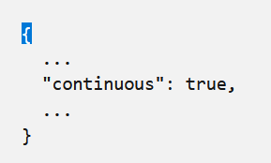
Changing – true false
The continuous flag in the pipeline settings controls the execution mode. Pipelines run in triggered execution mode by default. Set continuous to true if you require low latency refreshes of the tables in your pipeline.

Slide 16
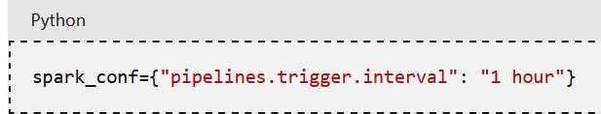
Pipelines trigger level
The execution mode is independent of the type of table being computed.
Both live and streaming live tables can be updated in either execution mode.
If some tables in your pipeline have weaker latency requirements, we can configure their update frequency independently by setting the pipelines.trigger.interval setting:

Slide 17
Tables and views in continuous pipelines
a) We can use both live tables or views and streaming live tables or views in a pipeline that runs continuously.
To avoid unnecessary processing, pipelines automatically monitor dependent Delta tables and perform an update only when the contents of those dependent tables have changed.
The Delta Live Tables runtime is not able to detect changes in non-Delta data sources.
The table is still updated regularly, but with a higher default trigger interval to prevent excessive recomputation from slowing down any incremental processing happening on the cluster.

Slide 18
Development and production modes
We can optimize pipeline execution by switching between development and production modes. Use the dev/pro buttons in the Pipelines UI to switch between these two modes.
By default, pipelines run in development mode.
When you run your pipeline in development mode, the Delta Live Tables system:
a) Reuses a cluster to avoid the overhead of restarts. By default, clusters run for two hours when development mode is enabled. We can change this with the pipelines.clusterShutdown.delay setting in the Cluster configuration.
b) Disables pipeline retries so you can immediately detect and fix errors.

Slide 19
Development and production modes
In production mode, the Delta Live Tables system:
a) Restarts the cluster for specific recoverable errors, including memory leaks and stale credentials.
b) Retries execution in the event of specific errors, for example, a failure to start a cluster.

Slide 20
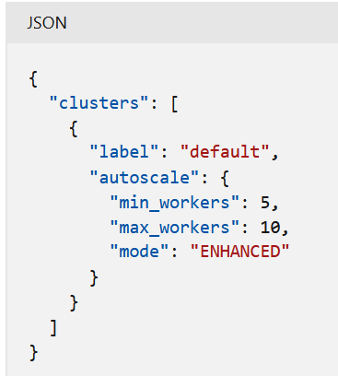
Databricks Enhanced Autoscaling
Databricks Enhanced Autoscaling optimizes cluster utilization by automatically allocating cluster resources based on workload volume, with minimal impact to the data processing latency of your pipelines.
Enhanced Autoscaling is the default autoscaling mode when you create a new pipeline in the Delta Live Tables UI.
We can enable Enhanced Autoscaling for existing pipelines by editing the pipeline settings in the UI.
We can also enable Enhanced Autoscaling when you create or edit pipelines with the Delta Live Tables API.

Slide 21
Product editions
We can use the Delta Live Tables product edition option to run your pipeline with the features best suited for the pipeline requirements.
The following product editions are available:
1) Core to run streaming ingest workloads. Select the Core edition if your pipeline doesn’t require advanced features such as change data capture (CDC) or Delta Live Tables expectations.
2) Pro to run streaming ingest and CDC workloads. The Pro product edition supports all of the Core features, plus support for workloads that require updating tables based on changes in source data.
3) Advanced to run streaming ingest workloads, CDC workloads, and workloads that require expectations. The Advanced product edition supports the features of the Core and Pro editions, and also supports enforcement of data quality constraints with Delta Live Tables expectations.

Slide 22
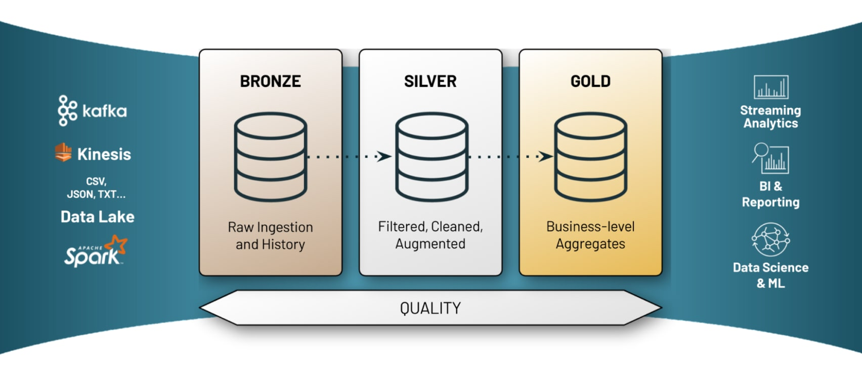
Scenario
Let’s begin by describing a common scenario.
We have data from various OLTP systems in a cloud object storage such as S3, ADLS or GCS.
Some data sets are updated regularly, and some are historical snapshots of the source system.
We have a general understanding of the consumers of the data and the transformations, and we will follow the Lakehouse Architecture to segment data quality into raw, refined, and aggregated tiers:

Slide 23
What do we care for ?
Each of these Gold tables may serve diverse consumers, from BI reporting to training machine learning models, and therefore the journey of this data from the source to the Gold layer will have different requirements that we care about as data engineers:
Latency: When we ingest new data, it must be visible in the silver table within 5 seconds”
Cost: “We cannot run a fixed capacity cluster 24/7 to support these updates”
Accuracy: “How much should I account for late arriving data in my real-time sources?”

Slide 24
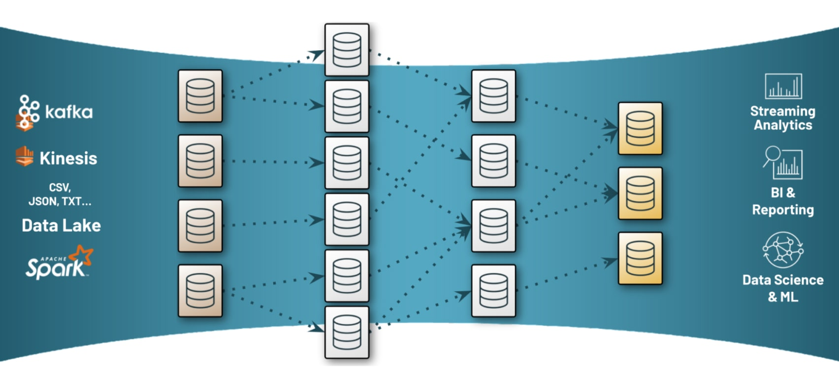
What are we looking at ?
At first glance, many of these requirements may seem simple to meet in the reference pipeline above.
However, while the lakehouse pipeline is intentionally elegant and simple, in reality we often are not dealing with a straightforward linear flow.
In reality it usually looks something like this:

Slide 25
Complexities
ETL complexity multiplies exponentially, and the following challenges cause these pipelines to become extremely brittle:
Error handling and recovery is laborious due to no clear dependencies between tables
Data quality is poor, as enforcing and monitoring constraints is a manual process
Data lineage cannot be traced, or heavy implementation is needed at best
Observability at the granular, individual batch/stream level is impossible
Difficult to account for batch and streaming within a unified pipeline

Slide 26
Sparks Capability
Spark provides the ability to use batch and streaming paradigms with a single API, and Delta Lake enables concurrent batch and stream operations on a single dataset hence eliminating the tradeoffs or reprocessing needed in a two-tier architecture

Slide 27
Procedural…..
When programming ETL pipelines, data transformations are often performed “procedurally”.
What this means ?
This means that actions to be performed on the data are expressed to the ETL engine as a series of computational steps to be carried out.
In many cases, even when you are using an orchestration tool such as Airflow or Azure Data Factory, jobs are launched which contain procedural logic. While the orchestrator may have to be aware of the dependencies between jobs, they are opaque to the ETL transformations and business logic.

Slide 28
Declarative ETL
Declarative ETL involves the user describing the desired results of the pipeline without explicitly listing the ordered steps that must be performed to arrive at the result.
Declarative means focusing on the what “what” is our desired goal and leveraging an intelligent engine like DLT to figure out “how” the compute framework should carry out these processes.

Slide 29
First PipeLine
We will be implementing a pipeline that suffers from these challenges and will use this as an opportunity to teach you how DLT’s declarative development paradigm enables simplified ETL development and improved quality, lineage, and observability across the lakehouse.
Reference used – Github repo
https://github.com/databricks/delta-live-tables-notebooks.git
https://raw.githubusercontent.com/databricks/delta-live-tables-notebooks/main/python/Retail%20Sales.py

Slide 30
Dataset
In our first pipeline, we will use the retail-org data set in databricks-datasets which comes with every workspace.
Delta Live Tables provides techniques for handling the nuances of Bronze tables (i.e., the raw data) in the Lakehouse.
We could use the Auto Loader feature to load the data incrementally from cloud object storage.

Slide 31
Bronze Datasets: Ingesting the dataset using Cloud Files
Bronze datasets represent the rawest quality.
We often will make minimal adjustments from the origin, leveraging the cost-effectiveness of cloud storage to create a pristine source off of which we can validate refined data, access fields that we may not usually report on, or create new pipelines altogether.
A common pattern at this stage is to continuously ingest new data from a location in cloud storage.

Slide 32
Steps
let’s create a Pipeline to ingest data from cloud object storage.
Create your first DLT Pipeline Notebook
Create a fresh notebook for your DLT pipeline such as “dlt_retail_sales_pipeline”
Copy the following code into the first cell:
- Copy the python code into your notebook.

Slide 33
4. Open Jobs in a new tab or window, and select “Delta Live Tables”
5. Select “Create Pipeline” to create a new pipeline
6. Specify a name such as “Sales Order Pipeline”
7. Specify the Notebook Path as the notebook created in step 2. This is a required step, but may be modified to refer to a non-notebook library in the future.
8. A Target is optional but recommended since the target is the target database where other authorized members can access the resulting data from the pipeline.
9. A Storage Location is optional but recommended. We may specify an external blob storage location if you have configured one.
This is where DLT will produce both datasets and metadata logs for the pipeline.
Tip:If storage is not specified, all data and logs generated from the DLT Pipeline will be stored in a path in your DBFS root storage created by DLT. You can find the path in the Edit Setting JSON file later on.
To store data and logs in an external (i.e. non-DBFS root) location, you must specify Storage Location for the DLT Pipeline.
10. Set Pipeline Mode to Triggered
11. Set the minimum and maximum numbers of workers used for cluster size
12. Select “Start”
13. We have created your first pipeline!

Slide 34
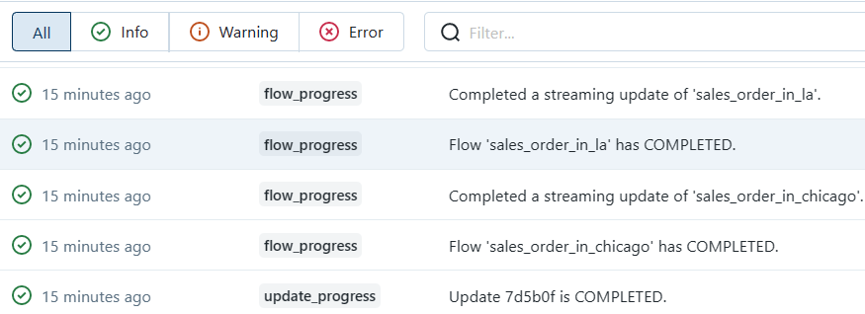
Pipeline Logs

Slide 35
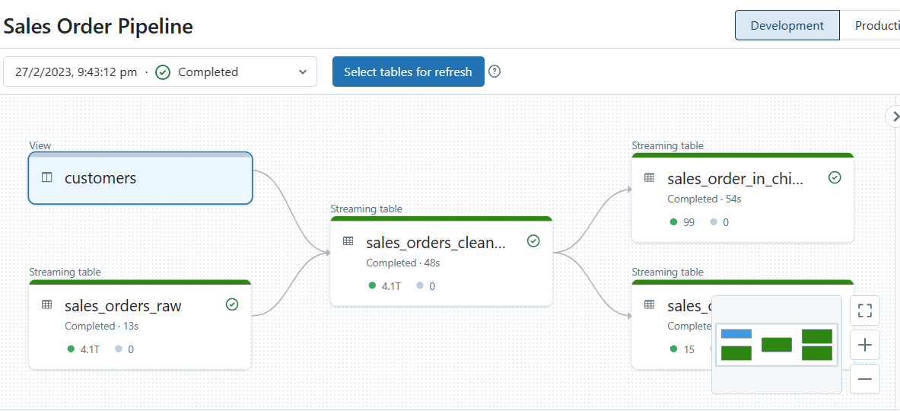
First Ingest Code Explained
These two tables we consider bronze tables. Specifically, they are Incremental Live Tables and we ingested them using the Auto Loader feature using the cloud_files function

Slide 36
Views and Tables in DLT
In DLT,
Views are similar to a temporary view in SQL and are an alias for some computation. A view allows you to break a complicated query into smaller or easier-to-understand queries. Views also allow you to reuse a given transformation as a source for more than one table. Views are available from within a pipeline only and cannot be queried interactively.
In DLT,
Tables are similar to traditional materialized views. The Delta Live Tables runtime automatically creates tables in the Delta format and ensures those tables are updated with the latest result of the query that creates the table.
Consumers can read these tables and views from the Data Lakehouse as with standard Delta Tables (e.g. for reporting in SQL or data science in Python), but they are being updated and managed by the DLT engine.

Slide 37
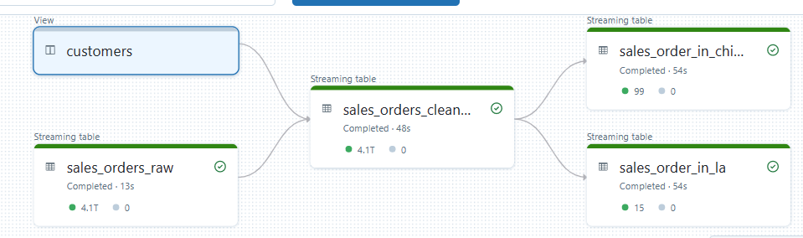
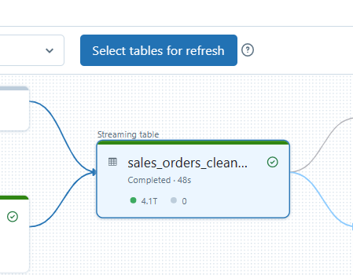
Silver Datasets: Expectations and high-quality data
The Silver layer is all about high-quality, diverse, and accessible datasets. These may not serve a specific use case such as serving a production report at low latency, but they have been cleansed, transformed, and curated so that data scientists and analysts can easily and confidently consume these tables to quickly perform preprocessing, exploratory analysis, and feature engineering so that they can spend their remaining time on machine learning and insight gathering.

Slide 38
Properties
Constraint: Constraints allow you to define data quality expectations. They take a statement that resolves as any Spark filter predicate, and an action to take upon failure. An action can be either to retain, drop, fail, or quarantine.
All constraints are logged to enable streamlined quality monitoring.
Tblproperties: a list of key-value pairs that may be either Delta Lake properties, DLT pipeline properties, or arbitrary. Arbitrary tblproperties are like tags that can be used for data cataloging. In this example, “quality”: “silver” is an arbitrary property that functions as a tag.
Comment: A string briefly describing the table’s purpose, for use with data cataloging in the future
Note: In SQL you will notice.

Slide 39
Gold data sets: complete vs streaming / continuous vs triggered
Many aggregations cannot be performed incrementally and must be performed as complete reprocesses, even if new data can be processed incrementally upstream of the aggregation at the bronze and silver layer.
Lakehouse Architecture enables a single pipeline with both real-time incremental “fast” bronze and silver layers, and a batch updated gold layer (made possible by the strong consistency guarantees of Delta Lake storage).
Rather divide ETL processing into Stream and batch mode ?
DLT allows you to choose whether each dataset in a pipeline is complete or incremental, with minimal changes to the rest of the pipeline. This makes it easy to scale pipelines involving combinations of bronze and silver real-time data with gold aggregation layers.

Slide 40
Some Exceptions
Fact bubble: some Spark aggregations can be performed incrementally, such as count, min, max, and sum.
In some simple cases, it may make sense to declare gold datasets as incremental.
However, even with simple counts and sums this may become inefficient and is not recommended if you are using multiple groupings (e.g. GROUP BY col1, col2, col3).

Slide 41
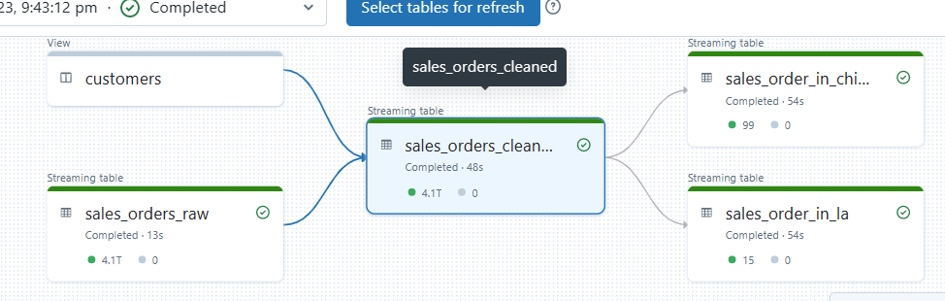
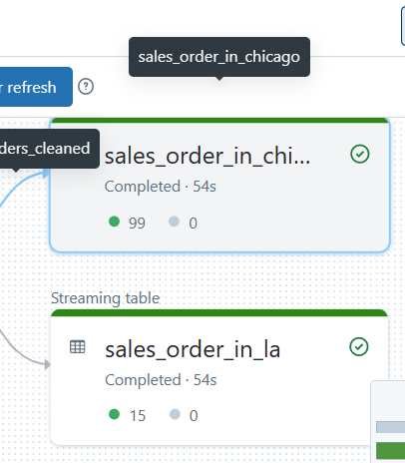
Gold Tables
Our gold tables, we are creating complete gold tables by aggregating data in the silver table by city

Slide 42
Continuous vs Triggered pipeline mode
In DLT, while individual datasets may be Incremental or Complete, the entire pipeline may be Triggered or Continuous.
When a continuous pipeline is started, it will spin up infrastructure and continue to ingest new data until the pipeline is stopped manually or via the API.
A triggered pipeline will consume all new data in the source once and will spin down infrastructure automatically.
A triggered pipeline will typically run on a schedule using an orchestrator or Databricks Multi-Task Jobs in production.

Slide 43
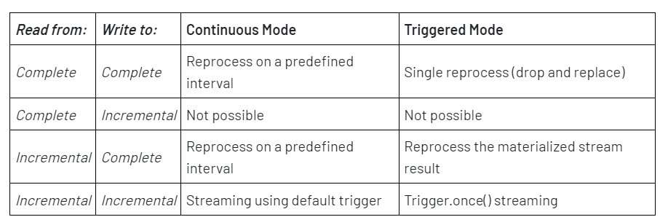
Change modes
To toggle between Triggered and Continuous modes, open your pipeline and select “Edit Settings.” Continuous will be a boolean in the JSON. Setting “continuous”: false” is equivalent to setting the pipeline to Triggered mode.

Slide 44
Productionization
We have now defined the pipeline.
We can conclude with the following steps:
Set a target database to make it easier for consumers to query the pipeline’s datasets
Set the pipeline to production mode
If we choose to use Triggered mode, we can schedule the pipeline using multi task jobs

Slide 45
Pipeline Observability and Data Quality Monitoring
Event Logs
DLT emits all pipeline logs to a predefined Delta Lake table in the pipeline’s Storage Location, which can be used for monitoring, lineage, and data quality reporting. You can import this generic log analysis notebook to inspect the event logs, or use dbutils to access the Delta table as {{your storage location}}/system/events.

