Slide 1
Socket Programming
Linux * Win

Slide 2
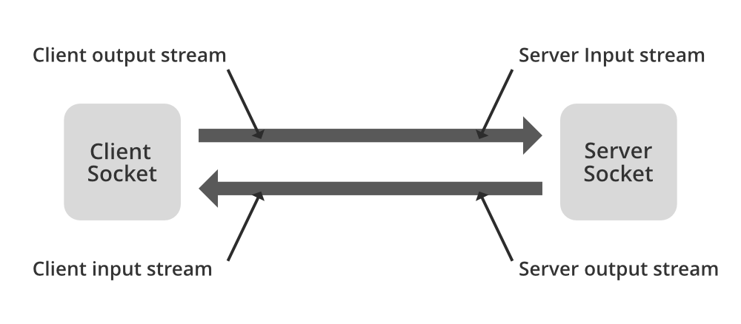
Intro
Sockets are a method of IPC that allow data to be exchanged between applications, either on the same host (computer) or on different hosts connected by a network.
The first widespread implementation of the sockets API appeared with 4.2BSD in 1983, and this API has been ported to virtually every UNIX implementation, as well as most other operating systems.

Slide 3
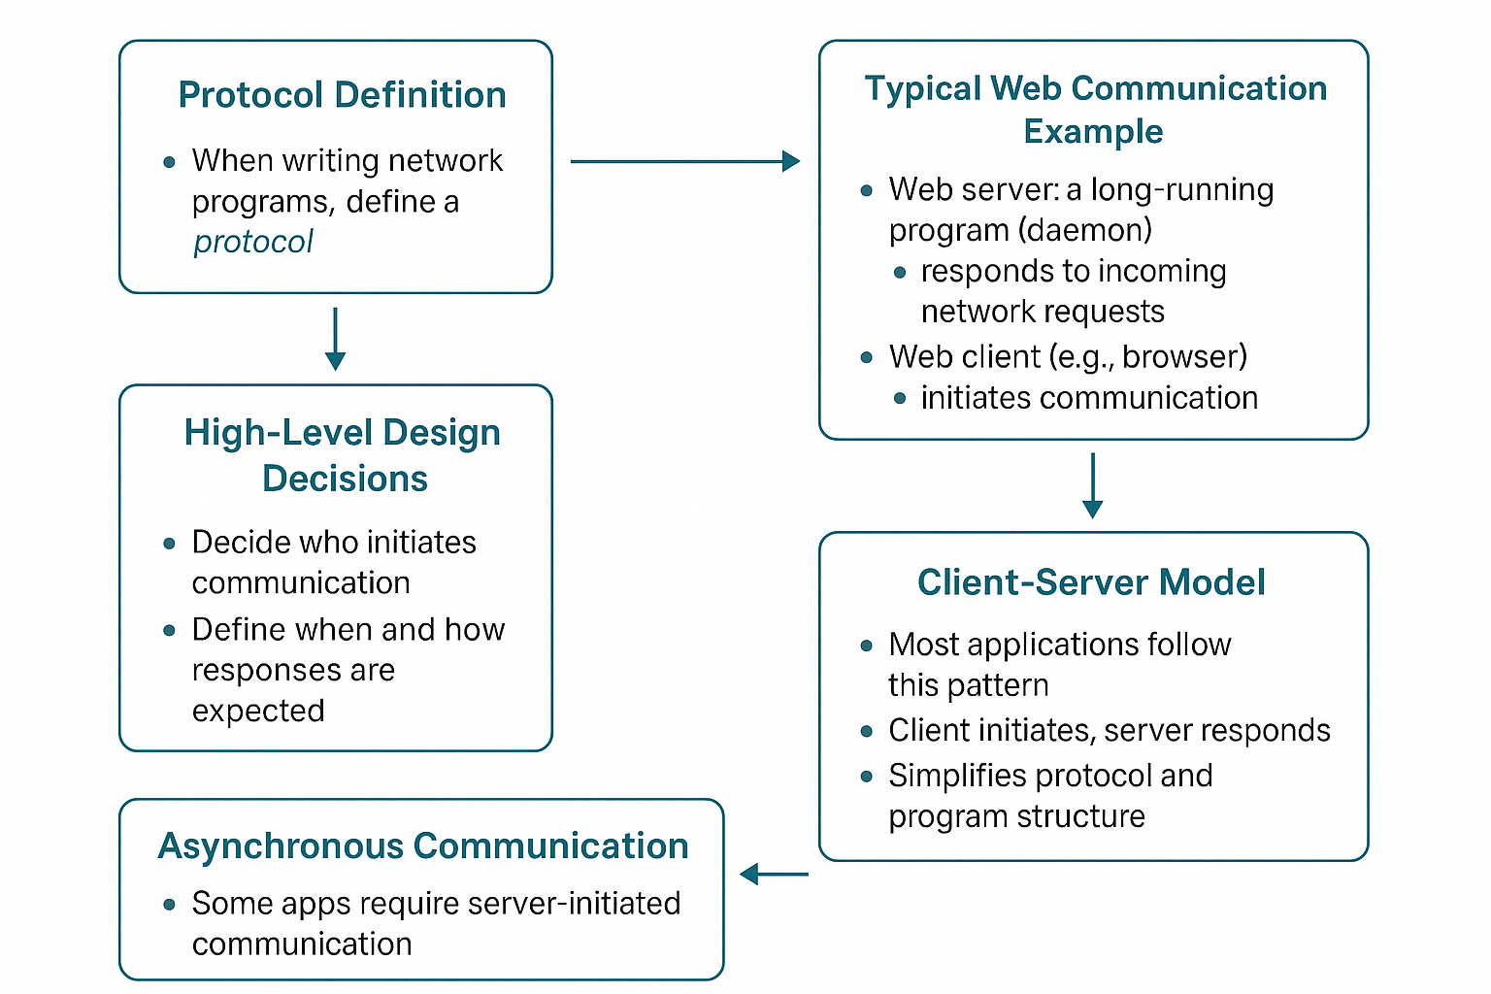
Designing Network Protocols: Key Considerations

Slide 4
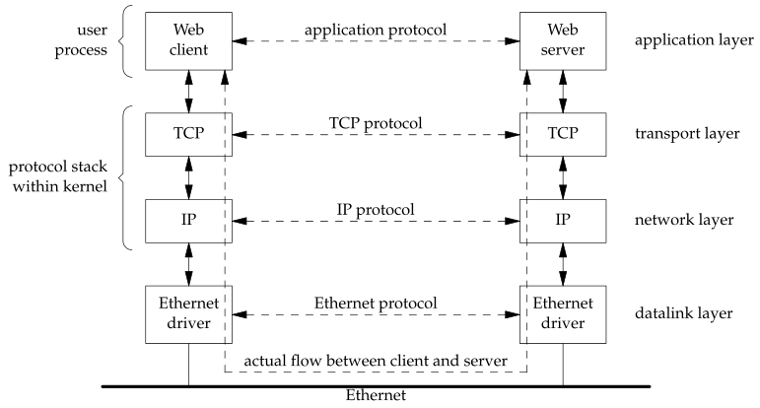
Multiple Layers
The client application and the server application may be thought of as communicating via a network protocol, but actually, multiple layers of network protocols are typically involved.

Slide 5
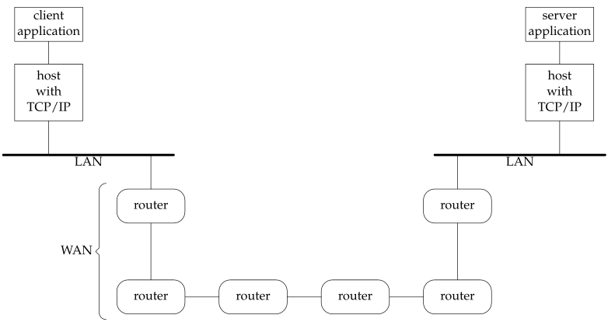
Client-Server on LAN ?

Slide 6
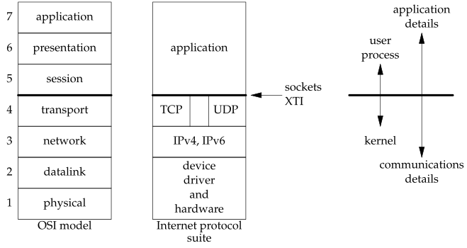
OSI Model

Slide 7
Transport Layer – TCP,UDP,SCTP

Slide 8
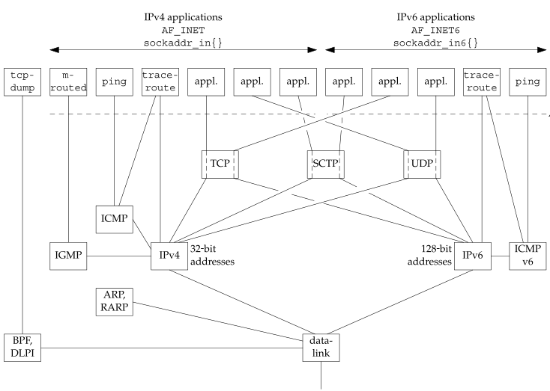
Big Picture

Slide 9
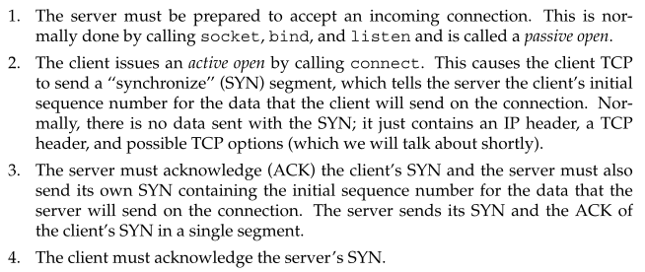
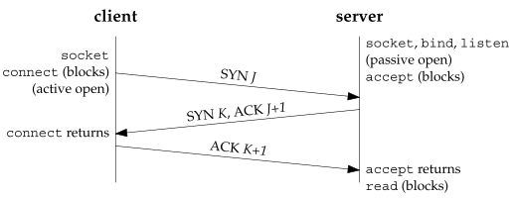
TCP Connection Establishment and Termination
TCP three-way handshake.

Slide 10
TCP Options
MSS option – Maximum segment size.
Window scale option
Timestamp option

Slide 11
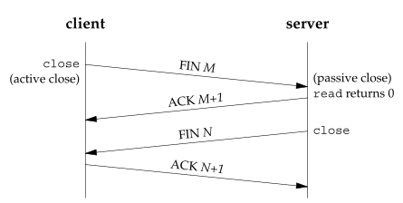
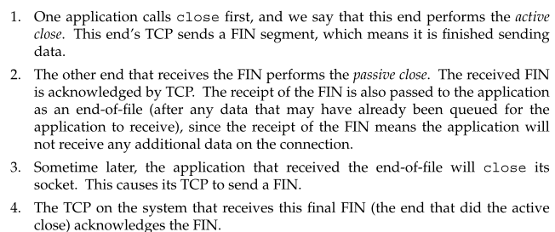
TCP Connection Termination

Slide 12
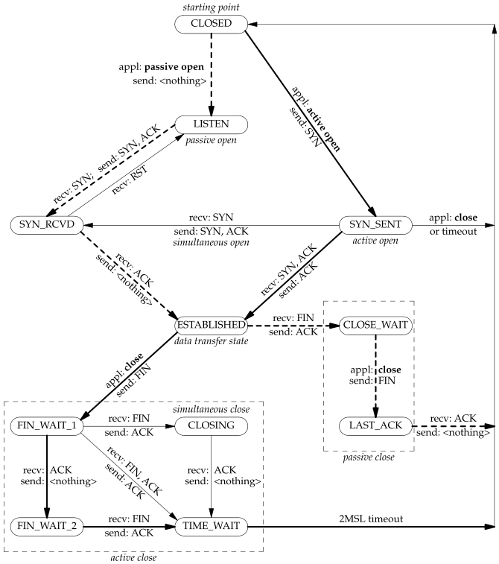

TCP State Transition Diagram

Slide 13
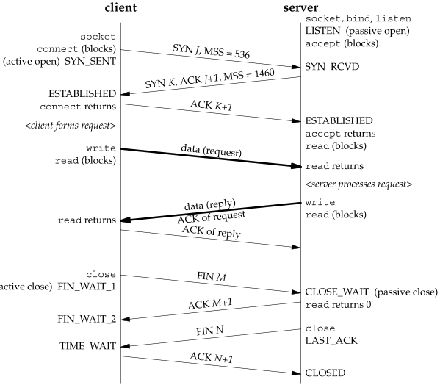
Packet exchange for TCP conn
DATA xchng

Slide 14
What’s TIME_WAIT state?

Slide 15

TIME_WAIT State

Slide 16
PORT numbers
Well known ports
When a client wants to contact a server, the client must identify the server with which it wants to communicate.
TCP, UDP, and SCTP deﬁne a group of well-known ports to identify well-known services.
Ephemeral Ports
Short-lived ports. These port numbers are normally assigned automatically by the transport protocol to the client.
Clients normally do not care about the value of the ephemeral port; the client just needs to be certain that the ephemeral port is unique on the client host.

Slide 17
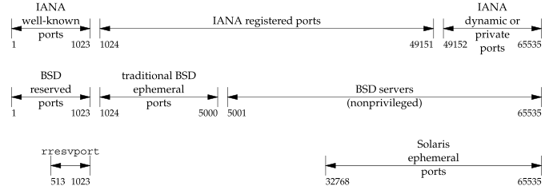
Port Ranges
Well know port numbers : 0-1023, controlled by IANA.
Registered Ports: 1024-49151
Dynamic or private ports: 49152 - 65535

Slide 18
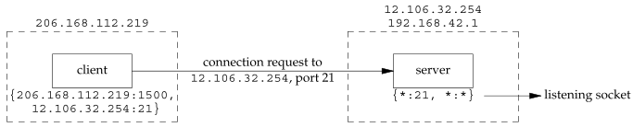
Socket Pair
🔹 TCP Socket Pair
Identified by a four-tuple: Local IP, Local Port, Foreign IP, Foreign Port
Uniquely defines each TCP connection on a network
Defining a Socket
A socket = IP address + Port number
Each endpoint in a connection is often referred to as a socket
🔹 UDP and Socket Pair Concept
UDP is connectionless, but...
The socket pair idea still applies
Helps describe communication endpoints
🔹 Socket Functions and Their Role
Functions like bind(), connect(), getpeername() control parts of the socket pair
bind() example:
Sets local IP and local port for TCP, UDP, and SCTP

Slide 19
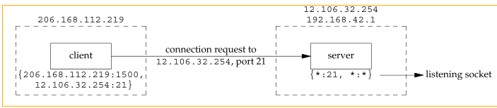
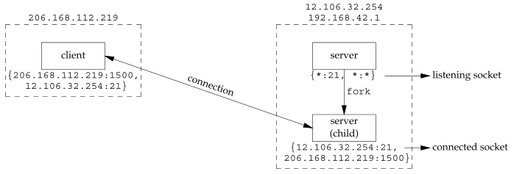
Concurrency
Connection request from client to server.
Concurrent server has child handle client

Slide 20
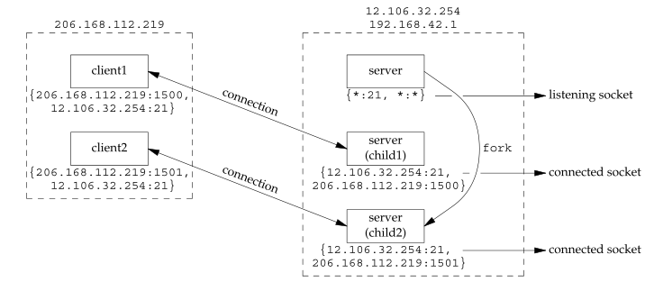
Concurrency
Second client connection with same server

Slide 21
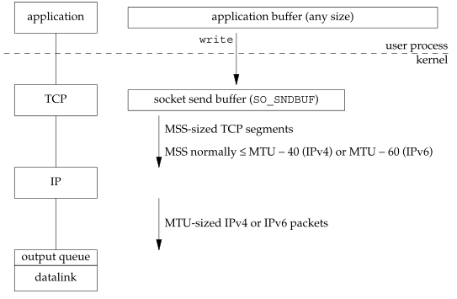
Steps and buffers involved when an application writes to a TCP socket

Slide 22
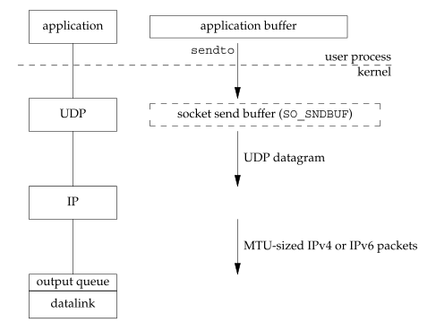
Steps and buffers involved when an application writes to a UDP socket

Slide 23
Foundations of Sockets - Sockets API

Slide 24
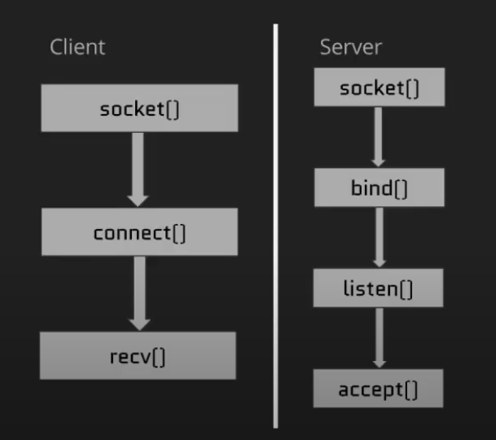
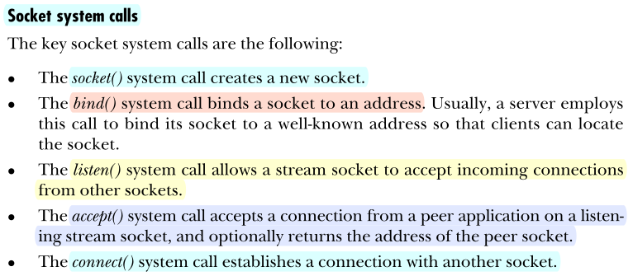
Sockets functions,API
The Socket API provides functions for creating and managing communication endpoints (sockets) in network programming.

Slide 25
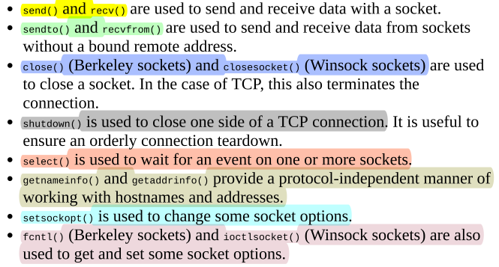
Socket functions

Slide 26
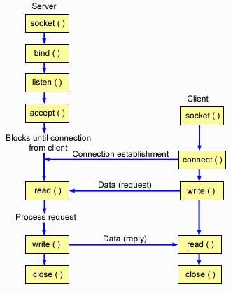
Socket IO
Socket I/O can be performed using the conventional
read() , write()
system calls
or
using a range of socket-specific system calls
(e.g., send(), recv(), sendto(), and recvfrom()).
By default these system calls block if IO calls cannot be completed immediately.
Nonblocking I/O is also possible, by using the fcntl().

Slide 27
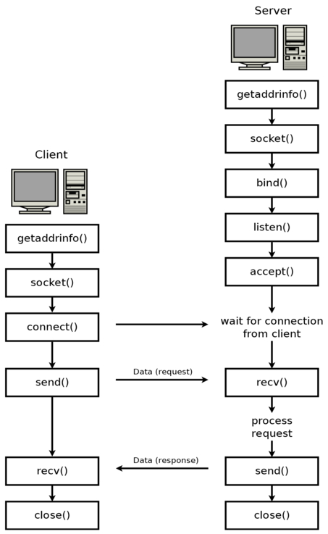
TCP program flow

Slide 28
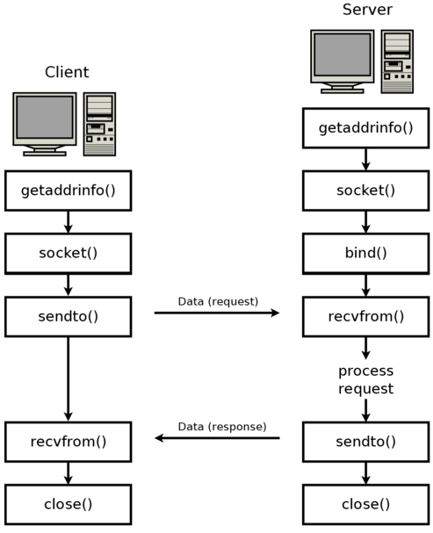
UDP Program flow

