Slide 1
FD / INTELLIGENCE MINOR PROJECT
FD E-Commerce Analytics Dashboard
Interactive intelligence for sales, customer preferences, marketing ROI and strategic decisions
FROM SCATTERED TRANSACTIONS
TO MEASURABLE BUSINESS DECISIONS
Python · MongoDB · Streamlit · Pandas · Plotly
Prepared by Jagjot Singh Passi | BCA | Course Instructor: Ms. Sarbjeet Kaur
Jagjot Singh Passi · 2446571 · PCTE
01

Slide 2
FD / INTELLIGENCE GOAL & SCOPE
What business problem are we solving?
Three official academic requirements drive the entire design.
01
Sales trends
Find seasonal movements, high-revenue products and regions.
02
Customer preferences
Measure repeat buying, customer segments and product mix.
03
Marketing return
Link campaign spend with attributed orders and report ROAS / ROI proxy.
Jagjot Singh Passi · 2446571 · PCTE
02

Slide 3
FD / INTELLIGENCE TECHNOLOGY
Implementation stack & architecture
Matches the Phase 1 evaluated stack; offline demo fallback is always labeled.
DATA SOURCES
Authorized CSV/Excel exports or reproducible simulation
VALIDATION
Six linked tables, arithmetic and referential checks
PERSISTENCE
MongoDB collections · SQLite local demo mode
ANALYTICS
Pandas KPI formulas, RFM, cohorts and attribution
FRONTEND
Streamlit controls + Plotly interactive charts
Jagjot Singh Passi · 2446571 · PCTE
03

Slide 4
FD / INTELLIGENCE DATA MODEL
Six related collections
Customer → order → order item → product; campaign → attributed delivered order
CUSTOMERS
ORDERS
ORDER ITEMS
PRODUCTS
Sign-up, region
Delivery, payment, amount
Product, quantity, price
SKU, category, cost
CAMPAIGNS
CONVERSIONS
Spend, clicks, impressions
Order attribution
Validated unique IDs, foreign keys, reconciliation and single-touch delivered-order attribution.
Jagjot Singh Passi · 2446571 · PCTE
04

Slide 5
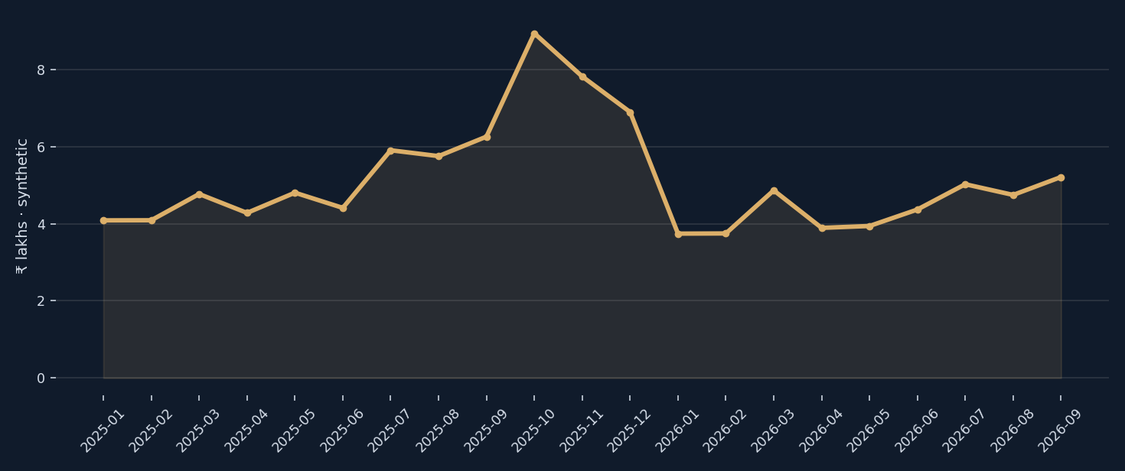
FD / INTELLIGENCE DYNAMIC SALES
Delivered revenue changes with filters
Date, region and category selection recalculate qualifying line-level revenue.
₹1.08 Cr
4,399
₹2,444
Synthetic realized sales
Delivered orders
Average selected order
Jagjot Singh Passi · 2446571 · PCTE
05

Slide 6
FD / INTELLIGENCE CUSTOMERS
From transactions to customer segments
RFM + cohort retention + exploratory clustering are different lenses on buying behavior.
01
RECENCY
Days since last delivered purchase
02
FREQUENCY
Number of delivered purchases
03
MONETARY
Sum of delivered spending
891
77.4%
Customers with delivered history
Repeat-buyer share
Jagjot Singh Passi · 2446571 · PCTE
06

Slide 7
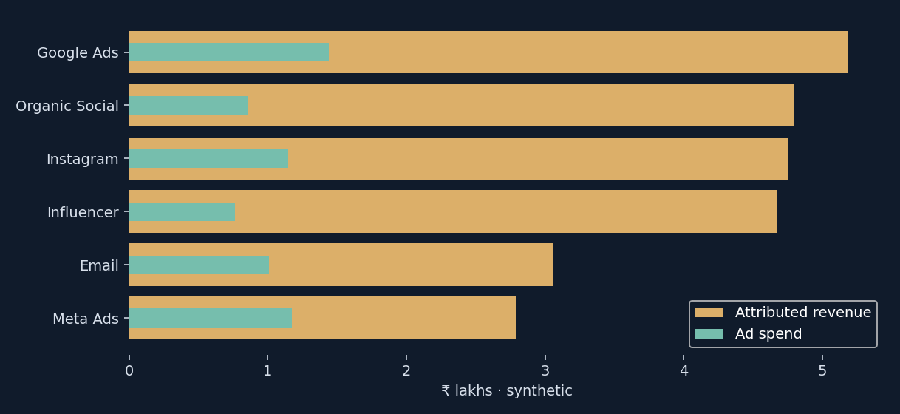
FD / INTELLIGENCE CAMPAIGN ANALYTICS
Attribution & marketing measurement
Reported national marketing spend is prorated for partial campaign date ranges.
₹6.39 L
₹25.25 L
3.96×
Advertising spend · synthetic
Attributed sales · synthetic
Single-touch ROAS
Jagjot Singh Passi · 2446571 · PCTE
07

Slide 8
FD / INTELLIGENCE METHODS
Know what the formulas mean
Never confuse attributed sales with verified incremental profit.
Revenue
Σ (delivered item quantity × sale price)
ROAS
Attributed delivered-order revenue ÷ campaign spend
CPA
Campaign spend ÷ attributed delivered orders
ROI proxy
(Attributed revenue − estimated product COGS − spend) ÷ spend
RFM
Recency · Frequency · Monetary based on delivered-order history
Jagjot Singh Passi · 2446571 · PCTE
08

Slide 9
FD / INTELLIGENCE QUALITY & GOVERNANCE
Dynamic imports, validation and audit trail
The application rejects broken datasets before activating their records.
INPUT
One workbook (six sheets) or six CSV files
QUALITY
Unique IDs, balanced totals, valid dates and status rules
DATABASE
MongoDB batch switch or SQLite transactional replacement
OUTPUT
Dynamic dashboards, CSV/Excel exports and backup ZIP
AUDIT
Import origin + timestamp + administrator action log
Jagjot Singh Passi · 2446571 · PCTE
09

Slide 10
FD / INTELLIGENCE VERIFICATION
10 automated checks completed
Tests were executed for the analytics core and SQLite database persistence.
01
Sales logic
Reconciliation, cancellation exclusion, category sums
02
Marketing logic
Single-touch aggregation, spend prorating
03
Customer logic
RFM labeling and cohort month 0
04
Data quality
Reject incorrect orders and attribution
05
Persistence
SQLite roundtrip, metadata and failed-validation safety
Jagjot Singh Passi · 2446571 · PCTE
10

Slide 11
FD / INTELLIGENCE DATA HONESTY
Real-world data: what is available and what is not
A simulation can demonstrate software, but it must never be presented as measured business activity.
PROVIDED NOW
NEXT DATA SOURCE
Reproducible, internally consistent synthetic records, realistic prices and seasonality, documented provenance.
Permissioned store exports, anonymized customers and authentic ad campaign logs with order-level attribution.
No actual FD-store transactions or live Shopify/webhook integration are claimed.
Jagjot Singh Passi · 2446571 · PCTE
11

Slide 12
FD / INTELLIGENCE CONCLUSION
A tested business intelligence prototype
Demonstrate: database persistence → live filter changes → sales → RFM → marketing → import/export.
01 Meets the analytical scope of the faculty brief
02 Upgrades the existing Python prototype with persistent database support
03 Provides explicit KPI definitions and source-lineage disclosure
04 Ready for authorized real exports and future live-platform integration
Thank you • Questions & demonstration
Jagjot Singh Passi · 2446571 · PCTE
12

