Slide 1
Combination Chemo-Immunotherapy for Glioblastoma
Caitlin Jagla and Tor Breza

Slide 2
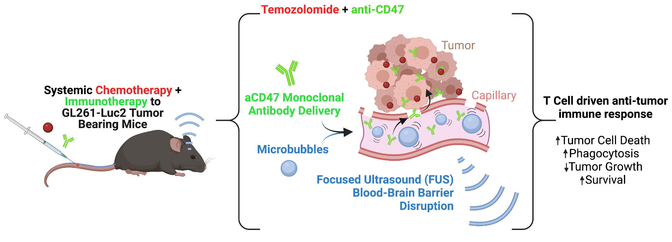
Introduction: Treating Glioblastoma
Glioblastoma is an aggressive primary brain tumor with many barriers to treatment
Focused Ultrasound (FUS) has been shown to improve drug delivery to brain tumors to improve growth control and survival
Created with BioRender.com
In this project, we compared the tumor volume of untreated glioma bearing mice with combination treated glioma bearing mice at day 20 post tumor implantation

Slide 3
Hypothesis
Reasoning:
Without intervention, tumors grow exponentially over time
The treatments used in the combination group are cytotoxic and induce an anti-tumor immune response, likely reducing tumor volume
Therefore, we hypothesized that the tumor volume of the untreated group would be greater than the combination treated group at day 20 post tumor implantation
μ(untreated) > μ(combination treated)

Slide 4
Methods
The raw volume data come from MR images
The raw data include:
2 experiments (5 and 6)
Volume at 2 time points (10 and 20)
4 treatment groups (Untreated, TMZ_11, Combo, Combo_FUS)
Weights at 2 time points (10 and 20)
To tidy the dataset:
We removed Experiment 6 because:
it tested different drugs than Experiment 5
the data are incomplete (Day_20_Tumor_Volume and weight values are missing)
We removed the Combo treatment group from Experiment 5 because we are interested in the Combo+FUS group only

Slide 5
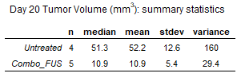
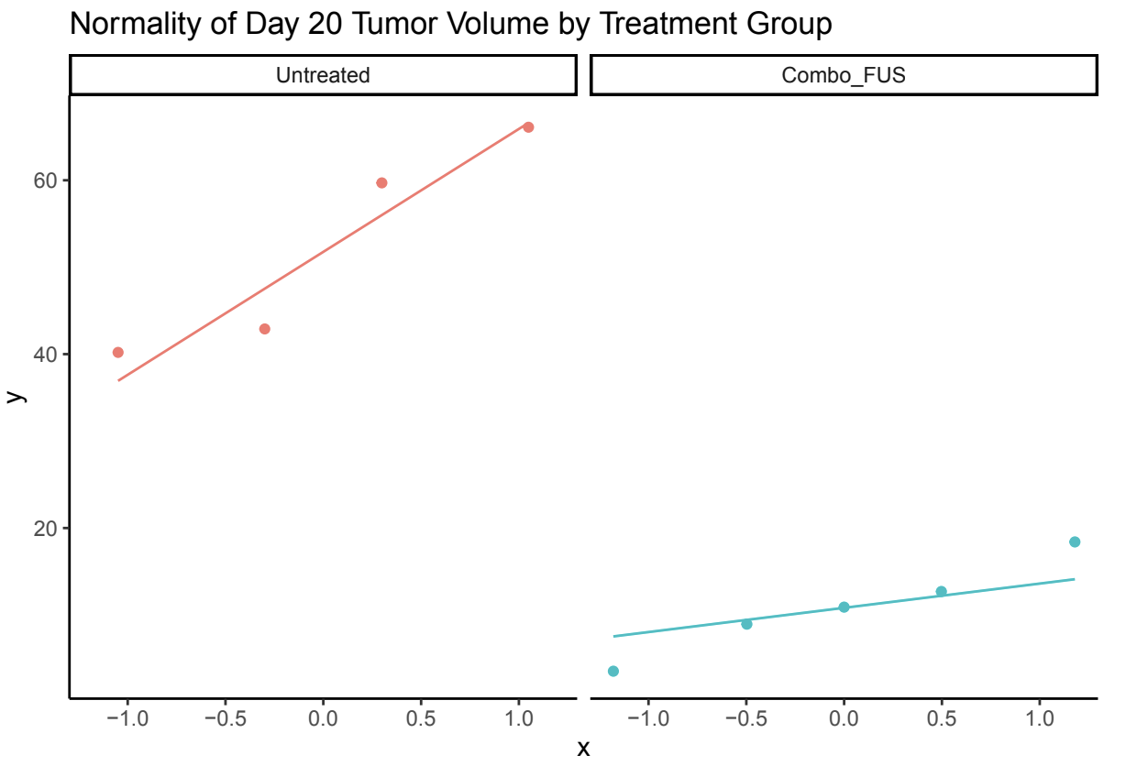
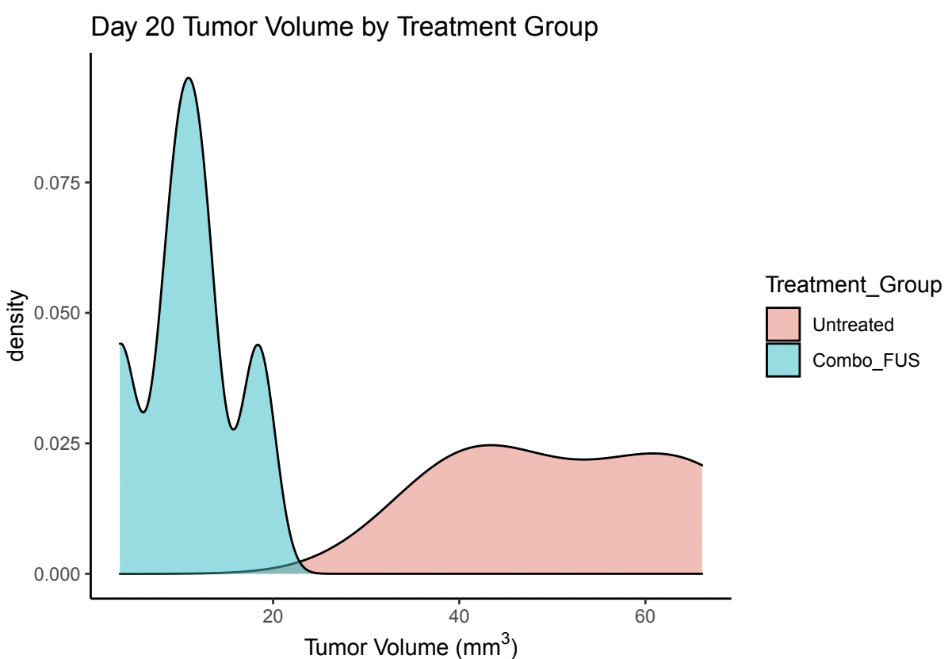
Methods: Evaluate Data Set and Check Assumptions
Checked normality: qq plot
Checked within group variance: Density plot and Descriptive Statistics

Slide 6
Statistical Test
Assumptions:
Independent Samples: The samples from both groups are independent
Normality: Data from both groups are normally distributed (based on qq plot)
Equal Variance: The variances are not equal (based on density plot and descriptive statistics)
Statistical test: Unpooled t-test
H0: μ(combo+FUS) = μ(untreated)
H1: μ(combo+FUS) != μ(untreated)
α = 0.05

Slide 7
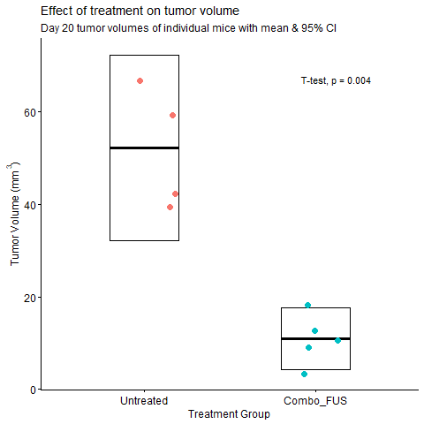
Results
We reject the null hypothesis that the mean of both groups are equal
The average tumor volume of the combination treated group is significantly (p= 0.004) smaller than that of the untreated group

Slide 8
Discussion
These results tell us that:
The combination treatment significantly improved tumor growth control against untreated control
These results are important because:
This treatment may be efficacious in treating glioblastoma by decreasing tumor volume
Next Steps:
While these results are promising, it is important to understand how the tumor growth control compares to other control groups
Additionally, the n of the groups are fairly small, so this could be an effective pilot study to calculate a power analysis

