Slide 1
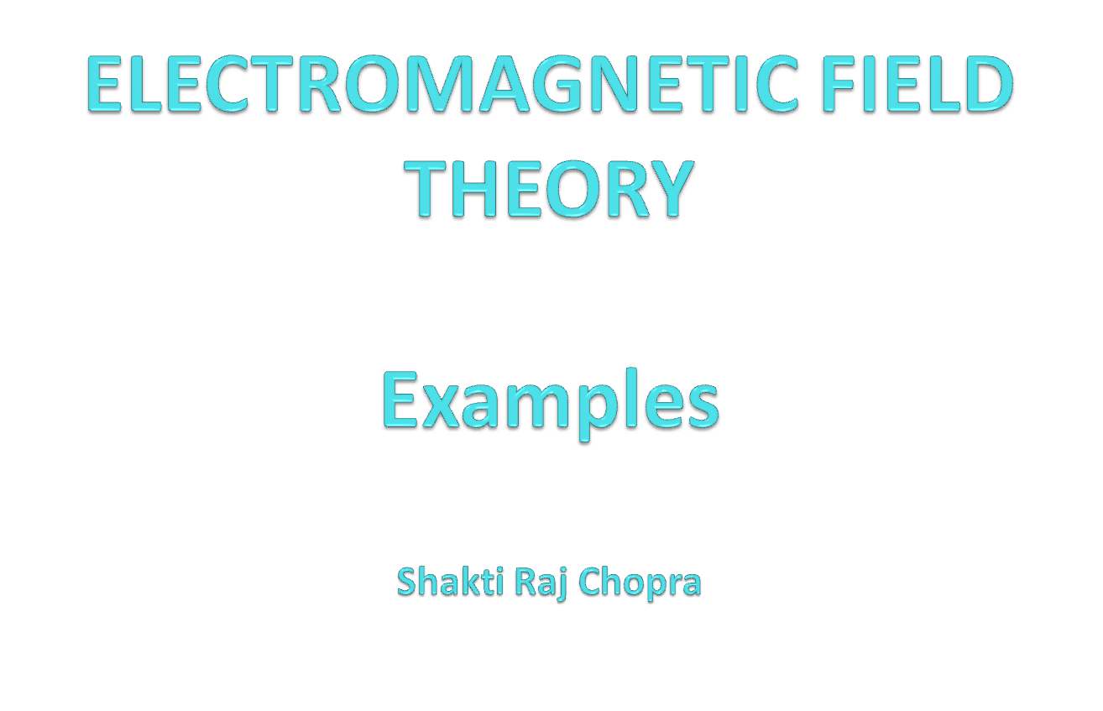

Slide 2

Example-1
Convert it into cylindrical and Spherical

Slide 3
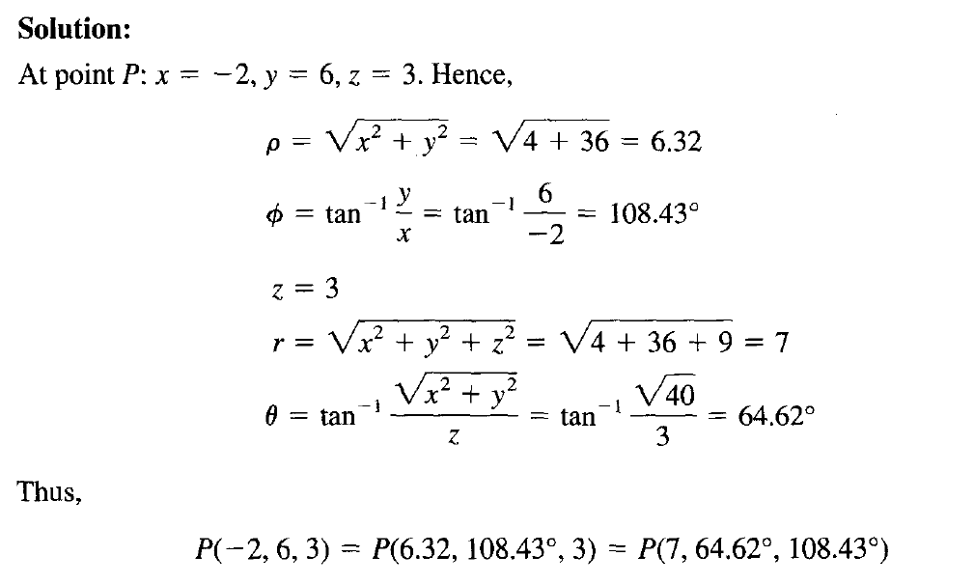

Slide 4
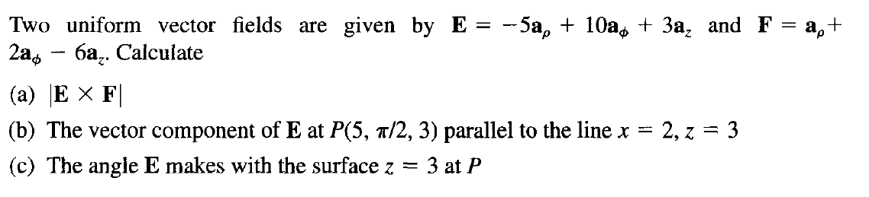
Example-2

Slide 5
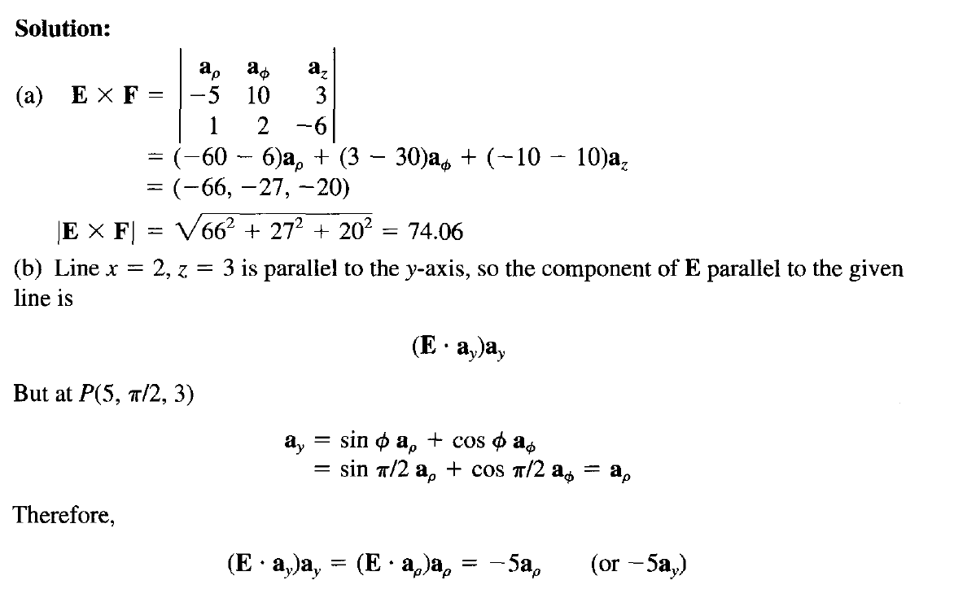

Slide 6
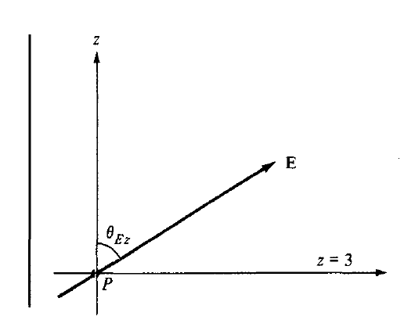
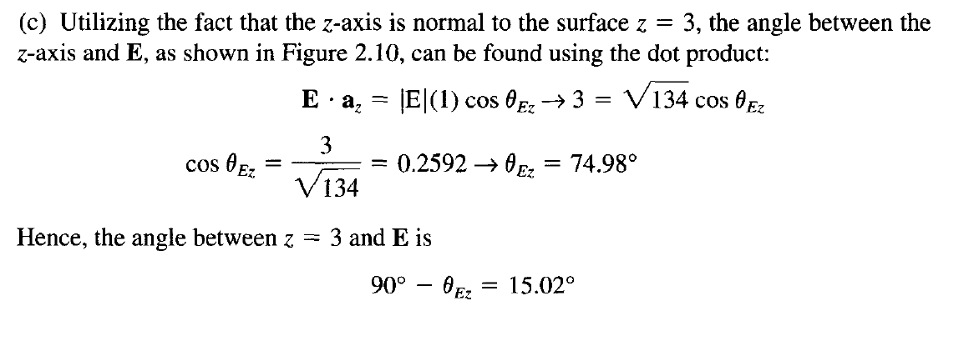

Slide 7

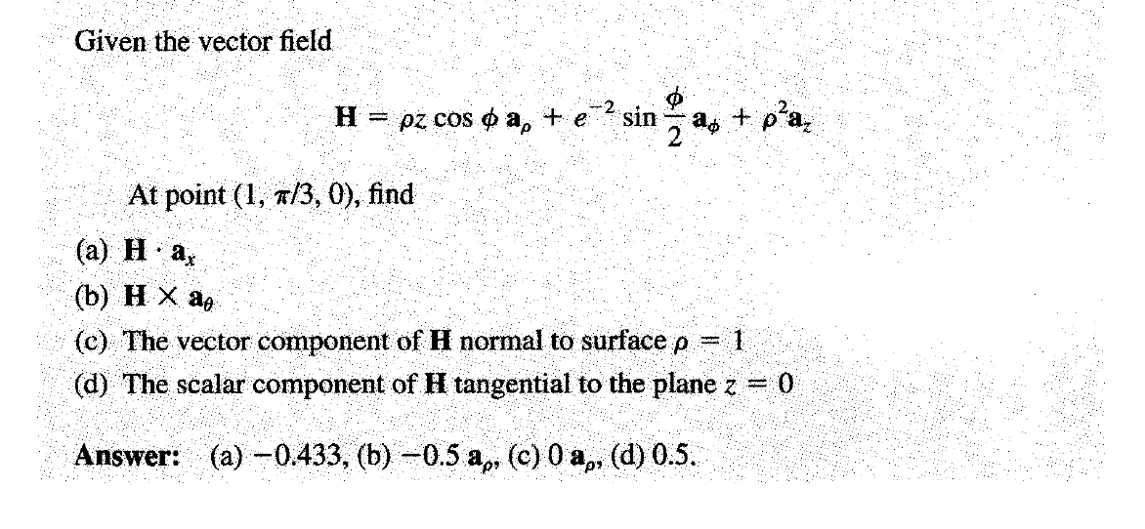
Example-3

Slide 8
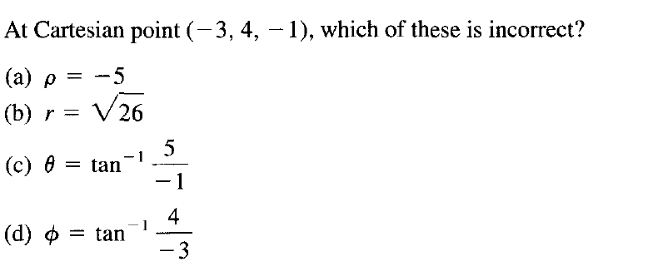

Slide 9
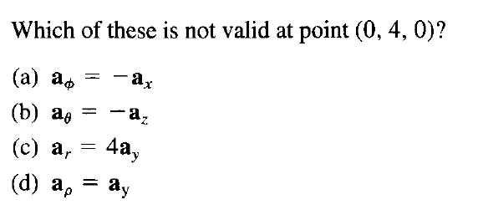

Slide 10
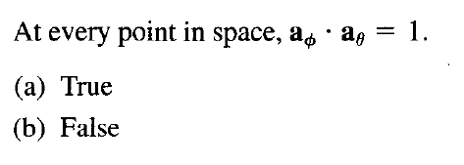

Slide 11
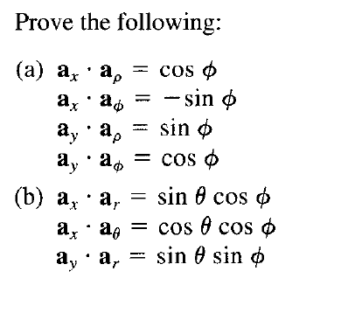
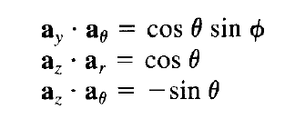

Slide 12
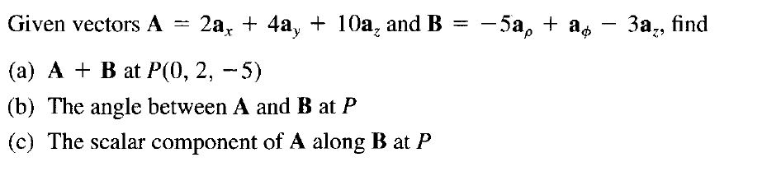

Slide 13
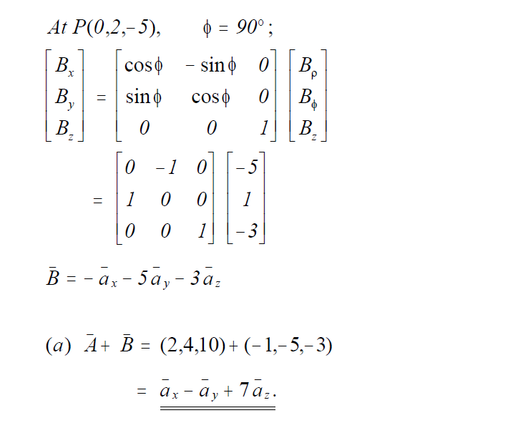
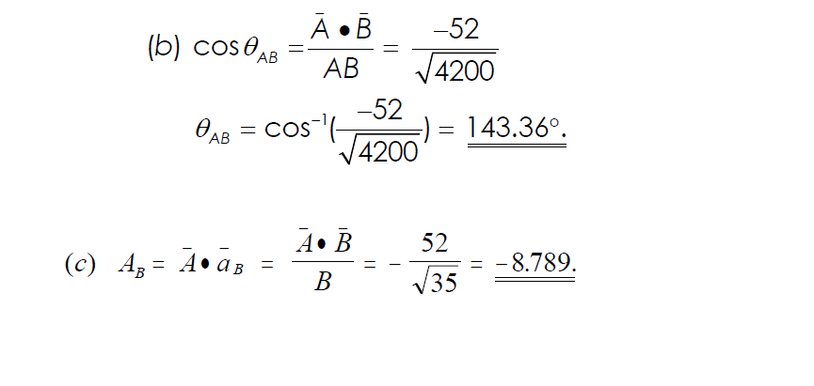

Slide 14
Ex-4
Which of the statement is/are true:
Aρ=AxCosΦ+AySinΦ
Aρ=AxCosΦ-AySinΦ
Aρ=AxSinΦ+AyCosΦ
Aρ=AxCosΦ-AySinΦ

Slide 15
Ex-5
Which of the statement is/are true:
AΦ= -AxCosΦ+AySinΦ
AΦ=AxCosΦ-AySinΦ
AΦ= -AxSinΦ+AyCosΦ
AΦ=AxCosΦ-AySinΦ

Slide 16
Ex-6
Which of the statement is true:
Aρ=ArSinθ+AθCosθ
Aρ=ArCosθ-AθSinθ
Aρ=ArCosθ+AΦSinθ
Aρ=ArCosθ+AθSinθ

Slide 17
Ex-7
Which of the statement is true:
Ar=AxSinθCosΦ+AySinθSinΦ+AzCosθ
Ar=AxSinθCosΦ+AySinθSinΦ-AzCosθ
Ar=AxSinθCosΦ-AySinθSinΦ+AzCosθ
Ar=AxSinθCosΦ-AySinθSinΦ-AzCosθ

Slide 18

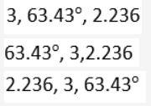

Ex-8

Slide 19

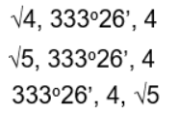
Ex-9

