Slide 1
ADDRESSING MODES OF 8085

Slide 2
Addressing Modes of 8085
To perform any operation, we have to give the corresponding instructions to the microprocessor.
In each instruction, programmer has to specify 3 things:
Operation to be performed.
Address of source of data.
Address of destination of result.

Slide 3
Addressing Modes of 8085
The method by which the address of source of data or the address of destination of result is given in the instruction is called Addressing Modes.
The term addressing mode refers to the way in which the operand of the instruction is specified.

Slide 4
Types of Addressing Modes
Intel 8085 uses the following addressing modes:
Direct Addressing Mode
Register Addressing Mode
Register Indirect Addressing Mode
Immediate Addressing Mode
Implicit Addressing Mode

Slide 5

Direct Addressing Mode
In this addressing mode, the instruction specifies some address which stores the data. This memory location is mentioned in the instruction as an operand. The size of an instruction in the direct addressing mode is 3 bytes. However, input/output instructions in direct addressing mode are 2 bytes.
Single memory reference to access data
No additional calculations to work out effective address
Limited address space

Slide 6
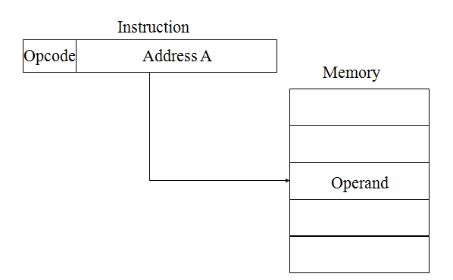
Direct Addressing Mode
In this mode, the address of the operand is given in the instruction itself.
LDA is the operation.
2500 H is the address of source.
Accumulator is the destination.
LDA 2500 H | Load the contents of memory location 2500 H in accumulator.

Slide 7
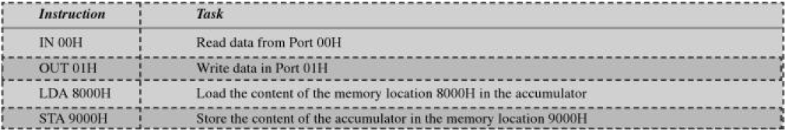

Slide 8
Register Addressing Mode
In this addressing mode, the instruction mentions a register which stores some data. The operation specified by the instruction is performed in the register specified by it.
The instruction can also specify two registers. The size of the instructions in register addressing mode is 1 byte. The instruction’s opcode includes both the register and the operation to be performed.
No memory access
Very fast execution
Very limited address space
Multiple registers helps performance
Requires good assembly programming or compiler writing

Slide 9
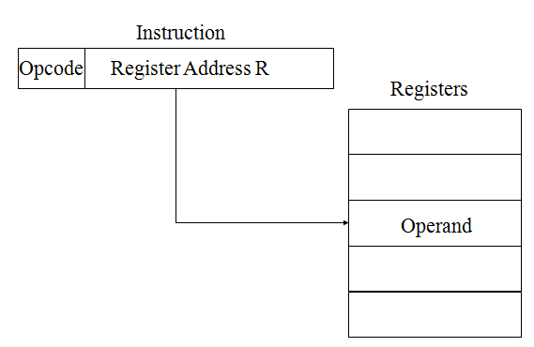
Register Addressing Mode
In this mode, the operand is in general purpose register.
MOV is the operation.
B is the source of data.
A is the destination.
MOV A, B | Move the contents of register B to A.

Slide 10
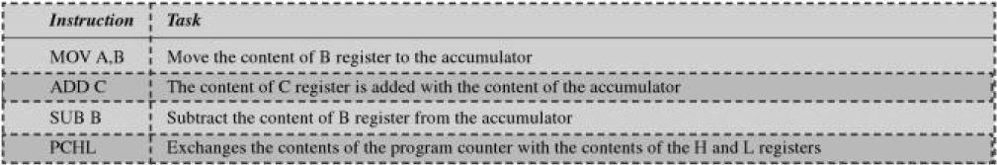

Slide 11
Register Indirect Addressing Mode
In this addressing mode, the data on which the operation is to be performed is stored in some memory location. This memory location is specified in a register pair. The instruction then specifies this register pair. Examples of instructions that use register indirect addressing mode are:
Large address space
2n where n = word length
May be nested, multilevel, cascaded
Multiple memory accesses to find operand
Hence slower

Slide 12
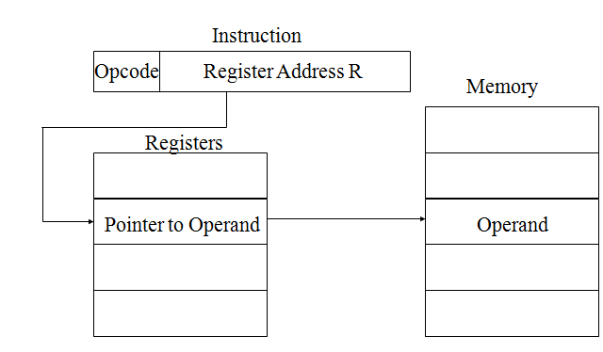
Register Indirect Addressing Mode
In this mode, the address of operand is specified by a register pair.
MOV is the operation.
M is the memory location
specified by H-L register pair.
A is the destination.
MOV A, M | Move data from memory location specified by H-L pair to accumulator.

Slide 13
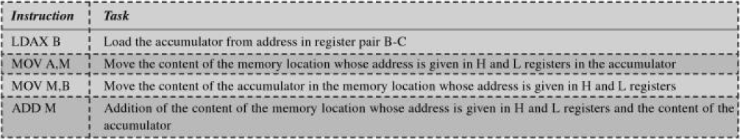

Slide 14
Immediate Addressing Mode
In this addressing mode, the data on which the operation is to be performed is mentioned in the instruction. Instead of specifying an address, the instruction specifies an operand along with the operation that is to be performed.
The instruction is 2 bytes when there is 8-bit data and 3 bytes when there is 16-bit data.
No memory reference to fetch data
Fast
Limited range

Slide 15
Immediate Addressing Mode
In this mode, the operand (Immediate data) is specified within the instruction itself.
MVI is the operation.
05 H is the immediate data (source).
A is the destination.
MVI A, 05 H | Move 05 H in accumulator.

Slide 16
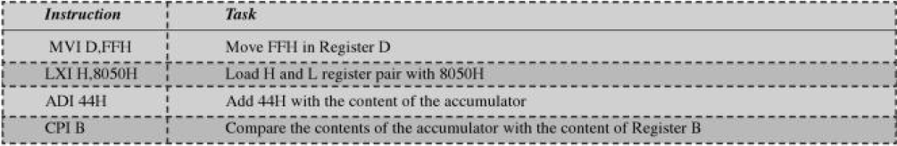

Slide 17
Implicit Addressing Mode
If address of source of data as well as address of destination of result is fixed, then there is no need to give any operand along with the instruction.
CMA is the operation.
A is the source.
A is the destination.
CMA | Complement accumulator.

Slide 18
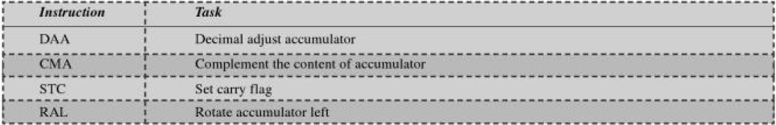

Slide 19
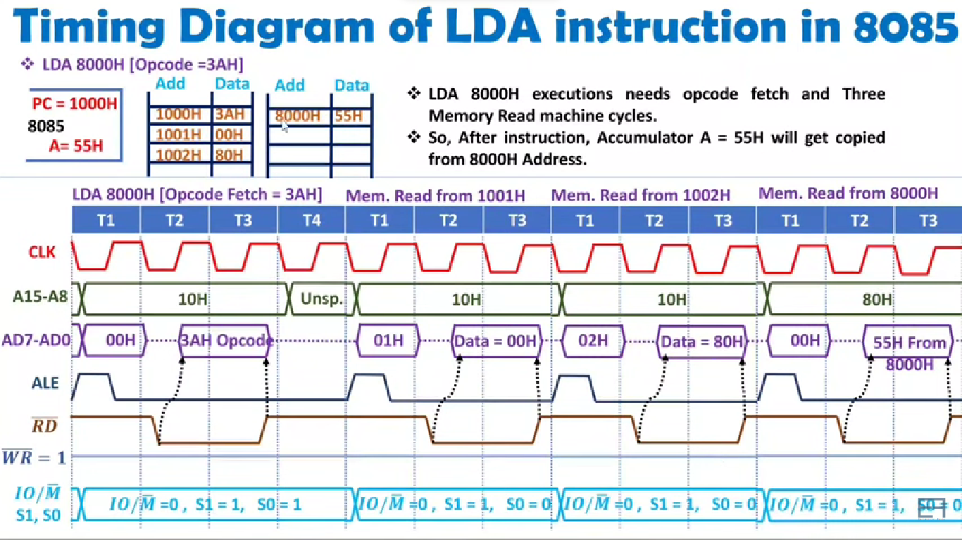
Instruction and timing cycles

