Slide 1
Exception Handling in C++

Slide 2
EXCEPTION
Types of errors:
Compile time > library reference, syntax error or
incorrect class import.
Run time -Exceptions
Exception: The events/errors that occurs during the execution of a program, which will destruct the normal behavior of a program.

Slide 3
Exception Handling
In other words, an exception is a runtime error. An exception may result in loss of data or an abnormal execution of program.
Exception handling is a mechanism that allows you to take appropriate action to avoid runtime errors, such as an attempt to divide by zero.

Slide 4
There are two types of exceptions:
Types of Exceptions:
1) Asynchronous Exceptions (Due to hardware)
2) Synchronous Exceptions
Examples of Synchronous:
1) Divide by zero
2) Unable to open a file

Slide 5
Constructs
Mechanism of exception is based upon Three keywords: try, catch, and throw.
Try : The try block contain statements which may generate exceptions. The code which can throw any exception is kept inside(or enclosed in) a try block.
Throw : When an exception occur in try block, it is thrown to the catch block using throw keyword.
Catch :The catch block defines the action to be taken, when an exception occur.

Slide 6
Keywords/Constructs
Three keywords: try, catch, and throw.
Try : The try block contain statements which may generate exceptions.
Throw : When an exception occur in try block, it is thrown to the catch block using throw keyword.
Catch :The catch block defines the action to be taken, when an exception occur.

Slide 7
SYNTAX
try
{
//code;;;;;;;;;
throw parameter;
}
catch(exception name ex)
{
//code to handle exception
}

Slide 8
Understanding Need of Exception Handling
int main()
{
int n1, n2 , result;
cout<<"\nEnter two numbers : ";
cin>>n1>>n2;
result = n1 / n2;
cout<<"\nThe result is : "<<result;
}

Slide 9
Solution for the previous Problem
Using try, catch and throw Statement

Slide 10
Example
We use signals all the time in real life to note that particular events have occurred.
For example,
During American football, if a player has committed a foul, the referee will throw a flag on the ground and whistle the play dead.
A penalty is then assessed and executed.
Once the penalty has been taken care of, play generally resumes as normal.

Slide 11

throw
In C++, a throw statement is used to signal that an exception or error case has occurred (think of throwing a penalty flag). Signaling that an exception has occurred is also commonly called raising an exception.

Slide 12

Problem
Let’s go back to our American football analogy: once a referee has thrown a penalty flag, what happens next? The players notice that a penalty has occurred and stop play. The normal flow of the football game is disrupted.
In C++, we use the try keyword to define a block of statements (called a try block).
The try block acts as an observer, looking for any exceptions that are thrown by statements within the try block.

Slide 13

Problem
Finally, the end of our American football analogy: After the penalty has been called and play has stopped, the referee assesses the penalty and executes it.
In other words, the penalty must be handled before normal play can resume.
Actually handling exceptions is the job of the catch block(s).
The catch keyword is used to define a block of code (called a catch block) that handles exceptions for a single data type.

Slide 14
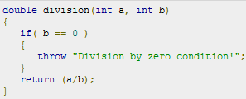
Throwing Exceptions
Exceptions can be thrown anywhere within a code block using throw statements. The operand of the throw statements determines a type for the exception and can be any expression and the type of the result of the expression determines the type of exception thrown.
Following is an example of throwing an exception when dividing by zero condition occurs:

Slide 15
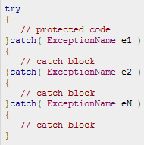
Try and Catch
Assuming a block will raise and exception, a method catches an exception using a combination of the try and catch keywords.
A try/catch block is placed around the code that might generate an exception. Code within a try/catch block is referred to as protected code, and the syntax for using try/catch looks like the following:

Slide 16
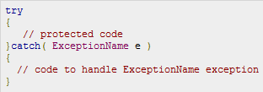
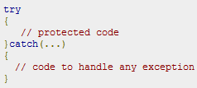
Catching Exceptions
The catch block following the try block catches any exception.
Above code will catch an exception of ExceptionName type. If you want to specify that a catch block should handle any type of exception that is thrown in a try block, you must put an ellipsis, ..., between the parentheses enclosing the exception declaration as left:

Slide 17
CONTINUE WITH EXCEPTION HANDLING

Slide 18
Catch All Exceptions
If a program has three types of exceptions that are integer, character and double.
If an exception occur of long type, no catch block will get execute and abnormal program termination will occur.
To avoid this, We can use the catch statement with three dots as parameter (...) so that it can handle all types of exceptions.

Slide 19
Catch (…)
{
// unhandled exceptions
}

Slide 20
Rethrowing an exception
Rethrowing exception is possible, where we have an inner and outer try-catch statements (Nested try-catch).
An exception to be thrown from inner catch block to outer catch block is called rethrowing exception.

Slide 21
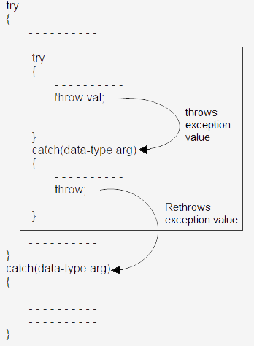

Slide 22
Multiple exceptions
A program can have multiple exceptions
Which one gets executed depends upon the type of the value thrown

Slide 23
Restricting Exceptions
We can restrict the type of exception to be thrown, from a function to its calling statement, by adding throw keyword to a function definition.
The program will abort because we have restricted the Demo() function to throw only integer and double type exceptions and Demo() is throwing character type exception.

Slide 24
Quiz Time
1. Which is used to handle the exceptions in c++?
a) catch handler
b) handler
c) exception handler
d) none of the mentioned
2. Which statement is used to catch all types of exceptions?
a) catch()
b) catch(Test t)
c) catch(…)
d) none of the mentioned

Slide 25
Quiz Time
3. C++ exception handling mechanism mainly uses how many keywords?
a) Four
b) Three
c) Two
d) None of the above
4. When an exception is thrown, it needs to be .....................
a) Executed
b) Handled appropriately
c) Resolved
d) None of the above

Slide 26
Programs
WAP with the following:
  A function to read two double type numbers from keyboard.
  A function to calculate the division of two numbers.

Slide 27
Thank You!!!

