Slide 1
Inverse DFT using FFT Algorithms

Slide 2
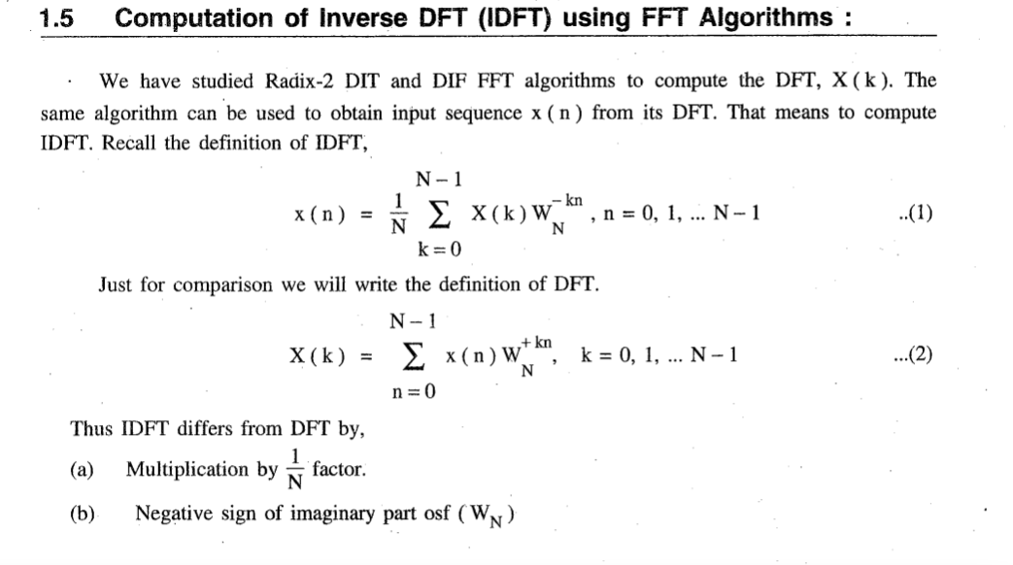

Slide 3
4 point Inverse DFT using FFT Algorithms

Slide 4

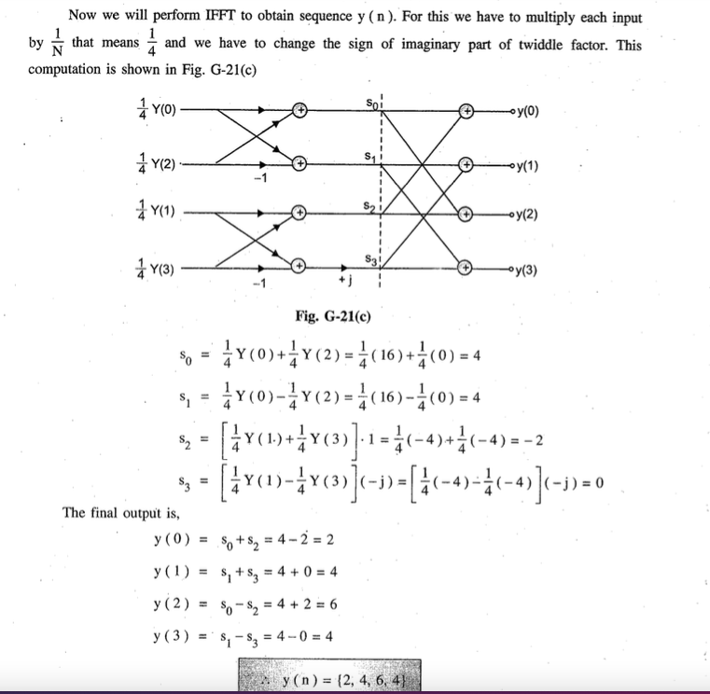
Find y(n) using DIT IFFT algorithm

Slide 5
8 point Inverse DFT using FFT Algorithms

Slide 6


Slide 7
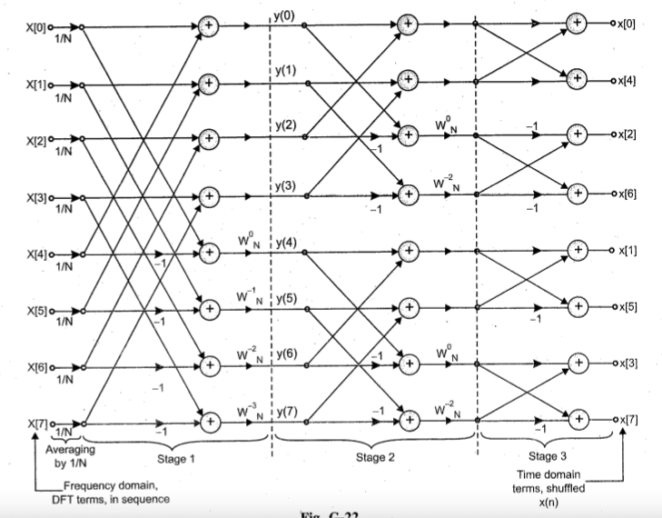

Slide 8
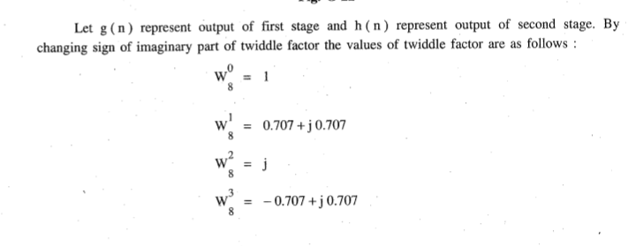

Slide 9
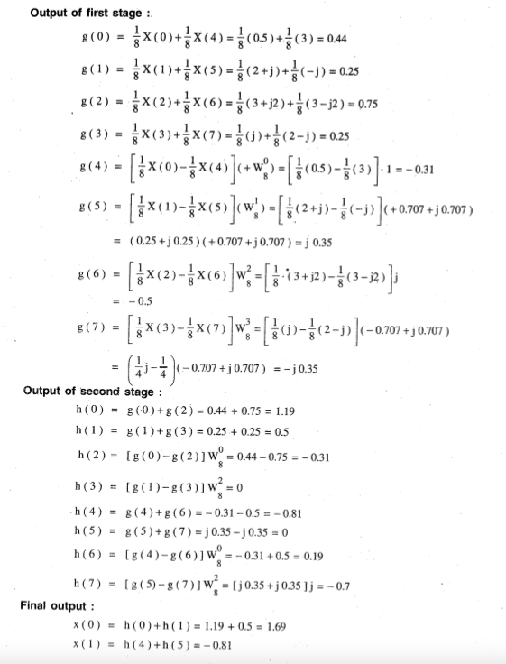

Slide 10
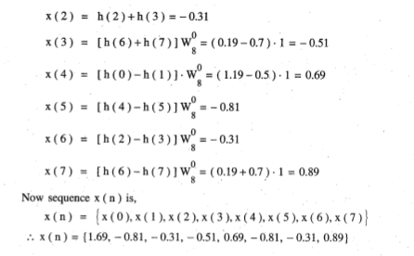

Slide 11
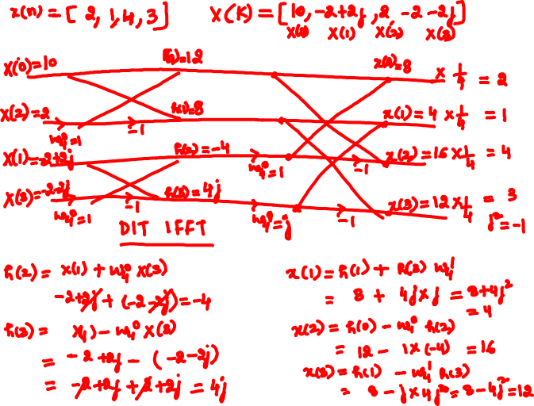


Slide 12
