Slide 1
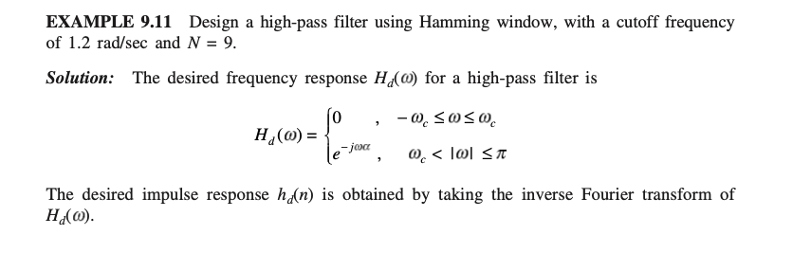

Slide 2
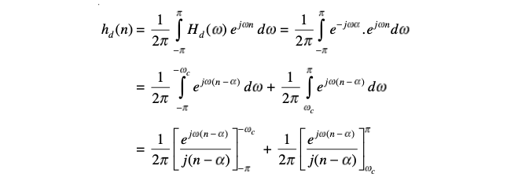

Slide 3
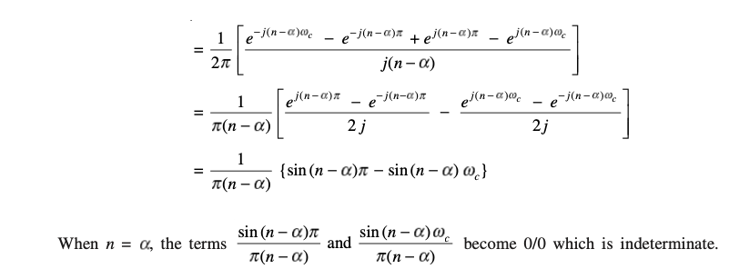

Slide 4

Use L hospital rule
$$\left[\begin{matrix}Lt & 1/ \\ n→α & π\end{matrix}\right]\frac{πcos⁡(n−α)}{1}−\frac{wc cos\left(n−α\right)}{1}$$
$$1/π[π−wc]$$

Slide 5
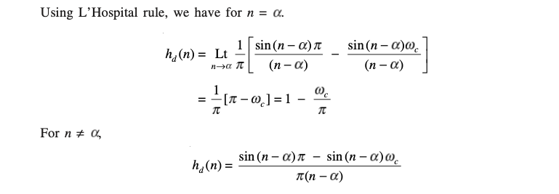

Slide 6
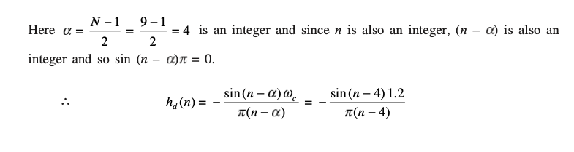

Slide 7
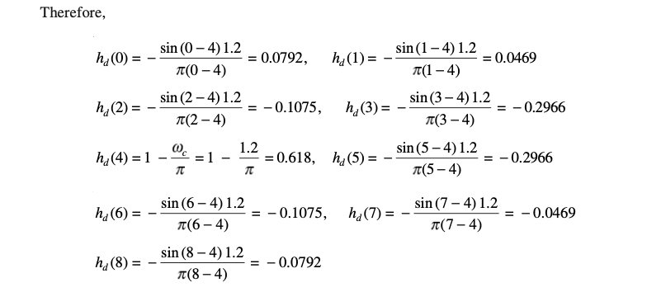

Slide 8
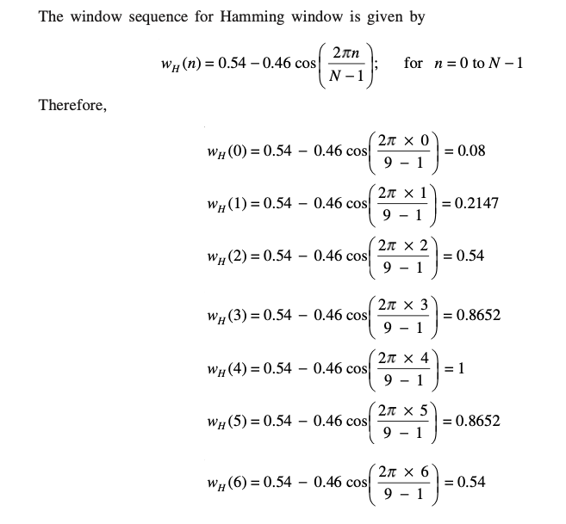

Slide 9
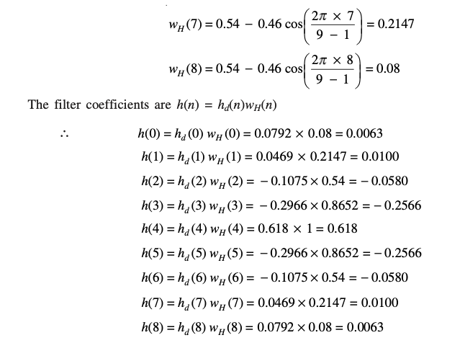

Slide 11
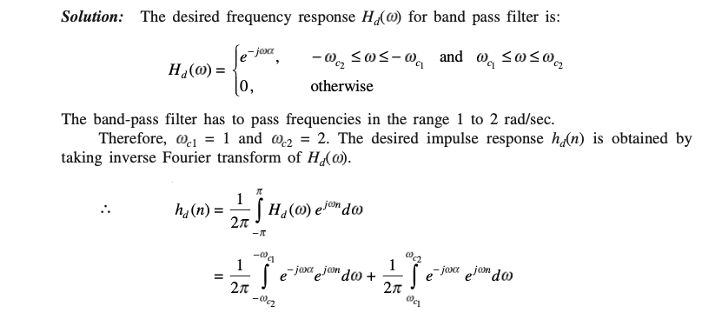

Slide 12
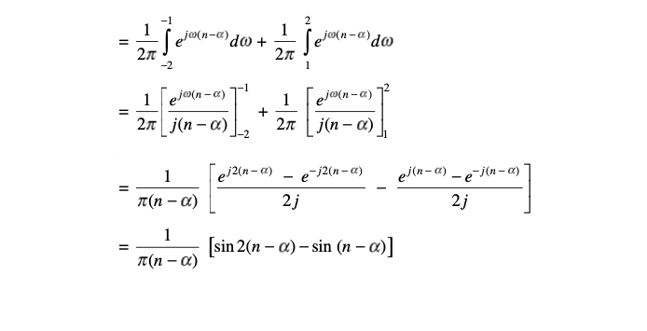

Slide 13
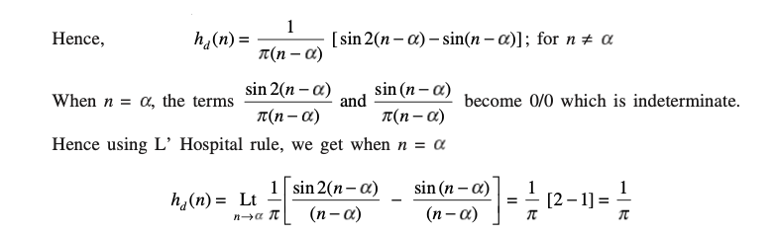

Slide 14
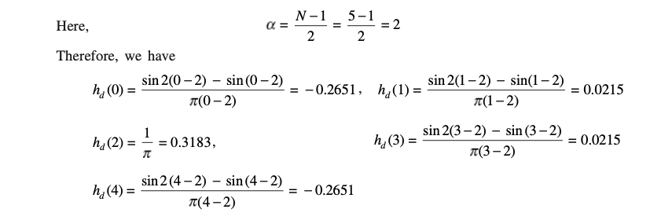

Slide 15
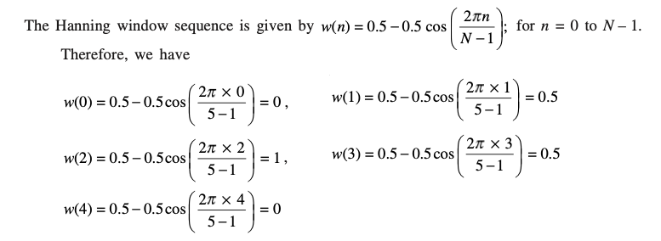

Slide 16
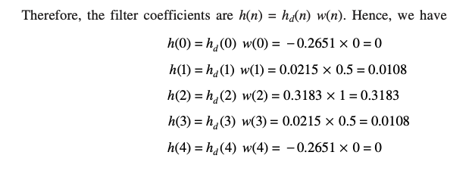

Slide 17
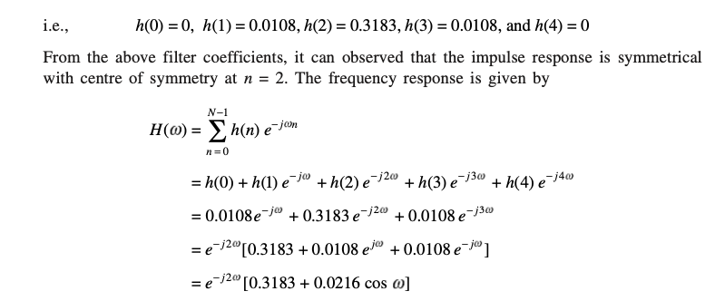

Slide 18
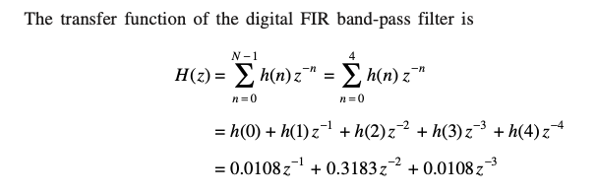

Slide 19


Slide 20
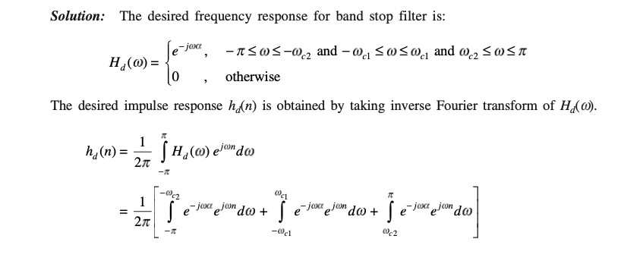

Slide 21
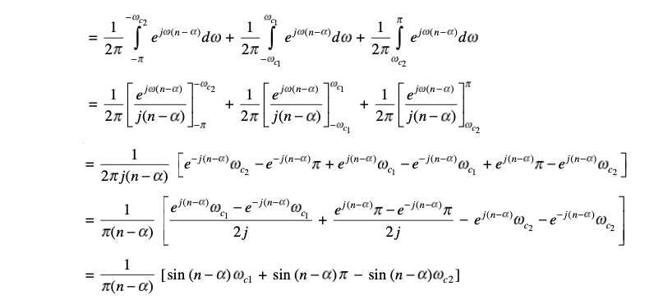

Slide 22
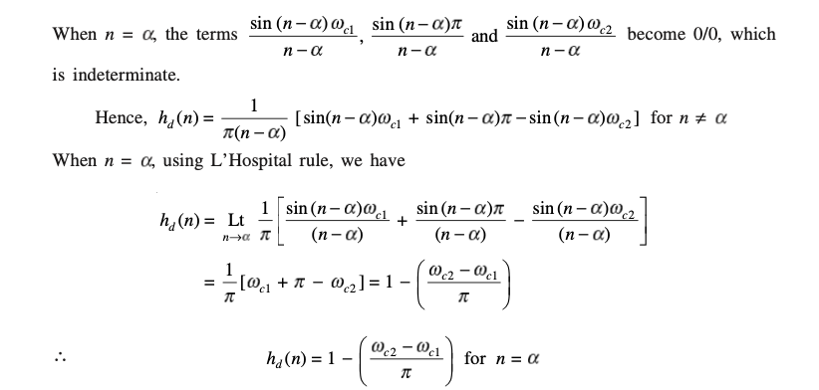

Slide 23
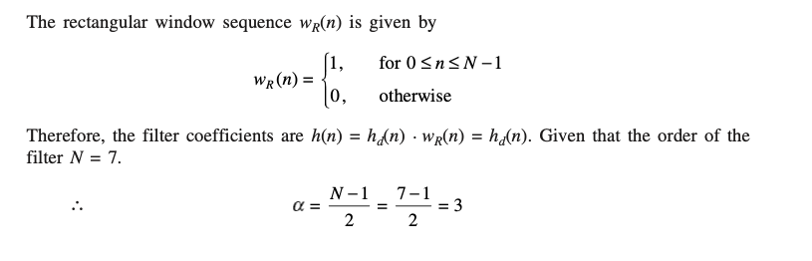

Slide 24
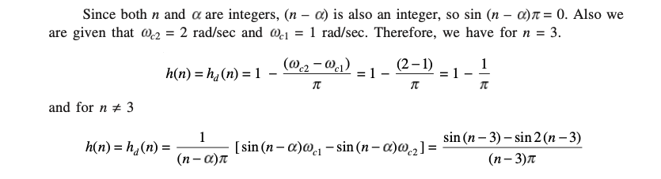

Slide 25
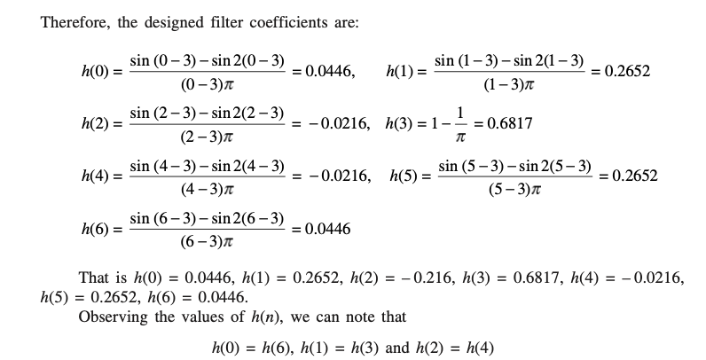

Slide 26
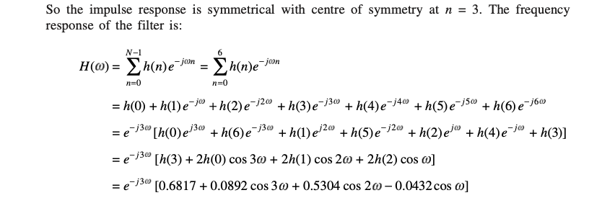

Slide 27
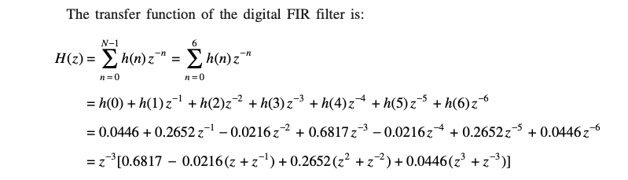

Slide 28
Linear Phase Response

Slide 29
Linear phase is a property of a filter where the phase response of the filter is a linear function of frequency. The result is that all frequency components of the input signal are shifted in time (usually delayed) by the same constant amount (the slope of the linear function), which is referred to as the group delay. Consequently, there is no phase distortion due to the time delay of frequencies relative to one another.

Slide 30
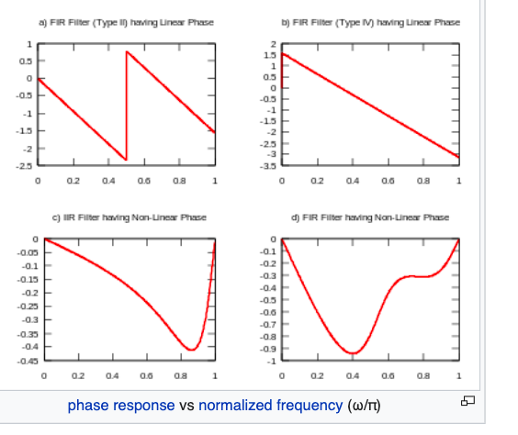

Slide 31
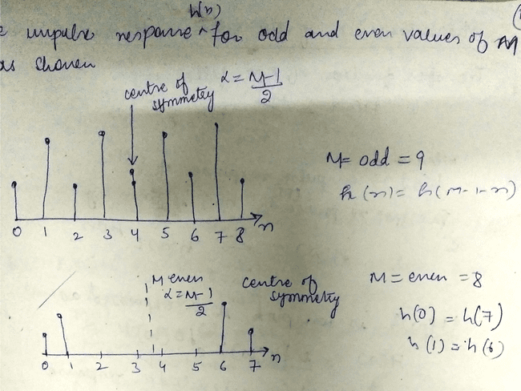

Slide 32
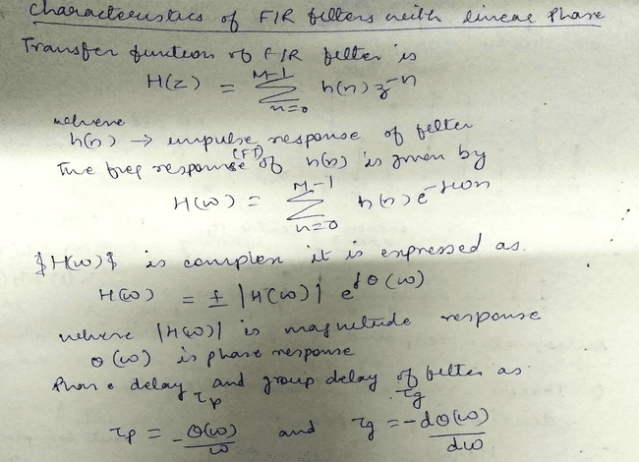

Slide 33
Consider the assertions given below. Which among them is an advantage of FIR Filter?
a. Necessity of computational techniques for filter implementation b. Requirement of large storage c. Incapability of simulating prototype analog filters d. Presence of linear phase response

Slide 34
d

Slide 35
Which among the following represent/s the characteristic/s of an ideal filter?
a. Constant gain in passband b. Zero gain in stop band c. Linear Phase Response d. All of the above

Slide 36
d

Slide 37
Basically, group delay is the delayed response of filter as a function of ________.
a. Phase b. Amplitude c. Frequency d. All of the above

Slide 38
c

Slide 39
A filter is said to be linear phase filter if the phase delay and group delay are _______
a. High b. Moderate c. Low d. Constant

Slide 40
d

