Slide 1

Questions on Design of Butterworth Filter

Slide 2
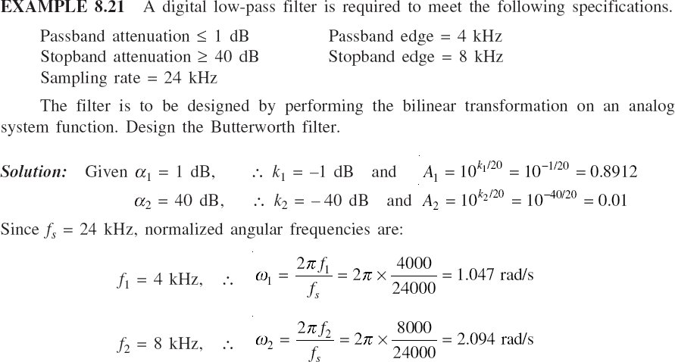

Slide 3


Slide 4
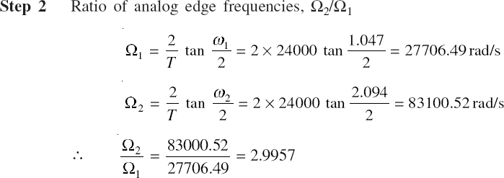

Slide 5
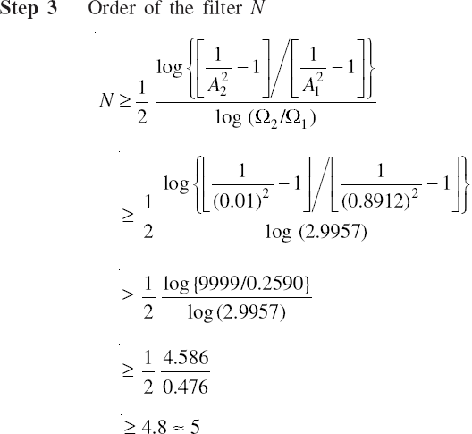

Slide 6
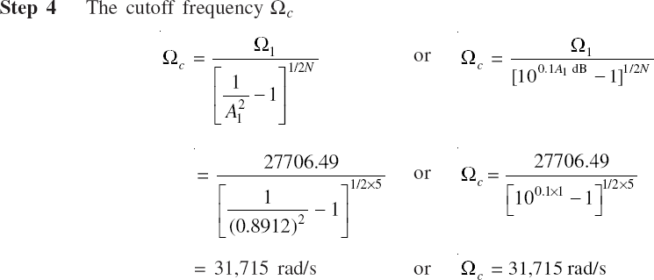

Slide 7


Slide 8
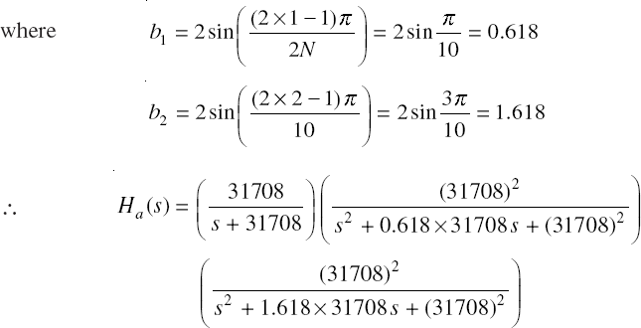

Slide 9
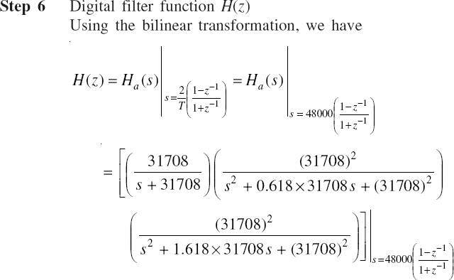

Slide 10
Which of the following is true in the case of Butterworth filters?
Smooth pass band
Wide transition band
Not so smooth stop band
All of the mentioned

Slide 11
d

Slide 12
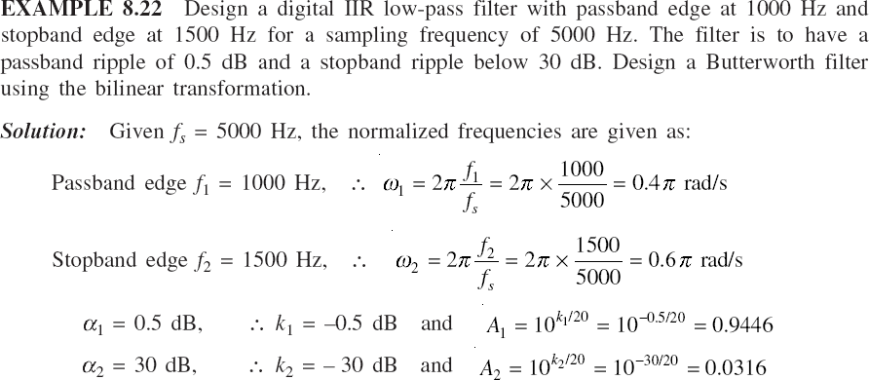

Slide 13
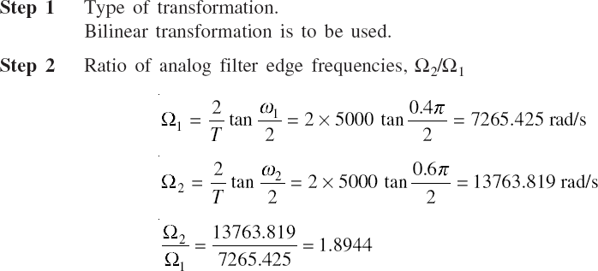


Slide 14
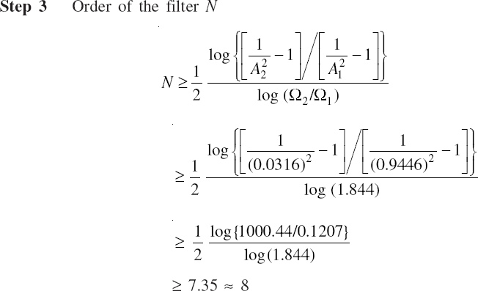

Slide 15
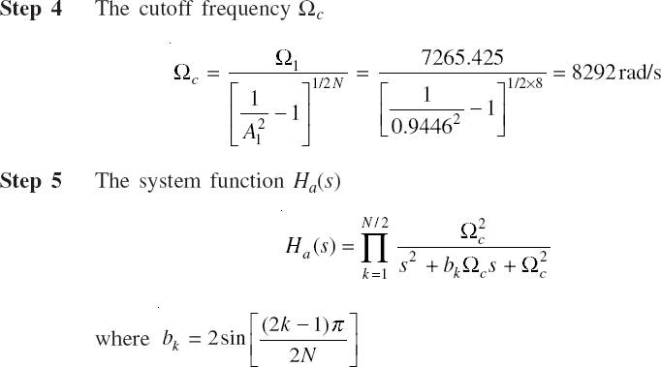

Slide 16
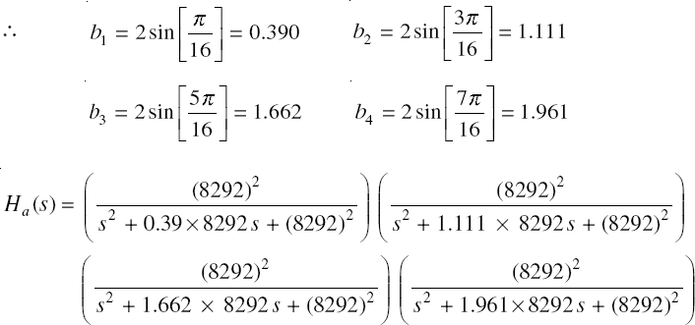

Slide 17
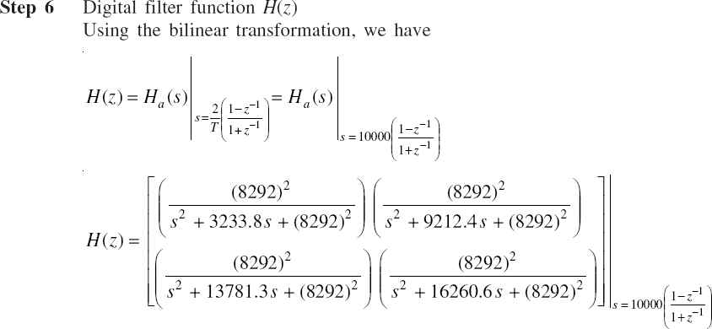

Slide 18


Slide 19
A

Slide 20
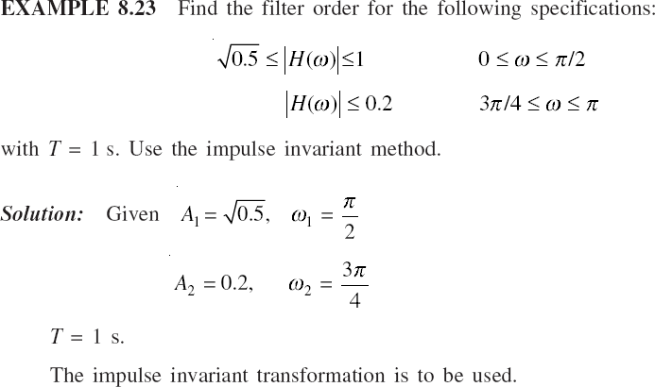

Slide 21
