Slide 1

Chapter 12
Multiple Access
12.<number>
Copyright © The McGraw-Hill Companies, Inc. Permission required for reproduction or display.

Slide 2

Figure 12.1 Data link layer divided into two functionality-oriented sublayers
12.<number>

Slide 3

Figure 12.2 Taxonomy of multiple-access protocols discussed in this chapter
12.<number>

Slide 4
12-1 RANDOM ACCESS
In random access or contention methods, no station is superior to another station and none is assigned the control over another. No station permits, or does not permit, another station to send. At each instance, a station that has data to send uses a procedure defined by the protocol to make a decision on whether or not to send.
Topics discussed in this section:
ALOHA
Carrier Sense Multiple Access
Carrier Sense Multiple Access with Collision Detection
Carrier Sense Multiple Access with Collision Avoidance
12.<number>

Slide 5

Figure 12.3 Frames in a pure ALOHA network
Advocates of Linux Open-source Hawaii Association
12.<number>

Slide 6

Figure 12.4 Procedure for pure ALOHA protocol
12.<number>

Slide 7

Figure 12.6 Frames in a slotted ALOHA network
12.<number>

Slide 8

Figure 12.7 Vulnerable time for slotted ALOHA protocol
12.<number>

Slide 9
To minimize the chance of collision and, therefore, increase the performance, the CSMA method was developed.
The chance of collision can be reduced if a station senses the medium before trying to use it.
Carrier sense multiple access (CSMA) requires that each station first listen to the medium (or check the state of the medium) before sending. In other words, CSMA is based on the principle "sense before transmit" or "listen before talk.“
CSMA can reduce the possibility of collision, but it cannot eliminate it. The reason for this is shown in Figure, a space and time model of a CSMA network.
12.<number>

Slide 10
Stations are connected to a shared channel (usually a dedicated medium).
The possibility of collision still exists because of propagation delay; when a station sends a frame, it still takes time (although very short) for the first bit to reach every station it idle, only because the first bit sent by another station has not yet been received.
At time t1 station B senses the medium and finds it idle, so it sends a frame. At time t2 (t2> t1)'station C senses the medium and finds it idle because, at this time, the first bits from station B have not reached station C. Station C also sends a frame.
The two signals collide and both frames are destroyed.
12.<number>

Slide 11
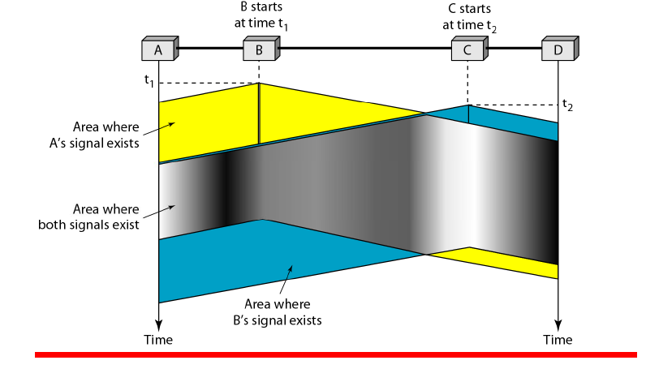
12.<number>

Slide 12

Figure 12.9 Vulnerable time in CSMA
12.<number>

Slide 13

Figure 12.10 Behavior of three persistence methods
12.<number>

Slide 14

Figure 12.11 Flow diagram for three persistence methods
12.<number>

Slide 15
12.<number>

Slide 16
The CSMA method does not specify the procedure following a collision.
Carrier sense multiple access with collision detection (CSMA/CD) augments the algorithm to handle the collision.
In this method, a station monitors the medium after it sends a frame to see if the transmission was successful. If so, the station is finished and If, however, there is a collision, the frame is sent again.
To better understand CSMA/CD, let us look at the first bits transmitted by the two stations involved in the collision.
Although each station continues to send bits in the frame until it detects the collision, we show what happens as the first bits collide.
12.<number>

Slide 17

In Figure , stations A and C are involved in the collision.
At time t1, station A has executed its persistence procedure and starts sending the bits of its frame.
Figure Collision of the first bit in CSMA/CD
At time t2, station C has not yet sensed the first bit sent by A. Station C executes its persistence procedure and starts sending the bits in its frame, which propagate both to the left and to the right.
The collision occurs sometime after time t2 Station C detects a collision at time t3 when it receives the first bit of A's frame.
12.<number>

Slide 18
Station C immediately
(or after a short time, but we assume immediately) aborts transmission.
Station A detects collision at time t4 when it receives the first bit of C's frame; it also immediately aborts transmission.
Figure Collision of the first bit in CSMA/CD
Looking at the figure, we see that A transmits for the duration t4 - tl; C transmits for the duration t3 - t2 Later we show that, for the protocol to work, the length of any frame divided by the bit rate in this protocol must be more than either of these durations.
At time t4, the transmission of A’s frame, though incomplete, is aborted; at time t3, the transmission of B's frame, though incomplete, is aborted.
12.<number>

Slide 19

Minimum Frame Size
For CSMA/CD to work, we need a restriction on the frame size. Before sending the last bit of the frame, the sending station must detect a collision, if any, and abort the transmission.
This is so because the station, once the entire frame is sent, does not keep a copy of the frame and does not monitor the line for collision detection.
Therefore, the frame transmission time T_{fr} must be at least two times the maximum propagation time T_{p}
12.<number>

Slide 20
Example 12.5
A network using CSMA/CD has a bandwidth of 10 Mbps. If the maximum propagation time (including the delays in the devices and ignoring the time needed to send a jamming signal, as we see later) is 25.6 μs, what is the minimum size of the frame?
Solution
The frame transmission time is T_{fr} = 2 × T_{p} = 51.2 μs. This means, in the worst case, a station needs to transmit for a period of 51.2 μs to detect the collision. The minimum size of the frame is 10 Mbps × 51.2 μs = 512 bits or 64 bytes. This is actually the minimum size of the frame for Standard Ethernet.
12.<number>

Slide 21

Figure 12.14 Flow diagram for the CSMA/CD
12.<number>

Slide 22

Figure Energy level during transmission, idleness, or collision
The level of energy in a channel can have three values: zero, normal,
and abnormal.
At the zero level, the channel is idle. At the normal level, a station has successfully captured the channel and is sending its frame.
At the abnormal level, there is a collision and the level of the energy is twice the normal level.
A station that has a frame to send or is sending a frame needs to monitor the energy level to determine if the channel is idle, busy, or in collision mode.
12.<number>

Slide 23
Throughput
The throughput of CSMAlCD is greater than that of pure or slotted ALOHA.
12.<number>

Slide 24
Carrier Sense Multiple Access with Collision Avoidance (CSMA/CA)
The basic idea behind CSMA/CD is that a station needs to be able to receive while transmitting to detect a collision.
When there is no collision, the station receives one signal: its own signal.
When there is a collision, the station receives two signals: its own signal and the signal transmitted by a second station.
To distinguish between these two cases, the received signals in these two cases must be significantly different.
In other words, the signal from the second station needs to add a significant amount of energy to the one created by the first station.
12.<number>

Slide 25
In a wired network, the received signal has almost the same energy as the sent signal because either the length of the cable is short or there are repeaters that amplify the energy between the sender and the receiver.
This means that in a collision, the detected energy almost doubles.
However, in a wireless network, much of the sent energy is lost in transmission.
The received signal has very little energy. Therefore, a collision may add only 5 to 10 percent additional energy.
This is not useful for effective collision detection. We need to avoid collisions on wireless networks because they cannot be detected.
12.<number>

Slide 26

Figure 12.17 Flow diagram for CSMA/CA
Channel idle? Don’t transmit yet!
Wait IFS time.
Still idle after IFS? Don’t transmit yet!
Now in Contention Window.
Choose random number and wait that
many slots.
Did you wait R slots and all slots were
available? Go ahead, transmit.
Now, wait time-out for a response.
(How big is a slot? 50 µs in 802.11 FH and
20 µs in 802.11 DS)
12.<number>

Slide 27

Figure 12.16 Timing in CSMA/CA
Carrier sense multiple access with collision avoidance (CSMA/CA) was invented for this network. Collisions are avoided through the use of CSMA/CA's three strategies: the interframe space, the contention window, and acknowledgments, as shown in Figure
12.<number>

Slide 28

Note
In CSMA/CA, the IFS can also be used to define the priority of a station or a frame.
12.<number>

Slide 29
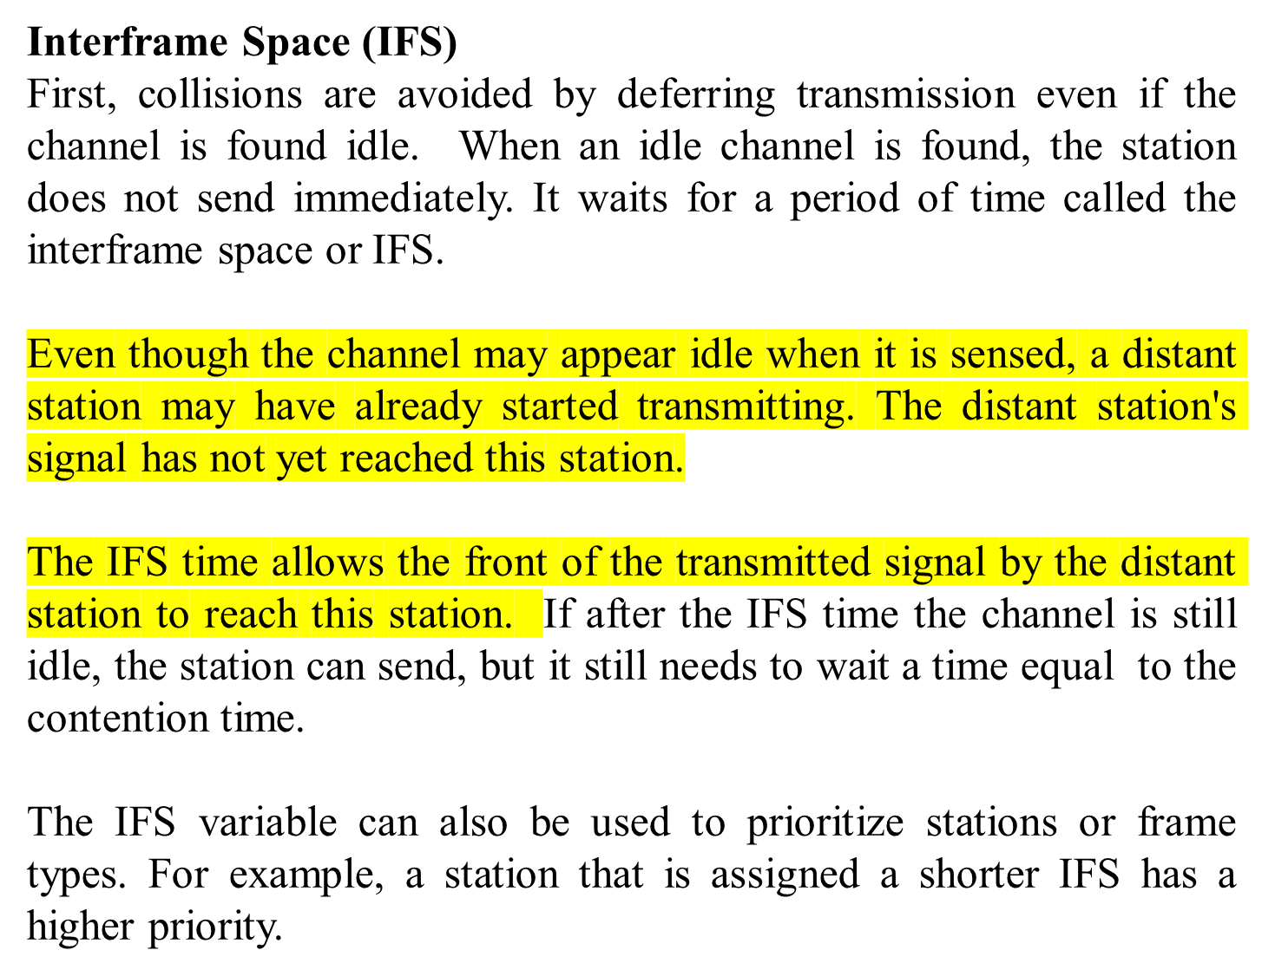
12.<number>

Slide 30
Contention Window
The contention window is an amount of time divided into slots. A station that is ready to send chooses a random number of slots as its wait time.
The number of slots in the window changes according to the binary exponential back-off strategy.
This means that it is set to one slot the first time and then doubles each time the station cannot detect an idle channel after the IFS time.
This is very similar to the p-persistent method except that a random outcome defines the number of slots taken by the waiting station.
12.<number>

Slide 31
Contention Window
One interesting point about the contention window is that the station needs to sense the channel after each time slot.
However, if the station finds the channel busy, it does not restart the process; it just stops the timer and restarts it when the channel is sensed as idle.
This gives priority to the station with the longest waiting time.
12.<number>

Slide 32
Acknowledgment
With all these precautions, there still may be a collision resulting in destroyed data.
In addition, the data may be corrupted during the transmission. The positive acknowledgment and the time-out timer can help guarantee that the receiver has received the frame.
12.<number>

Slide 33
CONTROLLED ACCESS
In controlled access, the stations consult one another to find which station has the right to send.
A station cannot send unless it has been authorized by other stations.
Three popular controlled-access methods.
Reservation
In the reservation method, a station needs to make a reservation before sending data. Time is divided into intervals. In each interval, a reservation frame precedes the data frames sent in that interval.
If there are N stations in the system, there are exactly N reservation minislots in the reservation frame. Each minislot belongs to a station.
When a station needs to send a data frame, it makes a reservation in its own minislot. The stations that have made reservations can send their data frames after the reservation frame.
12.<number>

Slide 34

Figure 12.18 Reservation access method
Figure shows a situation with five stations and a five-minislot reservation frame.
In the first interval, only stations 1, 3, and 4 have made reservations. In the second interval, only station 1 has made a reservation.
12.<number>

Slide 35

Figure 12.19 Select and poll functions in polling access method
Polling
Polling works with topologies in which one device is designated as a primary station and the other devices are secondary stations.
All data exchanges must be made through the primary device even when the ultimate destination is a secondary device.
12.<number>

Slide 36
The primary device controls the link; the secondary devices follow its instructions.
It is up to the primary device to determine which device is allowed to use the channel at a given time. The primary device, therefore, is always the initiator of a session .
If the primary wants to receive data, it asks the secondaries if they have anything to send; this is called poll function. If the primary wants to send data, it tells the secondary to get ready to receive; this is called select function.
12.<number>

Slide 37
Polling-
Select
The select function is used whenever the primary device has something to send.
Remember that the primary controls the link. If the primary is neither sending nor receiving data, it knows the link is available.
If it has something to send, the primary device sends it. What it does not know, however, is whether the target device is prepared to receive.
So the primary must alert the secondary to the upcoming transmission and wait for an acknowledgment of the secondary's ready status.
Before sending data, the primary creates and transmits a select (SEL) frame, one field of which includes the address of the intended secondary.
12.<number>

Slide 38
Polling-
Poll
The poll function is used by the primary device to solicit transmissions from the secondary devices.
When the primary is ready to receive data, it must ask (poll) each device in turn if it has anything to send.
When the first secondary is approached, it responds either with a NAK frame if it has nothing to send or with data (in the form of a data frame) if it does.
If the response is negative (a NAK frame), then the primary polls the next secondary in the same manner until it finds one with data to send.
When the response is positive (a data frame), the primary reads the frame and returns an acknowledgment (ACK frame), verifying its receipt.
12.<number>

Slide 39
Token Passing
In the token-passing method, the stations in a network are organized in a logical ring.
In other words, for each station, there is a predecessor and a successor.
The predecessor is the station which is logically before the station in the ring; the successor is the station which is after the station in the ring.
The current station is the one that is accessing the channel now.
The right to this access has been passed from the predecessor to the current station.
The right will be passed to the successor when the current station has no more data to send.

Slide 40
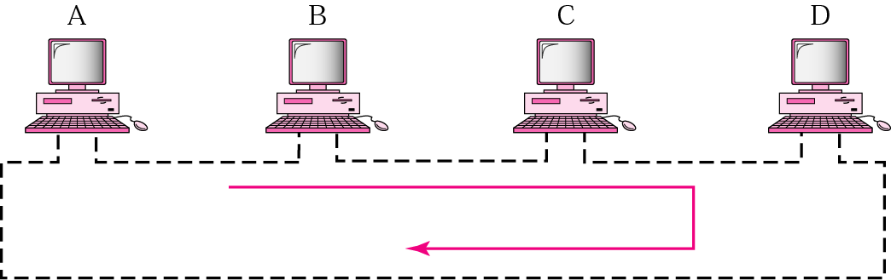
Token-passing network

Slide 41
But how is the right to access the channel passed from one station to another?
In this method, a special packet called a token circulates through the ring. The possession of the token gives the station the right to access the channel and send its data.
When a station has some data to send, it waits until it receives the token from its predecessor.
It then holds the token and sends its data. When the station has no more data to send, it releases the token, passing it to the next logical station in the ring.
The station cannot send data until it receives the token again in the next round. In this process, when a station receives the token and has no data to send, it just passes the data to the next station.
12.<number>

Slide 42
Token management is needed for this access method. Stations must be limited in the time they can have possession of the token.
The token must be monitored to ensure it has not been lost or destroyed. For example, if a station that is holding the token fails, the token will disappear from the network.
Another function of token management is to assign priorities to the stations and to the types of data being transmitted.
Token management is needed to make low-priority stations release the token to high priority stations.
12.<number>

Slide 43
12.<number>

Slide 44

Figure 12.20 Logical ring and physical topology in token-passing access method
12.<number>

Slide 45
12-3 CHANNELIZATION
Channelization is a multiple-access method in which the available bandwidth of a link is shared in time, frequency, or through code, between different stations. In this section, we discuss three channelization protocols.
Topics discussed in this section:
Frequency-Division Multiple Access (FDMA)
Time-Division Multiple Access (TDMA)
Code-Division Multiple Access (CDMA)
12.<number>

Slide 46
Note
We see the application of all these methods in Chapter 16 when
we discuss cellular phone systems.
12.<number>

Slide 47

Figure 12.21 Frequency-division multiple access (FDMA)
12.<number>

Slide 48
Note
In FDMA, the available bandwidth
of the common channel is divided into bands that are separated by guard bands.
12.<number>

Slide 49

Figure 12.22 Time-division multiple access (TDMA)
12.<number>

Slide 50
Note
In TDMA, the bandwidth is just one channel that is timeshared between different stations.
12.<number>

Slide 51
Note
In CDMA, one channel carries all transmissions simultaneously.
12.<number>

Slide 52

Simple idea of communication with code

Slide 53
Chip sequences

Slide 54
Encoding rules

Slide 55
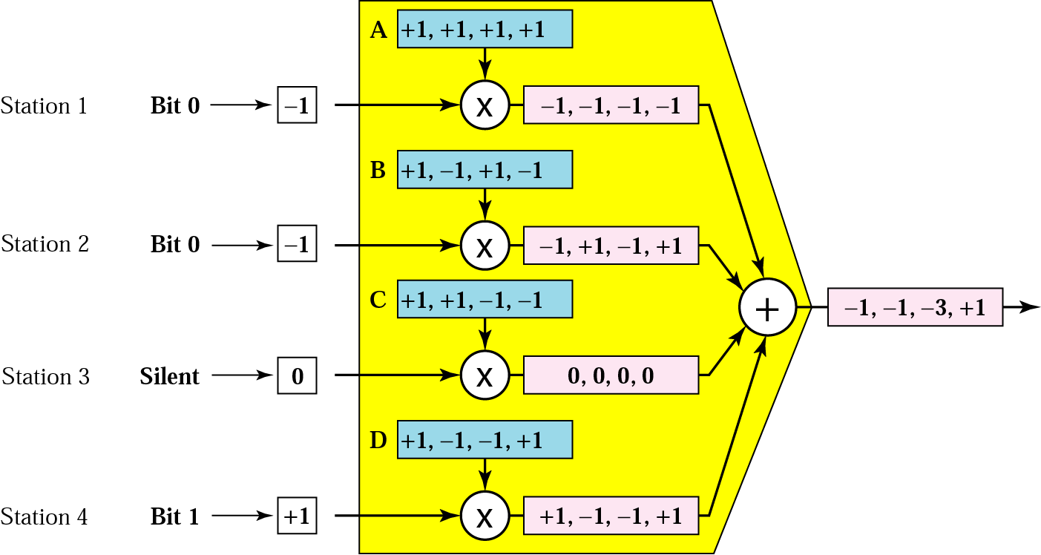
CDMA multiplexer

Slide 56

Digital signal created by four stations in CDMA

Slide 57
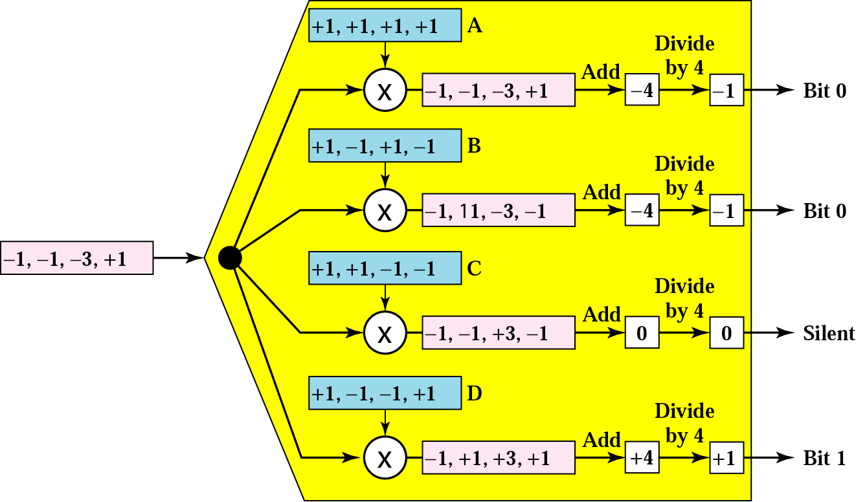
CDMA demultiplexer

Slide 58
Figure 12.27 Digital signal created by four stations in CDMA
12.<number>

