Slide 1
Network Models

Slide 2
In the early- and mid-1970s, networking was largely either government-sponsored (NPL network in the UK, ARPANET in the US, CYCLADES in France) or vendor-developed with proprietary standards, such as IBM's Systems Network Architecture and Digital Equipment Corporation's DECnet.
Public data networks were only just beginning to emerge, and these began to use the X.25 standard in the late 1970s
The U.S. Advanced Research Projects Agency Network (ARPANET) was the
first public packet-switched computer network.
X.25 is an ITU-T standard protocol suite for packet-switched data
communication in wide area networks (WAN).
2.<number>

Slide 3
The Experimental Packet Switched System in the UK circa 1973-5 identified the need for defining higher level protocols.
The UK National Computing Centre publication 'Why Distributed Computing' which came from considerable research into future configurations for computer systems, resulted in the UK presenting the case for an international standards committee to cover this area at the ISO meeting in Sydney in March 1977.
2.<number>

Slide 4
Beginning in 1977, the International Organization for Standardization (ISO) conducted a program to develop general standards and methods of networking.
A similar process evolved at the International Telegraph and Telephone Consultative Committee (CCITT)
Both bodies developed documents that defined similar networking models. The OSI model was first defined in raw form in Washington, DC in February 1978 by Hubert Zimmermann of France and the refined but still draft standard was published by the ISO in 1980
2.<number>

Slide 5
In 1983, the CCITT and ISO documents were merged to form The Basic Reference Model for Open Systems Interconnection, usually referred to as the Open Systems Interconnection Reference Model, OSI Reference Model, or simply OSI model.
It was published in 1984 by both the ISO, as standard ISO 7498.
The concept of a seven-layer model was provided by the work of Charles Bachman at Honeywell Information Systems.

Slide 6
LAYERED TASKS
We use the concept of layers in our daily life. As an example, let us consider two friends who communicate through postal mail. The process of sending a letter to a friend would be complex if there were no services available from the post office.
Topics discussed in this section:
Sender, Receiver, and Carrier
Hierarchy

Slide 7

Figure Tasks involved in sending a letter

Slide 8
THE OSI MODEL
Established in 1947, the International Standards Organization (ISO) is a multinational body dedicated to worldwide agreement on international standards. An ISO standard that covers all aspects of network communications is the Open Systems Interconnection (OSI) model. It was first introduced in the late 1970s.
Topics discussed in this section:
Layered Architecture
Peer-to-Peer Processes
Encapsulation

Slide 9

Note
ISO is the organization.
OSI is the model.

Slide 10

Figure Seven layers of the OSI model

Slide 11

Figure The interaction between layers in the OSI model
Service to the End-user
Translation/Compression /Encryption
Control/Synchronization
Segments/Message
Packets
Frames
Bits

Slide 12
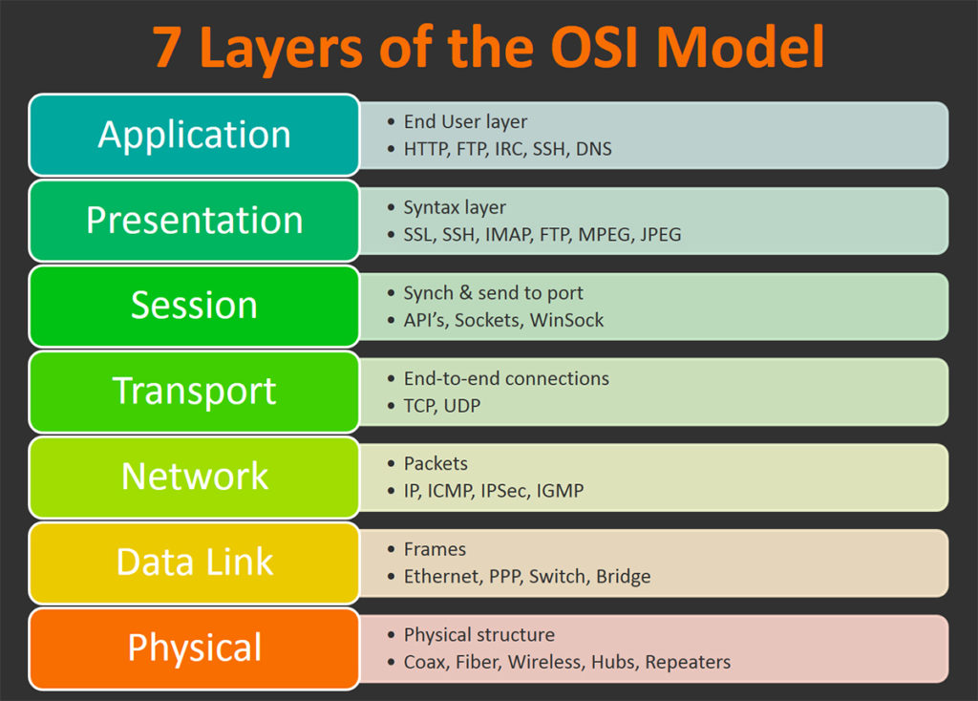
2.<number>

Slide 13
Common protocol used
Protocol | Acronym | Remarks
Point To Point | PPP | Used to manage network communication over a modem
Transfer/Transmission Control Protocol | TCP / IP | Backbone protocol. The most widely used protocol.
Internetwork package exchange | IPX | Standard protocol for Novell NOS
NetBIOS extended user interface | NetBEUI | Microsoft protocol that doesn’t support routing to other network. Running only Windows-based clients.
File transfer Protocol | FTP | used to send and received file from a remote host
Simple mail Transfer protocol | SMTP | Used to send Email over a network
Hyper text transfer protocol | HTTP | Used for Internet to send document that encoded in HTML
Apple Talk | Apple Talk | Protocol suite to network Macintosh computer and a peer-to-peer network protocol
OSI Model | OSI Layers | A way of illustrating how information functions travels through network of its 7 layers.
2.<number>

Slide 14

Figure An exchange using the OSI model

Slide 15
LAYERS IN THE OSI MODEL
In this section we briefly describe the functions of each layer in the OSI model.
Topics discussed in this section:
Physical Layer
Data Link Layer
Network Layer
Transport Layer
Session Layer
Presentation Layer
Application Layer

Slide 16

Figure Physical layer

Slide 17
T-----------S1----------S2-----------S3
Note
The physical layer is responsible for movements of
individual bits from one hop (node) to the next.

Slide 18

Figure Data link layer

Slide 19
Note
The data link layer is responsible for moving
frames from one hop (node) to the next.

Slide 20

Figure Hop-to-hop delivery

Slide 21

Figure Network layer

Slide 22
Note
The network layer is responsible for the
delivery of individual packets from
the source host to the destination host.

Slide 23

Figure Source-to-destination delivery

Slide 24

Figure Transport layer

Slide 25
Note
The transport layer is responsible for the delivery
of a message from one process to another.

Slide 26

Figure Reliable process-to-process delivery of a message

Slide 27

Figure Session layer

Slide 28
Note
The session layer is responsible for dialog
control and synchronization.

Slide 29

Figure Presentation layer

Slide 30
Note
The presentation layer is responsible for translation, compression, and encryption.

Slide 31

Figure Application layer

Slide 32
Note
The application layer is responsible for
providing services to the user.

Slide 33

Figure Summary of layers

Slide 34
Figure shows the layers involved when a message is sent from
device A to device D.
As the message travels from A to D, it may pass through many intermediate nodes.
These intermediate nodes usually involve only the first three layers of the OSI model.
In developing the model, the designers distilled the process of transmitting data to its most fundamental elements.
They identified which networking functions had related uses and collected those functions into discrete groups that became the layers.
2.<number>

Slide 35
Each layer defines a family of functions distinct from those of the other layers.
By defining and localizing functionality in this fashion, the designers created an architecture that is both comprehensive and flexible.
Most importantly, the OSI model allows complete interoperability between otherwise incompatible systems.
2.<number>

Slide 36
Within a single machine, each layer calls upon the services of the layer just below it.
Layer 3, for example, uses the services provided by layer 2 and provides services for layer 4.
Between machines, layer x on one machine communicates with layer x on another machine.
This communication is governed by an agreed-upon series of rules
and conventions called protocols.
The processes on each machine that communicate at a given layer are called peer-to-peer processes.
Communication between machines is therefore a peer-to-peer process using the protocols appropriate to a given layer.
2.<number>

Slide 37
Peer-to-Peer Processes
At the physical layer, communication is direct: In Figure, device A sends a stream of bits to device D (through intermediate nodes).
At the higher layers, however, communication must move down through the layers on device A, over to device B, and then back up through the layers.
Each layer in the sending device adds its own information
to the message it receives from the layer just above it and
passes the whole package to the layer just below it.
2.<number>

Slide 38
At layer 1 the entire package is converted to a form that can be transmitted to the receiving device.
At the receiving machine, the message is unwrapped layer by layer, with each process receiving and removing the data meant for it.
For example, layer 2 removes the data meant for it, then passes the rest to layer 3.
Layer 3 then removes the data meant for it and passes the rest to layer 4, and so on.
2.<number>

Slide 39
Interfaces Between Layers
The passing of the data and network information down through the layers of the sending device and back up through the layers of the receiving device is made possible by an interface between each pair of adjacent layers.
Each interface defines the information and services a layer must provide for the layer above it.
2.<number>

Slide 40
Interfaces Between Layers
Well-defined interfaces and layer functions provide modularity to a network.
As long as a layer provides the expected services to the layer above it, the specific implementation of its functions can be modified or replaced without requiring changes to the surrounding layers.
2.<number>

Slide 41
Organization of the Layers
The seven layers can be thought of as belonging to three subgroups. Layers 1, 2, and 3-physical, data link, and network-are the network support layers; they deal with the physical aspects of moving data from one device to another (such as electrical specifications, physical connections, physical addressing, and transport timing and reliability).
Layers 5, 6, and 7-session, presentation, and application-can be
thought of as the user support layers; they allow interoperability
among unrelated software systems.
2.<number>

Slide 42
Organization of the Layers
Layer 4, the transport layer, links the two subgroups and ensures that what the lower layers have transmitted is in a form that the upper layers can use.
The upper OSI layers are almost always implemented in software; lower layers are a combination of hardware and software, except for the physical layer, which is mostly hardware.
2.<number>

Slide 43
In Figure, which gives an overall view of the OSI layers, D7 means the data unit at layer 7, D6 means the data unit at layer 6, and so on.
The process starts at layer 7 (the application layer), then moves from layer to layer in descending, sequential order.
At each layer, a header, or possibly a trailer, can be added to the data unit. Commonly, the trailer is added only at layer 2.
When the formatted data unit passes through the physical layer (layer 1), it is changed into an electromagnetic signal and transported along a physical link.
2.<number>

Slide 44
Upon reaching its destination, the signal passes into layer 1 and is transformed back into digital form.
The data units then move back up through the OSI layers.
As each block of data reaches the next higher layer, the headers and trailers attached to it at the corresponding sending layer are removed, and actions appropriate to that layer are taken.
By the time it reaches layer 7, the message is again in a form appropriate to the application and is made available to the recipient.
2.<number>

Slide 45
Encapsulation
Figure reveals another aspect of data communications in the OSI model: encapsulation.
A packet (header and data) at level 7 is encapsulated in a packet at level 6. The whole packet at level 6 is encapsulated in a packet at level 5, and so on.
In other words, the data portion of a packet at level N - 1 carries the whole packet (data and header and maybe trailer) from level N.
2.<number>

Slide 46
Encapsulation
The concept is called encapsulation; level N - 1 is not aware of which part of the encapsulated packet is data and which part is the header or trailer.
For level N - 1, the whole packet coming from level N is treated
as one integral unit.
2.<number>

Slide 47
TCP/IP PROTOCOL SUITE
The layers in the TCP/IP protocol suite do not exactly match those in the OSI model. The original TCP/IP protocol suite was defined as having four layers: host-to-network, internet, transport, and application. However, when TCP/IP is compared to OSI, we can say that the TCP/IP protocol suite is made of five layers: physical, data link, network, transport, and application.
Topics discussed in this section:
Physical and Data Link Layers
Network Layer
Transport Layer
Application Layer

Slide 48
Similarities between the OSI and TCP/IP models.
Reference Model: Both the OSI as well as the TCP/IP are reference models. This means that we can take a reference or help from the specification of these two models during implementing the network.
Layered Architecture: Both the OSI and TCP/IP model have a layered architecture. Each layer provides different functionalities in the network. The OSI model has generally 7 layers, while the TCP/IP has 5 layers.
2.<number>

Slide 49
Protocols: Both the OSI as well as the TCP/IP model makes use of different protocols in different layers for the proper implementation of the model over the network.
Functionalities: The layers of the OSI and the TCP/IP model provides approximately the same functionality. The Application layer of the TCP/IP model acts as the upper three layers(Application, Presentation, and Session layer) of the OSI model, while the Internet layer in the TCP/IP model acts as the Network layer of the OSI model. Rest of the layers in both the models works the same.
2.<number>

Slide 50
Dissimilarities between the OSI and the TCP/IP model:
Evolution: The OSI model evolved as a logical and conceptual model. It was documented first and the functionalities of each layer are specified. Afterwards, the protocols for each layer are identified. On the other hand, the TCP/IP model is implemented first with the specified protocols and then it is documented. Hence, the OSI model evolved as a theoretical model, while the TCP/IP as a practical model. So, if someone just needs the theoretical aspects of the model, they should go with the OSI model. But if someone wants to practically implement the model, they should go with the TCP/IP model.
Objective: The objective of the OSI model is to come up with a generic standard model for specifying the connection procedures, layered architecture, services, interfaces, and protocols. On the other hand, the TCP/IP model aims to provide a reliable and end-to-end transmission model. So, if someone needs a generic and standard model, they should go for the OSI model. But if someone needs reliability and security over the network, they should go for the TCP/IP model.
2.<number>

Slide 51
3. Area Focused: The OSI model is a generic model, and hence universal in nature. It can be used accordingly in different types of networks as per the specifications. On the other hand, the TCP/IP model is dependent on protocols and is compatible with the current Internet architecture. Thus, the TCP/IP model is able to solve only a specific set of problems. So, if someone needs a universal model that can be applied to different networks, they should choose the OSI model. But if they have to perform some network functionalities on the Internet, they should choose the TCP/IP reference model.
4. Documentation: The OSI model is documented properly. The three major concepts, i.e., services, interfaces, and protocols are clearly specified in this model. On the other hand, the TCP/IP model is not properly documented. The specifications and functionalities of each layer are not so clear in the TC/IP model. So, if someone needs proper documentation and guidance during implementing the network, they should refer to the OSI model.
2.<number>

Slide 52
5. Set-up and Configuration: The OSI model is easy and standardized to set-up and configure, as it is a generic model. On the other hand, the TCP/IP model is complex to set-up and configure, as it is compatible with only specific domains of networks. So, the OSI model is better if we consider the network set-up and configuration functionality.
6. Modularity: Both models are modular in nature. But the OSI model has more layers(7) as compared to the TCP/IP model(5 layers). Hence, the OSI model is more modular then the TCP/IP model, and the functionalities of each module are clearly specified in the OSI model. So, if someone is focusing on a more modular network with proper functionalities, they should go for the TCP/IP model.
2.<number>

Slide 53
7. Replacing Protocols: The OSI model is a protocol-independent model. We can implement our own protocols as per our needs. On the other hand, the TCP/IP model is protocol dependent. It defines a specific set of protocols for implementing the model. It is very complex to make any changes or replace some protocols in the TCP/IP model. So, if someone just needs the specified set of protocols, they should go with the TCP/IP model, else the OSI model is better for implementing our own protocols.
8. Data Delivery: Data delivery is the functionality of the Transport layer in both models. In the OSI model, the transport layer facilitates the connection-oriented transfer and hence it guarantees the delivery of packets. On the other hand, in the TCP/IP model, the transport layer facilitates both connection-oriented as well as connectionless transfer, and hence it does not guarantees the delivery of data packets. So, we can use the OSI model if we want to guarantee the proper data delivery over the network.
2.<number>

Slide 54
Reliable and Secure Connection: The OSI model does not have any special mechanism for providing a reliable and secure connection for data transmission. On the other hand, the TCP/IP model has a 3 WAY HANDSHAKE MECHANISM for providing a reliable and secure connection link over the network. So, we can opt for the TCP/IP model is we want a reliable and secure network connection.
Conclusion
Thus, we can conclude that both models have their own advantages and disadvantages. If someone is focusing on the proper documentation, specification, and modularization, they should prefer the OSI model over the TCP/IP model. But if someone is focusing more on the implementation, reliability, and security of the network, they should prefer the TCP/IP model over the OSI model.
2.<number>

Slide 55
Main Differences Between TCP and IP
The Transmission Control Protocol carries out the task of delivering the data. On the other hand, the Internet Protocol carries out the task of finding the address to which the data is supposed to be delivered.
The TCP stands for the Transmission Control Protocol. On the other hand, the IP stands for the Internet Protocol.
The use of TCP includes the exchange of messages over a network. On the other hand, the use of IP includes tracking down the user’s location.
The Transmission Control Protocol generally works at the transport layer. On the other hand, the Internet Protocol works at the Network layer.
The TCP is responsible for the correction of error and end to end delivery. On the other hand, the IP is responsible for the judgment of a suitable path to delivering the data.
2.<number>

Slide 56
2.<number>

Slide 57

Figure TCP/IP and OSI model

Slide 58
ADDRESSING
Four levels of addresses are used in an internet employing the TCP/IP protocols: physical, logical, port, and specific.
Topics discussed in this section:
Physical Addresses
Logical Addresses
Port Addresses
Specific Addresses

Slide 59

Figure Addresses in TCP/IP

Slide 60

Figure Relationship of layers and addresses in TCP/IP

Slide 61
Example
In Figure, a node with physical address 10 sends a frame to a node with physical address 87. The two nodes are connected by a link (bus topology LAN). As the figure shows, the computer with physical address 10 is the sender, and the computer with physical address 87 is the receiver.

Slide 62

Figure Physical addresses

Slide 63
Example
Most local-area networks use a 48-bit (6-byte) physical address written as 12 hexadecimal digits; every byte (2 hexadecimal digits) is separated by a colon, as shown below:
07:01:02:01:2C:4B
A 6-byte (12 hexadecimal digits) physical address.

Slide 64
Example
Figure shows a part of an internet with two routers connecting three LANs. Each device (computer or router) has a pair of addresses (logical and physical) for each connection. In this case, each computer is connected to only one link and therefore has only one pair of addresses. Each router, however, is connected to three networks (only two are shown in the figure). So each router has three pairs of addresses, one for each connection.

Slide 65

Figure IP addresses

Slide 66
Example
Figure shows two computers communicating via the Internet. The sending computer is running three processes at this time with port addresses a, b, and c. The receiving computer is running two processes at this time with port addresses j and k. Process a in the sending computer needs to communicate with process j in the receiving computer. Note that although physical addresses change from hop to hop, logical and port addresses remain the same from the source to destination.

Slide 67

Figure Port addresses

Slide 68
Note
The physical addresses will change from hop to hop,
but the logical addresses usually remain the same.

Slide 69
Example
A port address is a 16-bit address represented by one decimal number as shown.
753
A 16-bit port address represented
as one single number.

Slide 70
Note
The physical addresses change from hop to hop,
but the logical and port addresses usually remain the same.

