Slide 1

CSE380: Programming in Java Topic: Operators in Java

Slide 2
Outlines
[Expected Time: 1 Hours]
Introduction
Assignment Operator
Arithmetic Operator
Relational Operator
Bitwise Operator
Conditional Operator
Unary Operator

Slide 3
Introduction
Operators are special symbols that perform specific operations on one, two, or three operands, and then return a result.

Slide 4
Assignment Operator
One of the most common operators is the simple assignment operator "=".
This operator assigns the value on its right to the operand on its left.
Example:
int salary = 25000; double speed = 20.5;
This operator can also be used on objects to assign object references.
Student s = new Student();
Student s2 = s;

Slide 5
Arithmetic Operators
Java provides operators that perform addition, subtraction, multiplication, and division.
Operator | Description
+ | Additive operator (also used for String concatenation)
- | Subtraction operator
* | Multiplication operator
/ | Division operator
% | Remainder operator

Slide 6
Compound Assignments
Arithmetic operators are combined with the simple assignment operator to create compound assignments.
Compound assignment operators are +=, -=, *=, /+, %=
For example, x+=1; and x=x+1; both increment the value of x by 1.
Notes:
6

Slide 7
Relational Operators
Relational operators determine if one operand is greater than, less than, equal to, or not equal to another operand.
It always returns boolean value i.e true or false.

Slide 8
Relational Operators
Operator | Description
== | equal to
!= | not equal to
< | less than
> | greater than
<= | less than or equal to
>= | greater than or equal to

Slide 9
Unary Operators
The unary operators require only one operand.
Operator | Description
+ | Unary plus operator; indicates positive value
- | Unary minus operator; negates an expression
++ | Increment operator; increments a value by 1
-- | Decrement operator; decrements a value by 1
! | Logical complement operator; inverts the value of a boolean

Slide 10
Boolean Logical Operators
The Boolean logical operators shown here operate only on boolean operands.
Operator | Result
^ | Logical XOR (exclusive OR)
|| | Short-circuit OR
&& | Short-circuit AND
! | Logical unary NOT
== | Equal to
!= | Not equal to
?: | Ternary if-then-else

Slide 11
The following table shows the effect of each logical operation:
A | B | A || B | A && B | A ^ B | ~ A
False | False | False | False | False | True
True | False | True | False | True | False
False | True | True | False | True | True
True | True | True | True | False | False

Slide 12
Short-Circuit Logical Operators
These are secondary versions of the Boolean AND and OR operators, and are known as short-circuit logical operators.
OR operator results in true when A is true , no matter what B is. Similarly, AND operator results in false when A is false, no matter what B is.
If we use the || and && forms, rather than the | and & forms of these operators, Java will not bother to evaluate the right-hand operand when the outcome of the expression can be determined by the left operand alone.

Slide 13
This is very useful when the right-hand operand depends on the value of the left one in order to function properly.
For example
if (denom != 0 && num / denom > 10)
The following code fragment shows how you can take advantage of short-circuit logical evaluation to be sure that a division operation will be valid before evaluating it.

Slide 14
The ? Operator
Java includes a special ternary (three-way)operator, ?, that can replace certain types of if-then-else statements.
The ? has this general form:
expression1 ? expression2 : expression3
Here,expression1 can be any expression that evaluates to a boolean value.
If expression1 is true , then expression2 is evaluated; otherwise, expression3 is evaluated.
Both expression2 and expression3 are required to return the same type, which can’t be void.

Slide 15
Bitwise Operators
These operators act upon the individual bits of their operands.
Can be applied to the integer types, long, int, short, char, and byte.

Slide 16
Operator Result
~ Bitwise unary NOT
& Bitwise AND
| Bitwise OR
^ Bitwise exclusive OR
>> Shift right
<< Shift left
&= Bitwise AND assignment
|= Bitwise OR assignment
^= Bitwise exclusive OR assignment
>>= Shift right assignment
<<= Shift left assignment

Slide 17
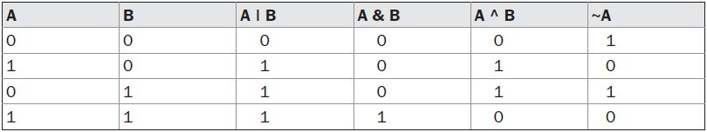
Bitwise Logical Operators
The bitwise logical operators are
~ (NOT)
& (AND)
| (OR)
^ (XOR)

Slide 18
The Left Shift Operator
The left shift operator,<<, shifts all of the bits in a value to the left a specified number of times.
value << num
Example:
65<< 2

Slide 19
The Right Shift Operator
The right shift operator, >>, shifts all of the bits in a value to the right a specified number of times. value >> num
It is also known as signed right shift.
Example:
36 >> 2

Slide 20
Operator Precedence
Highest
( ) | [] | .
++ | -- | %
+ | -
>> | >>> | <<
> | >= | < | <=
== | !=
&
^
|
&&
||
?:
= | Op=
Lowest

Slide 21
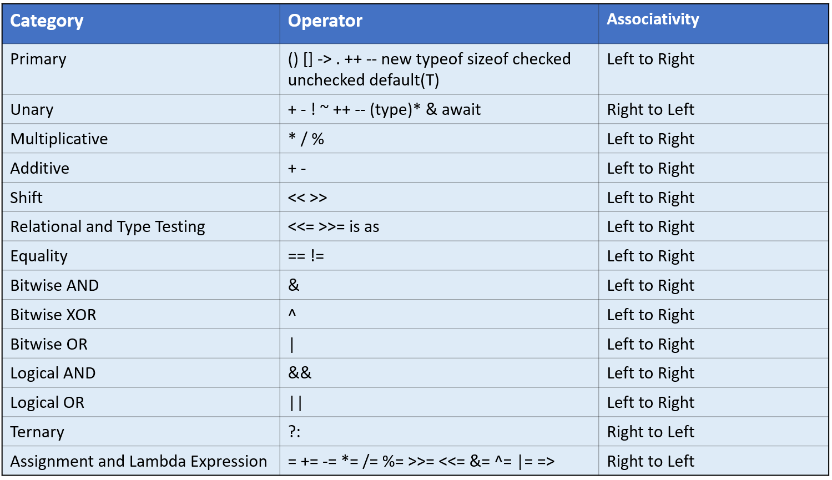

Slide 22
Brainstorming 1
What will be the output of the following code snippets?
byte b = 30; System.out.println(~b);
byte b = -53; System.out.println(~b);
System.out.println(34>>3);
System.out.println(-34>>3);
System.out.println(34<<3);

Slide 23
Brainstorming 2
int x = 10, y = 5;
if(x- - > 7 || + + y < 8 ){
System.out.print(x);
System.out.print(y);
}
95
67
78
48
77
N.O.T

Slide 24
Brainstorming
int x = 3, y = 5;
if(x-- > 7 || ++ y < 8 ){
System.out.print(x);
System.out.print(y);
}
35
25
27
37
47
N.O.T

Slide 25
Brainstorming 3
System.out.print(2>1||4>3?false:true);

Slide 26
Brainstorming 4
What is the result stored in x, after evaluating the following expression?
int x = 5;
x = x++ * 2 + 3 * –x;
Ans.:
x= -8

Slide 27
Brainstorming 5
Question: Write a program to check if a number is both positive and even.

Slide 28


