Slide 1
Inheritance

Slide 2
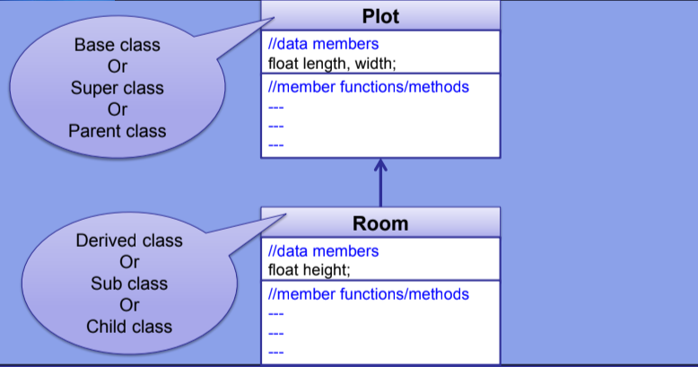
introduction

Slide 3

Syntax:

Slide 4
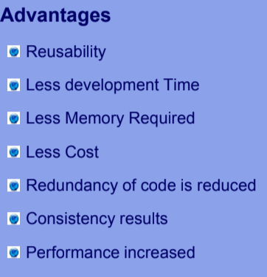

Slide 5
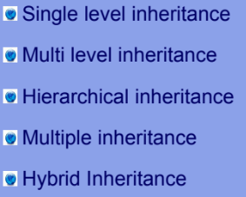
Types of inheritance

Slide 6
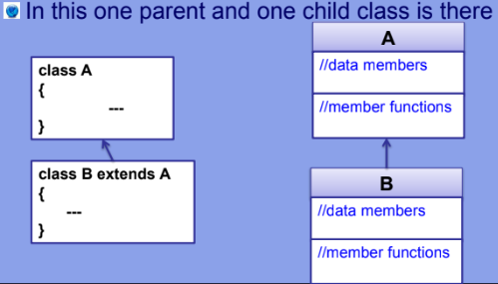
Single level inheritance

Slide 7
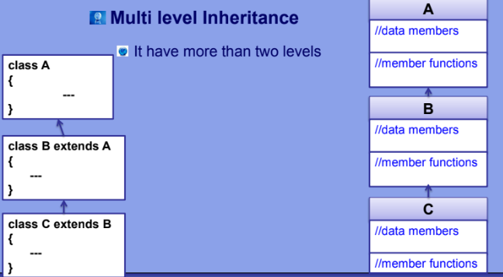

Slide 8
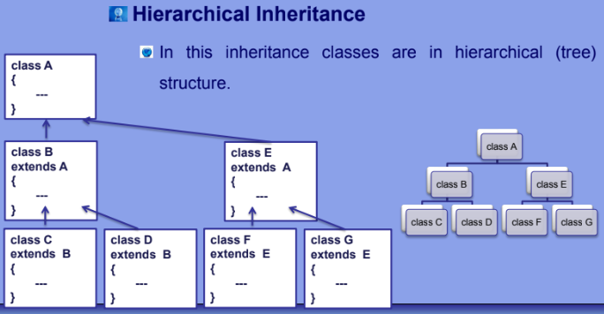

Slide 9
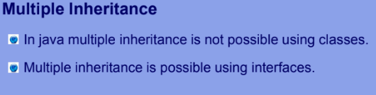

Slide 10
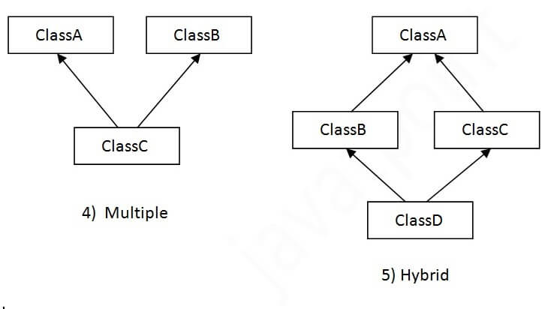

Slide 11
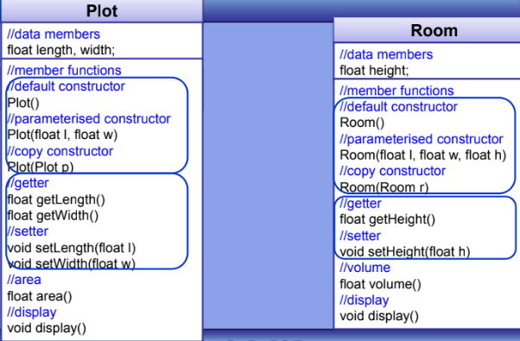
Code example

Slide 12
Question.
Create a base class Shape with a method draw() that prints "Drawing a shape". Create two derived classes:
Circle that overrides draw() to print "Drawing a circle"
Rectangle that overrides draw() to print "Drawing a rectangle"
Create objects of Circle and Rectangle in the main method and call their draw() methods.

Slide 13
Question
Create a base class Parent with a constructor that prints "Parent Constructor".
Create a derived class Child that calls the parent class constructor and prints "Child Constructor".
Create an object of Child in the main method.

Slide 14
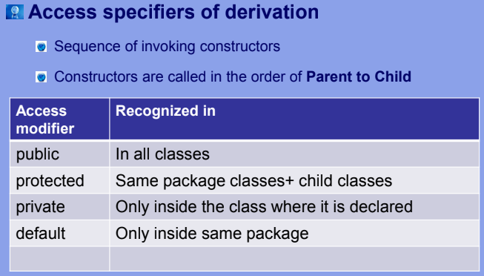
Access modifier

Slide 15
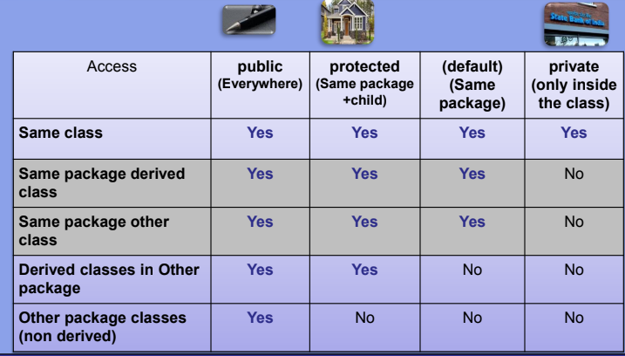

Slide 16
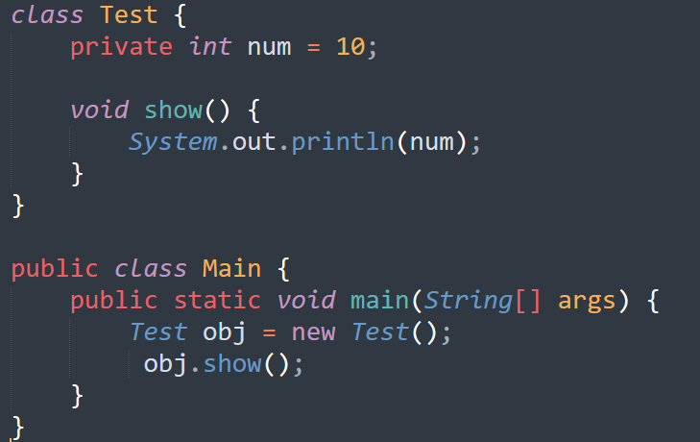
a) 10
b) Compilation Error
c) Runtime Error
d) 0

Slide 17
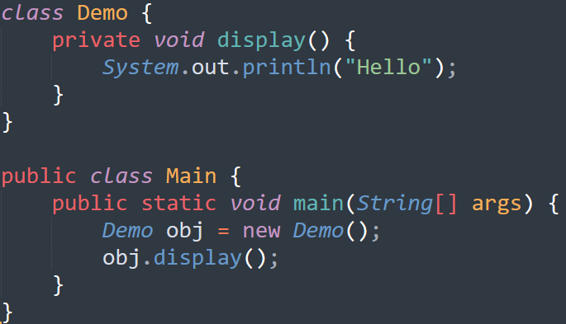
a) Change private to public
b) Create a public method to call display()
c) Make display() protected
d) Both (a) and (b)

Slide 18
Packages in java
A package in Java is used to group related classes. Think of it as a folder in a file directory.
Packages are divided into two categories:
Built-in Packages (packages from the Java API)
User-defined Packages (create your own packages)
Eg. import java.util.Scanner;
import package.name.*; // Import the whole package

Slide 19
package
A package is a namespace that organizes a set of related classes and interfaces. Conceptually you can think of packages as being similar to different folders on your computer.
Eg. import com.example.myproject.MyClass;
public class Main {
public static void main(String[] args) {
MyClass obj = new MyClass();
// use obj
}
}
MyClass is defined in the com.example.myproject package.

Slide 20
