Slide 1
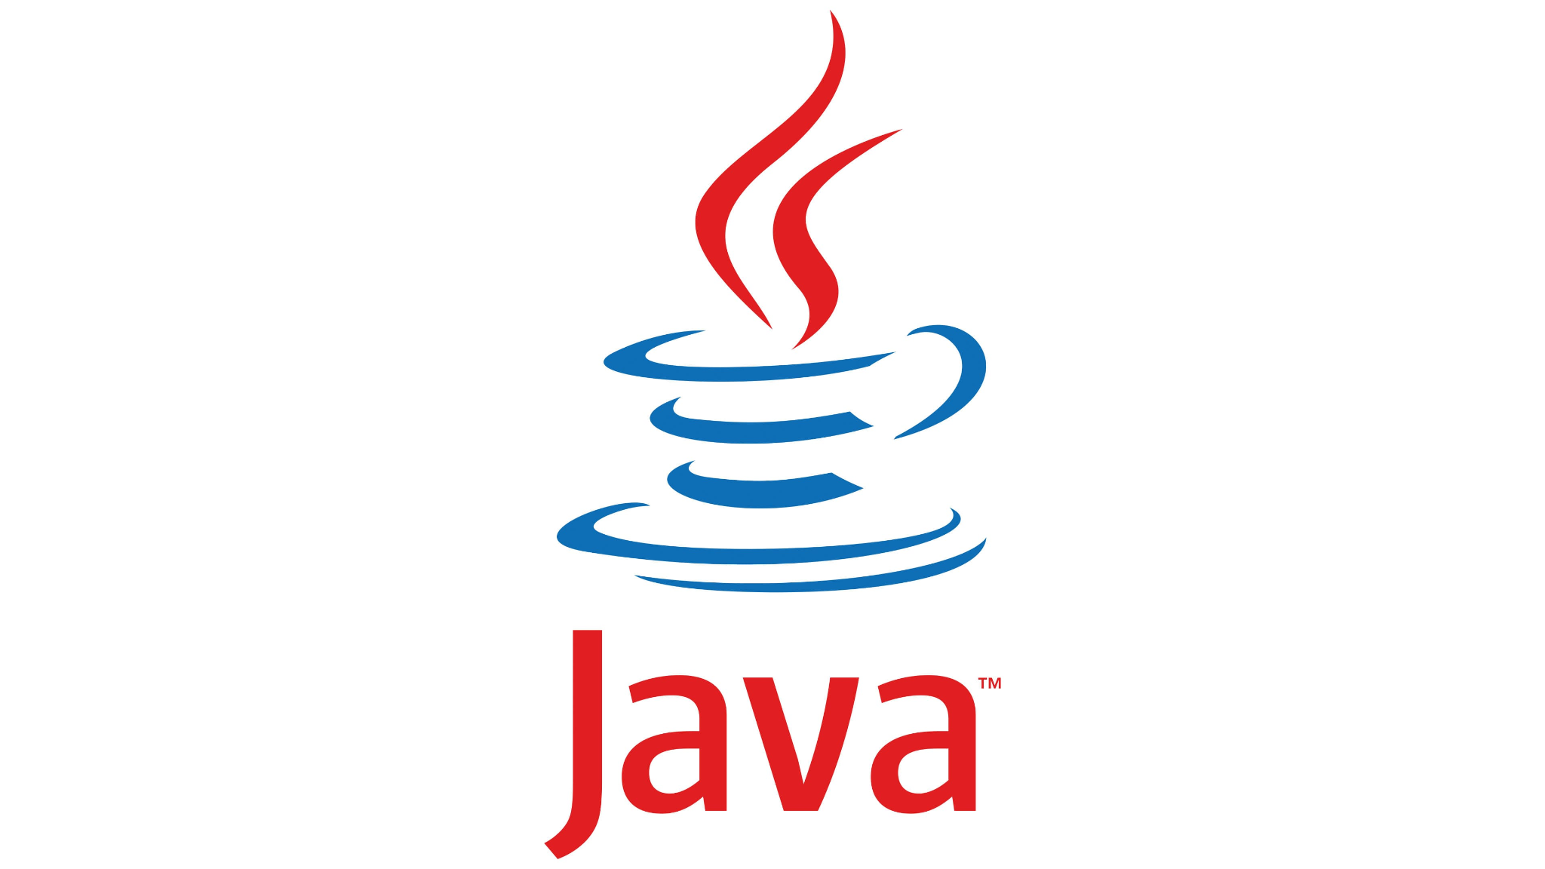
Introduction to Java Programming
Understanding the Basics of Java Programs

Slide 2
Introduction to Computer Programs
What is a Program?
=>A sequence of instructions written to perform a specific task.
Importance of Computer Programs:
Solves problems efficiently
Enhances productivity
Programming Languages:
Tools used to write programs (e.g., Java, Python, C++)

Slide 3
Key Features of the Java Language
Platform Independence: "Write Once, Run Anywhere" (WORA)
Object-Oriented: Based on classes and objects
Portable: Runs on any device with Java Virtual Machine (JVM)
Multithreaded: Supports concurrent execution
Robust and Secure: Exception handling and strong memory management

Slide 4
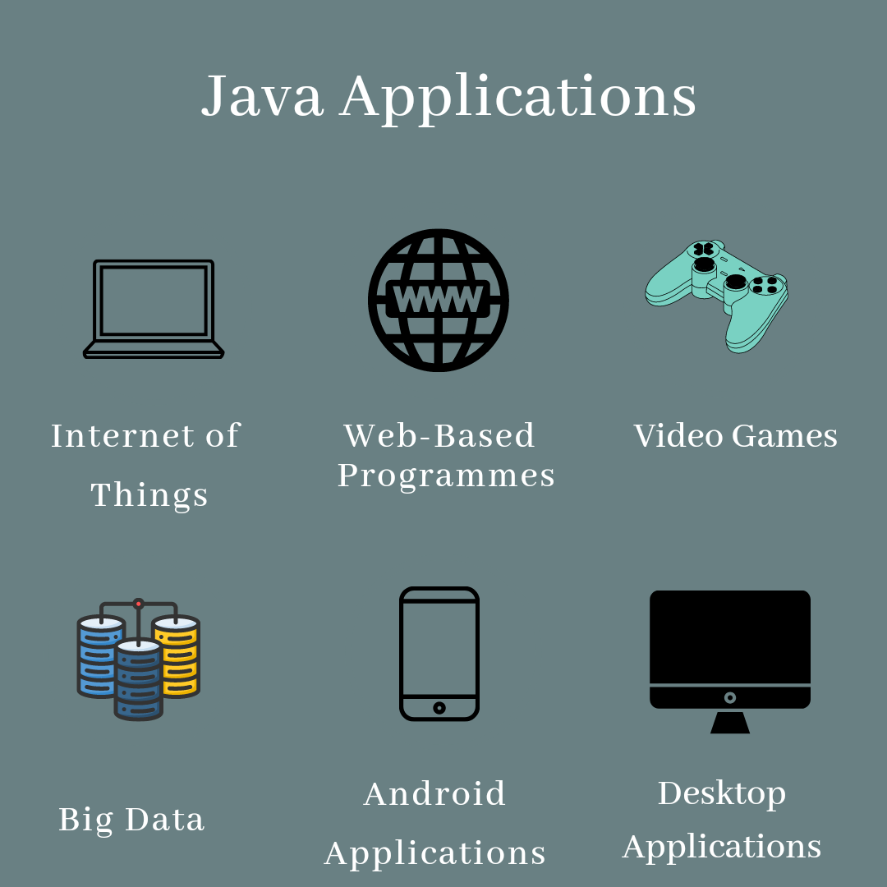
The Java Technology and Development Environment
What is Java?
a programming language and computing platform
Java Ecosystem
JVM (Java Virtual Machine): Executes Java bytecode.
JRE (Java Runtime Environment): Provides runtime environment.
JDK (Java Development Kit): Tools for developing Java applications.
Applications of Java:

Slide 5
Running/Testing a Java Program
Steps to Run a Java Program
Write code in a file with .java extension.
Compile using javac filename.java.
Run using java filename.
Common Errors
Compilation errors (syntax issues)
Runtime errors (logical issues)
Debugging tips
Testing Java Programs
Use unit testing frameworks like JUnit.

Slide 6
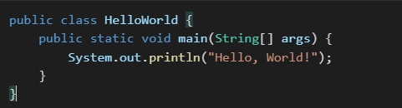
Example Java Program

Slide 7
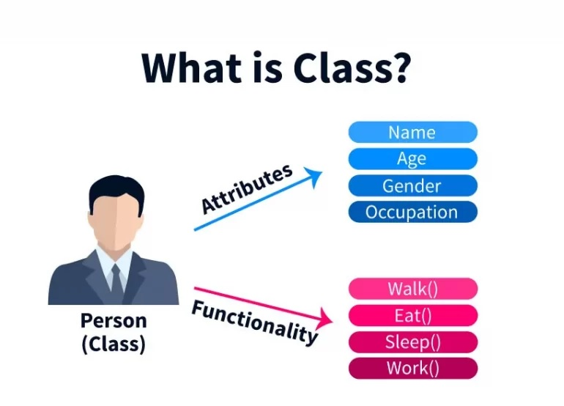
Introduction to Java Classes

Slide 8
What is a Java class?
A blueprint for creating objects. Defines attributes (fields) and behaviors
(methods). Components of a Class:
Fields(attribute): Variables to store data.
Methods: Functions that define the behavior.

Slide 9
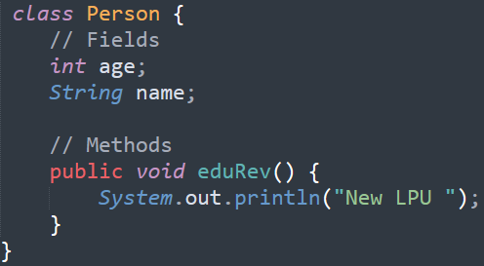
Syntax of a Java Class

Slide 10

The main method
Purpose of the main Method:
Entry point of a Java application.
JVM looks for public static void main(String[] args) to start execution.
Syntax:

Slide 11
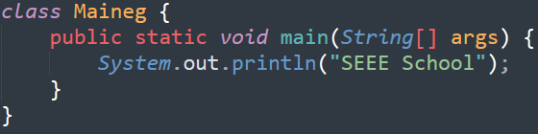
Example: Java Main Class
Steps to Run:
Save as Maineg.java.
Compile using javac Maineg.java.
Run using java Maineg.

Slide 12
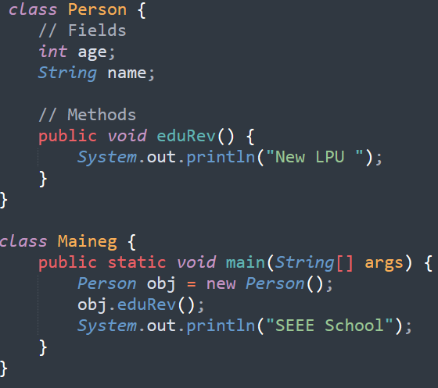
Combining Classes and main Method

Slide 13
The main() is mandatory for execution.

Slide 14
Take input from the user
Import java.util.scanner;
Class Main{
public static void main(String[] args)
{
Scanner sc = new Scanner(System.in);
// Enter first input
System.out.print("Enter First Number: ");
int a = sc.nextInt();
}
}

Slide 15
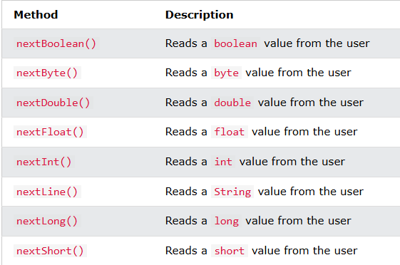

Slide 16
Steps to Set Up Java Environment
Download and install JDK.
Configure environment variables (e.g., PATH).
Choose an Integrated Development Environment (IDE): Eclipse, IntelliJ IDEA, or NetBeans.
Writing Your First Java Program
Use a text editor or IDE

