Slide 1


Programming in Java
The kick start session
Lecture #0

Slide 2


Programming in JAVA
Text Book:
PROGRAMMING WITH JAVA: A PRIMER by E. BALAGURUSAMY
Reference Books:
INTRODUCTION TO JAVA PROGRAMMING by Y. DANIEL LIANG
JAVA THE COMPLETE REFERENCE by HERBERT SCHILDT

Slide 3
Vision and Mission of University
Vision: To be a premier academic institution, recognized internationally for its contribution to industry and society through excellence in teaching, learning, research, internationalization, entrepreneurship and leadership.
Mission:
To transform education through academic rigour, practical orientation and outcome based teaching.
To develop and implement a relationship of cooperation between industry and academia.
To undertake impactful research addressing local, national and global challenges.
To prepare graduates to be lifelong learners with strong analytical and leadership skills.
To develop global professionals and entrepreneurs with innovative spirit, tolerance and desire to make a difference to the society.

Slide 4
Vision and Mission of SEEE
Vision: To become one of the leading Schools globally in Electronics and Electrical Engineering recognized for its academics and innovations by nurturing professionals, researchers and entrepreneurs for sustainable growth of industry and society.
Mission:
To provide a learning-based environment on technical concepts applied to real-life situations with measurable outcomes.
To establish connections with the industry for curriculum design, and creating internship cum career opportunities.
To address societal issues related to regional, national and global challenges through meaningful research.
To inspire graduates for pursuing lifelong learning in professional careers.
To develop leadership potential in ethically competent entrepreneurs.

Slide 5
Program Outcomes as specific to the particular course
PO-1:Engineering knowledge::Apply the knowledge of mathematics, science, engineering fundamentals, and an engineering specialization to the solution of complex engineering problems.
PO-2: Problem analysis::Identify, formulate, research literature, and analyze complex engineering problems reaching substantiated conclusions using first principles of mathematics, natural sciences, and engineering sciences.
PO-3:Design/development of solutions::Design solutions for complex engineering problems and design system components or processes that meet the specified needs with appropriate consideration for the public health and safety, and the cultural, societal, and environmental considerations.
PO-4:Conduct investigations of complex problems::Use research-based knowledge and research methods including design of experiments, analysis and interpretation of data, and synthesis of the information to provide valid conclusions.
PO-5: Modern tool usage::Create, select, and apply appropriate techniques, resources, and modern engineering and IT tools including prediction and modeling to complex engineering activities with an understanding of the limitations
PO-8:Ethics::Apply ethical principles and commit to professional ethics and responsibilities and norms of the engineering practice.
PO-9:Individual and team work::Function effectively as an individual, and as a member or leader in diverse teams, and in multidisciplinary settings.
PO-10: Communication: Communicate effectively on complex engineering activities with the engineering
PO-11: community and with society at large, such as, being able to comprehend and write effective reports and design documentation, make effective presentations, and give and receive clear instructions.
PO-12: Life-long learning::Recognize the need for, and have the preparation and ability to engage in independent and life-long learning in the broadest context of technological change.

Slide 6
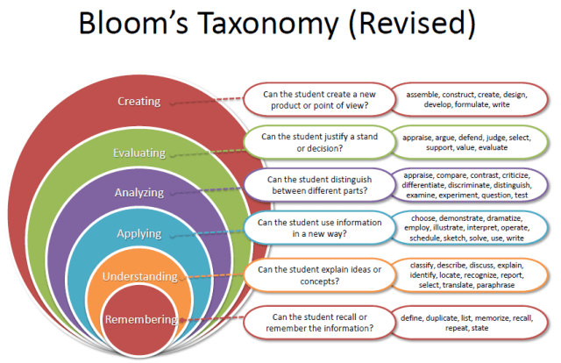
Revised Bloom’s Taxonomy
Notes:
‹#›

Slide 7


Course Contents?

Slide 8

Course Contents
Introduction to Java, Data In the Cart, Operators, Conditional Statements
Loops, Arrays and Enums, OOP Concepts, String Class
Inheritance and Polymorphism, Abstract Class and Interface
Functional Interface and Lambda Expressions, Nested Class, Utility Classes
Exceptions and Assertions, IO Fundamentals
Collections and Generics

Slide 9
Course Details
L T P - 0 0 4
Credit - 2

Slide 10
Complete evaluation criteria for the course
•CSE380 Marks break up*
•Attendance 5
•CA (Two only) 25
•MTT 20
•ETE 50
Total 100

Slide 11
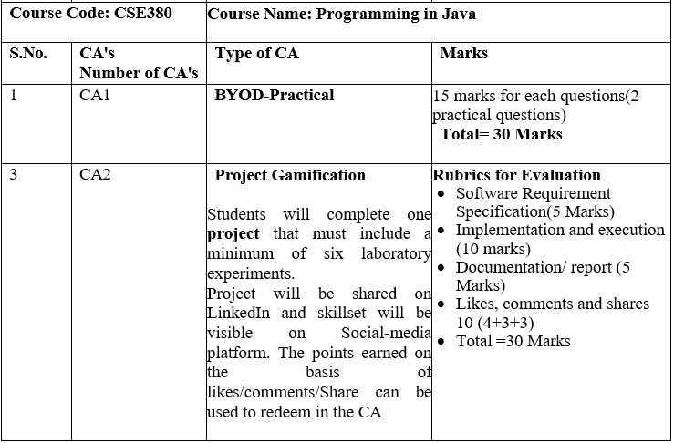

Slide 12
Why Star Course?
Industry demand
Product Based
Service Based

Slide 13
Course Outcomes
CO1:explain basic constructs of Java programming and apply them to solve the real-world problems
CO2: Illustrate the Object-oriented programming principles to write efficient and reusable codes.
CO3:demonstrate the concept of inheritance to reuse and extend the features of existing class with access control
CO:4 contrast the uses of abstract classes, interfaces and Lambda expressions
CO5: use of exception handling and input/output techniques to improve the robustness and reliability of Java applications
CO6: integrate collections and generics to ensure clean, robust, and maintainable Java code

Slide 14
Software Requirement
JDK 1.8
Notepad/Command Prompt
Netbeans IDE

Slide 15

Professional Benefits
Expand your knowledge base and validate your skills to appeal to potential employers.
Improve your potential earning power to command a higher salary.
Learn to perform complex, hands-on activities through lab, study and practice sessions.
Gain exposure to a wide variety of important features, functions and tasks to use on the job.

Slide 16
SkillSet
Programming Skills
Code analysis

Slide 17


Next Class: Introduction to Java

