Slide 1
STANDARDS AND PROTOCOLS

Slide 2
1. Organizations For Communication Standards
Standards are developed by cooperation among
standards creation committees, forums, and
government regulatory agencies.
Standards Creation Committees
International Standards Organization (ISO)
International Telecommunications Union (ITU)
American National Standards Institute (ANSI)
Institute of Electrical and Electronics Engineers (IEEE)
Electronic Industries Association (EIA)
Internet Engineering Task Force (IETF)

Slide 3
a) International Standards Organization (ISO)
A multinational body whose membership is drawn mainly from the standards creation committees of various governments throughout the world
Dedicated to worldwide agreement on international standards in a variety field.
Currently includes 82 memberships industrialized nations.
Aims to facilitate the international exchange of goods and services by providing models for compatibility, improved quality, increased quality, increased productivity and decreased prices.

Slide 4
b) International Telecommunications Union (ITU)
Also known as International Telecommunications Union-Telecommunication Standards Sector (ITU-T)
An international standards organization related to the United Nations that develops standards for telecommunications.
Two popular standards developed by ITU-T are:
i) V series – transmission over phone lines
ii) X series – transmission over public digital networks, email and directory services and ISDN.

Slide 5
c) American National Standards Institute (ANSI)
A non-profit corporation not affiliated with US government.
ANSI members include professional societies, industry associations, governmental and regulatory bodies, and consumer groups.
Discussing the internetwork planning and engineering, ISDN services, signaling, and architecture and optical hierarchy.

Slide 6
d) Institute of Electrical and Electronics Engineers (IEEE)
The largest national professional group involved in developing standards for computing, communication, electrical engineering, and electronics.
Aims to advance theory, creativity and product quality in the fields of electrical engineering, electronics and radio.
It sponsored an important standard for local area networks called Project 802 (eg. 802.3, 802.4 and 802.5 standards.)

Slide 7
e) Electronic Industries Association (EIA)
An association of electronics manufacturers in the US.
Provide activities include public awareness education and lobbying efforts in addition to standards development.
Responsible for developing the EIA-232-D and EIA-530 standards.

Slide 8
f) Internet Engineering Task Force (IETF)
Concerned with speeding the growth and evolution of Internet communications.
The standards body for the Internet itself
Reviews internet software and hardware.

Slide 9
2. Communication Protocols
Definition
Protocol is a set of rules that govern all aspect of data communication between computers on a network.
These rules include guidelines that regulate the following characteristics of a network: access method, allowed physical topologies, types of cabling, and speed of data transfer.
A protocol defines what, how, when it communicated.
The key elements of a protocol are syntax, semantics and timing.
Protocols are to computers what language is to humans. Since this article is in English, to understand it you must be able to read English. Similarly, for two devices on a network to successfully communicate, they must both understand the same protocols.

Slide 10
Elements of protocol
Syntax
The structure or format of the data.
Eg. A simple protocol;
Sender address
Receiver address
data
8 bits
8 bits
64 bits

Slide 11
ii) Semantics
- Refers to the meaning of each
section of bits.
- how is a particular pattern to be interpreted, and what action is to be taken based on that interpretation.
Eg. Does an address identify the route to be taken or the final of the message?

Slide 12
iii) Timing
Refers to two characteristics:
When data to be sent
How fast it can be sent
Eg. If a sender produces data at 100 Mbps but the receiver can process data at only 1 Mbps, the transmission will overload the receiver and data will be largely lost.

Slide 13
Characteristics of protocol
Direct / indirect
communication between two entities maybe direct or indirect.
i) point-to-point link
- connection provides a dedicated link between two devices
- the entities in these systems may
communicate directly that is data and
control information pass directly
between entities with no intervening
active agent.

Slide 14
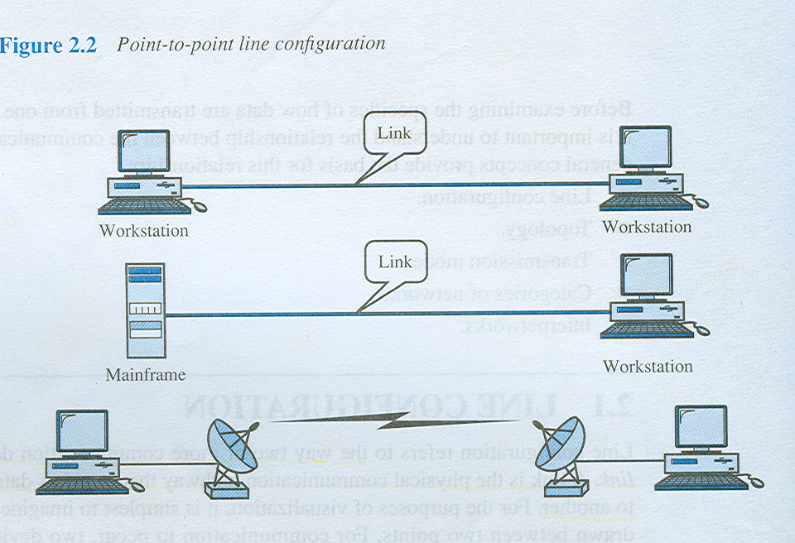
ii) multipoint link
- connection more than two devices can share a single link
- The entities must be concerned with the issue of access control and making the protocol more complex.

Slide 15
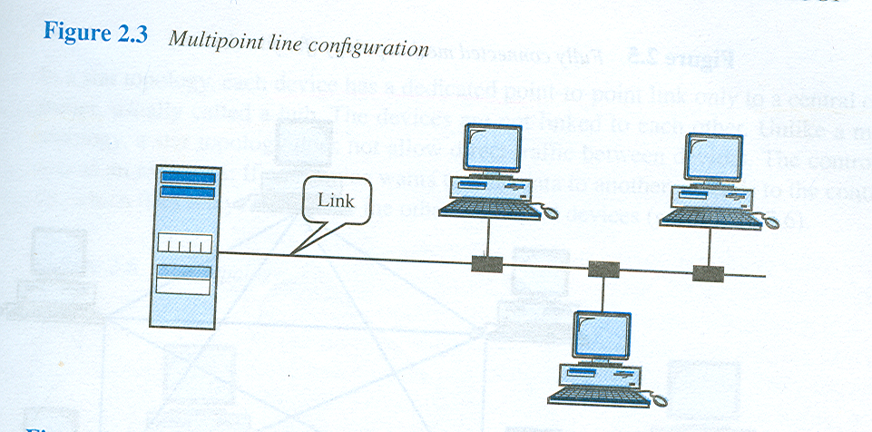
b) Monolithic / structured
- The task of communication between entities on different systems is too complex to be handled as a unit.

Slide 16
Eg. An electronic mail package running on two computers connected by a synchronous HDLC link. To be structured, the package would need to include all of the HDLC logic. If the connection were over a packet-switched network, the packaged would still need the HDLC logic to attach it to the network.

Slide 17
c) Symmetric / asymmetric
- Symmetric is the most use in
protocol and involve communication
between peer entities.
- Asymmetry may be dictated by the
logic of an exchange (eg; client and
a server process) the desire to keep
one of the entities or systems as
simple as possible.

Slide 18
d) Standard / nonstandard
If K different kinds of information sources have to communicate with L types of information receivers, as many as K x L different protocols are needed without standards and a total of 2 x K x L implementations are required
If all systems shared a common protocol, only K+L implementations would be needed.

Slide 19
Common protocol used
Protocol | Acronym | Remarks
Point To Point | PPP | Used to manage network communication over a modem
Transfer/Transmission Control Protocol | TCP / IP | Backbone protocol. The most widely used protocol.
Internetwork package exchange | IPX | Standard protocol for Novell NOS
NetBIOS extended user interface | NetBEUI | Microsoft protocol that doesn’t support routing to other network. Running only Windows-based clients.
File transfer Protocol | FTP | used to send and received file from a remote host
Simple mail Transfer protocol | SMTP | Used to send Email over a network
Hyper text transfer protocol | HTTP | Used for Internet to send document that encoded in HTML
Apple Talk | Apple Talk | Protocol suite to network Macintosh computer and a peer-to-peer network protocol
OSI Model | OSI Layers | A way of illustrating how information functions travels through network of its 7 layers.

Slide 20
3. Network Protocols
Simple Network Management Protocol (SNMP)
Allows simple maintenance and remote monitoring of any device on a network.
With SNMP, administrators can address issues such as problems with a network card in a server, a program, or service on the server, or a device such as a hub or a router.
When managing a network device using SNMP, an administrator can use the central management system and the management information base.
The management system allows the administrator to view performance and operation statistics of the network devices, enabling him to diagnose a network remotely.

Slide 21
b) User Diagram Protocol (UDP) Relay
A connectionless protocol that operates at the transport layer of the TCP/IP and OSI models.
UDP is an unreliable delivery service, it does not require receiving protocols to acknowledge the receipt of the packet.
The advantage of UDP is; it does not concentrate on establishing a connection, it can transmit more information in a smaller amount of time than TCP.

Slide 22
c) Virtual LAN(VLAN)
A logical grouping of network devices or users that are not restricted to a physical switch segment.
The devices or users in a VLAN can be grouped by function, department, and application, regardless of their physical segment location.
A VLAN creates a single broadcast domain that is not restricted to a physical segment and is treated like a subnet.

Slide 23
d) Routing Information Protocol (RIP)
- A protocol supplied with UNIX BSD systems.
Used to transfer routing information between routers that are located in the same domain.
RIP uses hop count as a routing metrics.
Allows the router to determine which path it will use to send, based on a concept known as distance-vector routing.

Slide 24
e) Open Shortest Path First (OSPF)
A link-state routing protocol based on open standards. A better description, might be “determination of optimum path” because this interior gateway protocol actually uses several criteria to determine the best route to a destination.
These criteria include cost metrics, which factor in such things as route speed, traffic, reliability, and security.

Slide 25
f) Quality Of Service (QoS)
Network management traffic
Provide traffic management on network particularly during times of congestion or failure.
QoS also give preferential treatment if a node does not reach the worth levels during the packets transmission.

