Slide 1
M3W1: Introduction to Supervised Machine Learning (SML)
& Linear Regression
Agenda:
Intro to Machine Learning
Supervised vs Unsupervised ML
Regression & Classification SML
Linear Regression Concepts
Case studies – USAirline Fare Analysis, Car-mpg
Q&A

Slide 2

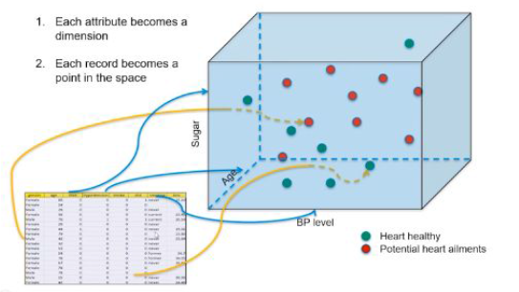
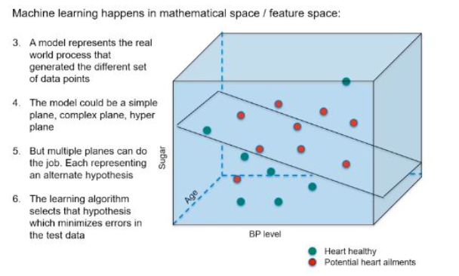
Machine Learning
World
(Data
Source)
Machine
Learning Model
Actionable inputs
Data
Learn
Associations
Trends
Cycles
Patterns
…
Predictions
Decision Science
Datasets
Mathematical Structures
To extract “Information”
Smart decisions
Data Science
Multi-dimensional (attributes) → data point

Slide 3
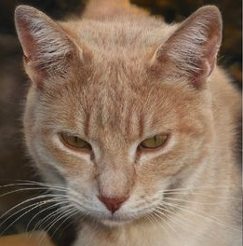
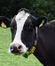
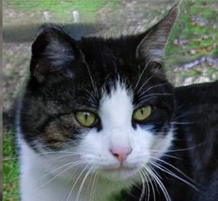
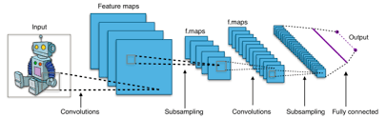

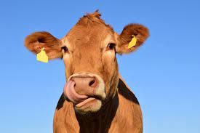
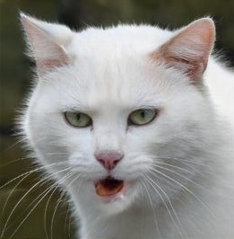


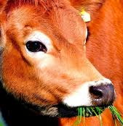

…..
-- -- --
Output
(Labels)
-- -- --
Supervised Machine Learning Illustration
Cat
Cow
Cat
Training Set
(Image-Label
pairs)
Classification model
Build
Machine Learning Model
(Mathematically relating input and output)
New Image input
Cow
Cat
Dog
Predict
Output
for new
Inputs
+
Dog
Test Set
Validate
Cow
Dog
? Label
Another Example
Concrete Strength = F(Cement mix, water%, sandmix%, Cement type,…)
-- -- --
-- -- --
…..
Regression model
Input – Images
(nxnx3 pixel data)
ML Model output

Slide 4
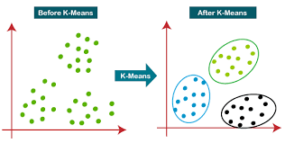
Unsupervised Machine Learning Illustration
--- ----
Machine Learning Model
K-means
--- ----
-- -- --
-- -- --
…..
--- ----

Slide 5

Supervised Machine Learning
Class of machine learning that work on externally supplied instances in form of predictor attributes and associated target values.
The target values are the ‘correct answers’ for the predictor model which can either be a regression model or a classification model (classifying data into classes.)
The model learns from the training data using these ‘correct answers/target variables’ as reference variables.
The model thus generated is used to make predictions about data not seen by the model before.
Ex1 : model to predict the resale value of a car based on its mileage, age, color etc.
Ex2 : model to determine the type of a tumor.
If the model does very well with the training data but fails with test data(unseen data), overfitting is said to have taken place. However, if the data does not capture the features of train data itself, we term it as under fitting.

Slide 6
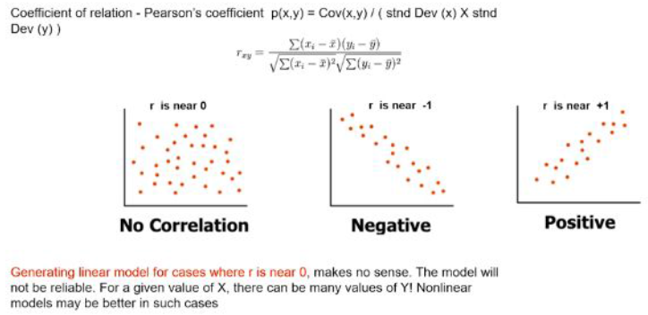

Measures of Association
Y
Rectangle is 2D
dispersion in data →
ΣRectangles
Covariance
Covariance is a measure of association between two variables.
It represents association in units of the two variables.
Correlation
Correlation is also a measure of association between two variables.
Moreover, it is a dimensionless quantity and thus enables comparison beyond units.
Coefficient of correlation is also known as Pearson’s coefficient
(X_{i}, Y_{i})
Std (Y)
Y
Cov (X_{i},Y_{i})
X
X
Std (X)
r_{xy}=Corr(X,Y) =$\frac{Cov (X,Y)}{Std\left(X\right)∗Std(Y)}$

Slide 7
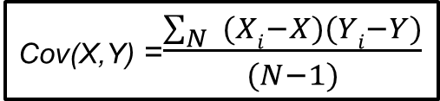
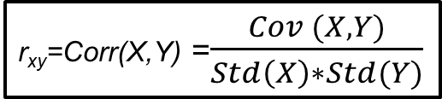
Recap of Applied Stats Week 1 Pearson’s Correlation
Y
Rectangle is 2D
dispersion in data →
Σ Area(Rectangles)
- X
X_{i}
(X_{i}, Y_{i})
Std (Y)
Y
Std_{y}
- X)² / (N-1)
Var =
Σ(X_{i}
Cov (X_{i},Y_{i})
X
Std_{x}
X
X
Std (X)
Std (X)
(X_{i}, X_{i})
X
Variance = Σ_{i} Area(Rectangles) / (N-1)
= Std_{x}²
Cov(X,Y) =$\frac{\sum_{N}{ (Xi−X})(Yi−Y)}{(N−1)}$
X
X
r_{xy}=Corr(X,Y) =$\frac{Cov (X,Y)}{Std\left(X\right)∗Std(Y)}$
Std (X)

Slide 8
Linear Regression
The term “Regression” generally refers to predicting a target value, which is generally a real number, for a data point based on its attributes.
The term “linear” in linear regression refers to the fact that the method models data with linear combination of the explanatory variables (attributes).
In case of linear regression with a single explanatory variable, the linear combination can be expressed as :
response = intercept + constant*explanatory variable

Slide 9
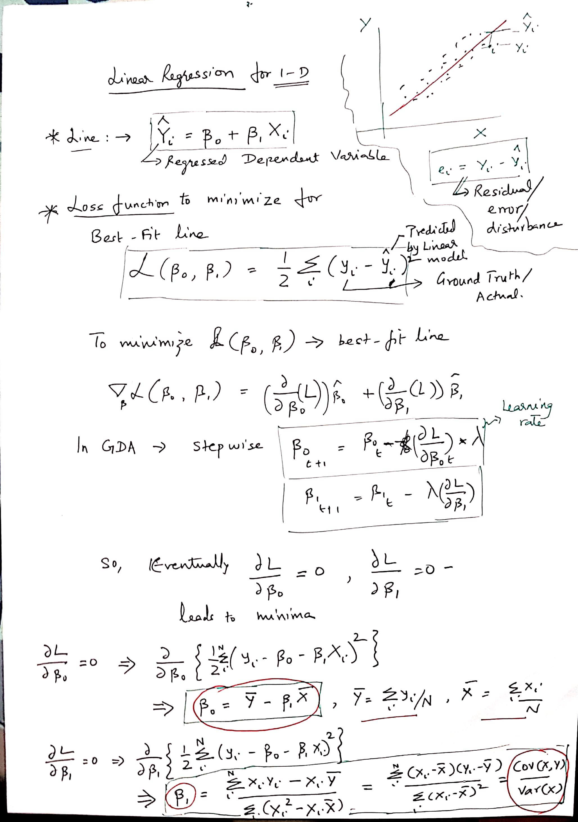
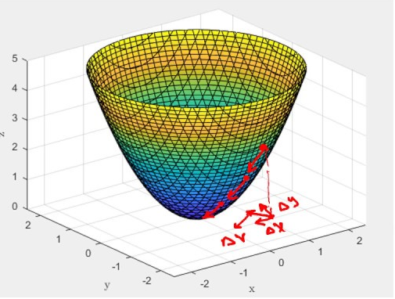
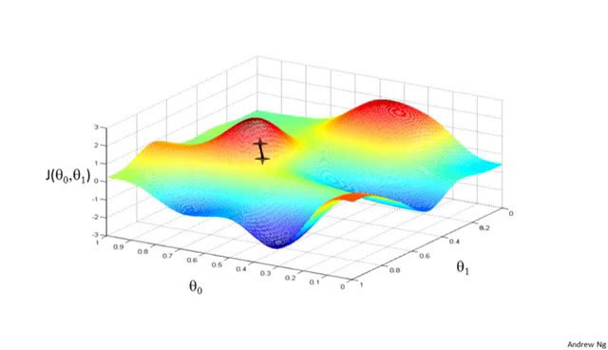
MINIMIZE LOSS FUNCTION
L & GRADIENT DESCENT
ALGORITHM
SSE
Ŷ_{i} = β₁X_{i} + β₀
e_{i} = Y_{i} – Ŷ_{i}
Y_{i}
Ŷ_{i}
e_{i}
β₁
β₀
Gradient Descent Algorithm
We can derive for
1-D →
X_{i}

Slide 10
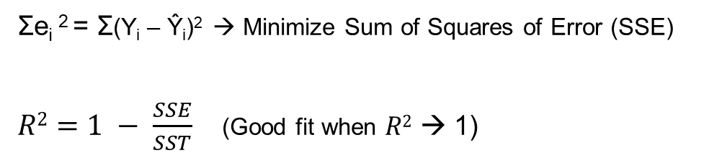
Best fit line using GDA
Y
Ŷ_{i} = β₁X_{i} + β₀
e_{i} = Y_{i} – Ŷ_{i}
Σe_{i} ² = Σ(Y_{i} – Ŷ_{i})² → Minimize Sum of Squares of Error (SSE)
$R2=1 − \frac{SSE}{SST}$ (Good fit when $R2$ → 1)
Y_{i}
e_{i}
Ŷ_{i}
Var(Y) = Σ(Y_{i} – Y)²
X
X_{i}

Slide 11
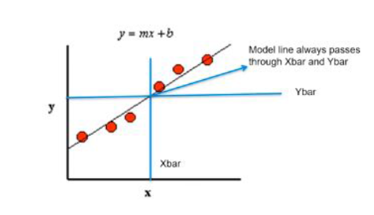
Best Fit Line
Learning from the data, the model generates a line that fits the data.
This line tries to explain the variance in the data.
Our aim is to find a regression line that best fits the data.
In the diagram below, we see the regression line. The red dots are the data points which constitute our data set.

Slide 12
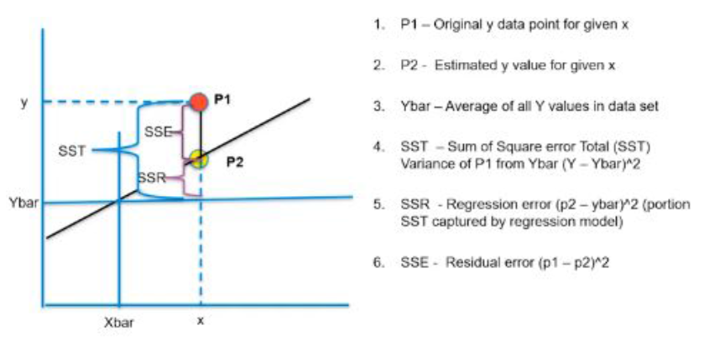
Best Fit Line Contd
R SQUARED VALUE
The r squared is considered a measure of goodness of a fit.
It is the portion of the variance in data that is covered by the model. This is given by -
R Squared = (SST-SSE)/SST
= SSR/SST
The picture shows the different measures of a fit.

Slide 13
Multiple regression
Till now we have seen a simple regression where we have one attribute or independent variable.
However, in the real world, a data point has various important attributes and they need to be catered to while developing a regression model.
Ex: predicting price of a house, we need to consider various attributes related with this house. Such a regression problem is an example of a multiple regression.
This can be represented by :
target = constant1*feature1 + constant2*feature2 + constant3*feature3 + …..+ intercept
The model aims to find the constants/ slope coefficients (m) and intercept (b) such that this line (hyperplane) is the best fit.
Ŷ is also termed conditional mean = E(Y_{i} | X_{i}), where Y_{i} - Ŷ = e_{i} (residual or error)
e_{i} is also termed as random error → catchall for all those variables that cannot be / is not included in the predictor variables (x1,x2,…,xn)
Best fit is obtained by minimizing the SSE = Σe_{i}² = Σ(Y_{i} – Ŷ_{i})² or maximizing R²
Watch out for multi-collinearity (p-value, VIF)
Ŷ = m1*x1 + m2*x2 + ….. + b

Slide 14
Case Study
Problem :
A certain bank wants to predict the credit loss based on the details provided by the customer while applying for loan. These details are Age, Years of Experience, Number of cars, Gender, Marital Status.
The objective is to come up with a regression model which can predict the credit loss based on the above parameters . Here are the details about the data set.

Slide 15
Case Study Contd.
Data Attributes:
Ac_no: The account of customer used as identifier.
Age: Age of the borrower
Years of experience: Working experience
Number of vehicles: Number of cars possessed
Gender: M/F
Losses in thousands: Target variable

Slide 16
Key Concepts
One-hot coding
Accuracy and robustness – both important for model (uniform variance assumption → homoscedasticity)
Error distribution is standard normal (Y = Ŷ + e), e→ (0, σ²)
Variables independent of each other in LR however if the variables are correlated → multi-collinearity (measured using p-value and VIF)
Error (Loss-function) minimization is achieved thru the Gradient-Descent Algorithm
Linear Regression concepts understanding easily scale to understanding polynomial and other regression forms

Slide 17
Pros and Cons of Linear Regression
Advantages
Simple to implement and easier to interpret the outputs coefficient.
Disadvantages
Assumes a linear relationships between dependent and independent variables.
Outliers can have huge effects on regression.
Linear Regression assume independence between attributes.

Slide 18
Case Study Contd.
Steps to follow:
Import libraries
Get the data
Find top 5 headings from the data
Plot histograms
Find the correlation between variables.
Drop variables which are of no use to the model.
Find the model using coefficients

Slide 19
References
https://towardsdatascience.com/machine-learning-an-introduction-23b84d51e6d0?gi=a05e6ebea37b
https://www.nature.com/articles/nmeth.4551
https://datajobs.com/data-science-repo/Supervised-Learning-[SB-Kotsiantis].pdf
http://www.utstat.toronto.edu/~brunner/books/LinearModelsInStatistics.pdf
https://towardsdatascience.com/simple-and-multiple-linear-regression-in-python-c928425168f9
https://towardsdatascience.com/introduction-to-machine-learning-algorithms-linear-regression-14c4e325882a
https://towardsdatascience.com/linear-regression-detailed-view-ea73175f6e86
https://towardsdatascience.com/linear-regression-using-gradient-descent-97a6c8700931

Slide 20

Thank You

