Slide 1
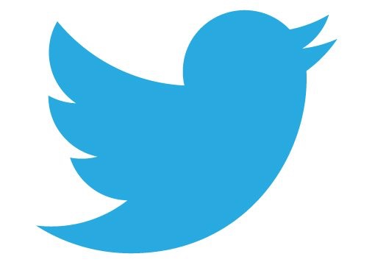
ANALYSIS OF EMOTIONS ON TWITTER
BLCU 2018
尤洁雪

Slide 2
MATERIALS
Twitter Samples corpus: free to use corpus, collected in July 2015
text processing: nltk
plotting: matplotlib
webpage: flask (work in progress, to be updated later)

Slide 3
TWITTER CORPUS
The Twitter Samples corpus is divided into two sub-corpora:
positive tweets and negative tweets. No metadata were provided.
All tweets were written in English
Analysis of the tweets can contain sentiment analysis, grammatical analysis, spelling,
lexical analysis, emoji use and more…

Slide 4
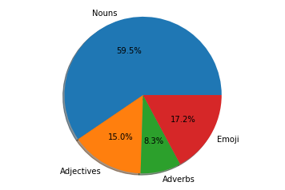
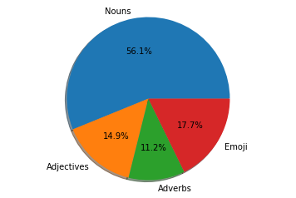
PART OF SPEECH ANALYSIS
Using automatic POC tagging + extra category of emoji
Counting noun, adjectives, adverbs and emoji
Pie chart of part of speech distribution:
Parts of speech in POSITIVE TWEETS. Parts of speech in NEGATIVE TWEETS

Slide 5
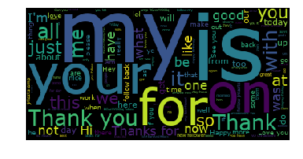
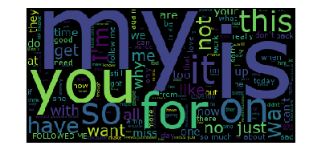
LEXICAL ANALYSIS
Positive tweets:
Thankful
Good
Negative tweets:
asking “why”
focused on what we “want”

Slide 6
LEXICAL ANALYSIS
Positive verbs: LOVE, HOPE
have was used 342 times
be was used 249 times
follow was used 186 times
are was used 184 times
love was used 136 times
know was used 135 times
get was used 132 times
do was used 129 times
see was used 98 times
Have was used 88 times
go was used 70 times
am was used 67 times
want was used 66 times
hope was used 63 times
Negative verbs: WANT, CAN’T, DON’T
have was used 306 times
be was used 240 times
want was used 193 times
miss was used 171 times
get was used 165 times
are was used 157 times
do was used 156 times
go was used 131 times
can't was used 124 times
know was used 121 times
don't was used 100 times

Slide 7
LEXICAL ANALYSIS
Positive nouns (incl. pronouns):
Thanks was used 204 times
day was used 202 times
thanks was used 178 times
Hi was used 141 times
Thank was used 129 times
i was used 115 times
time was used 105 times
today was used 104 times
Friday was used 92 times
Negative nouns (incl. pronouns):
i was used 397 times
ME was used 165 times
time was used 136 times
PLEASE was used 131 times
FOLLOWED was used 102 times
today was used 100 times
@justinbieber was used 92 times
day was used 91 times
please was used 84 times
people was used 70 times
work was used 66 times

Slide 8
EMOJI ANALYSIS
Positive tweets: SMILE, HEART
:) was used 3691 times
:-) was used 701 times
:D was used 658 times
:p was used 138 times
<3 was used 135 times
❤ was used 29 times
;) was used 27 times
♥ was used 19 times
😂 was used 17 times
💕 was used 12 times
Negative tweets: SAD, CRY, but also HEARTS
:( was used 4585 times
:-( was used 501 times
>:( was used 47 times
😭 was used 30 times
<3 was used 25 times
😂 was used 24 times
♥ was used 22 times
❤ was used 21 times
😩 was used 14 times
:'( was used 13 times

Slide 9
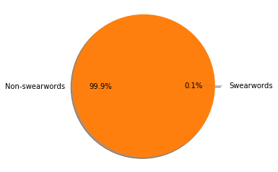

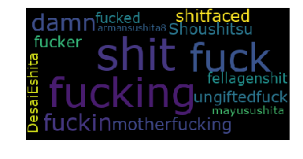
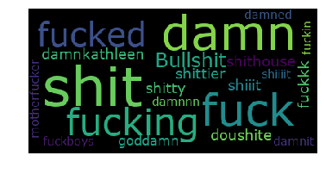
LEXICAL ANALYSIS: SWEARWORDS
Profanities can convey various emotions
Positive tweets: less swearwords than in negative tweets
shitty, bullshit exclusive to negative tweets
fucking, motherfucking more prominent in positive tweets

