Slide 1
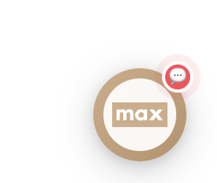
AI CHATBOT
Architecture Overview
Landmark Group · Private Cloud · 2026
1

Slide 2
Agenda
1
Self-Hosting Advantage
5
What We Are Offering
2
Tech Stack
6
Why No Third-Party Chatbots
3
Architecture Diagram
7
Developer Experience & Comparison
4
Flow Diagram
8
Cost & Pricing
2

Slide 3
Self-Hosting Advantage
Fully hosted on Landmark's private cloud infrastructure
Zero customer data shared with any third-party vendor
Full data sovereignty — conversation history, order data & profiles never leave LMG servers
No vendor lock-in — we own the code, the model calls, and the data
Compliant with internal data governance and security policies
Full control over uptime, scaling, and access permissions
3

Slide 4
Tech Stack
Layer | Technology
Backend | Spring Boot 3.5.6 · Java 21
AI Orchestration | Spring AI 1.0.3
Language Model | OpenAI GPT-4o-mini (intent classification + responses)
Relational DB | MySQL — clients, analytics, ingest jobs
Vector DB | Redis — semantic RAG search + response caching
Cache | Caffeine — 1hr TTL, chatbot + intent cache
4

Slide 5
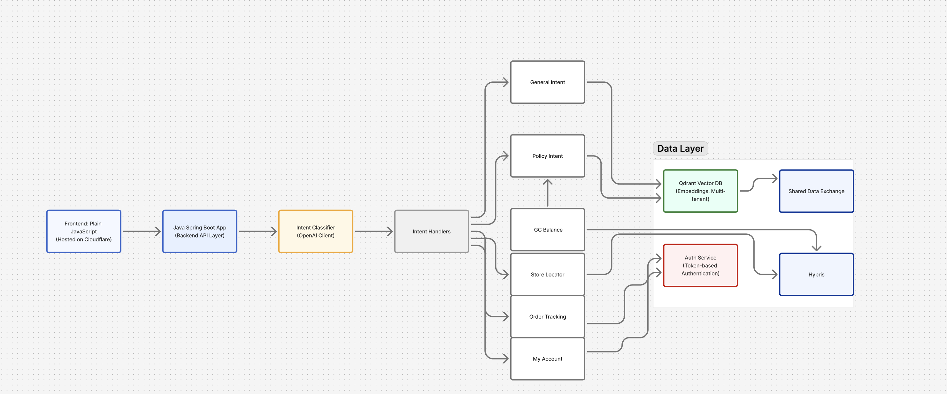
Architecture Diagram
[ Insert Architecture Diagram Here ]
5

Slide 6
Flow Diagram
User Message
→
Pattern Matcher
→
Intent Classifier · GPT-4o-mini
ORDER_TRACKING
→ Hybris Order API
ORDER_LISTING
→ Hybris Orders API
STORE_LOCATOR
→ Store API
GIFT_CARD_BALANCE
→ Gift Card API
CUSTOMER_PROFILE
→ Profile API
POLICY_QUESTION
→ Redis Vector DB (RAG)
GENERAL_QUERY
→ GPT-4o-mini
ChatbotResponse<T>
→
Widget Renderer
→
User
6

Slide 7
What We Are Offering
Flow-Based (Menu & Submenu)
Free Text (Natural Language)
Structured navigation with clickable categories
Main Menu → Submenu → Action
No typing required
Track Order · Store Locator · Gift Card · Write to Us · My Profile
Ideal for guided navigation
User types anything in their own words
AI automatically classifies the intent
Routes to the correct handler + API
Handles typos, variations, mixed queries
No rigid structure required
7

Slide 8
Why Not Third-Party Chatbots
Aspect | LOIPL (Ours) | SaaS
Data Privacy | ✅ Private cloud, zero sharing | ❌ Data sent to vendor
Brand Customisation | ✅ Full control, multi-brand | ⚠️ Limited to platform templates
API Integration | ✅ Direct Hybris/OMS/CRM, no middleware | ❌ Requires connectors / webhooks
Cost | ✅ Only OpenAI token cost | ❌ Monthly SaaS licensing fees
Vendor Lock-in | ✅ None — we own the code | ❌ Locked to vendor platform
Custom Intent Logic | ✅ Any business rule possible | ❌ Constrained by platform
8

Slide 9
Developer Experience & Comparison
Adding a new feature in LOIPL — 5 steps · ~1–2 hours
Create DTO (response shape)
Create Tool — API caller with @Tool annotation
Create Intent Handler — @Component implements IntentHandler
Add one bullet to Intent Classifier prompt
Spring auto-discovers — zero manual wiring
Framework | Effort to Add New Intent
LOIPL | ~1–2 hrs · Java · no retraining
Dialogflow | NLU training + webhook config + entity setup
Rasa | Training data + ML retraining + pipeline rebuild
LangChain | Python chains + custom memory + tool wiring
Generic SaaS Bot | Platform UI config + no direct API access
9

Slide 10
AI Chatbot Cost Summary
Estimated for 1,000 Requests / Day
Cost Per Request
Total Cost
Component | Cost
Intent Classification (LLM) | $0.00025
RAG Response (LLM) | $0.00032
Embedding | $0.000002
Total per request | ~$0.00057
Usage | Estimated Cost
Daily (1,000 requests) | ~$0.57
Monthly | ~$17
Yearly | ~$205
Key Highlights
▸ No platform or licensing fees
▸ Pay-per-use model — token-based billing only
▸ Predictable, linear scaling with traffic
▸ Enterprise-grade AI at very low operating cost
10

