Slide 1
PROBLEM STATEMENT
NPS 2025: 38% of customers complained about frontliners quality answer.
EES 2025 shows why, with 36% of 1,200 frontliners unable to easily find the answer.
1,200
38%
36%
> 20 mins
frontliners on the front line
of customers complained · NPS H1 2025
cannot find the answer · EES 2025
searching, per case, per RM
BEFORE · WHAT DOES THE RM NEED TO KNOW?
DURING · WHO IS THE RM WITH, AND WHAT TO ADVISE?
AFTER · WHAT TO OFFER, AND WHAT DID THE RM LEARN?
01 PRODUCT KNOWLEDGE
03 CUSTOMER 360
05 NEXT BEST RECOMMENDATION
TODAY
TODAY
TODAY
PDF manuals and intranet pages, mixed in with expired documents
A desk-only system; none of it travels to the meeting
Judgement and memory, one RM at a time
WHAT IT COSTS
WHAT IT COSTS
WHAT IT COSTS
Frontliners cannot easily find the answer
The RM meets the customer without their full picture
Offers stay generic; cross-sell is left on the table
02 LIVE PROMOTIONS
04 ADVISORY TOOLS
06 VOICE: WHAT WAS SAID
TODAY
TODAY
TODAY
Email blasts; the latest version is whoever's inbox
Spreadsheets on a laptop, back at the branch
A call report typed up later, if it is typed at all; nothing is captured while it is still fresh
WHAT IT COSTS
WHAT IT COSTS
WHAT IT COSTS
Expired offers are still quoted at the counter
Advice waits until after the conversation has ended
What the customer said is lost before the next meeting
THE COST COMPOUNDS: the customer waits, the offer is generic, and what they told us is gone before the next meeting.
ORBIT · Omnichannel Relationship and Banking Intelligence Tool
01

Slide 2
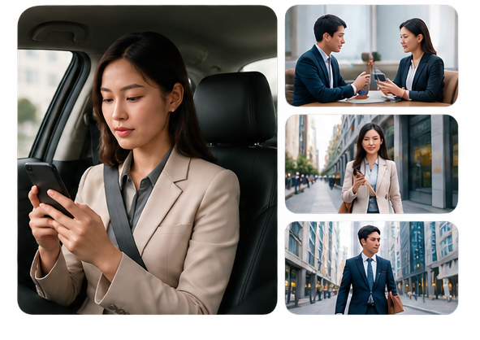

PROBLEM STATEMENT · WHO THE RM IS
RMs work away from their desks and differ widely in age and comfort with technology, so an assistant that is desk-bound or text-only will miss most of them
HIGH MOBILITY
DIVERSE AGE AND TECH LITERACY
RMs spend most of their time outside the office
Not all RMs are comfortable or efficient with text-based chatbot interaction
THE TOOL HAS TO GO WHERE THE RM GOES: mobile first, and voice as well as text, or it reaches only part of the front line.
ORBIT · Omnichannel Relationship and Banking Intelligence Tool
02

Slide 3

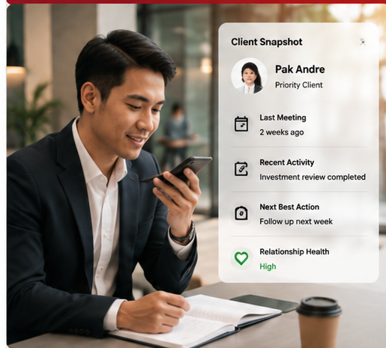
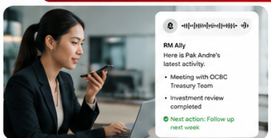

PROPOSED SOLUTION · ORBIT
ORBIT fixes every one of these problems: one platform that holds everything an RM needs
ORBIT
Works on the move
Better prepared for every conversation
one tool, five capabilities
Hands-free access
Product & promo wiki
Access information on the move
Customer 360
Faster to get information
Less reading and typing
Next best recommendation
60+ words → 20–30 words
Conversation: voice & text
Inclusive for all RMs
Easier for every RM to use
Memory of every meeting
More natural for different ages & tech familiarity
ORBIT · Omnichannel Relationship and Banking Intelligence Tool
03

Slide 4
ORBIT · SEE IT IN ACTION
ORBIT in action: one RM's day end to end, from the first meeting to a personalised pitch deck built from what the customer said
Click to play. Everything after the opening is the live application, with real model output.
ORBIT · Omnichannel Relationship and Banking Intelligence Tool
04

Slide 5
COST & BENEFIT ANALYSIS · PROJECTION
On projection, ORBIT returns far more each month than it costs to run: hours released back to the front line, and new-to-product sales opened
COST
FINANCIAL BENEFIT 1 · PRODUCTIVITY VALUE
FINANCIAL BENEFIT 2 · NTP (NEW TO PRODUCT)
FINANCIAL BENEFIT
CAPEX · ONE OFF
Cases handled
18,000 / month
Cases handled
18,000 / mo
PRODUCTIVITY VALUE
Database, 500 GB
Handling: today → ORBIT
~20 min → 1 min
×
Ask what to buy *
10% = 1,800
IDR 342 Mio
One off. Amount not yet costed
hours released, not cash
OPEX · PER YEAR
=
Time saved per case
19 min
×
Accept and buy *
10% = 180
Database IT direct charge
3 MD
=
Hours released
5,700 h / month
×
Value per purchase *
IDR 2.5 Mio
NTP REVENUE
Develop ORBIT
30 MD
IDR 450 Mio
Deployment
15 MD
×
Value of an hour
IDR 60,000
* Assumption
new product sales
Cloudera licence
IDR 200 Mio
18,000 x 19 min / 60 x IDR 60,000
18,000 x 10% x 10% x IDR 2.5 Mio
Running cost
− IDR 20 Mio
Cloudera maintenance
IDR 6 Mio
IDR 342 Mio / month
IDR 4.1 Bio / year
IDR 450 Mio / month
IDR 5.4 Bio / year
A YEAR OF COST, COVERED BY NTP IN
IDR 240 Mio a year
Under a month
IDR 20 Mio a month
The two are not added: one is time, one is cash.
NON-FINANCIAL BENEFIT
1
2
3
4
5
Faster customer service
Consistent, accurate information
Higher frontliner productivity
Less dependence on Product Owners
Better customer experience
Waiting and response time both come down
One source; expired terms are never quoted
Time returns to selling and serving
Fewer escalations for routine answers
Answered in the conversation, first time
ORBIT · Omnichannel Relationship and Banking Intelligence Tool
05

Slide 6
PATH TO VALUE CAPTURE
Capturing the value takes integration, upskilling and a changed workflow; the risk to manage is a full customer view travelling on a phone
PATH TO VALUE CAPTURE · WHAT HAS TO CHANGE
ENABLER 1
ENABLER 2
ENABLER 3
ENABLER 4
INTEGRATION
UPSKILLING
WORKFLOW CHANGE
ADOPTION & MEASUREMENT
Connect the product content, core banking and the customer feeds so one tool holds product, promo and customer
RMs learn to ask in plain words and to capture by voice. Light, because voice needs no training
The call report becomes a voice note, the pitch deck becomes one click, and the day starts from the ranked list
Track usage and outcomes so the hours released and the sales opened can be evidenced
WHAT IT UNLOCKS
WHAT IT UNLOCKS
WHAT IT UNLOCKS
WHAT IT UNLOCKS
One source behind every answer
Every RM can use it, whatever their tech literacy
Time saved becomes time actually released
The benefit can be proven, not claimed
CHALLENGES · DATA, ACCESS AND RISK
1
2
3
4
Data feeds and integration
Access rights
Customer 360 on a phone
Data stays inside, and is traceable
HOW IT IS MANAGED
HOW IT IS MANAGED
HOW IT IS MANAGED
HOW IT IS MANAGED
The customer 360 is only as good as the systems behind it.
Sequence the feeds before the rollout.
An RM sees only their own book.
Entitlements enforced at the source, not inside the app.
· Supervisor approval away from the branch, time limited
· Session bound: nothing cached, screenshots blocked
· Sensitive fields masked by default
· Every view logged against the RM and the customer
It runs inside the bank's own network; nothing leaves the perimeter.
Every answer cites its document and every view is attributable.
ORBIT · Omnichannel Relationship and Banking Intelligence Tool
06

Slide 7
APPENDIX · ARCHITECTURE AND TECH STACK
Four layers, each replaceable on its own: the model can move on-prem without touching the app, and the app can change without touching the data
EXPERIENCE
ORBIT web app
Voice in, voice out
Phone, tablet, desktop
what the RM touches
INTELLIGENCE
Qwen ASR: speech to text
Chat orchestration
Librarian: walks the wiki
Qwen TTS: text to speech
what listens, answers and speaks
DOMAIN
RM service: customers, portfolios, holdings
Transactions and interaction history
what it knows about the customer
DATA AND MODEL
Wiki corpus: product and promo
Customer and portfolio data store
Qwen 3.8 27B
what it runs on
TECH STACK
Python + FastAPI
React
Qwen 3.8 27B
Librarian, chat orchestration, customer and portfolio APIs
ORBIT web app
The language model, on-prem capable
Qwen ASR
Qwen TTS
Wiki corpus
Speech to text, so the RM can just talk
Text to speech, for answers read back
One document per page, every answer cited
ORBIT · Omnichannel Relationship and Banking Intelligence Tool
07

Slide 8
APPENDIX · BENEFIT AND COST ESTIMATION
How every figure in this deck was arrived at, with the formula behind each one
Cost or benefit | Type | Metric, and the formula | Assumption and source | Confidence
CAPEX, one off | Cost | Database, 500 GB | Storage provisioning for the wiki corpus and the system of record. Not yet costed | Low
OPEX, per year | Cost | IDR 240 Mio a year, IDR 20 Mio a month 3 MD + 30 MD + 15 MD + IDR 200 Mio + IDR 6 Mio = IDR 240 Mio | Database IT direct charge 3 MD, develop ORBIT 30 MD, deployment 15 MD, Cloudera licence IDR 200 Mio, Cloudera maintenance IDR 6 Mio | Medium
Productivity value | Quantified | 5,700 hours a month, IDR 342 Mio a month, IDR 4.1 Bio a year 18,000 x 19 min / 60 x IDR 60,000 | 18,000 cases a month; 20 min today to 1 min; IDR 60,000 an hour | Medium
New-to-product revenue | Quantified | 180 purchases a month, IDR 450 Mio a month, IDR 5.4 Bio a year 18,000 x 10% x 10% x IDR 2.5 Mio | 1 in 10 ask what to buy, 1 in 10 of those buy, IDR 2.5 Mio each | Medium
Faster customer service | Qualitative | Waiting and response time at the counter | Follows from the handling-time reduction above | Medium
Consistent, accurate information | Qualitative | Variance between answers; expired offers quoted | One sourced wiki; every answer cites its document | High
Higher frontliner productivity | Qualitative | Share of time serving rather than searching | Same basis as the productivity value | Medium
Less dependence on Product Owners | Qualitative | Routine escalations a month | Fewer escalations once answers are self-serve | Medium
Better customer experience | Qualitative | NPS and first-contact resolution | NPS H1 2025: 38% complained about the answers given | Medium
ORBIT · Omnichannel Relationship and Banking Intelligence Tool
08

