Slide 1





ARCHITECTURE REVIEW
IN SHORT
Chat in the app
TANYA AI
customers ask in the app's chat
Safe first
every message is checked first
Architecture overview
Understands the need
works out what the customer wants
A safe, helpful assistant in the bank's app
Trusted answers
only the bank's own information
Always looked after
two sites, watched by support teams
October 2026

Slide 2
EXECUTIVE SUMMARY
TANYA AI answers customers safely, from grounded facts, on two active sites
Chat in the app
customers ask TANYA AI through Tencent Chat
1
Safe first
two guard models screen every message
2
Smart routing
the Router LLM works out what the customer needs
3
Grounded answers
replies use only facts from RM Ally and BE OM
4
Always watched
two active sites, monitored in Grafana with L1–L3 support
5
Source: TANYA AI architecture
2

Slide 3
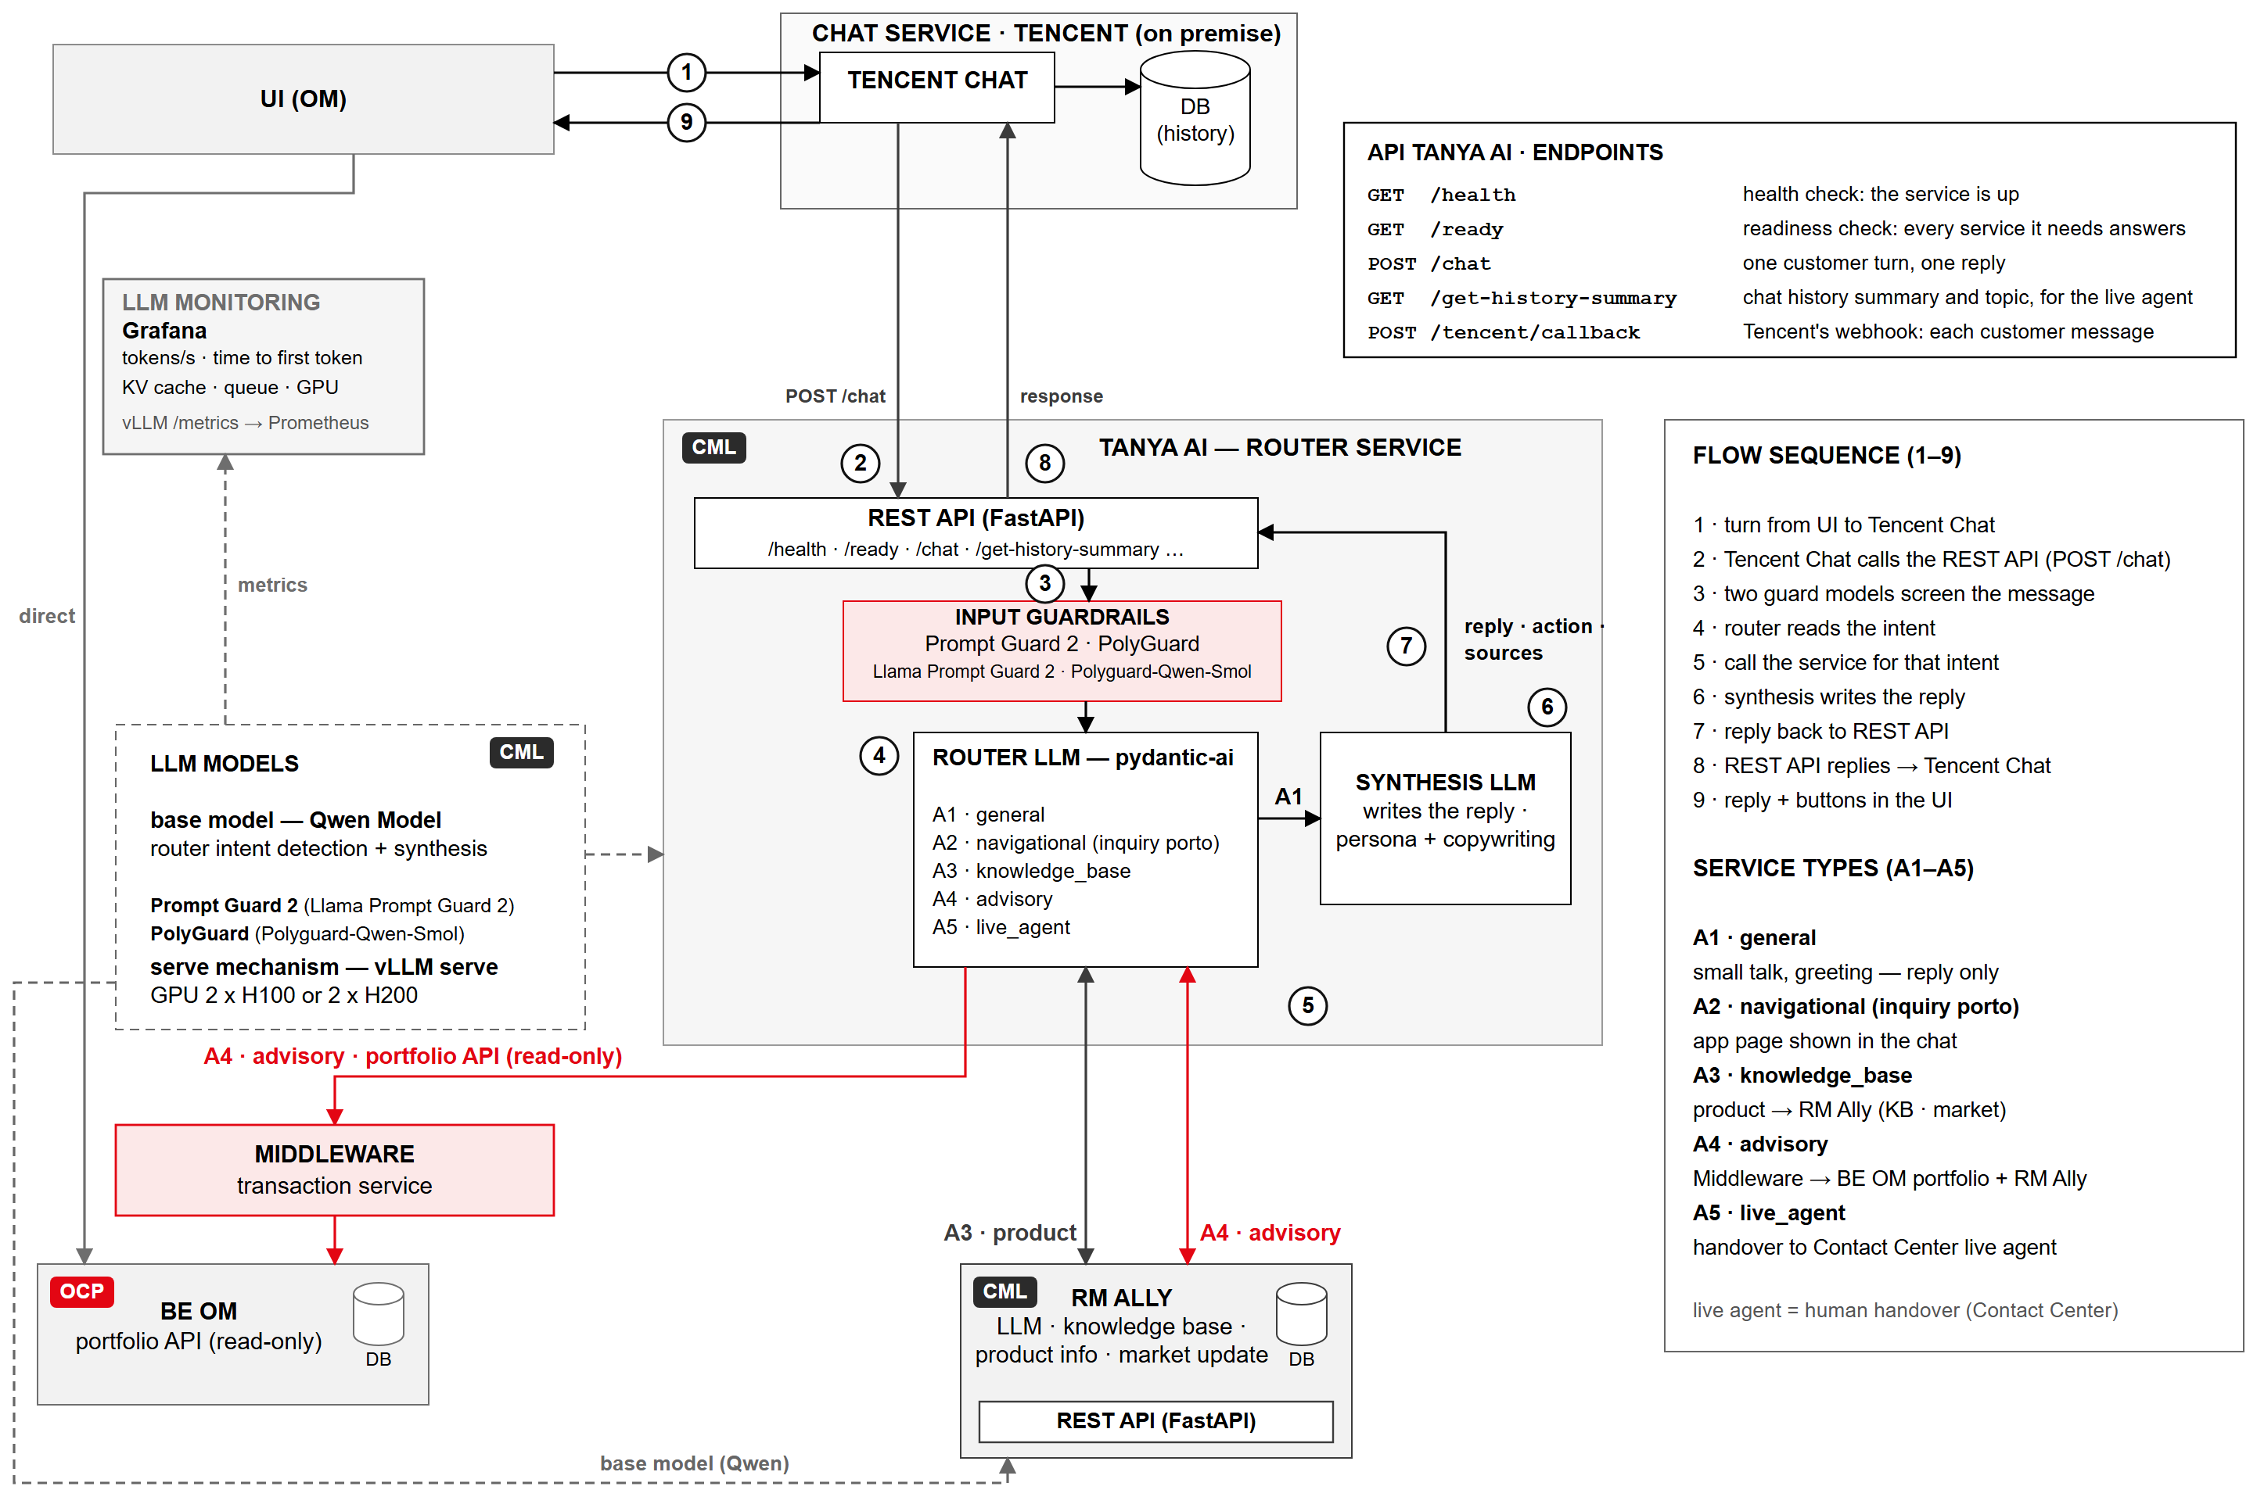
ARCHITECTURE OVERVIEW
TANYA AI screens, routes and grounds every turn Tencent Chat hands it
Key takeaways
1
Tencent Chat is the chat service: it calls the REST API directly (POST /chat) and gets the reply back
2
Prompt Guard 2 and PolyGuard screen every message in parallel before the Router LLM picks one or more of five intents
3
Answers stay grounded: RM Ally for products; advisory joins the BE OM portfolio with RM Ally
Source: TANYA AI architecture v3
3

Slide 4
ARCHITECTURE · HOW A MESSAGE FLOWS
Every message is screened first; then its history and intent are read in parallel
in parallel
TANYA AI
Tencent Chat and the app
1
2
3
4a
4b
5
6
7
8
Customer chats
Tencent sends
Guardrails screen
Read history
Classifier
Call tools
Synthesis LLM
Reply sent
Customer sees it
types a message in the app
Tencent Chat passes the message to TANYA AI
two guards check for attacks and harmful content
the Router reads recent chat from Tencent as context
the Router LLM decides what the customer wants
fetch the facts: app pages, products, portfolio
writes the reply from what the tools returned
TANYA AI posts the reply back to Tencent Chat
the reply appears in the app's chat
OM app
Tencent Chat
Prompt Guard 2 · PolyGuard
Tencent chat history
Router LLM
RM Ally · BE OM
Synthesis LLM
Tencent Chat
OM app
refused → polite decline, stop
So what the guards see every message first; history and intent come in parallel; the reply uses only what the tools returned
Source: TANYA AI architecture v3
4

Slide 5
ARCHITECTURE · TENCENT INTEGRATION
Tencent delivers each customer message to the Router through a signed webhook
Tencent → Router · deliver the message (Group.CallbackAfterSendMsg)
POST /tencent/callback?RequestTime=…&Sign=…
{
"CallbackCommand": "Group.CallbackAfterSendMsg",
"GroupId": "t1790749600a1b2c3d4e5f6",
"Type": "Private",
"From_Account": "budi",
"Operator_Account": "budi",
"Random": 170595681,
"MsgId": "144115233406643804-1790749679-170595681",
"MsgSeq": 3,
"MsgTime": 1790749679,
"OnlineOnlyFlag": 0,
"MsgBody": [{
"MsgType": "TIMTextElem",
"MsgContent": { "Text": "cara top up e-money gimana?" }
}],
"CloudCustomData": "{\"v\":1,\"source\":\"app\"}",
"EventTime": "1790749679123"
}
Router answers
{"ActionStatus":"OK","ErrorCode":0,"ErrorInfo":""}
Key fields
Sign
sha256(callback token + RequestTime), checked first
GroupId
the chat thread: the message's group
From_Account
the customer who wrote
MsgId
a MsgId seen before is ignored
So what Tencent gets a 200 OK; the Router handles the turn in the background, task by task
Source: TANYA AI workflow (localhost:5175) · General Workflow, step 2
5

Slide 6
ARCHITECTURE · TENCENT INTEGRATION
Inside the Router: screen first, then history and intent in parallel, then tools and reply
in parallel
1
Screen
2a
Read history
2b
Classify
3
Call tools
4
Write the reply
TASK 4
TASKS 1–3
TASKS 5–6
TASKS 7–9
TASKS 10–11
the guard models and the site's own patterns: injection, content, jailbreak
build the turn, find the thread by its GroupId, read its latest messages
from the message: what kind of turn, its language and topic, which app pages
API OM: the customer's money and transactions · RM Ally: the knowledge wiki
one generation from the persona and the briefing; then follow-ups and the title
+
IN THE WORKFLOW EXAMPLE
IN THE WORKFLOW EXAMPLE
IN THE WORKFLOW EXAMPLE
IN THE WORKFLOW EXAMPLE
IN THE WORKFLOW EXAMPLE
refused → stop
a polite decline; nothing is read or routed
the thread's recent messages
context for the LLM models
intent
knowledge_base
sources
RM Ally
“Deposito bisa dibuka mulai Rp 8.000.000 dengan tenor 1, 3, 6 atau 12 bulan.”
chip: Bedanya deposito dan tabungan?
title: Syarat buka deposito
Then task 12 sends the reply into the thread's group; task 13 names the thread on its first reply
Source: TANYA AI workflow (localhost:5175) · General Workflow, step 2, tasks 1–11; order shown: screen first, history and classify in parallel
6

Slide 7
ARCHITECTURE · TENCENT INTEGRATION
The Router reads the thread's chat history from Tencent, as context for the LLM models
Router → Tencent · read this thread's conversation
POST {TANYA_TENCENT_BASE_URL}/v4/group_open_http_svc/group_msg_get_simple
?sdkappid={SDKAppID}&identifier=administrator&usersig={UserSig}&random={uint32}&contenttype=json
{
"ActionStatus": "OK", "ErrorCode": 0, "ErrorInfo": "",
"GroupId": "t1790749600a1b2c3d4e5f6", "IsFinished": 1,
"RspMsgList": [
{ "From_Account": "tanya_ai", "MsgSeq": 4, "MsgBody": [{ "MsgType": "TIMTextElem",
"MsgContent": { "Text": "Aku sambungkan ke live agent ya, mereka sudah
menerima percakapan ini." } }] },
{ "From_Account": "budi", "MsgSeq": 3, "MsgBody": [{ "MsgType": "TIMTextElem",
"MsgContent": { "Text": "iya, mau ngobrol sama orang" } }] },
{ "From_Account": "tanya_ai", "MsgSeq": 2, "MsgBody": [{ "MsgType": "TIMTextElem",
"MsgContent": { "Text": "Wah, itu perlu dicek. Mau aku sambungkan
ke live agent?" } }] },
{ "From_Account": "budi", "MsgSeq": 1, "MsgBody": [{ "MsgType": "TIMTextElem",
"MsgContent": { "Text": "kartu kreditku ketagih dua kali" } }] }
]
}
Request
{ "GroupId": "t1790749600a1b2c3d4e5f6", "ReqMsgNumber": 20 }
Key fields
ReqMsgNumber
20 a page, newest first
TANYA_HISTORY_MESSAGES
how many recent messages the Router keeps, starting at a customer message
RspMsgList
the turn's chat history: context for the LLM models
GroupId
nothing is filtered: every message in the group is this thread's
So what the models answer with the conversation so far; Tencent is the only store of the chat
Source: TANYA AI workflow (localhost:5175) · General Workflow, step 2, task 3; response abridged (IsPlaceMsg, MsgPriority, MsgRandom, MsgTimeStamp, CloudCustomData left out)
7

Slide 8
ARCHITECTURE · GUARDRAILS
Two guard models screen every message in parallel, and one refusal is enough to stop routing
in parallel
Customer message
from Tencent Chat
Prompt Guard 2
yes
Router LLM
Llama Prompt Guard 2 · attacks
Both pass?
one verdict per guard
routes the turn to its services
PolyGuard
no
Main model sees the refusal
Polyguard-Qwen-Smol · toxicity
writes a polite decline; nothing is routed
Prompt Guard 2
PolyGuard
Model: Llama Prompt Guard 2 · attacks on the assistant
Model: Polyguard-Qwen-Smol · toxicity prompts, small multilingual
Catches
prompt injection: 'ignore your instructions', instructions hidden in pasted text
jailbreak attempts: role-play and 'pretend you are' tricks to slip the rules
Why the models must only ever follow the bank's instructions, never the customer's
Catches
harmful or unsafe requests: violence, self-harm, hate, illegal activity
multilingual: Bahasa Indonesia and English alike, and mixed messages
Why customers write in their own language; an English-only guard misses most of it
So what both guards pass → the Router LLM routes the turn · either refuses → the main model declines
Source: TANYA AI Router service; Llama Prompt Guard 2 and Polyguard-Qwen-Smol model cards
8

Slide 9
ROUTER · HOW IT DECIDES
The AI understands each request; the bank's own code then fetches the answer safely
1
Understand
2
Check
3
Fetch
4
Answer
the AI reads the message and decides what the customer needs
that plan is checked against the list of allowed actions
the bank's code calls the systems, never the AI itself
the reply uses only the facts that were fetched
The customer wants… | What TANYA AI does | Where the facts come from
to chat or say hello | replies in a friendly way | no lookup needed
a page in the app (e.g. check portfolio) | shows the right app page in the chat | the list of app pages
to know about a product | answers from the product information | RM Ally (product wiki)
advice on their portfolio | combines their portfolio with product information | BE OM and RM Ally
to talk to a person | hands the chat to a live agent, once the customer agrees | the live agent team
Design rule the AI only suggests what to do; the bank's code makes every call, with safety checks
Source: TANYA AI Router service design
9

Slide 10
ARCHITECTURE · TENCENT INTEGRATION
The Router sends the reply into the same chat group, as tanya_ai
Router → Tencent · send the reply
POST {TANYA_TENCENT_BASE_URL}/v4/group_open_http_svc/send_group_msg
?sdkappid={SDKAppID}&identifier=administrator&usersig={UserSig}&random={uint32}&contenttype=json
{
"GroupId": "t1790749600a1b2c3d4e5f6",
"From_Account": "tanya_ai",
"Random": 1287658,
"MsgBody": [{
"MsgType": "TIMTextElem",
"MsgContent": { "Text": "Deposito bisa dibuka mulai
Rp 8.000.000 dengan tenor 1, 3, 6 atau 12 bulan." }
}],
"CloudCustomData": "{\"v\":1,\"source\":\"tanya-ai\",
\"request_id\":\"6f1c2a9e-3b7d-4e21-9a55-0c8d7e4f1b20\",
\"intent\":\"knowledge_base\",\"action\":null,
\"sources\":[\"RM Ally\"],
\"chips\":[\"Bedanya deposito dan tabungan?\"],
\"title\":\"Syarat buka deposito\"}",
"ForbidCallbackControl": ["ForbidBeforeSendMsgCallback",
"ForbidAfterSendMsgCallback"]
}
Tencent answers
{"ActionStatus":"OK","ErrorCode":0,"ErrorInfo":"",
"MsgTime":1790749722,"MsgSeq":4}
Key fields
From_Account
tanya_ai, as TIMTextElem, into the thread's group
CloudCustomData
the action, sources, follow-ups (chips) and title; nothing names the thread
ForbidCallbackControl
keeps this write from coming back as a new turn
Then task 13: on the thread's first reply, the title becomes the group's Name (modify_group_base_info)
Source: TANYA AI workflow (localhost:5175) · General Workflow, step 2, task 12
10

Slide 11
INFRASTRUCTURE · DEPLOYMENT
TANYA AI runs active-active on two sites: 2 × H200 in the data centre and 2 × H100 at the DR site
TANYA AI (Router)
guards · router · synthesis call the models
both sites active
PRIMARY · DATA CENTRE
DR SITE · ACTIVE
vLLM serve Qwen 27B Flash Next (FP8) + guard models
vLLM serve Qwen 27B Flash Next (FP8) + guard models
failover
either site
GPU 1
tensor
GPU 2
GPU 1
tensor
GPU 2
H200 141 GB
H200 141 GB
H100 80 GB
H100 80 GB
parallel 2
takes all traffic
parallel 2
GPU MEMORY · 282 GB TOTAL
GPU MEMORY · 160 GB TOTAL
27
KV cache ~227 GB
~28
27
KV cache ~117 GB
~16
weights 27 GB · ~227 GB for conversations · ~28 GB other
weights 27 GB · ~117 GB for conversations · ~16 GB other
So what the DR site has about half the KV cache (~117 GB vs ~227 GB): load-test it carrying all traffic alone
Source: TANYA AI deployment plan; GPU memory figures are estimates to confirm with a load test
11

Slide 12
OPERATIONS · MONITORING
Prometheus and Jaeger feed one Grafana view, and alerts escalate from L1 to L3
Sources
Collect
See and alert
Respond
vLLM serve
Prometheus
L1
TCH command center
Grafana
alerts
tokens/s · time to first token · KV cache · queue
METRICS
watches dashboards and alerts; first response
vLLM metrics
GPU metrics
dashboards and alerts
escalate
GPUs
metrics and traces in one place
the same view for every tier
alerts go to L1 first
L2
Backend Management (BEM) infrastructure
DCGM exporter: GPU use and memory
servers, GPUs and platform
escalate
Router service
Jaeger
L3
Service level
OpenTelemetry spans for every model and tool call
TRACES
OpenTelemetry traces
the TANYA AI service: router, guards and models
So what one Grafana view for metrics and traces; alerts land at L1, then escalate to L2 or L3
Source: TANYA AI observability design; support tiers L1–L3
12

Slide 13
AI STACK
Twelve layers make up the AI stack, from Tencent Chat at the edge to tracing and GPU monitoring
Layer | Component | Technology | Hosting | Notes
Messaging | Chat service | Tencent Chat (IM) · REST API and group webhook | On premise | One Tencent group per chat thread; the chat history lives there
API | Router REST API | Python 3.11 · FastAPI + uvicorn | CML · 3 replicas | /chat · X-API-Token
Guardrails | Input screening | Prompt Guard 2 (Llama Prompt Guard 2) for attacks + PolyGuard (Polyguard-Qwen-Smol) for toxicity prompts, multilingual · deterministic credential and card detection | CML | Fails closed; blocks prompt injection and out-of-scope
Intent routing | Router LLM | pydantic-ai tool calling on Qwen 27B Flash Next | CML | Five intents, several per message, schema-validated
Generation | Synthesis LLM | Qwen 27B Flash Next (FP8) · persona and copywriting prompts | CML | Writes the reply; credentials redacted from history
Model serving | vLLM serve | OpenAI-compatible API · tensor parallel 2 | 2 × H200 (data centre) · 2 × H100 (DR site) | 27B FP8 leaves ~227 GB KV cache on H200, ~117 GB on H100
Model monitoring | LLM metrics dashboards | vLLM /metrics → Prometheus → Grafana · DCGM exporter for GPUs | Platform | Tokens/s, prompt and output tokens, time to first token, KV cache, queue, GPU use
Tracing | Request traces | OpenTelemetry → Jaeger → Grafana | to confirm | One trace per turn: every model and tool call, with timings
Product knowledge | RM Ally | LLM + WIKI · REST API (FastAPI) | CML | Product info and market updates; base-model fallback
Navigation | App page registry | Page catalogue | In-process | Only registered pages can be offered
Enterprise data | BE OM portfolio API | REST, read-only, through the Middleware | OCP | A4 advisory, joined with RM Ally
Observability | Logging | JSON stdout → Filebeat → Elasticsearch → Kibana, Grafana | Platform | request_id joins all logs; no customer content
Note: GPU memory figures are estimates; log shipper and retention to confirm with the platform teams
13

Slide 14
REQUIREMENTS & DEPENDENCIES
Three dependencies need to be settled with other teams
#
WHAT IS NEEDED
DETAIL
WITH WHOM
Network access to the OM API
CML must open a network access request (NAR) to the OM API in SIT and UAT, so the Router can reach BE OM
To discuss with IT Security, DevOps and OM
1
Final API contract for the Router
the Router's API contract, written from the final requirements
Depends on the final requirements
2
API contracts from OM and Live Agent
OM: get the user ID by CIF
Live Agent: get the list of topics
From OM and the Live Agent team
3
Source: TANYA AI project team
14

Slide 15
Thank you
Questions and discussion
TANYA AI · ARCHITECTURE OVERVIEW · OCTOBER 2026

