Slide 1
OSG EXECUTIVE BRIEFING · BANK LEADERSHIP
OSG Smart Guide
A secure AI assistant that gives frontliners instant, source-cited answers on products, promotions and services, grounded only in the bank's own content.
PROJECT TEAM
Name
Name
Name
Name
Name

Slide 2
CONTENTS
From the problem to the solution to the business impact
01
Executive summary
The problem, the AI solution, and the projected impact at a glance
02
Project charter
Scope, strategic alignment, high-level timeline, and executive sponsorship
03
Background, problem & proposed solution
The cost of inefficiency today, the AI-driven enabler, and the proof it is built
04
Cross-functional process map
As-Is vs To-Be workflow, time saved, and risk mitigated by design
05
Cost & benefit analysis
CAPEX vs OPEX, projected payback, and the recommended pilot
OSG AI Assistant Banking
02

Slide 3
EXECUTIVE SUMMARY
A lean, secure AI single source of truth turns slow, scattered lookups into instant, cited answers, with a fast payback and launch by April 2026
Background
01
EES 2025: 36% of frontliners (1,200+) cannot easily find current product, promo and procedure information. It is scattered across email, intranet and other channels and mixed with expired documents, with no single source of truth, so frontliners search manually or repeatedly ask Product Owners, cutting productivity at branches and Head Office.
36%
frontliners affected
Problem statement
02
Three pain points compound on every interaction: productivity (answers can take until next-day / H+1 from manual search and Head-Office bottlenecks); accuracy (inconsistent, biased information with no single source of truth); and customer experience (NPS H1 2025: 38% of customers complained about frontliner answer quality).
38%
NPS complaints
Project objective
03
Deliver one secure AI single source of truth so frontliners answer product, promotion and service questions instantly, accurately and bilingually (ID/EN). Key results: cut lookups from >30 minutes / next-day to ≤ 5 seconds; raise answer accuracy to 95%; cut NPS complaints to below 10%; and reduce reliance on Product Owners.
≤ 5 sec
target lookup
Proposed solution
04
OSG is a secure AI assistant that answers only from the bank's own approved content and shows the source for every answer. Expired offers are flagged; it is bilingual, self-updating and vendor-flexible, and never handles customer secrets such as PINs or passwords. It is already live with 2,758 documents across 51 categories.
2,758
documents live
Cost & benefit analysis
05
A lean design keeps costs low across CAPEX (build, integration, content set-up) and OPEX (AI usage, hosting, maintenance). Benefits are MECE across efficiency (frontliner-hours reclaimed), revenue (higher first-contact resolution and cross-sell) and risk mitigation (fewer errors, secrets never exposed), for a fast projected payback.
Fast
projected payback
OSG AI Assistant Banking
03

Slide 4
PROJECT CHARTER
One AI-based single source of truth, targeting ≤ 5-second lookups, 95% answer accuracy and cutting customer complaints to < 10%
Situational context
Objective & key results
▪ EES 2025: 36% of frontliners (1,200+) cannot easily find current product, promo and procedure information; it is scattered across email, intranet and other channels, and mixed with expired material.
▪ No single source of truth, frontliners search manually or ask Product Owners directly, who then field hundreds to thousands of repeat questions, cutting productivity at branches and Head Office.
Objective one AI single source of truth for product & promo information.
KR1
≤ 5 sec
frontliner lookup (from >30 min)
KR2
95%
accuracy of frontliner answers
KR3
< 10%
NPS: weak frontliner advisory
KR4
↓
frontliner reliance on POs
Problem statement
Scope & constraints
● Productivity: frontliners wait up to next-day (H+1) for answers, from manual search and Head-Office bottlenecks.
Scope Central platform · Content management · Training · Monitoring
● Accuracy: answers to customers vary and can be biased, with no single source of truth.
▪ PO uploads verified before publishing.
▪ Dual control on every upload to the content hub.
▪ Start/end dates prevent use of expired content.
● Experience: NPS H1 2025: 38% of customers complained about frontliner answer quality.
HIGH-LEVEL TIMELINE · content upload from Nov 2025, live by Apr 2026
PO content upload to CMS Hub
W4 Nov 2025 to W2 Feb 2026
UAT: OSG Admin & SQM
W3 Feb 2026
UAT: OSG by Product Owners
W3 Mar 2026
Launch OSG
W2 Apr 2026
OSG AI Assistant Banking
04

Slide 5
BACKGROUND, PROBLEM & SOLUTION
About 6,000 customer questions a day take ~49,300 hours to answer today; OSG returns a cited answer in seconds, ~8 hours in total
01
BACKGROUND
The bank's front line
1,200
frontliners, the bank's front line
~6,000
customer questions every day
Every question needs a fast, correct and trusted answer, on first contact.
02
PROBLEM
Scattered knowledge, slow answers
493 min
49,300 hrs
36%
38%
elapsed per case
per day, all frontliners
cannot find the answer
of customers complain
escalate to a Product Owner, wait to H+1
493 min x 1,200 x 5 cases
email, intranet, old PDFs · EES 2025
late, inconsistent answers · NPS H1 2025
03
SOLUTION
OSG: one AI source of truth
~5 sec
~8 hrs
100%
1st-contact
cited answer per case
per day, all frontliners
source-cited & current
resolved & traceable
ask in plain words, get the source
5 sec x 1,200 x 5 cases
one approved single source of truth
confident, correct, auditable
OSG AI Assistant Banking
05

Slide 6
PROOF · BUILT & LIVE TODAY
Live since April 2026: 1,313 users have asked 12,944 questions, with 86% answered correctly
1,313
12,944
326
86%
users
questions asked
products & promos live
answered correctly
Live pilot · 6 Apr to 6 Jul 2026 · adoption and accuracy climbing toward the 95% target
WHAT USERS ASK
ANSWER QUALITY
Product & promo
76%
86% answered correctly
14%
Operational terms & policy
15%
14%
are not wrong answers, they are questions OSG deliberately does not guess on:
Greetings
8%
Most questions are exactly what OSG is built for, product and promo answers, and it handles them in seconds.
▪ Internal data or policy questions
▪ Internal procedures and authorization
▪ Real-time data, such as currency rates
▪ Data outside the current period, e.g. a future-month promo
OSG AI Assistant Banking
06

Slide 7
CROSS-FUNCTIONAL PROCESS MAP · BEFORE (WITHOUT OSG)
Today, a manual chain from Product Owner to branch, with an H+1 escalation whenever the answer is not on hand
CUSTOMER
Customer asks a question
Customer helped, same day
Customer helped, next day (H+1)
FRONTLINER
Material found?
Search the materials the PO uploaded
Answer the customer, same day
Follow up and answer the customer
YES
NO
PRODUCT OWNER
Escalate to the PIC PO; PO replies (H+1)
OSG AI Assistant Banking
07

Slide 8
CROSS-FUNCTIONAL PROCESS MAP · AFTER (WITH OSG)
With OSG, one centralized CMS Hub feeds the AI, and the frontliner answers from the source in seconds
CUSTOMER
Customer asks a question
Customer helped, in seconds
FRONTLINER
Log in to OSG and search
Answer the customer, in seconds
OSG · AI
Answer found?
OSG pulls from CMS Hub; KB updates
Answer with source and full detail
YES
NO
CMS HUB · PO
Upload materials to the CMS Hub
PIC PO updates the CMS Hub
OSG AI Assistant Banking
08

Slide 9
PROPOSED SOLUTION
Smart Guide turns a slow, multi-step search into a 5-second answer, freeing up to 2.5 hours per frontliner every day
BEFORE SMART GUIDE
WITH SMART GUIDE
BUSINESS VALUE
10 minutes to next-day (H+1)
One question, instant answer
What the bank gains
1
Customer asks
1
Customer asks
50 minutes to 2.5 hours saved
Search in email
Ask Smart Guide
per frontliner, every working day
2
2
Search on the intranet
The system finds the answer
Higher productivity
3
3
staff stay with the customer, not searching
4
Find & contact the Product Owner
4
Answer received
More cross-sell opportunities
5
Wait for a reply
fast, confident answers open the conversation
5 seconds
6
Answer received
Higher customer satisfaction
from question to a cited answer
accurate, source-cited answers, first time
~ 5 product / promo questions per frontliner each day · 1,207 frontliners as of 26 May 2026
OSG AI Assistant Banking
09

Slide 10
COST & BENEFIT ANALYSIS
A lean ~Rp 206 Mio a year to run, set against an estimated productivity and service benefit many times larger
Cost item
Qty
Price (Mio)
Y1
Y2
Y3
Y4
Y5
CAPEX · one-time
Database (500 GB)
1
61.8
62
OPEX · build & recurring
Database IT direct charge
3
3.75
11
Man-days, develop OSG
30
3.75
113
Man-days, IT deployment
15
3.75
56
Cloudera license
1
5,000
200
200
200
200
200
Cloudera maintenance
1
152
6
6
6
6
6
Total cost per year (Rp Mio)
448
206
206
206
206
POTENTIAL BENEFIT · estimate (ramps with adoption)
Productivity & operations (time saved)
3,500
5,600
7,000
7,000
7,000
Potential revenue (cross-sell & retention)
1,000
1,800
2,500
2,500
2,500
Net per year (benefit less cost)
4,052
7,194
9,294
9,294
9,294
Costs are actual estimates (Rp Mio = million); license and maintenance priced as total contract value, with the annual charge in Y1 to Y5. 5-year cost ~Rp 1,272 Mio.
About 10 minutes saved per frontliner per day (1,200 frontliners, ~240 days) valued at ~Rp 0.15 Mio/hour and ramping with adoption, plus a conservative customer-experience and cross-sell uplift. To be validated in pilot.
OSG AI Assistant Banking
10

Slide 11
RISK, SECURITY & GOVERNANCE
The risks executives worry about most (accuracy, data security and auditability) are mitigated by design, not bolted on
Accuracy & trust
Data security & privacy
Content governance (CMS Hub)
▪ Answers come only from approved bank content
▪ Every answer shows its source, so it can be checked
▪ Expired offers are flagged; if there's no answer, it says so
▪ Runs in a tightly controlled, secure environment
▪ Can run entirely inside the bank, no data leaves
▪ Never handles customer secrets such as PINs or passwords
▪ Product Owners keep the CMS Hub current, the single source of truth
▪ Start and end dates set at upload, so expired offers are never served
▪ Dual control on uploads; every change is logged and auditable
Bottom line: the process assigns clear ownership: Product Owners must keep materials and their start/end dates current in the CMS Hub, so OSG always answers from approved, in-force content, with every answer traceable to source.
OSG AI Assistant Banking
11

Slide 12
USER FEEDBACK
What our users say about OSG
“
“
“
Add the user’s feedback statement here. Share a real quote about how OSG changed their day.
Add the user’s feedback statement here. Keep it short, specific and in their own words.
Add the user’s feedback statement here. A number or a before/after detail makes it land.
Username
Title / Role · Branch
Username
Title / Role · Branch
Username
Title / Role · Branch
OSG AI Assistant Banking
12

Slide 13
USER FEEDBACK
More voices from the pilot
“
“
“
Add the user’s feedback statement here. A Product Owner or branch lead perspective works well on this slide.
Add the user’s feedback statement here. Highlight time saved, accuracy, or customer reaction.
Add the user’s feedback statement here. Close on the impact for the customer.
Username
Title / Role · Team
Username
Title / Role · Team
Username
Title / Role · Team
OSG AI Assistant Banking
13

Slide 14
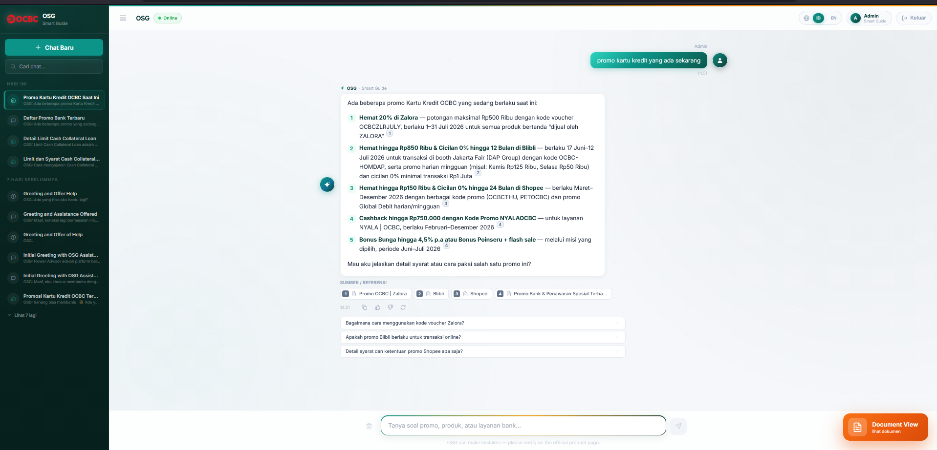
DEMO
A real question, answered: OSG lists every current card promo with amounts, codes, dates and sources in seconds
1
Ask in plain language
A frontliner types an everyday question, no keywords or product codes needed.
1
2
2
A complete, structured answer
Five current card promos with amounts, voucher codes and validity dates.
3
Every answer cites its source
Zalora, Blibli, Shopee and the bank promo page, one click to verify.
3
4
4
Guided follow-ups
Suggested next questions open terms and how-to-use in a single tap.
OSG AI Assistant Banking
14

Slide 15
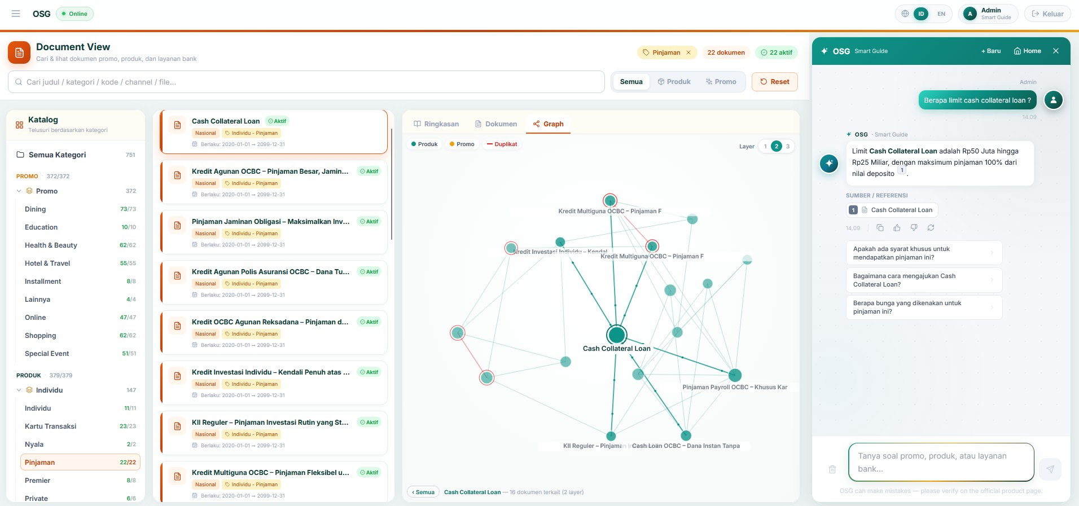
DEMO
See it in action: browse the catalogue, explore the knowledge graph, and ask OSG for a source-cited answer
1
Browse the catalogue
751 documents across 51 categories, filtered by product or promo.
3
2
Explore the knowledge graph
See how a product links to related and duplicate offers.
1
4
2
3
Ask in plain language
OSG replies in seconds, in Bahasa Indonesia or English.
4
Every answer cites its source
One click opens the exact document behind the answer.
OSG AI Assistant Banking
15

Slide 16
OSG · SMART GUIDE
Thank you
Faster, source-cited answers for every frontliner. Questions and discussion welcome.

