Slide 1
Code First Girls Introduction to Python & Apps Recipe Search Project
Jagoda Giurg
8 February 2024
Notes:
© Copyright PresentationGO.com – The free PowerPoint and Google Slides template library

Slide 2
Recipe Search Application
coded in Python
run in Terminal
as input the application accepts text – ingredients the user wants to search the recipe data base by
application asks additional questions, more questions in regards to search criteria can be easily added based on needs
as output the application return list of recipes with links
Notes:
© Copyright PresentationGO.com – The free PowerPoint and Google Slides template library

Slide 3
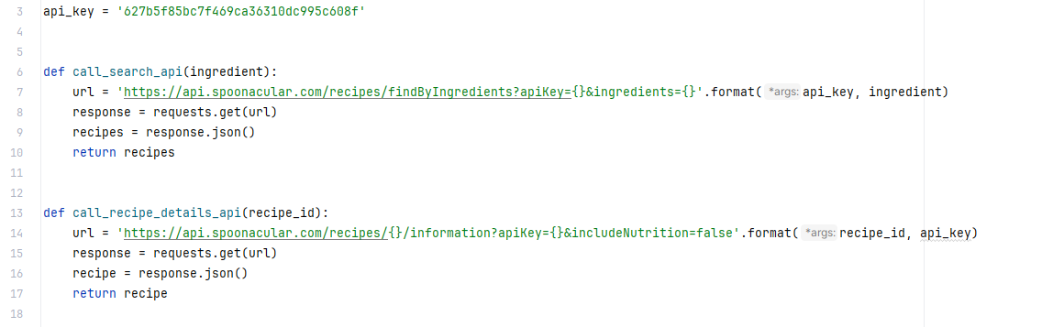
Functions to call API
API used: https://spoonacular.com/food-api
API key as a global variable – the same key used by two functions and might be used more in the future
Notes:
© Copyright PresentationGO.com – The free PowerPoint and Google Slides template library

Slide 4
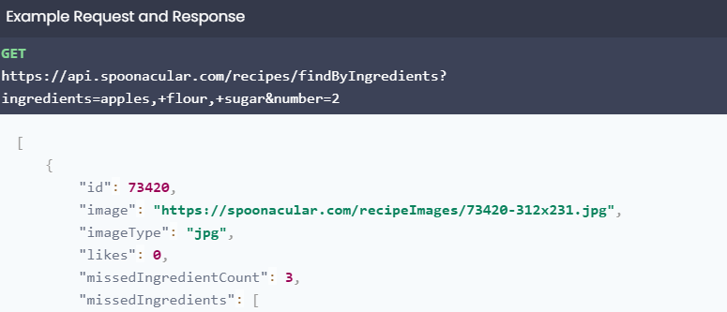
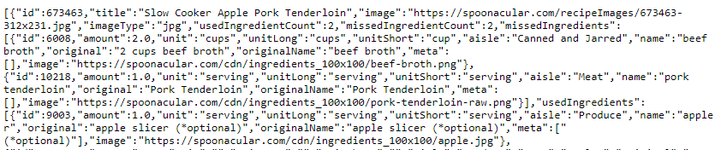
Why two functions?
API documentation – search by ingredients
Test call in a browser
Notes:
© Copyright PresentationGO.com – The free PowerPoint and Google Slides template library

Slide 5

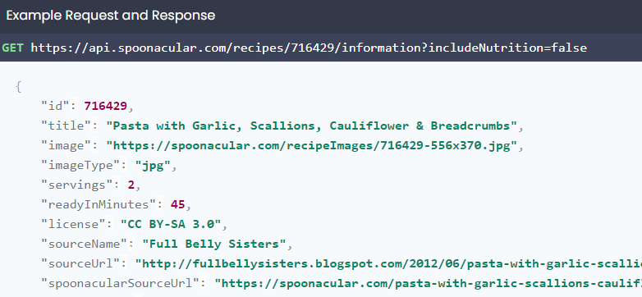
very limited data for each recipe from the search alone
to get more details get recipe information call needed
Notes:
© Copyright PresentationGO.com – The free PowerPoint and Google Slides template library

Slide 6
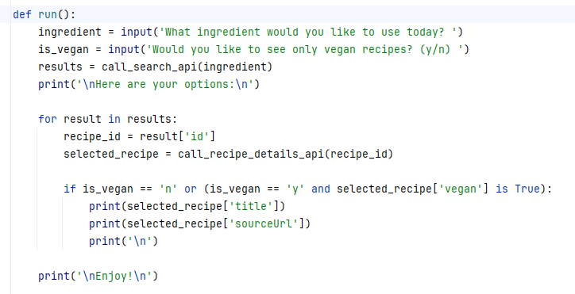
run() function
user is asked for an ingredient and about vegan recipes filter
search by ingredient function is called
the run() function iterates through the results, extracts recipe ID and checks conditions, extracts value for ‘vegan’ to use it if needed
selected recipes are printed with urls
Notes:
© Copyright PresentationGO.com – The free PowerPoint and Google Slides template library

Slide 7
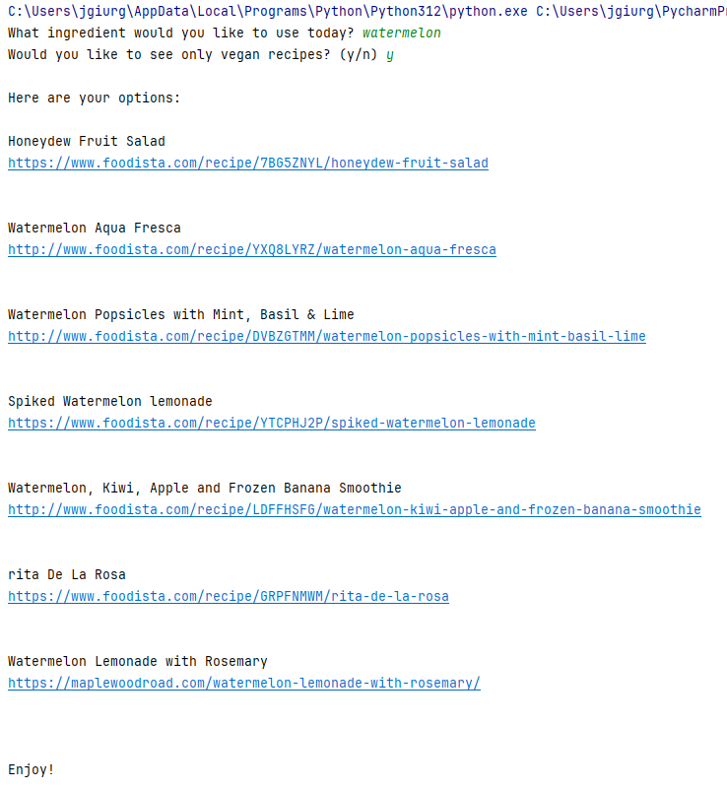
Application in action ☺
Notes:
© Copyright PresentationGO.com – The free PowerPoint and Google Slides template library

Slide 8
Thank you!
Notes:
© Copyright PresentationGO.com – The free PowerPoint and Google Slides template library

