Slide 1

Everything you always wanted to know about pointers in the C programming language*
*but were afraid to ask

Slide 2
5 essential questions

Slide 3
5 essential questions
What are pointers? 👉
(And why they exist at all?)

Slide 4
5 essential questions
What are pointers? 👉
(And why they exist at all?)
What are pointers used for? 🎛️

Slide 5
5 essential questions
What are pointers? 👉
(And why they exist at all?)
What are pointers used for? 🎛️
What have pointers to do with strings? 📝

Slide 6
5 essential questions
What are pointers? 👉
(And why they exist at all?)
What are pointers used for? 🎛️
What have pointers to do with strings? 📝
What is pointer arithmetics? 🧮
(And what is that good for?)

Slide 7
5 essential questions
What are pointers? 👉
(And why they exist at all?)
What are pointers used for? 🎛️
What have pointers to do with strings? 📝
What is pointer arithmetics? 🧮
(And what is that good for?)
And what else is going on with Pointers? 👨‍💻

Slide 8
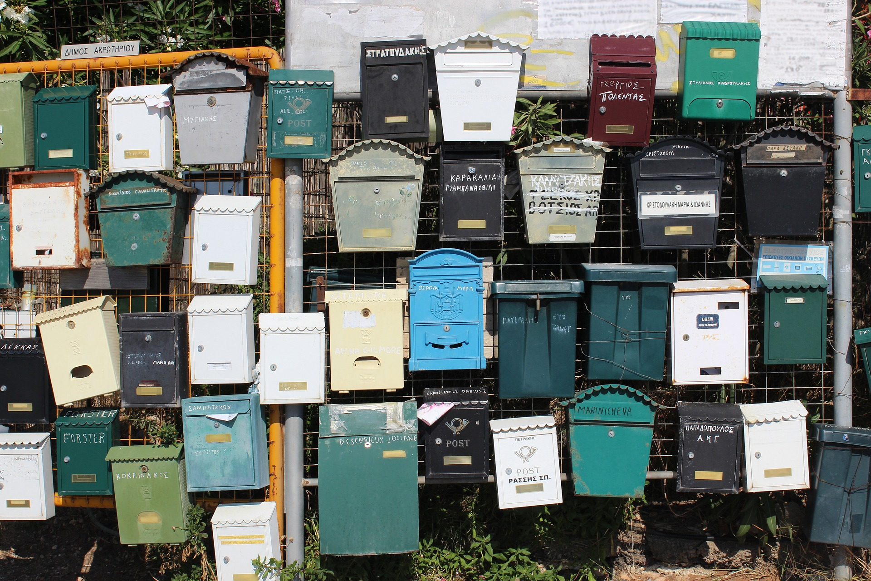
Like mailboxes

Slide 9
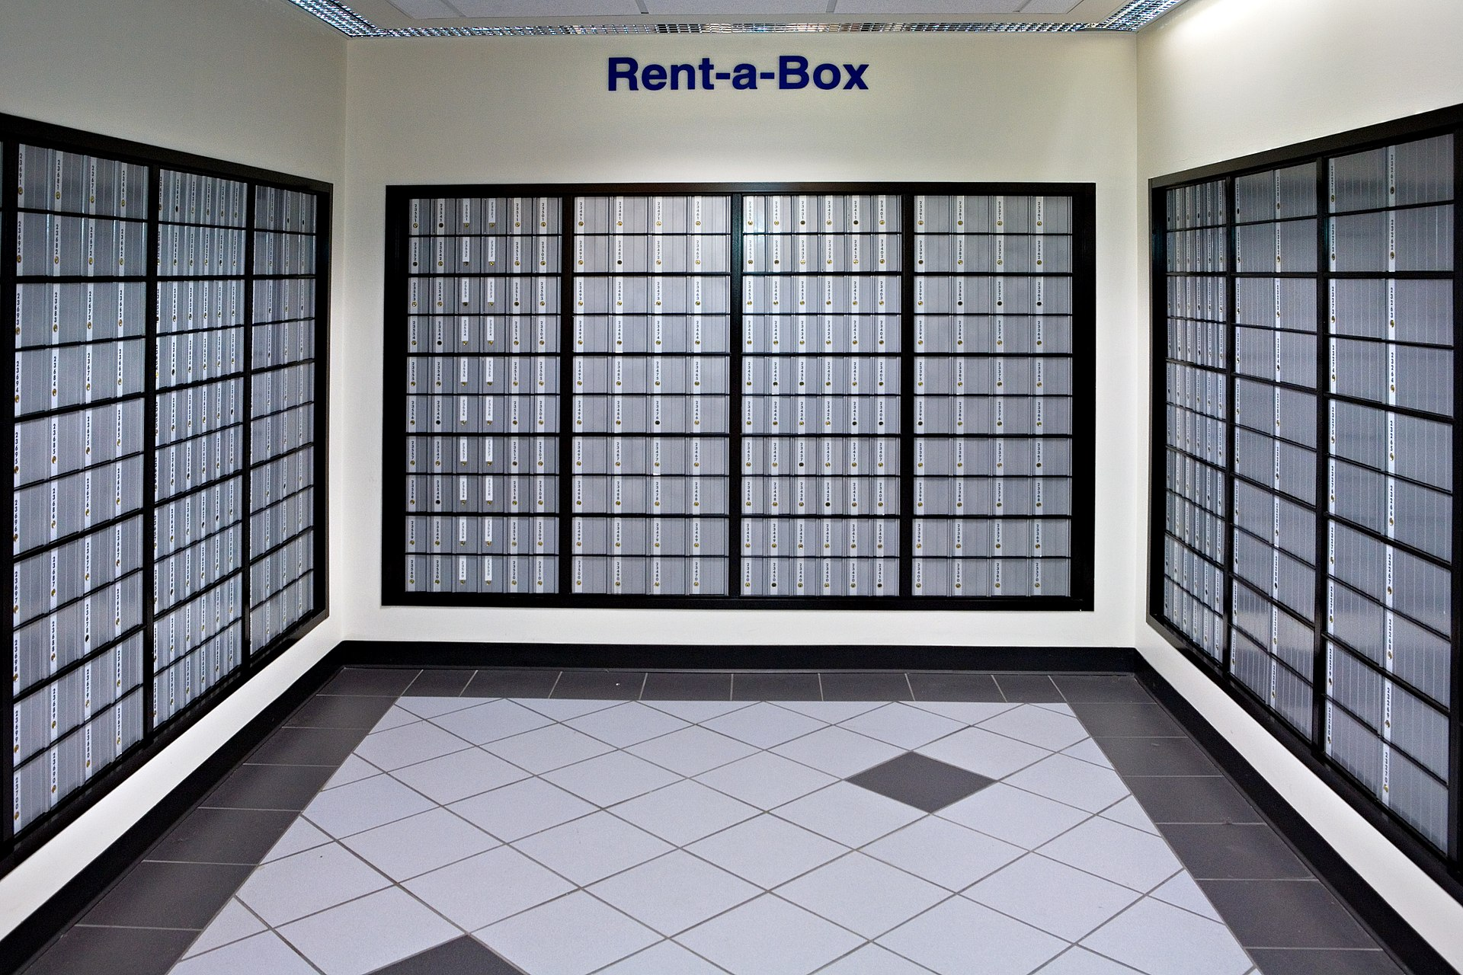
More like po boxes

Slide 10
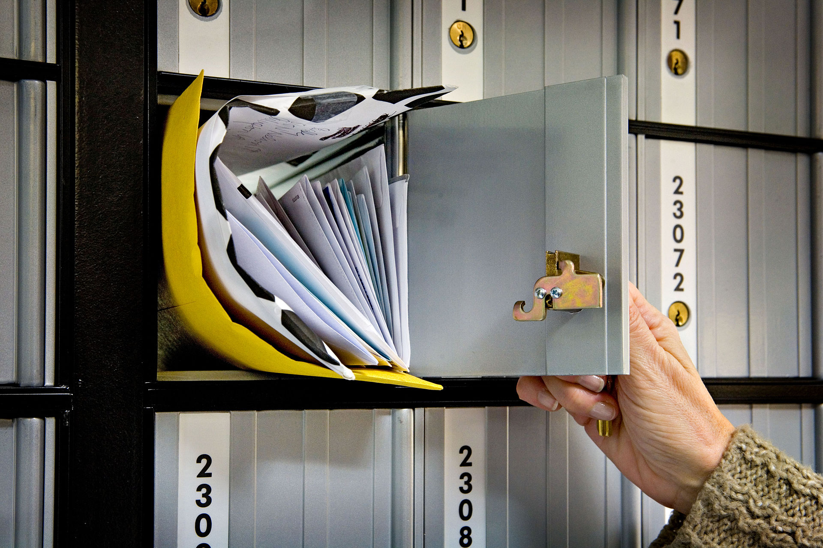
Have values in

Slide 11
Value storage in RAM

