Slide 1


TRIP INSIGHTS
Presented by:
Jagpreet Singh Sethi

Slide 2
Dataset Description
Columns: 21
Records: 1494926
Time Period: Sept 2015

Slide 3
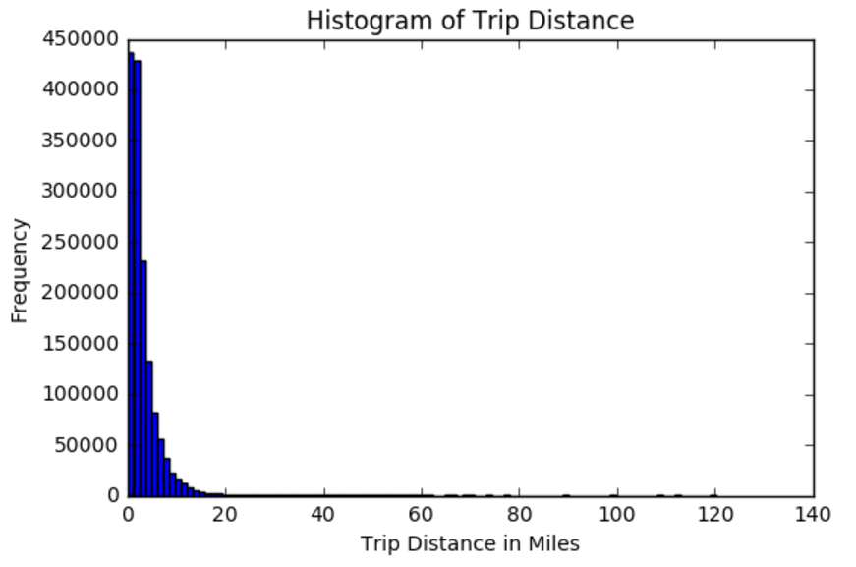
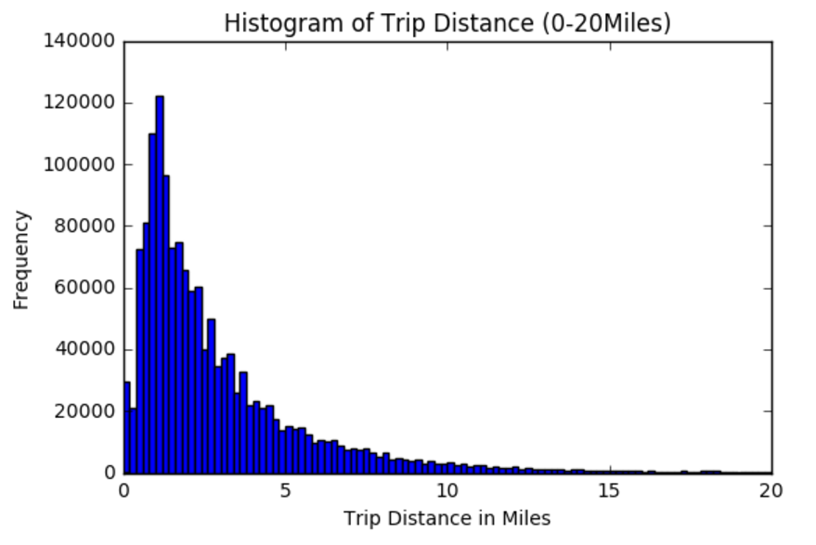
Trip Distance
Green Taxi has traveled as long as 140 Miles.
Most of the trip rides were short distanced from 1 mile to 4 miles i.e. within city or borough.
95% of the trip rides are upto 10 miles.

Slide 4
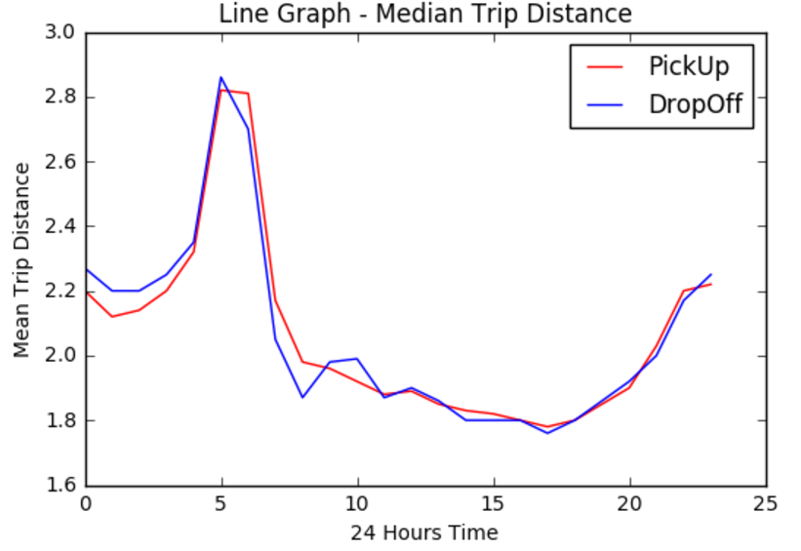
Trip Distance
Between 4 AM to 7 AM, miles commuted by passengers is maximum.
During office hours like 10 AM to 4 PM, people hire taxes for short distances.
From 5PM evening, people like to travel back to their home which is at an considerable distance from work place.

Slide 5
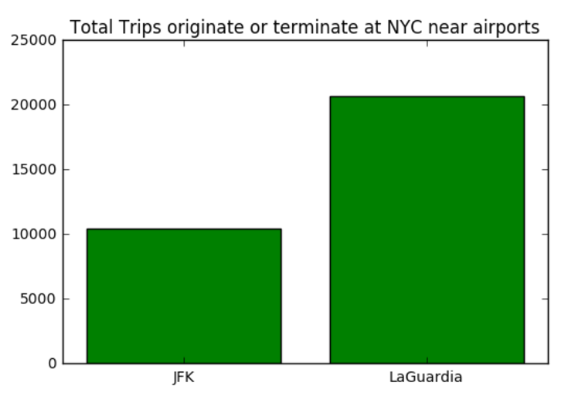
NYC Airport Trips
Lot of people use Green Taxi to reach LaGuardia airport rather than JFK Airport

Slide 6
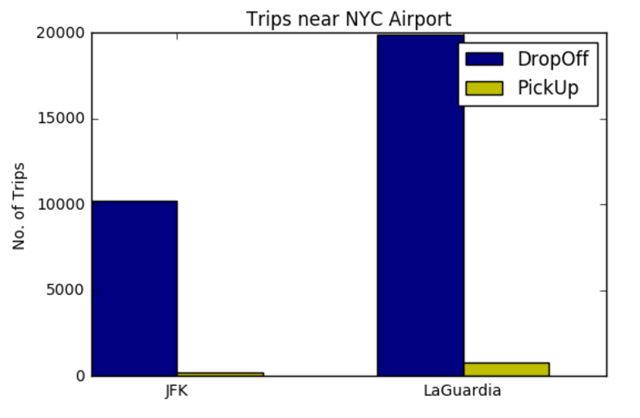
NYC Airport Trips
JFK AIRPORT:
DropOff: 10225
PickOff: 235
Total: 10460
LAGUARDIA AIRPORT:
DropOff: 19889
PickOff: 799
Total: 20688
Interpretation
DropOffs are much higher than PickUps for both the NYC airports. This signifies people do prefer Green Taxi from the city to reach airport. All these trips needs to be pre-booked and hence, we see only the drop-off traffic. However, neither can customers hail these green taxi's at the Airport areas nor can they pre-book these taxis from different city. That's why we see only the DropOffs for both the airports.

Slide 7
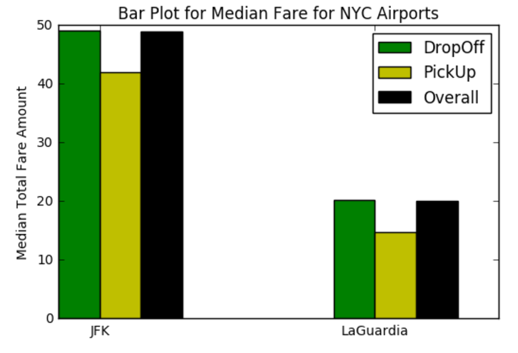
Fare Amount to NYC Airports
Mean Fare Amounts:
JFK is $48
LaGuardia is $23
Median total fare amount for DropOff or PickUp trips to JFK Airport is roughly double as compared to Laguardia airport.

Slide 8
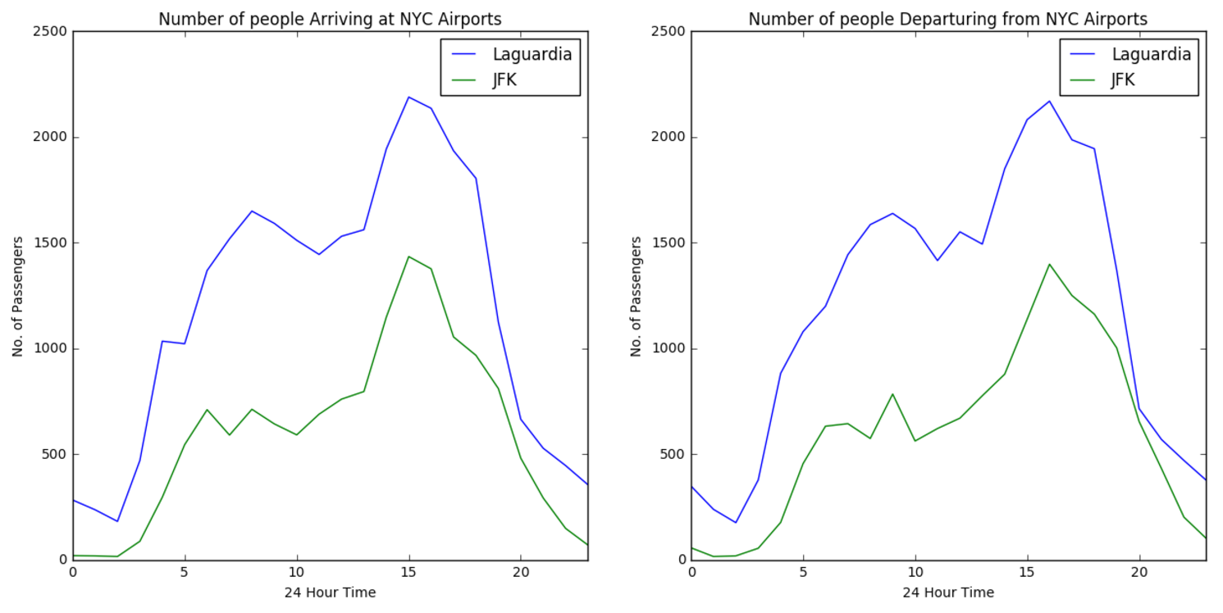
Passengers Airport Transit Traffic
Both the Arrival and Departure graph show sudden surge in number of people during afternoon hours
Later in the evening, their demand drastically decreases. This could is because they receive lot of hails from street passengers and don't prefer airport pre-bookups any more. This fact is well justified from the graph previous built up.

Slide 9
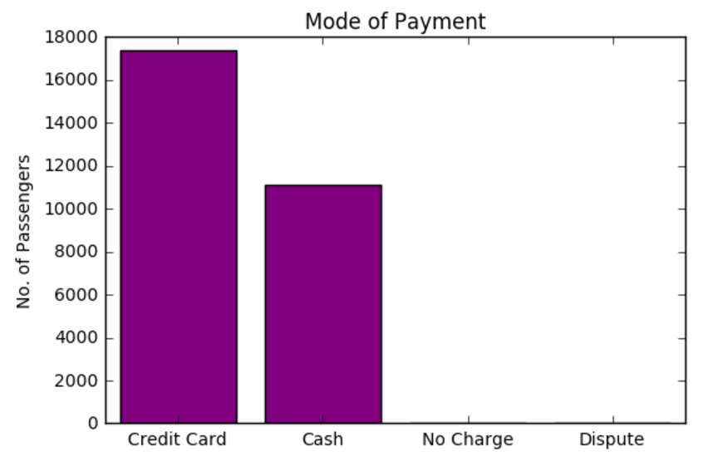
Mode of Payment
Credit Card is the most preferred mode of payment.
54% more customers prefer Credit card over cash payments

Slide 10
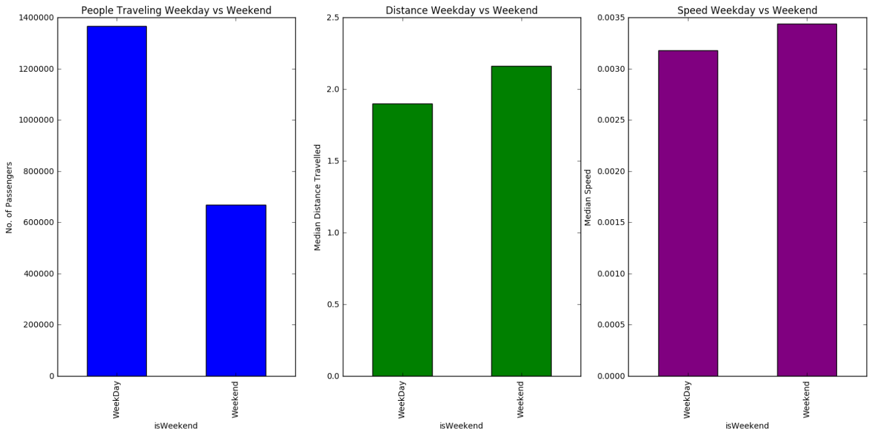
Passenger behavior analysis – Weekday vs Weekend

Slide 11
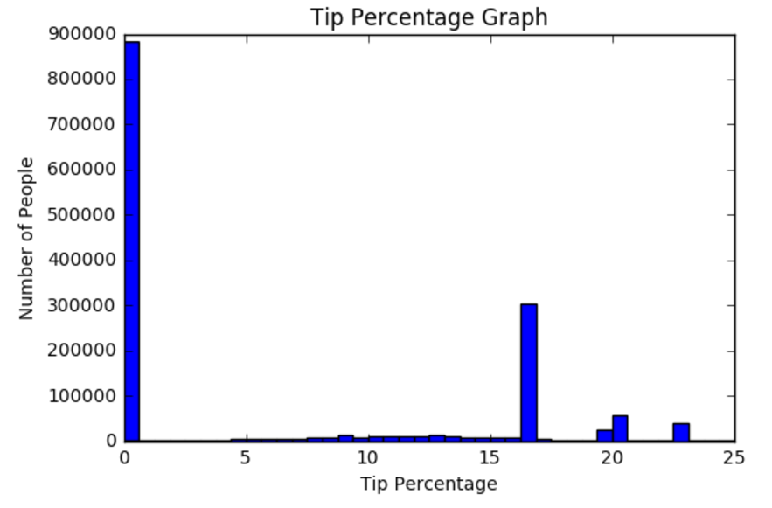
Tip Percentage
2nd Top most preferred tip is 16.6 %
64% passengers don’t any tip.

Slide 12
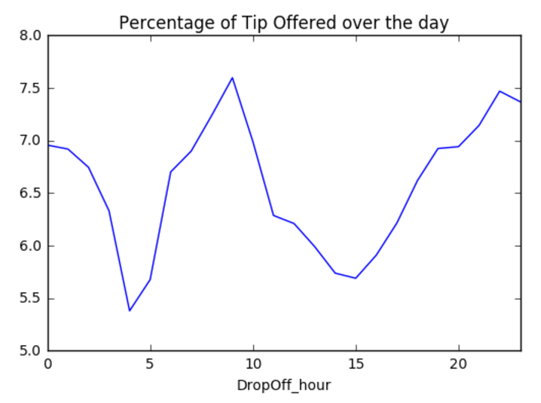
Tip Percentage
Mornings and late evenings is when passengers prefer to give tip with an average tip of 7.5 %

Slide 13
Mode of Payment
Credit Card is the most preferred mode of payment.
54% more customers prefer Credit card over cash payments

Slide 14
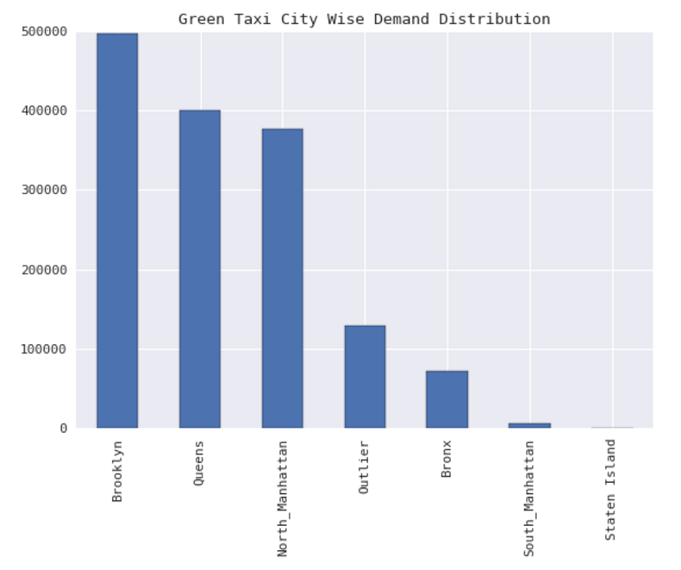
Green Taxi City Wise Demand Distribution
Brooklyn is the place where Green Taxi’s are in demand and Staten Island is the least.
Analysis is based on Sept’2015 data

Slide 15
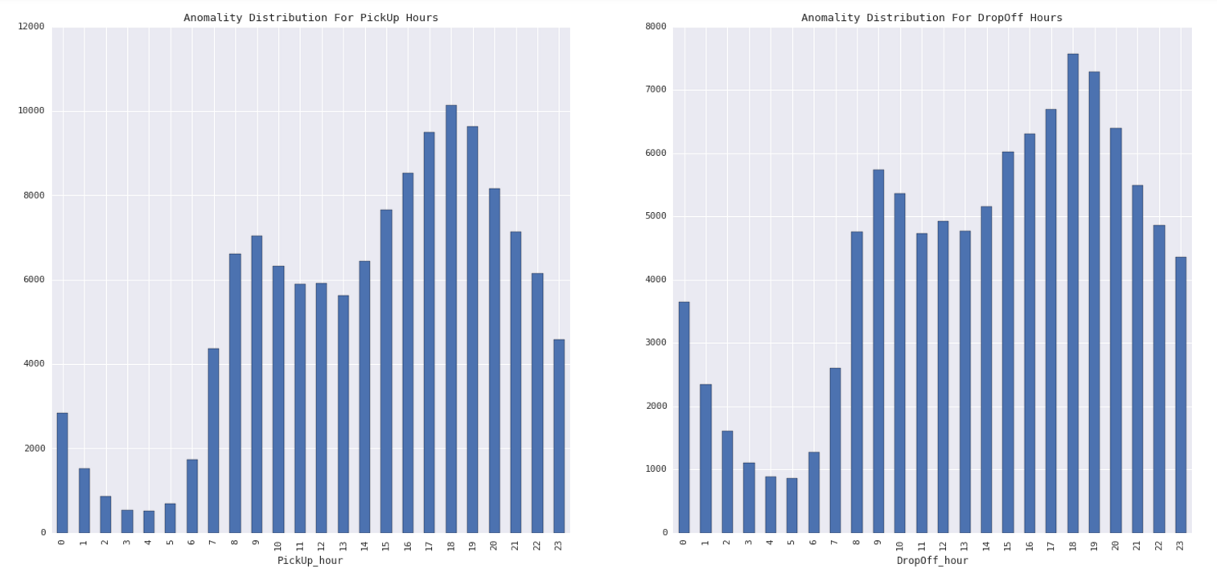
Hourly Based Anamoly Distribution
Situations where passenger hailed the taxi in one of boroughs and took it over to a place where Green Taxi's generally don't operate like New Jersey. On return drivers tend to look for a passenger who wants to go to one of those boroughs.
Thus, Outlier at a DropOff Hour is followed by Outlier at Pickup hour.

Slide 16
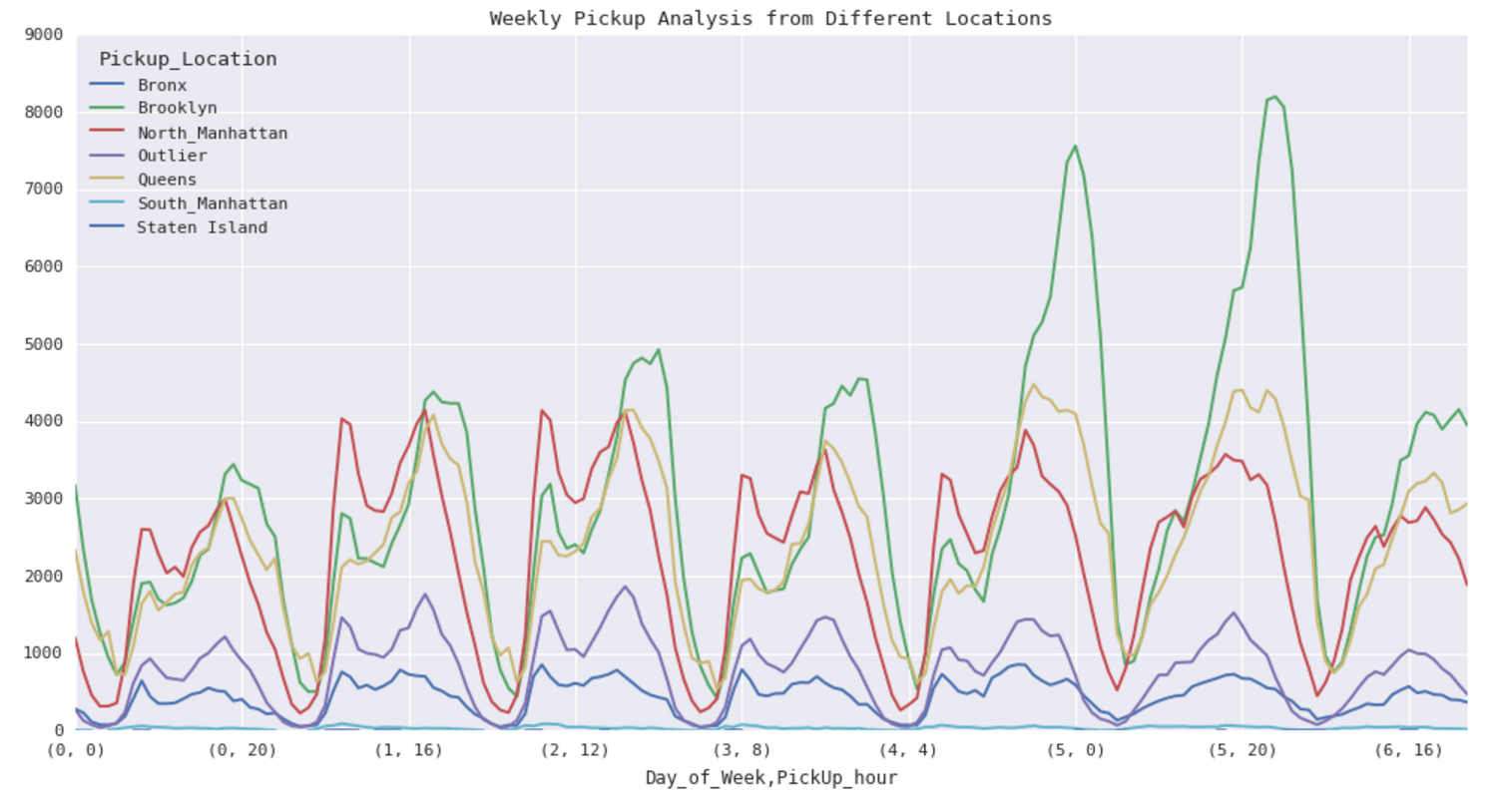
Weekly Pickup Analysis from Different Locations
From the above graph we can conclude that on Friday's and Saturday's there is a sudden surge in demand for Green Taxis in Brooklyn area.
Demand from Queens and North Manhattan types area follows relatively same pattern through out week.

