Slide 1
Banking Churn Prediction Pod Lannister

Slide 2
Contents
Introduction
Exploratory Data Analysis
Feature Engineering
Classification Model
Discussion
Conclusion

Slide 3
Introduction

Slide 4
Overview
The bank offers a special savings account for middle class professionals.
Interest is accrued on a monthly basis in the account subject to conditions.
A small fee is charged when a customer withdraws from the account.
The incentive is to continually deposit into the account to take advantage of the interest.
A larger portfolio gives the bank a larger liquidity buffer to fund activities and investments.
Customer churn has been identified as one of the main sources of fund outflow from the bank.
Our task was to develop a model to identify customers who are likely to churn.
Project Findings
0.83 for pre-May data vs 0.59 for May data for training dataset before covid.
0.69 for April data vs 0.65 for May data for training dataset on covid.

Slide 5
Dataset Description
The data provided consists of two datasets, one containing customer data and other containing monthly transaction data.
Customer dataset includes columns such as customer ID, date of birth, state, starting balance, and creation date.
Transaction dataset includes columns such as date of system check, account ID, customer ID, amount of transaction, transaction date, deposit.
Range of dates to use for the model are 2007-01-31 to 2020-05-31.
The model should identify customers who will churn in the following month.
Macroeconomic data from the Federal Reserve will be used to provide external features for our model.
Potential variables include GDP, inflation, unemployment rates, interest rates, consumer sentiment index.

Slide 6
Exploratory Data Analysis

Slide 7
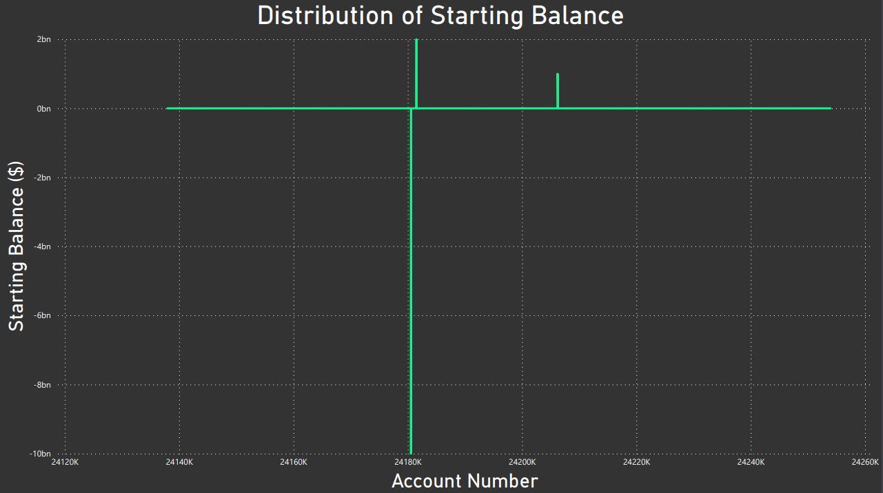
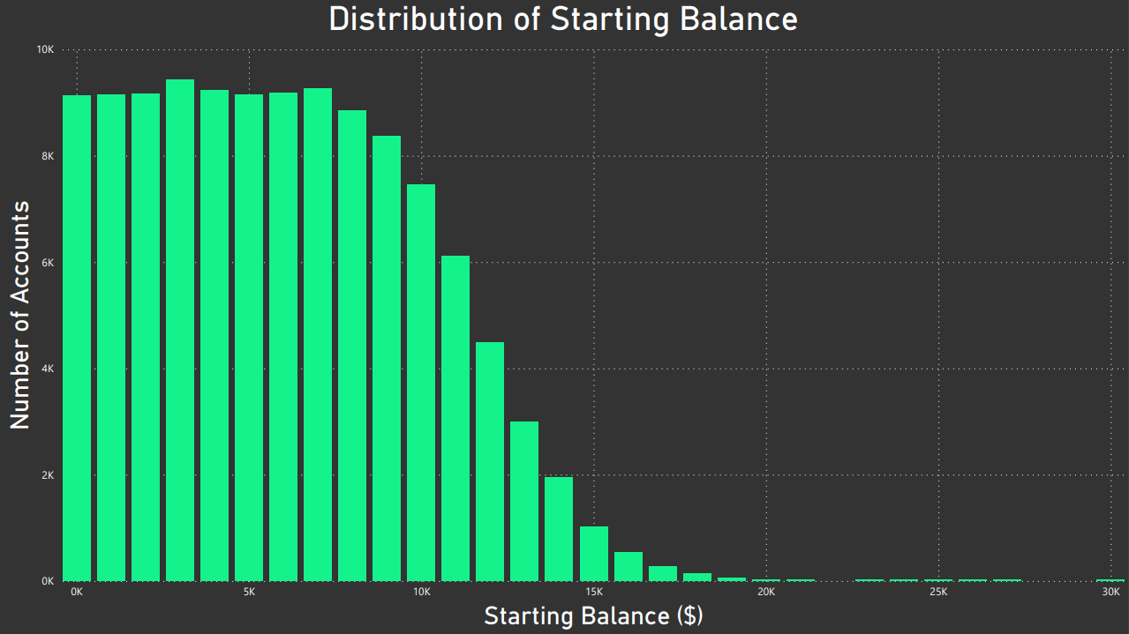
Starting Balance
Several anomalies where starting balance of a few accounts was exceedingly high or low.
Risk of distorting the overall picture of the data and skew the results in the model.
Rows were removed as these outliers are not important data points.

Slide 8
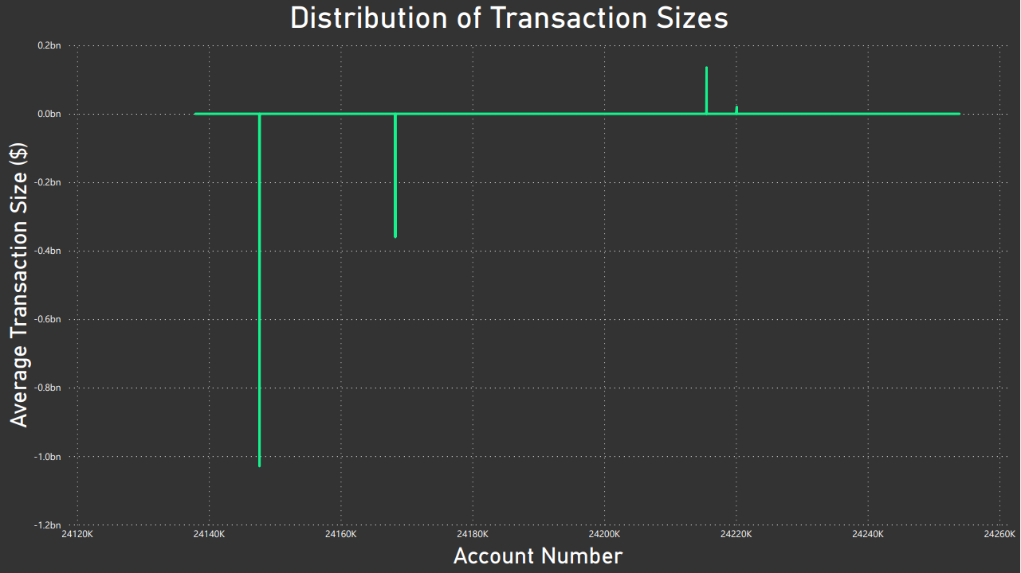
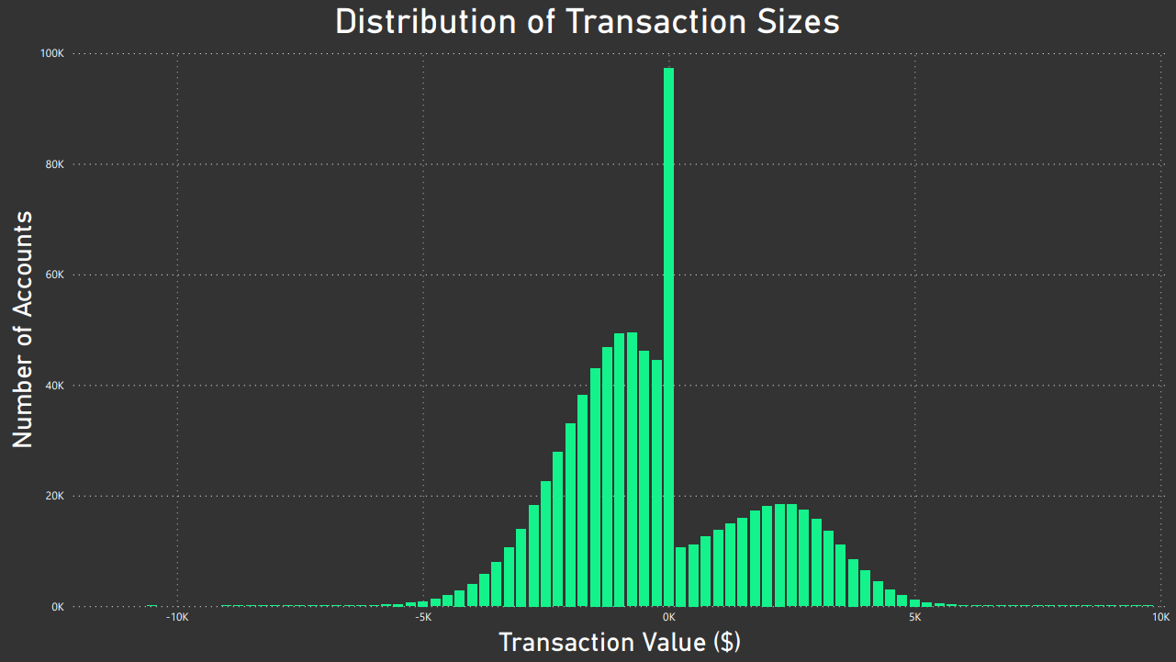
Transaction Size
Erroneous transactions with the amount in the billions
Would disrupt the validity of our model so rows were removed
Graph on the right shows distribution after bad data was removed

Slide 9
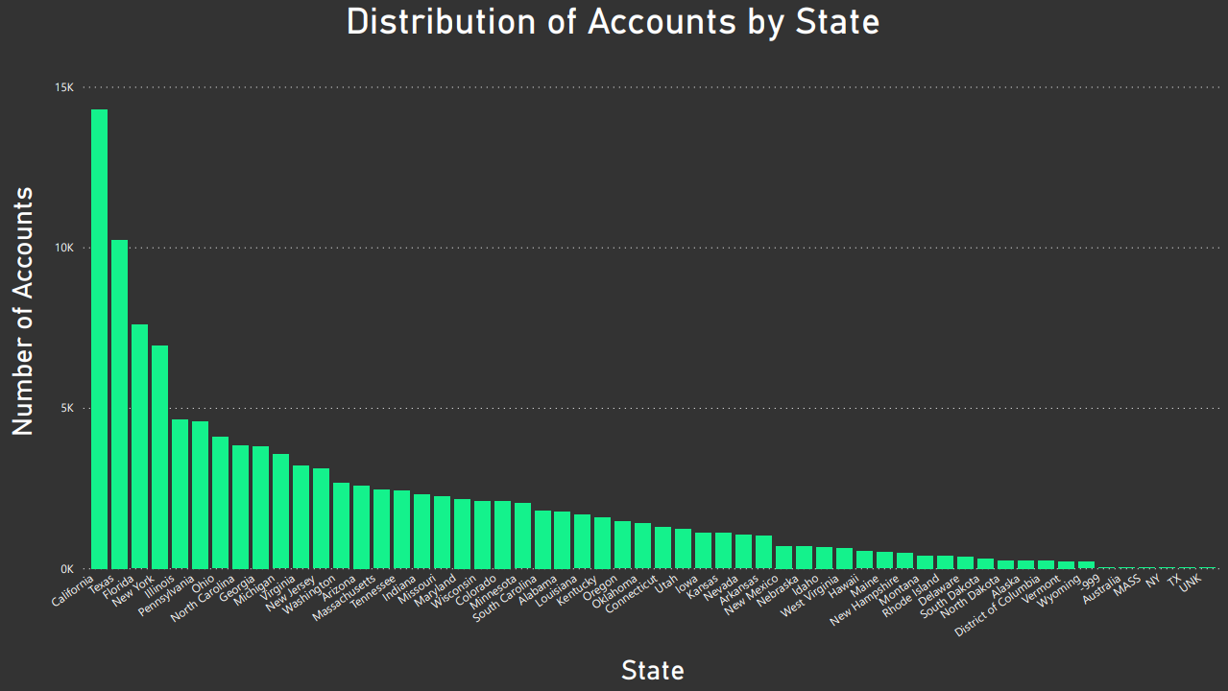
Location of Customer
Incorrect data included values such as Australia, -999, MASS, NY, TX, and UNK
Removed rows as this data shouldn’t be included for our model

Slide 10
Data Pre-Processing
We performed the following pre-processing steps to have a single collection of data to use for our model:
Merge customer and transaction datasets into one.
Homogenise data types by column (state column had instances of number entries).
Homogenise data styles (state column had instances of state codes or block capital entries).
Remove accounts with negative starting balances.
Remove erroneous data entries with incorrect or false data (Australia entry in state column).
Remove anomalous data such as transactions or starting balances with billions of dollars.
Reduce entries for every customer to a single row.

Slide 11
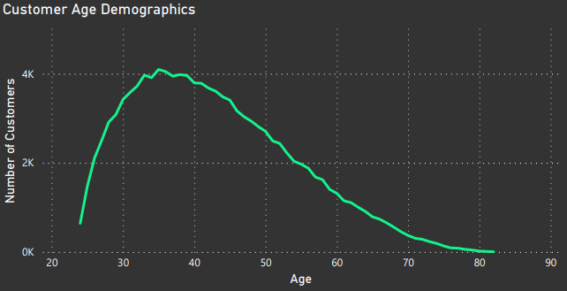
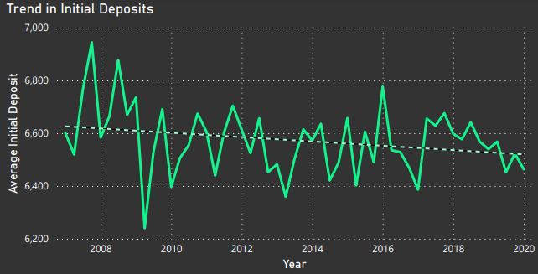
Further Analysis
Age distribution of customers may add contextual information about saving habits.
Trend in initial deposits has been on a slight decline over the given time period, could influence churn rate.

Slide 12
Feature Engineering

Slide 13
Churn Definition
Since the datasets received were unlabelled (it was missing a churn column), it was crucial for us to define what churn was and create the column so that we could relate customer activity to it.
We created the churn column based on the date column in the transaction dataset, which can be interpreted as the bank’s internal logging system checking to see if any deposits/withdrawals were made in that month.
A row was created per month that a customer had an account, and a zero (no churn) value was inserted in the corresponding churn column for each row every month up until the last month where that customer’s account was logged.
Churned | Not Churned
Logging of customer data ceases before May 2020 | Account active at May 2020

Slide 14
Engineered Features
Customer Behaviour
Consecutive Monthly Withdrawals
Behaviour Change Monthly
Macroeconomic
Interest rate
Unemployment rate
Other Attributes
Starting balance
Monthly Balance
State
Account age in months
Customer age
Monthly Net Transaction Amount
Consumer sentiment
Net Deposit/Withdrawal over 3 months

Slide 15
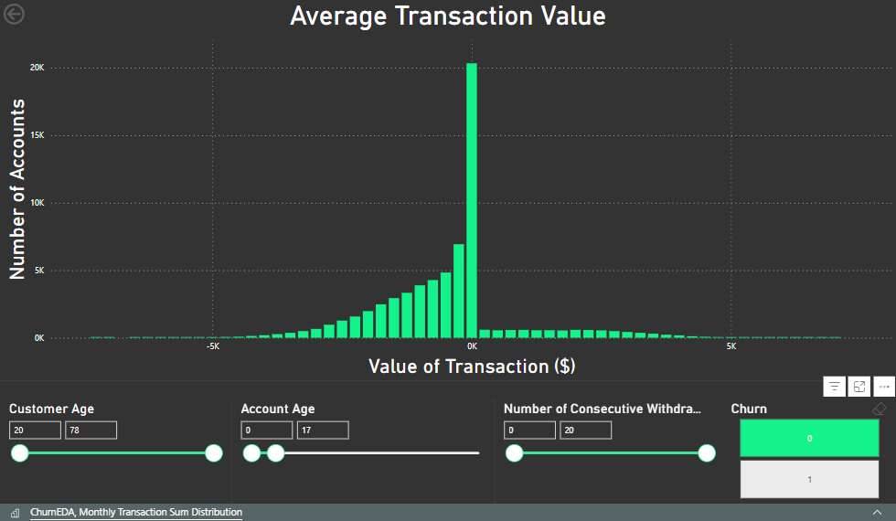

Slide 16


Slide 17
Macroeconomic Features
These features allow us to add contextual information to the model and improve its predictive capabilities.
The macro variables we decided to use were the University of Michigan Consumer Sentiment Index, unemployment rate, and interest rates:
The consumer sentiment index gives us a measure of how confident consumers were feeling in respect to the economy and discretionary spending.
The rate of unemployment is a critical macroeconomic variable as it can show us how much of the population is currently in work and thus able to save money in a savings account.
Interest rates play a significant role in determining the behaviour of customers in banking. A higher interest rate may result in a reduced churn rate as customers look to deposit more money with the bank.

Slide 18
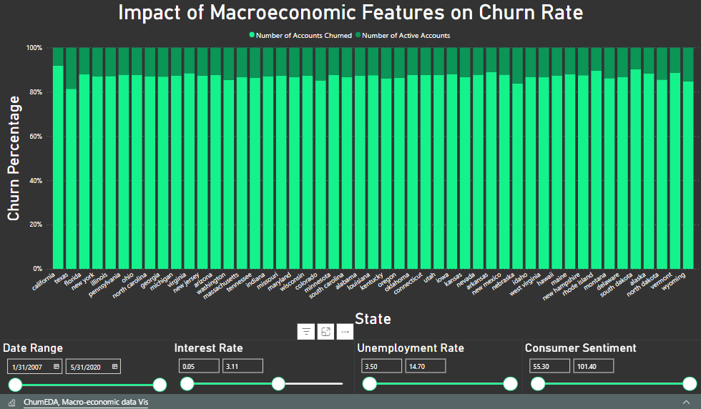

Slide 19
Alternative Approaches
This dataset poses an interesting question regarding feature engineering and there are several ways that the task could be approached.
One alternative to the solution we chose to proceed with was to create a model with a rolling window for each customer.
Would have meant not creating a row per month per customer but the model would train on all data for every account and roll through two three-month windows.
Each window being associated with a target column of whether the customer churned after the window or not.
This meant that we would end up training on our test data and so the approach was discarded.

Slide 20
Model Infrastructure and Evaluation

Slide 21
Model Architecture
Binary classification problem – whether the customer is going to churn or not
Remove May 2020 data for testing stage
Split data into covid data for training and pre-covid for test
Take a training df
Resample to give 50/50 split of churn and not churn – this is X
Y is just churn feature
Train Model
Random Forest with grid search (max_depth, min_samples_leaf, n_estimators) and cross validation
Best Model Params: max_depth = 12, min_samples_leaf = 6, n_estimators = 150
Feature importance – dropped features with importance < mean
Our Pipeline: Transformer, Feature Selector (with baseline model), Final model on selected features
Tested model on 2018 with sampling to give proportion of average churn:not_churn ratio of Jan-Apr 2020

Slide 22
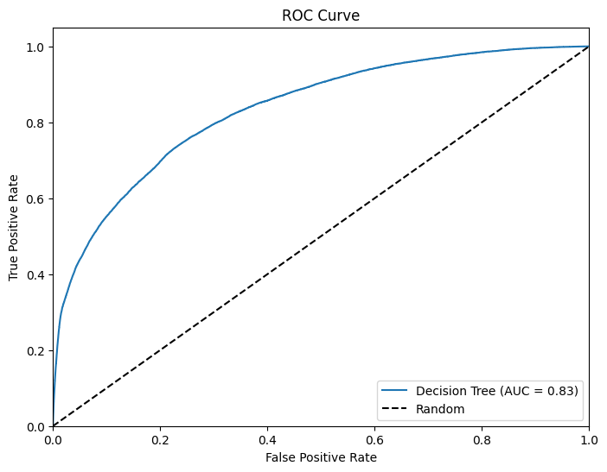
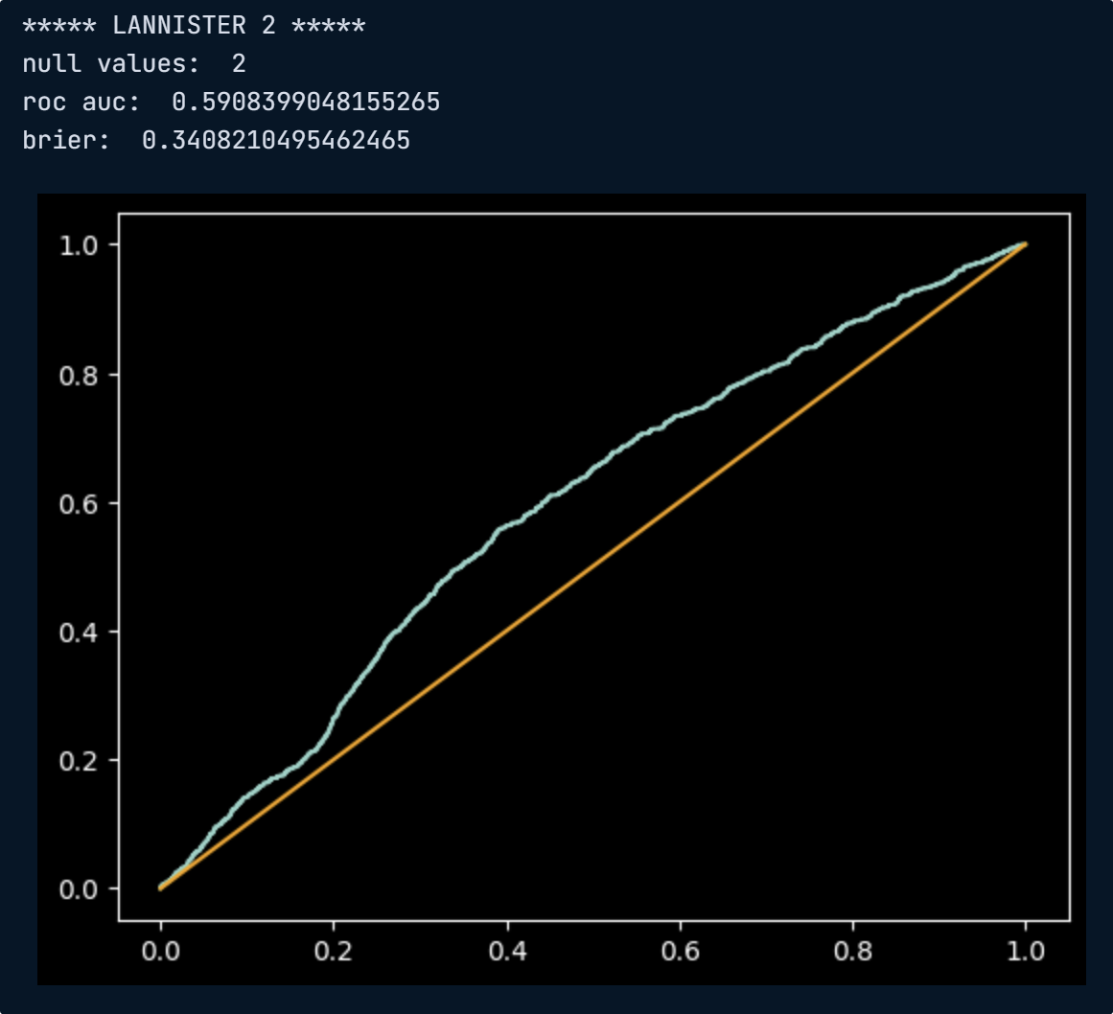
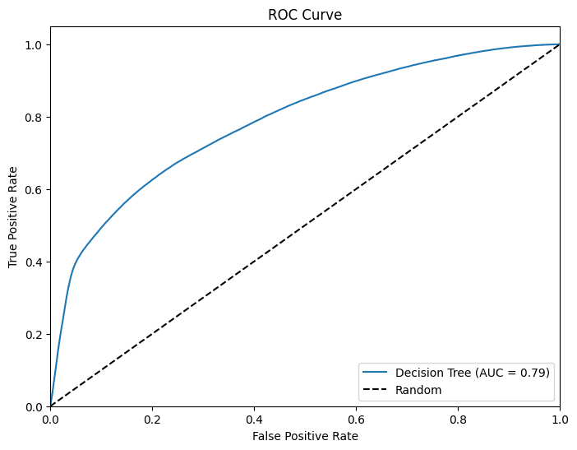
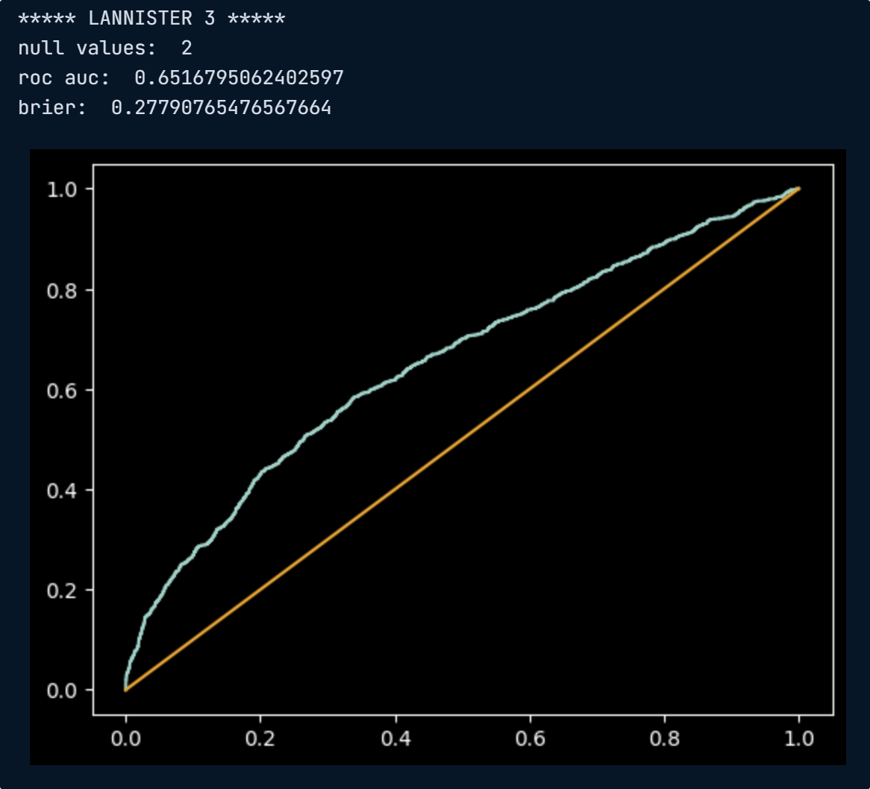
Model Evaluation
Testing not on May
Test on May
Training before 2018 and testing after gives a good ROCAUC of 0.83.
However, when this model was tested on May 2020, it scored only 0.60
Instead, we retrained the model to only include data in which covid was breaking out (Dec 2019 onward)
When testing this on pre covid data, it obviously did worse (ROCAUC = 0.69)
Improved to 0.65 on May 2020 data
Training pre April and testing on April gave 0.69 but still scored 0.65 on May
Training before covid
Training on covid

Slide 23
Discussion

Slide 24
Positive Outcomes
Working model which identifies several key predictors for customer churn
Able to segregate the customer into segments for prediction
Assume customer behaviour based on whether they will churn or not

Slide 25
Limitations and Challenges
More information on the data would be helpful to ensure we have correctly identified churning customers
Change in customer behaviour relating to Covid – need more time sensitive data to accurately predict this change.
More precise customer data is needed relating to personal circumstances.
Computational limitations, long time to run models.

Slide 26
Conclusion

Slide 27
Summary
Create a banking churn classifier to accurately predict which customers were at risk of churning to prevent the bank from losing liquidity.
Generated features for customer behaviour, reflect macroeconomics, and other attributes.
Model performance was 0.83 for not May data vs 0.59 for May data for training set before covid, compared to 0.69 for April data vs 0.65 for May data for training set on covid.
If further information and data is available, the bank could feasibly use this model to generate a more comprehensive model to predict the churning of customers.

Slide 28
Thanks for listening. Any questions?

