Slide 1
Sprint 4 Presentation
Team 4
Team 4

Slide 2

EduMart
A market for educational resources.

Slide 3
UseCases
MVP Features
1. Authentication
3. Data Persistence
1.1 User Login
1.2 Register
1.3 Admin Login
3.1 Retain User Information
3.2 View cart
3.3 Purchase History(User)
3.4 Inventory History(Admin)
2. Customer Functionality
2.1 View products
2.2 Filter and Search
2.3 Manage Cart(Add, Remove, Check out, Payment) 2.4 Inventory Management(Add, Remove, Update)
10% Feature
4. Enhancement 1
5. Enhancement 2
4.1 Author Authentication
4.2 Request for Revise/Update 4.3 Products(Author)
4.4 Approve request(Admin)
5.1 One-on-one session purchase

Slide 4
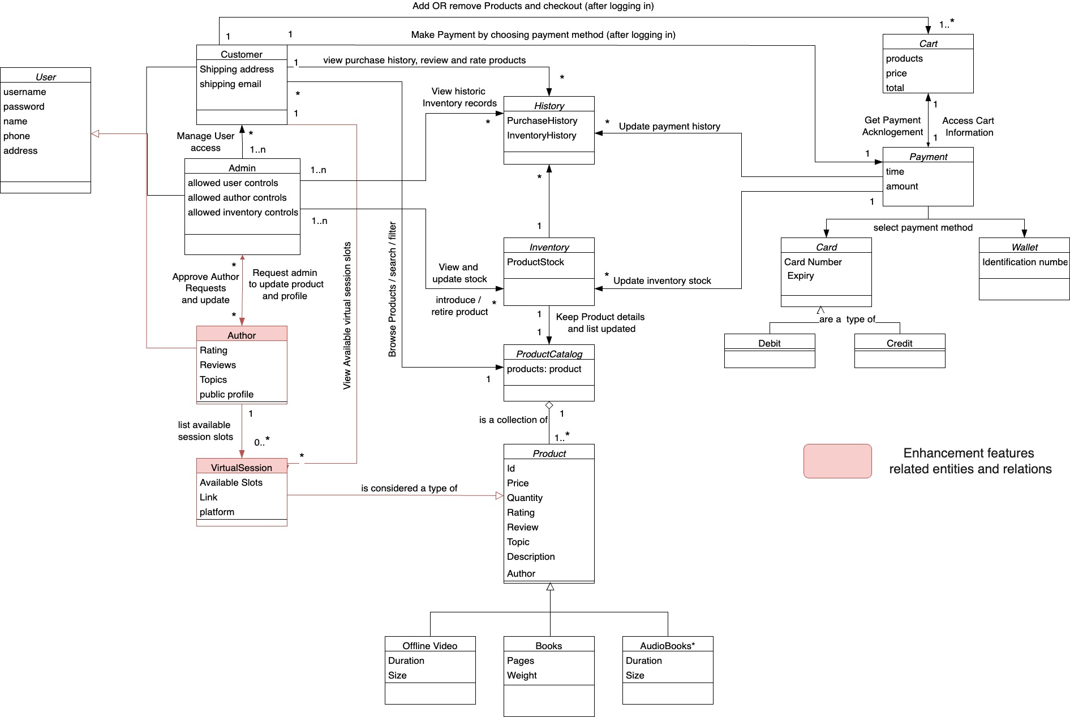
Domain diagram

Slide 5
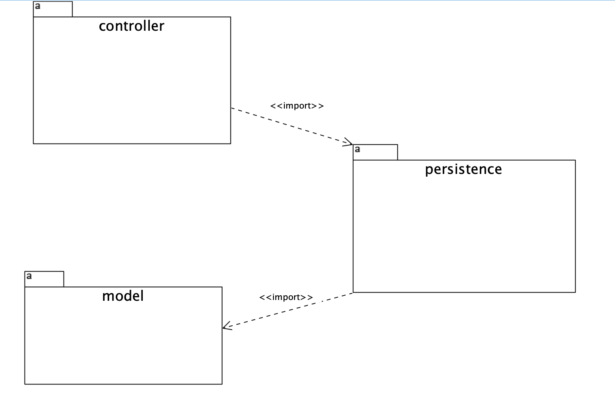
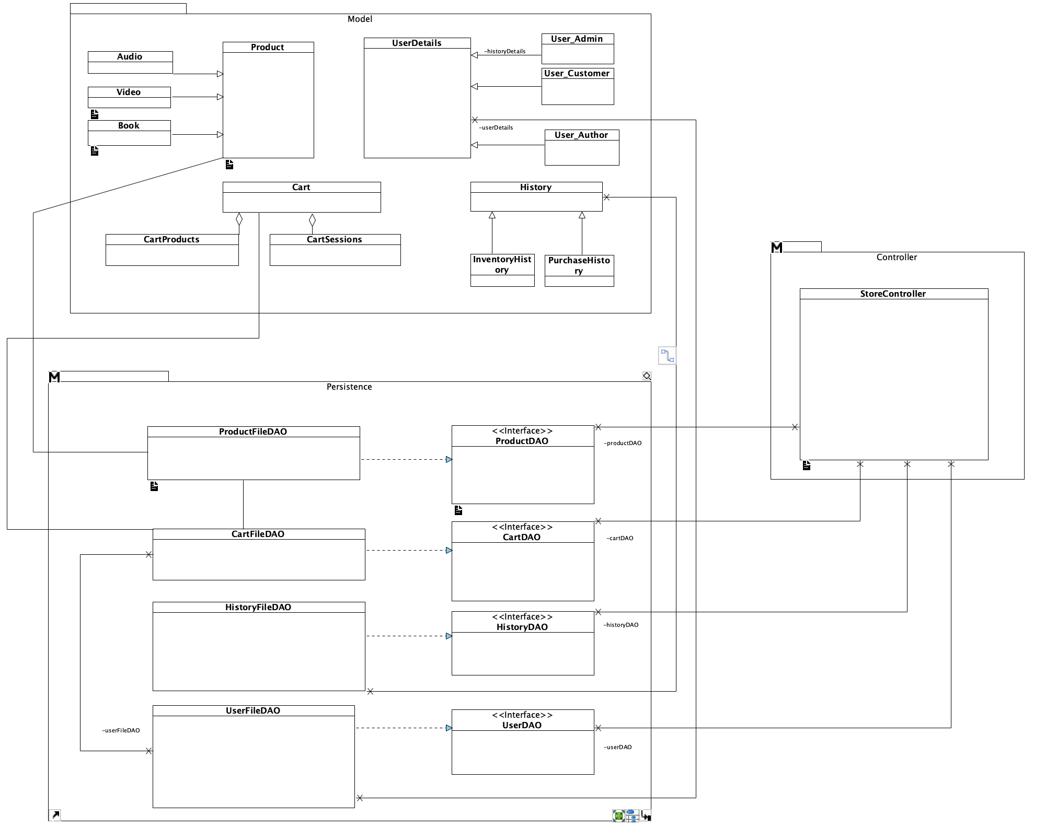
Package Diagram
Class Relations
The system is divided into three Packages (as shown above) and each package contains the classes and relations (as illustrated in the diagram on left)
Note: class details are abstracted out here and are explained in further slides

Slide 6
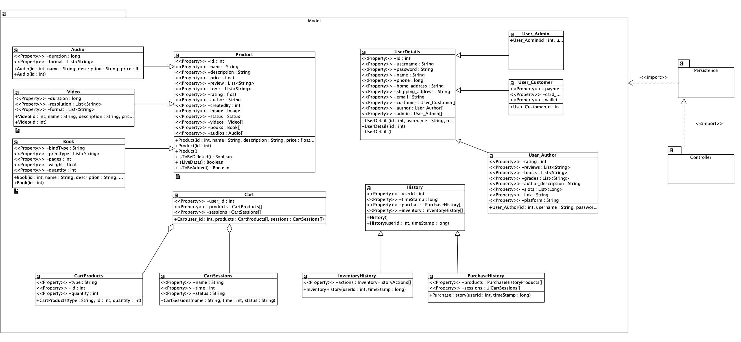
Model Package – Detailed Class Diagram

Slide 7
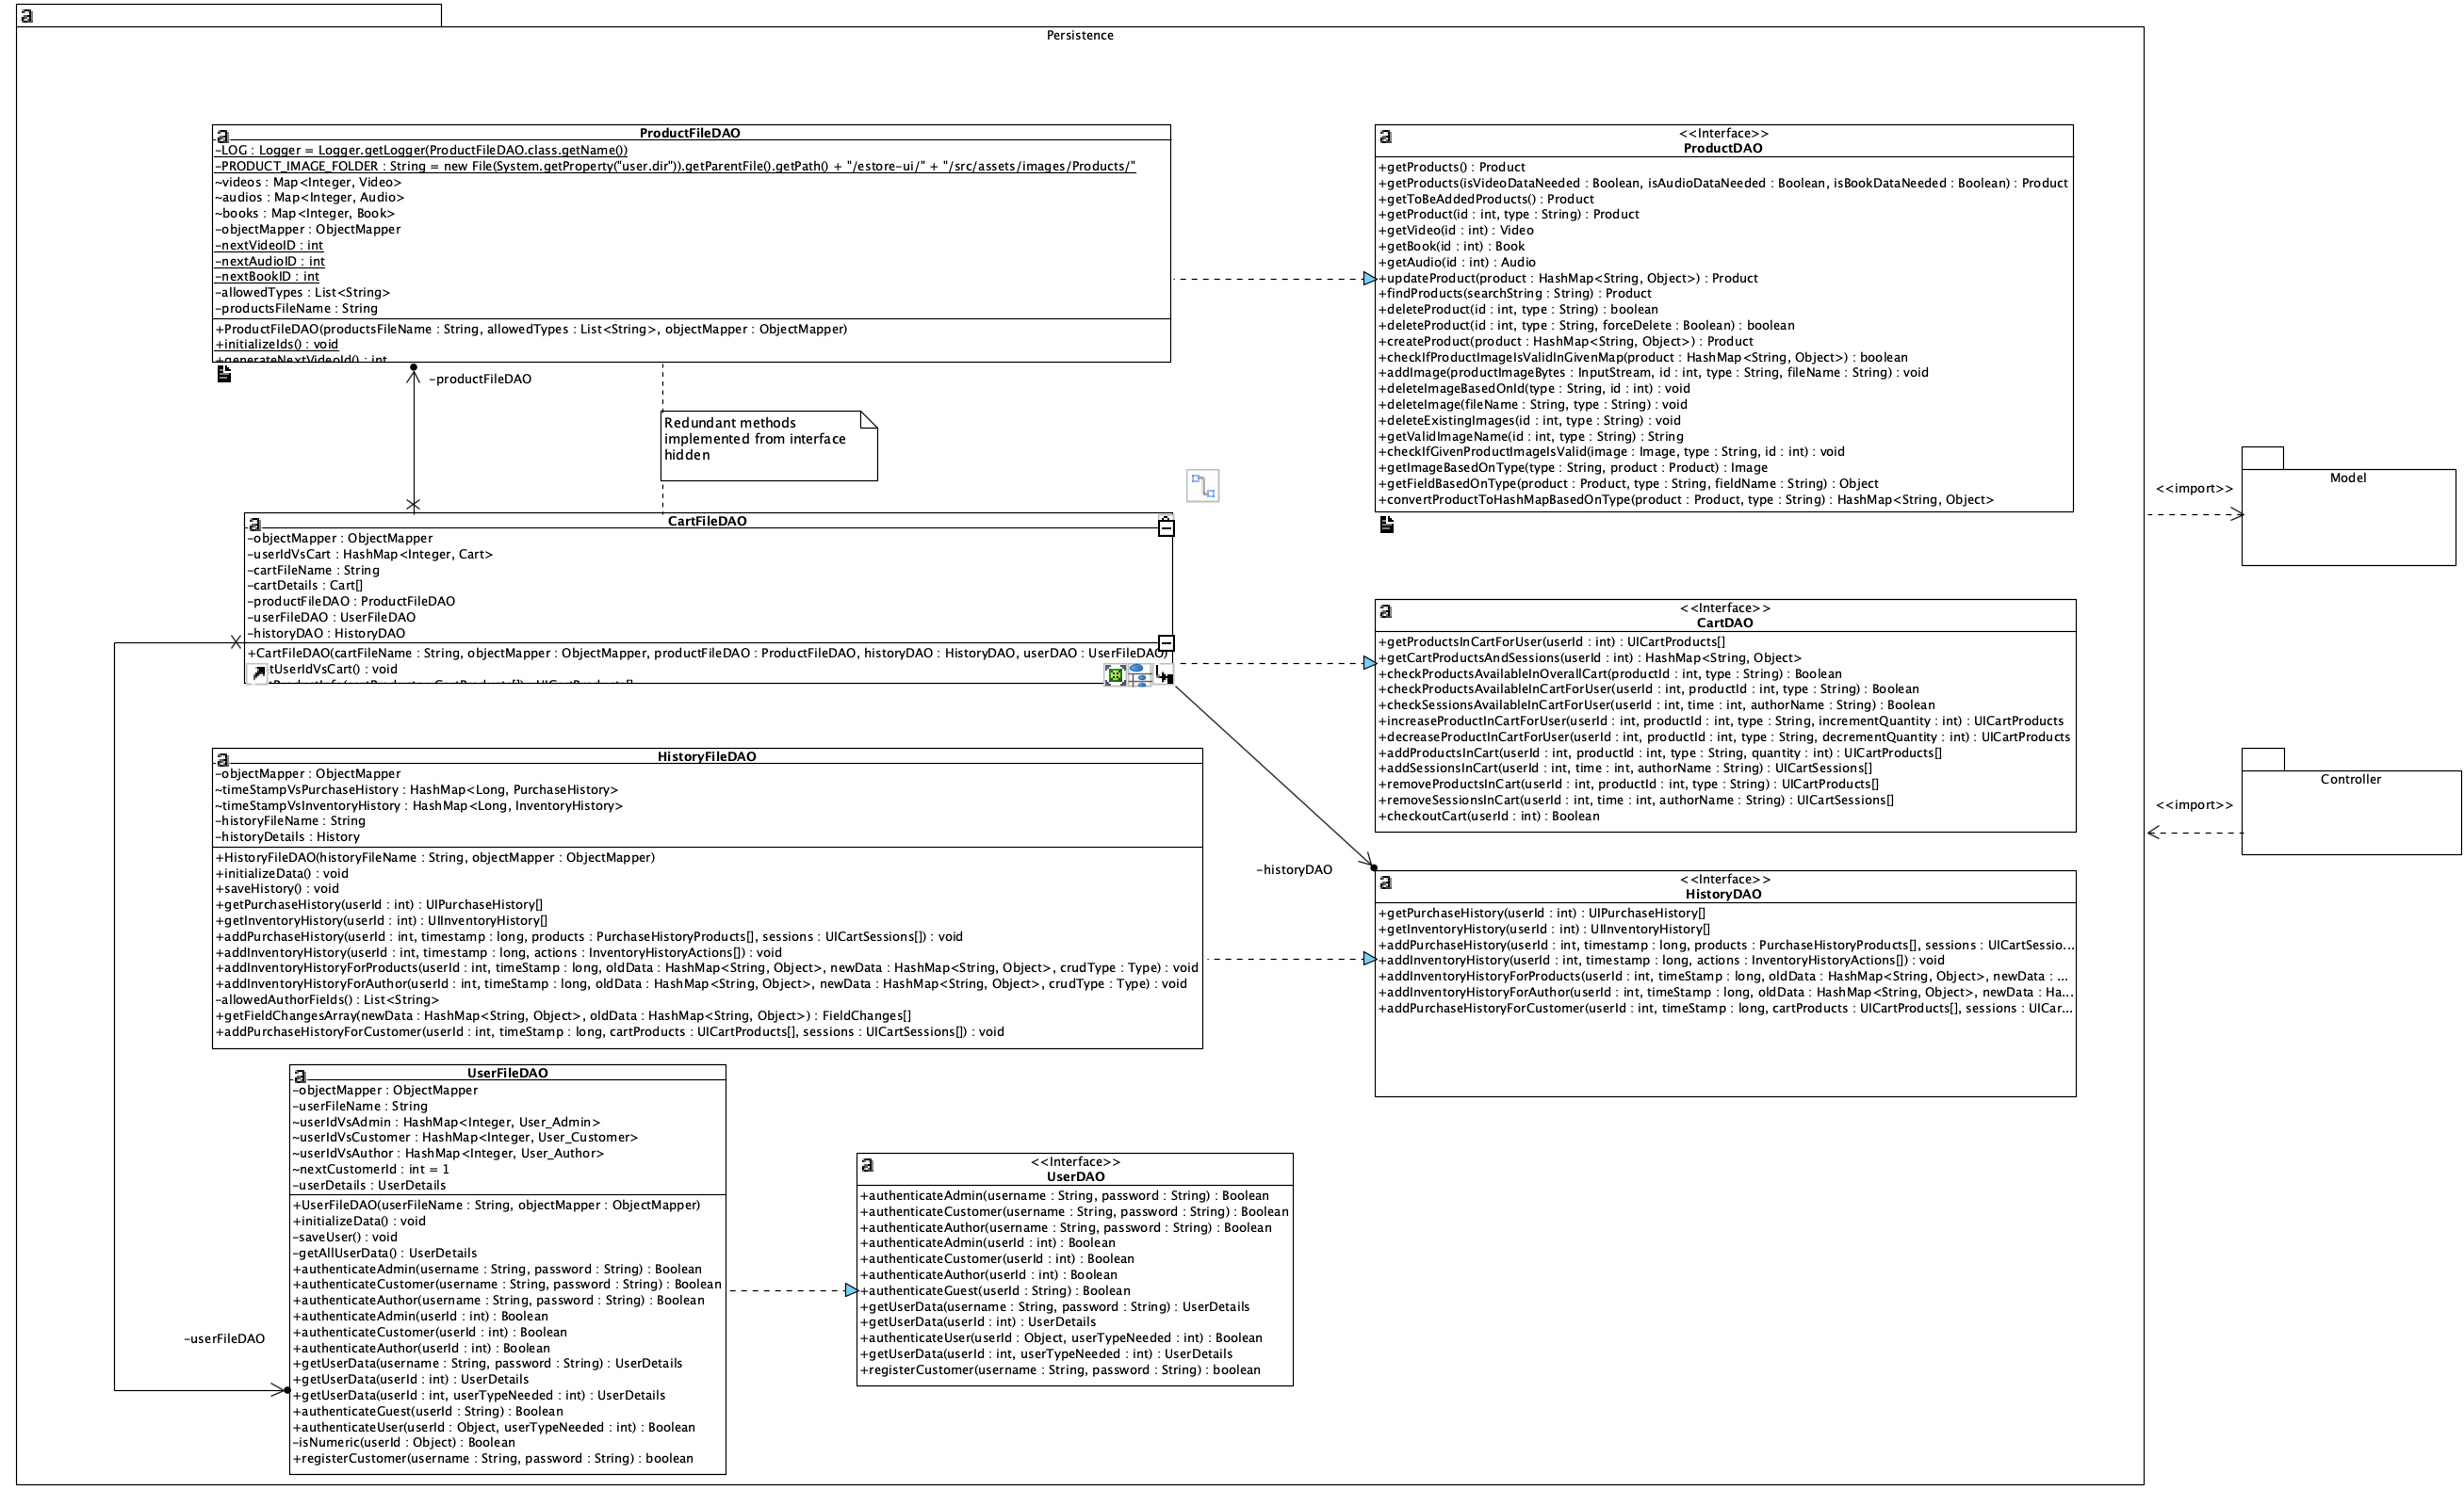
Persistence Package – Detailed Class Diagram

Slide 8
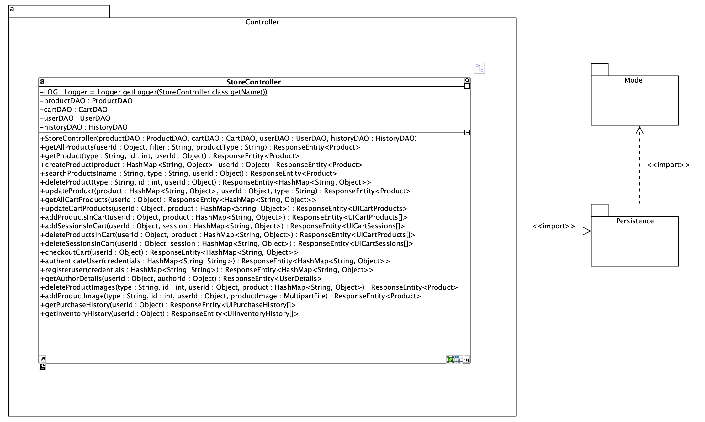
Controller Package – Detailed Class Diagram

Slide 9
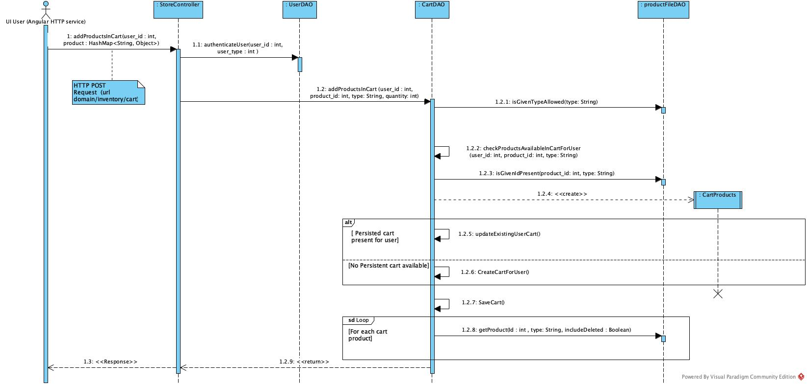
Sub class diagram – Customer Adding Items to cart

Slide 10
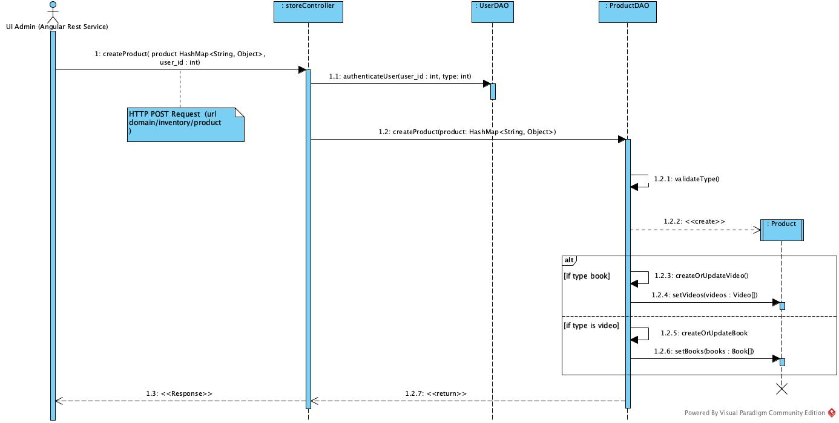
Sub class diagram – Admin add product to inventory

Slide 11


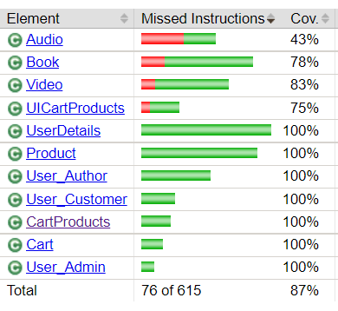
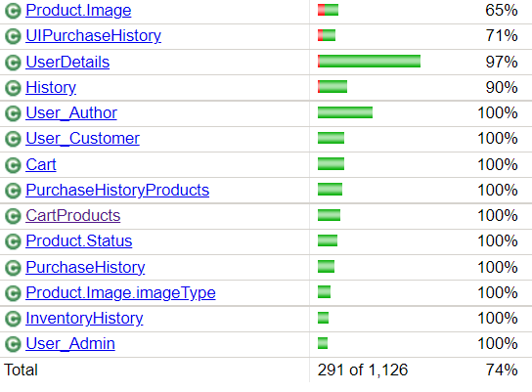
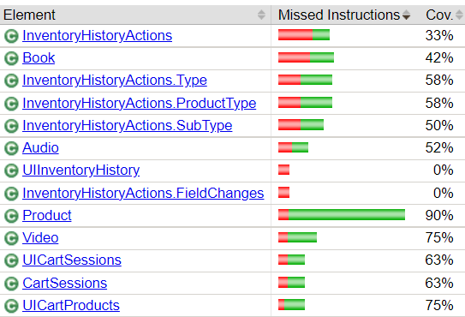
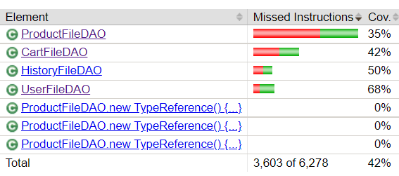
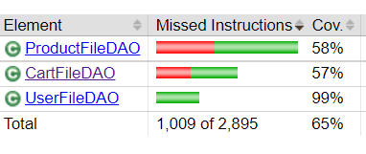
Unit Testing and Coverage
End of sprint 2
End of sprint 3
controller
Retesting refactored modules, exponential growth in new functionality forced the team to focus only on crucial parts of testing in the time available for sprint 3,
Hence, though the coverage has grown the percentage coverage seems lesser than sprint 2.
controller
model
model
persistence
persistence

Slide 12
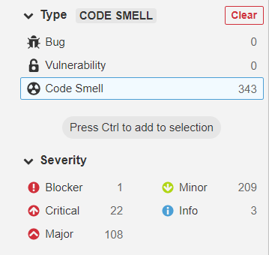
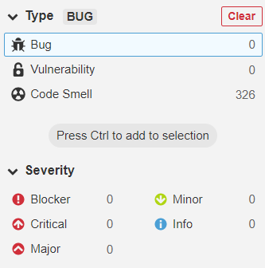
Static Code Analysis highlights
estore-api end of sprint 2
estore-api end of sprint 3
Key changes made to reduce code smell
String repetency avoiding – CodeSmellFixer java class was introduced to define and reuse names and strings. This helped maintain standard and avoiding case changes of same variables.
String readability was improved using standard camel case style guides
Exception handling was made more specific:
Ex: throw new Exception("INVALID_BODY")
was changed to
throw new IllegalArgumentException();
Variable naming convention standards were practiced better.
Declaration of data structures was changed to match standards of latest java.
Ex: ArrayList<Integer> a = new ArrayList<Integer>()
was changed to
ArrayList<Integer> a = new ArrayList<>()
~1000 lines of code
~2000 lines of code
throw new Exception("INVALID_BODY")
throw new Exception("INVALID_BODY")
11:23
throw new IllegalArgumentException();
throw new Exception("INVALID_BODY")
11:23
throw new IllegalArgumentException();
11:23
throw new IllegalArgumentException();

Slide 13
Improvements and changes in Backend API during sprint 3
File handling was added to add images to products using product addition and update forms
CodeSmellFixer class was introduced to standardize the strings and names.
Cart and Inventory history persistence layer and respective access APIs were added.
The following new functionality were introduced as a part of Enhancements (10% feature):
a) Author can now login and raise request for addition of new product.
b) Admin can view the author requests and approve for the product to be listed on inventory and e-store.
c) Customer can view author details and add author listed webinar sessions to cart .
Authentication and registration related improvemnts were added

Slide 14
Improvements changes in UI in sprint 3
Addition of angular material components
Overhaul in landing page UI
New cards for products
New search bar
New navbar
Overhaul of how list are displayed (now in tables)
Overhaul and additions of validation in forms
Improvements in cart CSS

Slide 15
Recommendations for design improvements
Split Controller into multiple modules to separate the concerns and increase maintainability.
Add Utils package to centralize some business logic and reduce the redundancy of logic in similar functions or pages.
Add service classes where necessary to separate concerns and responsibilities of the DAO. So that DAO is only focusing on data access.
Add another routing layer on top of the api controllers based on category of request.

