Slide 1
IEM-SC 2020
Optimised Hierarchy Based Shortest Path Algorithm
Authors:- Jagreet Das Gupta, Anirban Bhattacharjee

Slide 2
Shortest Paths and it's Significance
Efficiently determining Shortest Paths on Road Maps has been a heavily engineered function for many routing apps like Google Maps & Yandex Maps for years now. Dutch computer scientist, Edsger W. Dijkstra set the stepping stone by formulating the now famous, Dijkstra’s algorithm for shortest paths. Later it was improved upon by newer algorithms like A*. We introduce a way to implement modern algorithms such as Contraction Hierarchy, Highway Hierarchy and PHAST Algorithm to find optimal shortest paths in real life scenario road maps. It bases heavily on constructing a virtual “highway” which the shortest path should pass through theoretically as they are heavily traversed in real life generally. It considers parameters such as Road Distance between nodes(Edge Weight), Importance Factor during Contraction Hierarchy Phase, Cartesian Distance From Target, External Real Time Factors like Weather and Traffic. We determine a Heuristic Function using the above parameters and then use that to run a Bi-Directional PHAST based A* from both the source and the target node and then determine the shortest path once a common highway exists in both directional search’s settled vector or a fallback stage is reached.

Slide 3
Optimised Hierarchy Based Shortest Path Algorithm
Introduction
Related Works
Preparation Phase
Highway Orienting Phase
Fallback Phase
Conclusion
Referrences

Slide 4
Introduction
The Algorithm can be broken down into 3 Phases :
1) Pre-processing or Preparation Phase
2) Highway-Orienting Phase
3) Fallback Phase
Heuristic Function Parameters :
1) Road Distance or Edge Cost (c)
2) Importance Function or CH Parameter (i)
3) Cartesian Distance from Target (d)
4) Real-Time Weather (w)
5) Average Traffic (t)

Slide 5
CONSTRAINTS AND IDEAL APPLICATION SCENARIO :
Before diving deep into the working of the algorithm, it is necessary to state the constraints based on which the algorithm will work and the ideal scenario its application is suited to.
Similar to Dijkstra’s algorithm,
It does NOT work upon:-
Graphs with negative edge weights
Graphs with self cycles
Also ideally, this approach is more tailored for a large surface area road-map usually comprising a state or two. Enlarging or Reducing the working area of the graph may produce unsatisfactory results.

Slide 6
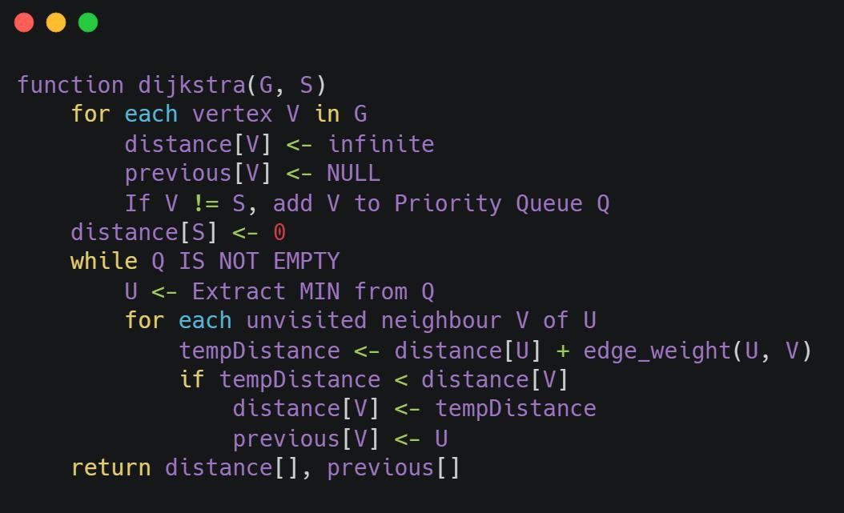
Related Works
DIJKSTRA’S ALGORITHM :
The origin of all shortest path algorithms, Dijkstra’s algorithm uses a greedy approach to quickly select the nodes closest to the source and relax the edges greedily maintaining a priority-queue to store the shortest distances to each node explored till the iteration.

Slide 7
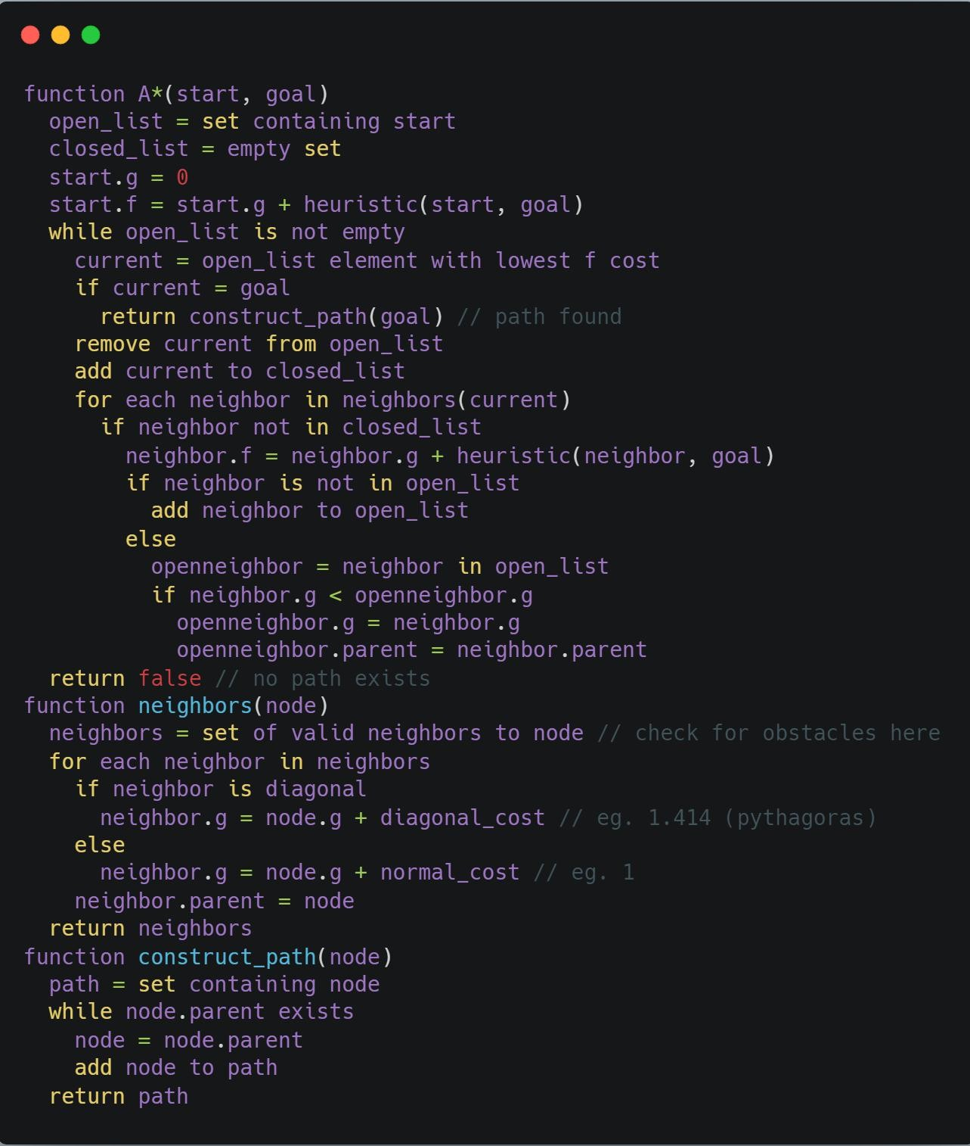
Related Works
A* ALGORITHM :
A* Algorithm is an improvement upon Dijkstra’s Algorithm as it takes into consideration a heuristic value which indicates how far a given node is from the target node. The structure is similar to Dijkstra’s Algorithm

Slide 8
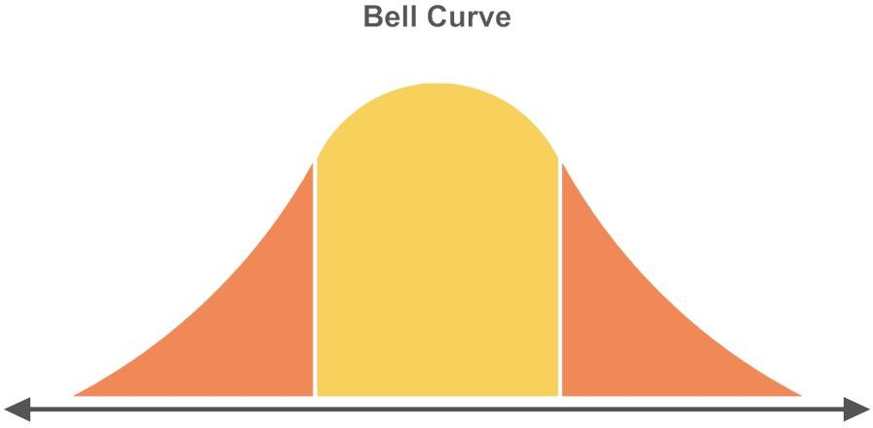
HIGHWAY HIERARCHY :
The idea of Highway Hierarchy is that most long-distance trips go through highways or technically speaking, follows a bell-curve similar to the graph shown
Where the Y axis represents the “importance” of the road traversed and the X axis represents the part of journey covered.

Slide 9
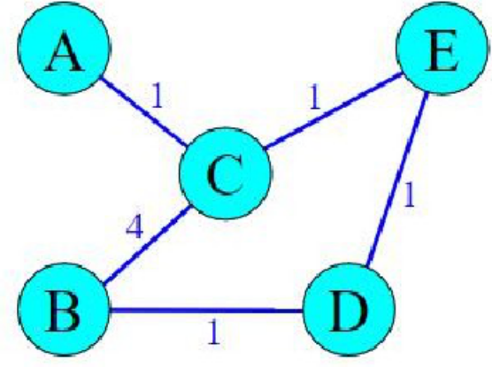
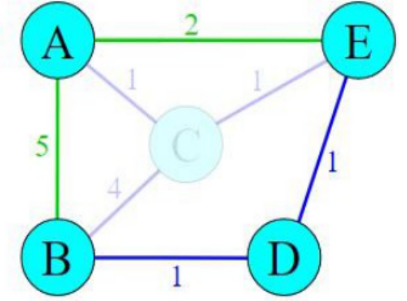
CONTRACTION HIERARCHY :
Contracting a node means removing an unimportant node from the graph and adding shortcuts between all pairs of nodes(u,v) such that the path between (u,v) that passed through the given unimportant node is represented with a single edge in the augmented graph rather than two edges and a node previously.

Slide 10
CONTRACTION HIERARCHY :
We choose the order in which the node is contracted such that :
1) The no of added shortcuts is minimized.
2) The important nodes(to be defined in the following section) is spread across the graph
3) Minimize the no of edges in the shortest paths in the augmented graph
In order to exhaustively choose this order, we first define some importance factor associated with each node which depends on the following factors :
1) The overall edge difference( Σ(added shortcuts) - Σ(in-degree of contracted nodes) - Σ(out-degree of contracted nodes) ) is minimized in the augmented graph
2) No of Contracted Neighbors of any contracted node is minimized
3) Upper Bound on the Maximum Node Level in any shortest path passing through this node between any pair of vertices(u,v) is minimized
4) Nodes which have less average No of Traversals through it in Real Life are contracted first
Proof that atleast one node will be contracted every |V| (No of Vertices) Iterations :
1) If we don’t contract a node, we update its importance
2) After |V| attempts, all nodes will have updated importance
3) The node with the minimum updated importance will be checked after that but its importance will turn out the same because it has already been recomputed and hence it gets contracted.
4) In Real Life, it has been seen the average no of iterations to contract a node is maximum one or two

Slide 11
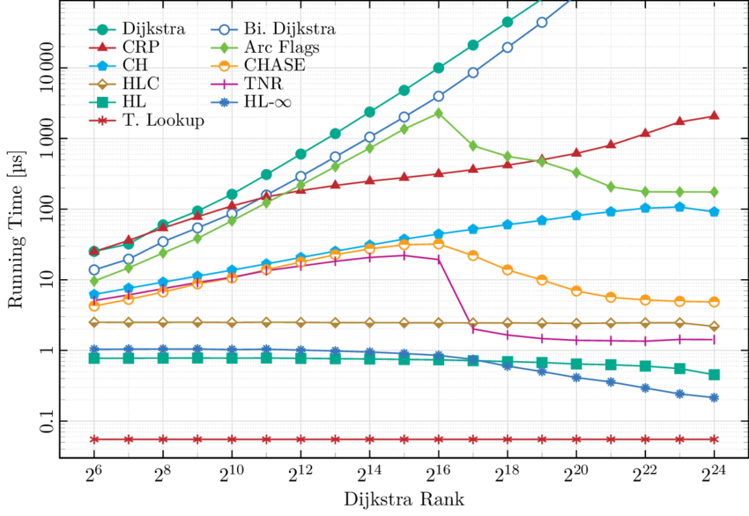
COMPARISION BETWEEN DIJKSTRA AND CH :
On a graph of Europe with 18 million nodes, random pairs of vertices were chosen, Dijkstra had an avg run-time of 4.365 seconds while CH had an avg run-time of 0.18 milliseconds. Almost 25000 times faster !
Here is a more exhaustive statistical comparison of running times between popular shortest path algorithms :

Slide 12
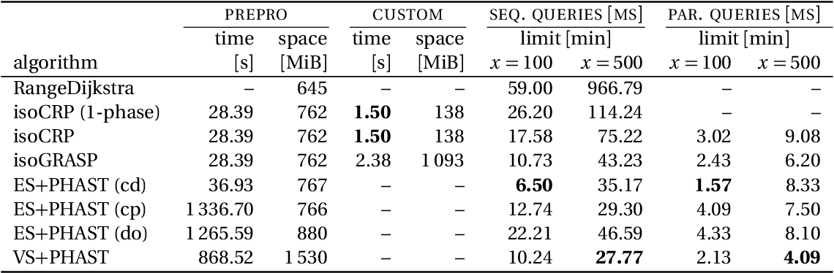
PHAST ALGORITHM :
In the original PHAST, the pre-processing search begins with a forward upward search from the source node and the backward search from the target node determines distance to all nodes. It does so by relaxing all edges(u,v) in the backward graph such that rank(u)>rank(v). We extend this idea in the forward search as well thereby obtaining a comparitively linear graph traversal

Slide 13
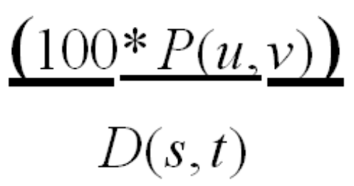
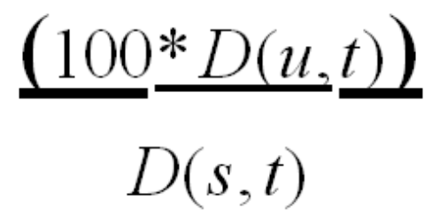
Preparation Phase:
First we make an exhaustive list of all the parameters involved and then form an efficient equation for the heuristic function of A*.
1) Weather (w)
2) Traffic (t)
3) Edge Cost / Road Distance (c)
4) Cartesian Distance from Target Node (d)
5) Importance (i)
All Parameters lie in the tentative range [0-100]. Some parameters may exceed or fall below this range in extreme cases.
  Edge Cost (c)
  Cartesian distance from Target Node(d)

Slide 14
Preparation Phase:
Weather :
We divide the entire graph into a four fold grid-square system, determine the average weather in each square grid and denote the weather parameter in all nodes in that grid by the same. Weather function of an edge is the mean of the two nodes it connects. It has an index of 1 and a co-efficient 2 in the heuristic function. A value of 0 indicates minimal weather involvement while a value of 100 indicates extreme weather interference.
Traffic :
It is the mean traffic across the nodes in the previous few days. Traffic function of an edge is the mean of the two nodes it connects. It has an index of 3 and co-efficient 1. A value of 0 indicates no traffic while 100 indicates a Jammed road.

Slide 15
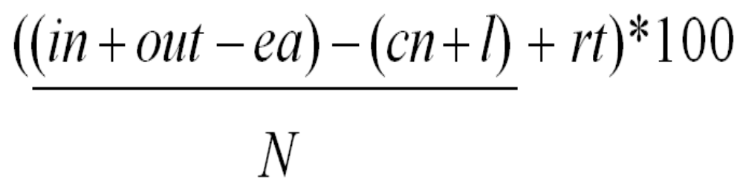
Preparation Phase:
The Importance parameter depends on several factors and is given by the equation :
in : The Summation of in-degrees of the contracted nodes in CH
out : The Summation of out degrees of the contracted nodes in CH
ea : Edges Added during the shortcut creation part of CH
cn : Number of Contracted Neighbors of the given Node
rt : Average probability of this node being traversed in a shortest path
l : Upper Bound on the node level in any shortest path passing through it

Slide 16
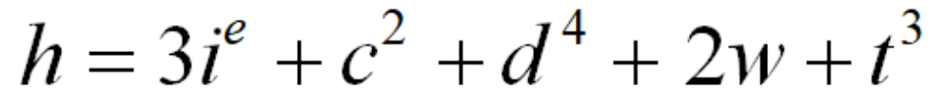
Preparation Phase:
Heuristic Function :
We will use this heuristic function to direct our A* search in later stages of the algorithm.
The next part of the Preparation Phase is the Contraction and PHAST Phase. Contraction Heuristic
Algorithm contracts the graph into an augmented graph as explained previously using another
parameter called the probability function and then PHAST is run on the augmented graph to
memoize the highway path for later lookup. This terminates the preparation phase.

Slide 17
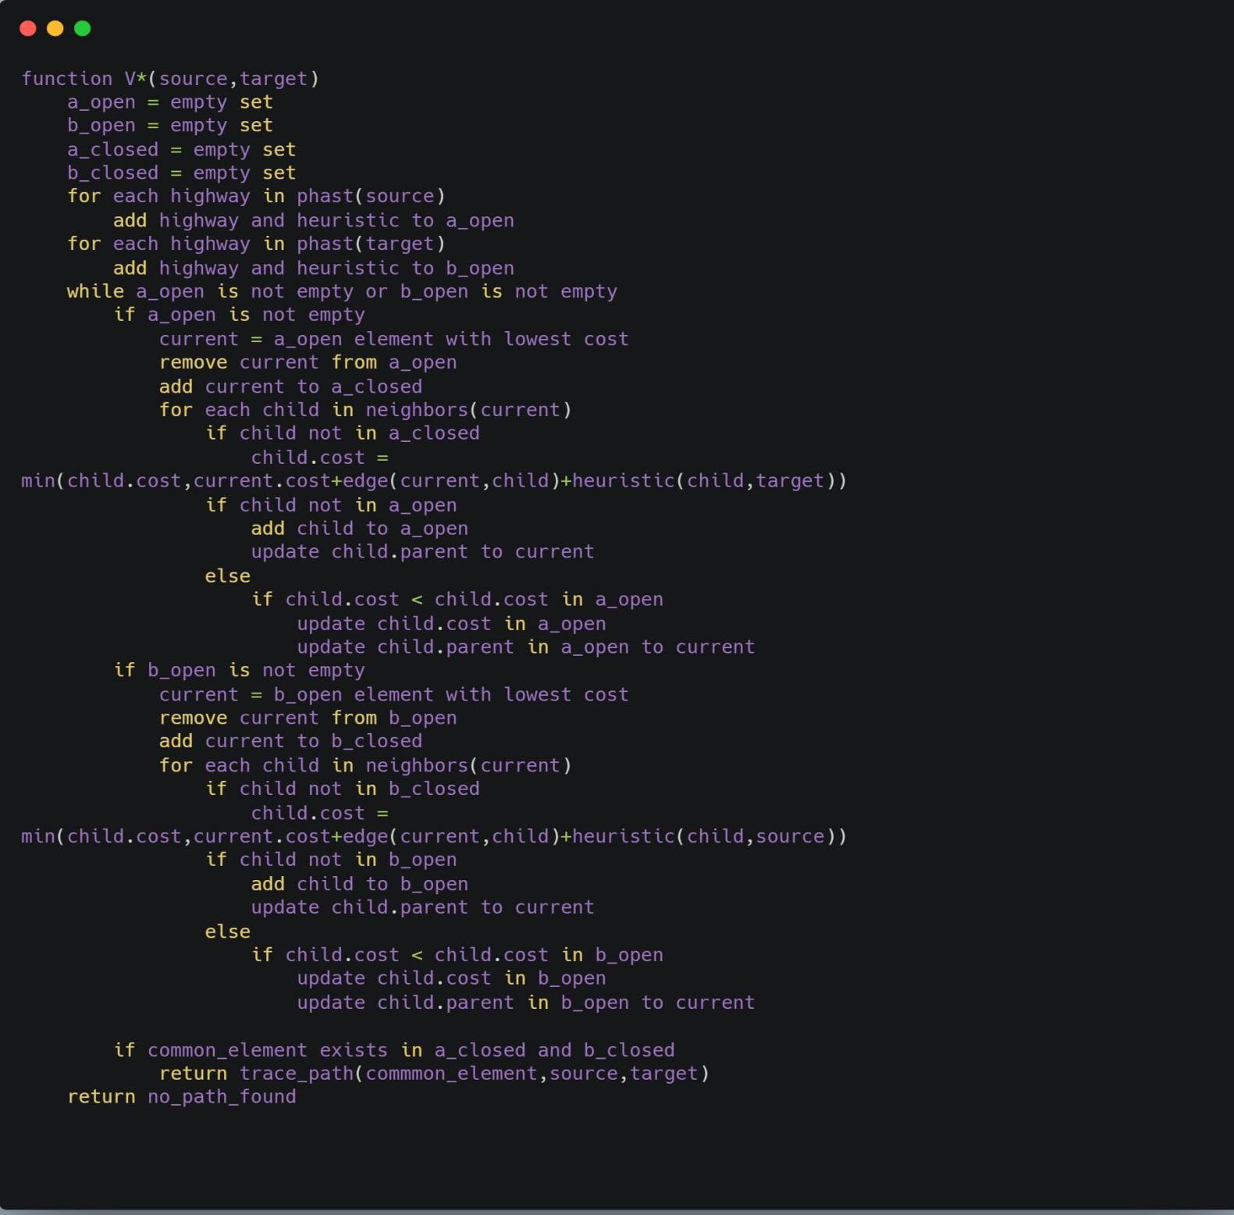
Highway Orienting Phase
This is the core phase of the algorithm and generally yields the fastest query times. Initially it sets a live traffic variable for each highway edge and a suitable threshold traffic is selected.
If during any point of time during this phase, the live traffic variable on any highway edge exceeds the threshold, the algorithm automatically transitions over to Fallback Phase. The A* Directed search during this phase is as follows :

Slide 18
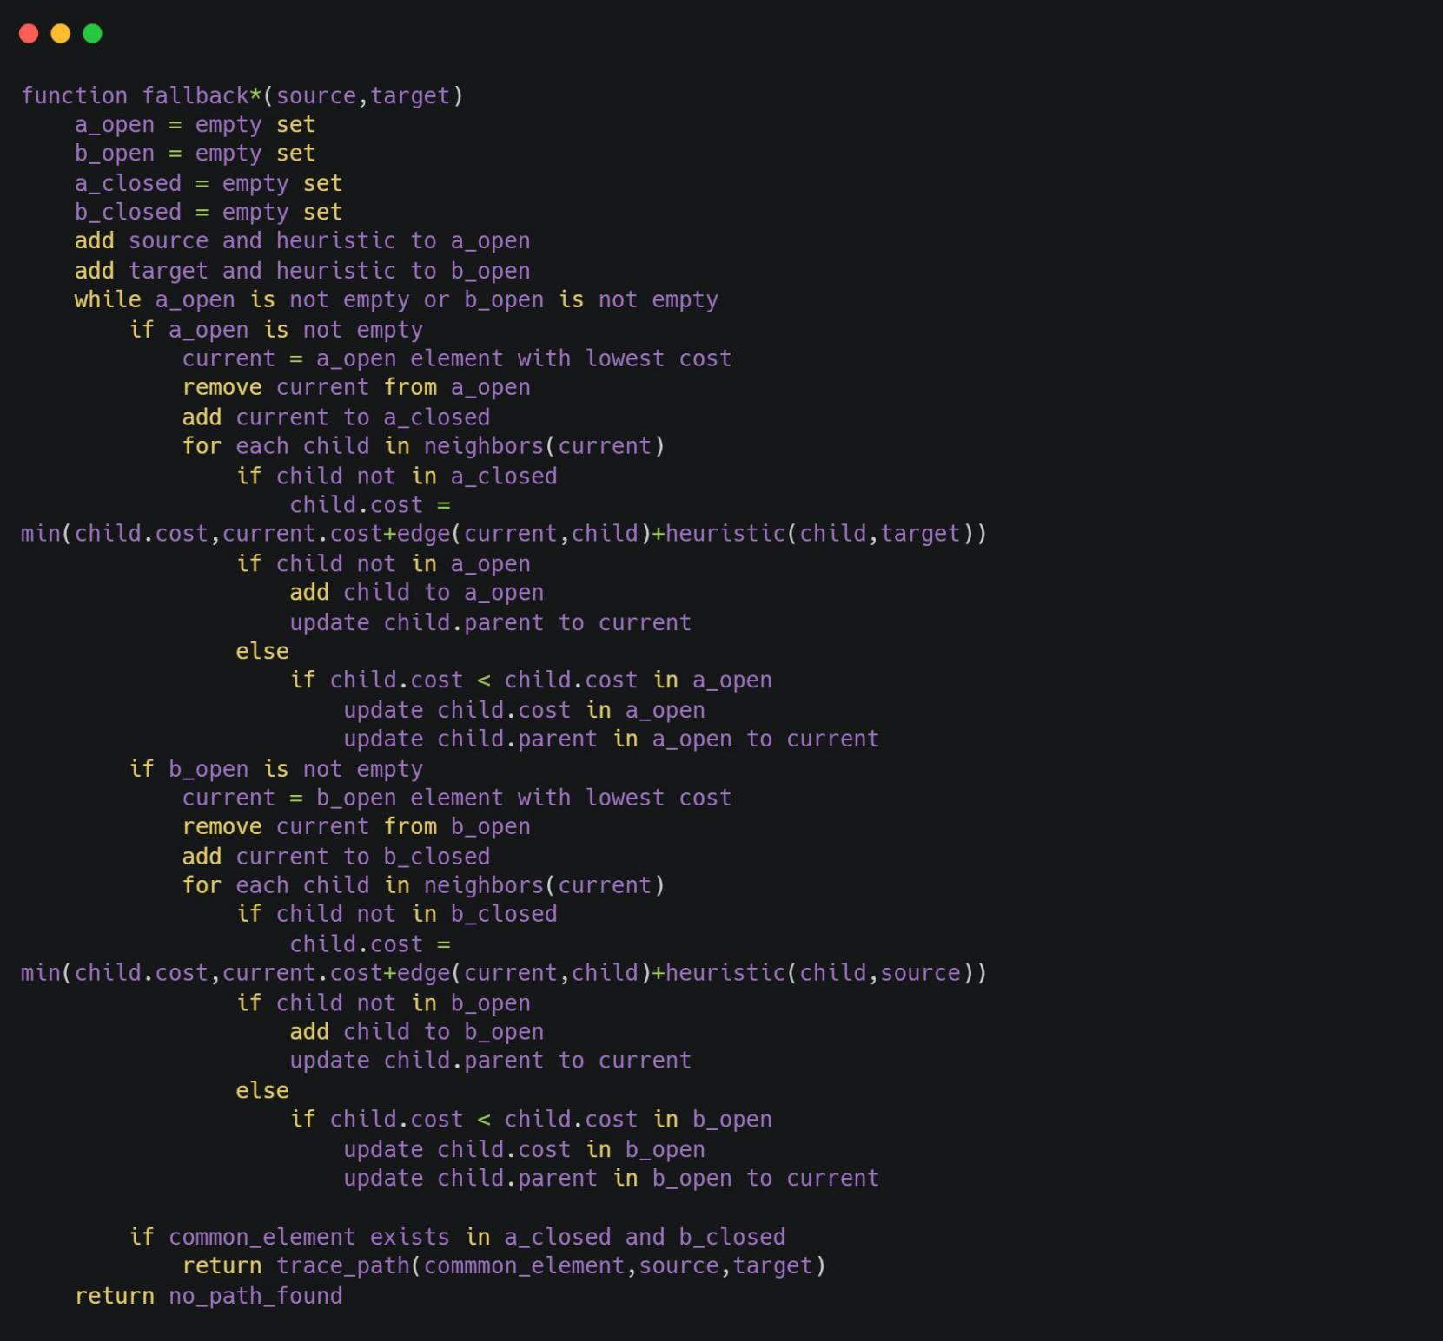
Fallback
This phase only runs when the traffic in any one of the highways crosses the threshold.
Highway Hierarchy and PHAST Optimization has to be abandoned until the traffic stabilizes.
The running time of this phase is significantly lower than Highway-Oriented Phase as it doesn’t use the PHAST Memorizations but in turn provides a more traffic friendly routing to prevent deadlocks in highways.

Slide 19
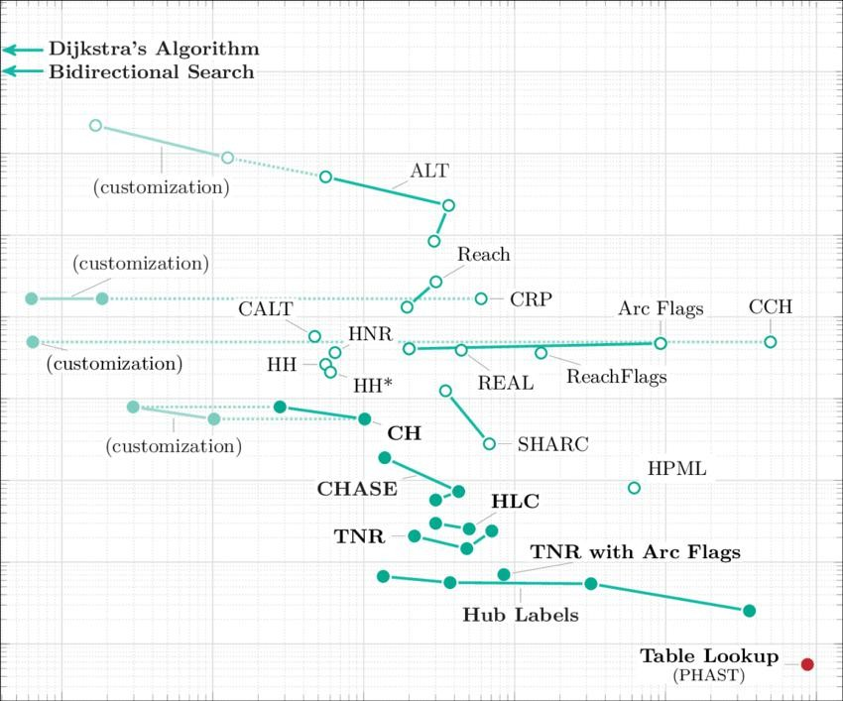
Conclusions:
Dijkstra and A* algorithms do the job efficiently but are unscalable on large graphs.
Modern algorithms like Contraction Hierarchies, CALT, ALT, CRP etc. tend to achieve acceptable numbers, memorization algorithms like PHAST although outperform them.
Here is a graphical comparison between the most popular shortest-path algorithms.

Slide 20
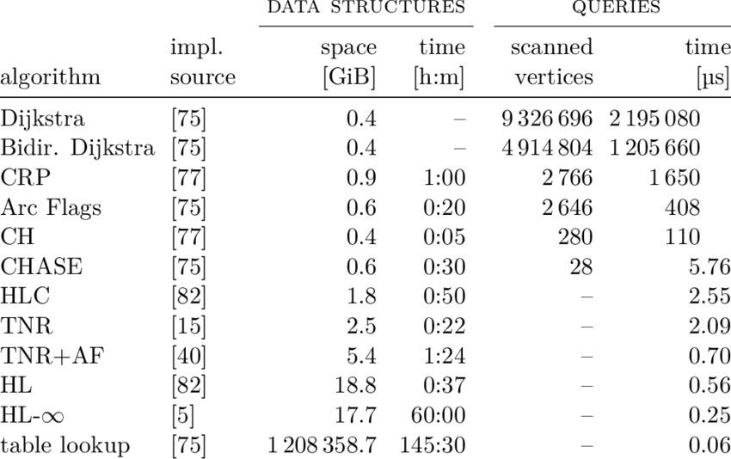
Conclusions:
The proposed approach in this paper presents a hybrid algorithm, which combines the pros of the common algorithms and provides an efficient, scalable solution to the shortest-path problems in road-network graphs.
But we may not always have the necessary memory power needed for efficient PHAST Execution, as it tends to take up rather ridiculous chunks of memory as illustrated by this memory-time usage table of shortest-path common algorithms :

Slide 21
References:
PHAST : Daniel Delling, Andrew V. Goldberg, Andreas Nowatzyk, Renato F. Werneck, Microsoft Research Silicon Valley, 1065 La Avenida, Mountain View, CA 94043, USA https://www.microsoft.com/en-us/research/wp-content/uploads/2010/09/phastTR.pdf
Engineering Highway Hierarchies : Peter Sanders and Dominik Schultes, Universit¨at Karlsruhe (TH), 76128 Karlsruhe, Germany http://algo2.iti.kit.edu/documents/routeplanning/esa06HwyHierarchies.pdf
Transit Node Routing Reconsidered : Julian Arz, Dennis Luxen, Peter Sanders, Karlsruhe Institute of Technology (KIT), 76128 Karlsruhe, Germany http://algo2.iti.kit.edu/documents/chbasedtnr_TR.pdf
Contraction Hierarchies : Robert Geisberger, Peter Sanders, Dominik Schultes, and Daniel Delling, Universit¨at Karlsruhe (TH), 76128 Karlsruhe, Germany http://algo2.iti.kit.edu/schultes/hwy/contract.pdf
Dijkstra : Edsger W. Dijkstra. A Note on Two Problems in Connexion with Graphs. Numerische Mathematik, 1(1):269–271, 1959.
A* : Andrew V. Goldberg and Chris Harrelson. Computing the Shortest Path: A* Search Meets Graph Theory. In Proceedings of the 16th Annual ACM–SIAM Symposium on Discrete Algorithms (SODA’05), pages 156–165. SIAM, 2005.

Slide 22


