Slide 1

EVALUATION OF MACHINE LEARNING METHODS FOR DETECTING LEGITIMACY OF NEWS ON EXTENDED DATASET
PRESENTED BY:
Jagriti Shahi
16/ICS/025
Integrated B.Tech +M.Tech (AIR)
SUPERVISED BY:
Dr. Anurag Singh Baghel
DEPARTMENT OF COMPUTER SCIENCE AND ENGINEERING
GAUTAM BUDDHA UNIVERSITY
GREATER NOIDA-201310, UTTAR PRADESH, INDIA

Slide 2

OUTLINES
INTRODUCTION
STUDY AND REVIEW OF LITERATURE
PROBLEM IDENTIFICATION
DATASET DESCRIPTION
RESEARCH OBJECTIVES
RESEARCH METHODOLOGY
IMPLEMENTATION
RESULTS AND COMPARISON OF MODELS
CONCLUSION
REFERENCES
2

Slide 3

INTRODUCTION
What is Fake News ?
Fake news :
are false or untruthful information
intends to mislead readers
are information which is actually false, but seems true
What is Fake News Detection ?
Detecting the legitimacy of news by some methodology as real or fake.
a straight forward classic text classification problem
Used, e.g., for spam filtering

Slide 4
STUDY AND REVIEW OF LITERATURE
Reference No. | Title , Author and Year | Conference/Journal | Methodology, Findings
1. | "A Sensitive Stylistic Approach to Identify Fake News on Social Networking.“,Nicollas R. de Oliveira, Dianne S. V. Medeiros and Diogo M. F.Mattos, 2020 | IEEE Signal Processing Letters | Methodology:Applied unsupervised learning algorithms such as one-class SVM Findings: Accuracy=86%
2. | “Fake news Detection using Logistic Regression” Fathima Nada, Bariya Firdous Khan, Aroofa Maryam, Nooruz-Zuha, Zameer Ahmed,2019 | International Research Journal of Engineering and Technology (IRJET) | Methodology: Feature extraction(TF-IDF) and logistic regression classifier Findings: Accuracy=72%
3. | "Fake News Detection Using Naive Bayes Classifier”, Mykhailo Granik, Volodymyr Mesyura, 2017 | IEEE First Ukraine Conference on Electrical and Computer Engineering (UKRCON) | Methodology:Naïve Bayes Classifier Findings: Accuracy=74%
4

Slide 5
RESEARCH OBJECTIVES
Objective 1: To detect illegitimate news, which is a classic text classification problem by using existing machine learning models on extended dataset.
Objective 2: To compare some of predictions method and check which is more accurate and efficient.

Slide 6
DATASET USED
Dataset Description:
Dataset 1:
The dataset used for this project is drawn from Kaggle.
The training dataset has about 20,800 rows of data from various articles on the internet.
A full training dataset has the following attributes:
id: unique id for a news article
title: the title of a news article
author: author of the news article
text: the text of the article; incomplete in some cases
label: a label that marks the article as potentially unreliable
1: fake
0: real

Slide 7
DATASET USED
Dataset 2:
This dataset has around 20800 rows and 6 columns. The description of each of the column is given below:
id: This is a distinctive identification no. assigned to each news article
headline: It is the title of the news article.
news: It contains the full content of the news article
Unnamed:0: It is a serial number
written_by: It represents the author of the news article
label: a tag name provided to each article to categorize it in two groups
1:counterfeit
0: genuine

Slide 8
RESEARCH METHODOLOGY
Flow of implementation
Dataset 1
Data-preprocessing (Stopword removal tokenzing, missing rows elimination etc.)
Dataset
Feature Extraction (DOC2VEC)
Dataset 2
Splitting the dataset
K-nearest neighbor
Random Forest Classifier
Long short-term Memory
Prediction
Genuine
Fake

Slide 9
DATA PREPROCESSING
Data preprocessing allows for the removal of unwanted data with the use of data cleaning, this allows the user to have a dataset to contain more valuable information after the preprocessing stage.
Perform various text cleaning steps (remove all non-alphanumeric characters, delete stopwords, delete missing rows,stemming etc.)
Stopword are the words in any language that does not add much meaning to a sentence.
So, to save time and memory space they should be removed.

Slide 10
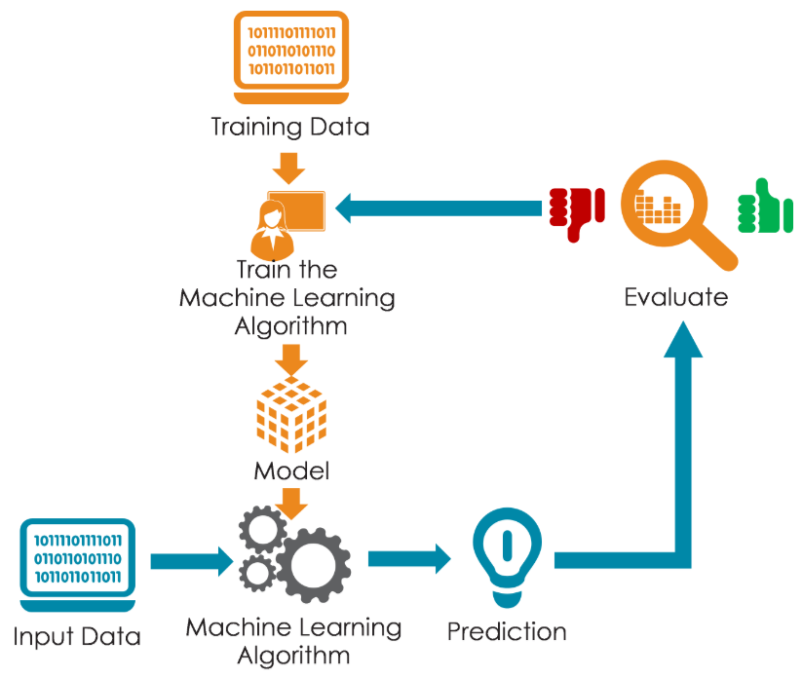
TRAINING A MODEL
Models used-
K-nearest neighbor (KNN)
Random Forest Classifier
Long Short-Term Memory (LSTM)

Slide 11
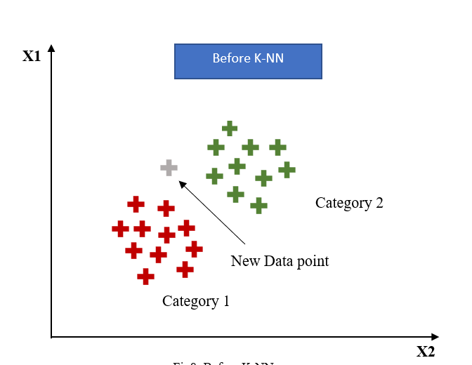
K-Nearest Neighbor
K-Nearest Neighbors is one of the most basic yet essential classification algorithms.
The KNN computations are predicted on the presumption that similar items occur in close enough proximity.
As per Euclidean distance, closest neighbors are find out.
On the basis of closest neighbors in category, the new data point is assigned to that category.
It belongs to the supervised learning domain and finds intense application in pattern recognition, data mining and intrusion detection.

Slide 12
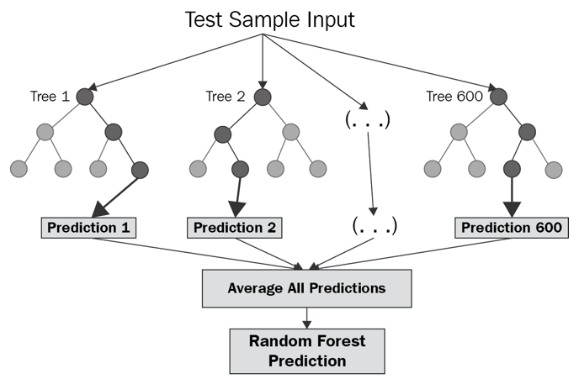
Random Forest Classifier
It is a supervised Machine learning algorithm used for classification, regression, and other tasks using decision trees.
It creates a set of decision trees from a randomly selected subset of the training set.
Then It collects the votes from different decision trees to decide the final prediction.

Slide 13
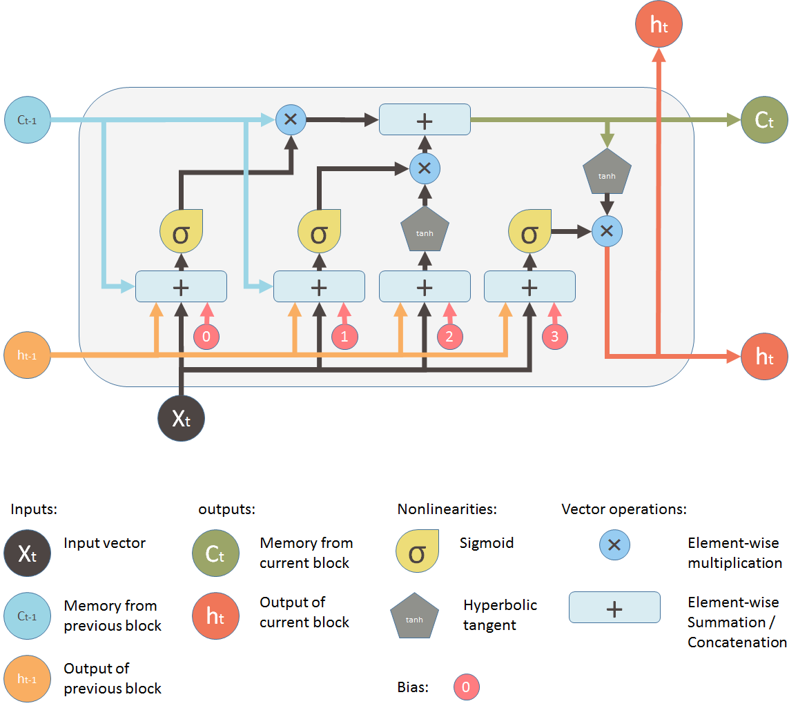
LSTM(Long short-term memory )
Long short-term memory (LSTM) is an artificial recurrent neural network (RNN) architecture used in the field of deep learning.
Unlike standard feedforward neural networks, LSTM has feedback connections.
A common LSTM unit is composed of a cell, an input gate, an output gate and a forget gate.
Applicable to tasks such as unsegmented, connected handwriting recognition, speech recognition and anomaly detection in network traffic or IDSs (intrusion detection systems).

Slide 14
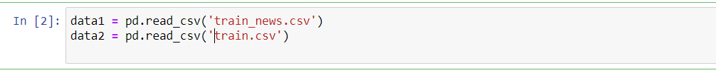
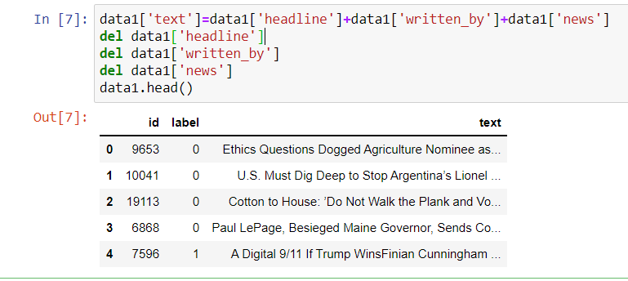
IMPLEMENTATION
Reading datasets:
Merging all the field of dataset 1 that contains content of articles like ‘headline’, ‘written_by’ & ‘news’ into one column with name ‘text’ which will be same as name of column in dataset 2, and then deleting these columns i.e; ‘headline’, ‘written_by’, ‘news’ from dataset:

Slide 15
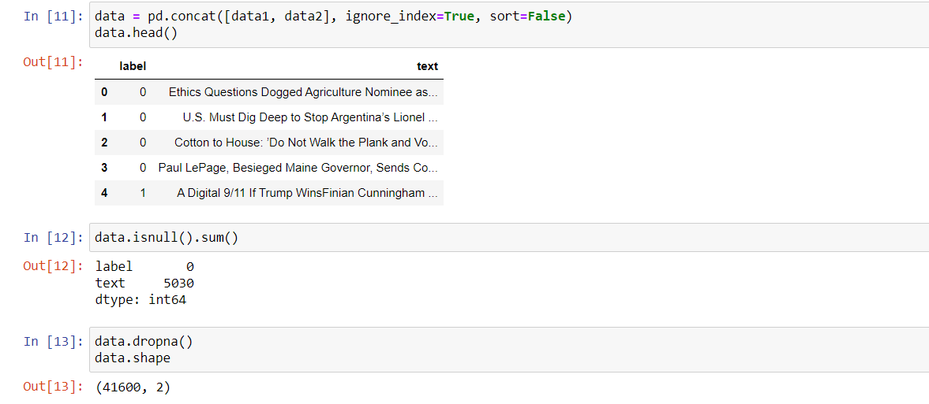
IMPLEMENTATION
Concatenating both datasets:
Dropping null values from data frame:

Slide 16
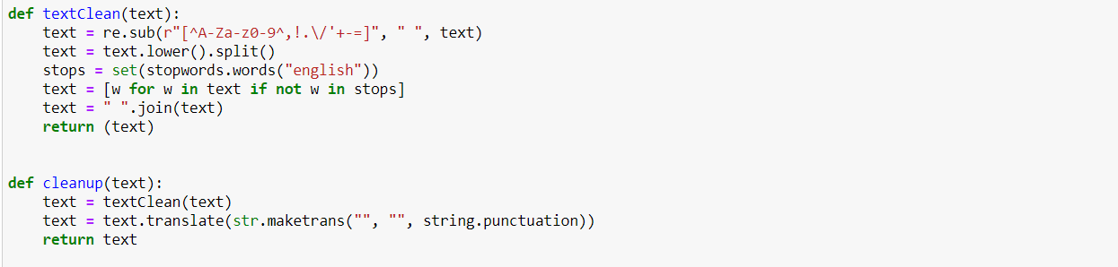
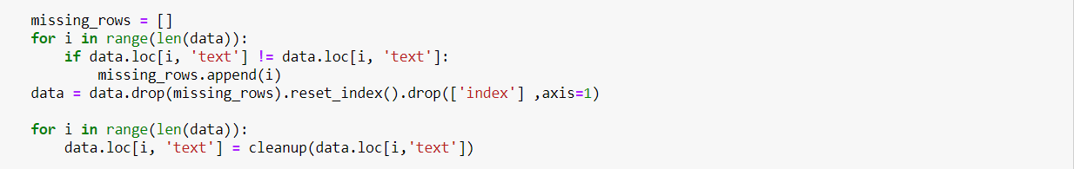
IMPLEMENTATION
Data preprocessing has been done that includes removing stop words, punctuation, and missing rows:

Slide 17
IMPLEMENTATION
Doc2Vec is using two things when preparing the model, labels and the real data. The labels can be anything, yet to make it simpler each document name will be its label.
Doc2Vec model has been applied and data frame is splitted into train & test set.
train set: 80%
test set: 20%
Train set is fitted with model to train it and then test dataset is used to evaluate the fitted model:

Slide 18
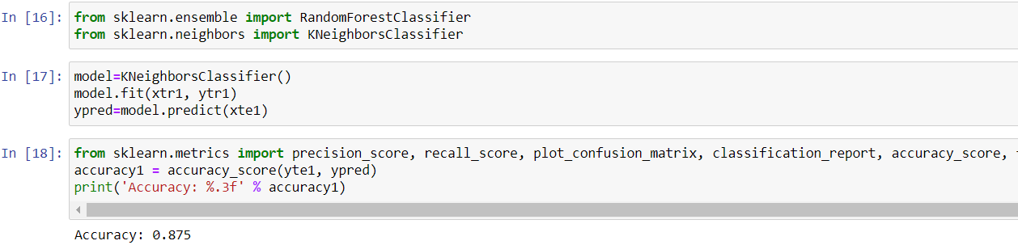
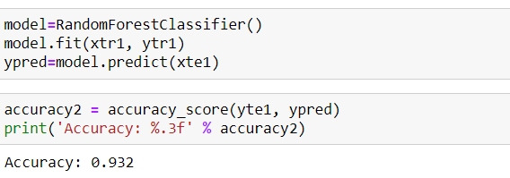
IMPLEMENTATION
Training the KNN model:
Accuracy score is calculated for KNN:
Training the Random Forest model:

Slide 19
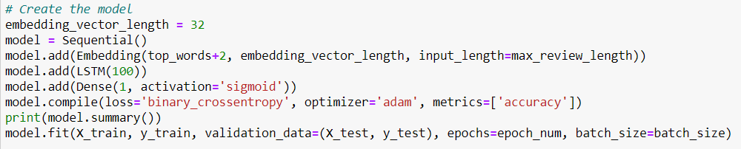
IMPLEMENTATION
Accuracy score is calculated for KNN:
Training LSTM model:

Slide 20

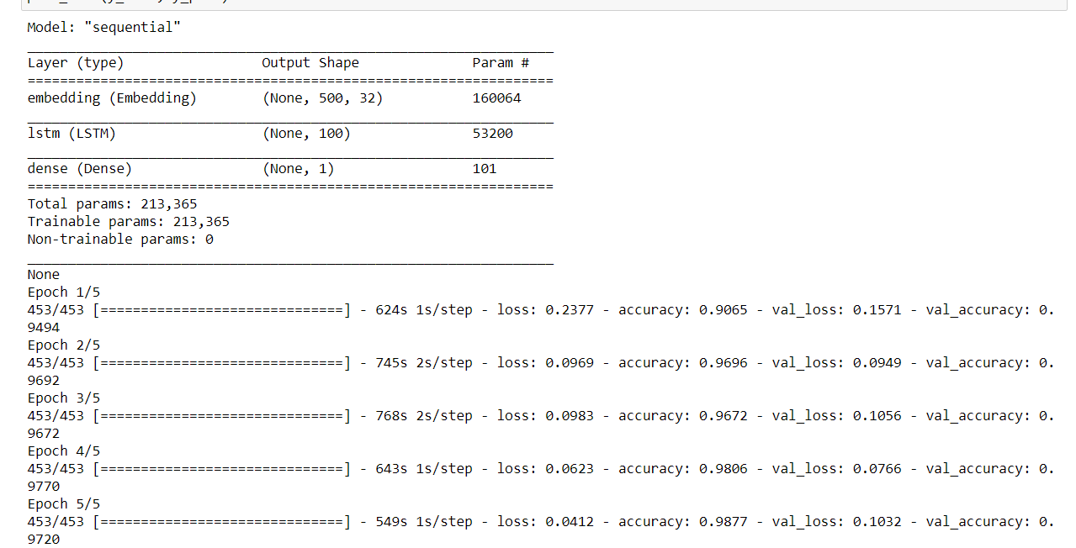
IMPLEMENTATION
Accuracy score is calculated for LSTM:

Slide 21
RESULTS AND COMPARISON OF MODELS
The results showed up by computing the accuracies of the different models referenced previously.
On the basis of accuracies achieved by model as shown in above Table, the chart in Figure below is built by putting the algorithms and accuracies on X and Y axis respectively.
MODEL | ACCURACY
K-NN | 87.50%
Random Forest Classifier | 93.04%
LSTM | 97.20%

Slide 22
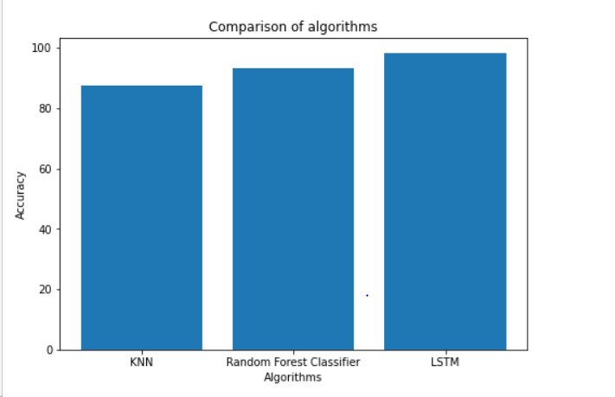
RESULTS AND COMPARISON OF MODELS
It is construed that LSTM achieves the most noteworthy accuracies followed by Random Forest Classifier and K-NN.

Slide 23
CONCLUSION
The main purpose of this project was to achieve better accuracy in task of categorizing illegitimate & legitimate news as compared to previous research work.
For obtaining the required result, we have trained some existing models on a larger dataset as compared to our base paper work and also lot of data pre-processing has been done to improve its performance.
Further, the three methodologies are researched and contrasted with their accuracies.
This approach accomplishes its most noteworthy accuracies when utilizing LSTM. The highest achieved accuracy in this task of identifying counterfeit news is 97.20%.

Slide 24
REFERENCES
[1]. de Oliveira, Nicollas R., Dianne SV Medeiros, and Diogo MF Mattos. "A Sensitive Stylistic Approach to Identify Fake News on Social Networking." IEEE Signal Processing Letters , 27 , 1250-1254,2020.
[2]. Fathima Nada, Bariya Firdous Khan, Aroofa Maryam, Nooruz-Zuha, Zameer Ahmed,“Fake news Detection using Logistic Regression”, International Research Journal of Engineering and Technology (IRJET),2019.
[3]. Shu K., Sliva A., Wang S., Tang J., Liu H., Fake News Detection on Social Media: A Data Mining Perspective, ACM SIGKDD Explorations Newsletter,19(1), 2017
[4]. Mykhailo Granik, Volodymyr Mesyura, Fake News Detection Using Naive Bayes Classifier, IEEE First Ukraine Conference on Electrical and Computer Engineering (UKRCON), 2017.
[5]. Akshay Jain, Fake News Detection, IEEE International Students’ Conference on Electrical, Electronics and Computer Sciences,2018.
[6].LSTM: https://towardsdatascience.com/exploring-activation-functions-for-neural-networks-73498da59b02

Slide 25
THANK YOU!

