Slide 1
OrgSight 2.0
Organizational Structure Analysis
Scenario: test_2
Dataset: OrgSight_Rationalisation_Test_100rows.xlsx
Exported: 25 Jun 2026
Confidential — Alvarez & Marsal

Slide 2
Executive Summary — test_2
Metric | Baseline | Current (To-Be) | Delta
Headcount | 97 | 90 | -7
Total FTE | 97.0 | 90.0 | -7.0
Total Cost | $10,062,350 | $9,357,600 | $-704,750
SAVINGS & IMPACT SUMMARY
Full-Year Annualized Savings: $169,300
Prorated In-Year Savings: $98,758
Months Remaining in FY: 7
Flagged Removed Roles: 10
Flagged Removed Value: $1,014,800
Total Changes Logged: 3
OrgSight 2.0 | test_2 | Page 2

Slide 3
Scenario Comparison Analysis
Scenario Name | HC | FTE | Cost | Δ HC | Δ Cost | Changes
Baseline | 100 | 100.0 | $10,372,400 | +3 | $+310,050 | 0
test_scenario [Baseline] | 97 | 97.0 | $10,062,350 | +0 | $+0 | 8
test_2 (Active) | 90 | 90.0 | $9,357,600 | -7 | $-704,750 | 3
OrgSight 2.0 | test_2 | Page 3

Slide 4
Implementation Phasing Timeline
Month | Adds | Removals | Net HC | Cost Delta | Cum. Cost Delta
Undated | 0 | 2 | -2 | $-169,300 | $-169,300
OrgSight 2.0 | test_2 | Page 4

Slide 5
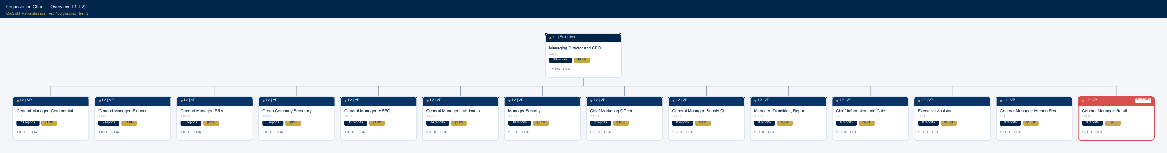
Organization Chart — Overview (L1–L2)
OrgSight 2.0 | test_2 | Page 5

Slide 6
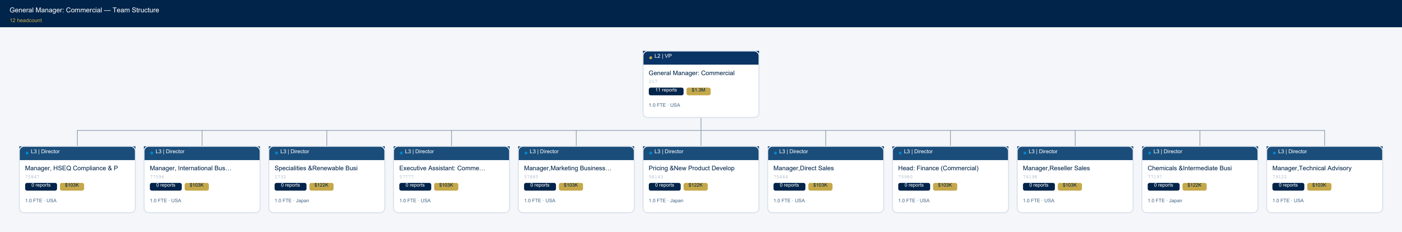
General Manager: Commercial — Team Structure
OrgSight 2.0 | test_2 | Page 6

Slide 7
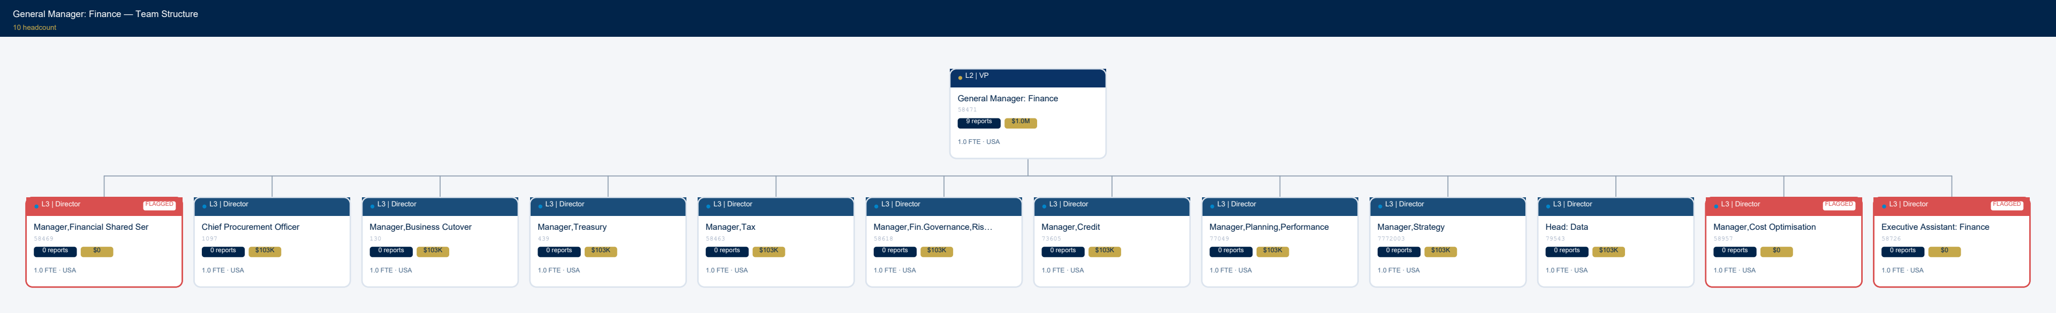
General Manager: Finance — Team Structure
OrgSight 2.0 | test_2 | Page 7

Slide 8
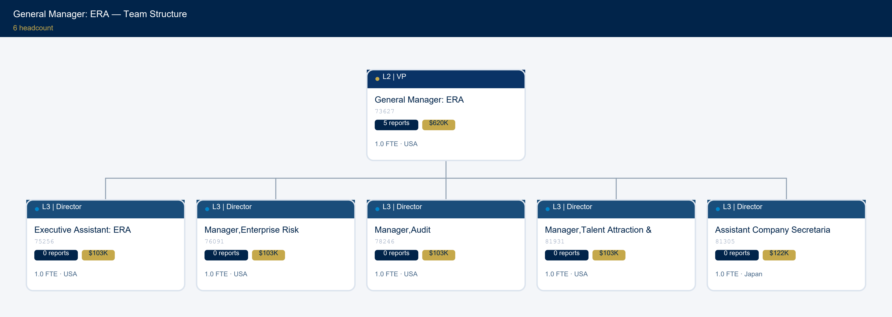
General Manager: ERA — Team Structure
OrgSight 2.0 | test_2 | Page 8

Slide 9
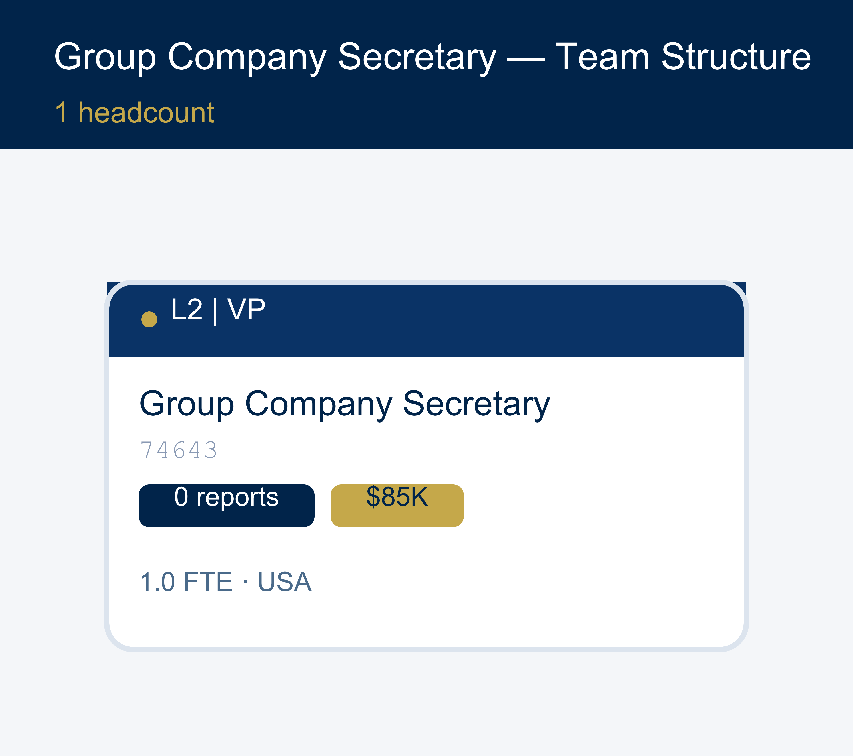
Group Company Secretary — Team Structure
OrgSight 2.0 | test_2 | Page 9

Slide 10
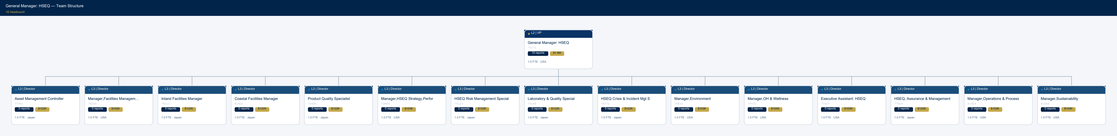
General Manager: HSEQ — Team Structure
OrgSight 2.0 | test_2 | Page 10

Slide 11
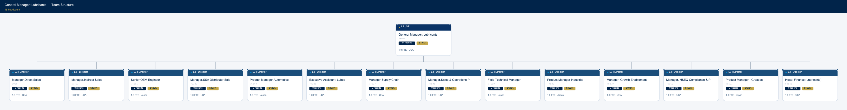
General Manager: Lubricants — Team Structure
OrgSight 2.0 | test_2 | Page 11

Slide 12
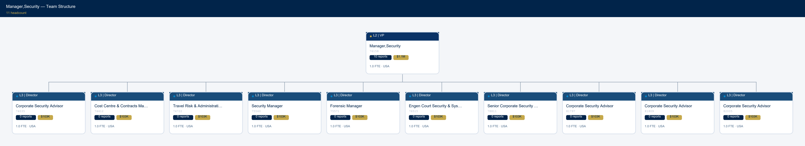
Manager,Security — Team Structure
OrgSight 2.0 | test_2 | Page 12

Slide 13
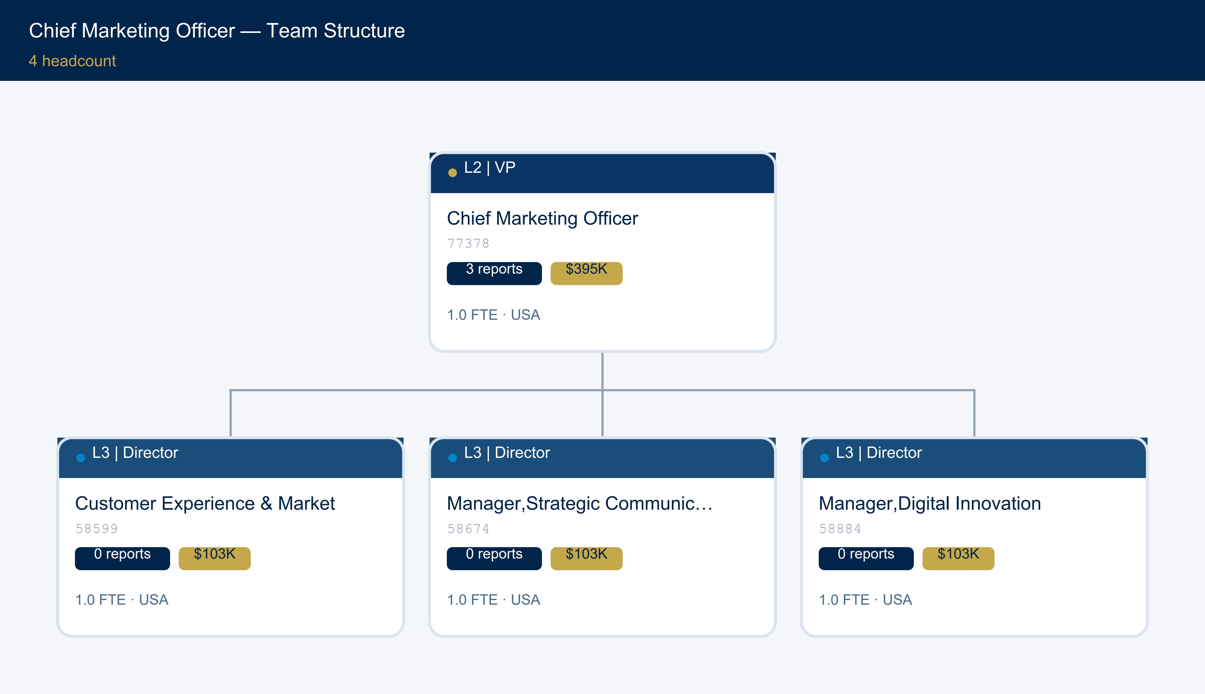
Chief Marketing Officer — Team Structure
OrgSight 2.0 | test_2 | Page 13

Slide 14
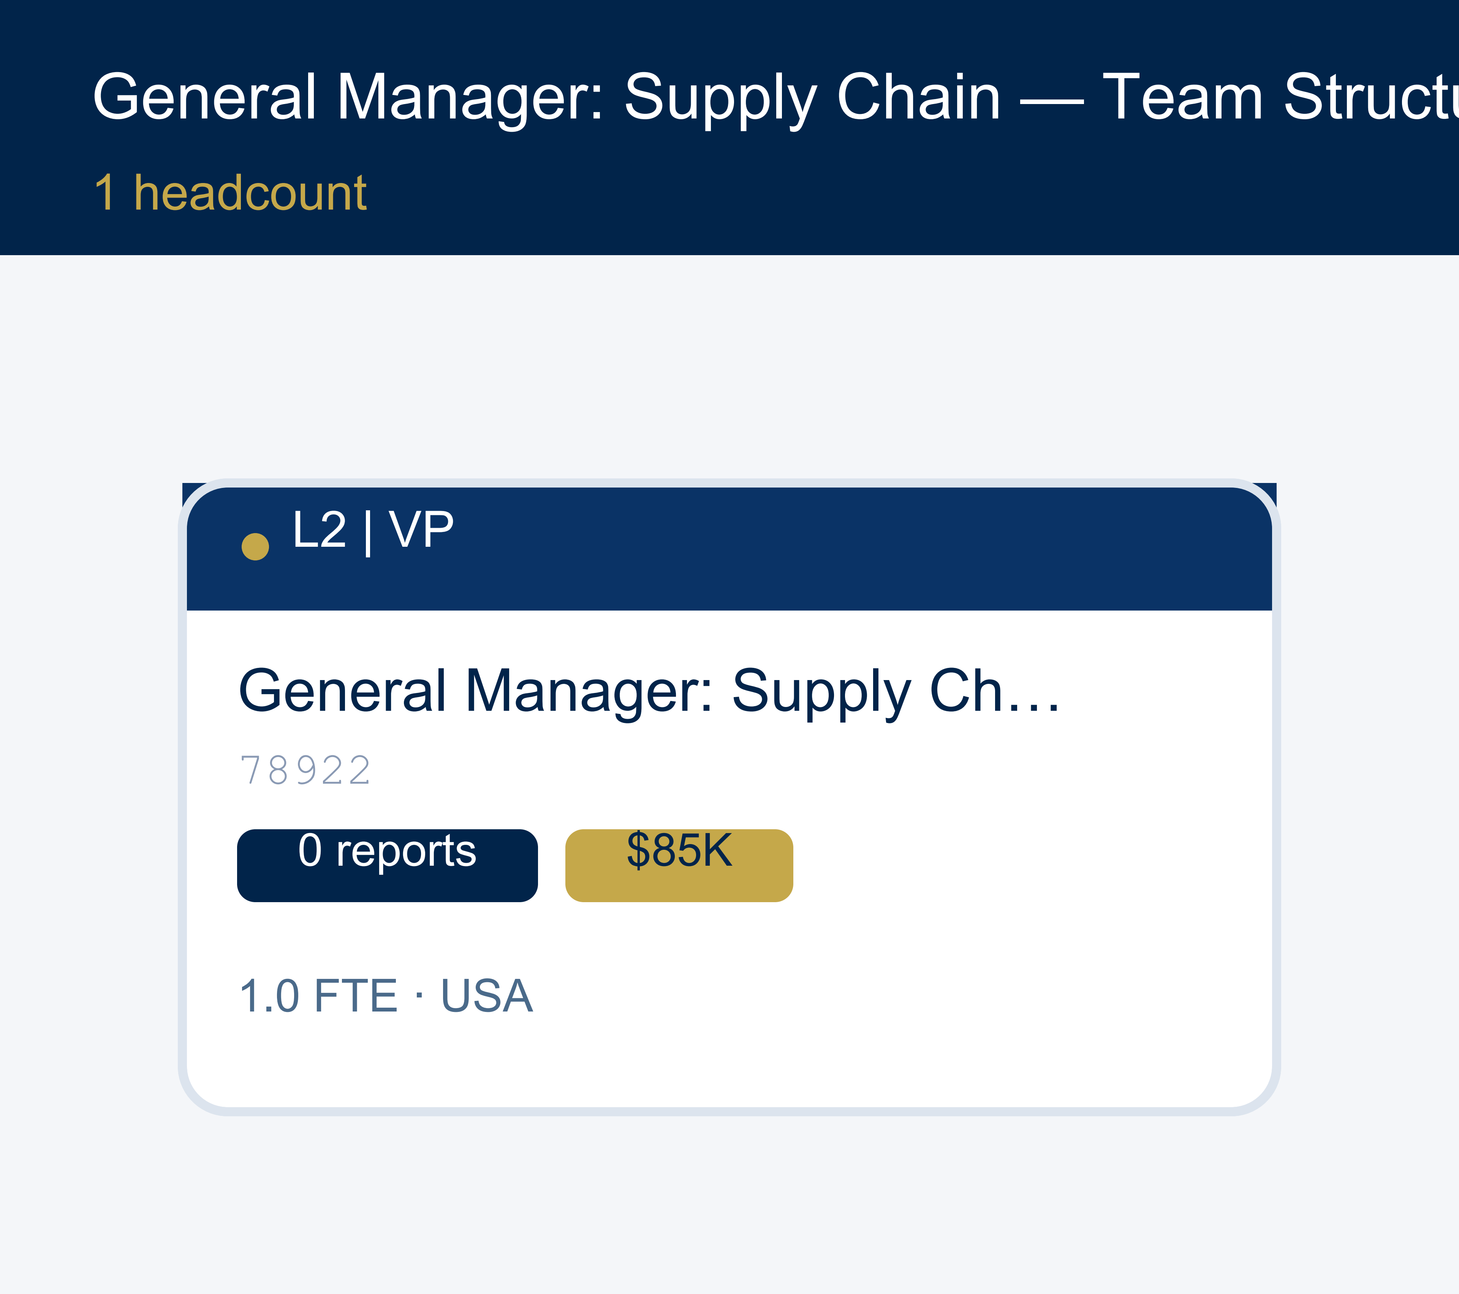
General Manager: Supply Chain — Team Structure
OrgSight 2.0 | test_2 | Page 14

Slide 15

Manager, Transition, Repurpose — Team Structure
OrgSight 2.0 | test_2 | Page 15

Slide 16
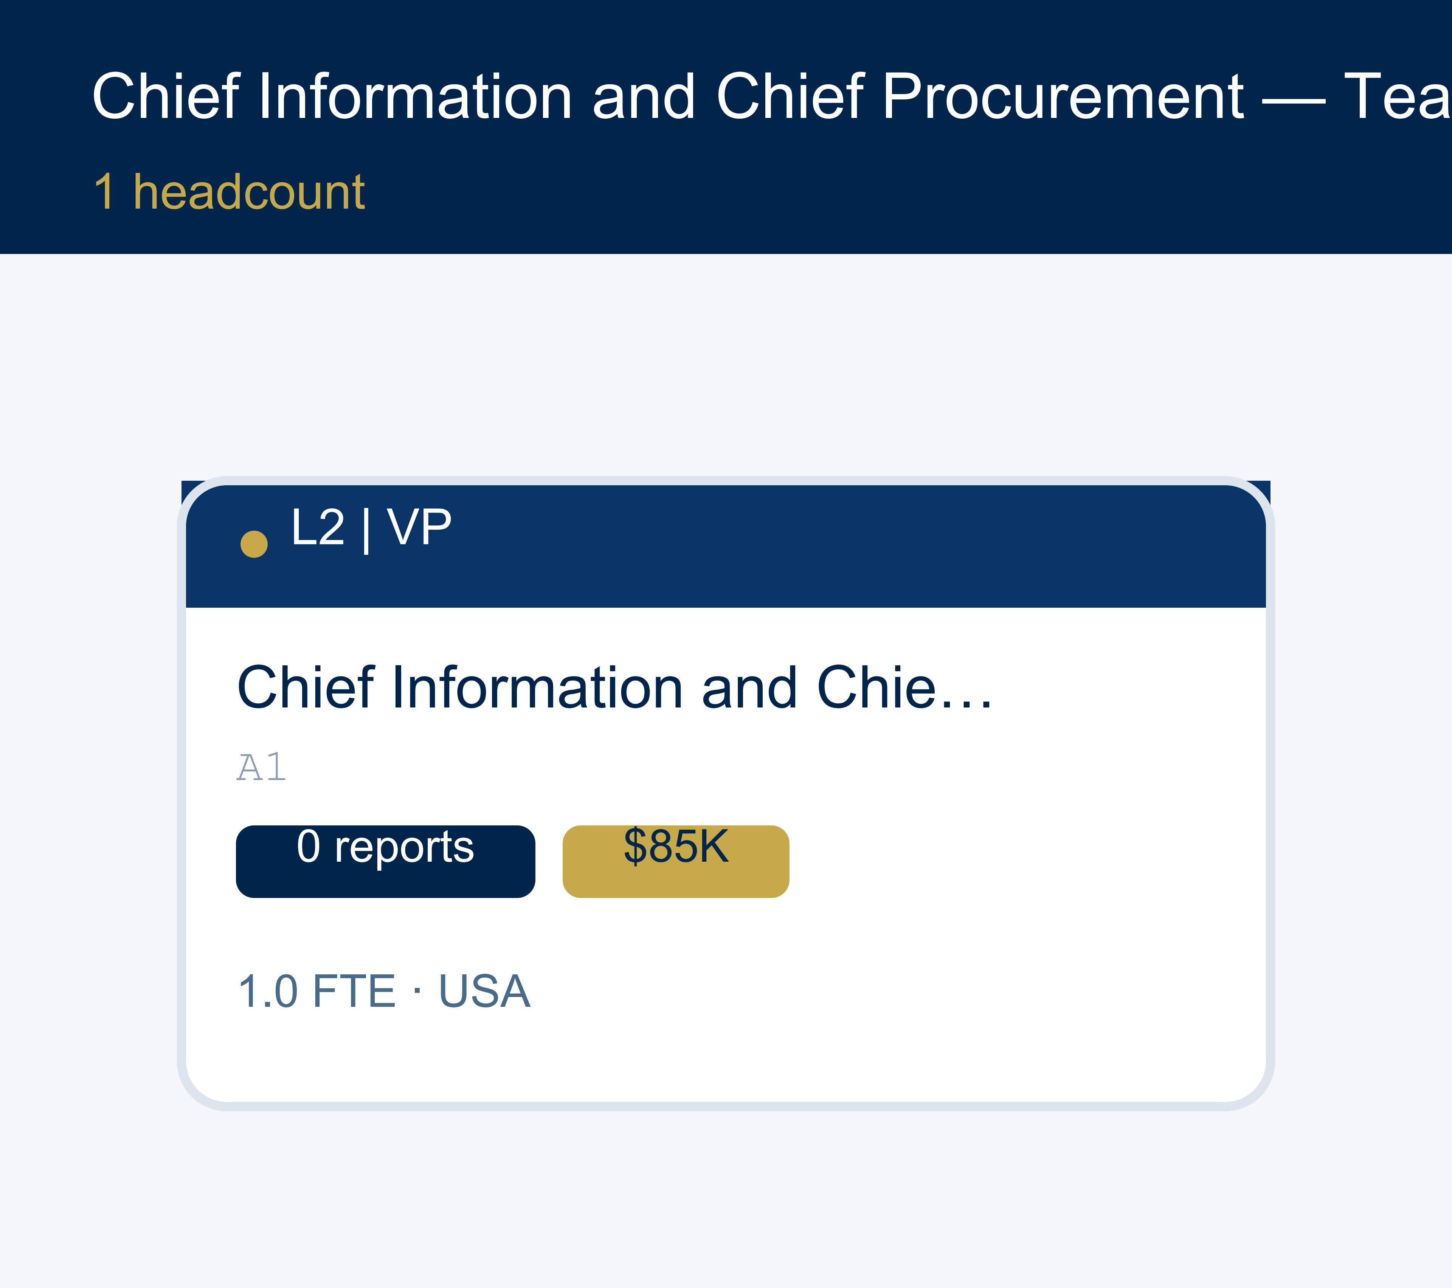
Chief Information and Chief Procurement — Team Structure
OrgSight 2.0 | test_2 | Page 16

Slide 17
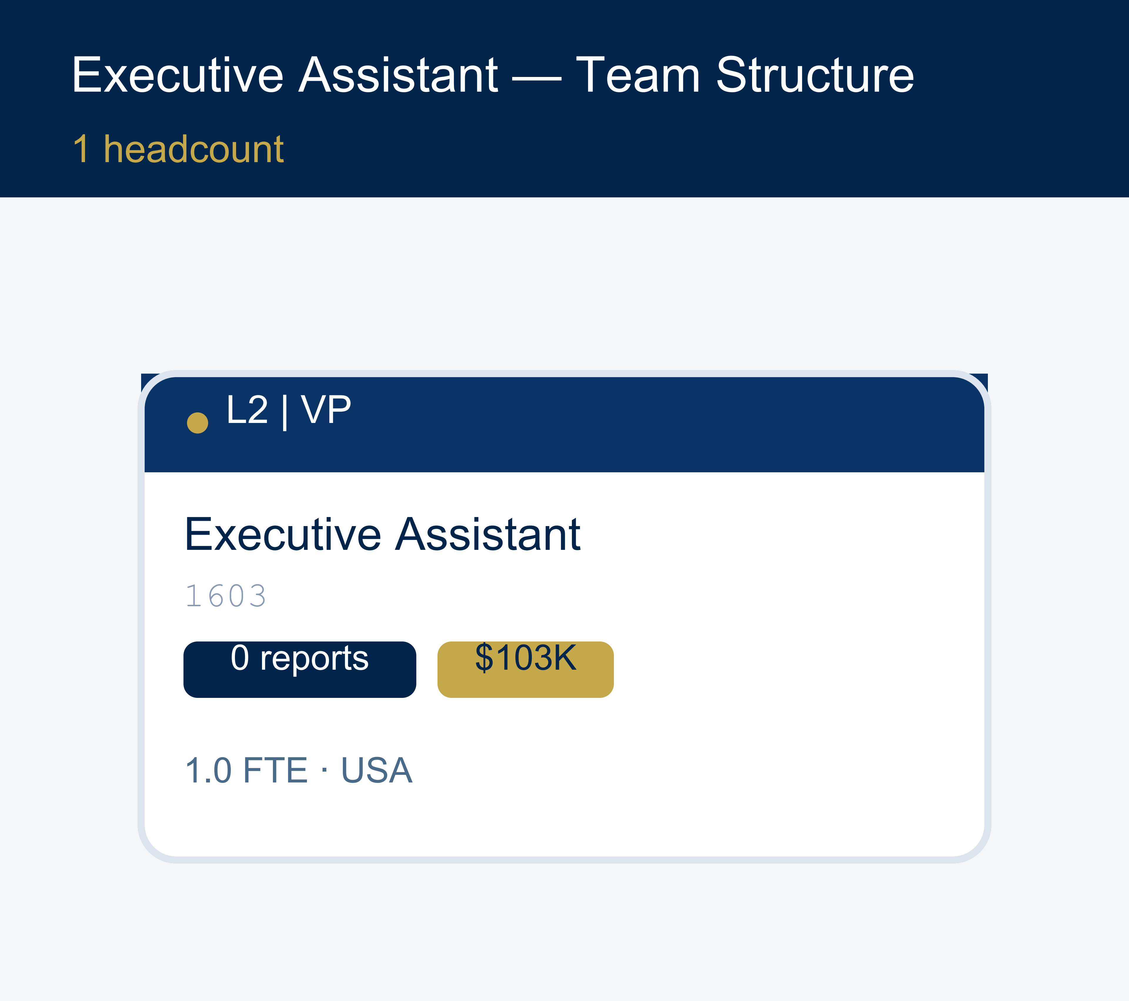
Executive Assistant — Team Structure
OrgSight 2.0 | test_2 | Page 17

Slide 18
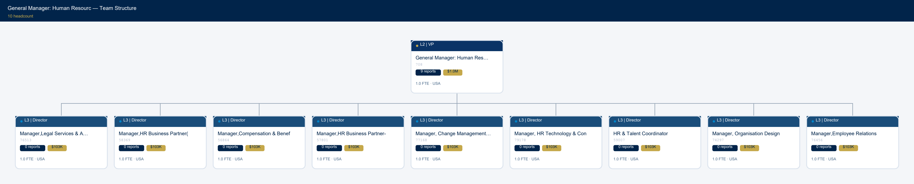
General Manager: Human Resourc — Team Structure
OrgSight 2.0 | test_2 | Page 18

Slide 19
Change Log
Action | Employee | From | To | Field | Timestamp
flag_remove | 75889 |  |  | flag_remove | 2026-06-24 16:03:42
unflag_restore | 75889 |  |  | unflag_restore | 2026-06-24 16:04:36
flag_remove | 75889 |  |  | flag_remove | 2026-06-24 16:04:39
OrgSight 2.0 | test_2 | Page 19

