Slide 1
The Dream team: An RLS Monitor design proposal
Isabel Anderson, Mauricio builes, James Grusy, Xavier Williams

Slide 2
Data flow process
1.
Record data over 5 day period
2.
Data transferred from device to clinician’s computer
3.
Data processed through filters or through clinician controlled filters
4.
5.
Display data on an interactive GUI
Final Report

Slide 3

Target Device Specifications
Data Collection of limb acceleration
Data rendering and identification on PC
Wirelessly transmitted data
Sealed enclosure
Cleanable device
No user interface for patient
Battery life of at least 5 days

Slide 4

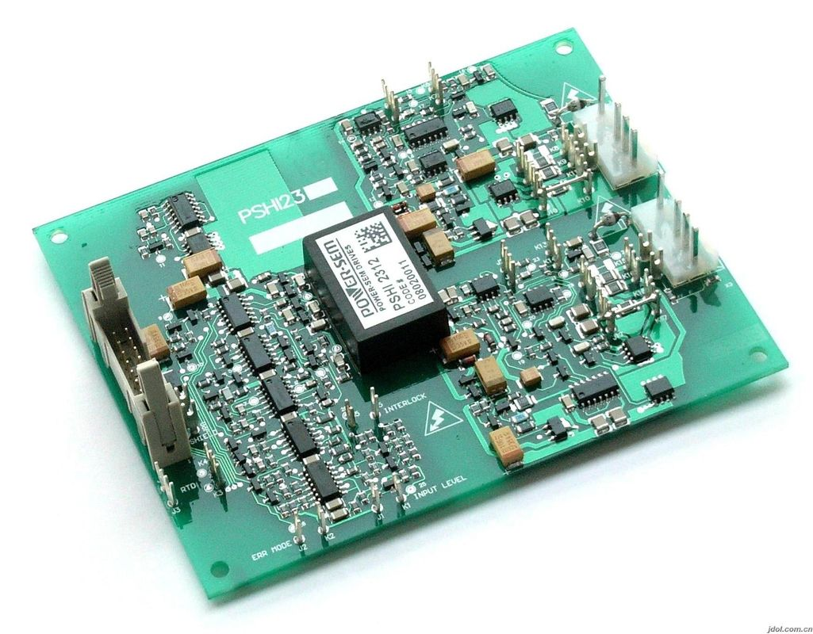
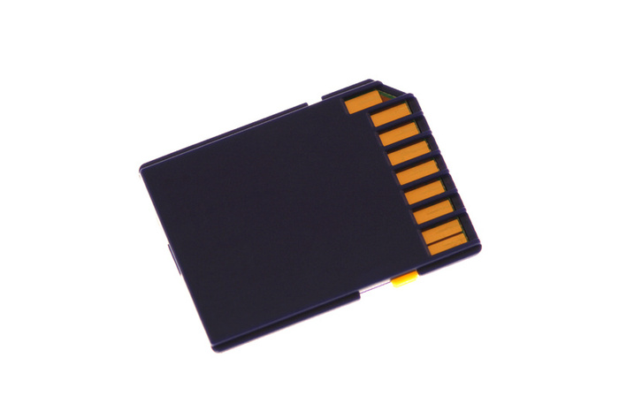


Data Acquisition
Movement Detected
Picked up by accelerometer on circuit board
Stored in internal memory
Data wirelessly transmitted once charging is detected

Slide 5
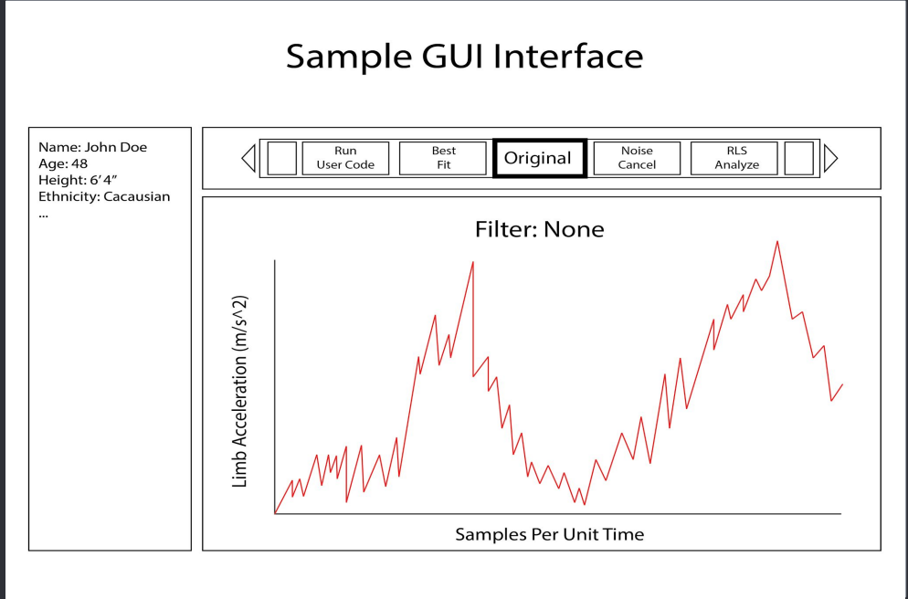
Software Development and integration
Graphical interface for clinicians to view data
Ability to execute filters that help identify movements
Wireless data transfer

Slide 6
schedule
Planning
Part Ordering
GUI Improvements
Embedded Software Improvements
PCB Design
Packaging
Presentation

Slide 7
status
Meeting Expectations

