Slide 1
SALES & CUSTOMER
Performance Dashboards
A Tableau Project | Data Source to Interactive Dashboard
Educational Internship | Bharat Cares, in association with IBM & AICTE

Slide 2
Introduction
This project involved designing and building two Tableau dashboards to help sales managers and executives analyze year-over-year sales performance and understand customer behavior — from raw CSV data all the way to a polished, interactive product.
Internship
Bharat Cares
(IBM x AICTE)
Self-Initiated Project
Sales Dashboard
Designed & built independently, end-to-end
Sales, profit & quantity trends
Tool
Customer Dashboard
Customer behavior & top contributors
Tableau

Slide 3
Objective
Build two dashboards that let sales managers and executives:
01
02
03
04
Monitor KPIs
Compare Years
Spot Trends
Understand Customers
See high-level metrics at a glance
Track current vs. previous year performance
Identify highs and lows quickly
Recognize behavior & top profit contributors

Slide 4
Data & Process
Dataset & Tools
Build Process
Dataset: Sales and Customers Dashboard dataset — four related CSVs (Products, Orders, Customers, Location)
1
Built the data source by joining/relating the four CSV files
2
Performed data cleaning to handle inconsistencies
Tool: Tableau — used directly for data viewing & exploration
3
Conducted data analysis to identify key metrics & trends
Calculated fields: Built using SQL logic within Tableau
4
Designed and built two interactive dashboards with cross-filtering

Slide 5
Sales Dashboard
Requirements & how they were delivered
KPI overview
BAN cards for sales, profit & quantity with % vs. prior year
Monthly trend & highs/lows
Sparklines with color-coded highest / lowest points
Subcategory comparison
Diverging bar chart: 2022 vs 2021 sales + profit/loss
Weekly trend vs. average
Dual charts with average line & above/below shading

Slide 6
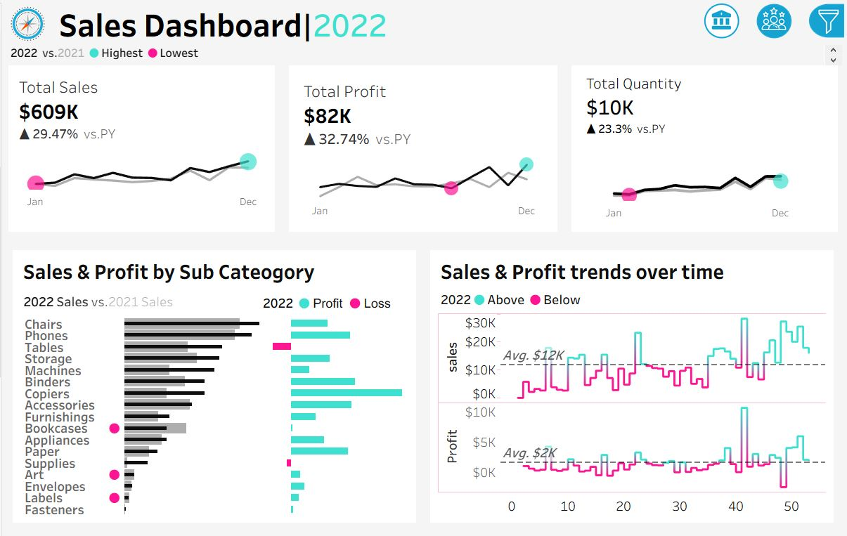
Sales Dashboard
2022 Result: $609K sales (+29.5%) • $82K profit (+32.7%) • 10K units (+23.3%) vs. prior year

Slide 7
Customer Dashboard
Requirements & how they were delivered
KPI overview
BAN cards for customers, sales/customer & orders
Monthly trend & highs/lows
Same sparkline treatment as Sales Dashboard
Distribution by order count
Bar chart of customer counts across order frequency (1–7)
Top 10 customers by profit
Ranked table: rank, name, last order, profit, sales, orders

Slide 8
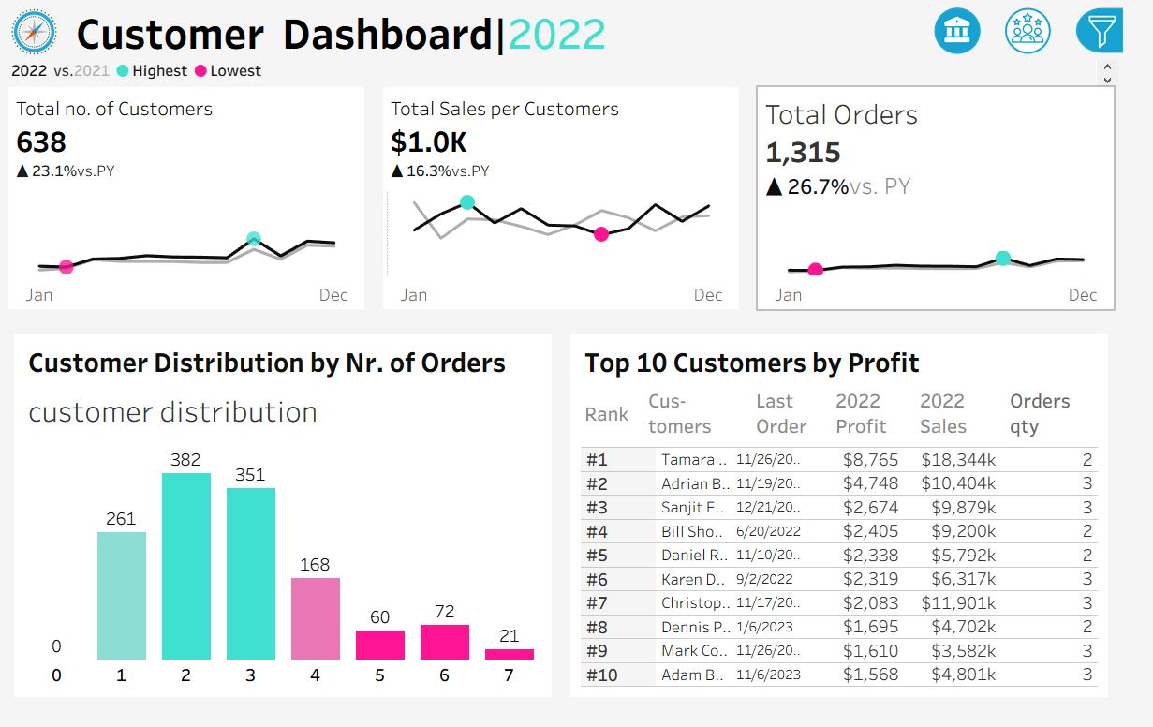
Customer Dashboard
2022 Result: 638 customers (+23.1%) • $1.0K sales/customer (+16.3%) • 1,315 orders (+26.7%) vs. prior year

Slide 9
Design Approach
1
2
3
Consistent Visual Language
BAN + Sparkline Pattern
Global Filters
Same header style, filter icons, and teal / pink coding for highest & lowest values across both dashboards
Combines a KPI's current value and its trend in a single compact component
Used throughout both dashboards to keep every view interactive

Slide 10
Challenges
Structuring Containers
Getting nested containers to behave so the dashboard layout stayed responsive and clean across screen sizes.
Customer Distribution Chart
Careful bucketing of customers by order count to build a clear, accurate distribution view.

Slide 11
Outcome
Both dashboards give stakeholders a single-screen view of performance, replacing manual report pulls and making year-over-year comparisons and outliers immediately visible.
$609K
$82K
638
1,315
Total Sales
Total Profit
Customers
Total Orders
+29.5% vs PY
+32.7% vs PY
+23.1% vs PY
+26.7% vs PY

Slide 12
Thank You
Questions & Discussion

