Slide 1
ReliefFlow : HIGH-PERFORMANCE PARALLEL DISASTER RELIEF ALLOCATION & DYNAMIC SUPPLY NETWORK ENGINE
2510030038-Kruthika Reddy
2510030406-Jagruthi Jetti

Slide 2
OVERVIEW
During natural disasters (e.g., floods, earthquakes, urban fires), emergency systems experience massive data overloads. Thousands of victims post unstructured calls for help on social platforms, send SMS messages, or place emergency calls. Simultaneously, transport networks suffer severe disruptions, with roads blocked and relief inventories constrained.
ReliefFlow is an end-to-end processing engine designed to solve this crisis management bottleneck. It ingests high-volume unstructured crisis data, pre-filters and structures it, packages optimal physical supplies into delivery vehicles, and routes convoys along dynamic, damaged road networks in sub-second execution times.
01

Slide 3
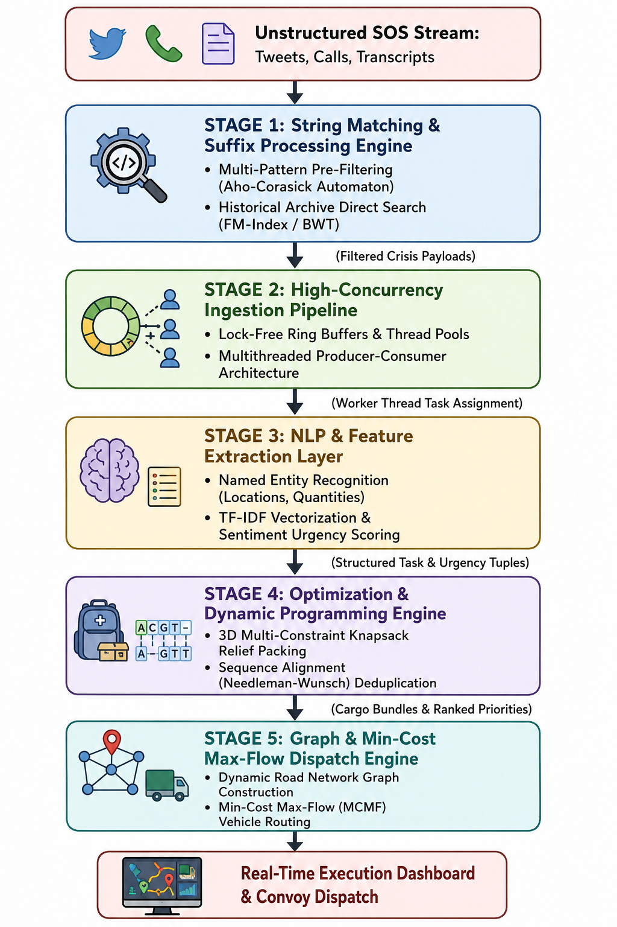
FEATURES & FUNCTIONS
A. Fast Search & Filtering
  Aho-Corasick Automaton: Scans incoming text instantly to catch key keywords in a single pass.
  FM-Index & BWT: Compresses large amounts of past text data so it takes up minimal space while letting us search it directly.
B. Resource Optimization (Dynamic Programming)
  Multi-Constraint Knapsack: Figures out the best way to pack and allocate resources without exceeding weight, space, or budget limits.
  Needleman-Wunsch Alignment: Compares text sequences line-by-line to find and combine repeated or duplicate reports.
C. Network Routing & Flow
  Dynamic Network Graph: Maps out the entire supply network as a web of starting points, drop-off locations, and connecting routes.
  Dinic's Algorithm & MCMF: Finds the absolute best routes to move maximum supplies at the lowest cost and effort.
02

Slide 4
ROLES
  Kruthika Reddy - Data Ingestion & Sequence Algorithmic Lead
  Functional Role: Responsible for building the high-speed text processing pipeline, handling live SOS message feeds, multi-pattern search, and record deduplication.
  Focus: Stream Parsing, String Algorithms, Fuzzy Matching, and Parallel Processing.
Jagruthi - Graph Optimization & Dynamic Programming Lead
Functional Role:- Responsible for modeling real-world supply networks, computing optimal delivery routes around damaged infrastructure, and managing supply packing.
Focus: Resource Allocation, Network Flow Routing, and Multi-Constraint Optimization.
03

Slide 5
EXPECTED OUTCOME
Instant Response Times: Cuts decision time from hours down to split seconds by automating message processing and dispatch.
Zero Wasted Resources: Prevents over-packing or sending the wrong supplies by using smart optimization algorithms.
Maximum Supply Delivery: Moves the highest possible volume of relief goods safely across damaged roads without overloading bridges.
Handles Heavy Traffic: Processes tens of thousands of incoming SOS messages per minute smoothly without crashing.
No Duplicate Reports: Automatically combines repeated emergency posts so response teams have a clean, accurate picture of the situation.
04

Slide 6
APPLICATIONS IN REAL WORLD
01
02
03
Disaster Management
Powers city command centre's during major crises (floods, earthquakes) by automatically processing SOS feeds and dispatching first responders.
Smart City Traffic
Integrates with municipal traffic systems to dynamically route relief trucks and clear green corridors through heavily damaged roads.
NGO & Relief Logistics
Helps organizations like the Red Cross optimize warehouse inventory and prioritize delivery of medical supplies to high-urgency zones.
05

Slide 7

GITHUB LINK
06

Slide 8
REFERENCES
Motivation: Real-Time Crisis Operations during Assam Floods
During extreme weather events such as the severe multi-wave floods in Assam, emergency response teams face massive operational bottlenecks:
Communication Overload: Tens of thousands of distress posts flood social media, SMS, and emergency hotlines simultaneously, creating a triage bottleneck.
Infrastructure Failure: Flooded roads and collapsed bridges constantly alter transit networks, complicating relief routing.
Supply Allocation Gaps: Coordinating multi-agency dispatch (NDRF, SDRF, NGOs) often leads to over-allocation in easily accessible areas and delays in remote pockets.
This project was built to directly address these type of systemic bottlenecks by creating an automated, algorithmic backend designed for high-throughput message de-duplication, dynamic network re-routing, and optimal multi-constraint resource packing.
07

Slide 9
THANK YOU
Team G-7

