Slide 1

Relief Flow - Review 2
During natural disasters (floods, earthquakes), emergency helplines and social media channels are flooded with frantic text messages. Traditional dispatch systems fail to quickly extract location/urgency details, identify bottlenecked roads, and assign limited relief supplies optimally.

Slide 2
Agenda
1
Literature Review
Three problem classes and seminal methods
2
Comparative Analysis
Gaps, strengths, and algorithmic trade-offs
3
Conclusion
4
References

Slide 3

1. Core Contributions of Goldberg, Tardos & Tarjan
Push–relabel framework: localized operations leading to strongly polynomial bounds for many instances
Capacity/cost scaling: multi-level refinement to accelerate convergence for min-cost problems
Dynamic trees: data-structure acceleration for repeated augmentations and path operations
Systematic complexity analysis: polynomial vs strongly polynomial algorithm distinctions

Slide 4

Comparative Strengths — Algorithmic & Data-Structure Insights
The paper unites algorithm design with data-structure engineering: push–relabel for locality and parallel potential, scaling strategies to bound work per phase, and dynamic trees to collapse repeated path costs. These choices yield provable complexity improvements and practical speedups on structured inputs.

Slide 5

Identified Research Gaps (Theory → Practice)
Limited experimental validation on modern, large-scale benchmarks
Frameworks assume static networks — inadequate for time-varying or disrupted infrastructures
Sparse treatment of parallel, distributed, or GPU-accelerated implementations
Minimal integration with data-driven or ML-assisted heuristics for prediction and warm-starting
Addressing these gaps is critical to deploy flow algorithms in real-world, time-sensitive domains such as disaster response.

Slide 6
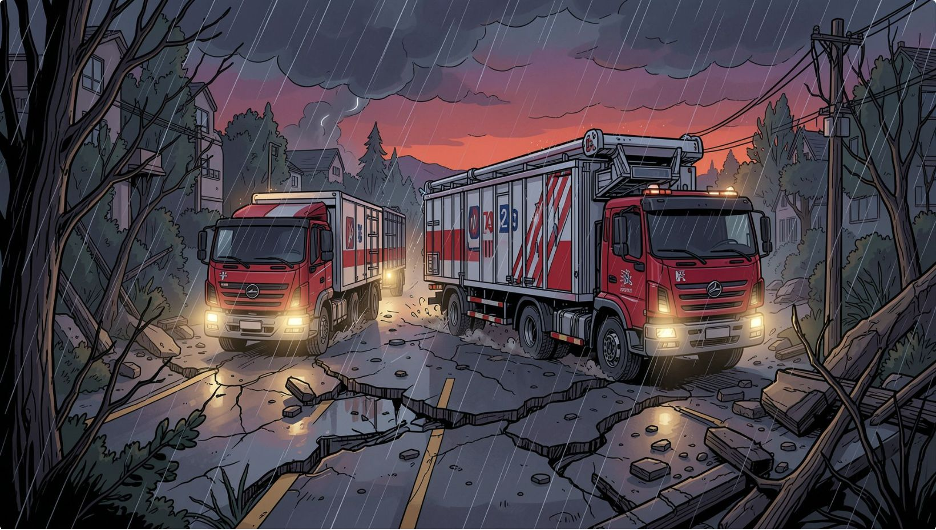
2. Application: Relief Distribution Optimization
Multi-Commodity Network Flow Optimization Model (NFOM) paired with Demand Shortage Clearance Model (DSCM). Objectives: minimize transport cost and worst-case demand gap while mapping vehicle requirements and routes under probabilistic road failures.
Supply regions (RES) ↔ demand regions (RED)
Stochastic road failure simulations inform route feasibility
Multi-objective trade-off: cost vs maximum demand shortfall

Slide 7

Limitations & Opportunities
NFOM/DSCM do not capture real-time network dynamics or asset reallocation under unfolding events
Assumptions on capacities, speeds, and demands reduce fidelity
Opportunities: online routing, ML demand forecasts, and scalable parallel solvers
Formulate NFOM
Integrate DSCM
Simulate & Iterate
The diagram summarizes the methodological pipeline used to adapt classical flow models for disrupted humanitarian contexts.

Slide 8

3. Application: Ambulance Dispatch Optimization
Stochastic optimization with two policy classes: Static Dispatch Control (SDC) for deterministic baseline and Dynamic Dispatch Control (DDC) that adapts dispatch probabilities using observed demand deviations.
Handles nonstationary and high-variance demand
Theoretical performance guarantees supported by simulation
Gaps: simplified traffic/geo models, limited large-scale real-data validation, and extra computational burden for DDC

Slide 9
Limitations & Opportunities in Ambulance Dispatch
While the DDC model offers theoretical performance guarantees, several practical challenges and areas for improvement exist for real-world deployment:
Simplified Models
Computational Burden
Data Validation
Experiments primarily use synthetic or simplified EMS configurations, often omitting real-world complexities like dynamic traffic, hospital availability, road conditions, and geographic constraints.
Dynamic Dispatch Control (DDC) introduces significant computational complexity, requiring careful parameter tuning and efficient algorithms for real-time application.
There is limited validation using large-scale, real-time ambulance datasets, which are crucial for assessing the model's performance in varied operational environments.

Slide 10
Emerging Solutions & Future Directions
Addressing the identified gaps requires innovative approaches that leverage dynamic modeling, advanced AI, and robust data infrastructure.
Time-Expanded Dynamic Graph Routing
Uncertainty-Aware Human-in-the-Loop Triage
High-Throughput Spatial Ingestion
Models fluctuating road capacities and transit risks across discrete time steps as floodwaters rise over time, enabling adaptive route planning.
Uses Monte Carlo Dropout to calculate ML urgency confidence variance and automatically route low-confidence SOS predictions to human operators for validation.
Combines an in-memory Redis buffer with PostGIS R-Trees to absorb massive SOS traffic spikes and accelerate DBSCAN clustering execution time for real-time analysis.

Slide 11

Conclusions
Bridging Theory & Practice
Dynamic & Robust Models
Large-scale experimental evaluations on modern benchmarks and real-world disaster datasets.
Extend push–relabel and scaling methods to time-dependent, uncertain, and partially observed networks.
Scalable Implementations
Data-driven Enhancements
Explore parallel/GPU implementations and distributed solvers using dynamic-tree-like accelerations.
Use ML for demand prediction, warm-starting flows, and adaptive heuristics for real-time routing.
References
Andrew V. Goldberg, Éva Tardos & Robert E. Tarjan.
Network Flow Algorithms — foundational theory and algorithmic contributions.
Additional references: contemporary studies on NFOM, DSCM, and ambulance dispatch literature (detailed bibliography to accompany this deck).

