Slide 1
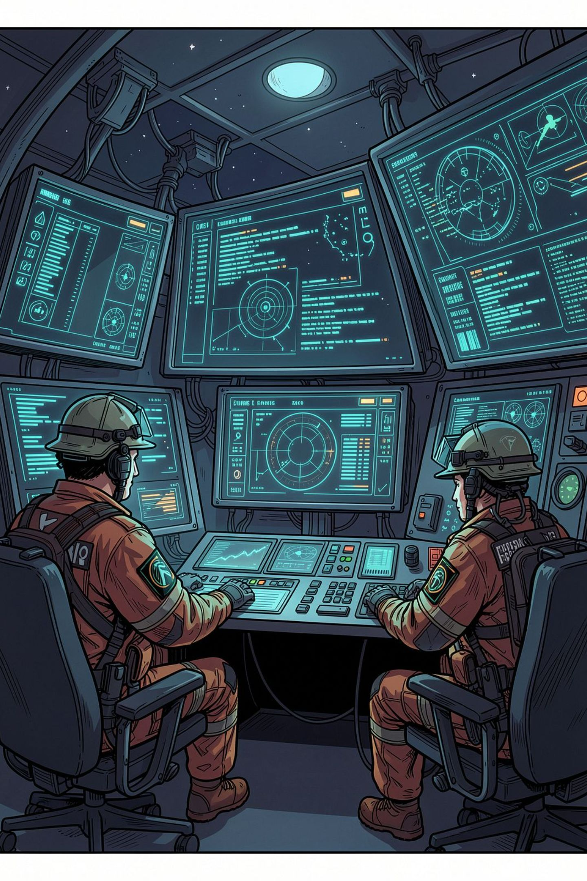
ReliefFlow — Real-Time Emergency Triage & Telemetry Pipeline
Algorithmic Optimization Overview :-
(Review 3 — 75% Milestone Completion)
Member 1 : M Kruthika Reddy
Multi-Pattern Automaton & Ingestion Filtering Engine
Member 2 : Jagruthi Jetti
Priority Heap Extraction, Single-Pattern Matching & Telemetry

Slide 2
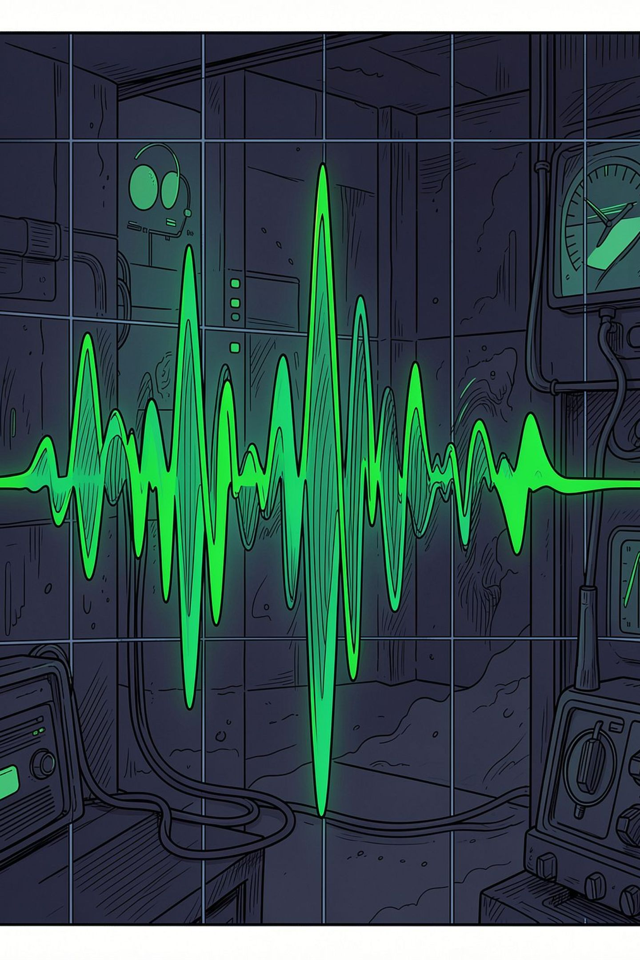
Problem Statement & Workload-to-Algorithm Mapping
Real-World Problem
Raw distress streams contain heavy noise (e.g., minor traffic, routine checkups). Processing unindexed streams under server strain requires dynamic algorithmic filtering rather than standard, slow database queries.
Workload-to-Algorithm Mapping
Single-Target Verification
Dictionary Crisis Screening
KMP Algorithm — O(N + M)
Aho-Corasick Automaton — O(N + L + Z)
Dynamic Priority Dispatch
Binary Max-Heap — O(1) Peak Extract

Slide 3

System Architecture & Smart Triage Filter
Aho-Corasick
Multi-pattern match flags emergency vs routine.
CSV Stream
Triage Split
Continuous input of records for filtering.
Emergency → max-heap; routine bypasses queue.
Emergency Path (Flag Match)
Routine Path (No Flag)
Pushed directly into the Binary Max-Heap Priority Queue for immediate urgency ordering.
Bypasses the emergency queue entirely to prevent queue saturation and preserve throughput.

Slide 4




End-to-End Execution Flow
The ReliefFlow pipeline processes raw emergency distress data through four sequential stages, each governed by a distinct algorithmic component. The design eliminates redundant passes over the stream and bounds total latency to the sum of individual algorithm complexities.
① CSV Distress Stream
② Aho-Corasick Automaton
Raw unformatted emergency messages ingested line-by-line from batch input files
Simultaneous multi-keyword search flags crisis terms — "trapped", "bleeding" — in a single linear pass
③ Binary Max-Heap Queue
④ Priority Dispatch Telemetry
Auto-sorts incoming flagged signals by calculated urgency score in O(log K) per insertion
Extracts top-urgency dispatches with sub-millisecond execution tracking via System.nanoTime()
Design Invariant
Key Benefit
Each stage hands off only flagged, scored records to the next — the heap never receives unmatched records, keeping K ≪ N and bounding memory consumption regardless of stream volume.
No character-pointer backtracking, no repeated full-stream scans, no secondary sort passes. The pipeline is architected for a single bounded traversal from ingestion to dispatch output.

Slide 5
Algorithmic Complexity Matrix
Algorithm | Structure | Use Case | Time Complexity | Space
Aho-Corasick | Trie + BFS Failure Links | Multi-Keyword Triage Filtering | O(N + L + Z) | O(Σ · L)
KMP | LPS (π) Array | Single Keyword Target Match | O(N + M) | O(M)
Max-Heap | Complete Binary Tree Array | Dynamic Urgency Ordering | O(1) Fetch / O(log K) Push | O(K)
Dijkstra (Planned) | Min-Heap + Adjacency List | Dispatch Route Navigation | O((V + E) log V) | O(V + E)
Supply Trie (Planned) | Prefix Tree | Medical Asset Lookup | O(L) | O(Σ · L · N)

Slide 6
Code Mechanics
AHO-CORASICK FILTER
Key Implementation Highlights
1
Trie Build
Builds dictionary state tree for crisis terms: "trapped", "bleeding", "collapse", "unconscious", "flood", "fire“
Mechanics: Inserts all 6 crisis keywords into a root-anchored tree. Each path down the tree represents a character sequence of the emergency dictionary.
2
BFS Failure Transitions
Precomputes failure pointers to enable fast non-backtracking text scanning
Failure Transitions: Calculates fallback pointers for every node. If a character mismatch occurs while reading distress text, the search pointer follows the failure link to the longest valid suffix without resetting the input stream pointer back to the beginning.
3
Triage Decision
Signals MainDemo.java to push flagged text into the priority queue
Filter Handoff: Returns a populated list of matched keywords. If matches exist, it flags the record as a verified emergency and hands it off to Member 2's Max-Heap; otherwise, it routes the message away to the non-urgent log to prevent emergency queue saturation.

Slide 7
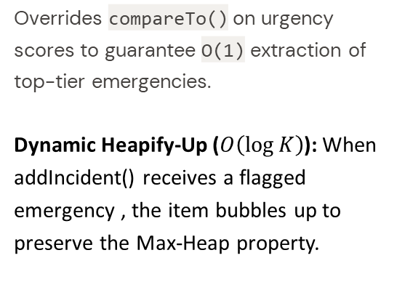
Code Mechanics
KMP & MAX-HEAP SORTING
KMP Prefix Function
Max-Heap Priority Queue
Telemetry Driver
Computes π-table in O(M) time for targeted single-keyword scans without character backtracking
Non-Backtracking Search: When executing KMPMatcher.search(text, pattern), the algorithm uses the LPS array on character mismatches to shift pattern alignment forward without re-evaluating previously matched text characters
Measures execution latency using System.nanoTime()
Telemetry Logging: Aggregates real-time pipeline performance metrics, recording total records processed (25), emergency incidents flagged (17), routine items filtered (8), and overall runtime (~41.24 ms).
Overrides compareTo() on urgency scores to guarantee O(1) extraction of top-tier emergencies.
Dynamic Heapify-Up ($O\left(\log{K}\right)$): When addIncident() receives a flagged emergency , the item bubbles up to preserve the Max-Heap property.

Slide 8
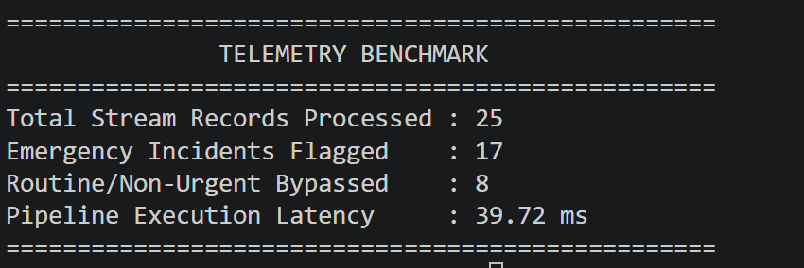
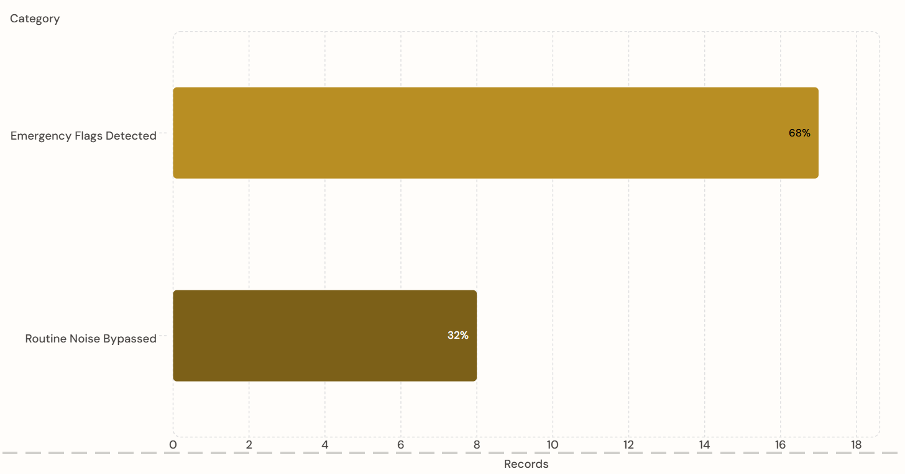
Live Execution Telemetry & Results
Telemetry Benchmark Setup: 25 Ingested Records across standard emergency/routine categories.
Pipeline Results:
  Total Records Ingested: 25
  Emergency Flags Detected: 17 records (68% of stream)
  Routine Noise Bypassed: 8 records (32% of stream)
  Pipeline Latency: ~41.24 ms
Key Takeaway: Filtering low-priority noise prior to heap
insertion keeps emergency queue operations fast and
lightweight.
Filtering low-priority noise prior to heap insertion keeps emergency
queue operations fast and lightweight.

Slide 9
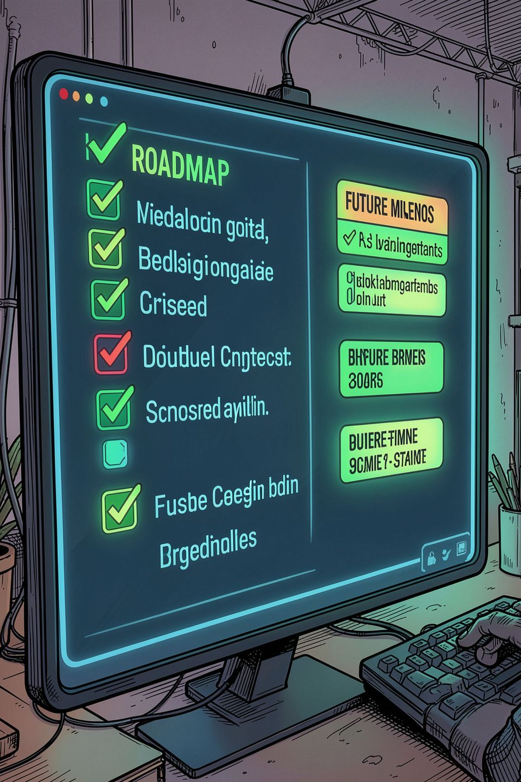
Project Deliverables & Review 4 Roadmap
REVIEW 3 DELIVERED — 75% MILESTONE
REVIEW 4 PLANNED — FINAL 25% MILESTONE
Multi-Pattern Aho-Corasick Automaton & KMP Matcher
DijkstraRouting.java for shortest path navigation
SupplyTrie.java for real-time medical asset auto-completion
Binary Max-Heap Priority Queue (UrgencyQueue)
Live CSV Ingestion, Smart Triage Filter & Telemetry Engine (MainDemo)

