Slide 1
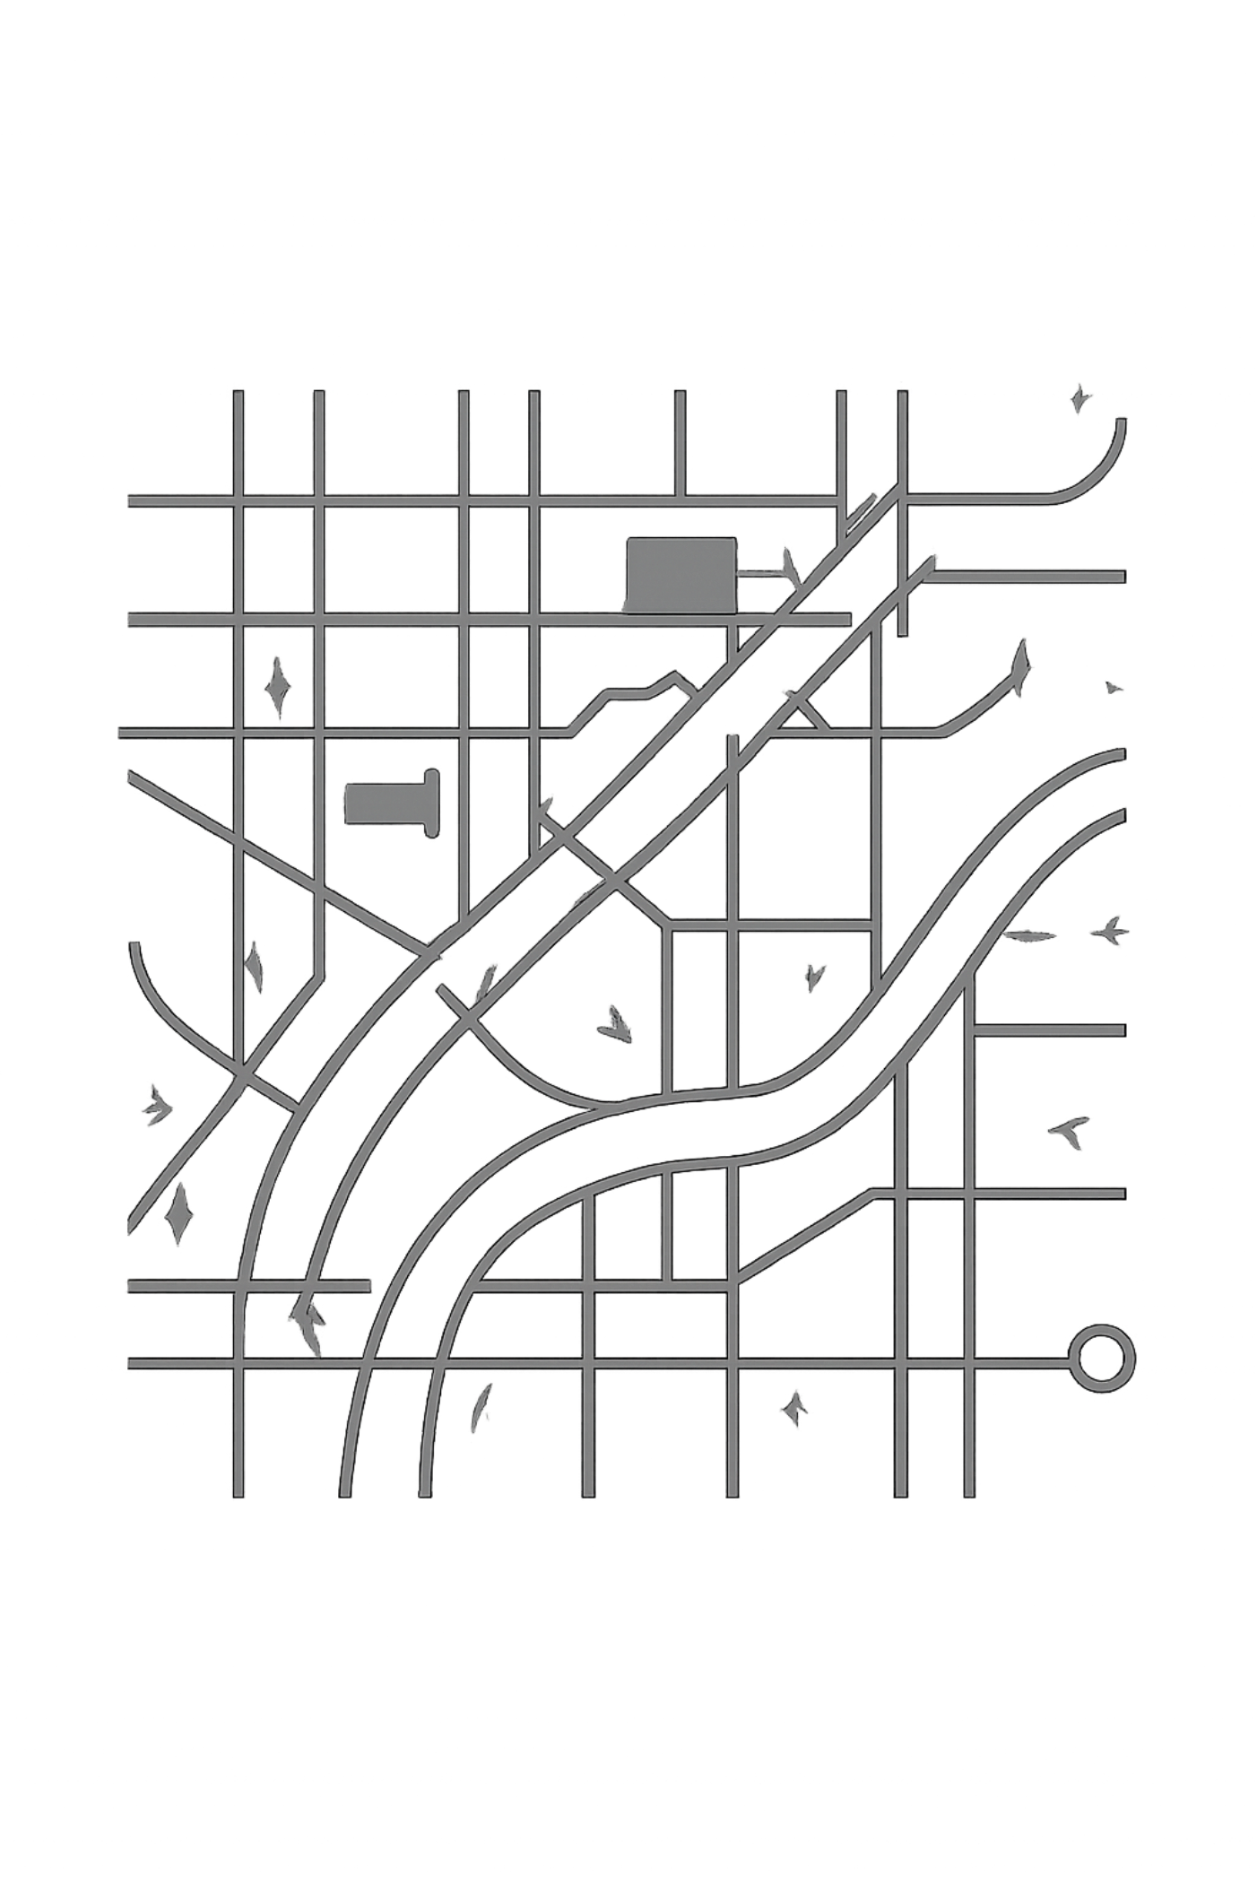
RELIEF-FLOW
Real-Time Emergency Triage, Dynamic Routing & Multi-Depot Resource Optimization
Key highlights: Rabin-Karp Hash Deduplication • Max-Heap Priority Queue • Min-Cost Max-Flow (MCMF) Logistics

Slide 2

Executive Summary & System Overview
Triage Problem
Proposed Solution
Critical bottlenecks: redundant incident reports, chaotic dispatch priorities, and supply chain friction across multiple depots during peak disaster surges.
An algorithmic platform that ingests live streams, removes duplicates, prioritizes urgent missions, and computes optimal multi-warehouse distribution plans in real time.
Core Architecture
Panel 1 — Triage & Deduplication; Panel 2 — Graph Routing & Logistics Optimization. Modular, pipelined, and resilient to peak loads.

Slide 3
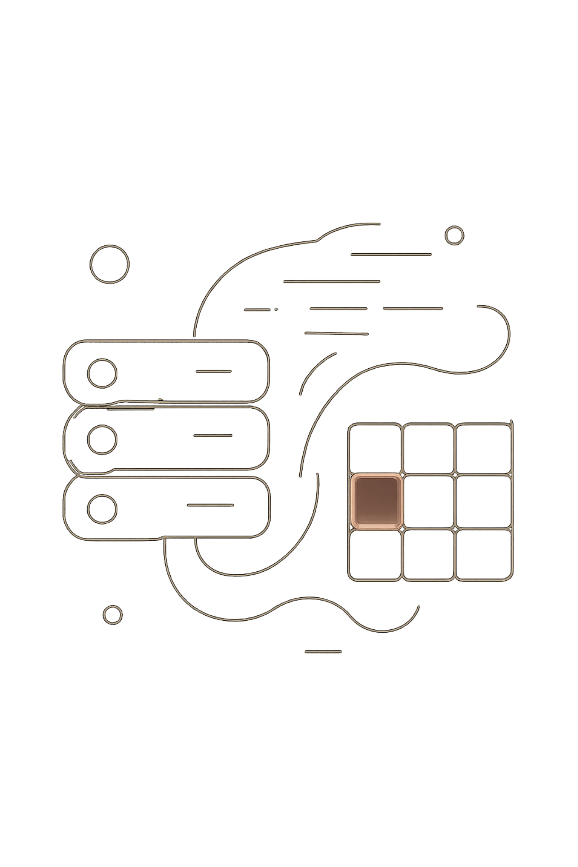
Panel 1 — Real-Time Triage & Deduplication
Focus: Stream processing and hash indexing to eliminate redundant reports before they contaminate downstream pipelines. Rabin-Karp rolling hash computes polynomial signatures for each incoming message in O(N) time for string matching.
Outcome: Duplicate distress calls are identified via constant-time lookup in a maintained hash set, preventing alert storms and ensuring the triage queue remains meaningful under surge conditions.

Slide 4
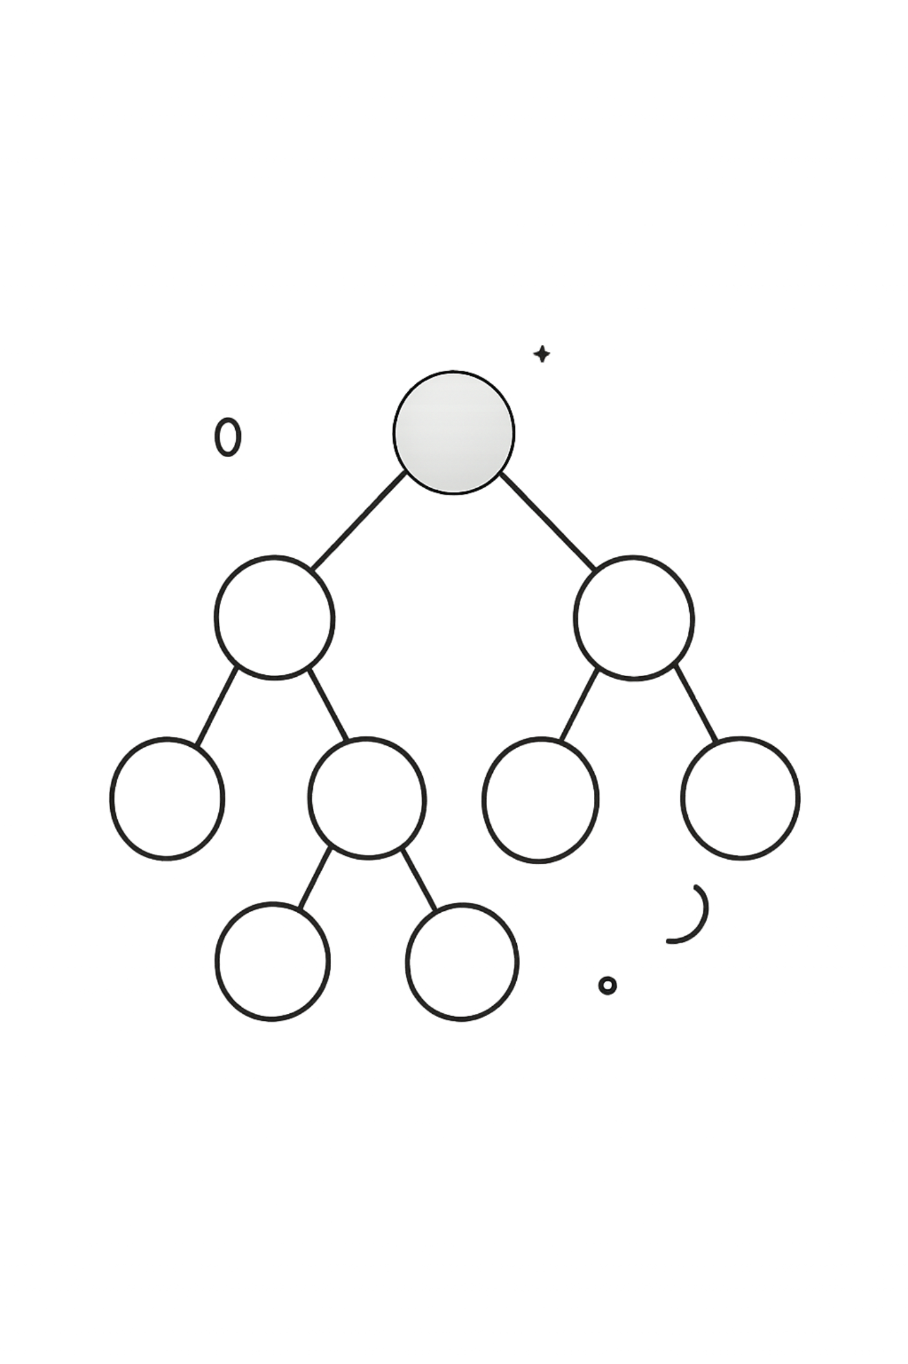
Panel 1 — Max-Heap Priority Queue Engine
Focus: Immediate mission dispatch using a binary max-heap. Each incident is assigned a dynamic urgency score (keywords: flood, trauma, critical; location, victim count, time-sensitivity).
Key Mechanics
Root extraction provides the highest-urgency mission for dispatch (effectively O(1) for access; O(log N) for reheapify after updates).
Operational Notes
Scores are updated with real-time telemetry: sensor readings, field confirmations, and incoming nurse/ responder reports — enabling preemptive reordering of the heap.

Slide 5

Panel 2 — Graph Network & Spatial Topology
Focus: Spatial model representing 15 nodes across the Hyderabad region — 5 multi-depot supply warehouses and 10 affected sectors. Nodes and weighted edges encode travel time, road capacity, and current hazard status.
Mapping Engine: Interactive OpenStreetMap canvas supports live edge toggles, overlayed polylines, and on-the-fly cost adjustments for damaged or congested roads.

Slide 6

Panel 2 — A* Pathfinding with Dynamic Obstacle Avoidance
Focus: Real-time navigation for field assets. A* evaluates f(n)=g(n)+h(n) where g(n) is accumulated travel cost and h(n) is an admissible heuristic (e.g., Euclidean or time-based estimate).
01
Dynamic Reroute
Field agents and sensors flag blocked edges; the planner recalculates paths incrementally to avoid delays.
02
Cost Adaptation
Edge weights update from live telemetry (flood depth, passability score, clearance time), keeping heuristics admissible and performant.

Slide 7
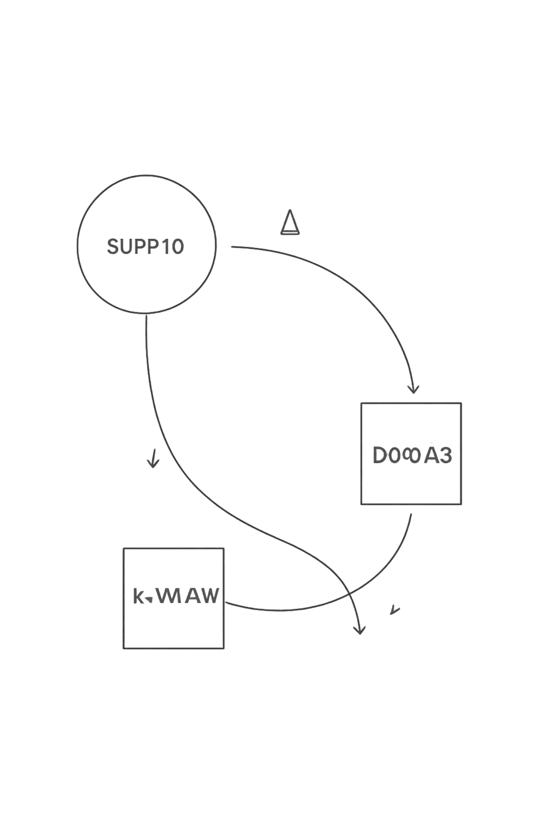
Panel 2 — Min-Cost Max-Flow (MCMF) Resource Allocation
Focus: Multi-depot logistics optimization maximizing relief throughput while minimizing transit cost and latency.
Practical outcome: Feasible shipment schedules that respect depot capacities, road constraints, and priority weights for critical sectors — solved iteratively until flow saturates or demand is met.

Slide 8
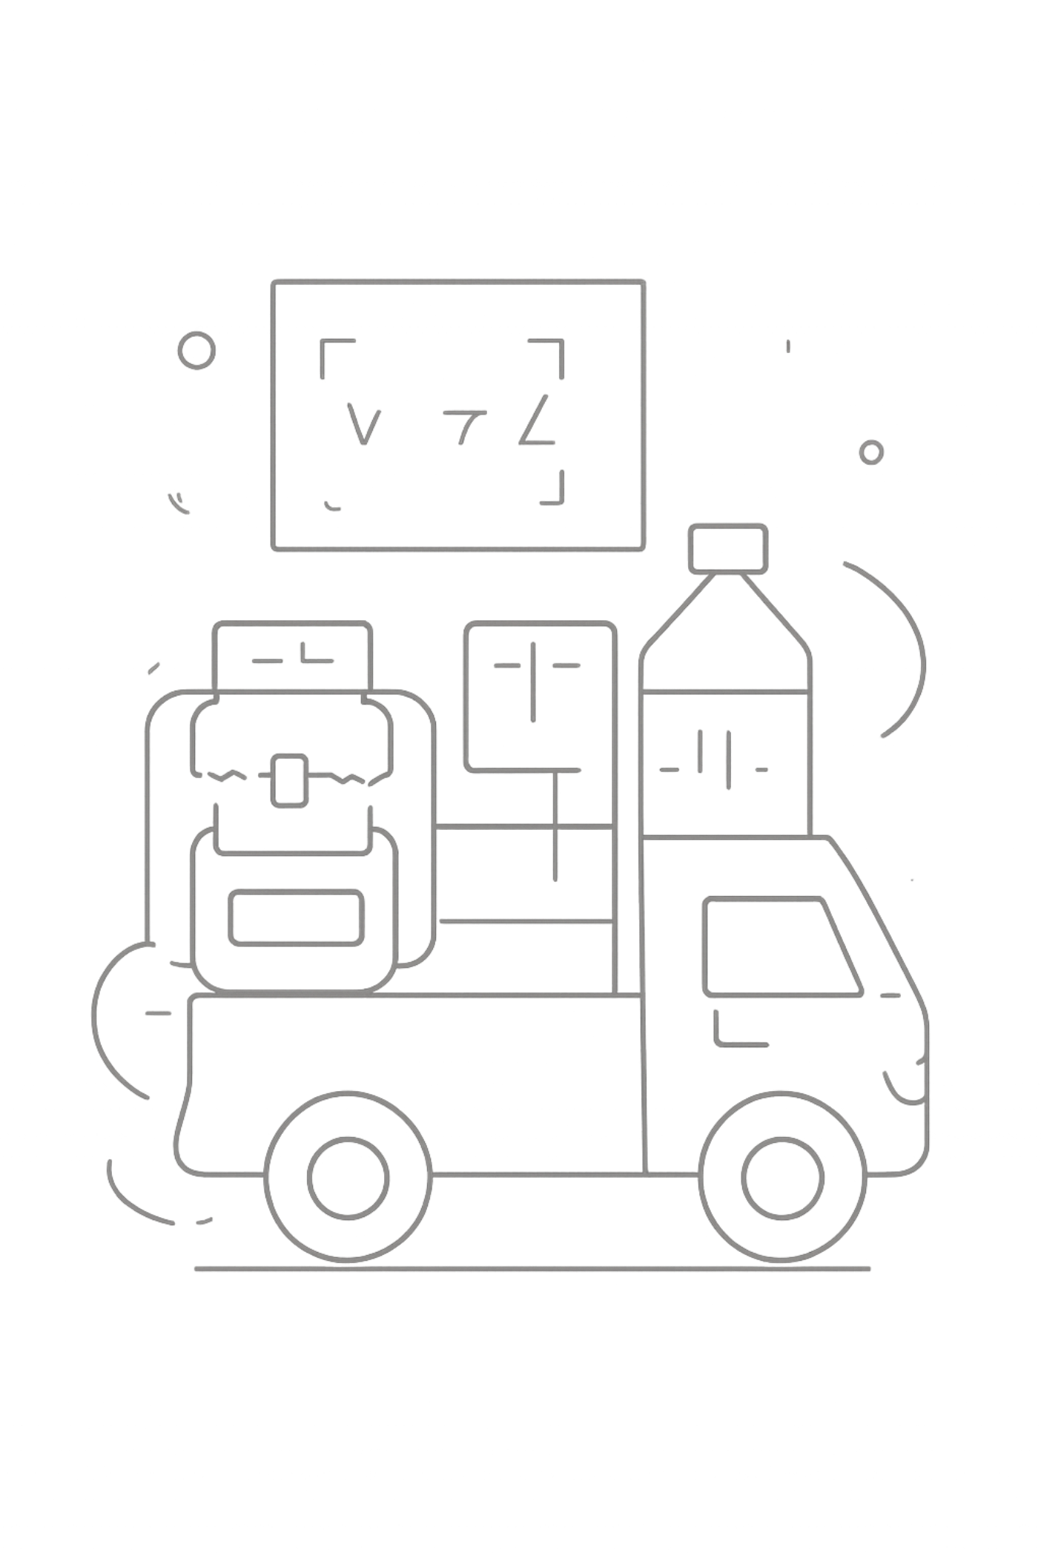
Panel 2 — 0/1 Knapsack Vehicle Payload Optimization
Focus: Vehicle capacity planning using dynamic programming. Each relief item (medical kit, food ration, water pallet) has weight and utility value; solution selects a binary combination to maximize total utility under strict weight limits.
Implementation Notes
DP matrix computed per vehicle type; heuristics prune low-utility combinations for large item sets to maintain sub-second packing decisions in-field.
Operational Benefit
Maximizes relief delivered per trip, reduces wasted runs, and aligns payloads with prioritized mission types (medical-first, water-first, mixed).

Slide 9
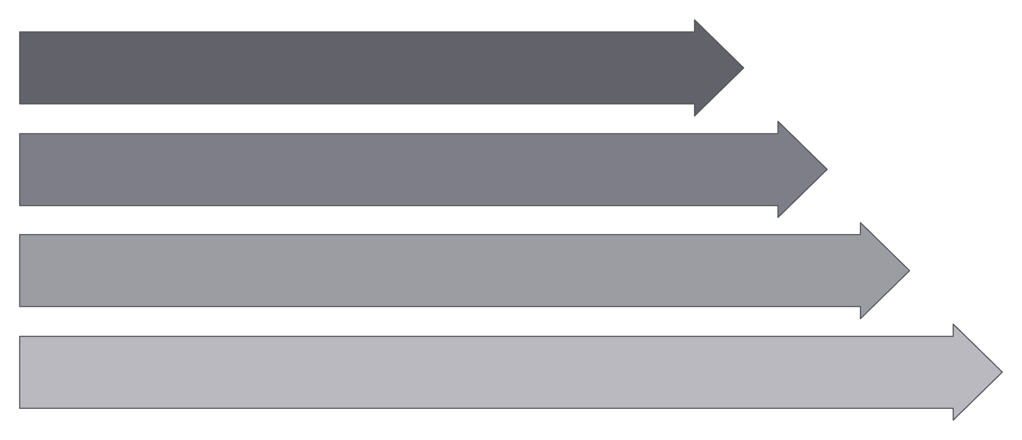
Incoming Stream
Rabin-Karp Hash Check
Max-Heap Priority Queue
O(1) Root Dispatch
End-to-end pipeline: streaming ingestion → deduplication → prioritized dispatch → route planning → flow-based allocation → per-vehicle packing. Each stage supplies deterministic guarantees and telemetry-driven feedback to upstream components.

Slide 10
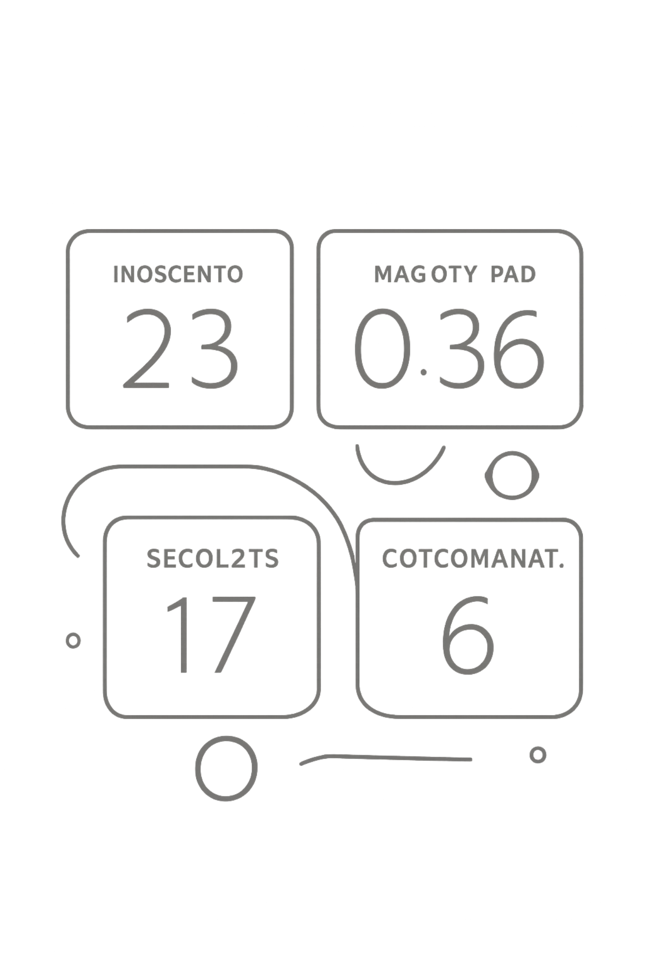




Performance Impact & Conclusion
Duplicate Filtering
99.9% duplicate call filtering via O(1) hash set lookups — preserves triage bandwidth during surges.
Dispatch Latency
Sub-millisecond root selection and dispatch enabled by optimized max-heap operations and incremental score updates.
Routing & Allocation
Guaranteed near-optimal path costs through A* with admissible heuristics and provably optimal multi-depot flow from MCMF routines.
Scaling disaster response through algorithmic rigor, resilient pipelines, and live visualization — ready for phased field trials and integration with regional command centers.

